Slide 1

Unit 1- Unit 5 Revision

Slide 2

Unit 1 What's the matter?
1.疾病表达
(1) “have+ a+ 疾病名”
发烧___________; 感冒___________
(2)“ have a +身体部位+ache”
头痛________________; 胃痛___________________;
牙痛________________
(3)“have a sore+ 身体部位”
喉咙疼___________________;
背疼_____________________
have a fever
have a cold
have a headache
have a stomachache
have a toothache
have a sore throat
have a sore back

Slide 3

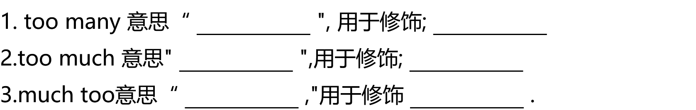






2.辨析too many, too much 与much too

Slide 4
3.辨析used to 与be used to
be used to doing sth
(1) 习惯于做某事_____________________( P6, 2b阅读）
(2)曾经；过去常常做某事__________________（P10，2d对话）
used to do sth
我妈妈习惯午饭后休息一会儿。
My mother _____ ______ ____ taking breaks after lunch.
他以前常常周五去看电影。
He ______ _______ go to the movies on Friday.
is used to
used to

Slide 5
4.辨析(so...that...)与so that
如此......以至于......
(1) so...that...意思“__________________"(U5: P38, 2b阅读）
(2）so that意思"_________________" (U1：P6, 2b阅读） （表目的）
( U4: P27,3a阅读）
为了；以便；这样
1.玛丽太累了，以至于她很快就睡着了。
Mary was _____ tired ______she fell asleep quickly.
2.你应该和你父母交谈，以便他们能更好地理解你。
You should talk to your parents__________ they can understand you better.
so that
so that

Slide 6
5.询问 某人患了何种疾病（U1）
遇到何种麻烦/烦恼时（U4）
重点句型：
一.________________________________________________
二.________________________________________________
What's the matter (with sb.)? 某人怎么了？
What's wrong (with sb.)? 某人怎么了？（哪儿不舒服？）
3.What happened (to sb.)? (某人）发生了什么？
4.Is there anything wrong (with sb.) ? 某人有什么问题吗？
5.What's the trouble (with sb.) ? 某人有什么问题吗?
6.Are you OK? 你没事吧？

Slide 7
6.情态动词should的用法
1.Should 为情态动词(表达情感态度的动词），意为___________
_______(能/不能）单独使用，其后跟动词_________________.
_______(有/无）人称和数的变化，用来表示征询意见、建议、要求或义务等。
1.你应该喝点加蜂蜜的热茶。
_____________________________________________________
2.你不应该打开窗户。
_____________________________________.
should
drink
some hot tea
with honey
You
You shouldn't open the window

Slide 8
重点短语
take one's temperature
right away
1.量体温_________________________
2.下车__________________
3.使......惊讶的是______________________
4.休息___________________________
5.多亏_________________________
6.立即；马上_______________
7.陷入麻烦________________
8.放弃__________________
9.用完；耗尽____________________
10.离开；从......出来____________________
get off
get into trouble
to one's surprise
give up
take a break
run out (of)
thanks to
get out of

Slide 9
重点短语
Unit 2 I'll help to clean up the city park.
clean up
1.打扫干净_________________________
2.使高兴起来__________________
3.照顾______________________
4.修理___________________________
5.推迟_________________________
come up with
6.想出；提出_________________________
7.打电话给;征召__________________
8.take after______________________
9.参加......的选拔________________________
10.建立；设立_________________________
11.make a difference_________________
cheer up
call up
care for
(外貌；行为）像
fix up
try out (for)
put off
set up
影响；有作用

Slide 10
不定式（to do) 的用法
不定式做宾语（动词+to do ），翻译为“去做”
would like to do sth 想要去做..../ decide to do 决定去做/need to do 需要去做/want to do想要去做/love to do 爱去做....../volunteer to do 志愿去做......
不定式做宾补（动词+sb.+to do ），翻译为“....某人去做”
ask sb. to do sth 要求某人去做..../ help sb. to do 帮助某人去做/tell sb. to do 告诉某人去做......
不定式做状语（目的 do A to do B），翻译为“为了；以便；目的是”
She volunteers here to help kids learn to read.
I'm making signs to put up around the school.

Slide 11
Unit 3 Could you please clean your room?
重点短语
in surprise
help out with
1.吃惊地；惊讶地_____________________
2.一直；频繁；反复__________________
3.一......就......______________________
4.倒垃圾___________________________
5.帮忙做_________________________
6.照顾；处理____________________
7.目的是；为了_____________________
8.depend on______________________
all the time
take care of
as soon as/
the minute
in order to
依靠；取决于
take out the rubbish
Will you play basketball this Sunday?
It ____________ the weather.
depend on

Slide 12
重点词汇短语
1.develop 养成（v.)
(1)_____________发展中的(adj.) （2）___________发达的（adj.)
(3)______________ 发展（n.)
With the _______________of the society, more and more ______________countries will become____________countires.
developed
developing
development
development
developing
developed
in a mess
2. mess 杂乱；不整洁（n.) 乱七八糟；杂乱不堪______________
3.at常考短语
______________ 至少 _______________起初；首先 _____________ 最后
at first
at last
at least

Slide 13
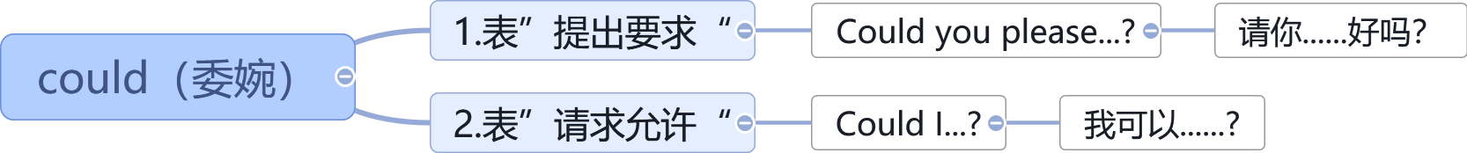
情态动词could的用法
请你打扫客厅好吗？
_______ _____ ______ ______ the living room?
我可以外面待到很晚吗？
_____ _____ ______ out late?
Could you please clean
Could I stay

Slide 14
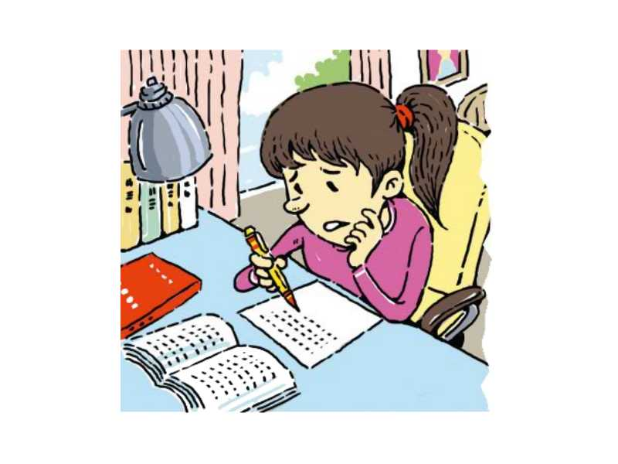
Unit 4 Why don't you talk to your parents?
重点短语
look through
1.快速翻看；查阅_________________________
2.归还__________________
3.重要的事______________________
4.顺利发展；解决___________________________
5.关系良好；和睦共处_________________________
give back
big deal
work out
get on with

Slide 15
连词三巨头
Until (肯定句）
直到......为止
(not)... until
(否定句）
直到......才......
so that (目的）
为了；以便
so that (结果）
因此；所以
Although（让步）
虽然；尽管；即使

Slide 16

堂堂清
1.You'd better stay in the classroom _______ the rain stops.
A. if B. until C. since D.although
2.Mike got up early this morning_________ he didn't miss the early bus.
A. so that B.while C.until D. but
3._______ Aron lost his right arm, he never gives up his dream of climbing.
A.Since B.Although C. If D.Unless

Slide 17
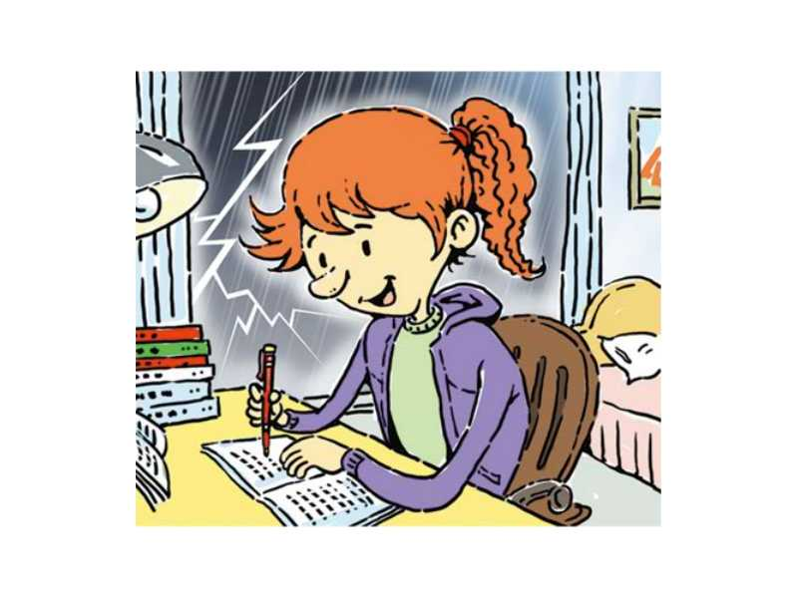
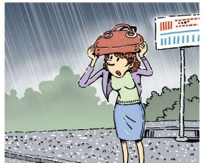
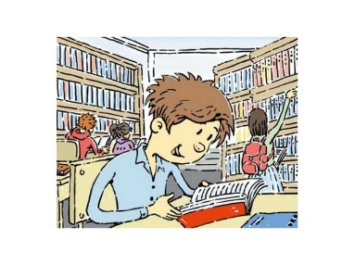
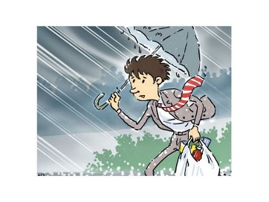
Unit 5 What were you doing when the rainstorm came?
重点短语
go off
1.发出响声_________________________
2.接电话；捡起；（开车）接送__________________
3.进入梦乡；睡着______________________
4.逐渐变弱；平息___________________________
5.看一看_________________________
6.前往；费力前进_____________________
7.拆除；记下_______________________
8.起初；首先________________________
pick up
fall asleep
die down
have a look
make one's way
take down
at first

Slide 18
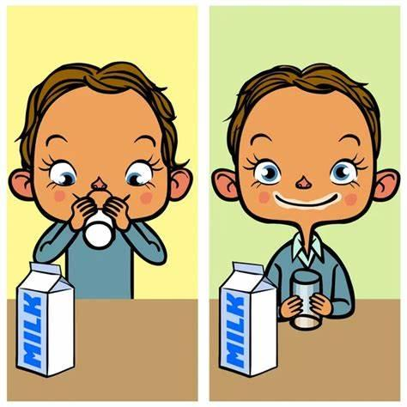
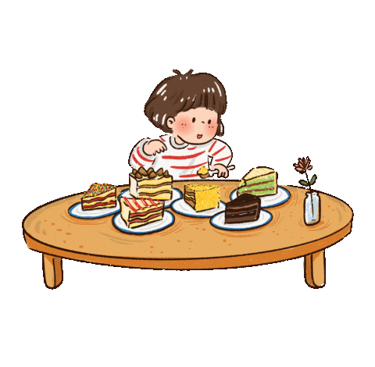
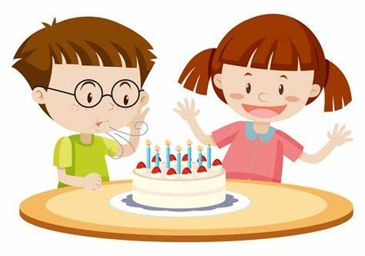
过去进行时 （was/were+动词-ing形式）
谁是犯人
谁昨晚10点正在喝牛奶？
_____ ____ ________ milk at 10 last night?
Who was drinking
特殊疑问词（what/who/why...)+was/were+(主语）+动词-ing...？
Who was eating the cake when mom came in?
她姐姐正在吃蛋糕
His elder sister _____ ______ the cake when his mom came in.
was eating
肯定句：主语+was/were+动词-ing+其他

Slide 19
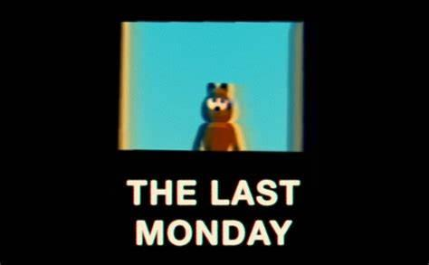

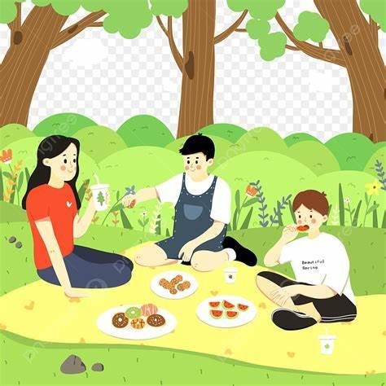
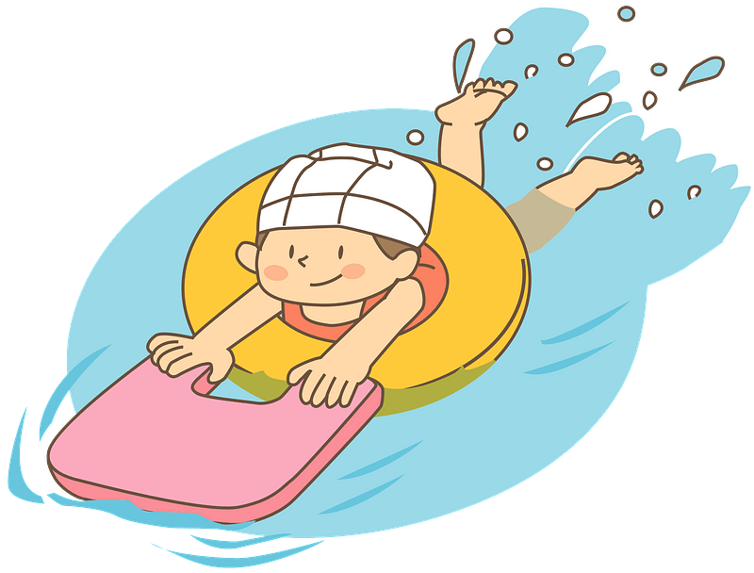
过去进行时 （was/were+动词-ing形式）
Story Time
at 2 o'clock last Monday
否定句：主语+wasn't/weren't+动词-ing+其他
他们没在家看电视。
They ________ ___________ TV at home.
他们正在公园野餐。
They ______ ______a picnic at that time.
weren't watching
were having
一般疑问句: Was/Were+主语+动词-ing+其他？
那时候杰克正在跑步吗？
______ Jack________at that time?
不，他没有。他那时正在游泳。
No,_____ _______. He _____ __________at that time.
Was running
Jack
he wasn't .
was swimming

Slide 20

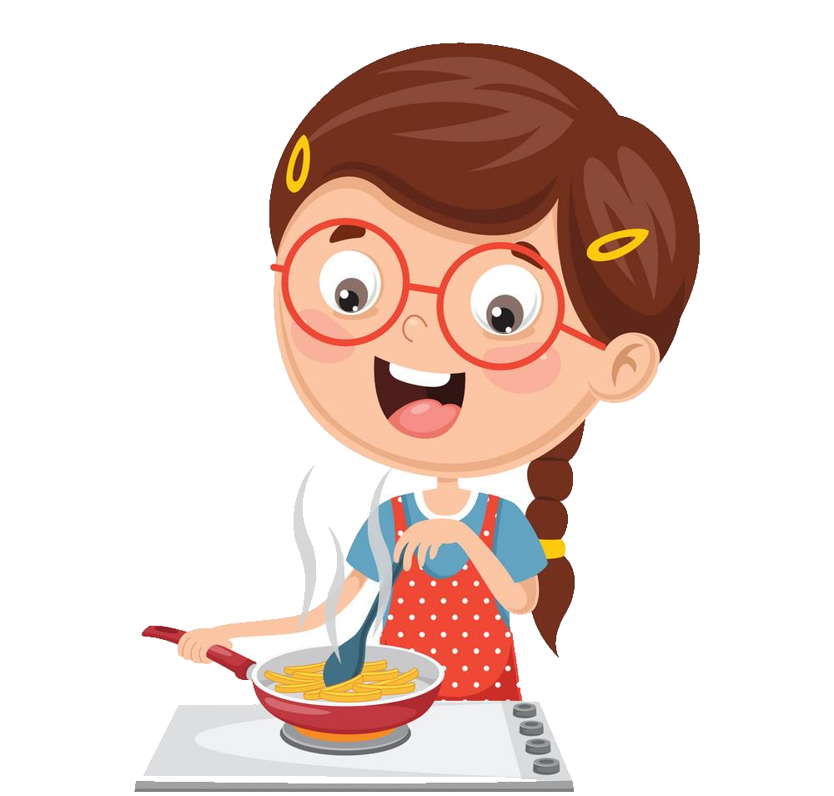

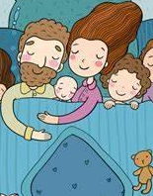
时间状语从句标志词 when & while
时间点： When (短动作）非延续动词+一般过去时（动词ed)
时间段：While(长动作）延续动词+过去进行时（was/were+动词ing)
两个长动作同时发生，只能用while（与......同时）
1._______ the phone rang last night, I was making dinner.
2.He was watching a movie ________ his parents were sleeping.
When
while

Slide 21
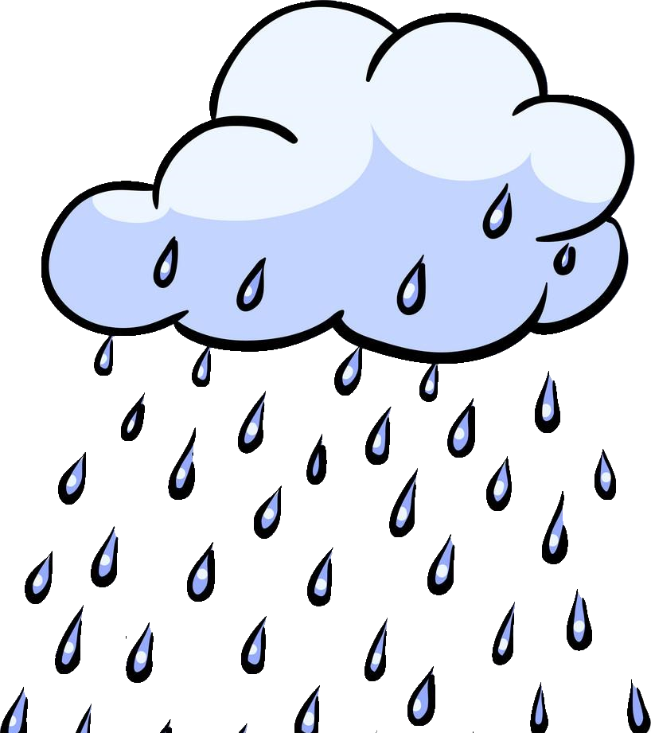
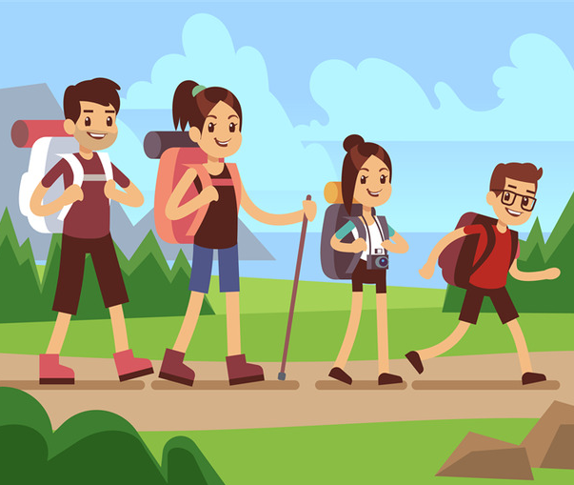
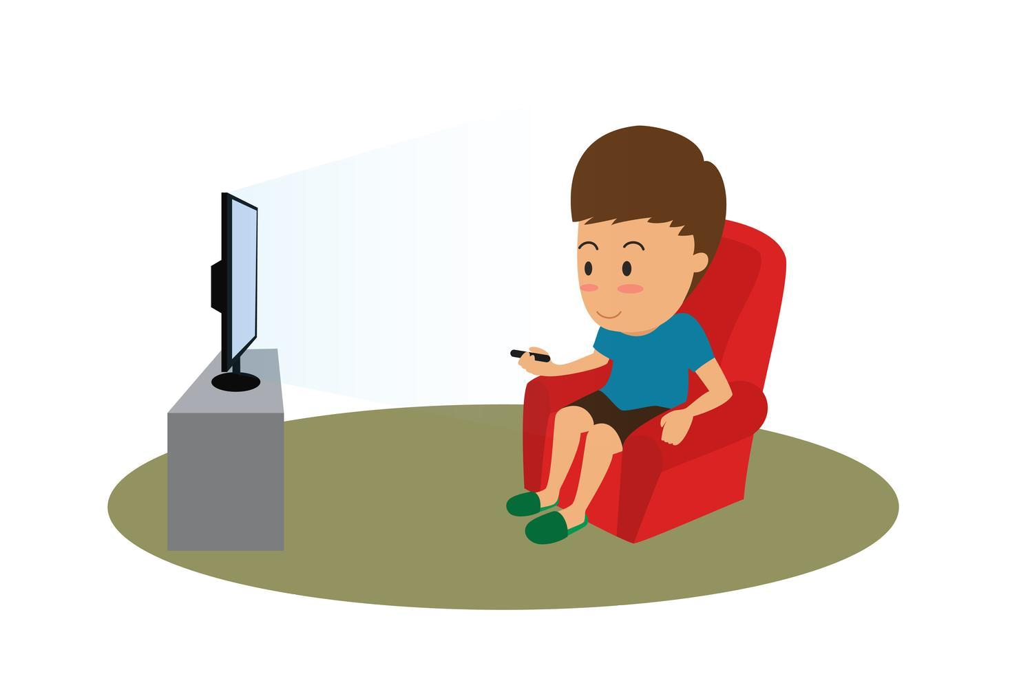

时间点： When (短动作）非延续动词+一般过去时（动词ed)
时间段：While(长动作）延续动词+过去进行时（was/were+动词ing)
两个长动作同时发生，只能用while（与......同时）
3. We were hiking _______ it began to rain.
4. _______ my sister was studying, my brother was watching TV.
when
While

