Slide 1





Trouble Away Book
Period 1. Section A (1a-2c)
----Talk about problems in daily life and give advice
Period 2. Section A (2d&GF-4c)
----Use the sentence pattern Why don’t you...to give advice
----Use the conjunctions until/ although/ so that correctly
Period 3. Section A (3a-3c)
----Find out Sad and Thirteen’s problems and give advice
----Realize the importance of communication and reflect how we can build good relations
Period 4. Section B (1a-1e)
----Listen to the problems Wei Ming talks about and the advice Alice gives to him
----Learn to face the difficulties and solve problems
Period 5. Section B (2a-2e)
----Get different people’s opinions on whether kids should take after-school activities
----Keep a balance between pressure and life
Period 6. Section B (3a-Self Check)
----Finish your Trouble Away Book
Notes:
Tang原创课件,请勿侵权！
小红书/抖音：Tang原创课件
淘宝：Tang原创课件

Slide 2








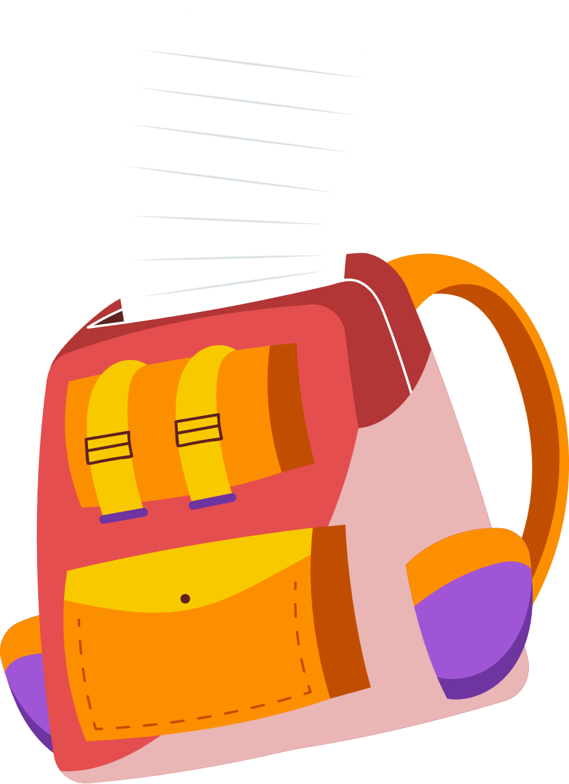




Unit 4
Why don’t you talk
to your parents?
Section B 3a-Self Check

Slide 3


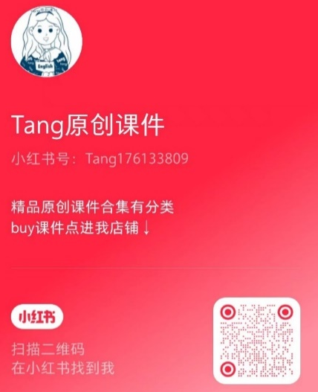
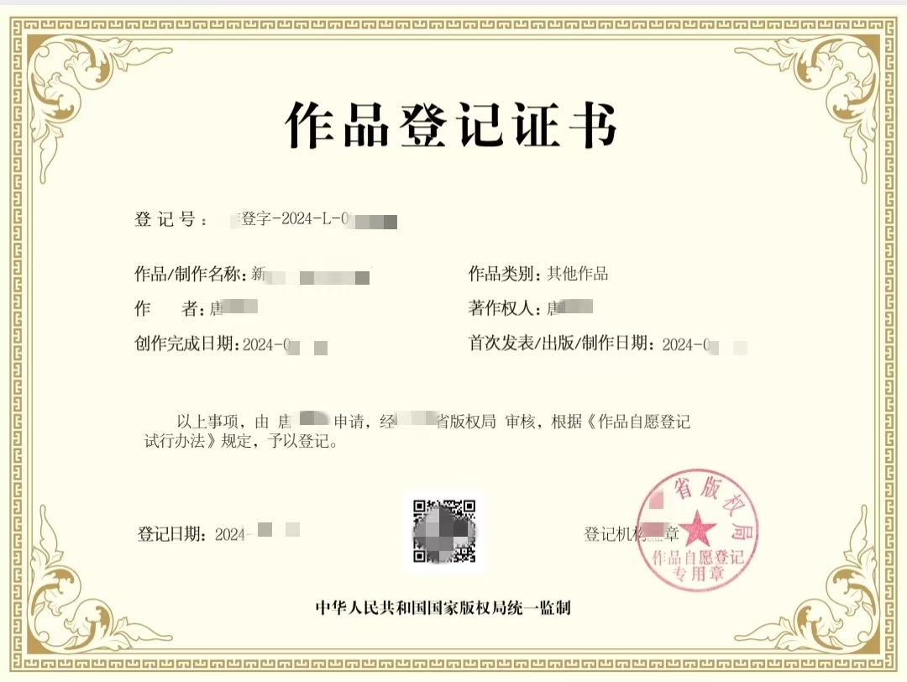
Tang原创课件使用须知
请您知悉课件由Tang原创。您购买的是使用权，没有参赛发表的权力，也没有转售的权利。如有侵犯本人合法权益，必用法律手段维权。请勿侵权！请勿侵权！
微信号：tang2025ppt
(已添加过tang老师的无需重复添加)
小红书/抖音：
Tang原创课件

Slide 4

通过本课时学习，我们能够：
通过对阅读文本的梳理和复习，进一步熟悉本单元目标语言的应用；并通过整理和评价阅读中的观点，熟悉不同社会群体看待问题的视角；能够理解阅读文本的观点并结合自己的思考去理解课后补习活动。 （学习理解）
1
将所学的语言知识、写作技能灵活运用到话题写作中，结合自己对课后活动的认知形成对课后补习班或兴趣班的看法，并给出合适的理由。（应用实践）
2
通过对课后补习活动的讨论拓展思考学业压力问题，从而结合实际去思考自己应该如何更好的协调课后学习活动和休闲活动，并积极探索平衡学习和生活的方式。（迁移创新）
3
Notes:
Tang原创课件,请勿侵权！
小红书/抖音：Tang原创课件
淘宝：Tang原创课件

Slide 5



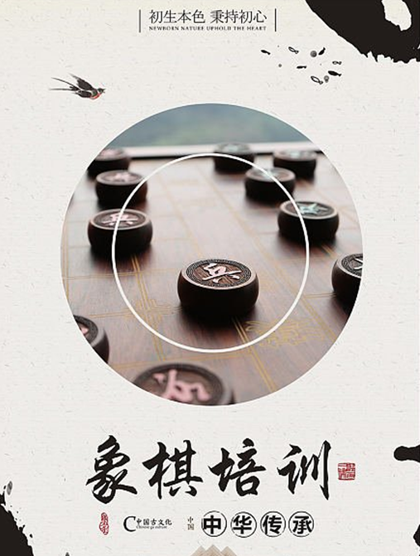
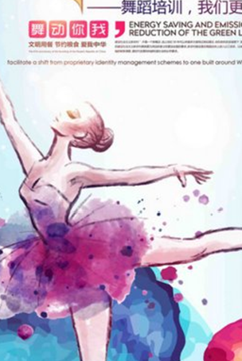


Why should you take after-school classes?
What after-school classes do you take?
Notes:
Tang原创英语课件
小红书：Tang

Slide 6



Why should children take after-school classes?
Youth Magazine interviewed some parents about after-school classes for children. Let’s see their opinions together.
Youth Magazine
Notes:
Tang原创英语课件
小红书：Tang

Slide 7

Why should children take after-school classes?
It helps them to better compete in life.
Youth Magazine
Notes:
Tang原创英语课件
小红书：Tang

Slide 8
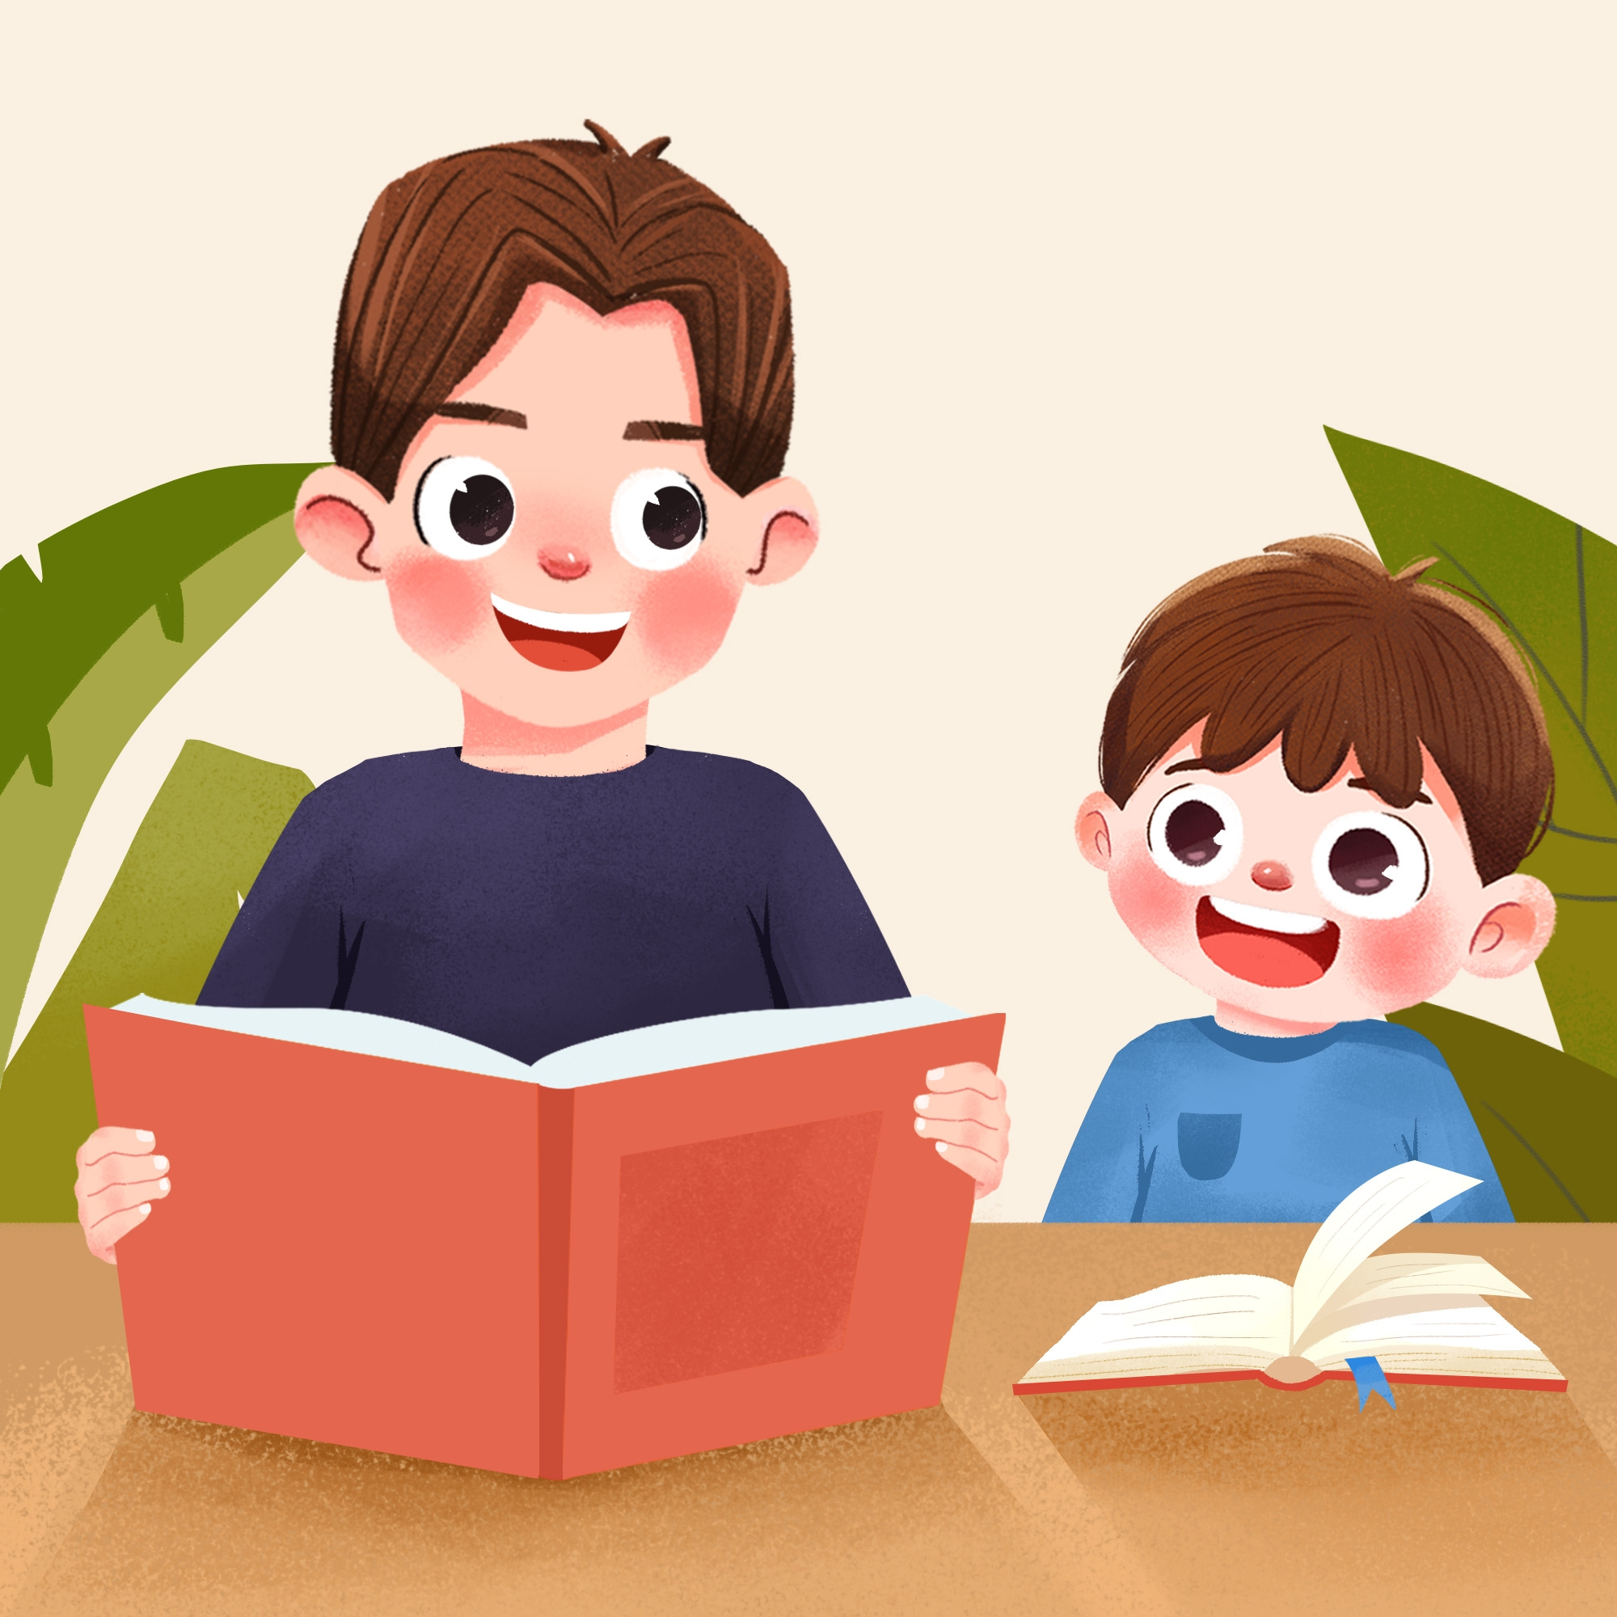
Why should children take after-school classes?
I want my child to be a successful person.
Youth Magazine
Notes:
Tang原创英语课件
小红书：Tang

Slide 9
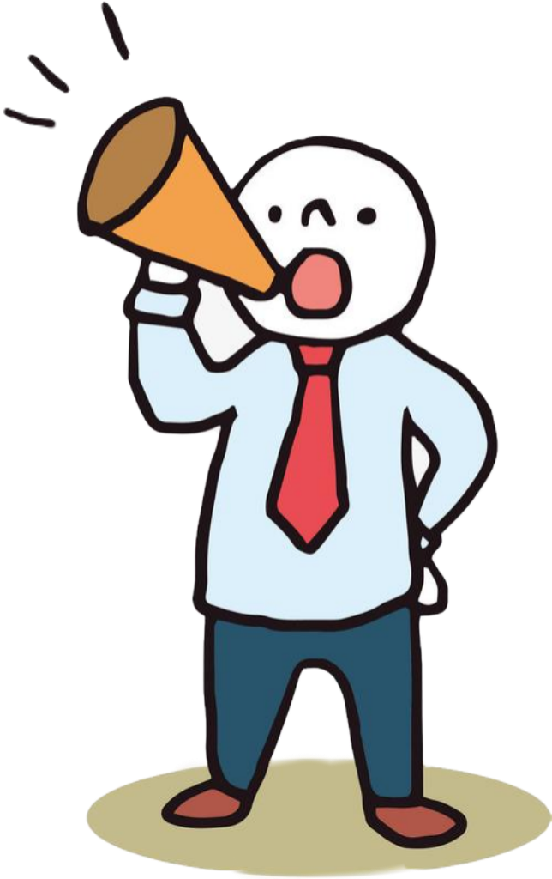
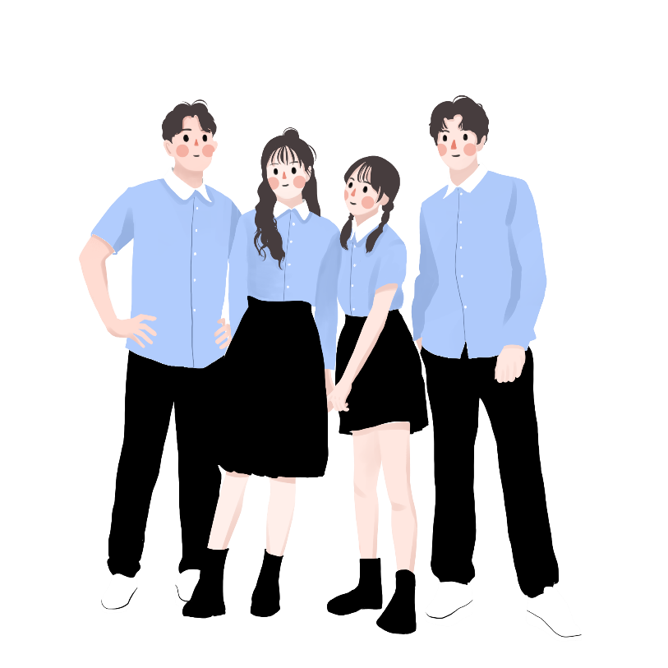
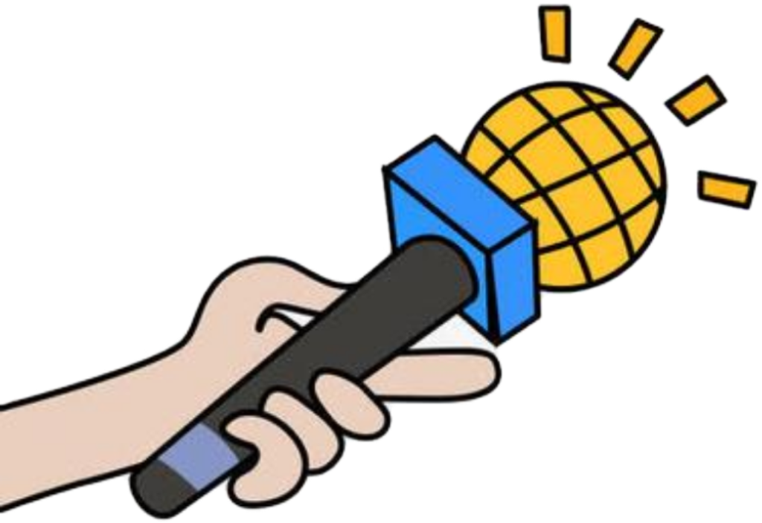
What are your opinions?
Do you agree with them?
Youth Magazine
Notes:
Tang原创英语课件
小红书：Tang

Slide 10
Should kids take after-school classes?
Children should take after-school classes because…
Children shouldn’t take after-school classes because…
After-school classes are good for the
children’s future. They can help children
learn more skills.
2. Some of these classes help children to feel
good about themselves.

Slide 11
Should kids take after-school classes?
Children should take after-school classes because…
Children shouldn’t take after-school classes because…
3. Some classes help children to learn important skills.
These skills may actually help children relax.
4. Children have more time than adults, so they should
learn as much as they can before they get too busy to
learn new things.

Slide 12
Should kids take after-school classes?
Children should take after-school classes because…
Children shouldn’t take after-school classes because…
1. After-school classes take away children’s
free time. Children have no time to relax
and just do nothing.
2. Children may be so busy that they have no
time to absorb what they have been taught.
Notes:
Tang原创课件,请勿侵权！
小红书/抖音：Tang原创课件
淘宝：Tang原创课件

Slide 13
Should kids take after-school classes?
Children should take after-school classes because…
Children shouldn’t take after-school classes because…
3. Some children are forced to learn what they
are not interested in.
4. These classes cause the children to be stressed.
5. These classes take away the children’s
childhood.

Slide 14

Write a letter to the magazine to express your opinions on after-school classes for children. Use the following expressions to help you.
3b
Youth Magazine
Notes:
Tang原创英语课件
小红书：Tang

Slide 15

写作策略：使用连接词让文章更有逻辑性
Try to write two paragraphs.
First, say if you agree or disagree. Dear…, I don’t really agree with…because… Although some parents are right about…, I think children should… | Then, explain why. In my opinion, it is important for children/parents to… I believe it is better if children/parents…so that… Perhaps children/parents should/could… If children…, they will…

Slide 16
Outline
Outline
Dear _________,
I agree/disagree with some parents. Because children should have more time to do what they
like. They don’t have to study all the time.
Beginning
Body
Some parents think...In my opinion, it’s important for kids to...At the same time, children need to...
In a word, I believe it’s better... Remember, happiness and health are more important than grades!
Ending
16
Notes:
Tang原创课件,请勿侵权！
小红书/抖音：Tang原创课件
淘宝：Tang原创课件

Slide 17
One possible version
Dear Sir or Madam,
I don’t really agree with what parents are saying about after-school classes because they only want to have successful children.
Although some parents are right about the importance of learning at a young age, I think children should be allowed to be children and have a carefree childhood.
In my opinion, it is important for parents not to push their children too hard. I believe it is better if parents try to really understand their children’s interests and abilities first

Slide 18
One possible version
so that they will not make their children take classes that are not suitable for them.
Perhaps parents could let their children decide for themselves if they want to have any after-school classes. If children are allowed to take the classes they choose for themselves, they will benefit more from these classes. They will grow up to be not only successful in their own way but happy too.
Yours truly,
Li Hua

Slide 19
Fill in the blanks with proper linking words or phrases.
Dear Sir or Madam,
Some parents think after-school classes can help kids get into a good university. ______ they take their children to all kinds of after-school classes on weekends.______ I don’t think so.
____________, it’s important for kids to relax themselves on weekends. On weekdays, they are busy studying all the time.
So
But
In my opinion

Slide 20
Fill in the blanks with proper linking words or phrases.
It’s true that every parent wants their children to be successful. They think getting good grades is the only way to be successful. They ______ think it’s good for children to start learning from a young age. _______________, children need to have a good rest on weekends. If they do, they will study better on school days.
The better they have a rest, the better they will study on school days.
also
At the same time

Slide 21

单元话题概述
本单元的话题和“烦恼(problems)”有关。对于初中生来说，“烦恼”是一个经常接触到的话题。和该话题有关的书面表达常见的命题形式是“诉说烦恼”和“给出建议”，一般是书信的体裁，
Notes:
Tang原创课件,请勿侵权！
小红书/抖音：Tang原创课件
淘宝：Tang原创课件

Slide 22
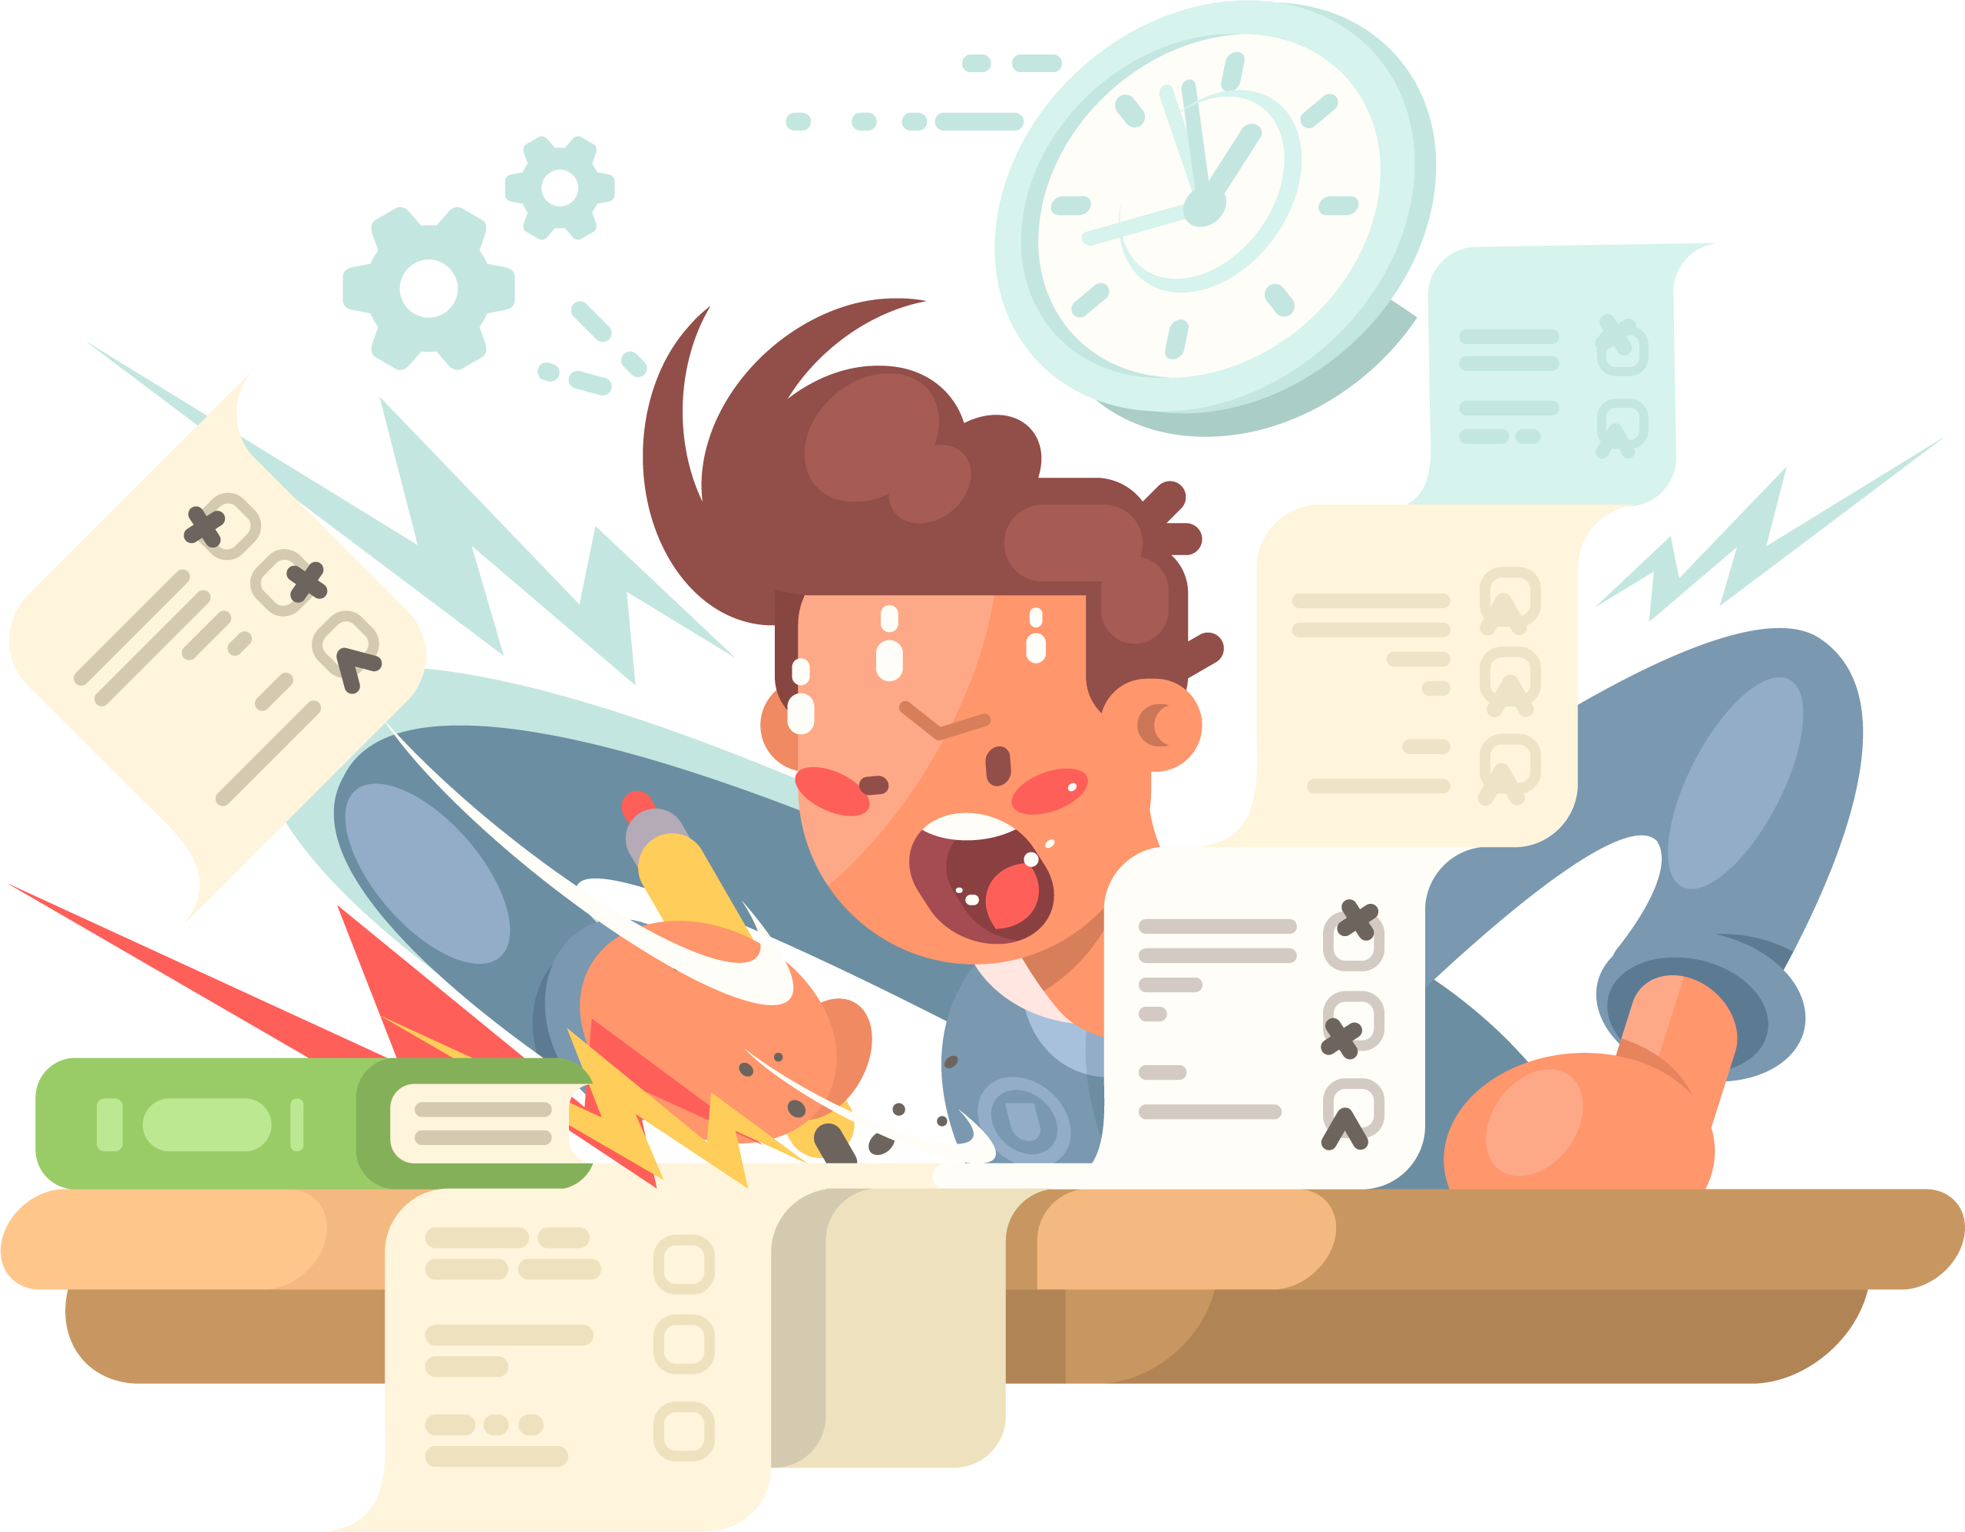
【It’s time to write】
“双减”政策出台后，李华不用再上补习班了，他想早点回家帮助父母做一些家务活。然而，他父母却给他报了很多艺术班，他们认为这能使孩子更成功。李华向朋友Rick倾诉自己的苦恼。假如你是Rick，请你给李华写一封回信谈谈你是否同意其父母的观点，说明理由并给出建议。
注意: 文章必须包含所给要点提示，
要求语句通顺,行文连贯。
Notes:
Tang原创英语课件
小红书：Tang

Slide 23
【It’s time to write】
【写作指导】
定时态：一般现在时
定人称：第一、二人称
定体裁：信件
要求：对李华父母的做法进行评价，给出理由并给出建议。
Notes:
Tang原创英语课件
小红书：Tang

Slide 24
How to show your opinion?
In my opinion, .
In my mind, .
I think .
I don’t think .
I agree .
I don’t agree/ disagree .
It’s important/necessary/fair/unfair for sb. to do sth .
Notes:
Tang原创课件,请勿侵权！
小红书/抖音：Tang原创课件
淘宝：Tang原创课件

Slide 25
Use linking words correctly!
1.表示并列或递进：and, both …and, not only …but also
2.表示结果：so …that, too …to …
3.表示转折：but, however, although …
4.表示因果：because, so, therefore, as a result …
5.表示条件：if, unless, …
6.表示对比：on the one hand …on the other hand …
7.表示举例：for example, such as …
8.表示顺序：first/first of all/ in the first place/to begin with; second,
what’s more, next, finally/in the end/last but not least…
9.表示目的：in order to, in order that….
10.表示结论：all in all, in a word…

Slide 26
Outline
Outline
Beginning
I agree / disagree with your parents.
I think / believe it would be better if children could do the housework every day.
In my opinion, too much pressure is not good for teenagers 'development…
Body
All in all, you should talk with your parents. If you tell them your feelings, they will understand you. Hope things work out.
Ending
Notes:
Tang原创课件,请勿侵权！
小红书/抖音：Tang原创课件
淘宝：Tang原创课件

Slide 27
One possible version
One possible version
Dear Li Hua,
I disagree with your parents, because they give you too much pressure. Although they want to help you become excellent, I don't think they are using a proper way.
In my opinion, it would be better if children could do the housework every day. Because they can get some life skills. A successful person should have many different abilities like communicating with others and solving problems by himself. I also believe too much pressure is not good for teenagers’ development.
Perhaps you should talk with your parents. If you tell them your feelings, they will understand you.
Hope things work out.
Yours,
Rick
Checklist
“SCE” |  | 自评 | 互评 | 师评
Structure | Use a clear structure
Contents | 1.Give at least two reasons 2.Express the opinion and reasons clearly
Expressions | 1.Few or no spelling and grammar mistakes 2.Use linking words 3.Use good words or sentences
Handwriting | Clean and clear.
Excellent Good To be improved
Notes:
Tang原创课件,请勿侵权！
小红书/抖音：Tang原创课件
淘宝：Tang原创课件

Slide 28

Solve the problem with your parents.
Have a talk with your friends.
Accept the advice of your teachers.
Running away from problems is useless.
Enjoy your life every day.
Communication
your problem and your happiness.
Be a happy teenager from now on.
Share

Slide 29
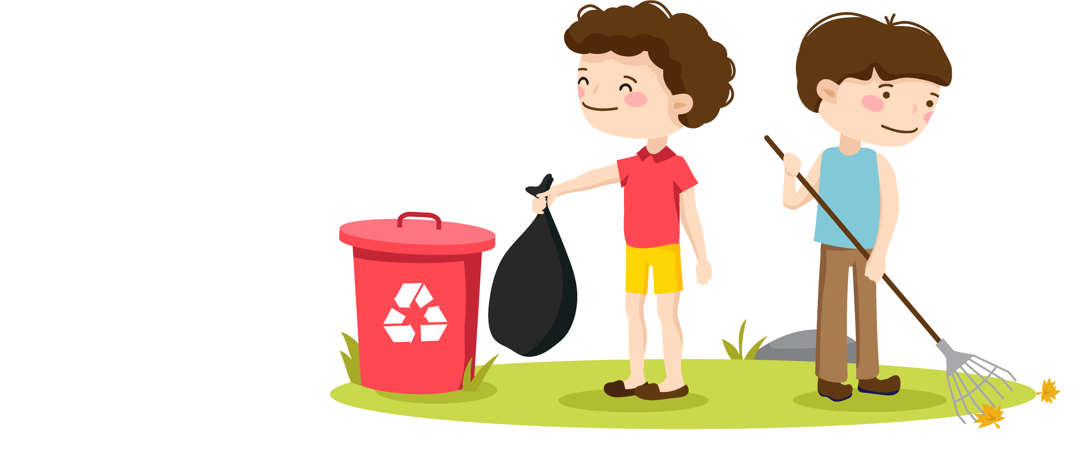
Self Check
1 Fill in the blanks using until, so that or although.
1.You should eat more now ______ you won’t be
hungry later.
2. ________ you may not like to do chores, you
should help your parents around the house.
so that
Although

Slide 30
Self Check
1 Fill in the blanks using until, so that or although.
so that
3. You could save more money ___________ you can
buy a gift for your friend’s birthday.
4. Kids shouldn’t play computer games _____ late at
night. They should rest early.
5. _________ many people like to eat junk food, they
should really eat more fruit and vegetables ______
they can be healthy.
until
Although
so that

Slide 31
Self Check
2 For each problem, choose the advice you agree
with more. Then write your own advice.
1. My best friend and I had a fight, and now she
won’t speak to me.
A: You should keep trying to talk to her until
she talks to you.
B: Why don’t you wait a few more days before
talking to her?
My advice: _____________________________
____________________________
You could write a letter to her so
that you can say you’re sorry.

Slide 32
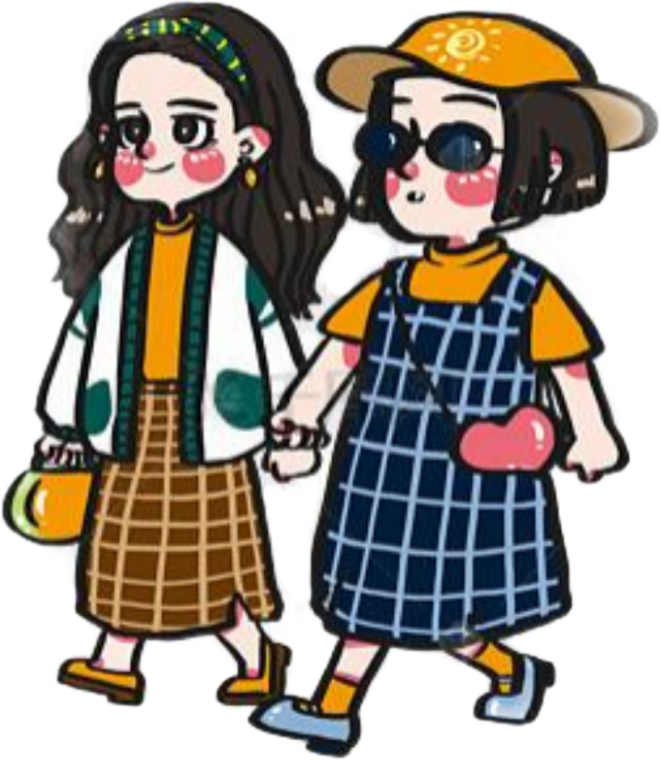
Self Check
2 For each problem, choose the advice you agree
with more. Then write your own advice.
2. My friend wants me to go to a party on the weekend,
but I want to study for my exams next week.
A: Why don’t you just go to the party? It’ll help
you to relax.
B: You should study for the exams because they’re
more important than a party.
My advice: _______________________________
_______________________________________
Why don’t you tell your friend that
your parents don’t allow you to go there?

Slide 33
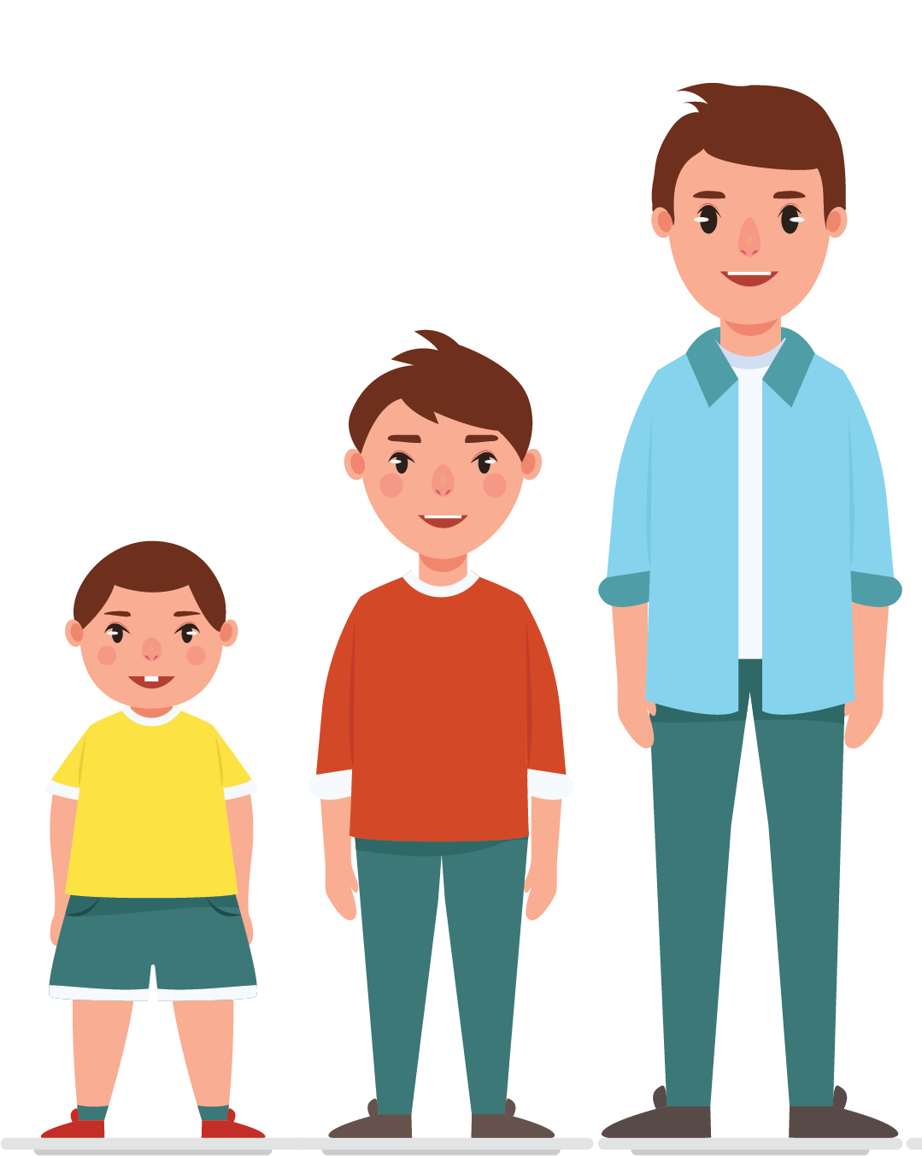
Self Check
2 For each problem, choose the advice you agree
with more. Then write your own advice.
3. My brother watches television while I’m trying
to study.
A: Why don’t you tell him to do something quiet
when you’re studying?
B: You could tell him to turn down the TV.
My advice:_____________________________
________________
You should tell your brother to
study with you.

Slide 34
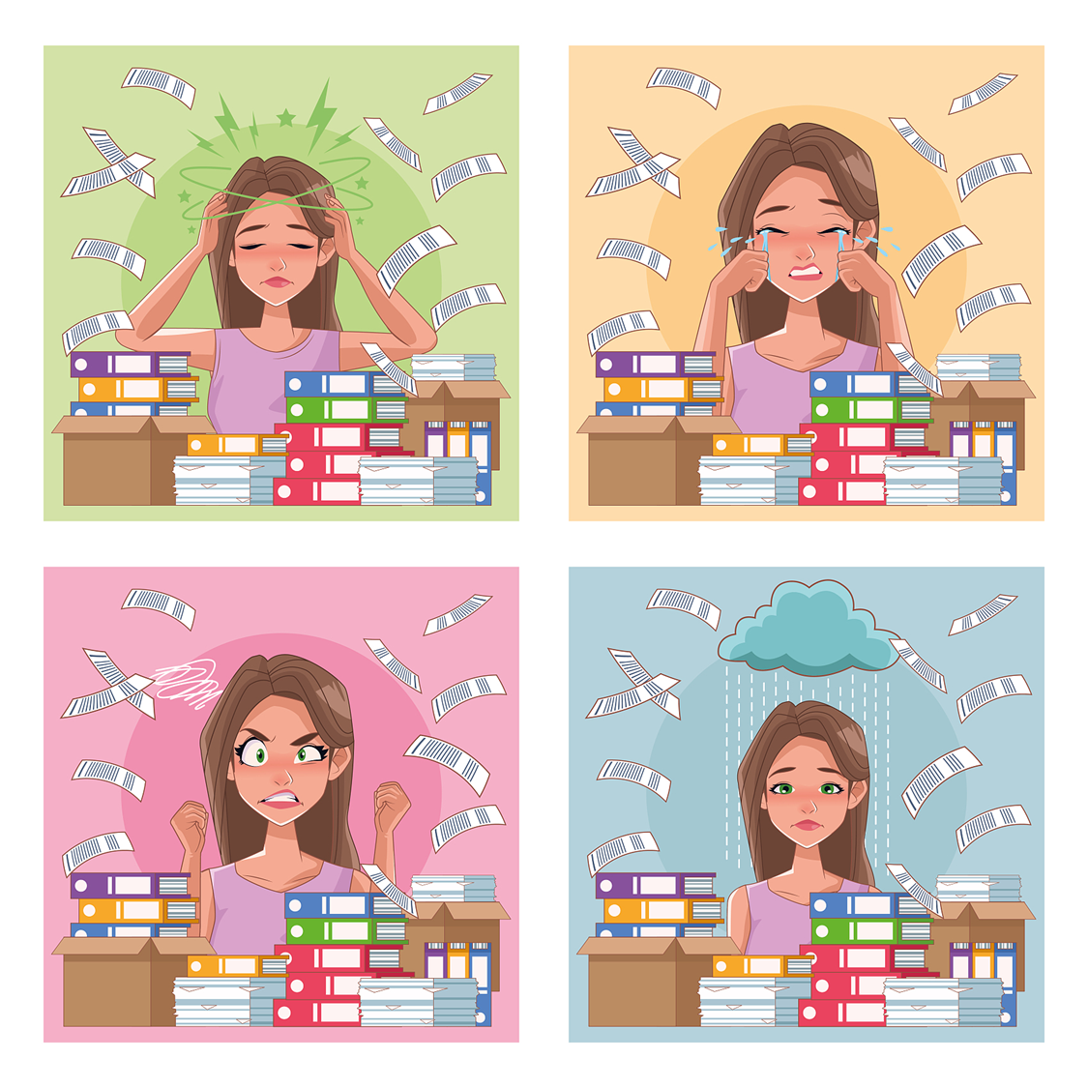
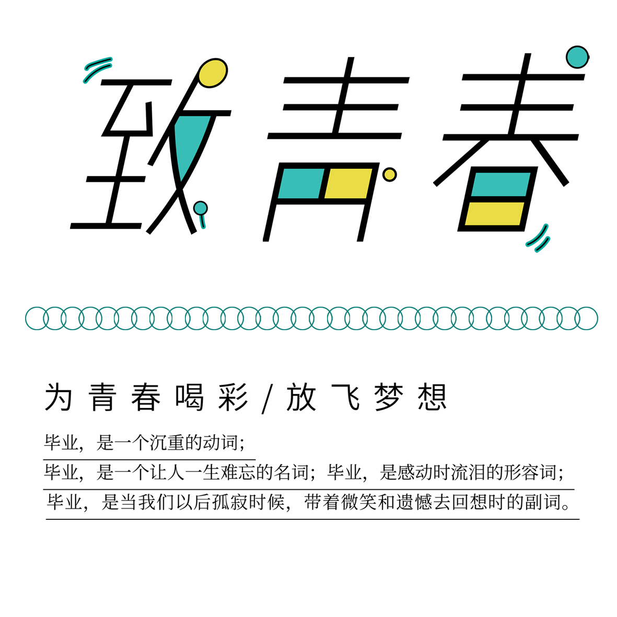
Trouble Away Book
大单元整体项目式教学：
通过本单元的学习，搜集整理青少年常见烦恼，分析原因，并给出建议，设计烦恼消失书。
1.描述问题与矛盾，正确看待成长中的问题；（描述烦恼）
2.分析问题与情感态度，客观理性地评价问题；（分析烦恼）
3.给出建议和表达观点，积极理性解决问题。（烦恼消失术）
Notes:
Tang原创课件,请勿侵权！
小红书/抖音：Tang原创课件
淘宝：Tang原创课件

Slide 35
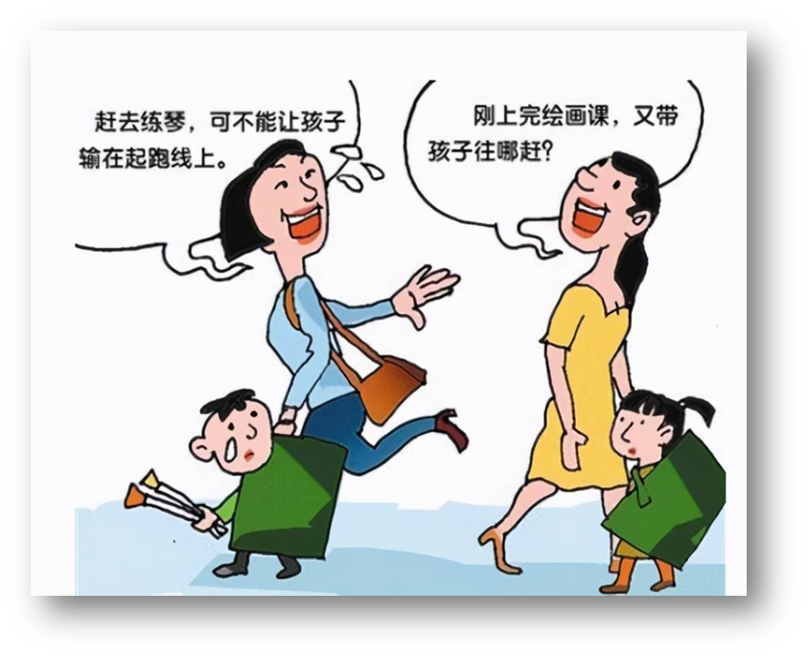
Trouble Away Book
Here is some advice for you.
…...
have too many
after-school classes
2
Notes:
Tang原创课件,请勿侵权！
小红书/抖音：Tang原创课件
淘宝：Tang原创课件

Slide 36
Homework
Homework
Must do: 1.Finish your Trouble Away Book;
2.Polish it according to your group members’ advice.
Try to do: 3.Draw a mind map to review Unit 4;
4.Try to help others by giving them some useful advice.
Notes:
Tang原创课件,请勿侵权！
小红书/抖音：Tang原创课件
淘宝：Tang原创课件

