Slide 1

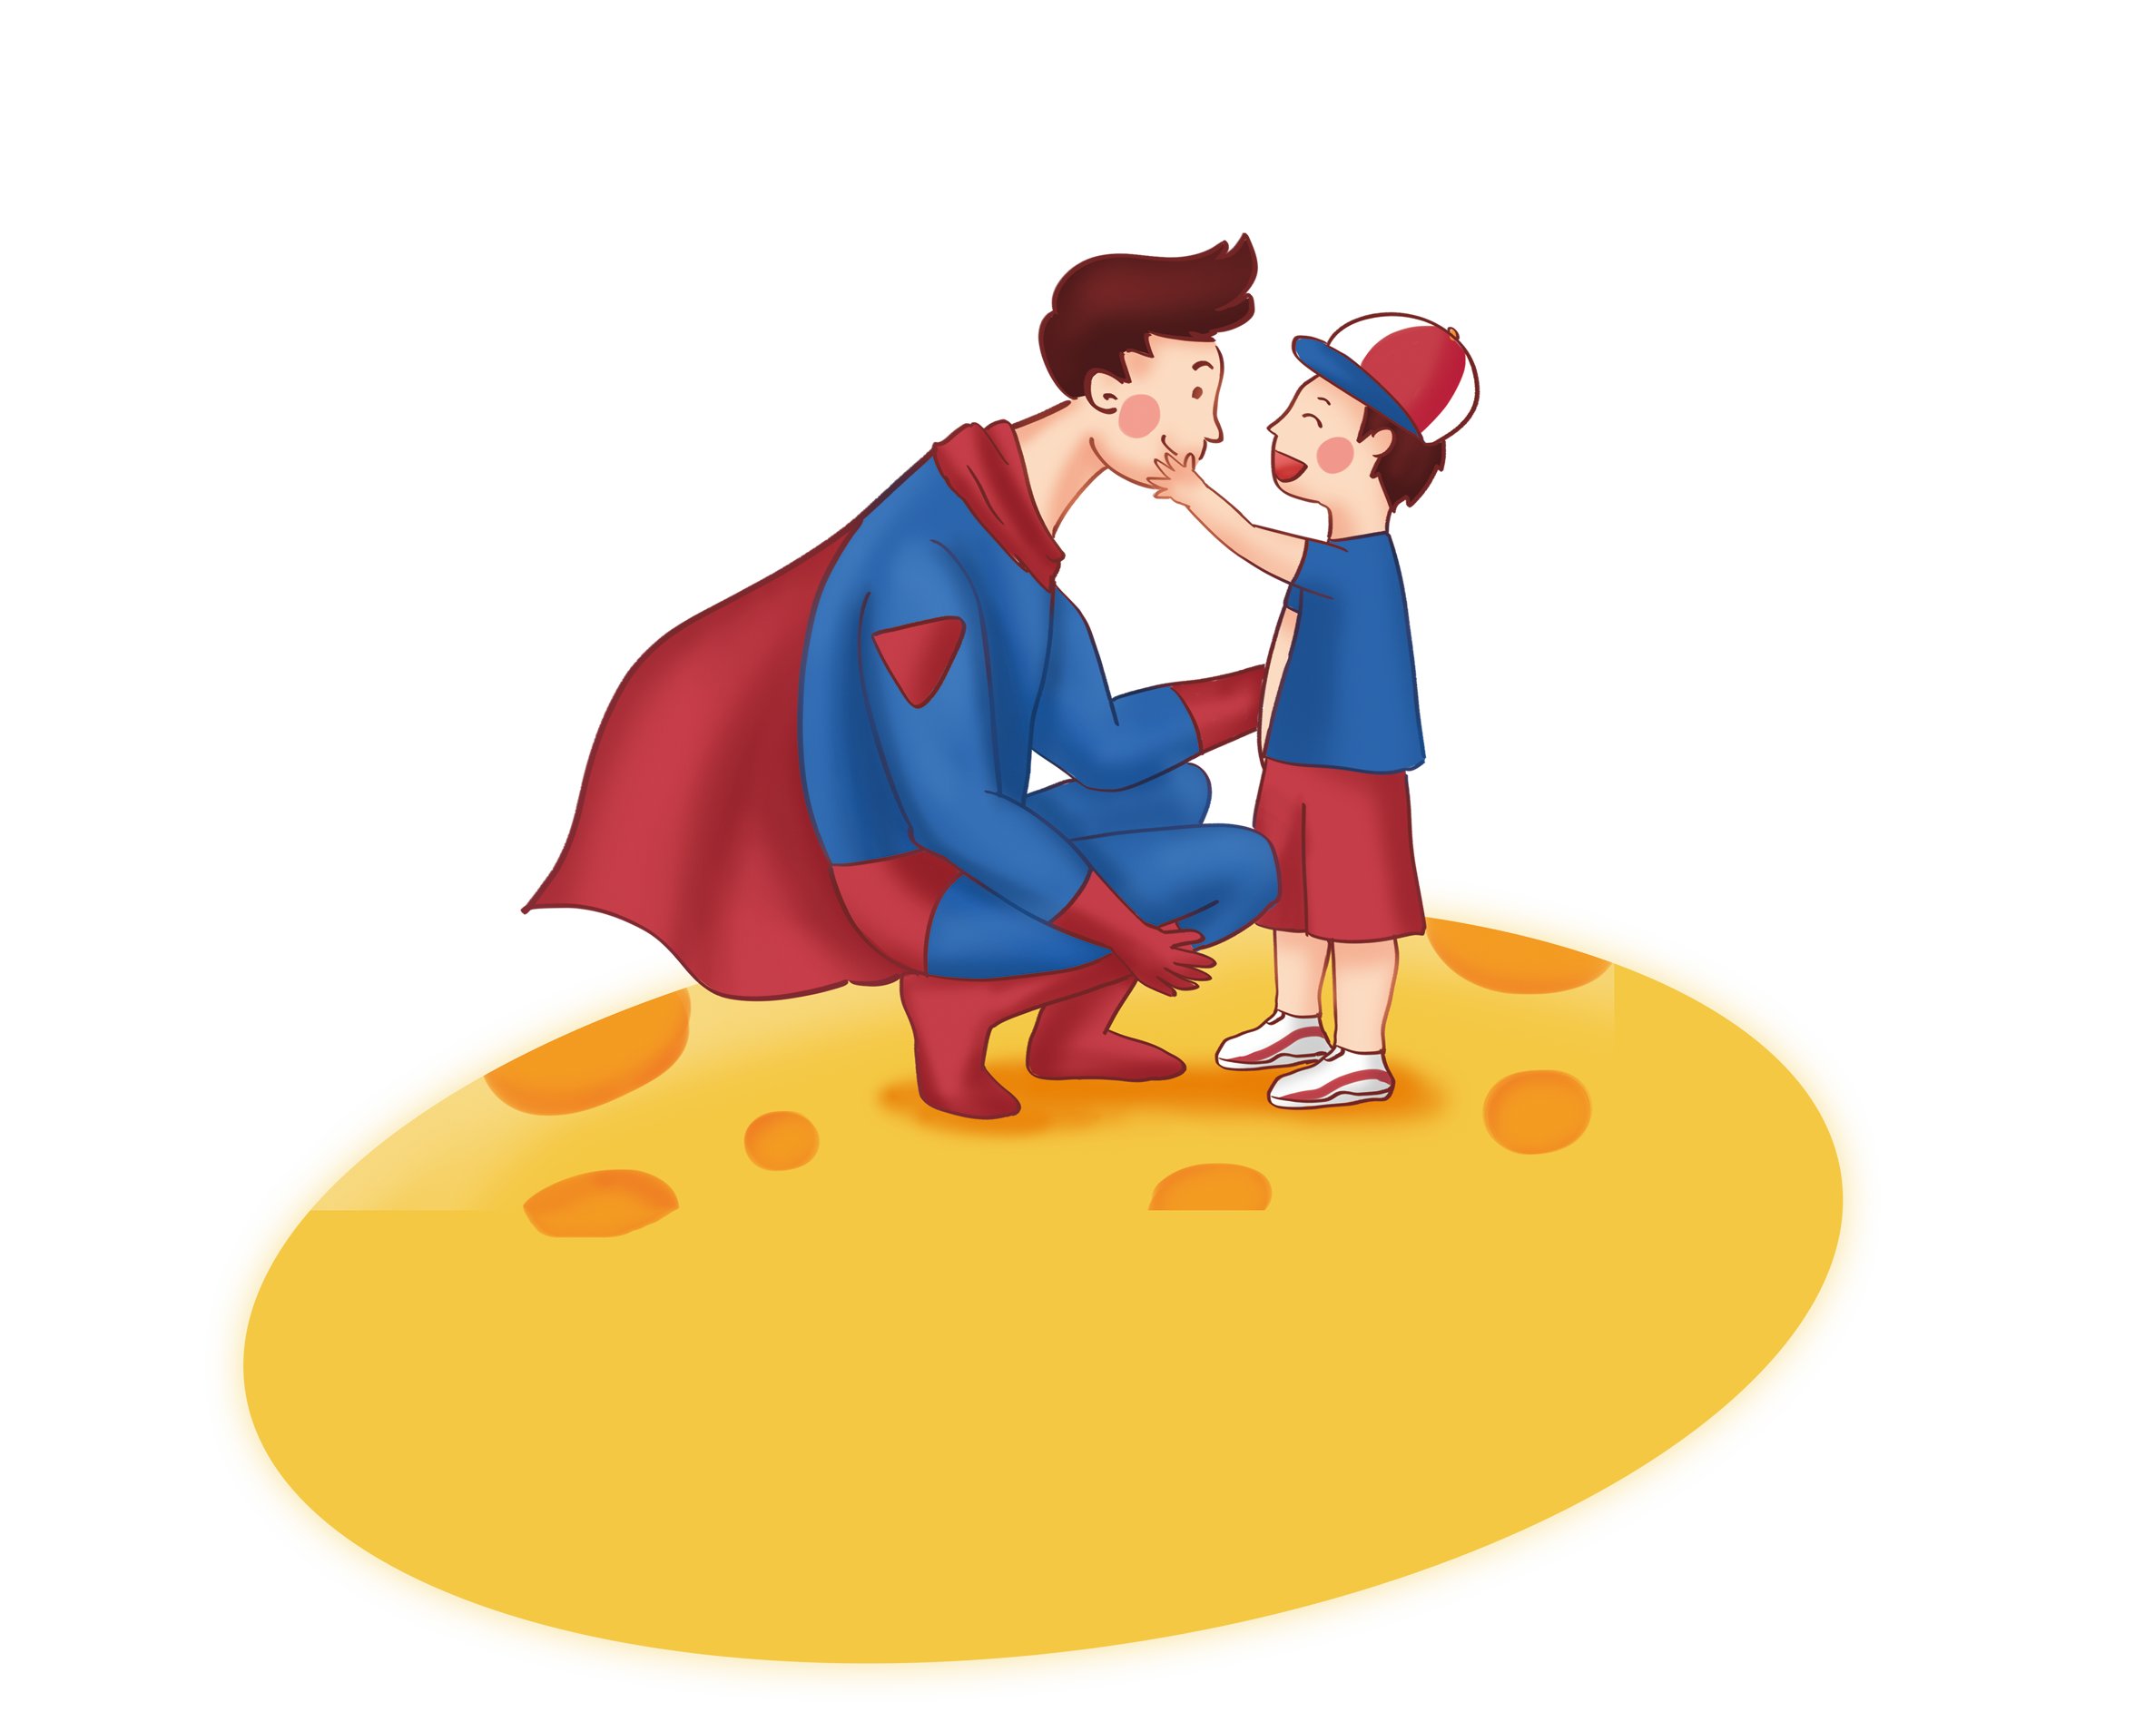
Unit 4
Why don’t you talk to your parents?
Section A 3a-3c

Slide 2

通过本课时学习，我们能够：
通过学习阅读文本，在掌握书信阅读技巧的同时，进一步熟悉本单元目标语言；并通过梳理阅读中人物所遇到的问题，理解家庭关系对于孩子健康成长的重要性，思考如何通过共同努力去营造良好的家庭关系。 （学习理解）
1
对文中所谈及的问题提出自己的看法，并分析问题中所涉及到的家人的做法、观点进行评论；能够用目标语言对两封信的内容进行归纳，并对Mr. Hunt的建议进行评价。（应用实践）
2
拓展了解到家庭关系对青少年生活和学习的影响，同时能够通过课外查询资料了解青少年常遇到的家庭问题（如父母吵架、二孩问题等），并了解有效的处理方式。（迁移创新）
3
Notes:
Tang原创课件,请勿侵权！
小红书/抖音：Tang原创课件
淘宝：Tang原创课件

Slide 3

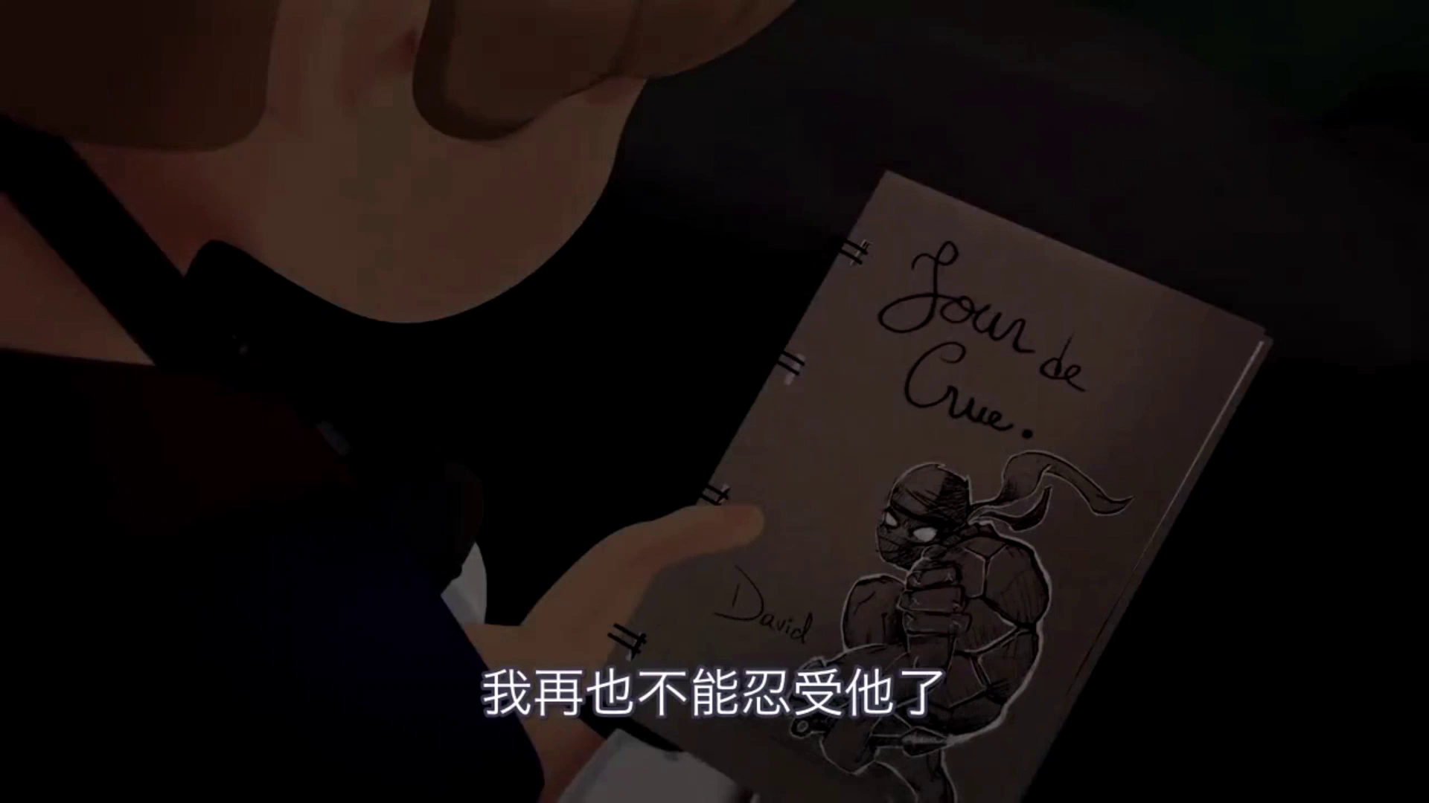


Watch the video and answer the questions:
1. What happened to the parents?
They argued with each other.
2. What was the boy’s feeling?
The boy was really sad and upset.
3. Did the boy get on well with his parents?
Notes:
Tang原创英语课件
小红书：Tang

Slide 4
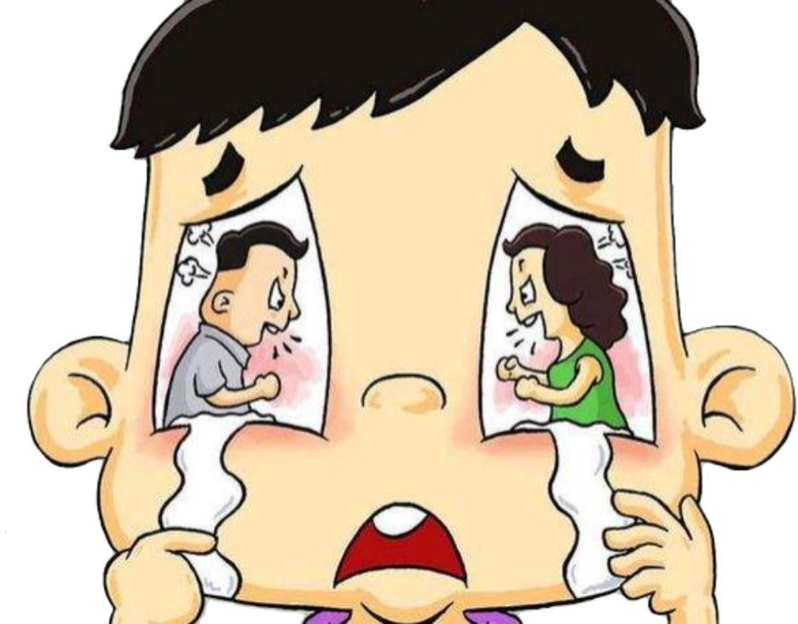
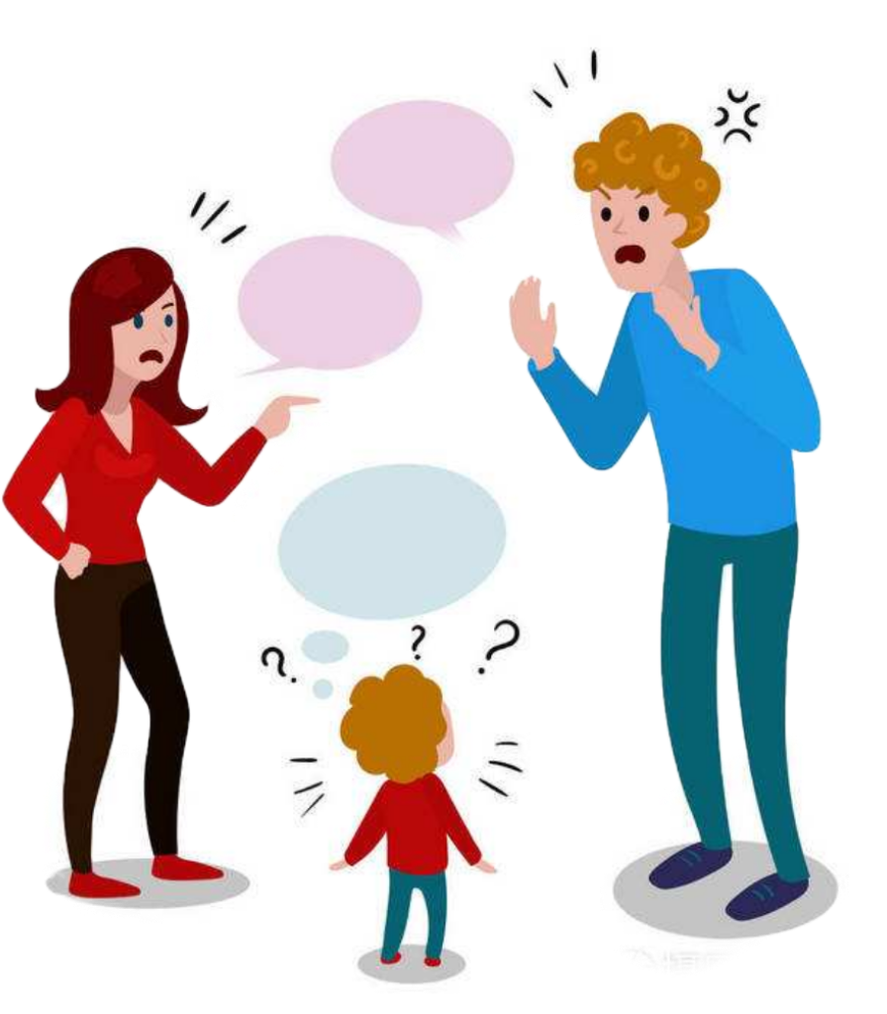

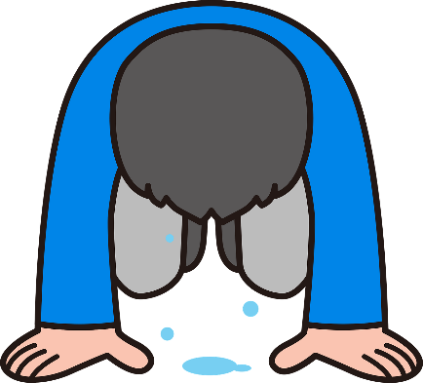
Free Talk
1
Do your parents often argue or fight a lot?
2
Can you get on well with your family?
If you have problems with
your family, who will you ask for help?
3
Are the relations between your family difficult?
Notes:
Tang原创英语课件
小红书：Tang

Slide 5

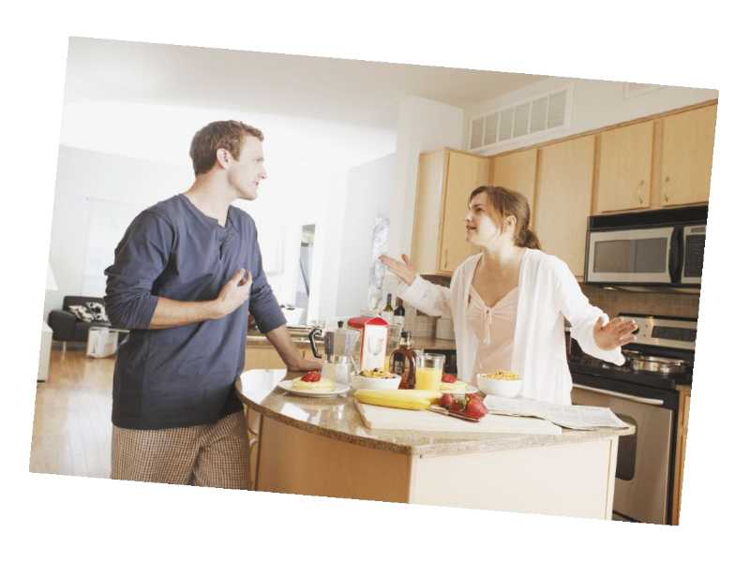
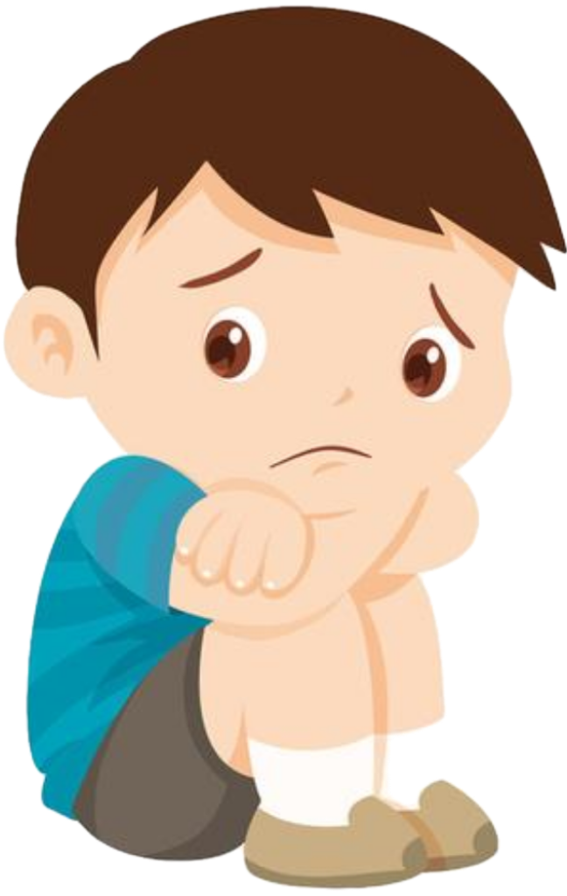

What's the problem with the parents?
Who can he
ask for help?
They argue with each other.
How does Sad and Thirteen feel ?
Scared, terrible, nervous, sad, lonely...
Sad and Thirteen
Notes:
Tang原创英语课件
小红书：Tang

Slide 6
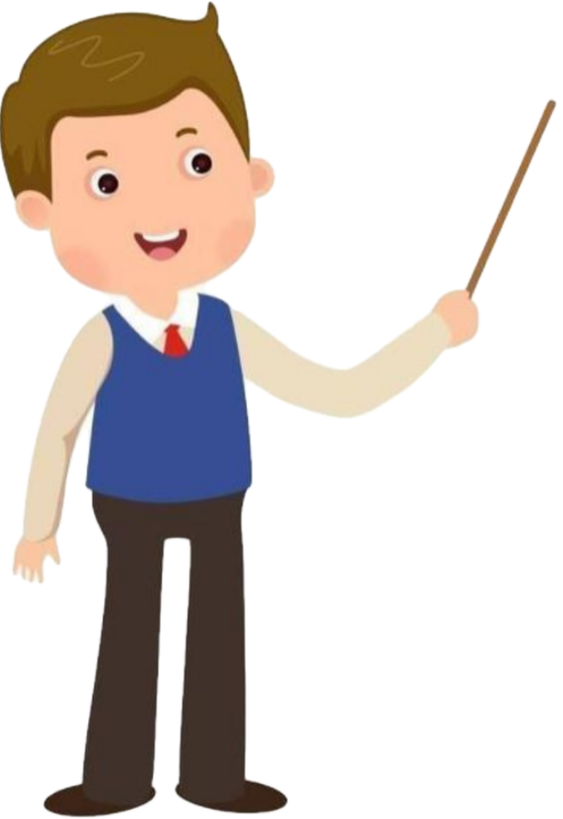



Mr. Hunt
Dear Mr. Hunt,
My problem is that I can’t get on with my family. Relations between my parents have become difficult. They fight a lot, and I really don’t like it. It’s the only communication they have. I don’t know if I should say anything to them about this.
When they argue, it’s like a big, black cloud hanging over our home. Also, my elder brother is not very nice to me. He always refuses to let me watch my favorite TV show. Instead he watches whatever he wants until late at night. I don’t think this is fair. At home I always feel lonely and nervous. Is that normal? What can I do?
Sad and Thirteen
Sad and Thirteen
Notes:
Tang原创英语课件
小红书：Tang

Slide 7
Read the letter and find out Sad and Thirteen’s problems.
Dear Mr. Hunt,
My problem is that I can’t get on with my family. Relations between my parents have become difficult. They fight a lot, and I really don’t like it. It's the only communication they have. I don’t know if I should say anything to them about this. When they argue, it’s like a big, black cloud hanging over our home. Also, my elder brother is not very nice to me. He always refuses to let me watch my favorite TV show. Instead he watches whatever he wants until late at night. I don’t think this is fair. At home I always feel lonely and nervous. Is that normal?
What can I do?
Sad and Thirteen
get on with
He can't___ __ ____his family.
elder
parents
________brother
not nice
refuses
Problems: He is___ ____to him.He_______to let him watch his favorite TV show. Instead,
————————————————.
fight
Problems:They a lot.It's the only ____________they have.
communication
he watches whatever he wants
unfair
Feeling: It's like a big, black cloud ______ _____ his home.
Feeling: This is . Sad and Thirteen feels_______and_______.
hanging over
lonely
nervous

Slide 8
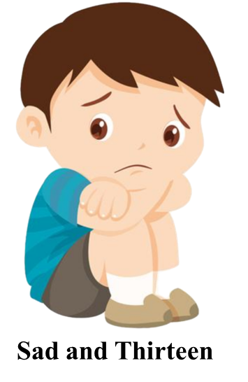

Try to retell Sad and Thirteen’s problems.
Sad and Thirteen has some _________. He can’t ____________ his family. His parents _____ a lot. It’s the only ______________ they have. When they _____, it’s like a big, black cloud ______________ their home. He doesn’t like it.
problems
get on with
What advice Mr. Hunt give to him?
fight
communication
argue
hanging over
His brother always watches ________ he wants until midnight.
He _______ to let Sad and Thirteen watch his favorite TV
TV show. So Sad and Thirteenhe thinks it’s______and always feels ______ and ________ at home.
whatever
refuses
unfair
lonely
nervous
Notes:
Tang原创课件,请勿侵权！
小红书/抖音：Tang原创课件
淘宝：Tang原创课件

Slide 9
Sad and Thirteen
Dear Sad and Thirteen,
It’s not easy being your age, and it’s normal to have these feelings. Why don’t you talk about these feelings with your family? If your parents are having problems, you should offer to help. Maybe you could do more jobs around the house
so that they have more time for proper communication.
Secondly, why don’t you sit down and communicate with your brother? You should explain that you don’t mind him watching TV all the time. However, he should let you watch your favorite show. I hope things will be better for you soon.
Robert Hunt
Mr. Hunt
Notes:
Tang原创英语课件
小红书：Tang

Slide 10
Read the letter and find out Mr. Hunt's advice.
Dear Sad and Thirteen,
It’s not easy being your age, and it’s normal to have these feelings. Why don’t you talk about these feelings with your family? If your parents are having problems, you should offer to help. Maybe you could do more jobs around the house so that they have more time for proper communication.
Secondly, why don’t you sit down and communicate with your brother? You should explain that you don’t mind him watching TV all the time. However, he should let you watch your favorite show. I hope things will be better for you soon.
Robert Hunt
运用不同的提建议句型：
1.Why don’t you do sth.?
2.You should do sth.
3.You could do sth.
Notes:
Tang原创课件,请勿侵权！
小红书/抖音：Tang原创课件
淘宝：Tang原创课件

Slide 11
Read the letter again and fill in the blanks.
normal
It’s _______ to have these feelings.
Advice
about parents
about brother
talk about
1. Why don’t you sit down and
________________ him?
2. You should _______ that you
don’t ____ him watching TV
all the time.
3. He should ___ you _______ your favorite show.
1.Why don’t you_________these
feelings with your family?
2. You should___________if your
parents are having problems.
3. Maybe you could____________
so that they have more time for
____________________.
communicate with
offer to help
explain
mind
do more jobs
let
watch
proper communication
Notes:
Tang原创课件,请勿侵权！
小红书/抖音：Tang原创课件
淘宝：Tang原创课件

Slide 12
Try to retell Robert Hunt’s advice.
Robert Hunt thinks Sad and Thirteen should __________ these feelings with his family. He should _____ to help.
talk about
offer
Maybe he _____________ jobs around the house so that
they have more time_____________________________
Secondly, he could sit down and ________________ his brother. He could ________ that he ____________ his brother watching TV all the time, however, his brother should let him watch his _____________.
could do more
for proper communication
communicate with
explain
doesn’t mind
favorite show

Slide 13

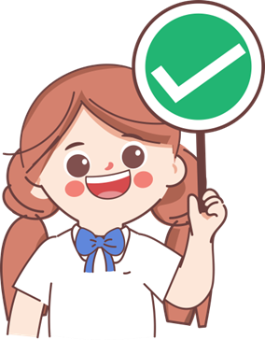
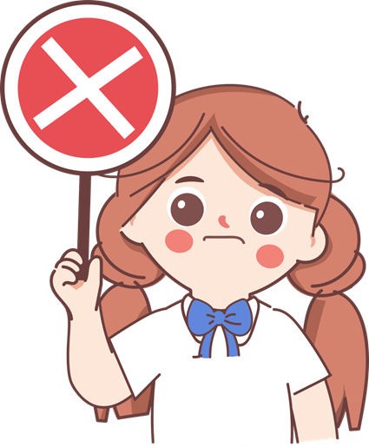
Do you agree or disagree with Mr. Hunt’s advice? Why?
3b
Can you give him some advice?
I agree / disagree with his advice because ...
I agree with Mr. Hunt’s advice because the parents will understand their kids and will not fight anymore after proper communication. And also, the brother will be nice to him if he explains his idea to his brother.
I disagree. The parents and elder brother may get even angrier as they may think that the writer is being disrespectful(不尊重的). They may feel that children should not comment(评论) on the behavior of their seniors(长辈).
Notes:
Tang原创英语课件
小红书：Tang

Slide 14

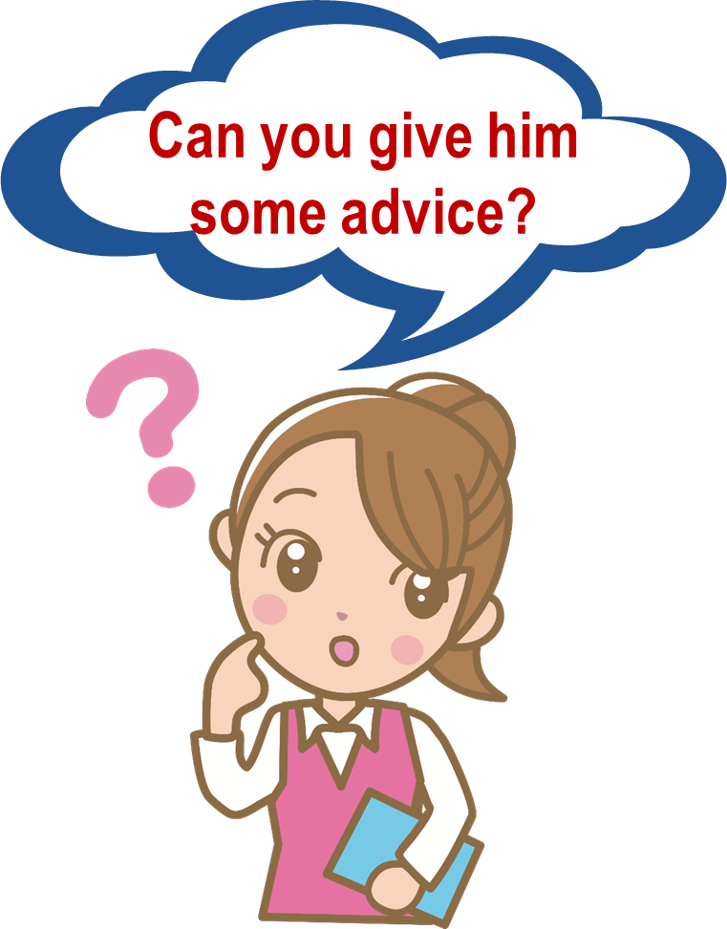
1. Tell your parents to keep cool communicate with each other.
2. Ask your grandparents for help.
3. Tell your elder brother to share something with others in life.
4. Tell your feelings to him. He should be nice to you.
5.......
A good relation depends on good communication.
A good relation depends on good communication.
Notes:
Tang原创英语课件
小红书：Tang

Slide 15
Is “Sad and thirteen” a real name?
How about you?
Sad and Thirteen
feelings
age
Happy/Worried/Lonely and Thirteen?
Notes:
Tang原创课件,请勿侵权！
小红书/抖音：Tang原创课件
淘宝：Tang原创课件

Slide 16

What problems do you have?
Please discuss them in groups and give your advice. Then give a report.
Name | Problems | Advice
John
not good at English
practice reading English and work harder at school
Checklist
Activities: Group work |  | 小组互评
Contents | Write down your problems and give advice
 | Use the phrases we have learned today
Speaking | Speak clearly and fluently
 | Use tone and body language properly
Excellent Good To be improved
Lily
argue with her his brother
communicate with your brother
Jack
not have enough sleep
go to bed early
Sample: In my group, John is not good at English. Lily
.... As for me....
In my opinion, John should practice.... Lily.....
I
......
......
Notes:
Tang原创课件,请勿侵权！
小红书/抖音：Tang原创课件
淘宝：Tang原创课件

Slide 17
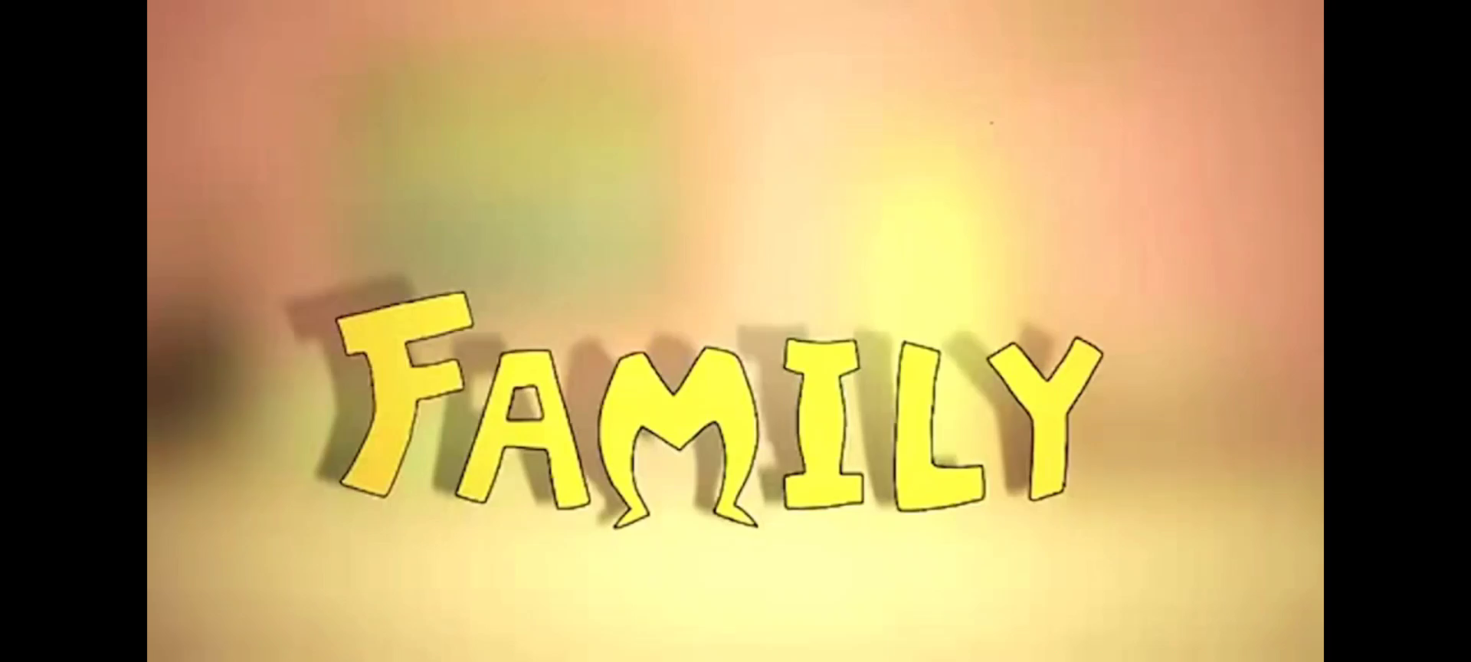
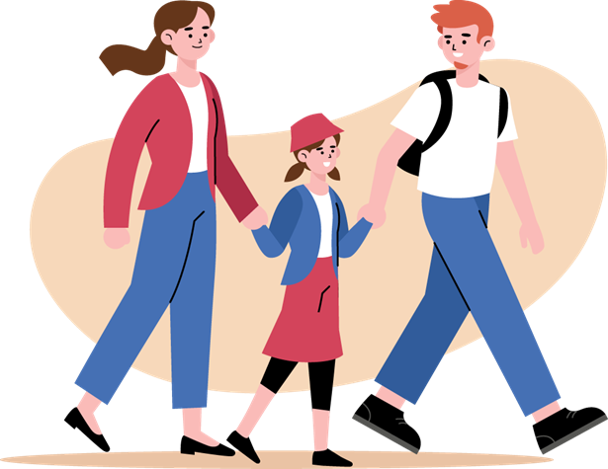
Father and mother I love you.
Notes:
Tang原创英语课件
小红书：Tang

Slide 18

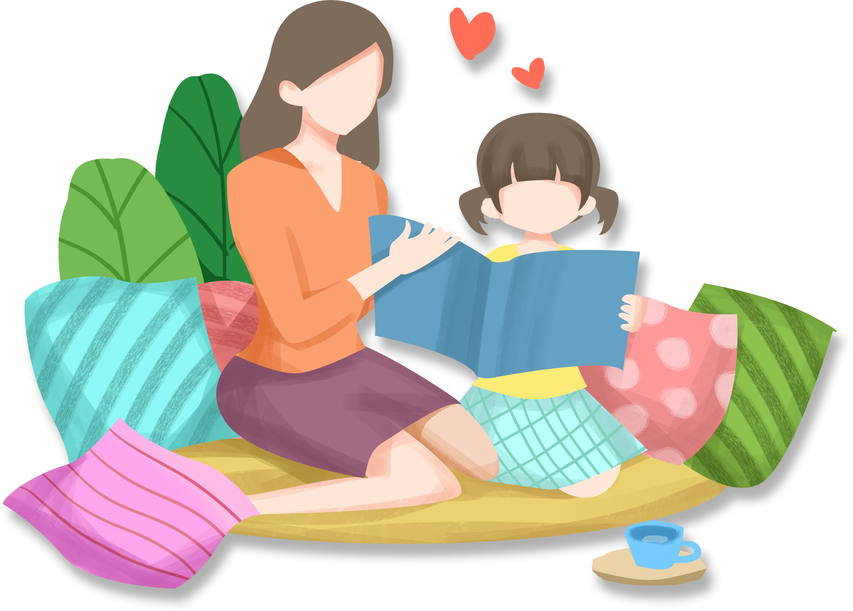

How should we get on well with our family?
First, listen to each other.
Then, open your mind.
Next, voice your true feelings.
Finally, equal(平等) to each other.
l
o
v
e

Slide 19
Which words or phrases in the letters have the same or similar meanings as the following? Write a sentence using each word or phrase.
3c
make sth. clear — explain
Can you explain to me how to do this math problem?
talk — ________________
________________________________________________
________________________________________________
communicate
Family members should communicate with each other so that they can understand each other better.

Slide 20
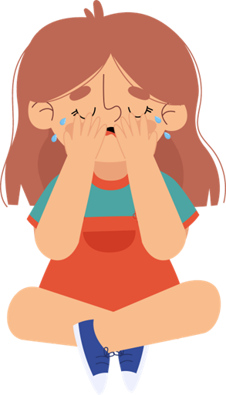
not allow — ________________
____________________________________________________
refuse
Tom refuses to let her younger brother use her computer.
worried — ________________
____________________________________________________
nervous
I'm always very nervous before a test.
get along with — ________________
____________________________________________________
____________________________________________________
get on with
John and I get on with each other because we have a lot in common.

Slide 21

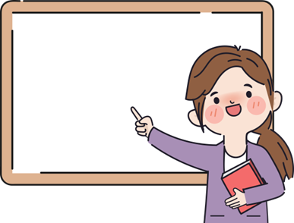
1.与某人相处得好
2.已变得很僵
3.经常争吵
4.与某人争吵
5.悬挂在上方/笼罩
6.对某人（不）好
7.拒绝做某事
8.代替/而不是做某事
9.感觉孤单和紧张
10.主动提供帮助
11.以便
12.向某人解释某事
13.介意某人做某事
14.一直
get on/along well with sb
have become difficult
fight a lot
argue with sb
hang over
be (not) nice to sb
refuse to do sth.
instead of doing sth.
feel lonely and nervous
offer to help
so that
explain sth. to sb.
mind sb. doing sth.
all the time
Notes:
Tang原创英语课件
小红书：Tang

Slide 22

Must do: 1.Retell the two letters according to the mind map;
2.Preview Section B 1a-1d.
Try to do: 1.Recite the article and review the key language points;
2.Write down more advice for Sad and Thirteen.
Notes:
Tang原创英语课件
小红书：Tang

Slide 23

Read and underline the language points.
= get along with 与某人相处
Dear Mr. Hunt,
My problem is that I can’t get on with my family. Relations between my parents have become difficult. They fight a lot, and I really don’t like it. It's the only communication they have. I don’t know if I should say anything to them about this. When they argue, it’s like a big, black cloud hanging over our home. Also, my elder brother is not very nice to me. He always refuses to let me watch my favorite TV show. Instead he watches whatever he wants until late at night. I don’t think this is fair. At home I always feel lonely and nervous. Is that normal?
What can I do?
Sad and Thirteen
表语从句
argue意为 “争吵,争论”。名词：argument
argue with sb. = have an argument with sb. 与某人争论
argue about sth. 就某事争论
定语从句
宾语从句
时间状语从句
笼罩
be nice to sb. 对某人友好
refuse to do sth. 拒绝做
无论什么他想要的东西
instead | “代替;反而;却” | 位于句首/句尾
instead of | “代替” “不是...而是...” | 后跟名词、代词、V-ing
Notes:
Tang原创课件,请勿侵权！
小红书/抖音：Tang原创课件
淘宝：Tang原创课件

Slide 24
Read and underline the language points.
Dear Sad and Thirteen,
It’s not easy being your age, and it’s normal to have these feelings. Why don’t you talk about these feelings with your family? If your parents are having problems, you should offer to help. Maybe you could do more jobs around the house so that they have more time for proper communication.
Secondly, why don’t you sit down and communicate with your brother? You should explain that you don’t mind him watching TV all the time. However, he should let you watch your favorite show. I hope things will be better for you soon.
Robert Hunt
条件状语从句
talk about sth. with sb. 和某人谈论某事
offer to do sth. 主动做某事
have time for sth.
communicate with sb. 和某人交流
explain sth. to sb. 向某人解释某事
宾语从句
mind sb. doing
介意某人做某事

Slide 25

二、 用括号内所给词的适当形式填空。
1. My __________(old) brother helps me to play basketball every day.
2. Firstly, you should listen to your teacher carefully. ___________ (second) , you need to take notes in class.
3. I think you should sit down and have good ________________ (communicate) with your friend.
4. Betty often offers _______ (do) the housework at home.
5. They __________(argue) him into withdrawing (撤回) his complaint(投诉) .
elder/older
Secondly
communication
to do
argued

Slide 26
三、 完成句子。
1. 我的问题是我不能和家人和睦相处。
My problem is that I can’t _____ ____ _____my family.
2. 他们总是为他们的小孩彼此争吵。
They always ______ ______ each other _______ their kids.
3. 我经常与朋友通信交流。
I often _____________ ________ my friends by letter.
4. 你应该向你的父母解释你的错误。
You should ________ your mistake ______ your parents.
get on with
argue with about
communicate with
explain to

Slide 27

Notes:
Tang原创英语课件
小红书：Tang

