Slide 1





Trouble Away Book
Period 1. Section A (1a-2c)
----Talk about problems in daily life and give advice
Period 2. Section A (2d&GF-4c)
----Use the sentence pattern Why don’t you...to give advice
----Use the conjunctions until/ although/ so that correctly
Period 3. Section A (3a-3c)
----Find out Sad and Thirteen’s problems and give advice
----Realize the importance of communication and reflect how we can build good relations
Period 4. Section B (1a-1e)
----Listen to the problems Wei Ming talks about and the advice Alice gives to him
----Learn to face the difficulties and solve problems
Period 5. Section B (2a-2e)
----Get different people’s opinions on whether kids should take after-school activities
----Keep a balance between pressure and life
Period 6. Section B (3a-Self Check)
----Finish your Trouble Away Book
Notes:
Tang原创课件,请勿侵权！
小红书/抖音：Tang原创课件
淘宝：Tang原创课件

Slide 2


Unit 4
Why don’t you talk to your parents?
SectionA 2d&Grammar Focus

Slide 3

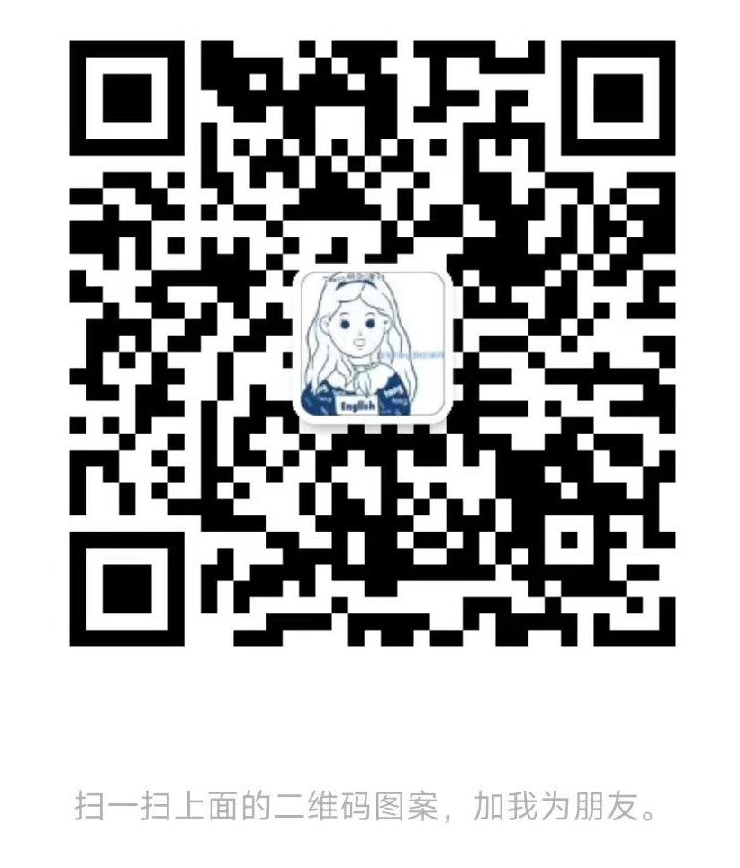
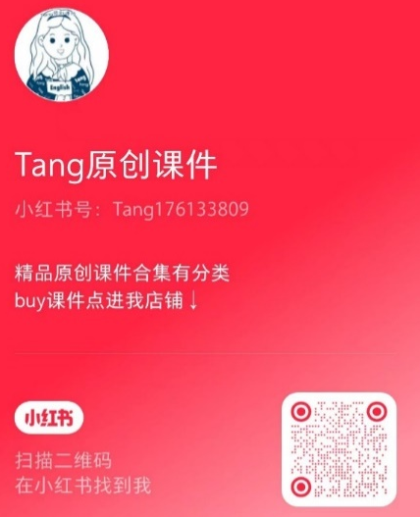
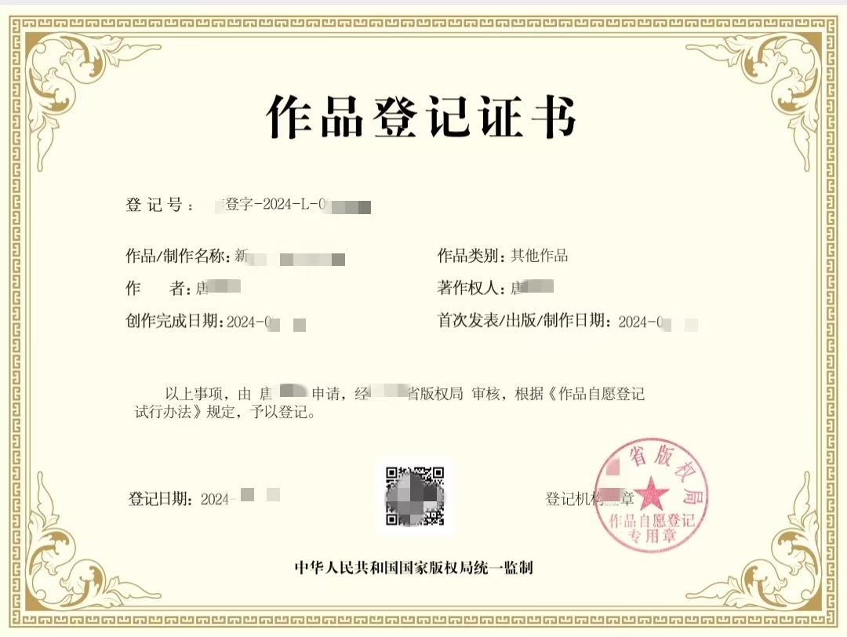
Tang原创课件使用须知
请您知悉课件由Tang原创。您购买的是使用权，没有参赛发表的权力，也没有转售的权利。如有侵犯本人合法权益，必用法律手段维权。请勿侵权！请勿侵权！
微信号：tang2025ppt
(已添加过tang老师的无需重复添加)
小红书/抖音：
Tang原创课件

Slide 4
Learning objectives
通过本课时学习，我们能够：
感知学习并掌握用should/could来询问他人具体问题或给出相关建议，能够较为熟练地运用一些常见的连词until/ although/ so that使表达更具有逻辑性。 （学习理解）
1
在实践交流中，用目标语言询问他人遇到的问题，并能结合问题给出相应且合理的建议；能够对青少年在生活和学习中常见的问题给出相应的处理办法。（应用实践）
2
通过对语法部分知识的归类掌握语言背后的思维逻辑；学会清晰准确地描述问题、分析问题原因、结合原因寻找解决办法；并在对问题的分析中，注意其逻辑关系。（迁移创新）
3
Notes:
Tang原创课件,请勿侵权！
小红书/抖音：Tang原创课件
淘宝：Tang原创课件

Slide 5

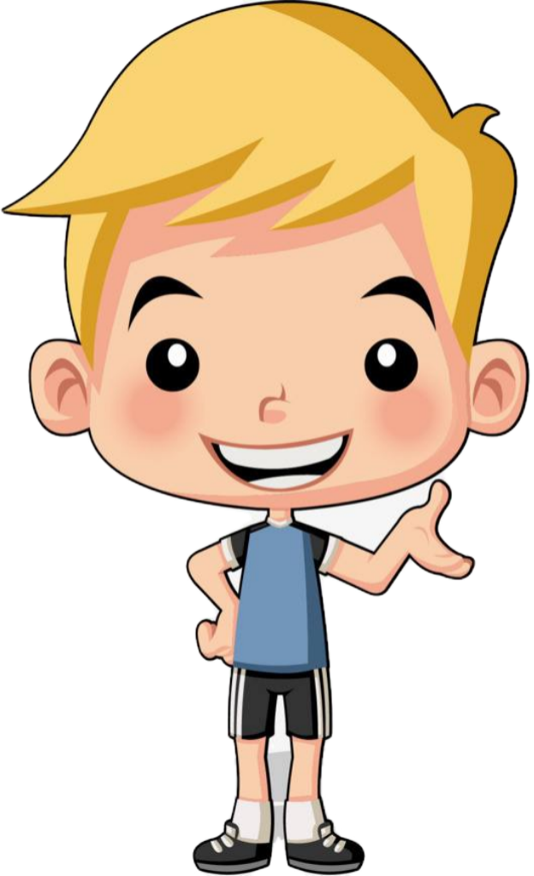

Nowadays more and more people have trouble or problems in their daily life.
Three of my friends shared their problems on Moments.
Let’s see what they shared.
Dave
Notes:
Tang原创英语课件
小红书：Tang

Slide 6
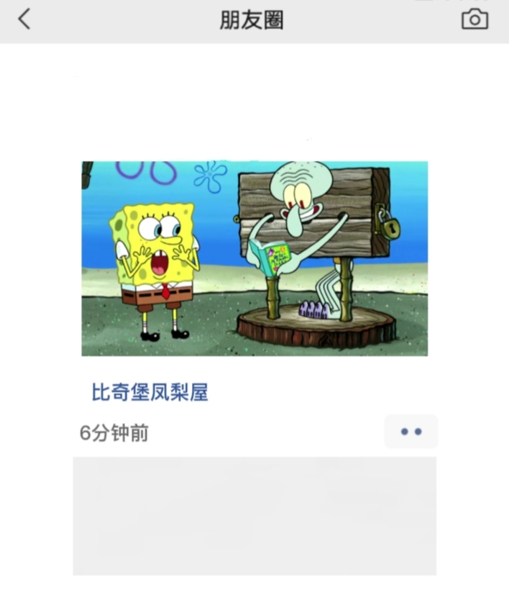
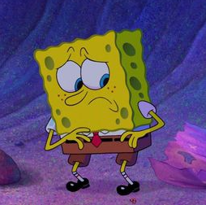




SpongeBob
What’s wrong with SpongeBob?
What’s his friends’ advice?
Squidward is reading my diary without my permission!! I hate him!
Can you give him some advice?
Bikini Bottom
Patrick
Why don’t you get into a fight with him?
Mr. Krabs
Why not use his money without his permission?
Dave
Notes:
Tang原创英语课件
小红书：Tang

Slide 7
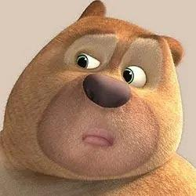
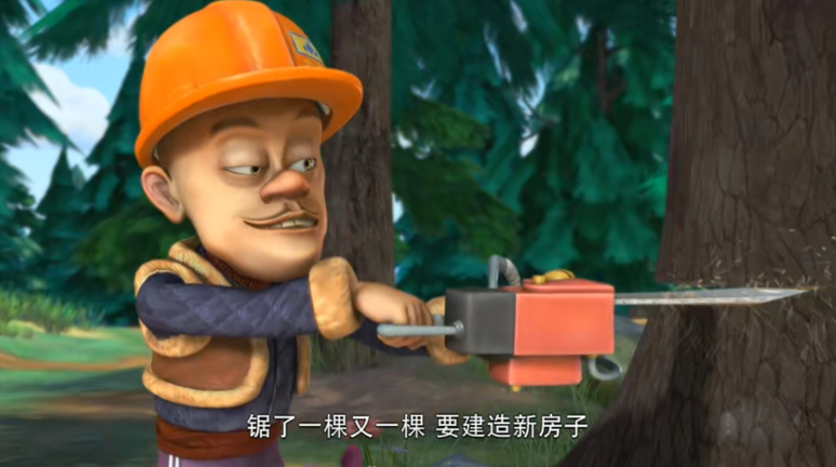
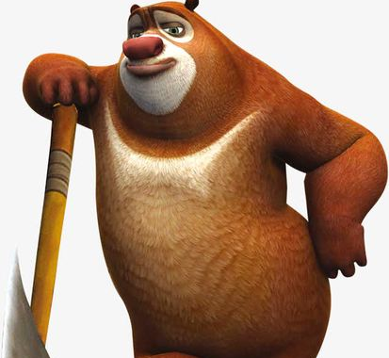
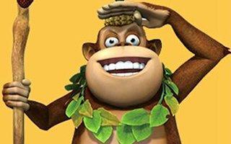
Bramble Bear
What trouble does Bramble Bear have?
Why is Logger Vick cutting down trees again??
What’s his friends’ advice?
Can you give him some advice?
In the forest
Briar Bear
Why not stop him?
Tiki
Dave
You should plant more trees.
Notes:
Tang原创英语课件
小红书：Tang

Slide 8

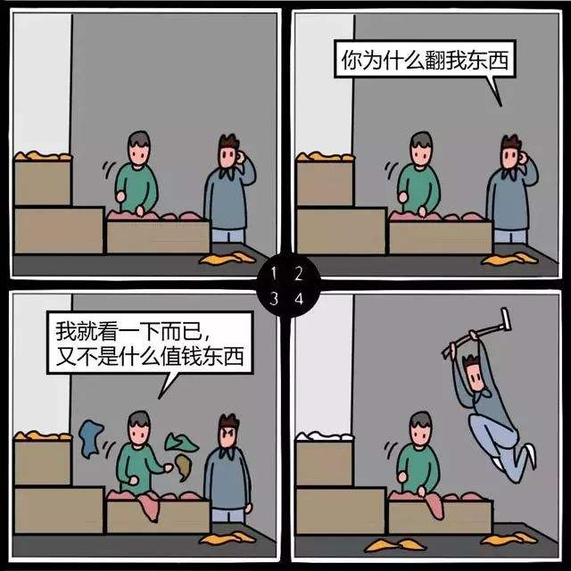
Kim
I called Kim to comfort her and give her some advice.
I found my sister looking through my things. She took some of my new magazines and CDs.
Can you find out what advice I gave her?
At home
Dave
Did she give them back to you?
Kim
@Dave:Yes, but I’m still angry with her.What should I do?
Dave
Notes:
Tang原创英语课件
小红书：Tang

Slide 9
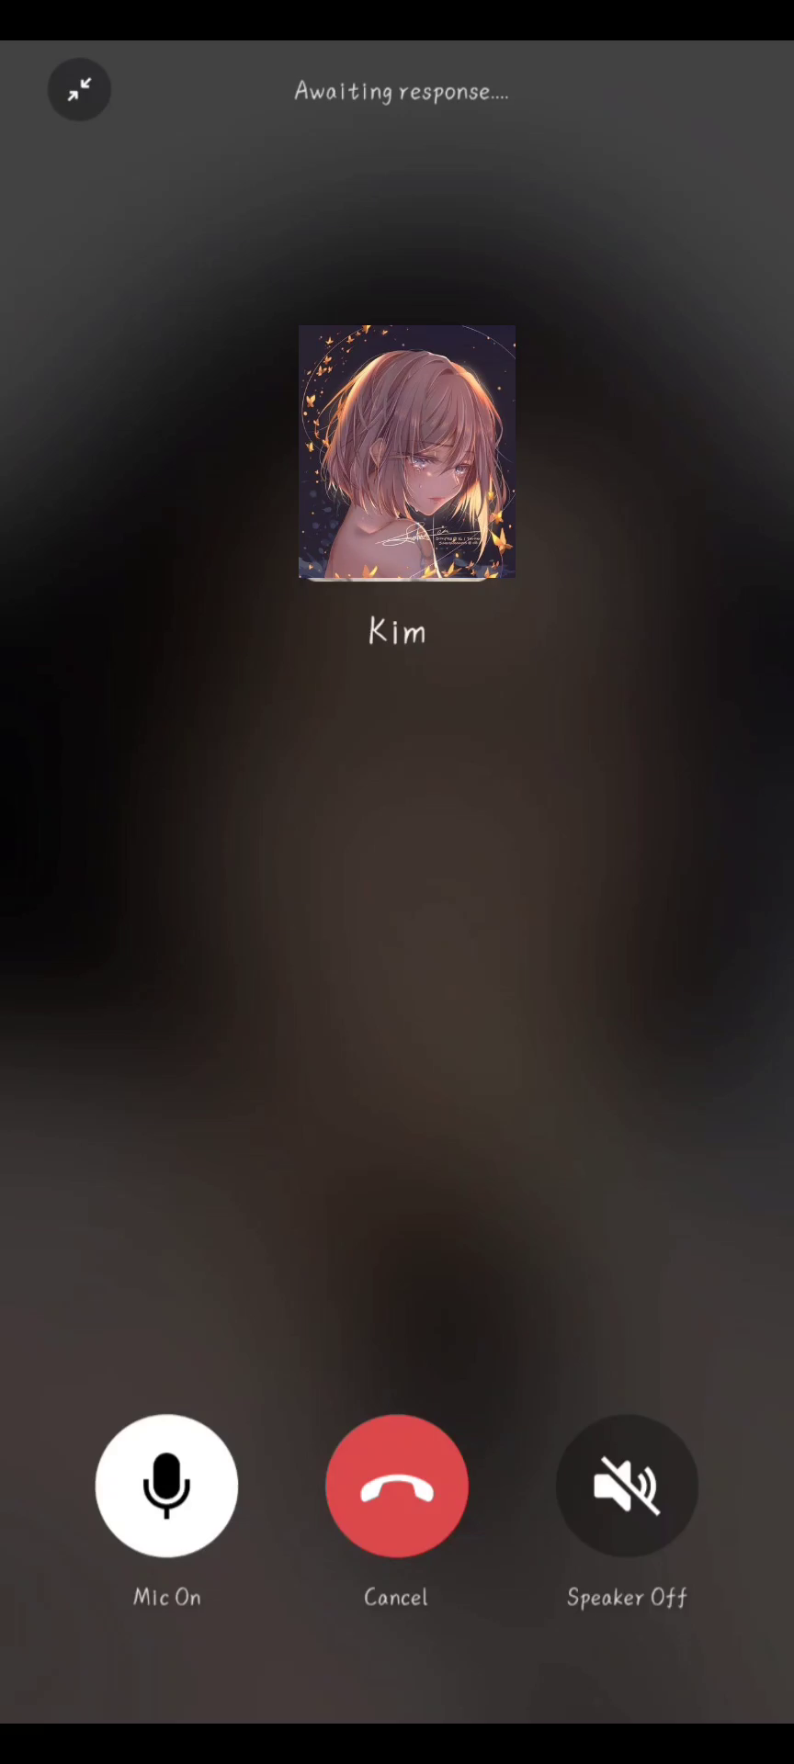

Can you find out what advice I gave her?
Kim could tell her sister to say sorry.
And she should forget about
it so that they can be friends again.
Dave
Notes:
Tang原创英语课件
小红书：Tang

Slide 10
Read 2d and answer the questions.
2d
Read 2d and answer the questions.
1. How does Kim feel about her sister after her sister gave back the things?
2. Does Dave think it is all right for Kim’s sister to take away Kim’s things? How do you know?
No, he doesn’t. He said that’s not very nice.
3. Does Dave think the two sisters have a serious problem? How do you know?
No, he doesn’t. Because he said it’s not a big deal.
4. What does Dave mean by saying “Hope things work out”?
He means they can be friends again.
Kim still feels angry with her sister.

Slide 11
Role-play the conversation.
2d
Role-play the conversation.
You look sad, Kim. What’s wrong?
Well, I found my sister looking through my
things yesterday. She took some of my new
magazines and CDs.
Hmm… That’s not very nice. Did she give them
back to you?
Yes, but I’m still angry with her. What should I do?
find sb. doing sth.
发现某人在做某事
look through意为“浏览；快速查看”，为“动词+介词”短语，后面接物。
be angry with sb.
生某人的气
Notes:
Tang原创英语课件
小红书：Tang

Slide 12
Role-play the conversation.
2d
Role-play the conversation.
Well, I guess you could tell her to say sorry.
But why don’t you forget about it so that you
can be friends again? Although she’s wrong,
it’s not a big deal.
You’re right. Thanks for your advice.
No problem. Hope things work out.
although 虽然； 尽管； 引导让步状语从句
deal名词，“协议；交易”。
big deal “重要的事”
work out句中意为“成功地发展”，是“动词+副词”型短语。还可意为“计算出（答案、数量、价格等）；解决”。

Slide 13
It’s not a big deal. 没什么大不了的。
deal n. ①协议，交易 ②大量 ③对待
make / sign / close a deal with sb 和某人做成一笔生意
a great / good deal of + 不可数名词 大量的…
It’s a deal. 一言为定；成交
deal with sb. 与某人打交道；应对某人
deal with sth. 应对、处理某物
You have run out of a great deal of money.
How will you deal with the money you got from your dad？

Slide 14
Try to retell the conversation.
2d
Try to retell the conversation.
looking through
Kim looks sad because she found her sister ______ ________ her things yesterday. Her sister _____ some of her new __________
and CDs.________ Kim’s sister give them back to her, Kim is still ____ with her. What should Kim do?
Dave thinks Kim could tell her sister to say sorry. But why don’t Kim forget about it ___ ____they can be friends again? Although Kim’ sister is wrong, it’s not __ ___ ____. Kim thanks for Dave’s ______. Dave hopes things ____ ___.
took
magazines
Although
angry
so that
a big deal
advice
work out

Slide 15
Brainstorm
Brainstorm
Can you give Kim some advice?
Kim should talk to her sister.
Kim could ask her parents for help.
Dave

Slide 16
Grammar Focus
Read the sentences and circle conjunctions.
You look tired. What’s the matter? | I did my homework until really late last night, so I didn’t get enough sleep.
What should I do? | Why don’t you forget about it? Although she’s wrong, it’s not a big deal.
What should he do? | He should talk to his friend so that he can say he’s sorry.
Maybe you could go to his house. | I guess I could, but I don’t want to surprise him.
although, so that及until引导的状语从句
Notes:
Tang原创英语课件
小红书：Tang

Slide 17
Using “although / though”
although的意思是 “尽管，虽然”，用来引导让步状语从句，在一般情况下可以和 though互换，但though比较口语化，而although较为正式，另外although的语气比though重。当although / though引导的从句放在句首时，主从句之间要用逗号隔开。
虽然Jack是你的好朋友,但你不能允许他抄你的作业。
Although Jack is your good friend, you can’t allow him to copy your homework.

Slide 18
Using “so that”
so that引导的目的状语从句表示动机（即一种可能性），而非事实。因此，从句中常带有can, will, could, would, should等情态动词。
他今天早上早起以便于可以赶上早班车。
He got up early this morning so that he could catch the early bus.
so... that...引导结果状语从句，陈述的是客观事实，常常不带情态动词。
这个婴儿太可爱了以至于我非常喜欢他。
The baby is so cute that I like him very much.

Slide 19
Using “until”
用于肯定句中，意为“直到……为止”。主句谓语动词须用延续性动词；
用于否定句中，有结构“not…until”, 意为“直到……才”。主句谓语动词通常用非延续性动词，也可用延续性动词
until引导的从句，主句为一般将来时，从句要用一般现在时表示将来。
直到闹钟响了我才起来。
I didn’t wake up until I heard the alarm clock.
我会等你等到七点。
I will wait you until seven o’clock.

Slide 20
although, so that及until引导的状语从句
 | 意思 | 引导状语从句的类型
although
so that
so...that…
until
虽然；尽管
让步状语从句
以便，为了
目的状语从句
以至于；结果
结果状语从句
直到……为止；
到……时
时间状语从句

Slide 21
although, so that及until引导的状语从句
 | 句中位置
although
so that
until
可以放在主句前面，也可以放在主句后面
一般放在主句后，且不用逗号隔开。
常放在主句之后，也可以放在主句之前
Although I gave him some advice, he didn’t take it.
He got up early this morning so that he could catch the early bus.
I didn’t wake up until I heard the alarm clock.
Notes:
Tang原创课件,请勿侵权！
小红书/抖音：Tang原创课件
淘宝：Tang原创课件

Slide 22
Translation
1. 尽管她不对，但这也不是什么大不了的事。
Although she’s wrong, it’s not a big deal.
2. 你必须现在就去，以便不会迟到。
You must go now so that you won’t be late.
3. 我做完作业了才上床睡觉。
I won’t go to bed until I finish my homework.

Slide 23
4a
Fill in the blanks with although, so that or until.
1. A: What’s wrong?
B: My sister borrows my clothes without asking. What should I do?
A: Well, you could tell her that this makes you
angry _______ she’ll ask you next time.
so that
2. A: I don’t have any friends at my new school. What should I do?
B: _________ you don’t have any now, you
will soon make some.
Although

Slide 24
4a
Fill in the blanks with although, so that or until.
3. A: I’m worried about my school grades.
What’s your advice?
B: You shouldn’t wait ______ the last minute
to study for a test.
until
4. A: Mike is my best friend, but he always copies
my homework. What should I do?
B: ________ he’s your best friend, you should
still tell him that copying others’ homework
is wrong.
Although

Slide 25
Read the following sentences and underline the sentences that ask questions about difficulties and problems.
You look tired. What’s the matter? | I did my homework until really late last night, so I didn’t get enough sleep.
What should I do? | Why don’t you forget about it? Although she’s wrong, it’s not a big deal.
What should he do? | He should talk to his friend so that he can say he’s sorry.
Maybe you could go to his house. | I guess I could, but I don’t want to surprise him.

Slide 26
Read the following sentences and underline the sentences that offer suggestions.
You look tired. What’s the matter? | I did my homework until really late last night, so I didn’t get enough sleep.
What should I do? | Why don’t you forget about it? Although she’s wrong, it’s not a big deal.
What should he do? | He should talk to his friend so that he can say he’s sorry.
Maybe you could go to his house. | I guess I could, but I don’t want to surprise him.
Notes:
Tang原创课件,请勿侵权！
小红书/抖音：Tang原创课件
淘宝：Tang原创课件

Slide 27
More sentence structures about giving advice:
do
do
为什么不做...?
1.Why don’t you+ ___ …?
=Why not＋___？
2.What/How about＋_________?
做...怎么样？
doing
3.You should / could + ______ ?
你应该/可以...
do
4.Let's ____ sth.
让我们...
do
5.Shall we ______ sth.?
我们...怎么样？
do
6.You'd better _____ sth.
你最好...
do
7.You'd better ________ sth.
你最好不要...
not do
8. Would you mind (sb.) _______?
你介意(某人)…吗？
doing

Slide 28
Write one piece of advice for each problem. Then compare your advice
with your partner’s and decide whether the advice is good or bad.
4b
1. I’m very shy.
Advice:
Why don’t you join a club at school and make more friends?
2. My sister and I fight all the time.
Advice:
You could try to do more fun things with her so that you will like each other better and not fight so often.

Slide 29
3. My sister spends all evening on the phone.
Advice:
Maybe you could encourage her to do other
things, such as go to a movie with you.
4. My cousin borrows my things without returning them.
Advice:
Maybe you should tell him nicely how you feel
about it and ask him to return your things.
5. My parents won’t let me have a pet.
Advice:
Perhaps they don’t think you will look after the pet yourself. Why don’t you try convincing them that you will be responsible and take care of the pet yourself ?

Slide 30
My cousin borrows my things without returning them.
Point
ruturn v. 归还；回来；返回
ruturn在此处作及物动词，意为“归还”，相当于give sth. back。ruturn sth. to sb. = return sb. sth., 意为“把某物还给某人”。
I'm going to return this book to Tom.=I'm going to return Tom his book.
【拓展延伸】return还可用作不及物动词，意为“回来；返回”，相当于come back。
return to+地点名词
返回某地
return+地点副词

Slide 31

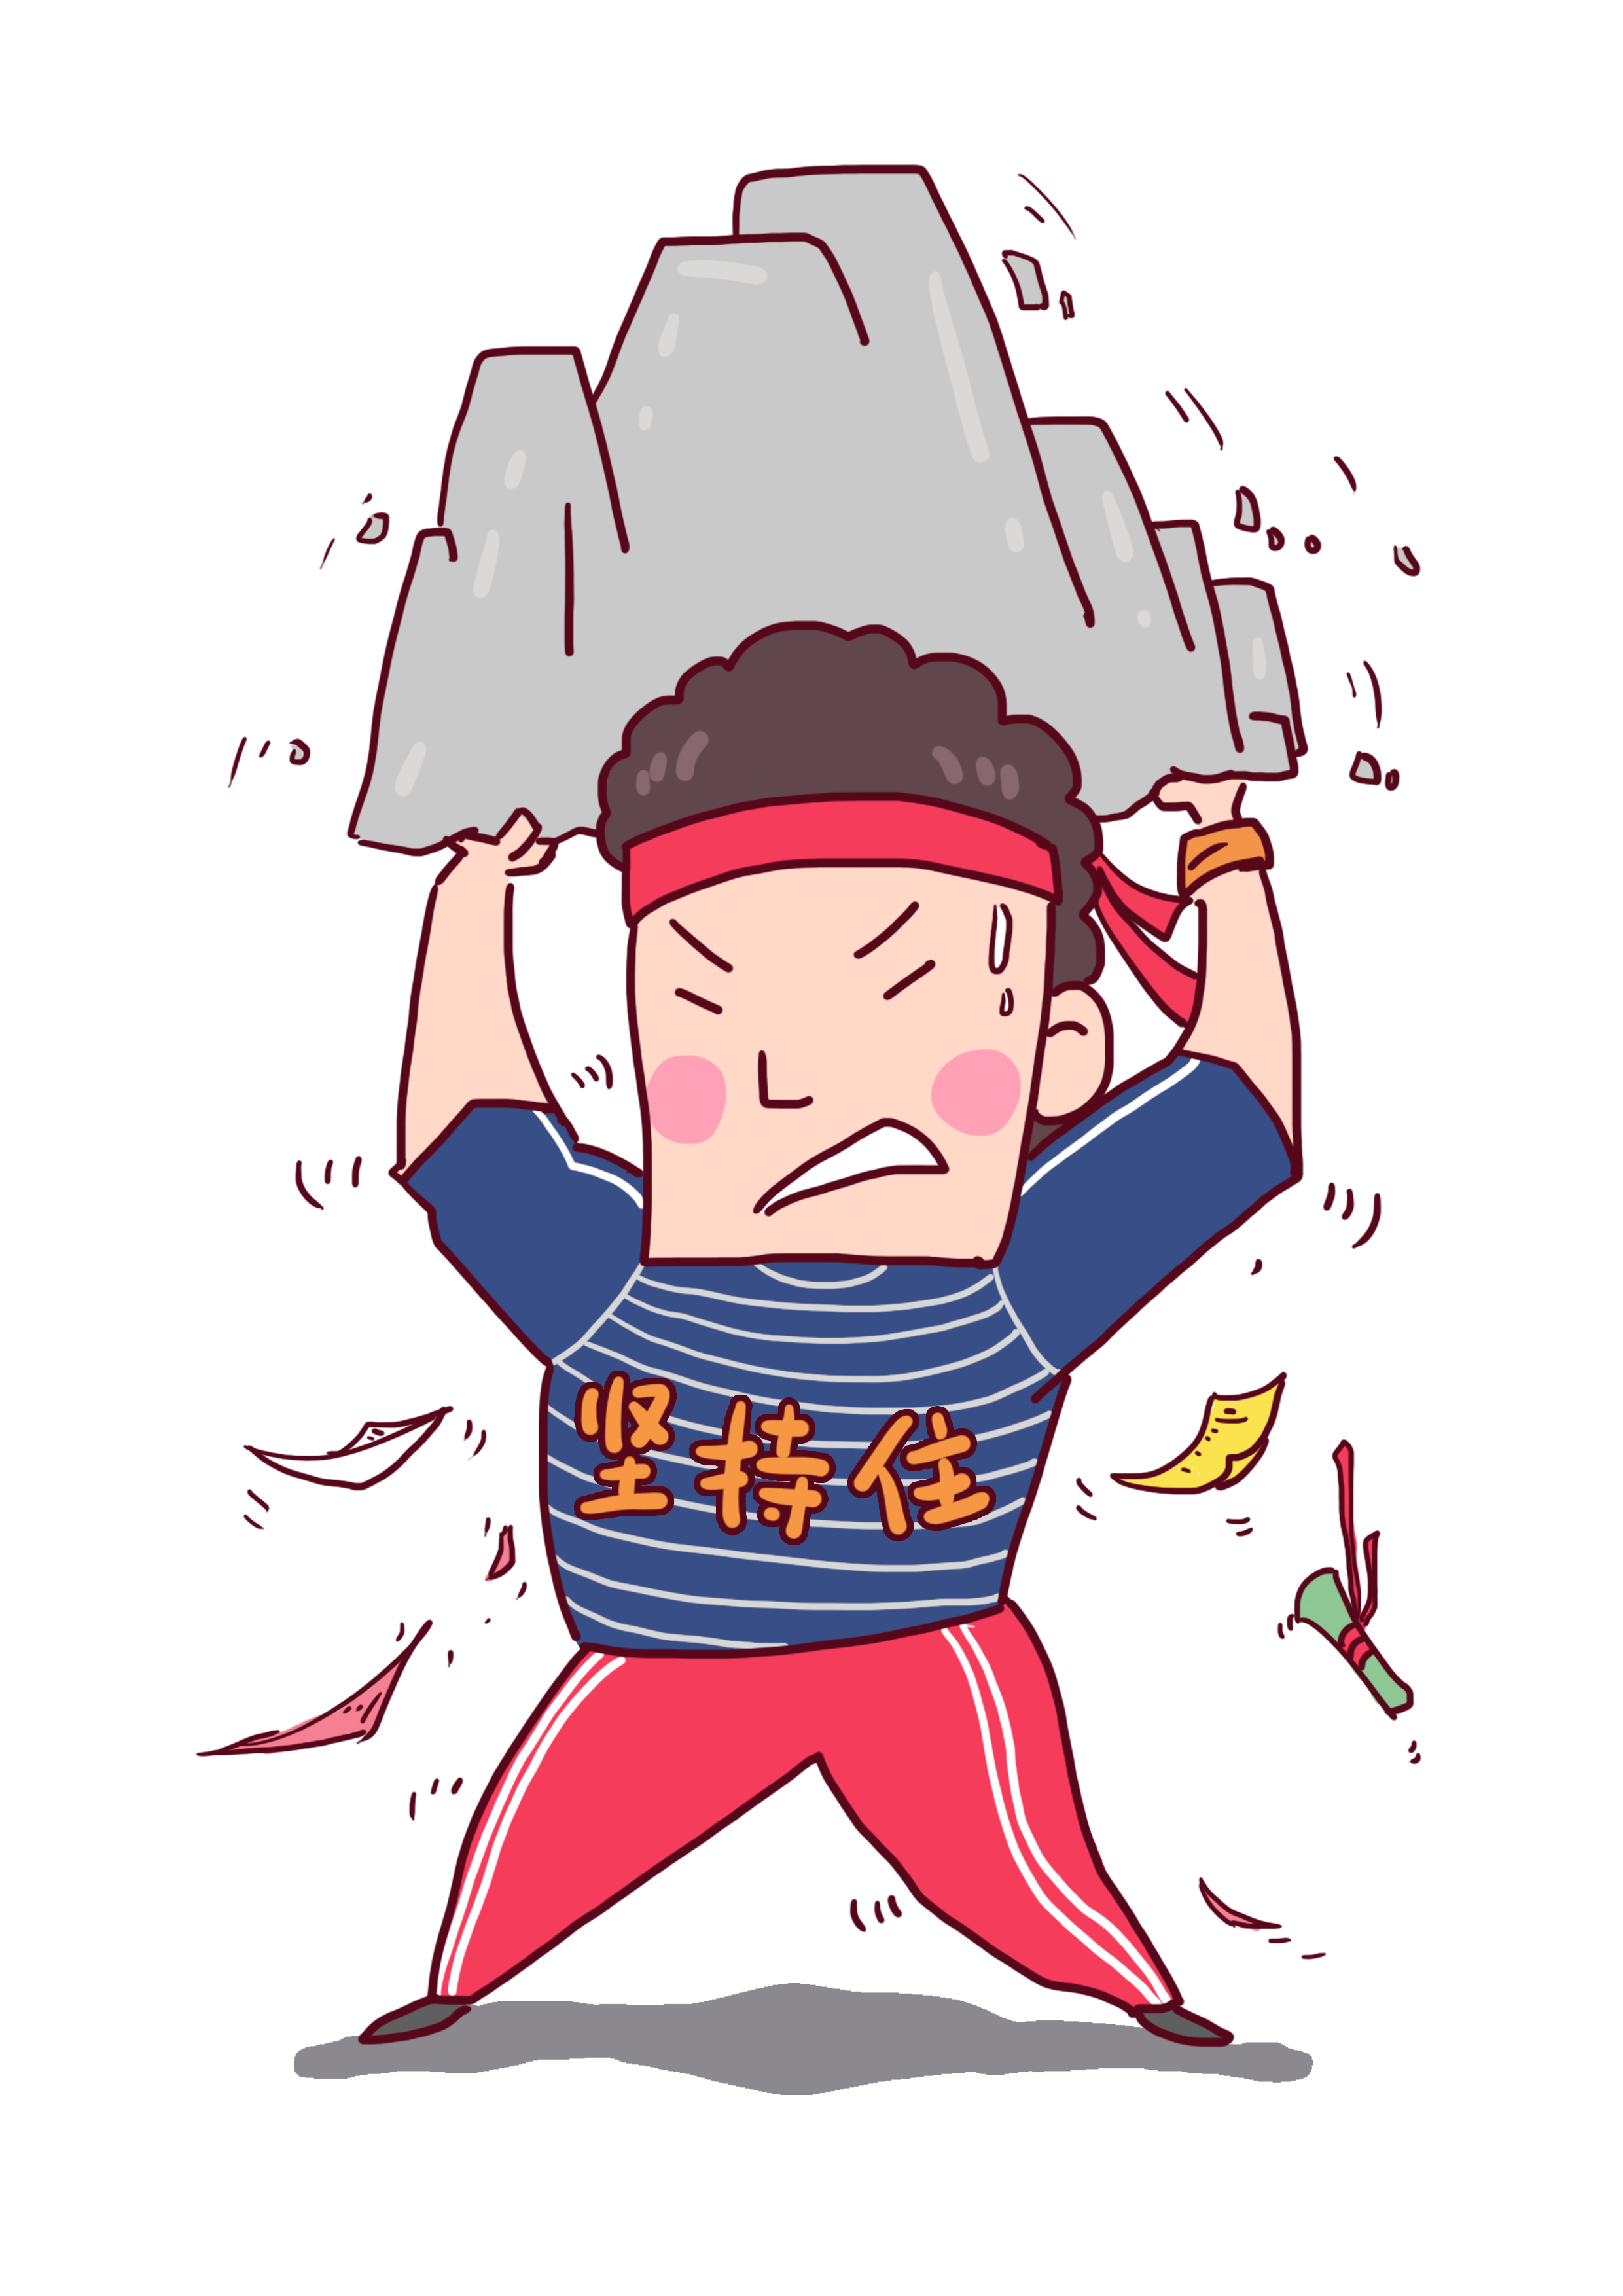
Choose one of the problems and ask your classmates for advice. Decide which classmate has the best advice.
4c
Problems
a. You left your homework at home. b. Your best friend is more popular than you. c. You are afraid of speaking in front of people. d. Your best friend does not trust you anymore. e. Your parents always argue.
not... anymore
=no more 不再……
Notes:
Tang原创课件,请勿侵权！
小红书/抖音：Tang原创课件
淘宝：Tang原创课件

Slide 32




My best friend is more popular than me. I want to be like him. What should I do?
You could try to be friendlier.
You should just be yourself.
Write down one of your problems on a piece of paper and then put it in
the box. Pick out a few pieces of paper and read them out. Please give some advice.
Notes:
Tang原创课件,请勿侵权！
小红书/抖音：Tang原创课件
淘宝：Tang原创课件

Slide 33
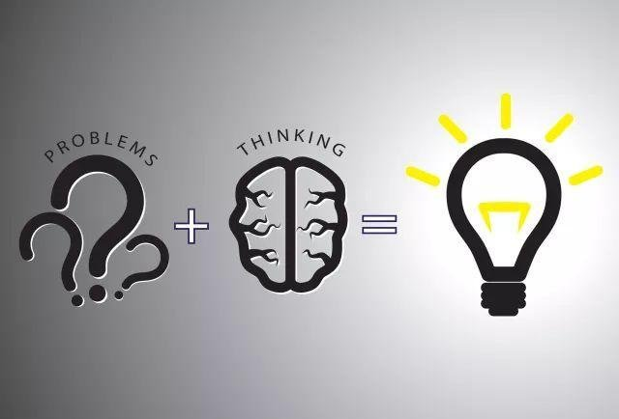

Life is colorful. Whatever problems you meet, whenever you meet them, don’t be afraid of them. Don’t complain too much. Just try hard to solve them. Believe that nothing is difficult if you try your best.
Notes:
Tang原创课件,请勿侵权！
小红书/抖音：Tang原创课件
淘宝：Tang原创课件

Slide 34
Exercises
Grammar Focus
① 你看上去很疲劳，怎么了？
You ____ tired. What’s _____ _______? ② 昨晚，我真的写作业到很晚，因此我没有睡足觉。
I did my homework ____ _____ ____ last night, so I didn’t ___ ______ sleep. ③ 我应该做什么？ _____ ______I do? 你为什么不忘掉此事呢？尽管她错了，但那不是一件大事。 _____ ____ you forget about it? _________ she’s wrong.
It’s not _____ _____ ______.
look
the matter
until really late
get enough
What should
Why don’t
Although
a big deal

Slide 35
Exercises
Grammar Focus
④ 他应当如何做？ _______ _______ he do? ⑤ 他应当和他的朋友交谈一下，以便于他能向他道歉。 He _____ _____ _____ his friends ____ ___ he can say he's sorry. ⑥ 或许你应当去他家。 _______ you ______ go to his house. ⑦ 我想我可以，但是我不想让他吃惊。 I think I _______, but I don't want to _______ _________.
What should
should talk to
so that
Maybe could
could surprise him

Slide 36
Exercises
1._____ it's a public holiday today, some firefighters in our city are still on duty.
A. Although B. Once C. If
2.—Jim, let's go out to play basketball.
—Oh, I won't do that _____ I finish my homework.
A. if B. until C. because D. since
3.You could climb the mountains _____ you can keep healthy.
A. until B. so that C. as soon as D. in order to
A
B
B

Slide 37
Excellent Good To be improved | 评价项目 | 自我评价 | 同伴评价 | 老师评价
 | 能够用should/could来询问他人问题并给出建议
 | 能够运用一些常见的连词until/although/so that使表达更具有逻辑性
 | 能够就青少年在生活和学习中常见的问题给出相应的处理办法
 | 能够清晰准确地描述问题、分析问题原因、结合原因寻找解决办法
Notes:
Tang原创课件,请勿侵权！
小红书/抖音：Tang原创课件
淘宝：Tang原创课件

Slide 38

Homework
Homework
Must do: 1.Write down your problems and give some advice;
2.Review the use of "although" , " until" and “so that”;
3.Preview Section A 3a.
Try to do: Recite Grammar Focus.
Notes:
Tang原创课件,请勿侵权！
小红书/抖音：Tang原创课件
淘宝：Tang原创课件

