Slide 1


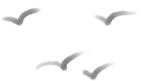


Personal housework schedule
Period 4. Section B (1a-1d)
----Use could to make requests and ask for permission
----Love doing chores and learn how to help others
Period 5. Section B (2a-2e)
----Get parents’ different opinions on whether young people should do chores at home
----Share your own ideas and know the importance of doing chores
Period 6. Section B (3a-Self Check)
----Finish your personal housework schedule
Period 1. Section A (1a-2c)
----Learn to make polite requests and ask for permission
Period 2. Section A (2d&GF-4c)
----Make polite requests and ask for permission rightly
Period 3. Section A (3a-3c)
----Find out why mom and Nancy are in conflict
----Show our own opinions about doing chores
Notes:
Tang原创课件,请勿侵权！
小红书/抖音：Tang原创课件
淘宝：Tang原创课件

Slide 2



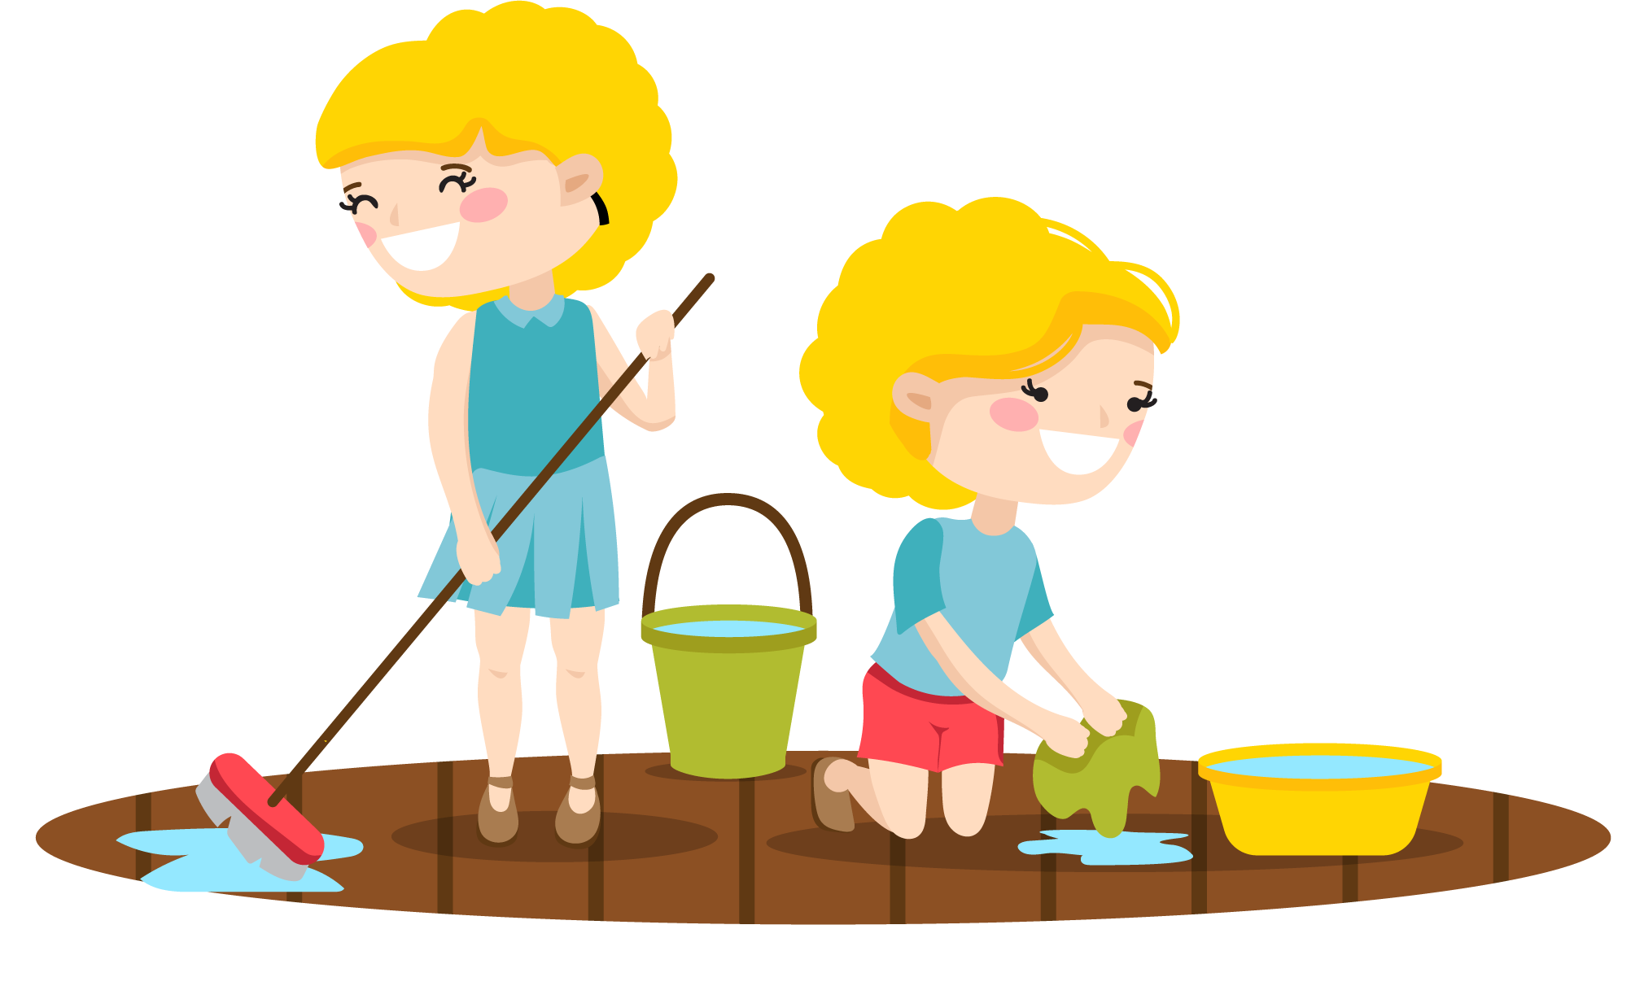
Unit 3
Could you please clean
your room?
Section B Writing

Slide 3
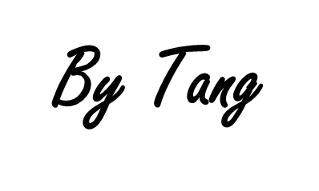
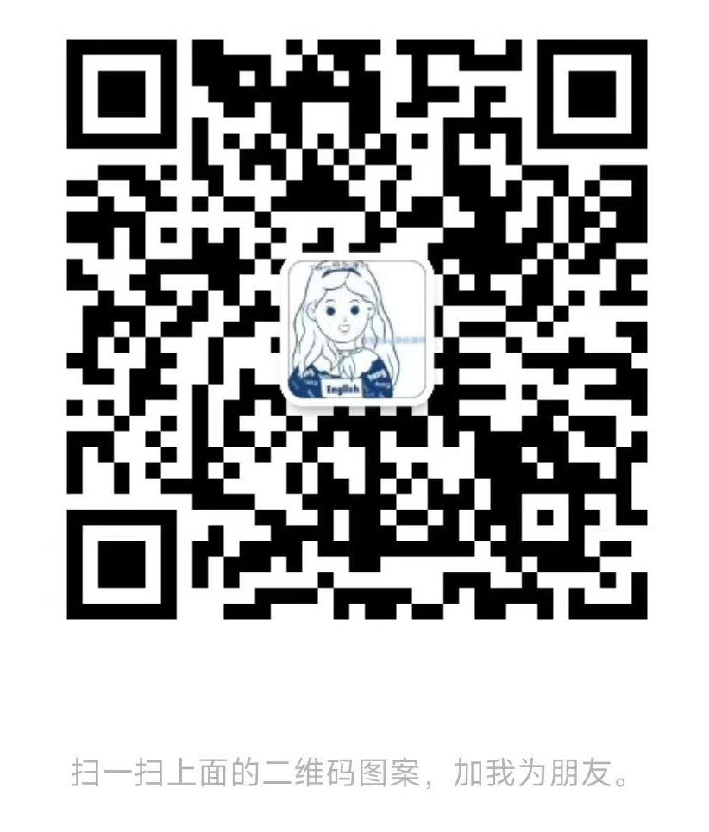
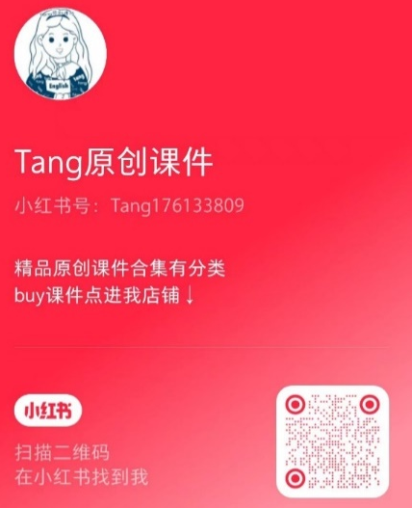
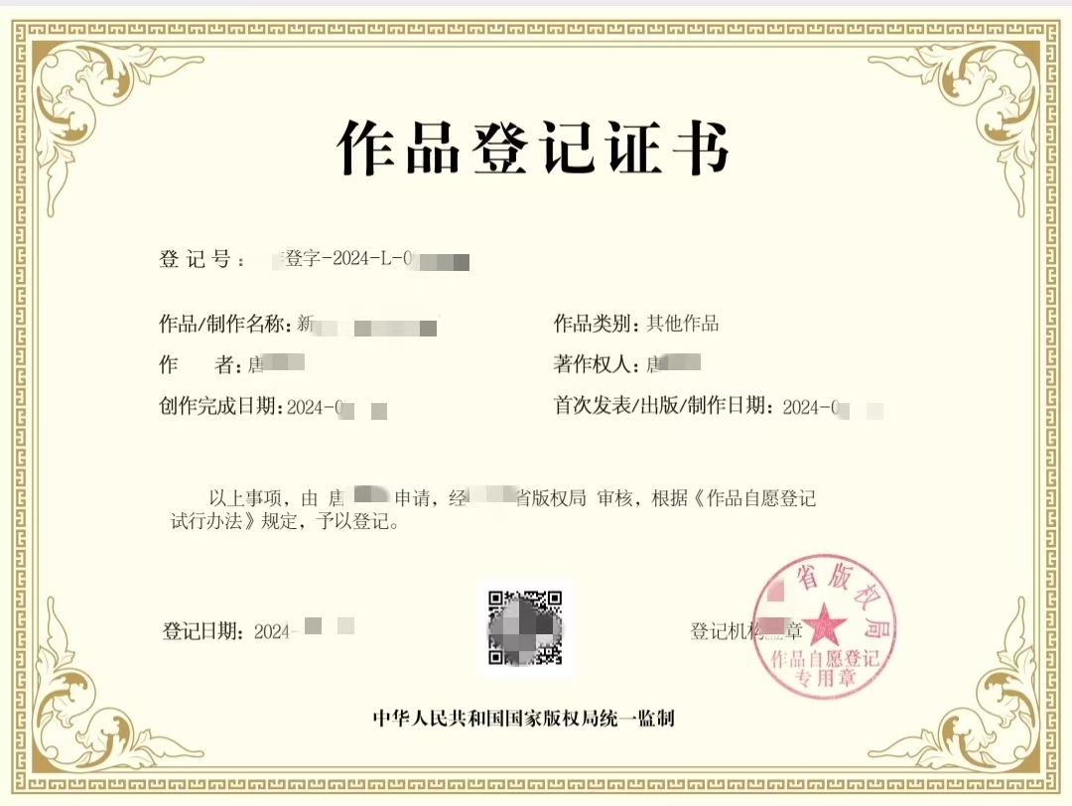
Tang原创课件使用须知
请您知悉课件由Tang原创。您购买的是使用权，没有参赛发表的权力，也没有转售的权利。如有侵犯本人合法权益，必用法律手段维权。请勿侵权！请勿侵权！
微信号：tang2025ppt
(已添加过tang老师的无需重复添加)
小红书/抖音：
Tang原创课件

Slide 4
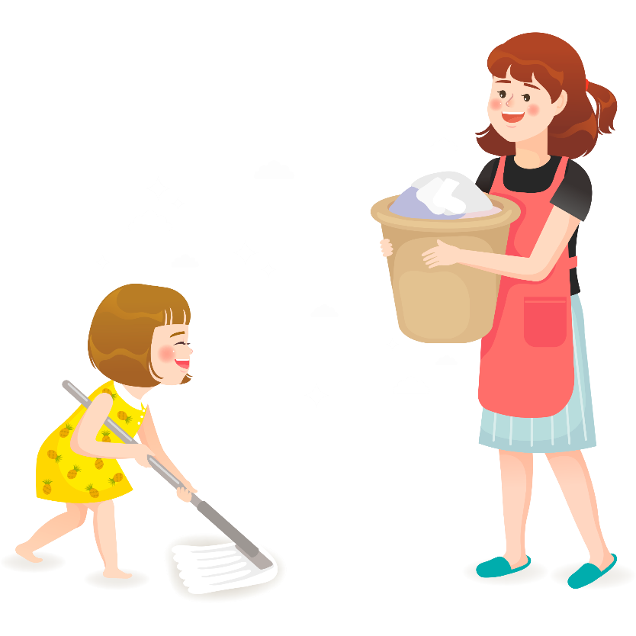
Learning objectives
通过本课时学习，我们能够：
通过对阅读文本的梳理和复习，进一步熟悉本单元目标语言的应用；并通过整理和评价阅读中的观点，熟悉其基本的论证方式，掌握议论文的写作结构；能够感知学习如何陈述自己的观点并合理论证自己的观点。 （学习理解）
1
将所学的语言知识和写作技能灵活运用到话题写作中，结合自己对家务劳动和家庭责任的看法形成对青少年是否要做家务的合理认知，并给出适当理由；增强家庭责任感，完成自己的个人家务劳动计划表。（应用实践）
2
通过对青少年是否做家务的探讨，拓展思考对家庭责任的分担以及和父母如何进行沟通的问题；结合自己实际情况尝试为以上问题找到合适的解决办法。（迁移创新）
3
Notes:
Tang原创课件,请勿侵权！
小红书/抖音：Tang原创课件
淘宝：Tang原创课件

Slide 5


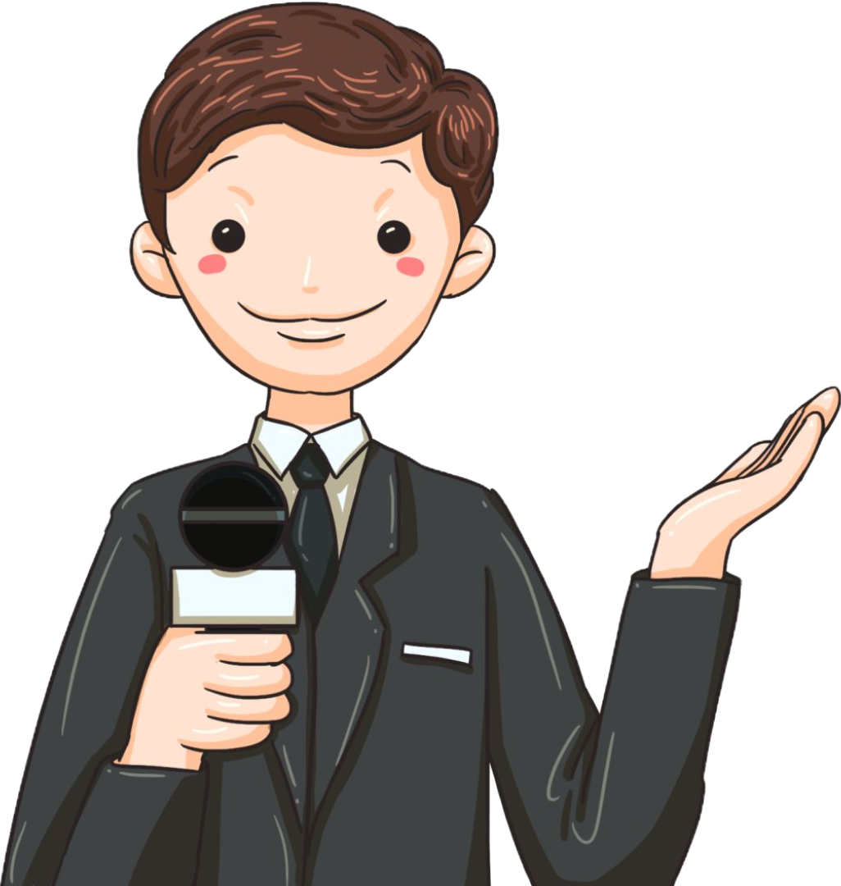
Task 1:
Collect some letters from parents to know their opinions about if children should do some chores at home.
Task 2:
Collect some letters from children to know their opinions about if children should do some chores at home.
Sunday
Mail magazine
Notes:
Tang原创课件,请勿侵权！
小红书/抖音：Tang原创课件
淘宝：Tang原创课件

Slide 6
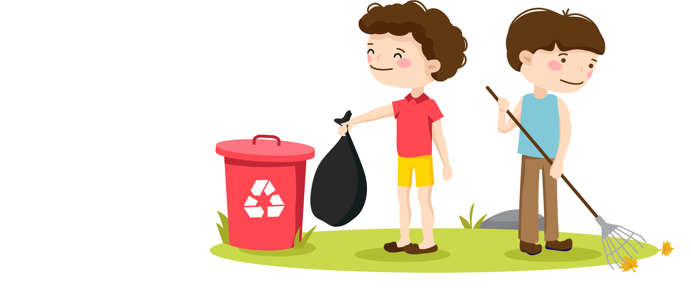
Do you think children should do some chores at home?
Why or why not? Discuss this with a partner and take notes.
3a
Children should do chores because… | Children should not do chores because…
Just getting good grades
at school is not enough.
Have too much stress from school. Don’t have time to do chores.

Slide 7

Just getting good grades at school is not enough.
Develop children’s independence and teach them how to look after themselves.
Understand the idea of fairness.
The earlier kids learn to be independent, the better it is for their future.
Children should do
chores because…
Should kids do chores at home?
Children should not
do chores because…

Slide 8
Children should do
chores because…
Have enough stress from school. Don’t have time to do chores.
Doing housework is a waste of time.
It’s more important to spend time on schoolwork to get good grades and get into a good university.
It’s the parents’ job to provide a clean and comfortable environment at home for children.
Should kids do chores at home?
Children should not
do chores because…

Slide 9

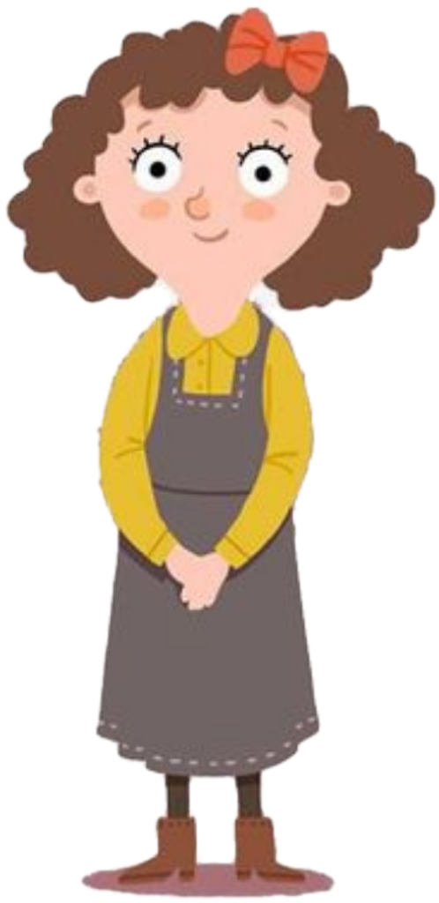

shouldn't
Opinion
论点
Kids do chores at home.
enough stress
Kids have from school.
to study
a waste of
They have no time .Housework is time.
spend
on
Reasons
论据
As students,they should their time schoolwork
get good grades
in order to
get older
They will have to do housework when they so there is for them to do it now.
Ms.Miller
no time
provide
It’s the parents’ job to a clean and comfortable
environment.
Conclusion结论
It's not ________. She does not mind ______ _____.
difficult
doing chores
Notes:
Tang原创课件,请勿侵权！
小红书/抖音：Tang原创课件
淘宝：Tang原创课件

Slide 10

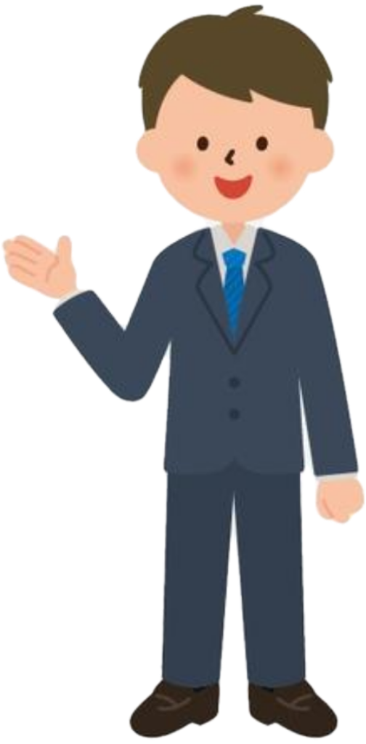

Opinion (陈述观点)
Opinion
Kids do chores at home.
should
Reasons
It is to get good grades.
not enough
Children their parents too much.
depend on
Reason (列出理由)
Doing chores helps children's .
develop
independence
It teaches them how to themselves.
look after
It helps them to understand the idea of .
fairness
take part in
Everyone should keeping houses
clean and tidy they live together.
Mr. Smith
since
Example (举出例子)
Example
son fell and his grades .
Neighbor’s
ill
dropped
Opinion (再次强调观点)
The earlier kids learn to be ,
the better it is for their .
independent
Conclusion
future
Notes:
Tang原创课件,请勿侵权！
小红书/抖音：Tang原创课件
淘宝：Tang原创课件

Slide 11
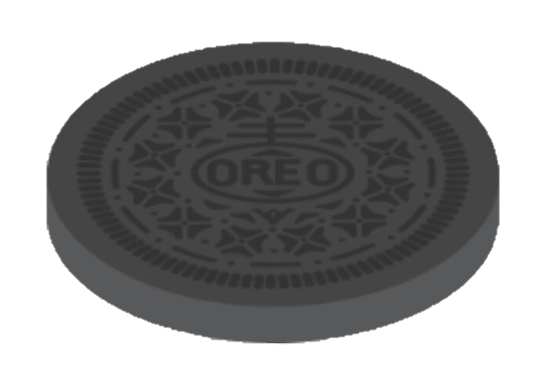
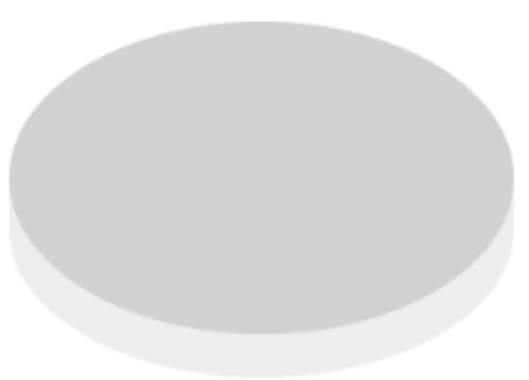
3b
Write a letter to the Sunday Mail and express your opinion.
Dear Sir or Madam,
I think/believe that ________________________.
I agree/disagree that _______________________.
I think it is fair/unfair for children to__________.
I think children should/should not _____________
because _________________________________.
For example, they should/should not ____________
because __________________________________.
In a word/All in all, I think children should (not) ...
Yours truly,
_______
称呼
O
R
E
0
结尾敬语
署名
Notes:
Tang原创课件,请勿侵权！
小红书/抖音：Tang原创课件
淘宝：Tang原创课件

Slide 12
Agree
I think/agree/believe that ..
Opinion
O
Disagree
I (don’t) think/disagree that ..
First, I think it’s fair...
Second, it’s more important to...
Last but not least,…
R
Reasons
E
Examples
For example,...
0
All in all,/In a word, /Anyway,/As a result...
Opinion/
Conclusion
Notes:
Tang原创课件,请勿侵权！
小红书/抖音：Tang原创课件
淘宝：Tang原创课件

Slide 13
Salutation (称呼语)
Dear Sir or Madam,
I believe that children should do some chores at home. I disagree that children’s only job is to study hard and do well at school.
Of course it is important for children to study hard. However, I think it is unfair for children to expect their parents to work hard outside and do all the chores at home. I think children should at least do some simple chores to help their busy parents.
For example, they should make their own beds and clean their own rooms because they are the ones who use these. They may not have time to help with the other parts of the house, but they should try to be responsible for their own area. This will help them to grow up to be independent and responsible adults.
In a word, the more housework we do, the happier our parents will be.
Yours truly,
Chen Shi
opinion
reasons
example
opinion/conclusion
Signature(署名)
Notes:
Tang原创课件,请勿侵权！
小红书/抖音：Tang原创课件
淘宝：Tang原创课件

Slide 14
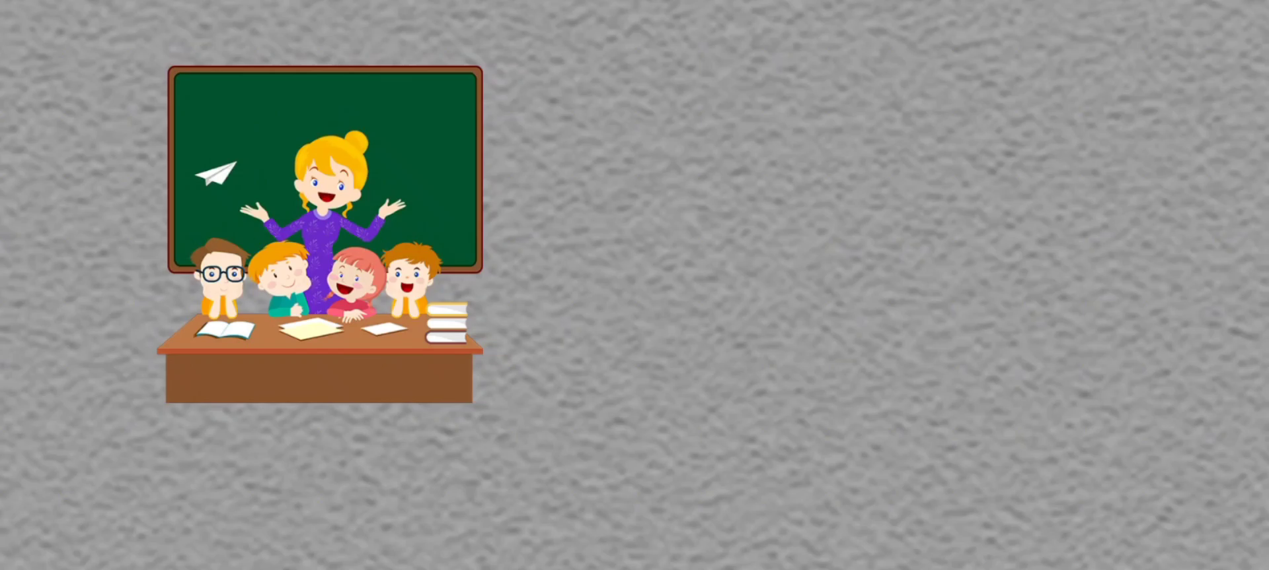
It’s important for us to do some chores!
Notes:
Tang原创课件
小红书Tang

Slide 15
【It’s time to write】
习近平主席在全国教育大会上强调”要在学生中弘扬劳动精神”。弘扬劳动精神，从做家务做起。更有研究表明，爱做家务的孩子更容易体验到幸福感，更有前途。请你以”Help with Some Housework”为题，写一篇80词左右的文章，谈论你对做家务的看法。
定时态
定人称
定体裁
一般现在时
第一人称
观点类议论文
Notes:
Tang原创课件
小红书Tang

Slide 16
Outline
Beginning
In my opinion, it’s important to do chores at home…
陈述自己的观点
O
Firstly, doing chores can help us learn to be independent.
Secondly,...
Last but not least,......
R
Body
说明理由并举例
E
0
Anyway, just remember the
earlier we learn to be independent,
the better it is for our future.
Ending
强调做家务的重要性
Notes:
Tang原创课件
小红书Tang

Slide 17
Self Check
1. Make a list of chores using these verbs.
1. do ______________________________
2. clean ____________________________
3. make ____________________________
4. fold _____________________________
5. sweep ___________________________
6. take out _________________________
do the dishes
clean the living room
make the bed
fold the clothes
sweep the floor
take out the rubbish

Slide 18
Use the phrases we have learned as many as possible!
1.浪费时间
2.目的是；为了
3.给某人提供某物
4.依靠；信赖
5.培养某人的独立性
6.理解公平的概念
7.照顾
8.学会独立
a waste of time
in order to
provide sth. for sb.
depend on
develop one’s independence
understand the idea of fairness
take care of
learn to be independent

Slide 19
Use linking words correctly!
1.表示并列或递进：and, both …and, not only …but also, neither …nor…
2.表示结果：so …that, too …to …
3.表示转折：but, however, although …
4.表示因果：because, so, therefore, as a result …
5.表示条件：if, unless, …
6.表示对比：on the one hand …on the other hand …
7.表示举例：for example, such as …
8.表示顺序：first/first of all/ in the first place/to begin with; second,
what’s more, next, finally/in the end/last but not least…
9.表示目的：in order to, in order that….
10.表示结论：all in all, in a word…

Slide 20
Help with Some Housework
In my opinion, it's important for children to do chores at home. I have several reasons for it.
First of all, doing housework can not only develop our life skills but also make us more independent. After all, we can’t depend on our parents all life. Secondly, many studies show that doing some chores can keep us healthy and strong, so we can regard it as a kind of physical exercise. Last but not least, by doing some housework, we can share parents’ work. It's a good chance for us to show our love and cheer parents up. It also helps us to understand the idea of fairness and responsibility. As a part of family, children should do a part in keeping our rooms clean and tidy.
Anyway, just remember the earlier we learn to be independent, the better it is for our future. It's never too late to learn something useful. Let’s help with some housework from now on!

Slide 21
Checklist
“SCE” |  | 自评 | 互评 | 师评
Structure | Use “OREO” structure
Contents | 1.Give two reasons 2.Give one example 3.Express the opinion and reasons clearly
Expressions | 1.Few or no spelling and grammar mistakes 2.Use linking words 3.Use good words or sentences
Handwriting | Clean and clear.
Excellent Good To be improved
Notes:
Tang原创课件,请勿侵权！
小红书/抖音：Tang原创课件
淘宝：Tang原创课件

Slide 22
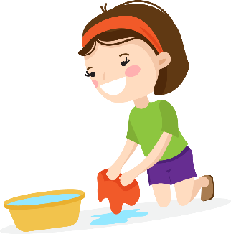
Self Check
2 Are these polite requests or permission? Write
the numbers in the correct places in the chart.
1. Could you please do your homework?
2. Could I watch TV?
3. Could you take out the rubbish first?
4. Could I use your computer?
5. Could I leave now?
6. Could you come back before nine?
Requests | Permission
1
3
6
2
4
5

Slide 23
Self Check
3 Use the questions in activity 2 to write a
conversation.
A: _________________________________
B: _________________________________
A: _________________________________
_________________________________
…
Could you please do your homework.
Yes, I can. But can I watch TV first?
No, you can’t. You must finish your homework first.

Slide 24
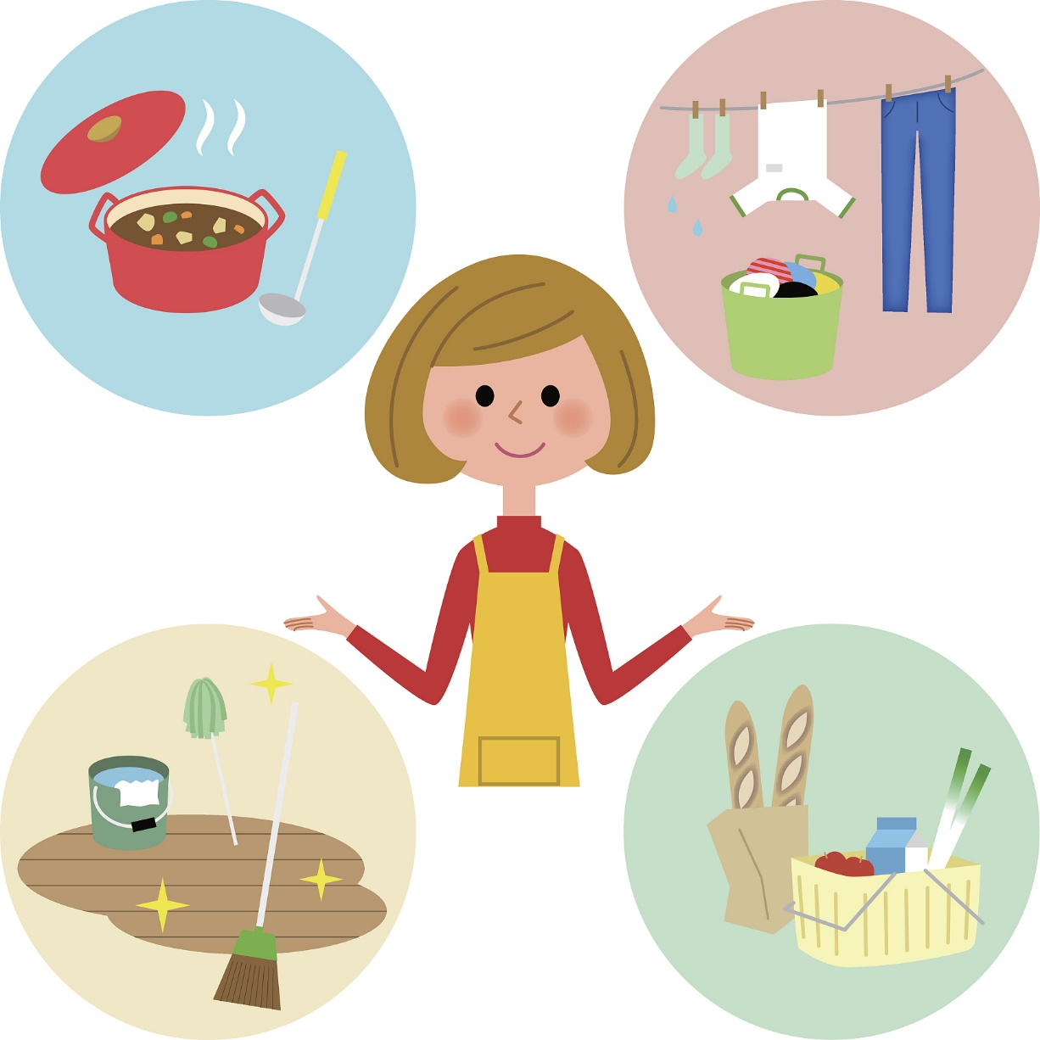
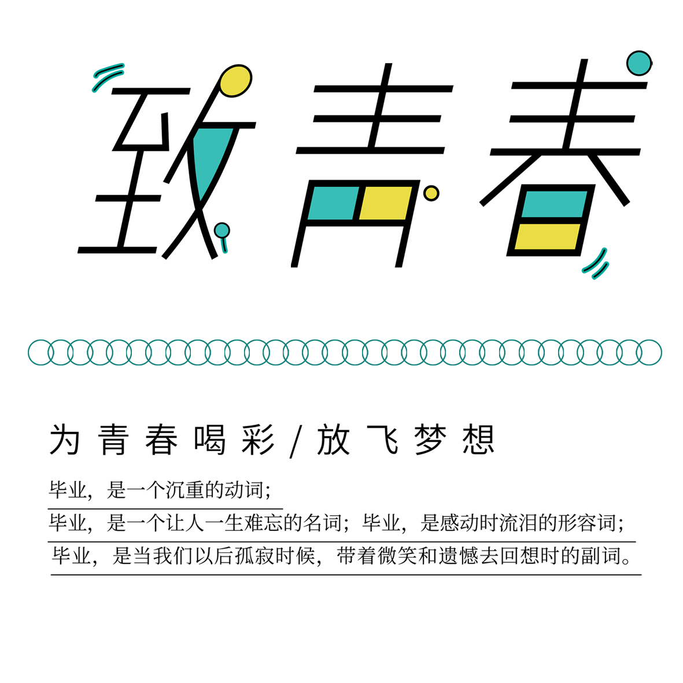
大单元整体项目式教学：
通过本单元的学习，设计自己一周的个人家务劳动计划表并将完成过程用自己喜欢的方式记录下来。
1.Know the chores：初识家务相关的基本表达，学会如何礼貌地表达请求及向对方征询许可；
2. Discuss the chores：进行思辨性思考，明确自己的立场，学会有逻辑地表达自己的观点；
3. Share the chores：换位思考并增强家庭责任感，完成自己的个人家务劳动计划表。
Personal housework schedule
Notes:
Tang原创课件,请勿侵权！
小红书/抖音：Tang原创课件
淘宝：Tang原创课件

Slide 25
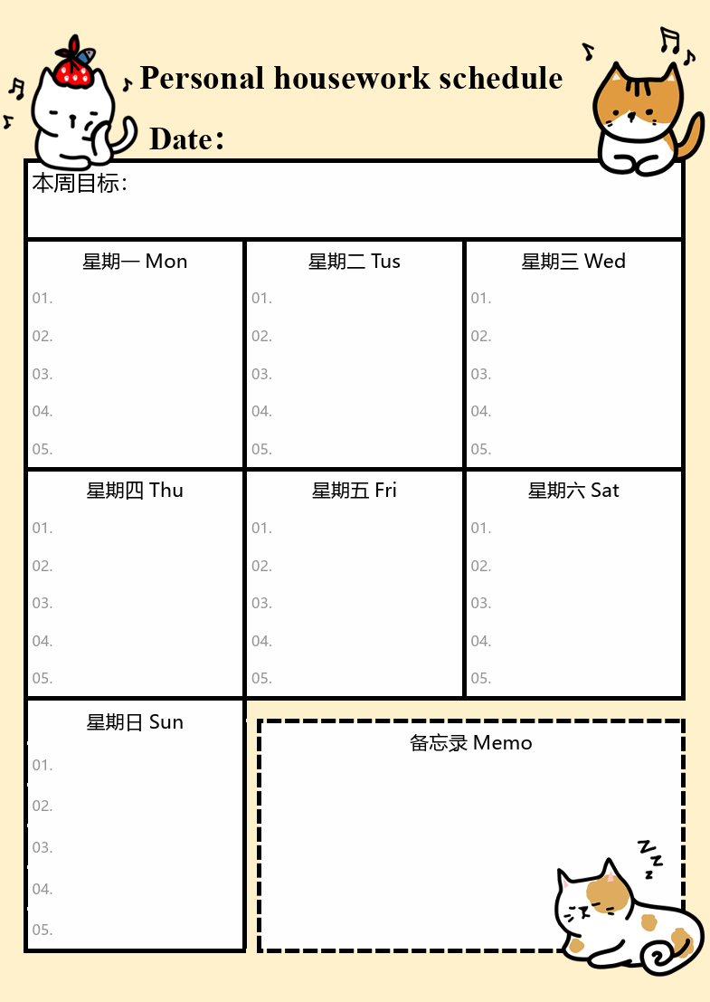
Personal housework schedule
Notes:
Tang原创课件,请勿侵权！
小红书/抖音：Tang原创课件
淘宝：Tang原创课件

Slide 26


It’s really important for us to do chores .
c
challenge ourselves（挑战自我）
help our parents（帮助父母）
h
o
obtain new skills( 获得技能 )
chores
r
reduce parents’ stress( 减少父母压力)
e
enjoy the life（享受生活）
shoulder the resposibility（承担责任）
s

Slide 27
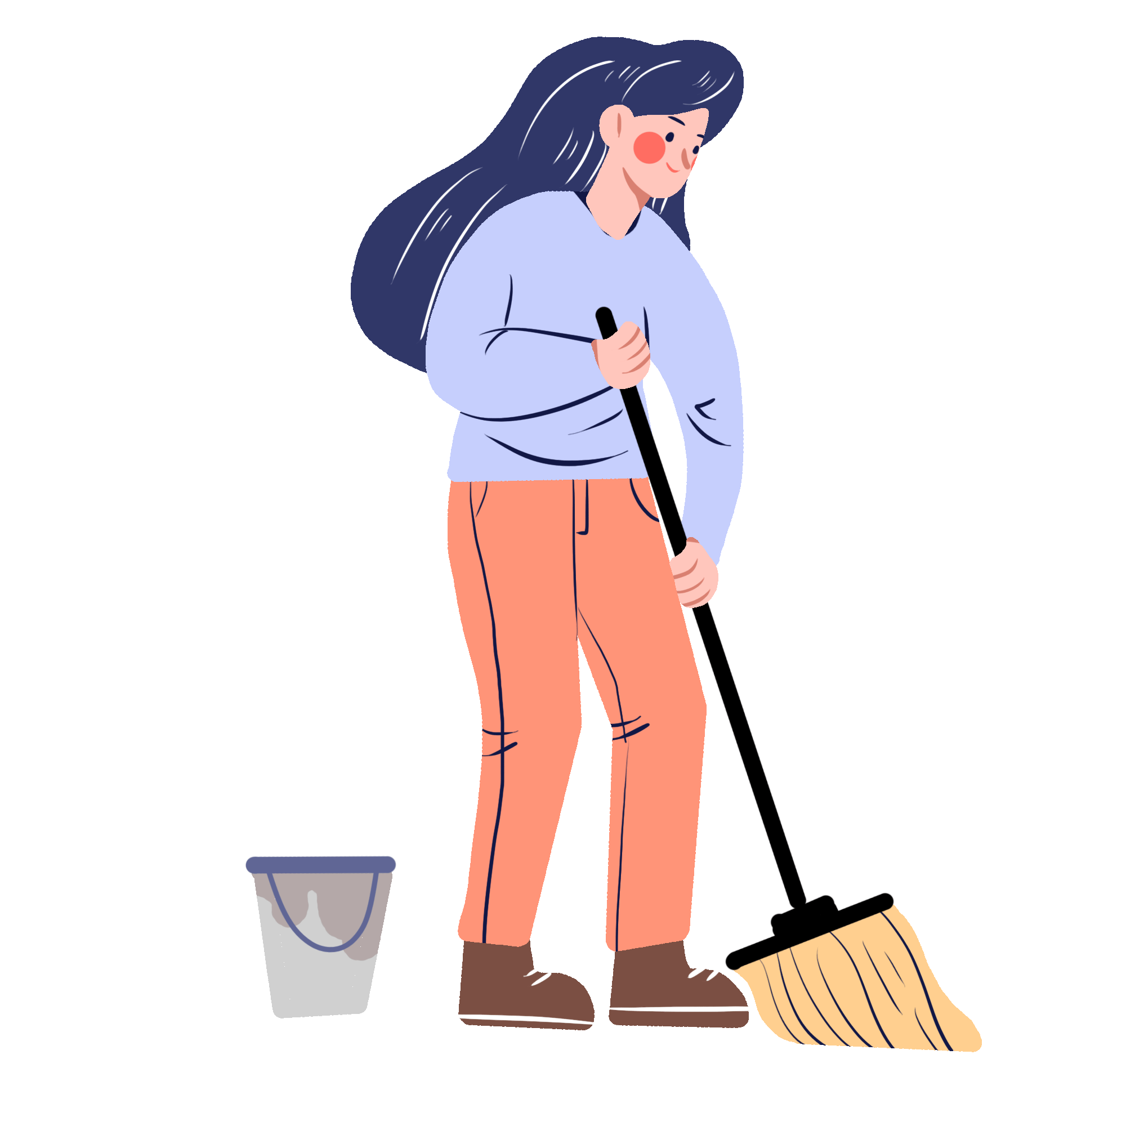
Homework
Homework
Must do: 1. Finish your Personal housework schedule;
2.Polish it according to your group members’ advice.
01
Try to do: 1.Draw a mind map to review Unit 3; 2.List all the chores you know and choose one or two to do tonight, then write down your feelings.
02
Notes:
Tang原创课件,请勿侵权！
小红书/抖音：Tang原创课件
淘宝：Tang原创课件

