Slide 1





Personal housework schedule
Period 4. Section B (1a-1d)
----Use could to make requests and ask for permission
----Love doing chores and learn how to help others
Period 5. Section B (2a-2e)
----Get parents’ different opinions on whether young people should do chores at home
----Share your own ideas and know the importance of doing chores
Period 6. Section B (3a-Self Check)
----Finish your personal housework schedule
Period 1. Section A (1a-2c)
----Learn to make polite requests and ask for permission
Period 2. Section A (2d&GF-4c)
----Make polite requests and ask for permission rightly
Period 3. Section A (3a-3c)
----Find out why mom and Nancy are in conflict
----Show our own opinions about doing chores
Notes:
Tang原创课件,请勿侵权！
小红书/抖音：Tang原创课件
淘宝：Tang原创课件

Slide 2

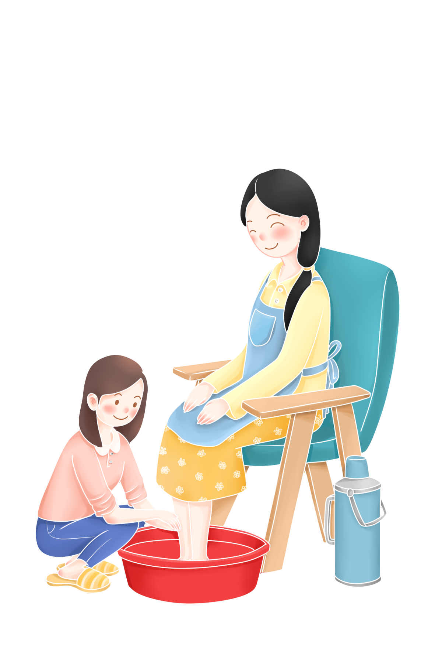

Unit 3
Unit 3
Could you please clean your room?
Section A (3a~3c)

Slide 3
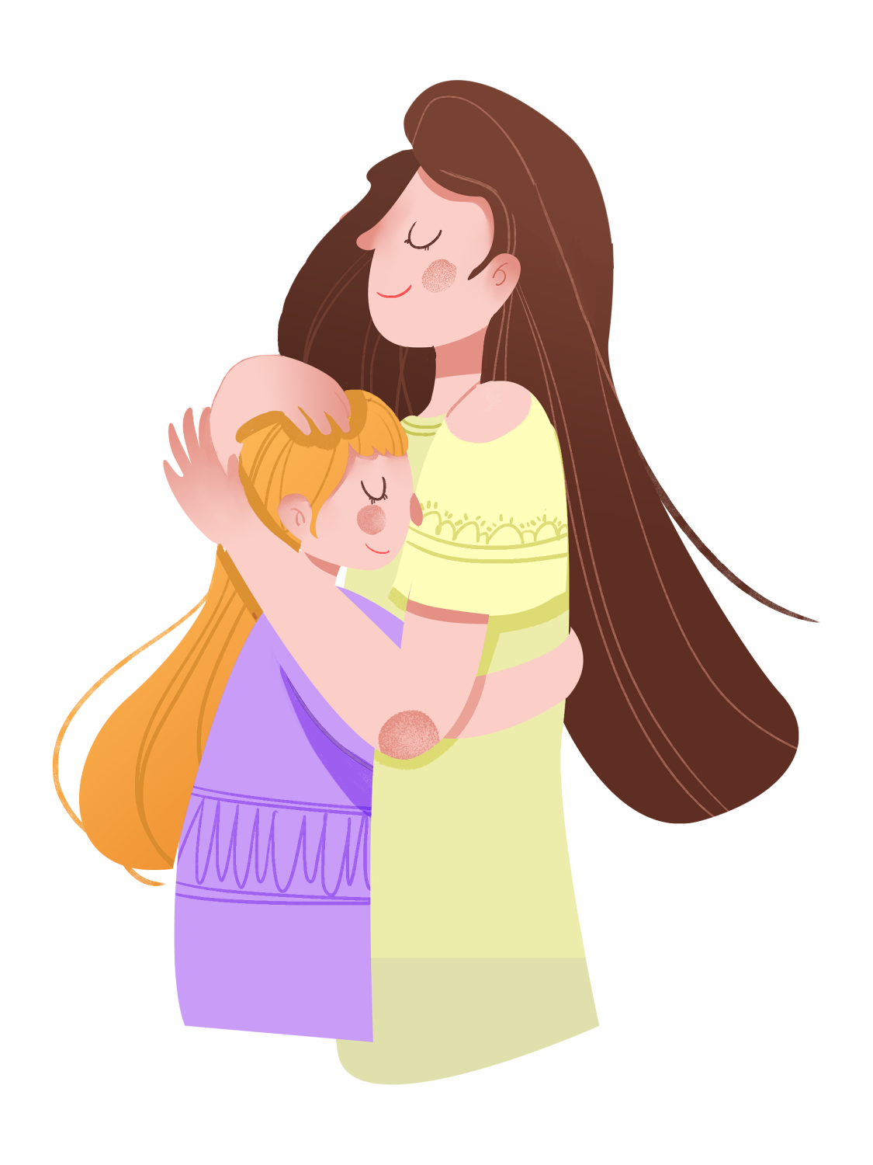
Learning objectives
通过本课时学习，我们能够：
通过学习理解并掌握阅读文本中与主题相关的词汇、短语和句式；能够理解故事中呈现的家人之间在家务分工和沟通交流之中遇到的问题并理解主动分担家务、增强家庭责任感的重要性。 （学习理解）
1
通过阅读学习掌握故事的六要素，并强化对单元主题内容及语言项目的理解，提高阅读技能；能够用目标语言向他人礼貌地提出请求或要求，并能够在生活实际中积极参与日常家务劳动，与家人一起积极共创良好的家庭关系。（应用实践）
2
对阅读文本中出现的人物观点及做法进行评价，形成正确的价值观；同时尝试去帮助解决本文主人公在沟通交流中遇到的问题。（迁移创新）
3
Notes:
Tang原创课件,请勿侵权！
小红书/抖音：Tang原创课件
淘宝：Tang原创课件

Slide 4
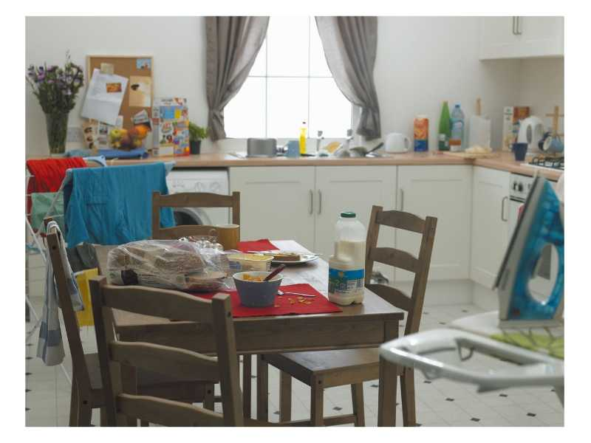
How do you like the kitchen of Nancy’s home?
It’s dirty and in a mess
What would you do if it is your house?
Who will clean the room, Nancy, her parents or anyone else?
Notes:
Tang原创课件
小红书Tang

Slide 5

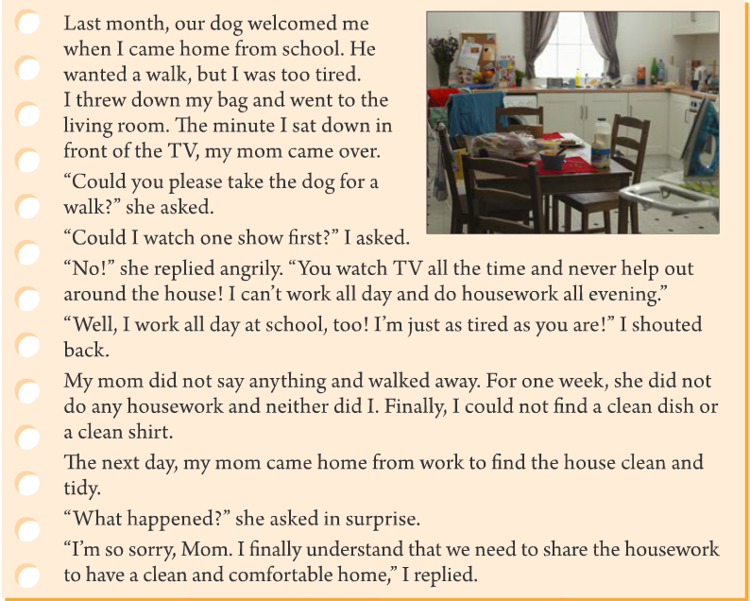

3a
Skimming
1.The general idea of the story
is about ________.
A. the story of Nancy and her mother
B. the story of Nancy and her dog
C. The story of Nancy and housework
A
Reading tip:Here you should move your eyes down quickly to catch more key words(关键词) to get the general idea.

Slide 6

How many paragraphs are there in this passage?
10
Para.1-2 (the cause 起因 of the story)
Para.3-6 (the development 发展of the story)
Para.7 (the climax 顶点of the story)
Para.8-10 (the ending of the story)

Slide 7
Read Part. 1 carefully and fill in the blanks.
Para.1-2 (the cause of the story)
Last month, our dog welcomed me when I came home from school. He wanted a walk, but I was too tired.
I threw down my bag and went to the living room. The minute I sat down in front of the TV, my mom came over.
When: ____________
Last month
Where: ___________
At home
Who: ________________
Nancy and her mom

Slide 8
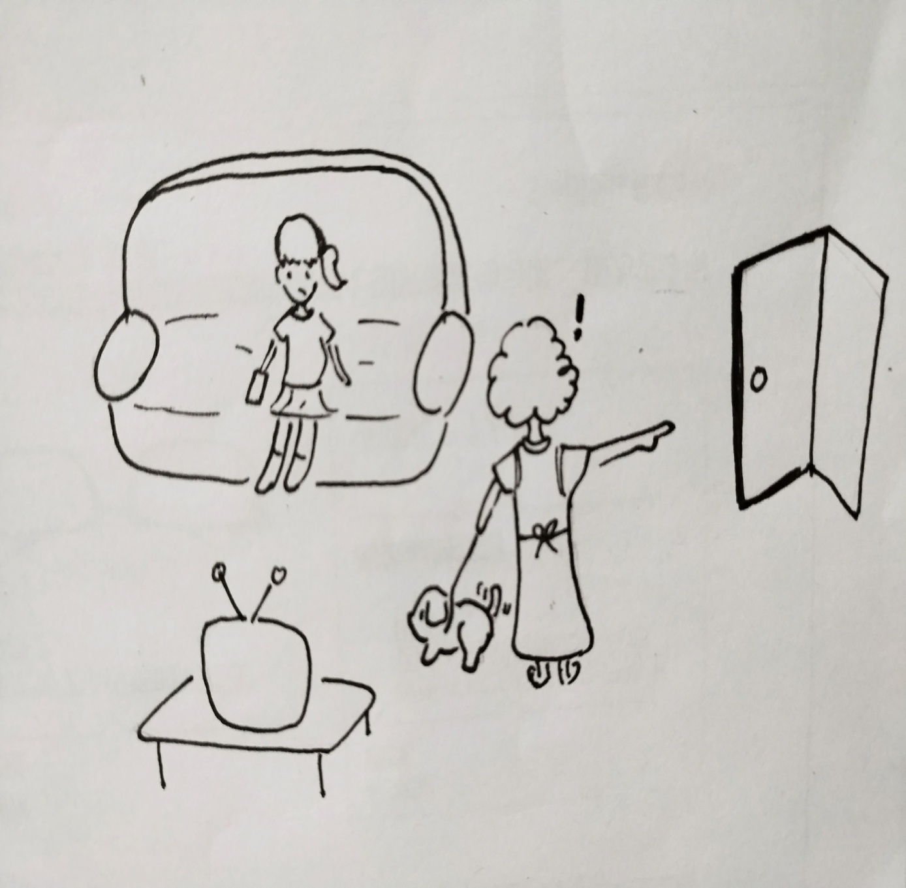
Read Part 1 again and finish the chart.
Names | Actions 行为 | Feelings
Nancy
The dog
Mom
came home from school
tired
threw down the bag
Last month, our dog welcomed me when I came home from school. He wanted a walk, but I was too tired.
I threw down my bag and went to the living room. The minute I sat down in front of the TV, my mom came over.
went to the living room
sat down in front of the TV
welcomed Nancy
and wanted a walk
happy
came over

Slide 9
Read Part. 2 and answer the questions:
1. What did her mother want her to do?
2.What did Nancy want to do?
3. Why was Nancy’s mom angry?
4. Why didn’t Nancy want to do the housework?
Her mother wanted her to take the dog for a walk.
She wanted to watch one show first.
Because she think Nancy watched TV all the time and never help out around the house.
Because she worked all day at school. She was just as tired as her mom is.

Slide 10
How did the feeling change?
Tip: Language can show the feelings .
feelings
Nancy
Mom
polite
angry / mad
What did Nancy and her mom do after the quarrel(争吵)?
sad and
disappointed
(失望的)

Slide 11
Read Part 4 and answer the questions:
1. Who did the housework at last ?
Nancy did.
2. How did Mom and Nancy feel?
Mom felt surprised and Nancy felt sorry and learned a lesson.
3.What did Nancy finally understand?
We all need to share the housework to have a clean and comfortable home.

Slide 12


If you meet the same problem like Nancy, what will you do ?
Try to understand and care for our parents .
Change the way to talk with parents.
Learn to share housework with parents.
Everyone is a part of a family. We need to share housework.

Slide 13
Read the sentences below. Underline the sentences from the reading that mean the same thing.
3b
1. Neither of us did any housework for a week.
2. My mom came over as soon as I sat down in front of the TV.
3. You're tired, but I’m tired, too.

Slide 14

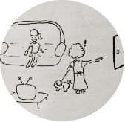
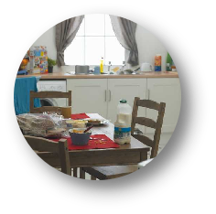
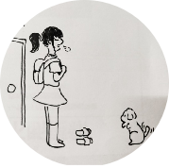
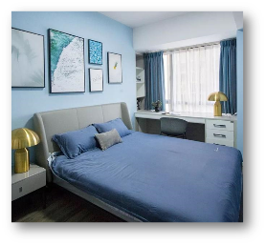
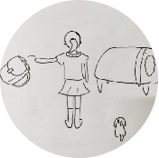
Try to retell the passage according to the pictures.
Presentation
the minute
=as soon as
take the dog for a walk
Last month
Mother didn't do...and neither did Nancy.
in front of
come over
come home from school
welcome
Neither of...
Could you...?
Could I...?
shouted back
angry
all the time
want a walk
tired
throw down
as
tried
as
in surprise
need to share
Notes:
Tang原创课件,请勿侵权！
小红书/抖音：Tang原创课件
淘宝：Tang原创课件

Slide 15
Please make your own mind map to retell the passage.
______________________________
_______________
climax
______________________________
_______________
Checklist
Activities: Group work |  | 小组互评
Contents | Make your own mind map
 | Use the phrases we have learned today
Speaking | Speak clearly and fluently
 | Use tone and body language properly
Excellent Good To be improved
development
______________________________
_______________
e.g. Mom wanted Nancy to ... but ...
cause
ending
Notes:
Tang原创课件,请勿侵权！
小红书/抖音：Tang原创课件
淘宝：Tang原创课件

Slide 16
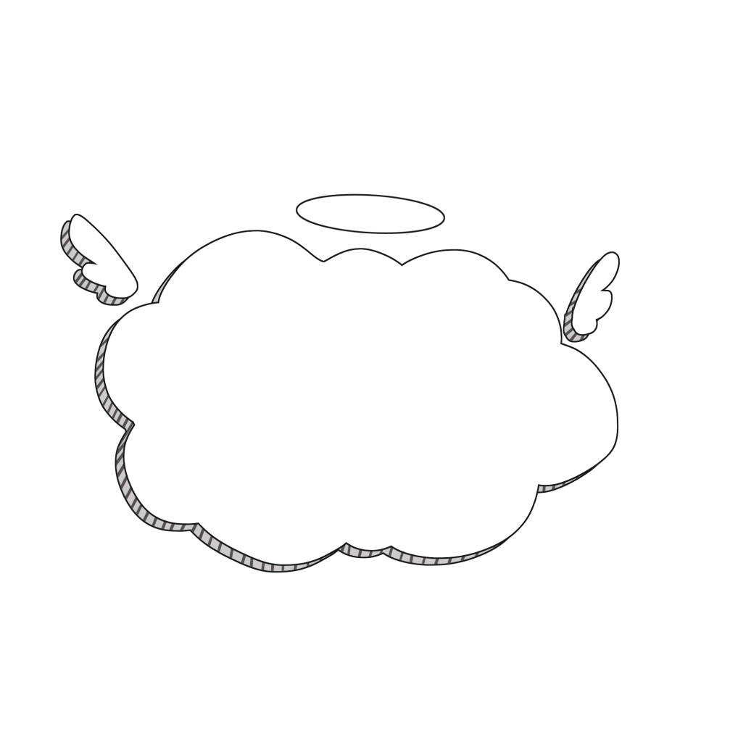
Decide whether the underlined words in the sentences are verbs or nouns. Then write another sentence using the underlined word in the other form.
3c
Could you take the dog for a walk? (noun)
2. Could I watch one show first?
转化（一种构词方式） ：相同词形的词语由一种词性转变为另一种词性。
I walked home from school. (verb)
Could you please show me your new book? (verb)
(noun)
3. I can’t work all day.
(verb)
My father has a lot of work to do this weekend. (noun)

Slide 17
Decide whether the underlined words in the sentences are verbs or nouns. Then write another sentence using the underlined word in the other form.
3c
4. You watch TV all the time.
5. “What happened?” she asked in surprise.
(verb)
My best friend bought me a watch as a birthday gift. (noun)
My parents surprised me on my birthday with a lovely birthday cake! (verb)
(noun)

Slide 18
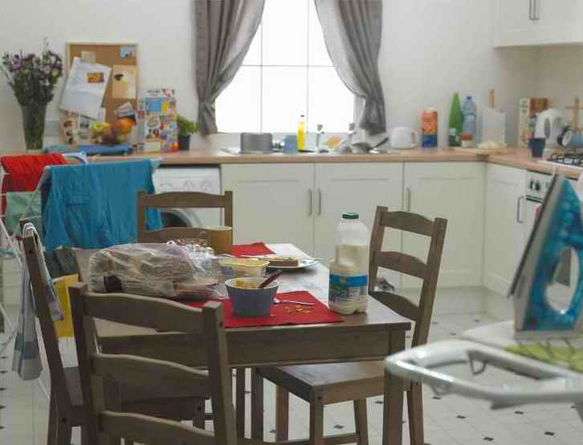
If you live in this room, what chores do you need to do?
clean the desk
do the dishes
fold the clothes
put things away
in a mess
Nancy’s room
Notes:
Tang原创课件,请勿侵权！
小红书/抖音：Tang原创课件
淘宝：Tang原创课件

Slide 19


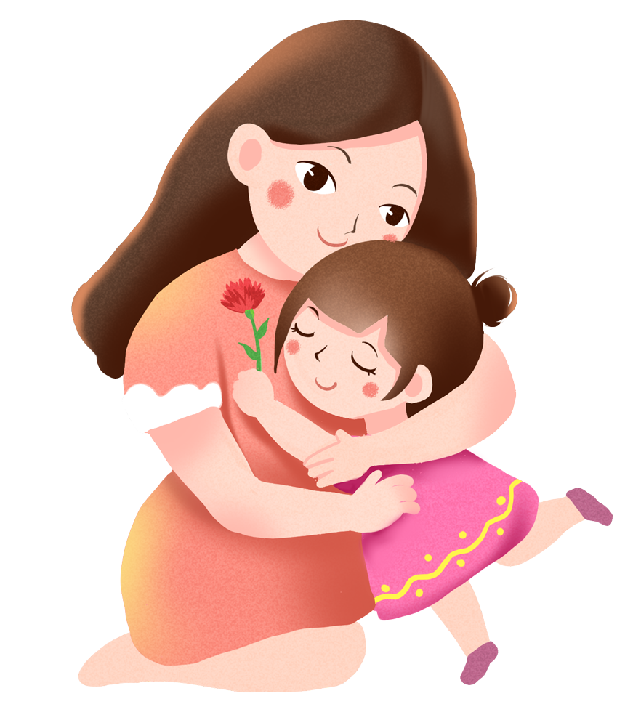

Homework
Must do: 1.Polish your mind map and retell the passage;
2.Preview Section B 1a-1d.
Try to do: 1.Recite the article and review the key language points;
2. Help your parents with some housework and keep a diary about what you did.
Notes:
Tang原创课件,请勿侵权！
小红书/抖音：Tang原创课件
淘宝：Tang原创课件

Slide 20


Read paragraphs 1 -- 4.
Underline the language points.
the minute 相当于 as soon as, 表示“一...就”，主将从现
Last month, our dog welcomed me when I came home from school. He wanted a walk, but I was too tired.
I threw down my bag and went to the living room. The minute I sat down in front of the TV, my mom came over.
“Could you please take the dog for a walk?” she asked.
“Could I watch one show first?” I asked.
in front of | 在...前面（外部） | A dog is in the front the car.一只狗在汽车前面。
in the front of | 在...前部（内部） | The driver is in the front of the car. 司机在小汽车的前部。
Notes:
Tang原创课件
小红书Tang

Slide 21
Read paragraphs 5 -- 7.
Underline the language points.
“No!” she replied angrily. “You watch TV all the time and never help out around the house! I can’t work all day and do housework all evening.”
“Well, I work all day at school, too! I’m just as tired as you are!” I shouted back.
My mom did not say anything and walked away. For one week, she did not do any housework and neither did I. Finally, I could not find a clean dish or a clean shirt.
as ... as 意为 “和……一样”
neither... nor ... 既不……也不……
Notes:
Tang原创课件
小红书Tang

Slide 22
Read paragraphs 8 -- 10.
Underline the language points.
The next day, my mom came home from work to find the house clean and tidy.
“What happened?” she asked in surprise.
“I’m so sorry, Mom. I finally understand that we need to share the housework to have a clean and comfortable home,” I replied.
in surprise 惊讶地；吃惊地

Slide 23

1.放学回到家
2.扔下
3.一……就……
4.坐在电视机前
5.走过来
6.遛狗
7.一直；总是
8.像……一样……
9.大声回应
10.走开
11.第二天
12.惊讶地
13.分担家务
come home from school
throw down
the minute/as soon as
sit down in front of the TV
come over
take the dog for a walk
all the time
as ... as ...
shout back
walk away
the next day
in surprise
share the housework
Summary
Notes:
Tang原创课件
小红书Tang

Slide 24
Retell
Last month,the dog welcomed Nancy she came home from school. Nancy was so that she her bag and went to the living room. she sat down
the TV, her mom .Mom asked her to
,but Nancy wanted to watch TV
.Mom got with Nancy.She said Nancy watched
TV all the time and never .
Nancy she was her mom.
when
tired
threw down
The minute
in front of
came over
take the dog for a walk
first
angry
helped out around the house
shouted back
as tired as

Slide 25
Retell
The next week Nancy ______her mother _________ any housework. The house was too ________. And Nancy couldn’t find anything clean. At last, Nancy cleaned the house and this really ___________ her mother. Nancy understood that she need _________ the housework ______her mother __________a clean and comfortable home.
neither
nor
did
messy
surprised
to share
with
to have

Slide 26
Exercises
I、单项选择
1.—Summer vacation is coming! I am thinking about visiting some places of interest.
—Why not ____ Jingzhou and have a look at the ancient
city wall? A. come out B. come along C. come up with D. come over to
2.Someday Changde will become as _____ as Shenzhen.
A. busy B. busier C. busiest
D
A

Slide 27
Exercises
3.Many tourists visit Hainan around the Spring Festival, because it’s _____too cold_____ too hot.
A. both...and B. not only...but also C. neither...nor
4._____ he heard the little girl crying for help outside, he rushed out of the room.
A. As soon as B. Unless C. If D. Although
C
A

Slide 28
Exercises
Ⅱ. 根据汉语意思，完成英语句子，每空一词。
1. 住在这里很吵，因为飞机频繁地飞过。
It’s very noisy to live here because planes are coming over _______ _______ _______.
2. 你一到北京就请给我打电话。
Please call me _______ _______ _______ you get to Beijing.
3. 我惊讶地看着他——没想到还能再见到他。
I looked at him _______ _______ — I didn’t expect to see him again.
all the time
as soon as
in surprise

Slide 29
Exercises
5. 当我放学回到家时，天就下雨了。
When I _____ ______ ______ _______, it started to rain.
6. 她一直很忙碌。
She is busy _____ _____ _______.
7. 我一到北京就给我妈妈打电话。
_____ ________ I arrived Beijing, I called my mother.
8. 他昨晚没来参加派对，Tony也是。
He ______ come to the party last night, ______ ____ Tony.
came home from school
all the time
The minute
didn't neither did

Slide 30

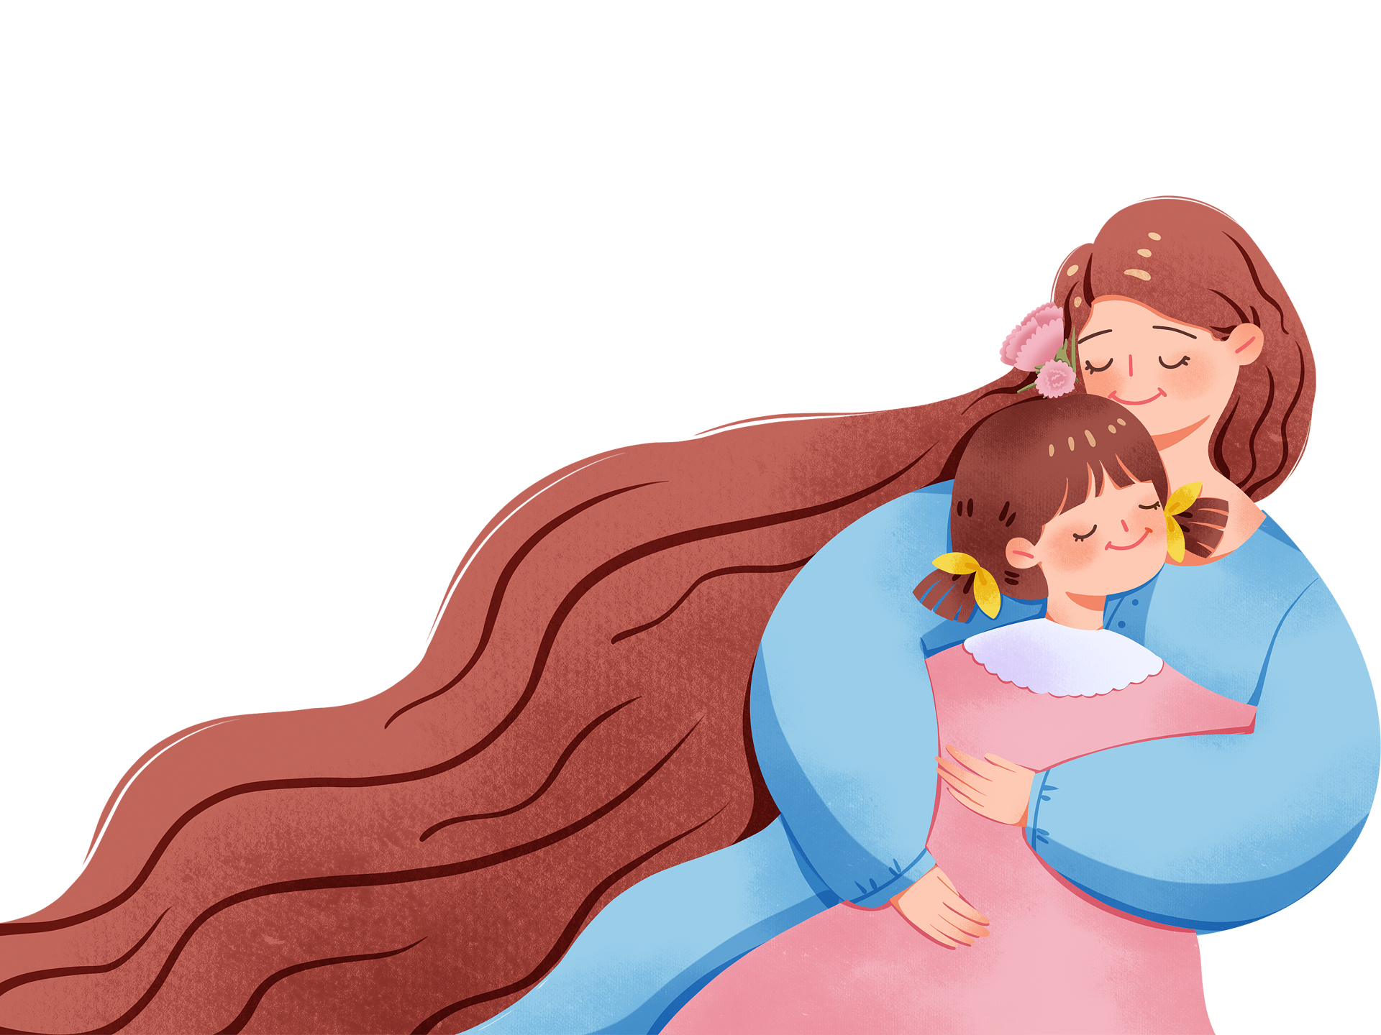
Notes:
Tang原创课件,请勿侵权！
小红书/抖音：Tang原创课件
淘宝：Tang原创课件

