Slide 1
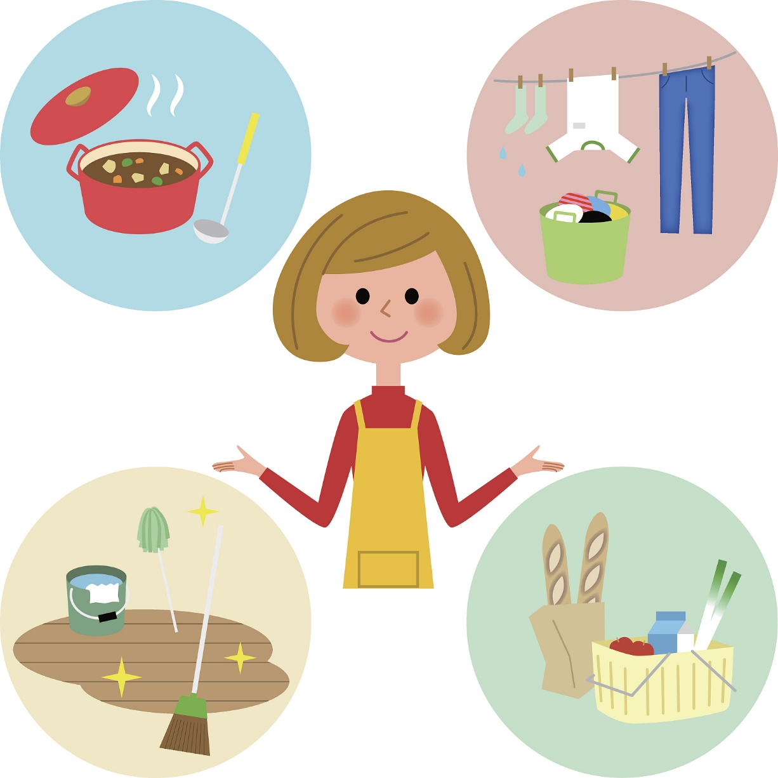

大单元整体项目式教学：
通过本单元的学习，设计自己一周的个人家务劳动计划表并将完成过程用自己喜欢的方式记录下来。
1.Know the chores：初识家务相关的基本表达，学会如何礼貌地表达请求及向对方征询许可；
2. Discuss the chores：进行思辨性思考，明确自己的立场，学会有逻辑地表达自己的观点；
3. Share the chores：换位思考并增强家庭责任感，完成自己的个人家务劳动计划表。
Personal housework schedule
Notes:
Tang原创课件,请勿侵权！
小红书/抖音：Tang原创课件
淘宝：Tang原创课件

Slide 2





Personal housework schedule
Period 4. Section B (1a-1d)
----Use could to make requests and ask for permission
----Love doing chores and learn how to help others
Period 5. Section B (2a-2e)
----Get parents’ different opinions on whether young people should do chores at home
----Share your own ideas and know the importance of doing chores
Period 6. Section B (3a-Self Check)
----Finish your personal housework schedule
Period 1. Section A (1a-2c)
----Learn to make polite requests and ask for permission
Period 2. Section A (2d&GF-4c)
----Make polite requests and ask for permission rightly
Period 3. Section A (3a-3c)
----Find out why mom and Nancy are in conflict
----Show our own opinions about doing chores
Notes:
Tang原创课件,请勿侵权！
小红书/抖音：Tang原创课件
淘宝：Tang原创课件

Slide 3

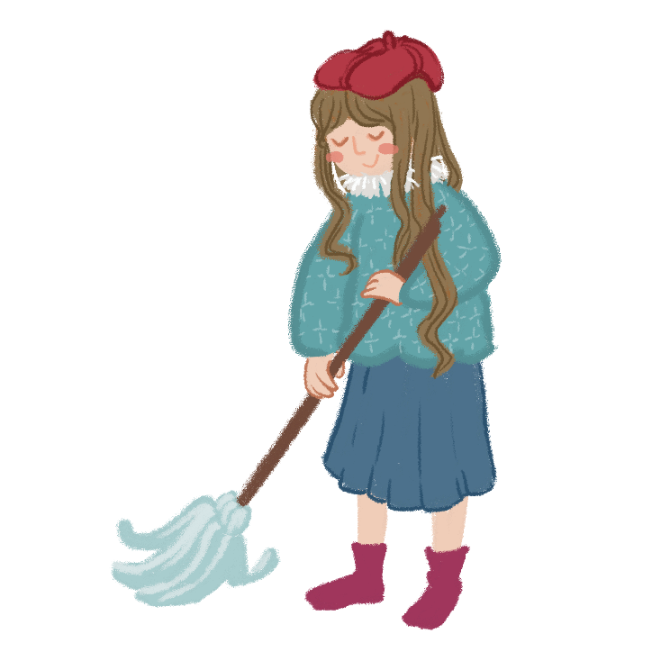
Unit 3
Could you please clean your room?
Section A (1a~2c)
Notes:
Tang原创课件,请勿侵权！
小红书/抖音：Tang原创课件
淘宝：Tang原创课件

Slide 4
Learning objectives
通过本课时学习，我们能够：
感知学习听力文本中与主题相关的词汇、短语和句式: mess, go out for dinner, go to the movies, stay out late, get a ride, work on, help out with, at least…能够理解在日常生活中参与家务劳动的意义及重要性。 （学习理解）
1
在实践交流中，用目标句式礼貌地表达请求并向对方征询许可；能够在生活实际中积极参与日常家务劳动，与家人一起积极共创良好的家庭关系。（应用实践）
2
对听力文本中出现的人物观点及做法做出评价，进行思辨性思考，明确自己的立场，学会有逻辑地表达自己的观点，形成正确的价值观；同时设计自己一周的个人家务劳动计划表并将完成过程用自己喜欢的方式记录下来，在单元学习结束后在班级内分享。（迁移创新）
3
Notes:
Tang原创课件,请勿侵权！
小红书/抖音：Tang原创课件
淘宝：Tang原创课件

Slide 5

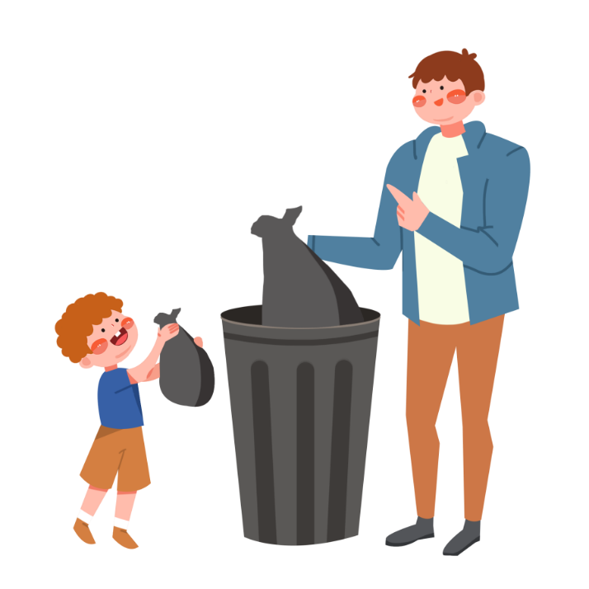
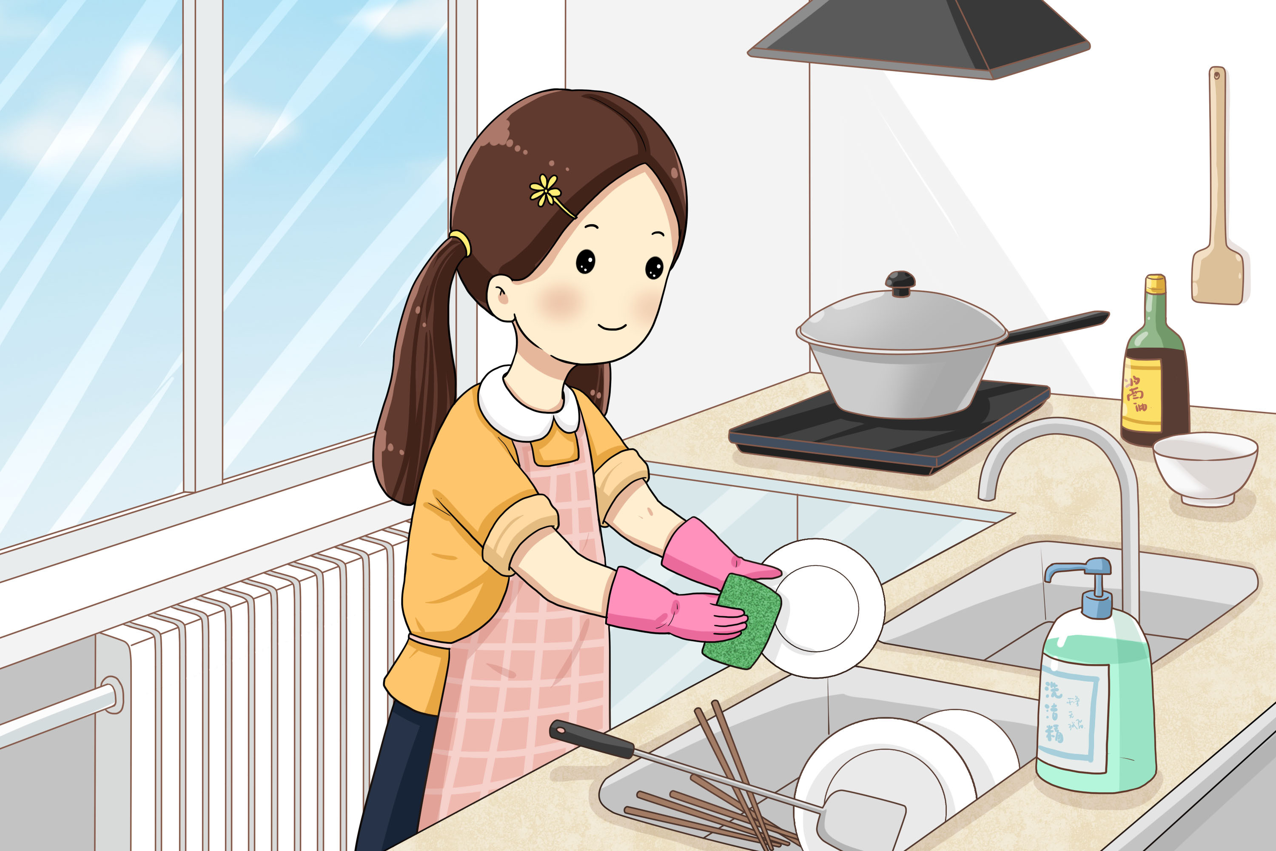
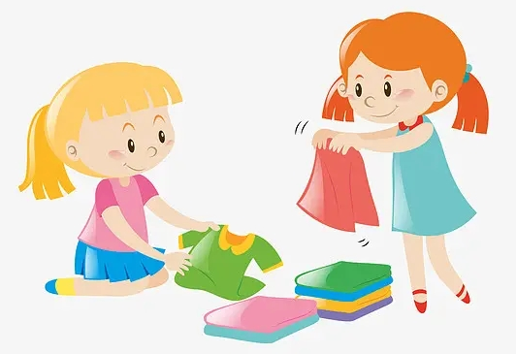
What chores do you do at home?
do the dishes
take out the rubbish
fold the clothes
['rʌbɪʃ]
[fəʊld]
Notes:
Tang原创课件,请勿侵权！
小红书/抖音：Tang原创课件
淘宝：Tang原创课件

Slide 6
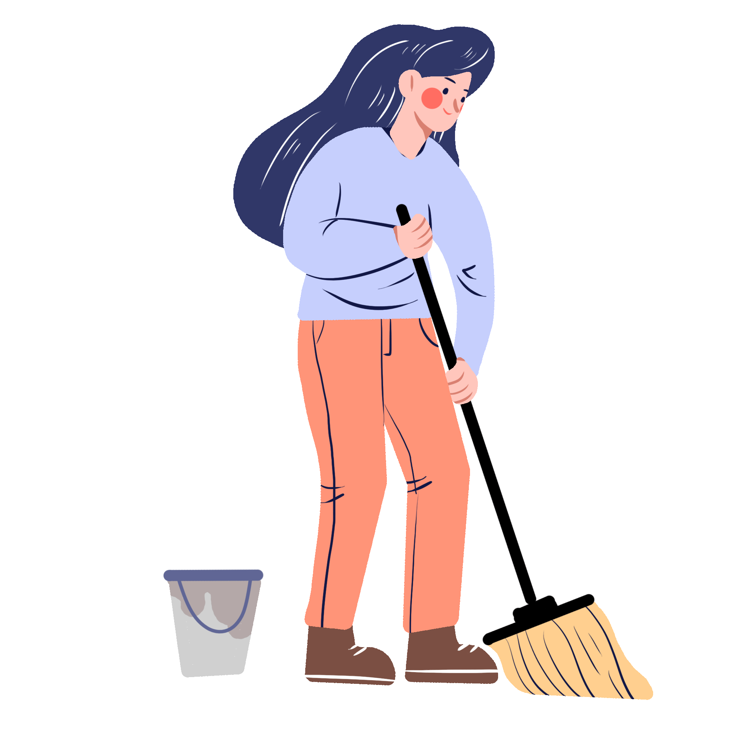
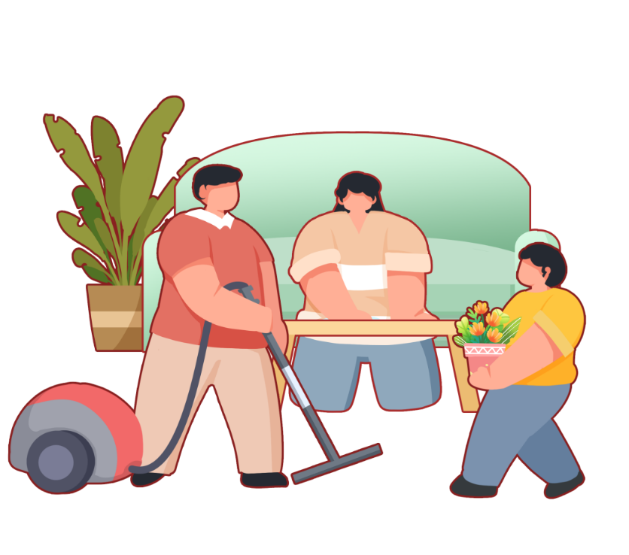
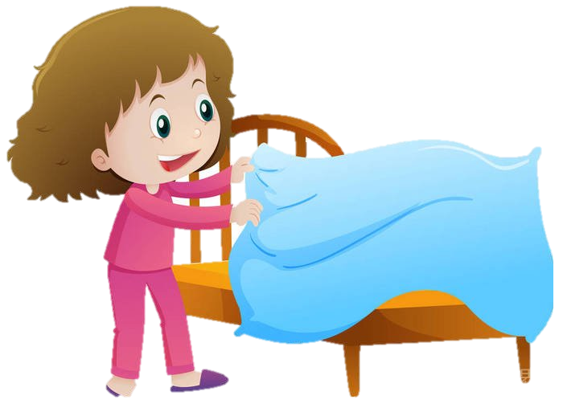
What chores do you do at home?
sweep the floor
make the bed
clean the living room
[swiːp]
[flɔːr]
Notes:
Tang原创课件,请勿侵权！
小红书/抖音：Tang原创课件
淘宝：Tang原创课件

Slide 7
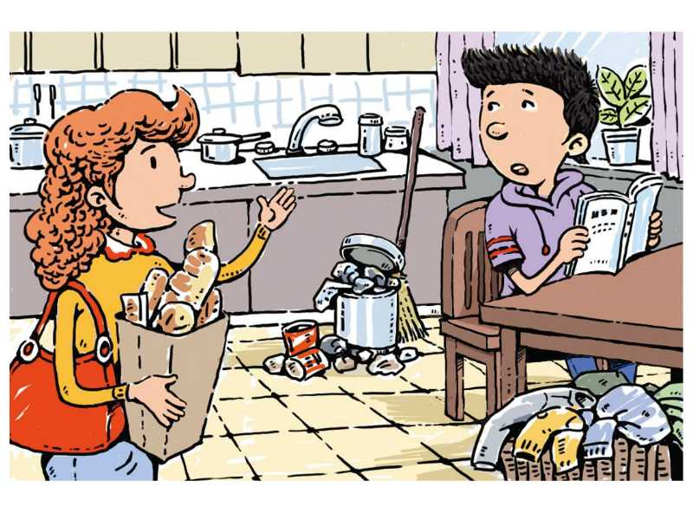
What can you see?
Sure, Mom.
Take out the rubbish.
1. What does Peter’s mother ask Peter to do ?
2.What is Peter doing?
3.Where are they ?
Reading a book.
Peter, could you please take out the rubbish?
In the kitchen.

Slide 8

Listen.Who will do these chores? Check( √ ) Peter’s mother or Peter.
1b
Why did they have to do chores at that time?
Because Peter’s grandmother was coming.
Chores | Peter’s mother | Peter
do the dishes
sweep the floor
take out the rubbish
make the bed
fold the clothes
clean the living room
✔
✔
✔
✔
✔
✔
Notes:
Tang原创课件,请勿侵权！
小红书/抖音：Tang原创课件
淘宝：Tang原创课件

Slide 9
To ask Peter to do chores, his mom says .
clean the house
Mom: Peter, we need to_________________.
Peter: Sure, but I need to ________________ first.
Mom: OK. Then after you finish your homework,
let’s ____________________. I can _____________
and ______________. Could you please take
out the rubbish?
Peter: Sure, mom.
Mom: Could you please______________and_________________?
Peter: All right.
Mom: I have to__________________before your grandma arrives.
To accept requests politely, we would say .
do my homework
clean up the kitchen
do the dishes
sweep the floor
Make polite requests
make your bed
fold your clothes
To refuse requests politely, we would say .
clean the living room
Notes:
Tang原创课件,请勿侵权！
小红书/抖音：Tang原创课件
淘宝：Tang原创课件

Slide 10
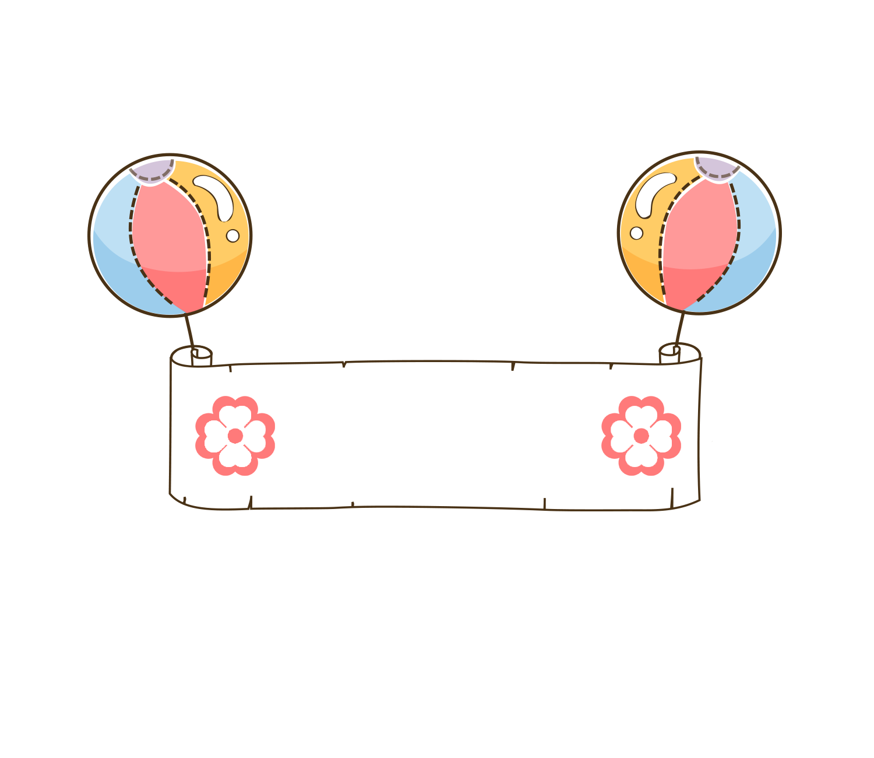
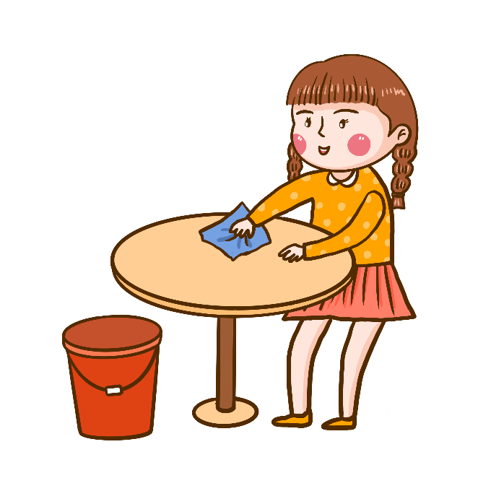
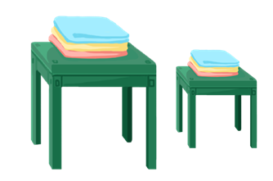
Language Point
Make polite requests 礼貌、委婉地提出请求
Could you please do sth ? 请你做某事好吗？
Could you please not do sth ? 请你不要做某事好吗？
肯定回答：Yes, sure. / All right. / Certainly./ No problem.
否定回答：Sorry, I can’t. / I’m afraid I can’t.
Sure,/I’d love to, but I have to
Notes:
Tang原创课件,请勿侵权！
小红书/抖音：Tang原创课件
淘宝：Tang原创课件

Slide 11
1c
Make conversations about the chores in 1a.
A: Could you please …?
B：Yes, sure. / All right. / Certainly./ No problem.
Could you please ...?
A: Yes, sure. / All right. / Certainly./ No problem.
Sorry, I can’t. / I’m afraid I can’t. I have to...
Notes:
Tang原创课件,请勿侵权！
小红书/抖音：Tang原创课件
淘宝：Tang原创课件

Slide 12
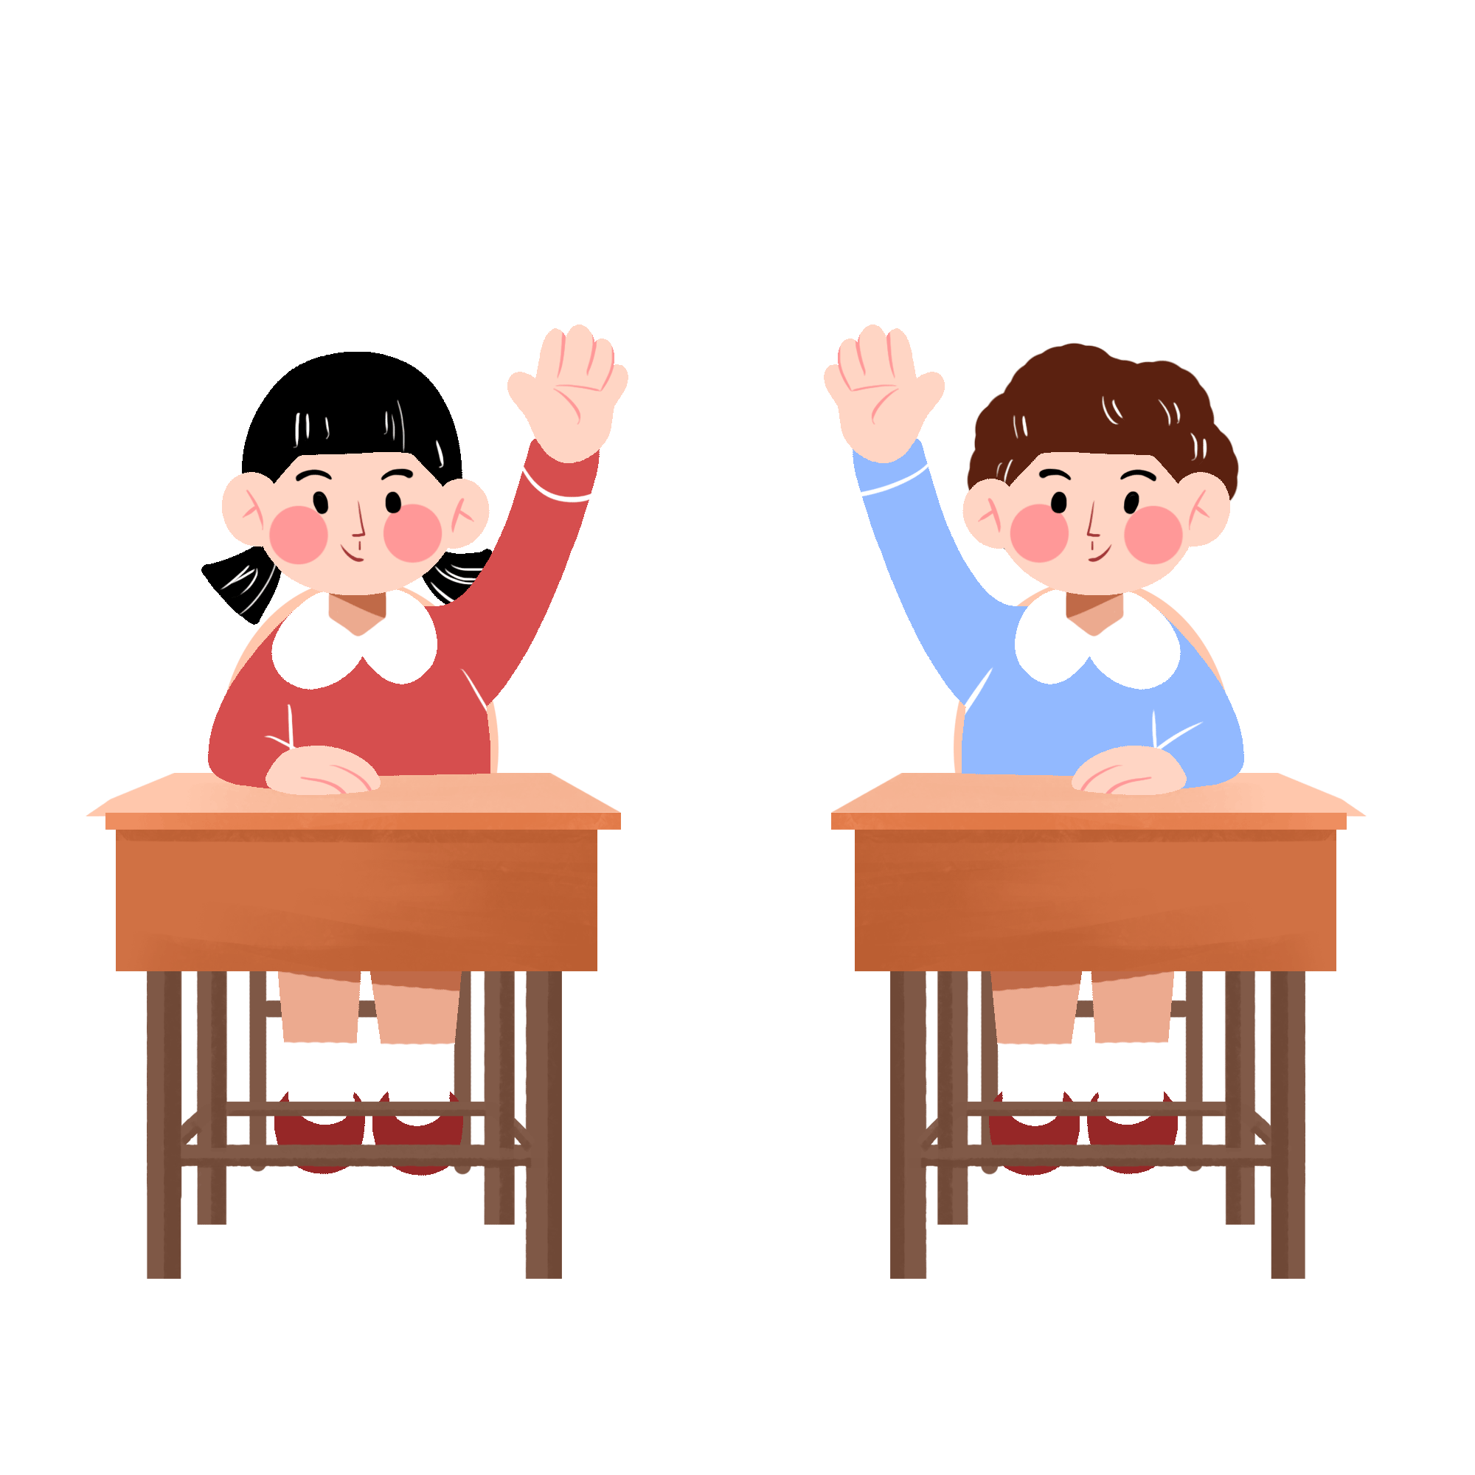
Listen. Peter asks his father if he can do four things. What does his father say? Check (√) yes or no.
2a
Peter wants to… | Peter’s father says…
go out for dinner. | Yes No
go to the movies. | Yes No
stay out late. | Yes No
get a ride. | Yes No
✔
✔
✔
✔
Notes:
Tang原创课件,请勿侵权！
小红书/抖音：Tang原创课件
淘宝：Tang原创课件

Slide 13
Listen again. Why does Peter’s father say “no”?
Draw lines to the reasons in the chart in 2a.
2b
Peter wants to… | Peter’s father says… | His father’s reasons
go out for dinner. | Yes No | I have to do some work.
go to the movies. | Yes No | You have to clean your room.
stay out late. | Yes No | I need to eat breakfast.
get a ride. | Yes No | You have a basketball game.
✔
✔
✔
✔
How will Peter go to the town?
He will call Alan.
Notes:
Tang原创课件,请勿侵权！
小红书/抖音：Tang原创课件
淘宝：Tang原创课件

Slide 14

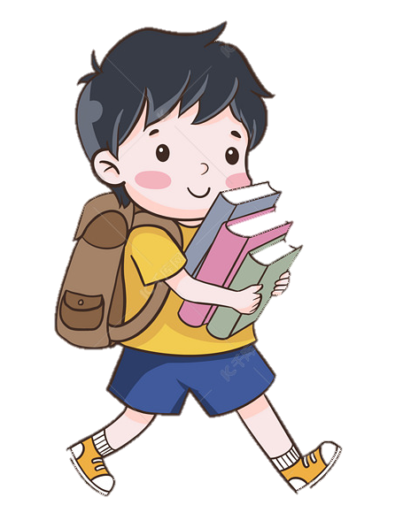
Listen again and fill in the blanks.
To ask for permission(允许), Peter says .
Peter: Hey, Dad?
Dad: Yes?
Peter: Could I ______________ with my friends tonight?
Dad: Sure, that should be OK.
Peter: Could I ________________ after that? My friends
said the new action movie is really good.
Dad: I guess so. But don’t ____________.
go out for dinner
go to the movies
stay out late
Notes:
Tang原创课件,请勿侵权！
小红书/抖音：Tang原创课件
淘宝：Tang原创课件

Slide 15

Listen again and fill in the blanks.
Peter: Could I stay out until eleven? We might get
something to drink after the movie.
Dad: No, you can’t. You have a basketball game
tomorrow, remember? You need to ______________.
Peter: Oh, yeah. Well, could you ______________ to
town now? If I take the bus, I’ll be late.
Dad: I can’t, Peter. I ___________________ now.
Peter: Oh, OK. ____________. I’ll call Alan. Maybe his
dad can give me a ride.
have a good rest
give me a ride
have to do some work
No problem

Slide 16

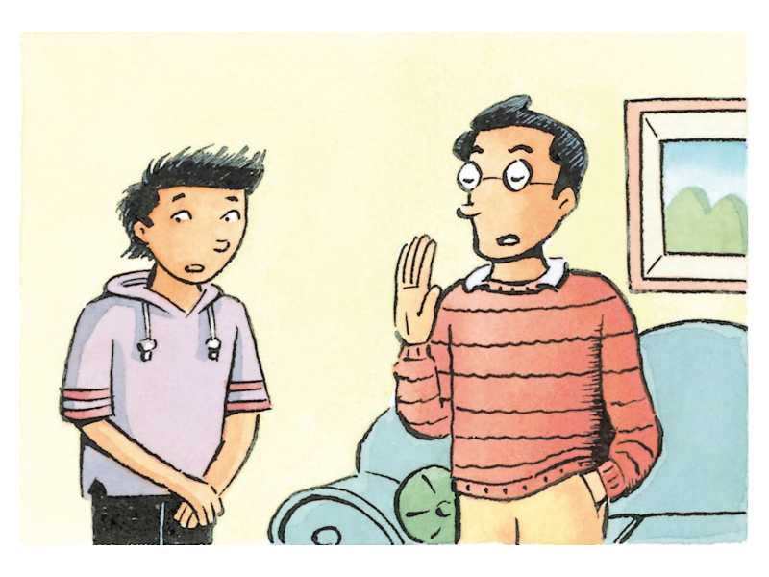

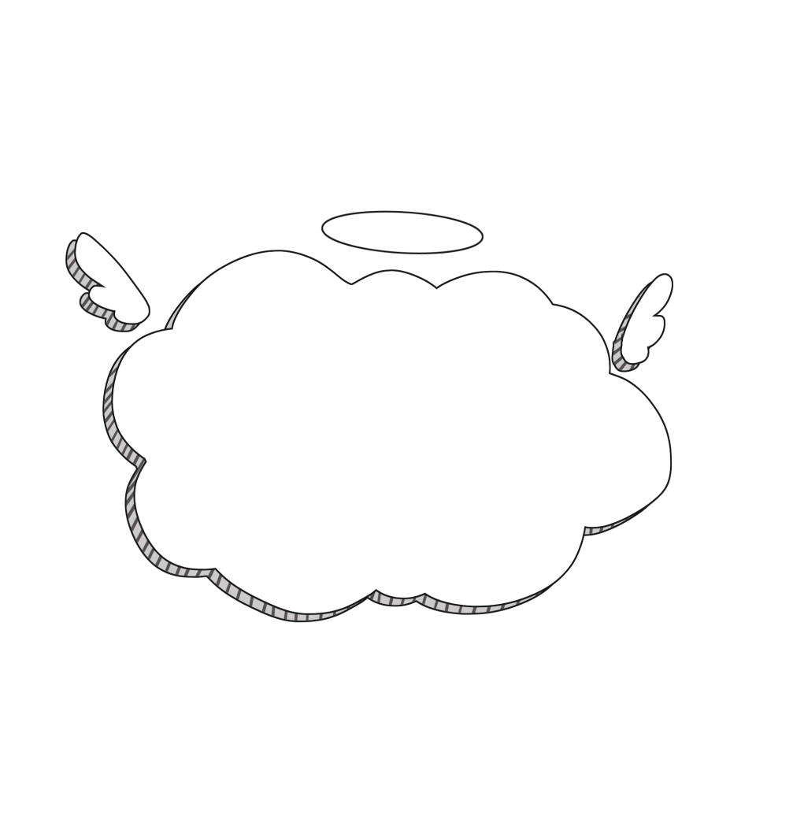
What do you think of Peter’s family?
when we make requests, we should show our politeness and respect.
peter's family gives us a good example of communication.
Notes:
Tang原创课件,请勿侵权！
小红书/抖音：Tang原创课件
淘宝：Tang原创课件

Slide 17

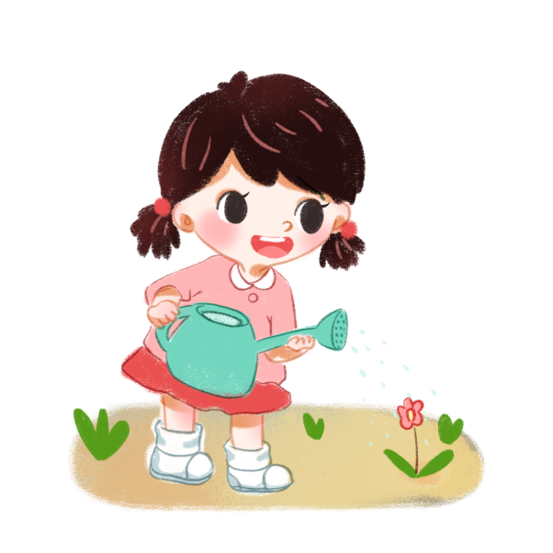
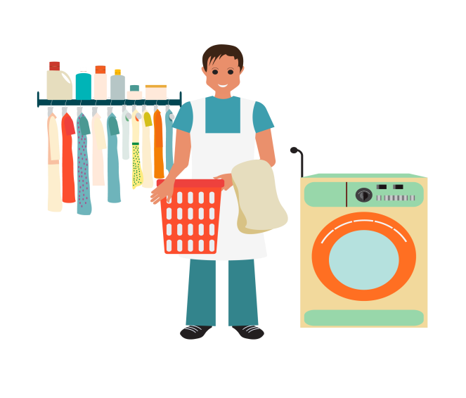

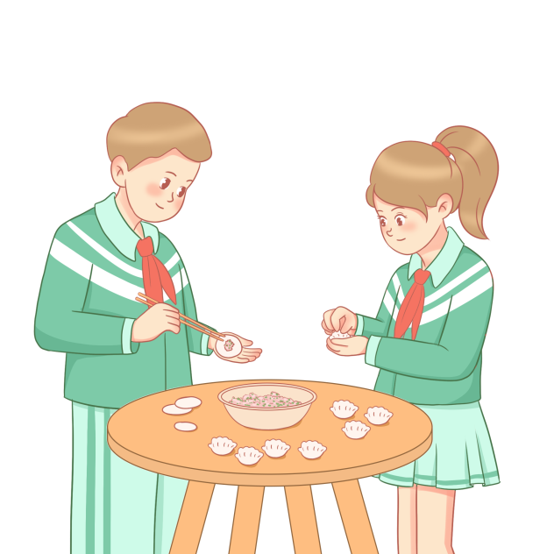
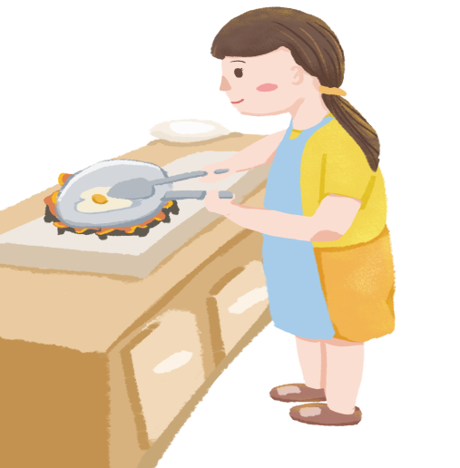
What chores could we help our family with?
We could...
wash the clothes
clean the living room
water the flower
Small things make a big difference!
Try to help out with a few things at home!
set the dinner table
=put the dishes on the table
prepare meals
Notes:
Tang原创课件,请勿侵权！
小红书/抖音：Tang原创课件
淘宝：Tang原创课件

Slide 18


Make polite requests
礼貌提出请求: Could you please do sth.?
Ask for permission
请求允许: Could I do sth.?

Slide 19
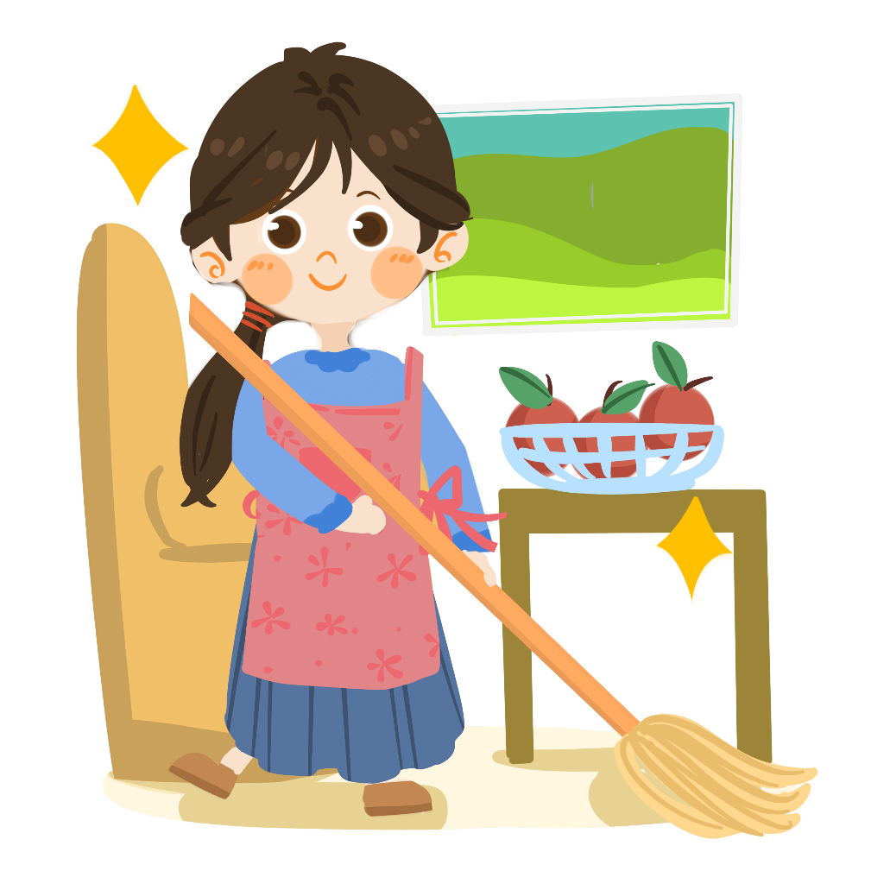
1.洗餐具
2.倒垃圾
3.叠衣服
4.扫地
5.铺床
6.打扫起居室
7.没问题
8.搭便车
9.外出吃晚饭
10.去看电影
do the dishes
take out the rubbish
fold the/one’s clothes
sweep the floor
make the/one’s bed
clean the living room
no problem
get a ride
go out for dinner
go to the movies
Notes:
Tang原创课件,请勿侵权！
小红书/抖音：Tang原创课件
淘宝：Tang原创课件

Slide 20

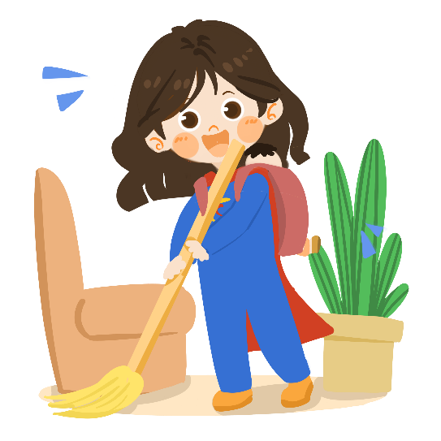
Practice
1. After dinner, you need to ___________.
2. After the washed clothes are dry, you need to ______________ .
3. If the dustbin is full, you have to _______________.
4. If there is lots of dust on the floor, you have to ____________.
5. After you get up in the morning, you need to ____________.
6. If your clothes are dirty, you need to ____________.
7. If your bike is dirty, you have to _____________.
do the dishes
fold your clothes
take out the trash
clean the floor
make the bed
do the laundry
clean the bike

Slide 21

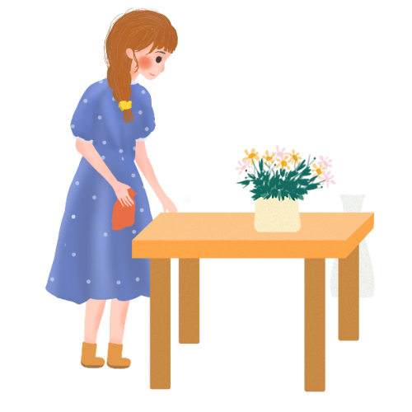
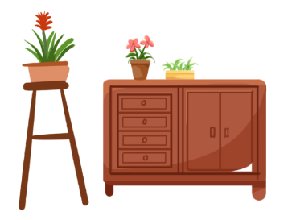
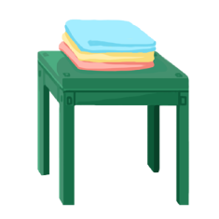
Homework
Must do: 1.Make a list of what chores need to be done around your house;
2.Preview 2d and Grammar Focus.
1
Try to do: Design a chore list after asking your family's ideas.
2
Notes:
Tang原创课件,请勿侵权！
小红书/抖音：Tang原创课件
淘宝：Tang原创课件

