Slide 1
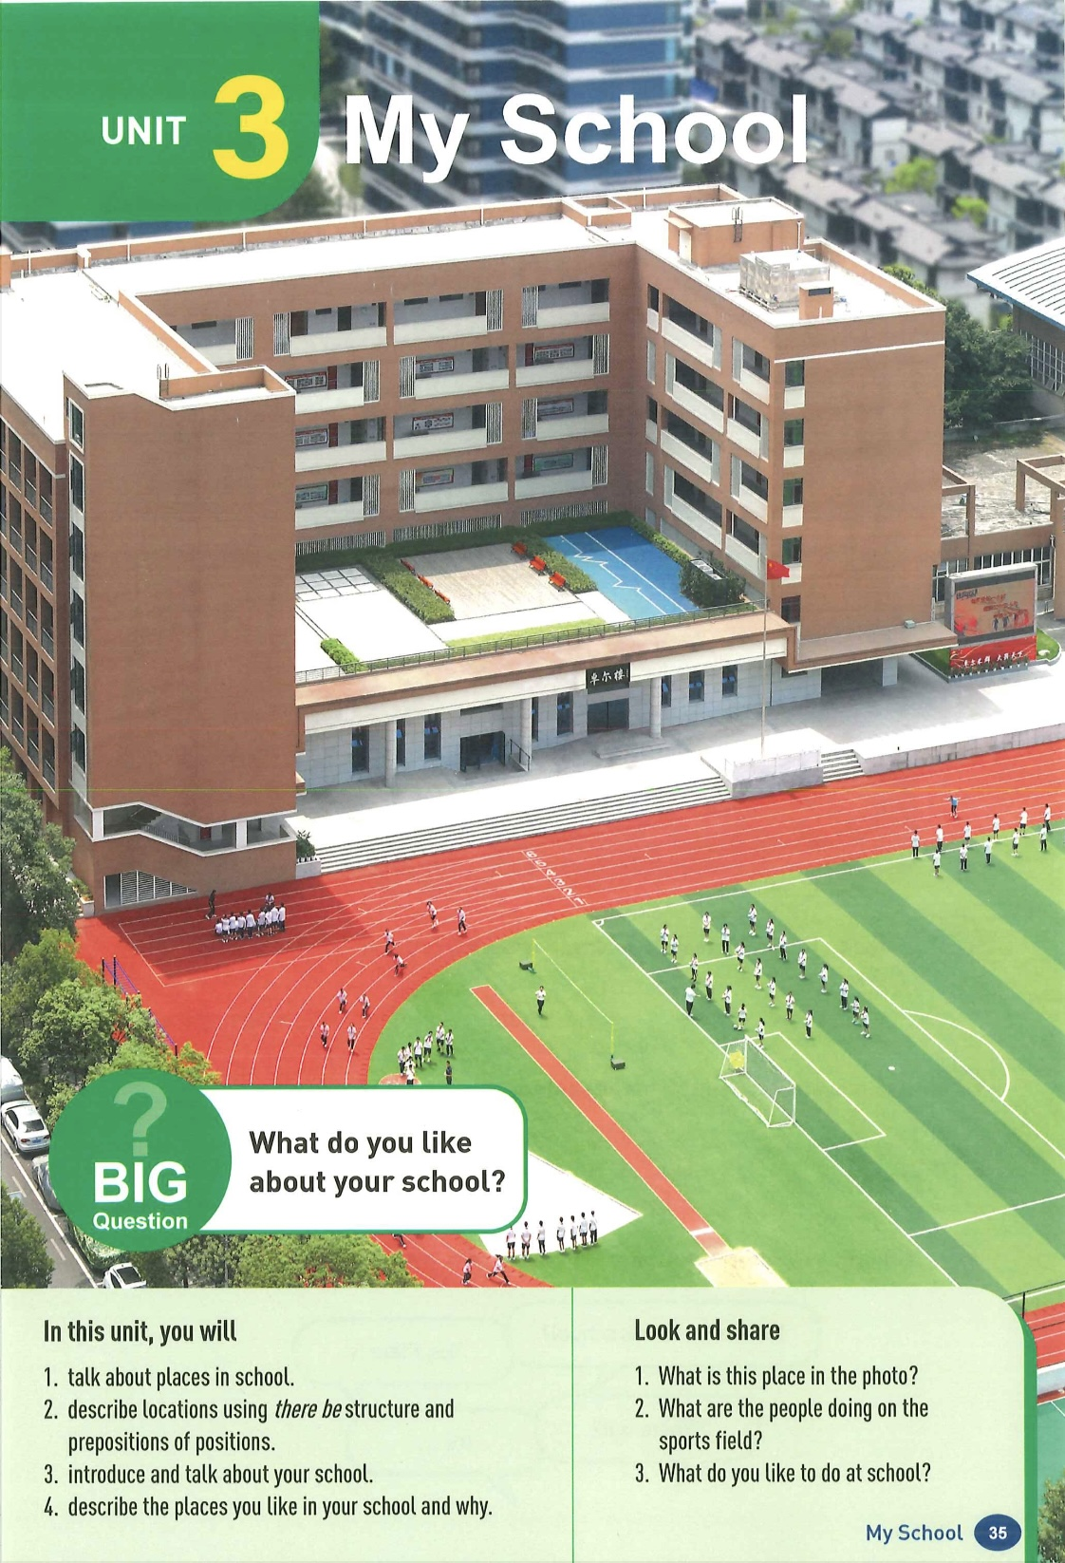
Unit3 My School
Section B & Project
教材内容解读和设计
嵊州市剡城中学
过王洁
2024.09.18

Slide 2
目 录
01
教材内容解读
CONTENT
02
教学目标分析
03
学习活动设计

Slide 3
单元主题内容框架图
Unit3 My school
What do you like about your school?
单元主题内容框架图
Section A
What is your school like?
Section B
What fun things do you do at school?
Project
Reading plus
静态校园（物理环境和文化环境）
动态校园（现代校园和丰富多彩的校园生活）
Lesson1
谈论学校建筑物及位置
(物理环境)
Lesson2
谈论教室设施、位置与功能
(物理环境)
Lesson3
描述校园花草树木、名人画像及教室设施
(物理、文化环境)
Lesson4
介绍校园设施、位置及功能，谈论喜欢的地方及原因
(物理、人文环境)
Lesson5
写一封回复邮件，描述自己的新学校
(物理、人文环境)
Lesson6
综合介绍自己的校园
(物理、人文环境)
*Lesson7
介绍孟加拉国floating school运作原理、教室设施、位置及功能
了解学校建筑物及其位置
用邮件描述学校
介绍校园
不同场所
了解国外的
学校
学校是梦想启航的地方，思考学校的重要意义，
积极投入学校的学习，更加珍惜学校和校园生活。

Slide 4
主题语言框架图）
What do you like about your school?
主题语言框架图（SectionA）
Section A
What is your school like?
Section B
What fun things do you do at school?
Talk about the school
Talk about the classroom
Talk about the school
What places & where they are
What things & where they are
What places &
where they are
Functions
Descriptions
Comments
Activities
寻找具体小地点
-Where’s Ms Gao’s office?
-It’s in … building.
-Where’s that?
-It’s +方位介词+n.
We put up…there.
We put…in…
It’s large.
What’s special in your classroom?
do morning exercises
raise the flag
spend most of the time…
change seats
eat many kinds of food
It/sth. is+方位介词+n.
There is a/another +n.+方介/地状+n.
There are +n.(pl)+方介/地状+n.
Are there any+n.(pl)+方介/地状+n.?
确认是否有某地
-Is there a …?
-Yes, there is.
-Where is it?
--It’s +方位介词+n.
My new school is great.
It’s beautiful/amazing/big and clean…
It’s a special way to…
It’s my favorite place because…
I love the Chinese food there.
A school is a place to start our dreams.

Slide 5
单元教学目标
1.发现日常校园中的闪光点，关注并乐于了解中外校园文化，开阔视野，提升国内校园文化自信；
2.珍惜自己的学习环境和学习机会，深刻理解学校对自己成长和发展的重要意义。
1.识别并谈论校园里的建筑物、基础设施以及教室里的物品及位置；
2.听辨并准确认读两组音素（ [ɔ:]和[ɒ]、[u:]和[ʊ]），以及包含这些音素的词汇，准确认读读多音节单词重读音节；
3.正确使用there be结构和介词短语描述校园建筑、设施以及教室内物品的具体位置。
1.根据身份与亲疏关系得体地打招呼，自己及他人信息；
2.听辨并准确认读两组音素（/ɪ/和/i:/、/e/和/æ/），以及带有这些音素的词汇，识别并正确朗读be动词缩略形式；
3.使用be动词正确形式准确连贯地个人信息。
单元目标分析
1.理解中西文化中姓名表达方式上的异同；
2.主动与他人交往，建立良好人际关系，尽快适应初中生活。
语言
能力
文化
意识
思维
品质
学习
能力
1.了解电子邮件的基本特征，能通过邮件介绍自己的学校，描述不同场所级相关活动，分享最喜欢的场所并说明原因；
2.运用表格、思维导图等方式，梳理文本内容，提炼文本关键信息；
3.通过在小组合作中绘制校园平面图和规划参观路线来提高合作能力。
1.掌握在交流中，借助手势、表情等体态语表达意义的交际策略；
2.运用表格、图表等方式，提炼文本关键信息，梳理文本内容；
3.通过在小组合作中个人信息表来提高合作能力。
1.通过分析比较，做出理性的交友判断和选择，提高理性思维能力；
2.围绕交友话题，通过自主发现、讨论交流、归纳总结等交友技巧，提高发散思维能力。
1.通过分析比较主人公学校和自己学校，提高逻辑思维能力；
2.通过自主发现、讨论交流、小组合作来归纳总结，提高发散思维能力。

Slide 6
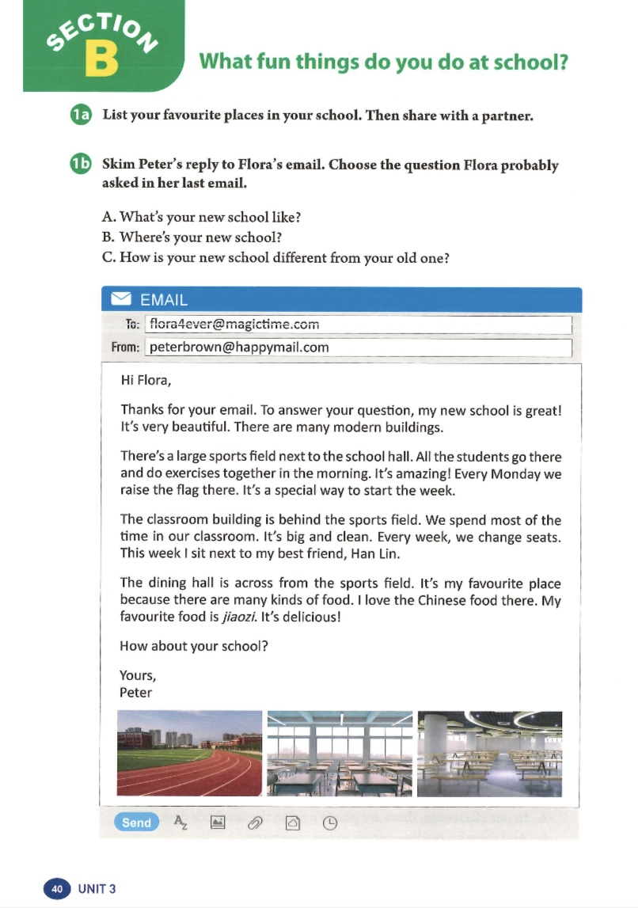
教材分析
主题范畴：“人与自我”
主题群：“生活与学习”
子主题内容：“多彩、安全、有意义的学校生活”
1a活动让学生在读前列举最喜欢的校园场所，并与同伴分享，关联阅读内容。引导学生热爱学校，体现新课标的育人价值。
1b活动让学生快速阅读并推测Flora在上一封邮件问了Peter什么问题，融入阅读策略，要求学生在理解文章主旨的基础上概括关键问题。
阅读语篇是Peter给朋友Flora的回复邮件，其中Peter描述了自己的新学校。鉴于邮件这一特殊文体，需引导学生关注邮件的格式（收件人、发件人、称谓、署名、开头、正文、结尾等）以及内容（重点谈论校园内不同场所，代表性活动以及最喜欢的场所及原因）。

Slide 7
教材分析
1c活动为scanning for details，要求学生找到形容词所描述的对象（地点和事物）。旨在培养学生的阅读策略：先找到key word(s)，再阅读整个句子（也有可能是前后句）来确定是否包含他们所需要的信息。
1d活动的前三个问题进一步挖掘语篇的细节信息。
最后一个问题基于语篇的拓展，让学生关联自己的学校，描述与Peter学校的相似之处。

Slide 8
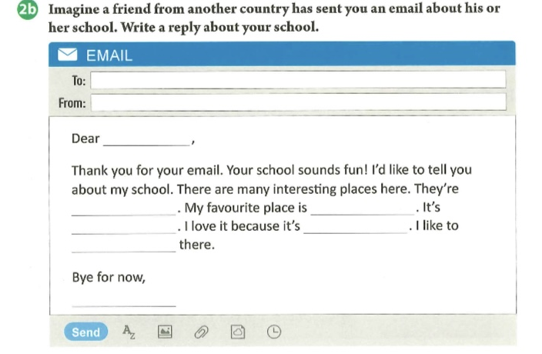
Places
2a的notes对应的分别是校园场所、最喜欢的场所、位置、原因及活动。阅读语篇为学生提供了写作的范文，2a让学生列出写作要点，作信息和语言的准备。
Favorite
词
Locations
Reasons
Activities
2b是一封邮件回复，学生需要完成的部分是收件人、寄件人、称谓、署名以及邮件内容。邮件内容部分是完成句子，学生只需将2a中列出的要点内容填入邮件中，降低学生的写作难度。
句

Slide 9
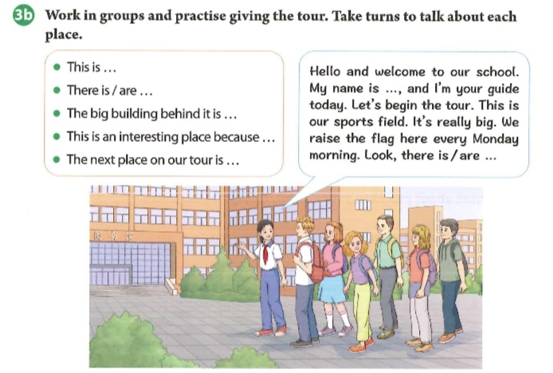
真实情景模拟（带领来访学生参观校园）
综合运用本单元所学语言
3a 画学校平面图，计划参观路线
3b 呈现介绍校园的各种句式
给出示范介绍的语言支架
小组练习（以学生导游的身份介绍校园）
3c 展示带领来访者参观的情景
投票选出最佳导游
层层铺垫，达成模拟真实场景的语言运用目标

Slide 10
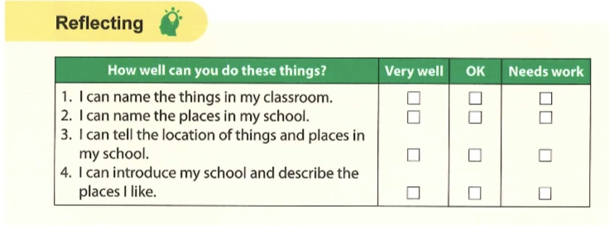
本单元的反思性评价表主要从词汇、语法、语言功能和产出任务几个方面引导学生回顾自己的学习过程和收获。1、2点要求学生回顾本单元所学的教室里物品的名称，以及校园内不同场所的名称。第3点检查学生对单元语言学习目标与语言功能项目掌握情况，即运用there be结构和方位介词谈论物品和场所的位置。第4点概括了本单元聚焦的语言表现任务，即运用所学语言介绍自己的学校、描述学校里自己喜欢的地方。
价值引领句揭示了学校的作用和意义。学校是人生旅程中的重要阶段，是一个人成长、学习、发展的重要场所。在这里，学生不仅获得了知识和技能，更重要的是发展独立思考、解决问题、创新和合作能力，健全品格，拓宽视野和思路。学校是梦想启航的地方。引导学生珍惜学校、爱护学校，鼓励他们为自己的梦想而努力奋斗。

Slide 11
语篇研读
【What】 语篇的主题和内容
本语篇属于“人与自我”主题范畴，涉及“生活与学习”子主题下的“多彩、安全、有意义的学校生活”。
语篇是Peter给朋友Flora的回复邮件，其中Peter描述了自己的新学校。内容包括校园内不同场所，代表性活动以及最喜欢的场所及原因。
【Why】 语篇传递的意义
通过学习邮件里Peter向朋友Flora描述自己的新学校，旨在帮助学生认识和熟悉新校园，让学生通过观察和描述学校，引导他们爱校爱班，努力营造良好的学习氛围。
主题意义
主要内容
语言修辞
【How】文体特征、内容结构
语篇是一封回复邮件，引导学生关注邮件的格式（收件人、发件人、称谓、署名、开头、正文、结尾等）以及邮件内容（重点谈论校园内不同场所，位置，代表性活动以及最喜欢的场所及原因）。围绕Peter的新学校展开，通过对学校不同场所的介绍，展示了Peter对新学校的喜爱。3张图片分别对应语篇里的三个重要场所（sports field, classroom building, dining hall）。
语言特点
语篇涉及介绍学校场所的语言表达，“有什么 ” (There be句型)：“There are …”, “There’s …”，“在哪里”（方位介词）：next to, behind, across from等，还有表达自己最喜爱的场所及原因：“…is my favourite place because…”以及代表性的活动：do exercises, raise the flag, change seats等。

Slide 12
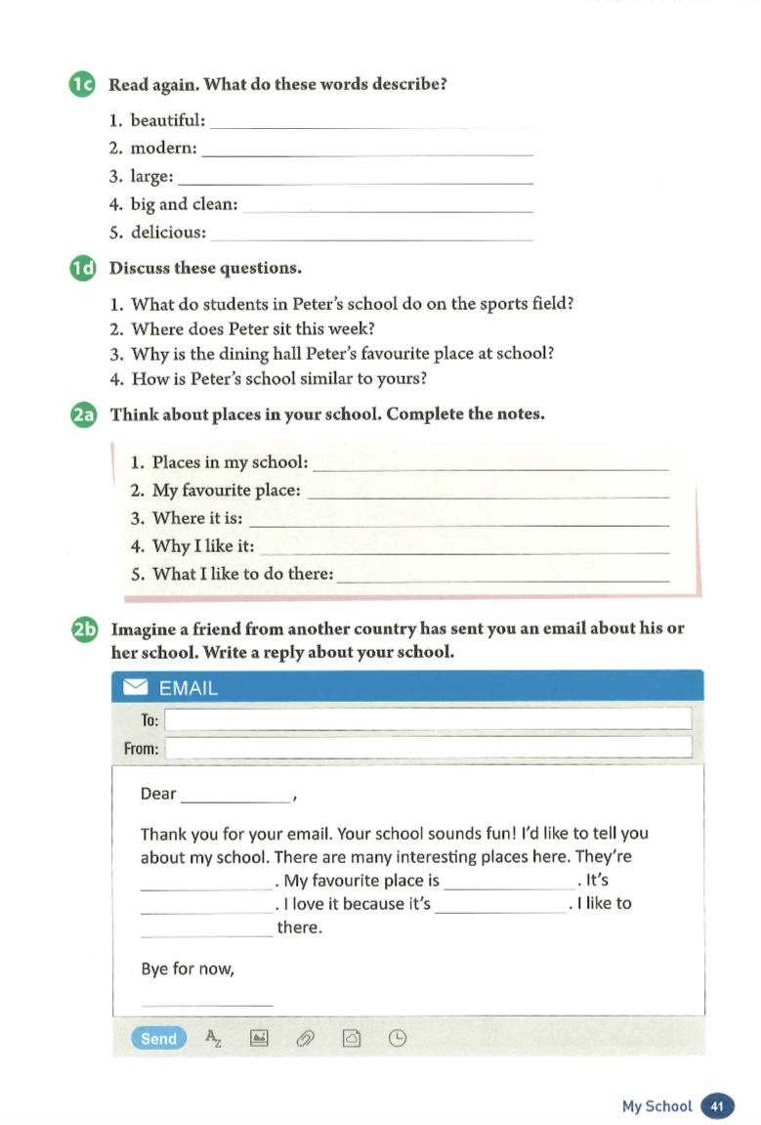
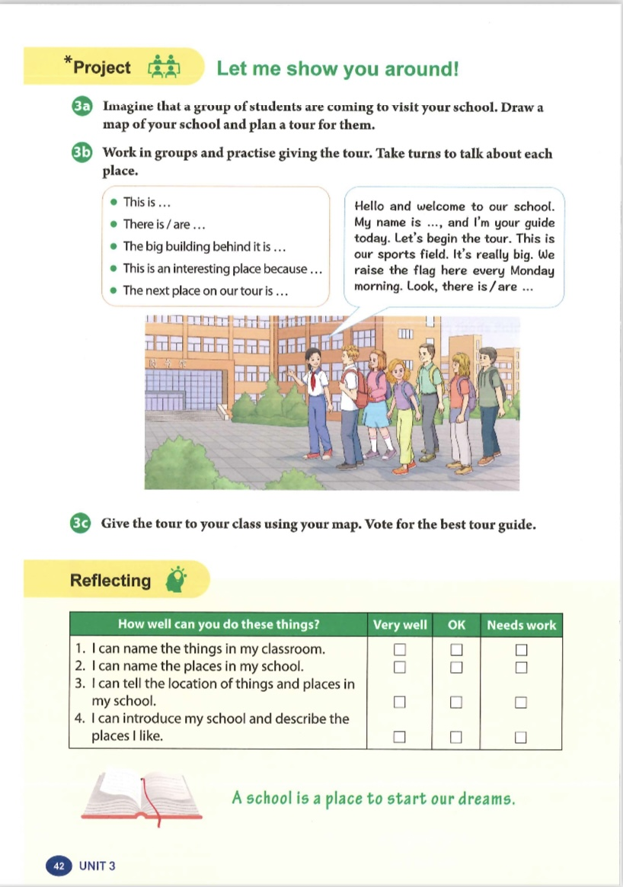
课时划分
第一课时
第二课时
第三课时

Slide 13
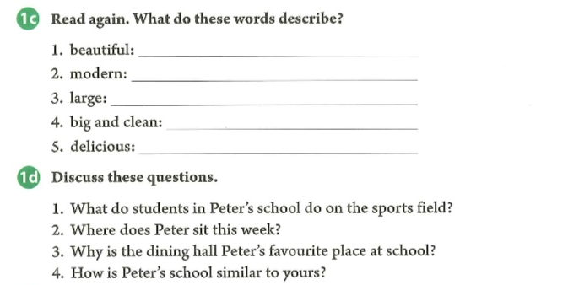
Section B(1a-1d)教学目标
通过本课的学习，学生能够：
观察、识别电子邮件的形态特征，了解邮件的内容结构和基本格式；
通过快速阅读了解电子邮件的内容大意，推断写回信的主要目的；
通过仔细阅读，获取邮件描述的校园内场所，位置、代表性活动以及最喜欢的场所及原因等信息；
根据语篇中的各类形容词推断作者的情感态度，用这些形容词描述自己的学校。

Slide 14
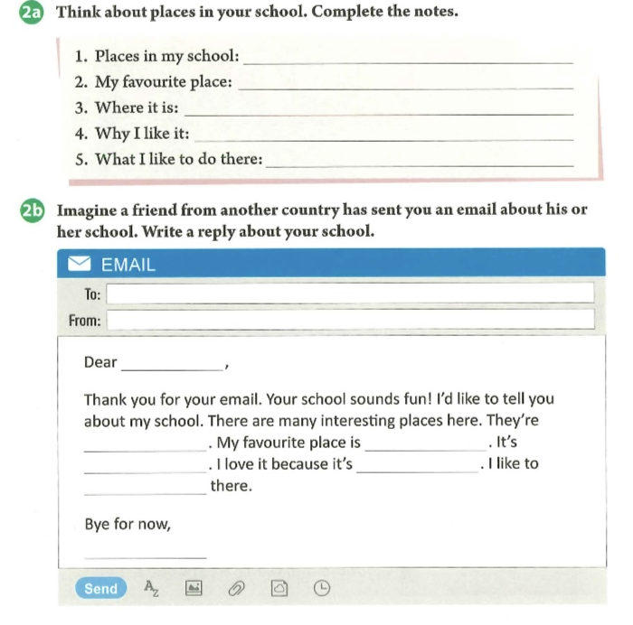
Section B(2a-2b)教学目标
通过本课的学习，学生能够：
通过复习邮件主体部分，借助思维导图梳理邮件的写作框架；
模仿课文的结构和语言给朋友写一封电子邮件，介绍自己的校园；
谈论自己在校园里喜欢做的事，增强对校园的了解和喜爱。

Slide 15
Project教学目标
通过本课的学习，学生能够：
小组合作完成校园平面图的绘制，合理规划参观路线；
根据校园平面图，运用本单元所学语言以模拟导览的方式介绍自己的学校；
学会爱学校和享受校园生活。

Slide 16
Unit３ Section B 1a-1d
阅读课学习活动设计

Slide 17
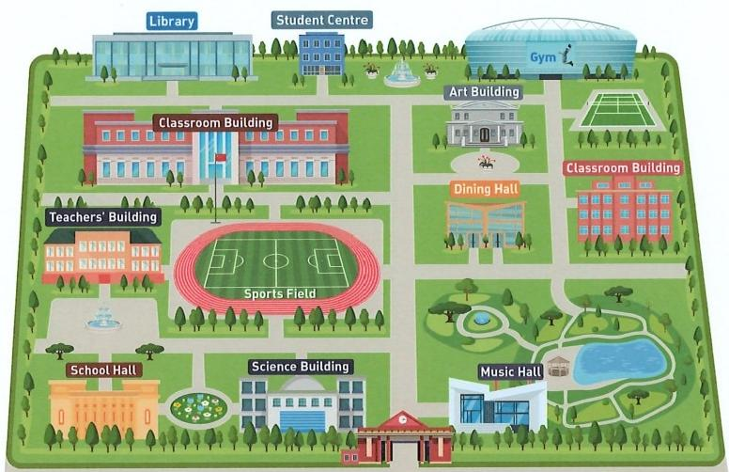
Pre-reading
Present a picture of school and ask:
What’s your favorite place at school?
My favorite place is … because…/
I like … best because…
What fun things do you usually do at school?
Do morning exercises./Play sports./
Sing and draw…
设计意图：引导学生描述他们最喜欢的场所及喜欢的活动，并鼓励学生用“because”讲述原因。

Slide 18
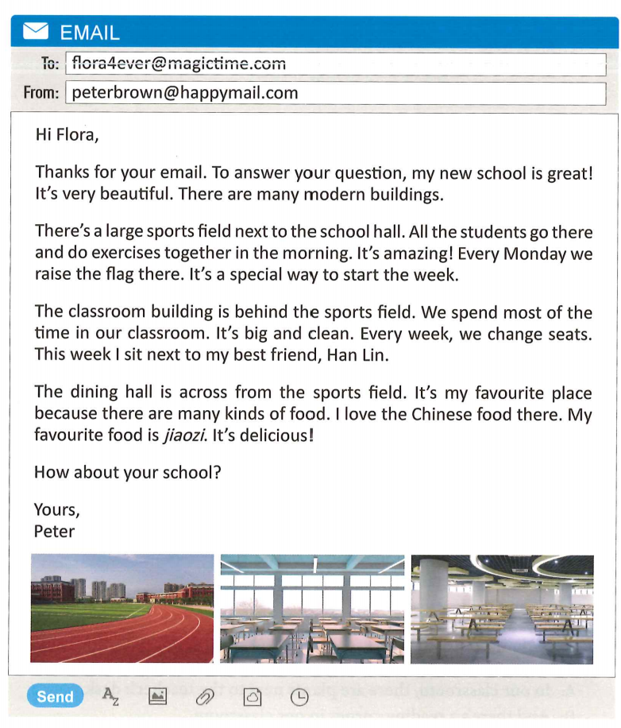
While-reading
What is the text?
Who writes the email?
What do you see in the pictures?
What is the text about?
Reading strategy:
The pictures and the beginning often help us get the main idea of the passage.
classroom building
设计意图：引导学生关注语篇体裁、发件者、收件者, 渗透阅读策略—通过图片和开头获得语篇大意。
sports field
dining hall

Slide 19
While-reading
the receiver（收件人）
the sender (发件人)
Salutation（称谓）
Beginning (开头)
(para. 1)
Format
(格式)
Body (正文)
(paras. 2-4)
Ending (结尾）
(para. 5)
设计意图：引导学生关注邮件的格式，包括收件人、发件人、称谓、署名、开头、正文、结尾等。
Signature (署名)

Slide 20
While-reading
Read Para. 1 and think.
Thanks for your email. To answer your question, my new school is great! It’s very beautiful. There are many modern buildings.
What question did Flora ask?
Reading strategy:
Pay attention to the context.
A. What’s your new school like?
B. Where’s your new school?
C. How is your new school
different from your old one?
设计意图：引导学生从回答推断问题，培养其逻辑思维能力。

Slide 21
While-reading
Read Paras. 2-4 and finish the chart.
My new school is very great!
Place
Location
Activities
Comments
next to the school hall
do exercises, raise the flag
amazing,
a special way
sports field
classroom building
behind the sports field
spend most of the time, change seats every week
big and clean,
next to my best friend
设计意图：鼓励学生与同伴合作，整体阅读邮件正文部分，获取语篇提及的学校场所、位置、代表性活动以及评价等信息，完成表格。
across from the sports field
eat many kinds of food
my favorite place, delicious jiaozi
dining hall

Slide 22
While-reading
Read Para. 5 and think.
Please give your ending for the passage.
I really love my new school.
I have a great time at my new school.
Looking forward to your early reply.
…
设计意图：通过鼓励学生思考其他可能的结尾，发散学生思维。

Slide 23
Post-reading
Think
What do you think of Peter’s school?
How is Peter’s school similar to yours?
We spend most of the time in the classroom too. It’s big and clean as well.
There are also many kinds of food in the dining hall. It’s my favorite place as well.
How is Peter’s school different from yours?
My classroom building is next to the sports field, and the dining hall is behind the classroom building.
设计意图：询问学生Peter的学校和自己的学校的相似之处和不同之处，让学生分析比较校园场所、位置、活动、最喜欢的场所及原因等方面，综合运用所学语言知识。
We change seats every two weeks.

Slide 24
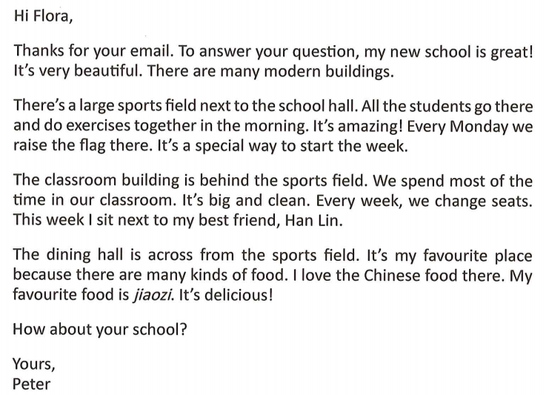
Reading strategy:
Adjectives can show the writer’s emotions and attitudes.
.
What do these words describe?
beautiful
modern
large
big and clean
delicious
new school
buildings
sports field
classroom
jiaozi
Peter loves his new school.
What can we know from these adjectives?
What does Peter feel about his new school?
Can you find more adjectives?
What do they describe?
设计意图：让学生找出1c中形容词所描述的对象，关注语言的得体性和适切性。接着让学生继续找语篇里其他形容词及所修饰的对象，进一步感知语言使用的语境。鼓励学生平时多关注、积累此类词汇，丰富自己的语言表达。最后引导学生关注形容词的感情色彩及其表达的作者的情感和态度。
amazing
special
best
favorite
activities on the sports field
way to start the week
friend
dining hall

Slide 25
Talk about your favorite places in our school and tell your reasons.
Group work
Hello, everyone. Our school is beautiful/great/…
…’s favourite place is … because ...
And … likes … best ...
How about …? His/Her favourite place is …
As for me, I love …
We have a lot of fun in our school.
School places | Descriptions
sports field, classroom building, dining hall, gym, library, school hall, science building, art building… | wonderful, fantastic, nice, big, clean, amazing...

Slide 26
Homework
Must do:
Polish your report and take turns to give the report after class.
Choose to do:
Find more expressions to introduce your new school.

Slide 27
Unit 3 Section B 2a-2b
写作课学习活动设计

Slide 28
Imagine that you are Flora. Please write a reply about your school to Peter .
How can we introduce our school?

Slide 29
Content analysis
Beginning (开头)
Transitional sentence
Show thanks
Show purpose
Body (正文)
Places& location
Favorite &reasons
Activities
Ending (结尾）
Ask about Flora’s school
设计意图：引导学生分析语篇结构和内容，为写作做好铺垫。

Slide 30
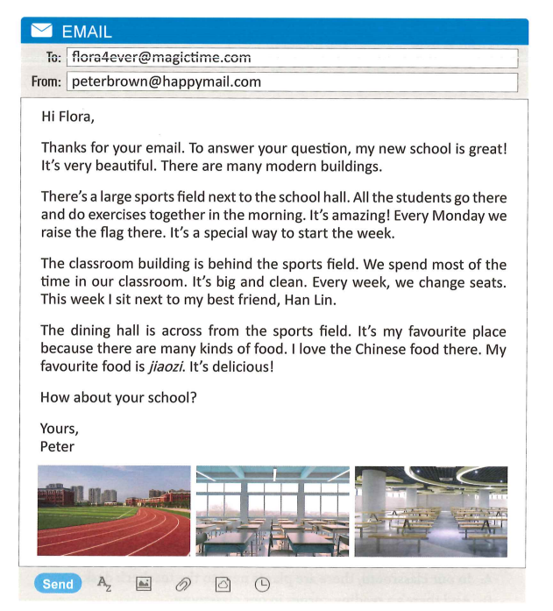
Beginning
Thank you for your email. Your school sounds fun.
I’d like to tell you about my school.
Body
There are many interesting places here.
They are..., … and …
Places
Favorite
My favorite place is...
Locations
It’s next to/behind/across from/in front of/between…and…
Reasons
I love it because it’s …
Activities
I like /love to...there.
设计意图：引导学总结表达场所、最喜欢的场所、位置、原因、或活动的词汇和句型。
Ending
I love my school. /
Looking forward to your early reply.

Slide 31
peterbrown@happymail.com
flora4ever@magictime.com
Dear Peter,
Thank you for your email. Your school sounds fun. I’d like to tell you about my school.
Bye for now,
Flora
Beginning
Body
Places
Favorite
Locations
Reasons
Activities
Ending
I love my school. /Looking forward to your early reply.

Slide 32
How can we make it better?
peterbrown@happymail.com
flora4ever@magictime.com
There are many buildings, such as science building, dining hall and sports field.
Dear Peter,
Thank you for your email. Your school sounds fun. I’d like to tell you about my school.
There are many buildings. My favourite place is the art building. I like drawing. It’s behind the classroom building. I can have art lessons there. I love my school.
Bye for now,
Flora
Tip1: Add more relative information.
(添加更多相关信息)
And my art teacher is kind to us.

Slide 33
How can we make it better?
peterbrown@happymail.com
flora4ever@magictime.com
Dear Peter,
Thank you for your email. Your school sounds fun. I’d like to tell you about my school.
There are many buildings. My favourite place is the art building. I like drawing. It’s behind the classroom building. I can have art lessons there. I love my school.
Bye for now,
Flora
because, so, but, and, or...
Tip2: Use linking words. (使用连接词)
My favourite place is the art building because I like drawing a lot.

Slide 34
How can we make it better?
peterbrown@happymail.com
flora4ever@magictime.com
Dear Peter,
Thank you for your email. Your school sounds fun. I’d like to tell you about my school.
There are many buildings. My favourite place is the art building. I like drawing. It’s behind the classroom building. I can have art lessons there. I love my school.
Bye for now,
Flora
Tip3: Use some adjectives to show your love. (使用形容词来表达你的喜爱)
There are many modern and beautiful buildings.
It’s amazing.

Slide 35
Tip1: Add more relative information. (添加更多相关信息)
Tip2: Use linking words. (使用连接词)
Tip3: Use some adjectives to show your love. (使用形容词来表达你的喜爱)
peterbrown@happymail.com
flora4ever@magictime.com
Dear Peter,
Thank you for your email. Your school sounds fun. I’d like to tell you about my school.
There are many modern and beautiful buildings, such as science building, dining hall and sports field. My favourite place is the art building because I like drawing a lot. It’s amazing. It’s behind the classroom building. I can have art lessons there. And my art teacher is kind to us. I love my school.
Bye for now,
Flora

Slide 36
Check your reply according to the checklist by yourselves.
More relative information?
Right linking words?
Proper adjectives?
Right grammar?
Right spelling?
Good handwriting?
Exchange your article with your partner and check it
according to the checklist again.

Slide 37
Homework
Must do:
Polish your email according to the checklist after class.
Choose to do:
Draw a map of your school and introduce it to your
friends.

Slide 38
Unit 3 Project
项目化学习活动设计

Slide 39
1.Project preparations
The project tasks:
collect and sort information
draw a map of the school
mark the places
plan a tour
【设计意图】引导学生关注项目活动标题和3a指示语，明确项目主题和任务。五人一组，进行讨论，明确需要完成的任务为：收集整理资料，绘制校园平面图，标注校园场所，规划最佳游览路线。鉴于课堂时间有限，建议在课前完成项目准备阶段的活动。

Slide 40
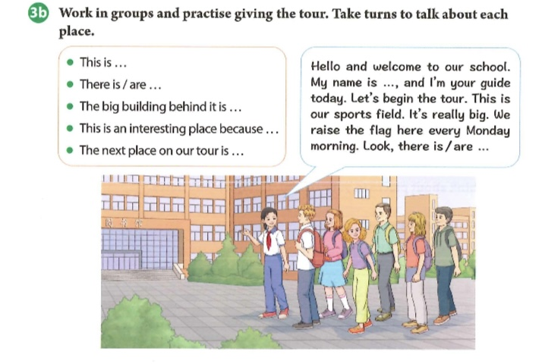
2.Project implementation
Hello and welcome to our school! My name is … and I’m your guide today. Let’s begin the tour.
This is our classroom building. It’s really big. We spend most of our time here. Look, there is a large sports field next to it. We do morning exercises together. Every Monday we raise the flag there. The big building behind it is our library. It is my favorite place. I enjoy reading all kinds of books there. The next place on our tour is the science building. This is an interesting place because we do many scientific experiments there. We learn a lot and have fun as well.
A school is a place to start our dream. I love my school so much and I hope all of you can enjoy the tour in our school.
项目实施阶段
学生进行小组合作，完成以下任务：
1.收集整理信息。收集并整理学校相关信息（建筑物、位置、游览路线等）。
2.绘制校园平面图。讨论确定平面图风格、建筑物位置、路线选择等，完成平面图的绘制。
3.设计游览介绍词。根据3b呈现的语言支架，讨论决定游览介绍词，鼓励学生使用丰富的语言表达。
Work in groups：
collect and sort information
draw a map of the school
mark the places
plan a tour

Slide 41
3.Project presentation
Suggested questions for visitors:
1. Where’s the school dining hall? What about the food?
2. How many buildings are there in your school? Which is the highest?
3. Which floor is your classroom on?
4. What are the opening hours for the library?
5. Which is your favorite place in your school?
6. What do you usually do on the sports field?
7. Is there a music hall in your school?
…
Presentation:
The group members work as the guides and take turns to introduce places in the school. While listening, the other students work as visitors and ask about what they’re interested in.
项目展示
各小组成员全员参与项目成果展示，根据所绘地图，轮流介绍校园。与此同时，其他学生扮演游客，可即时向导游提问，了解自己感兴趣的内容，丰富成果展示的内容。

Slide 42
4.Project evaluation
Checklist
Items | Stars
A clear tour line.（线路清晰）
Rich contents. （内容丰富）
Timely responses. (回应及时)
Fluent language. （语言流利）
Proper manners. （举止得体）
【设计意图】教师在邀请小组展示前，给出checklist,让学生以此为依据投票选出最佳导游。各小组展示完成后，教师要引导学生及时给予评价和反馈。接着，教师引导学生投票，选出最佳小组，并给予奖状，鼓励学生。
Vote for the best guide according to the checklist.

Slide 43
Homework
Must do:
Polish your conversation after class.
Choose to do:
Work in groups to make a promotional video of your school.

Slide 44
不当之处
请批评指正
Thanks

Slide 45
Deep thinking
Do you raise the flag every Monday?
What do you think of it?
The flag is the symbol of a country. It is solemn to raise the national flag. Raising the flag shows our love to our motherland. It’s duty for everyone.

Slide 46
Deep thinking
What do you think of changing seats every week?
It’s good for our eyes and protect our eyesight.
We can know more about classmates and make more friends.
It’s fair for every student.

