Slide 1
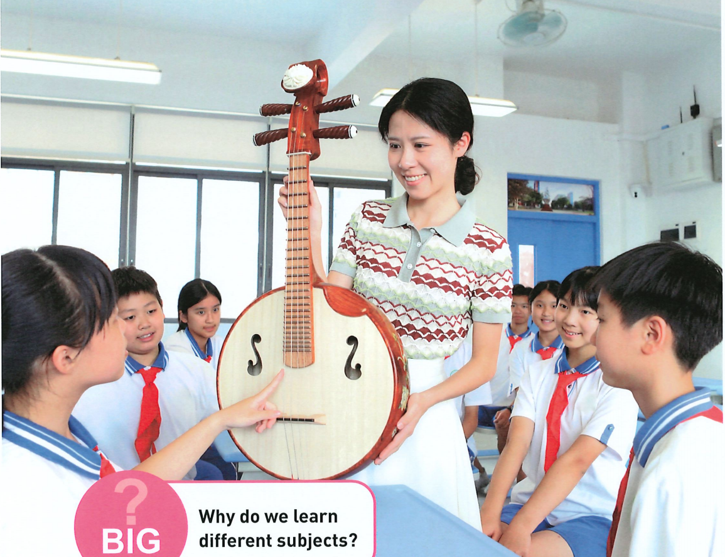
Unit 4
My Favourite Subject
Section A 1a - 1d
Why do you like this subject?

Slide 2

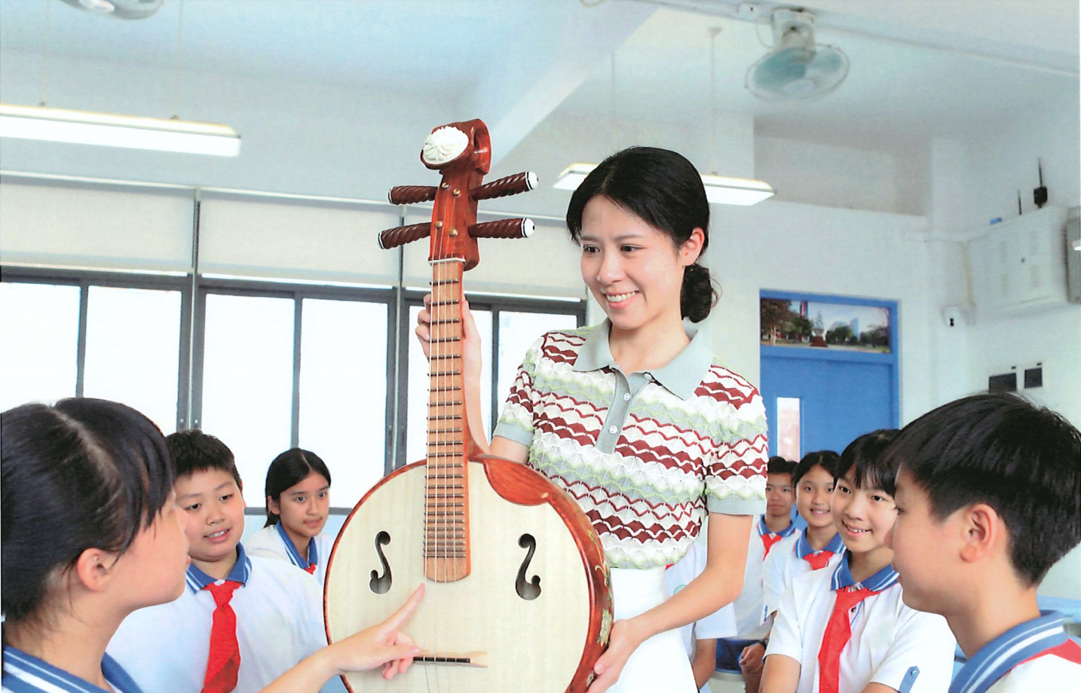
Look and share

Slide 3





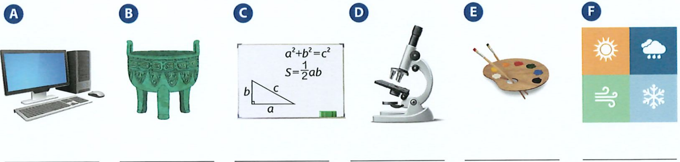




Look and share
What's your favourite subject?

Slide 4




microscope
显微镜
biology
geography
B
A
/baɪ’ɒlədʒɪ/
/dʒɪ’ɒgrəfɪ/
C
history
/’hɪstrɪ/
D
historical relic
文物
IT

Slide 5
Let’s read.
Read the subjects by yourself according to the pronunciation.
根据音标，自己读一下单词。
art
biology
Chinese
IT
English
/ɑː/
/aɪ/
/i:/
/baɪ’ɒlədʒɪ/
/ɪ/
/ɪ/
geography
history
maths
music
PE
/dʒɪ’ɒgrəfɪ/
/’hɪstrɪ/
/æ/
/ju:/
/ɪ/

Slide 6

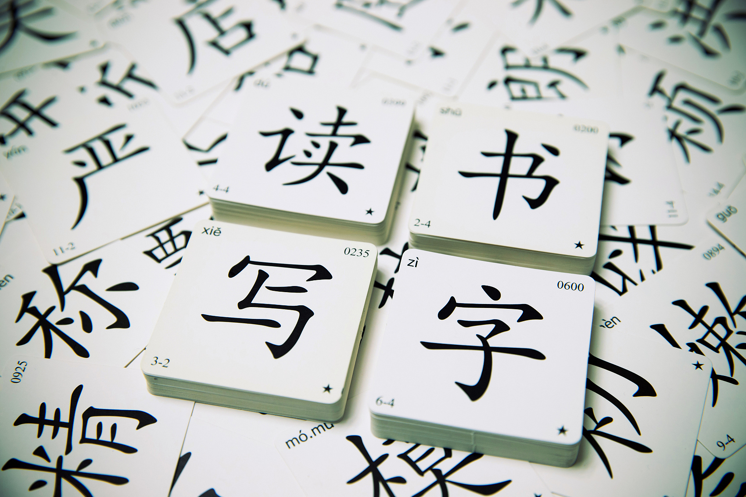


Match the school subjects in the box with the pictures. Some subjects are extra.
art
biology
Chinese
IT
English
geography
history
maths
music
PE
G
H
I
J

Slide 7


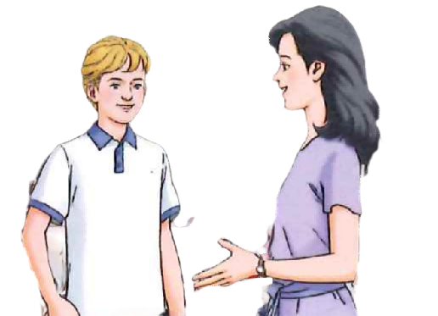
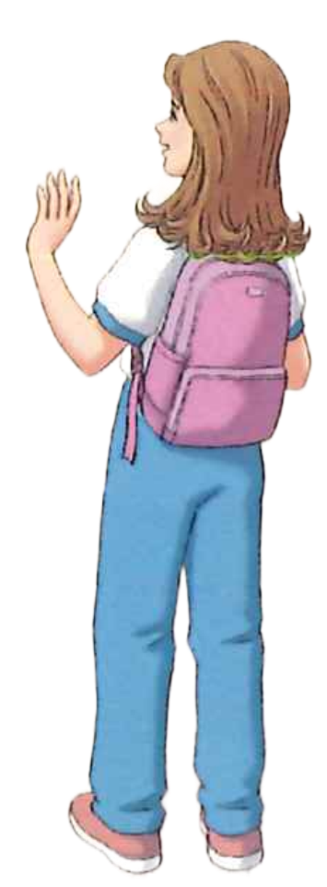

Listen and tick
1b. Listen to two conversations. Tick the subjects Ella and Peter talk about.
Ella
history
Peter
Chinese
maths
maths
art
biology
music
IT
geography
PE
Listen for the key words(subjects).
(听关键词).

Slide 8
Listen and circle
1c. Listen again. Circle the coloured words you hear.
1. Ella doesn’t like history / geography because it’s hard / boring.
2. Ella’s favourite subject is art / maths because it’s fun / important.
3. Peter doesn’t like maths / IT because it’s boring / difficult.
4. Peter’s favourite subject is Chinese / PE because it’s useful / exciting.
/ˈbɔːrɪŋ/
/ˈjuːsfl/
/ɪkˈsaɪtɪŋ/
Listen for the key words(subjects and adjectives)
(听关键词). 形容词

Slide 9


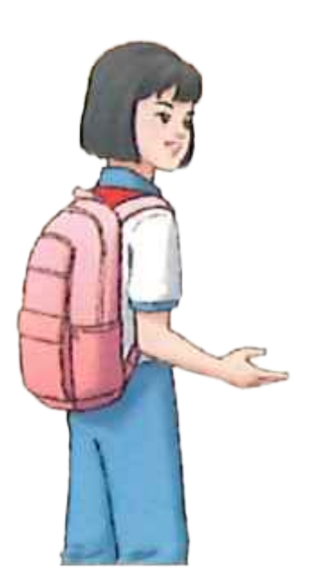
Listen and think
Conversation 1
Fu Xing: Hi, Ella. Are you OK?
Ella: Hi, Fu Xing. Not really. Today is Tuesday.
Fu Xing: So?
Ella: I have history on Tuesday mornings.
Fu Xing: You don’t like history?
Ella: No, it’s hard for me.
Fu Xing: So, what’s your favourite subject?
Ella: Maths.
Fu Xing: Why?
Ella: Because it’s fun.
Fu Xing: What other classes do you have today?
Ella: I have art and geography. I like those subjects too.
Q: How does Ella feel?
ask for the reason
(原因)
A. Ask for more information.
doesn’t like
Ella __________ history.
B. Change the topic. (转换话题)
favourite
Ella’s _______ subject

Slide 10

Listen and imitate
模仿语音、语调，注意人物情感。
Conversation 1
Fu Xing: Hi, Ella. Are you OK?
Ella: Hi, Fu Xing. Not really. Today is Tuesday.
Fu Xing: So?
Ella: I have history on Tuesday mornings.
Fu Xing: You don’t like history?
Ella: No, it’s hard for me.
Fu Xing: So, what’s your favourite subject?
Ella: Maths.
Fu Xing: Why?
Ella: Because it’s fun.
Fu Xing: What other classes do you have today?
Ella: I have art and geography. I like those subjects too.

Slide 11
Read and answer
Conversation 2
Ms Gao: Good morning, Peter.
Peter: Good morning, Ms Gao.
Ms Gao: What classes do you have today?
Peter: I have Chinese and maths first.
Ms Gao: Do you like those subjects?
Peter: I like Chinese because it’s fun, but I don’t like maths.
Ms Gao: Why?
Peter: Because maths is boring to me.
Ms Gao: But every subject is important. What other classes do you have today?
Peter: IT and PE.
Ms Gao: What’s your favourite class?
Peter: PE, because it’s exciting.
What is Ms Gao’s opinion(观点) about subjects?
We should try our best to learn every subject！
（尽全力）

Slide 12
Read and explore
How do they start their conversation?
Conversation 2
Ms Gao: Good morning, Peter.
Peter: Good morning, Ms Gao.
Ms Gao: What classes do you have today?
Peter: I have Chinese and maths first.
Ms Gao: Do you like those subjects?
Peter: I like Chinese because it’s fun, but I don’t like maths.
Ms Gao: Why?
Peter: Because maths is boring to me.
Ms Gao: But every subject is important. What other classes do you have today?
Peter: IT and PE.
Ms Gao: What’s your favourite class?
Peter: PE, because it’s exciting.
greet
talk about subjects
talk about reasons
(原因)

Slide 13
Pair work
Let’s talk about your favourite subjects and reasons.
Greet
A: Good morning! / Hello! / ...
B: ...
A: What classes do you have today?
B: I have ...
A: Do you like ... ?
B: ...
A: What’s your favourite subject?
B: My favourite subject is …
Talk about subjects
Talk about reasons
A: Why do you like ... ?
B: Because it’s ...

Slide 14
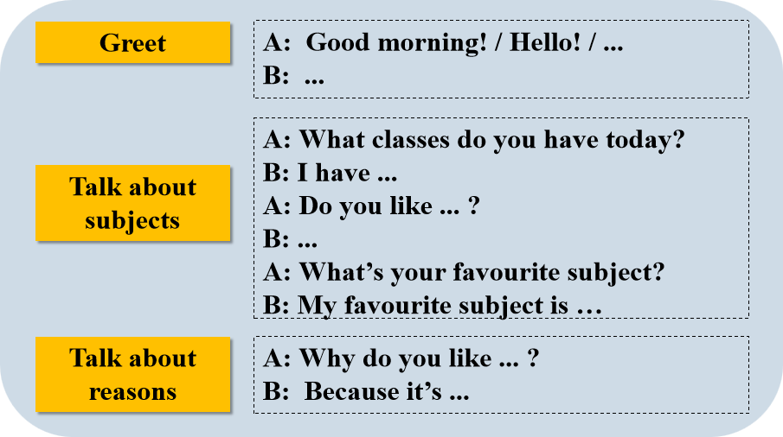

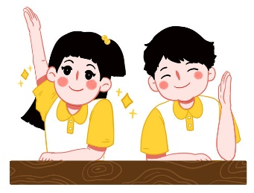
Pair work
Get to know each other better.
Interview your classmates about their favourite subjects and reasons.
采访
Checklist
Talk about subjects and reasons. (谈论科目及原因)
Talk properly and politely. (说话得体、礼貌)
Talk with the proper intonation and emotion. (语调正确且有感情)
They can get ______ stars .

Slide 15
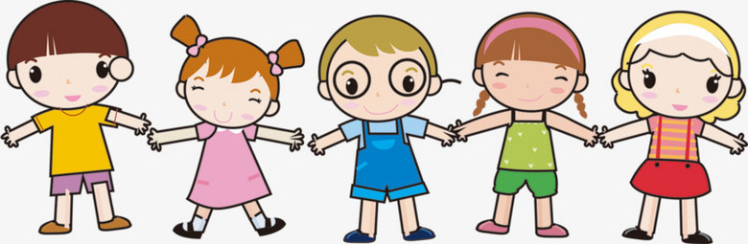
Homework
Must Do:
Role play the listening scripts with your partner at least twice;
Do a survey on students’ favourite subjects and reasons and then report.
Choose To Do:
Draw your own ideal schedule for a week and explain why.

Slide 16



Unit 4 My Favourite Subject
Section A 1a - pronunciatioin
Every subject is important.
Subjects:
art maths
IT PE
history science music English Chinese
biology geography
Greet
-Good morning! / Hello! / ...
-What classes do you have today?
-I have ...
-Do you like ... ?
- ...
-What’s your favourite subject?
-My favourite subject is ...
/aɪ/
Talk about subjects
/aɪ/
/aɪ/
Adjectives:
-Why do you like it?
-Because it’s ...
Talk about reasons
fun important exciting intereting
hard boring difficult

