Slide 1
Unit 1
What do we need to know about a new friend?
Section B 1a-2b
By Toby Pukou Middle School

Slide 2
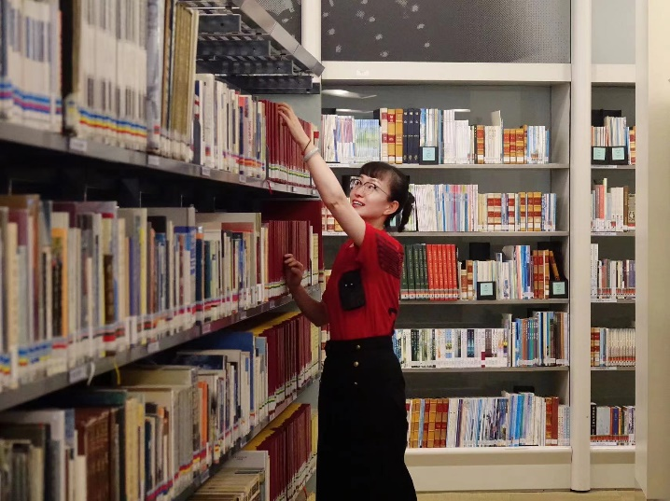
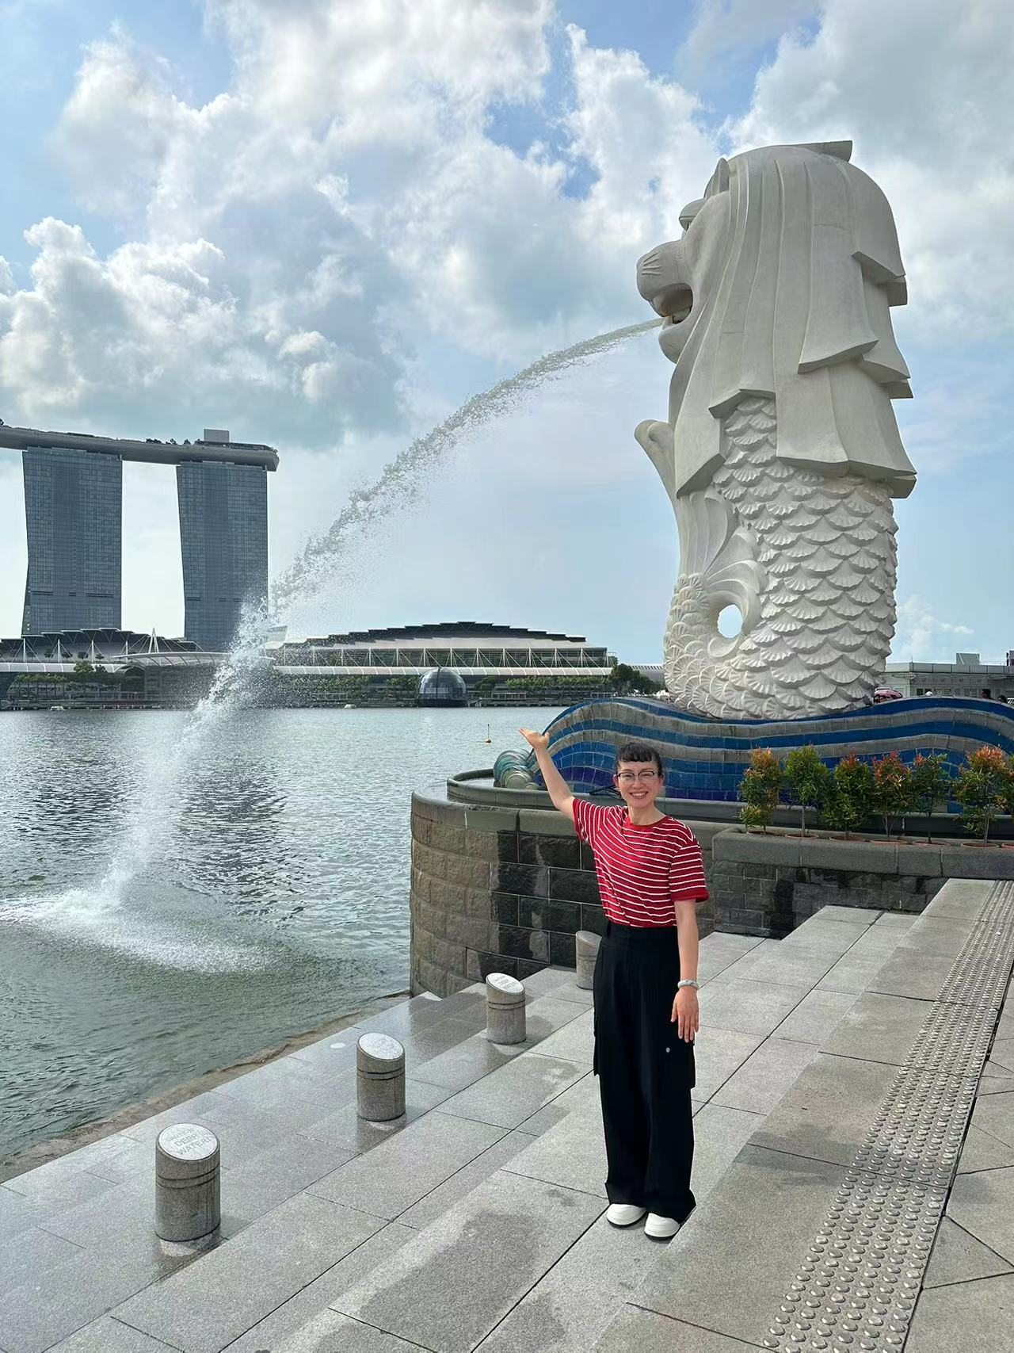
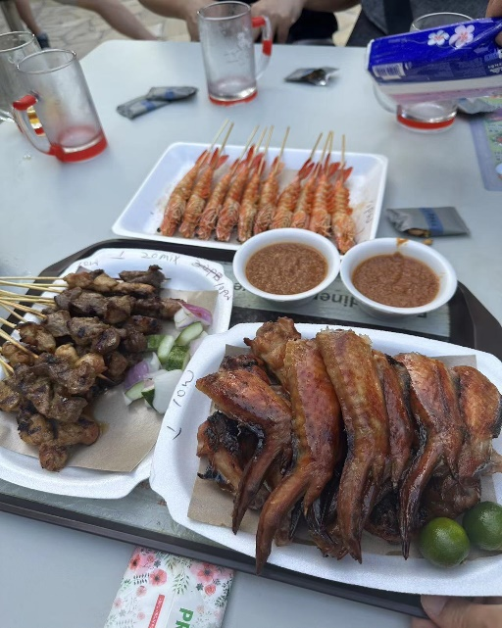
Look at my photo board. What do you learn about me?
Singapore
/ˌsiŋɡəˈpɔː(r)/

Slide 3
1a
Look at two students’ photo boards. Label the photos with the words in the box.
/ˈpærət/
/ɡɪˈtɑːr/
/ˈtenɪs/
parrot
Beijing roast duck
the UK
Singapore
guitar
the Great Wall
tennis
In Picture 1, I see...
Merlion （鱼尾狮）
Big Ben （大本钟）

Slide 4
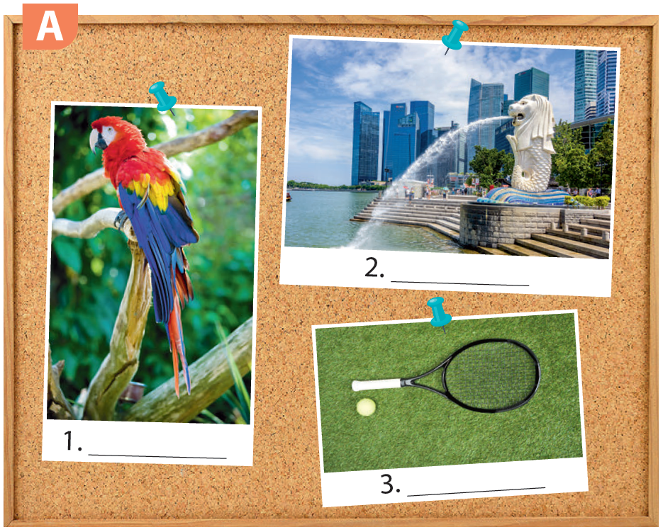
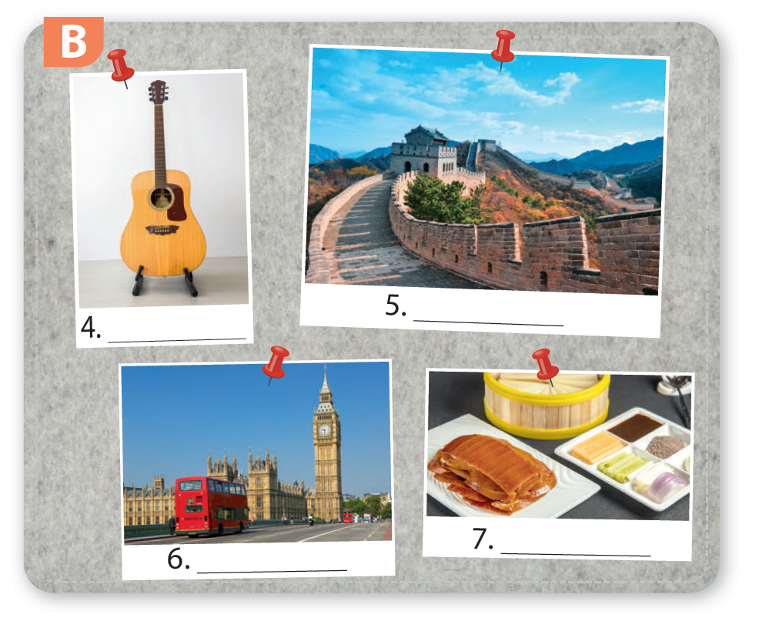
What do you learn about the two students?
Singapore
guitar
the Great Wall
parrot
tennis
Beijing roast
duck
the UK
Why do they show these photos?

Slide 5
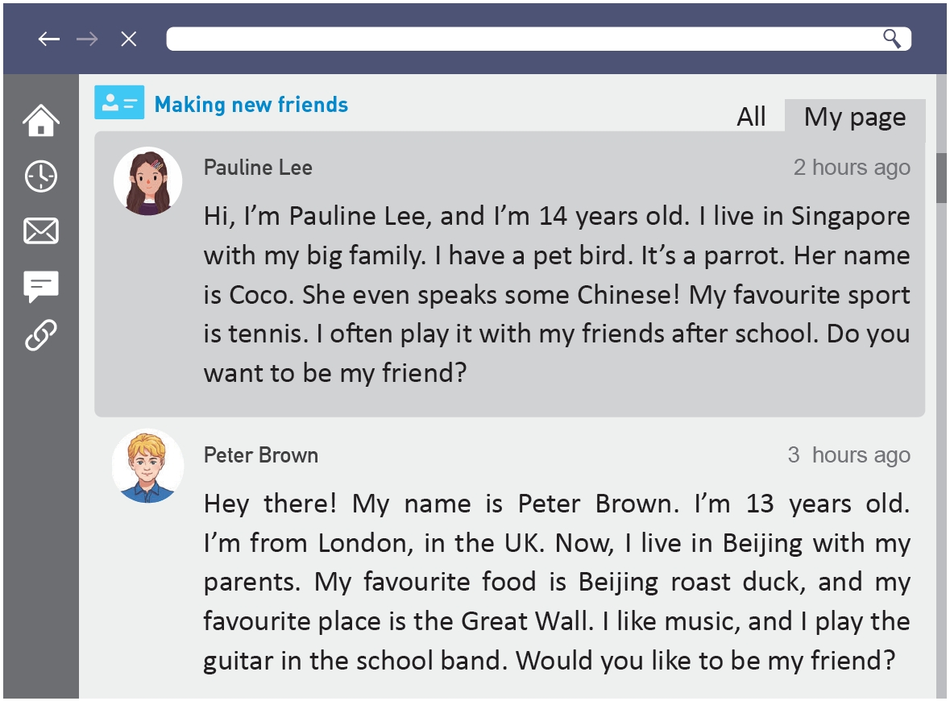
Read fast and answer the questions.
What is the text?
A. Post. B. Story.
Who wrote the posts?
Pauline Lee and Peter Brown.
Why did they write the posts?
They wanted to make new friends online.

Slide 6
1b
Read the two students’ posts. Match the students with their photo boards.
Pauline: ________ Peter: ________
A
B
Singapore
parrot
tennis
guitar
the Great Wall
the UK
Beijing roast
duck

Slide 7
1c
Read again and complete the table with the information from the posts.
/,ɪnfə'meɪʃn/ n.(不可数) 信息；消息
Information | Pauline | Peter
Age
Country
Family
Pet
Favourite food
Favourite place
Hobby
14
13
Singapore
the UK
big family
Peter & his parents
a parrot called “Coco”
Beijing roast duck
the Great Wall
tennis
play the guitar in the school band

Slide 8
Let’s think.
Why can Coco speak Chinese?
Culture tip：
Most of the Singaporeans are ethnic Chinese (华裔). They can not only speak English but also Chinese.

Slide 9
Retell the passage with the information.
Information | Pauline | Peter
Age
Country
Family
Pet
Favourite food
Favourite place
Hobby
14
13
Singapore
the UK
big family
Peter & his parents
a parrot called “Coco”
Beijing roast duck
the Great Wall
tennis
play the guitar in the school band

Slide 10
Introduce yourself. And compare either Pauline or Peter with yourself.
Information | Pauline | Peter | I
Age
Country
Family
Pet
Favourite food
Favourite place
Hobby
14
13
Singapore
the UK
big family
Peter & his parents
a parrot called “Coco”
Beijing roast duck
the Great Wall
tennis
play the guitar in the
school band

Slide 11
Discuss the questions with your partner.
Who do you want to be friends with? Why?
I want to be friends with Pauline / Peter because ...

Slide 12
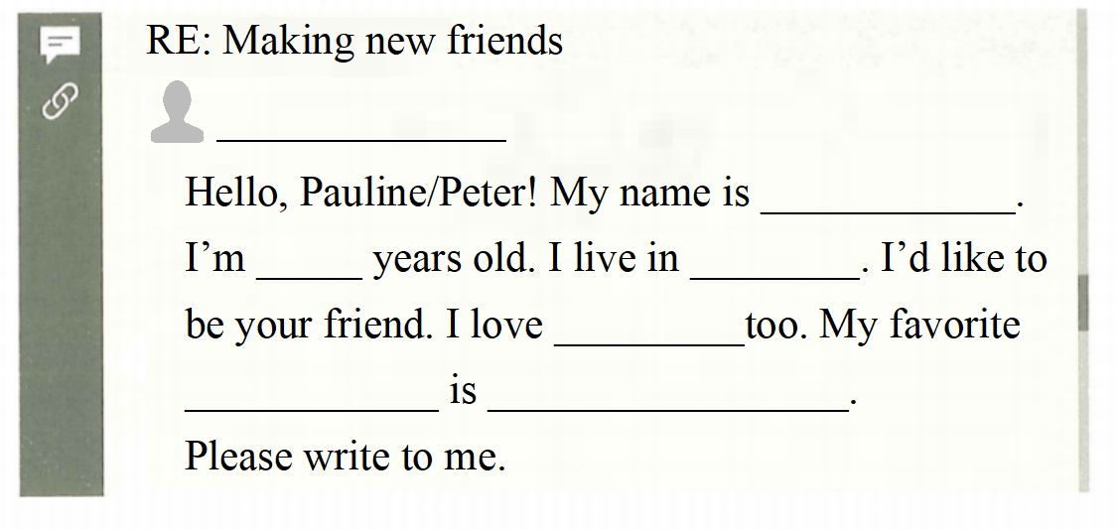
2b
Complete your reply to Pauline or Peter to make friends.
回复
name
age
country
interest/hobby

Slide 13
Homework
Must do
1. Remember the new words
and expressions.
2. Write a passage to
introduce yourself to
make new friends.
3. Preview Project.
Choose to do
Make a mind map to summarize the expressions for making new friends.

Slide 14
Thank you!

