Slide 1
Unit 1 You and Me
Lesson 1 Section A 1a-1d

Slide 2
talk and share
Let’s get to know each other!(互相了解)
Ask questions to know about me.
name
country(国家)/
province(省份)/
city(城市)
...
age(年龄)
hobby(爱好)
Full name：Zhao Danna
/fʊl/

Slide 3
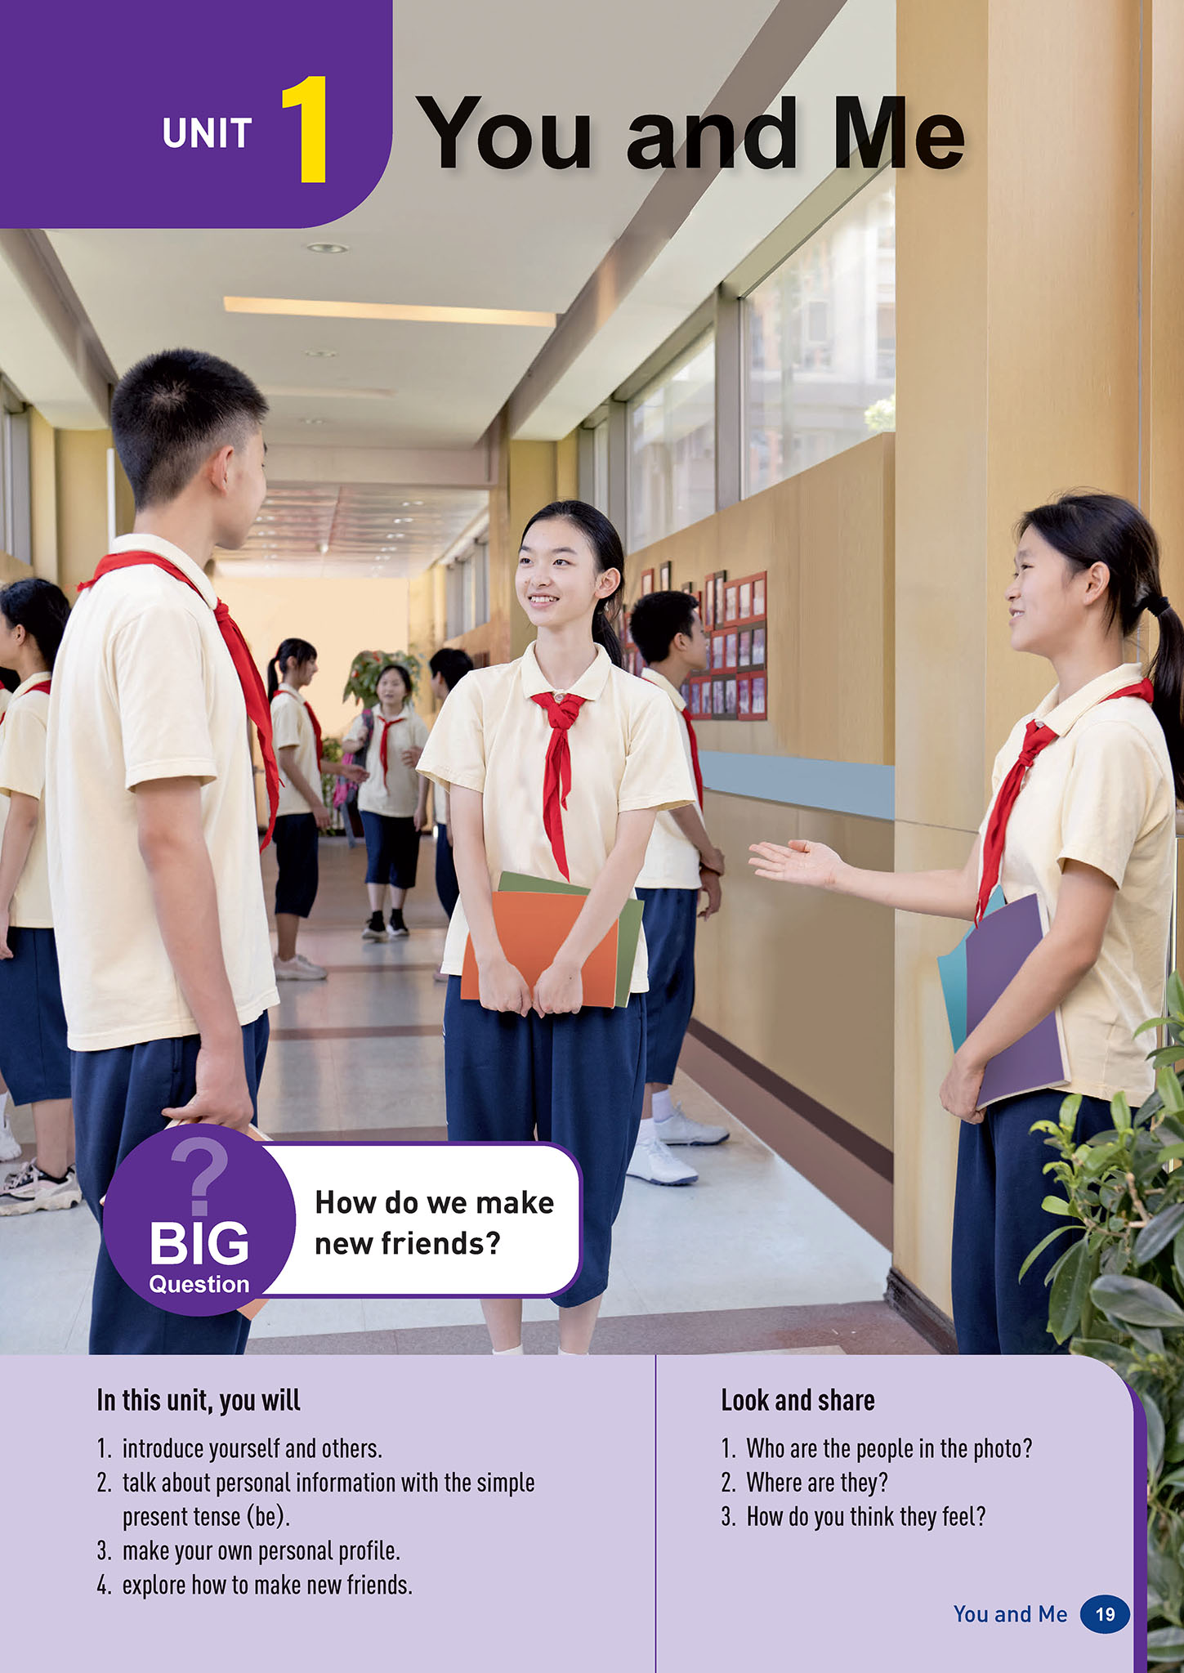
look and share
smile
1. Who are the people in the photo？
They are students.
2. Where are they？
They are in the school.
3. How do you think they feel？
They are happy.

Slide 4
What will they say to know each other(互相了解)？
Hello.
Good morning.
Nice to meet you.
May I have your name?
How do you spell your name?
How old are you?
Where are you from?
What class are you in?
greet
ask for personal information（个人信息）
name
May I have your name?
Hello.
How do you spell your name?
age(年龄)
How old are you?
Good morning.
province/city
Nice to meet you.
country
Where are you from?
class
What class are you in?

Slide 5
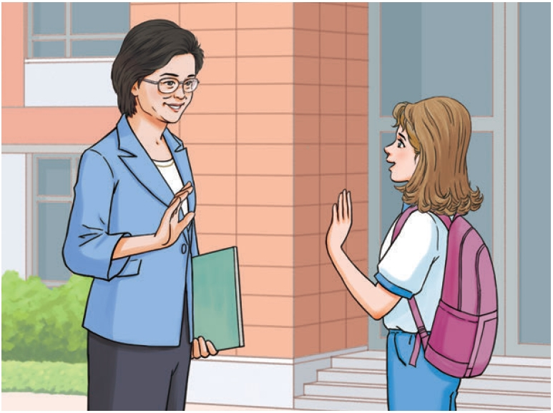
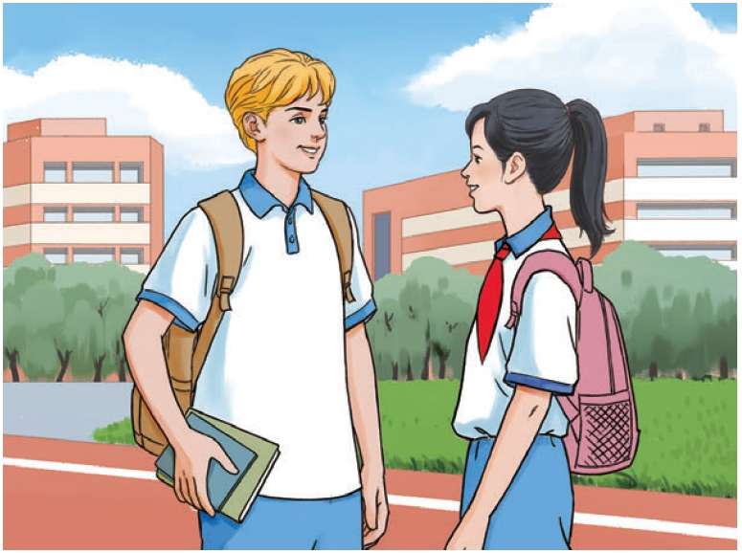
look and answer
TIP 1:
When we talk with others, we should use proper facial expressions and body language.
(使用恰当的面部表情和肢体语言)
What is their relationship(关系)？
A. Teacher and student.
B. Mother and daughter.
Ella
Peter

Slide 6
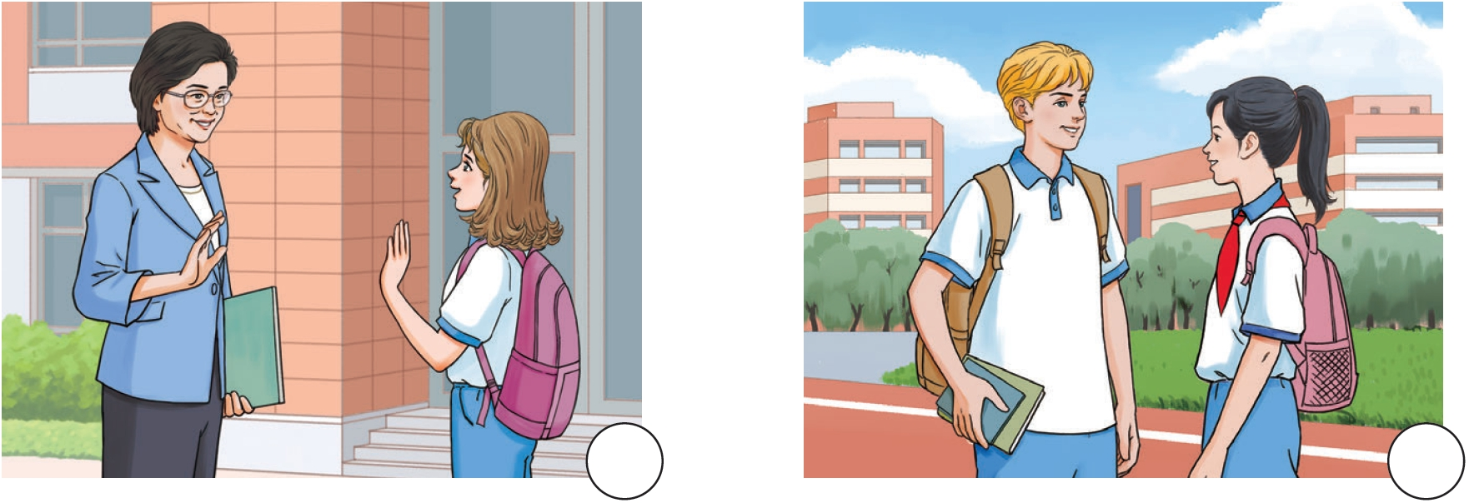
listen and number
1b. Listen to two conversations and number the pictures in the order you hear them. (听两段对话，并按照你听到的顺序给图片编号)
2
1
Picture A
Picture B

Slide 7
listen and circle
1c. Listen again and circle the coloured words you hear.
1. Peter’s full name is Peter Brown / Green.
2. Peter is from the UK / the US.
3. Meimei is in Class 1 / 2, Grade 7 / 8.
4. Ella’s last name is Smith / Miller.
5. Ella is 12 / 13 years old.
/ɡreɪd/

Slide 8
culture note
first name
last name
English name
Peter Brown
full name
/fʊl/
Chinese name
Song Meimei
last name
first name

Slide 9
listen and find
Contraction(缩写)
Circle contractions in the conversations.
Meimei: Hello, I’m Song Meimei. May I have
your name?
Peter: Hi, I’m Peter Brown. Nice to meet you.
Meimei: Nice to meet you too. How do you
spell your name?
Peter: P-E-T-E-R, Peter. B-R-O-W-N, Brown.
Meimei: Where are you from?
Peter: I’m from London, in the UK.
Meimei: Wow, that’s far. What class are you in?
Peter: I’m in Class 1, Grade 7.
Meimei: Wow, we’re in the same class!
Ella: Good morning, Ms Li.
Ms Li: Good morning! Are you Emma?
Ella: No, Ms Li. I’m Ella.
Ms Li: Sorry, Ella. What’s your last name?
Ella: It’s Miller.
Ms Li: How old are you, Ella?
Ella: I’m 12 years old.
Ms Li: Well, it’s nice to meet you.
Ella: Nice to meet you too.
P83

Slide 10
Contractions(缩写) - be
I’m
= I am
Hi, I’m Peter Brown.
/aɪm/
/æm/
it’s
= it is
It’s Miller.
/ɪts/
/ɪz/
that’s
= that is
Wow, that’s far.
/ðæts/
/ɪz/
what’s
= what is
What’s your last name?
/wɒts/
/ɪz/
we’re
= we are
Wow, we’re in the same class!
/wɪə(r)/
/ɑːr/

Slide 11
How do they start their conversation？
read and explore
Meimei: Hello, I’m Song Meimei. May I have
your name?
Peter: Hi, I’m Peter Brown. Nice to meet you.
Meimei: Nice to meet you too. How do you
spell your name?
Peter: P-E-T-E-R, Peter. B-R-O-W-N, Brown.
Meimei: Where are you from?
Peter: I’m from London, in the UK.
Meimei: Wow, that’s far. What class are you in?
Peter: I’m in Class 1, Grade 7.
Meimei: Wow, we’re in the same class!
greet
Hello. /Hi. /Nice to meet you./
Nice to meet you too.
name:
-May I have our name?
-I’m ...
-How do you spell your name?
-....
TIP 2:
When we talk with others, we should give proper responses .
(给予恰当回应 )
ask for
personal
information
（个人信息）
country/city:
-Where’re you from?
-I’m from...
response(回应)
class:
-What class are you in?
-I’m in Class..., Grade ...

Slide 12
read and explore
Put the underlined sentences into the right column.
Ella: ①Good morning, Ms Li.
Ms Li: Good morning! ②Are you Emma?
Ella: No, Ms Li. I’m Ella.
Ms Li: Sorry, Ella. ③What’s your last name?
Ella: It’s Miller.
Ms Li: ④How old are you, Ella?
Ella: I’m 12 years old.
Ms Li: Well, ⑤it’s nice to meet you.
Ella: Nice to meet you too.
①Good morning,...
greet
⑤It’s nice to meet you.
ask for
personal
information
（个人信息）
name:
②Are you Emma?
③What’s your last name?
age:
④How old are you?

Slide 13
pair work
Talk with your partner and get to know more about each other.
(与同伴交谈，增进对彼此的了解)
Checklist
greet politely (礼貌问候) | ☆
talk about personal information (谈论个人信息) | ☆
give proper responses (给予恰当的回应) | ☆
talk with proper facial expressions and body language (面部表情和肢体语言) | ☆
greet
Hello. /Hi. /Nice to meet you./
Nice to meet you too.
Good morning,...
name:
-May I have our name?
-I’m ...
-How do you spell your name?
-....
country/city:
-Where’re you from?
-I’m from...
ask for
personal
information
（个人信息）
age:
-How old are you?
-I’m ... years old.
-Are you...?
-No,I’m .../Yes, I am.
-What’s you last name?
-It’s ...

Slide 14
HOMEWORK
Must do：
Listen to the conversations in 1b and imitate them.
Choose to do：
Make a creative school card about yourself and introduce more information about yourself to your classmates.

