Slide 1
Unit 9 Can you come to my party?
复习课件
人教版八年级上册

Slide 2
Unit 9 Can you come to my party?
复习课件

Slide 3
学习目标
Make, accept and decline invitations;
Talk about obligations
Language goal
能发出，接受或拒绝邀请；
谈论职责和义务
Can for invitations
Grammar goal
正确使用can引导的句子表达邀请
Write an invitation and reply
Writing goal
发出邀请并回复

Slide 4
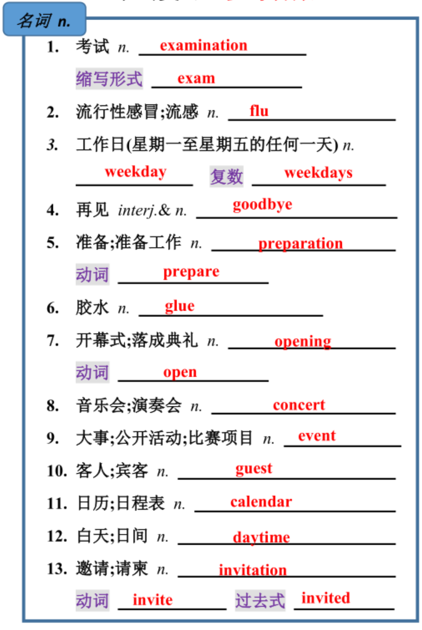
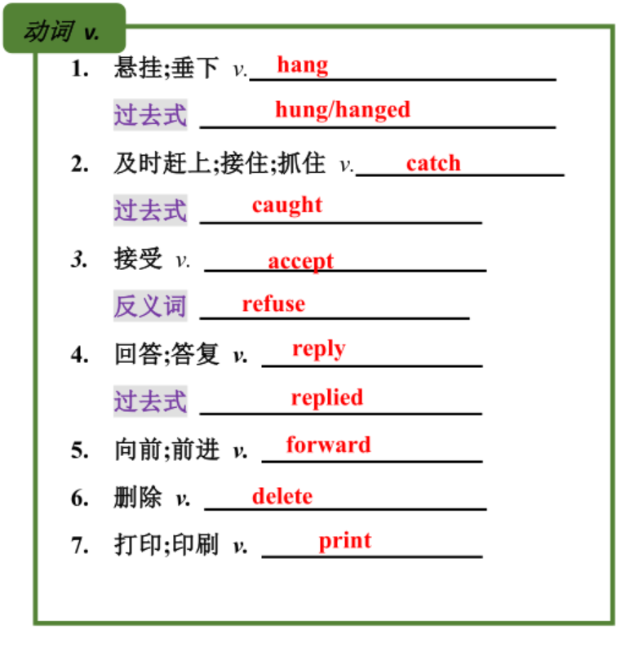
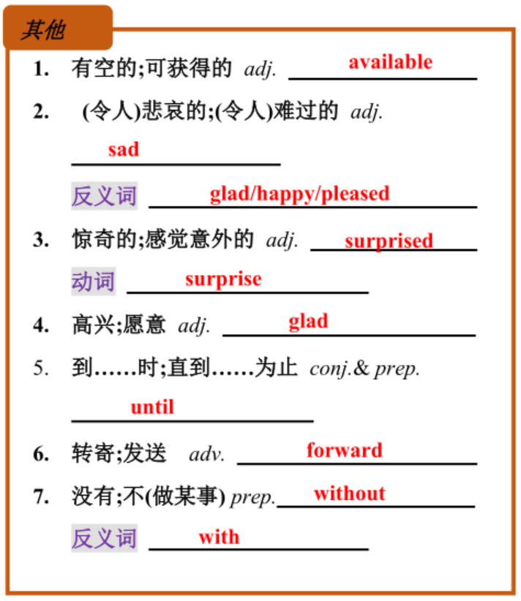
单词复习

Slide 5
单词练习
They didn’t (赶上) the last bus, so they took a taxi home.
We usually go to work on (weekday) and relax on weekends.
We all received an （invite）to her wedding.
Tom left the room without （say）a word.
He is looking forward to （see）his favorite singer.
Careful （prepare）for the exam is very important.
We are （surprise）at the news.
All the g had a good time at the party.
She loves music but she’s never gone to any (音乐会)．
Mrs. Miller never sleeps at home during the (白天)．
catch
weekdays
invitation
saying
seeing
preparations
surprised
uests
concerts
daytime

Slide 6
短语复习
为……做准备
去看医生
其他时间；别的时间
直到……才……
闲逛；常去某处
备考数学考试
计划做某事
参加考试
去聚会
患流感
前天
后天
照料；照顾
拒绝
书面回复
成功
接到（某人的）信、电话等
盼望；期待
以便；为了
帮助分担工作、解决难题
在这个月末
去旅行
做某事最好的方法
prepare for
look after
go to the/a doctor
turn down
another time
reply in writing
not … until…
make it
hang out
hear from
study for a math test
look forward to(doing sth.)
plan to do sth.
so that
have an exam
help out
go to the party
at the end of this month
have the flu
take a trip
the day before yesterday
the best way to do sth.
the day after tomorrow

Slide 7
短语练习
1. 昨晚珍妮直到她妈妈回来才去睡觉。
Jenny go to bed her mother came back last night.
2. 他没有拒绝我的邀请。
He didn’t my invitation.
3. 你们打算去上海旅游吗？
Are you going to to Shanghai?
4. 彼得(Peter)上周收到了他朋友的信。
Peter his friend last week.
5. 他们通常在月底看望老人。
They usually visit the old people the month.
6. 我决定早点儿出发,为的是赶上早班车。
I decide to set out early I can catch the early bus.
didn’t
until
turn
down
take
a
trip
heard
from
at
the
end
of
so
that

Slide 8
短语练习
用方框中所给单词或短语的适当形式填空
look forward to；turn down；look after；
the day before yesterday；have the flu； take a trip
Peter bought a popcorn machine _____________________________.
Lily did not go to school last week，because she _______________.
She often _________ her sister when her mother and father are busy.
I invited him to go to the movies, but he ______________ my invitation.
She is going to _______________ to Hong Kong.
Yunnan is beautiful and I'm _______________ visiting it again.
the day before yesterday
had the flu
looks after
turned down
take a trip
looking forward to

Slide 9
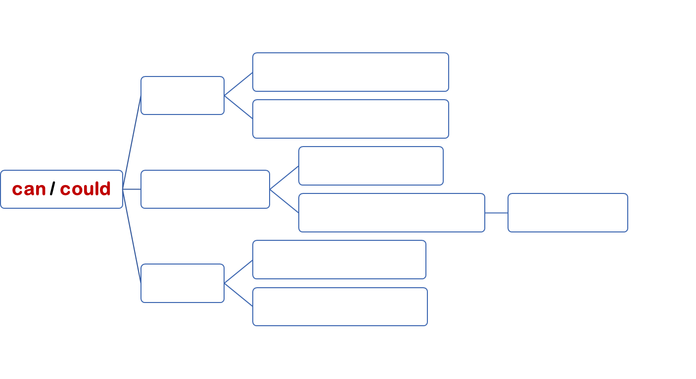
语法复习
情态动词
没有人称和数的变化，其后要接________
动词原形
can现在的能力
I can play the piano.
表能力
could过去的能力
I could play the piano when I was 12.
can语气生硬
Can you come to my party?
表请求/邀请
could语气委婉礼貌
回答用can
Could you come to my party?
can’t 表不可能
The red hat can’t be his, because his is black.
表推测
could不确定推测
He won’t do this. It could be wrong.
回答用may/can
may表请求
语气委婉礼貌
May I sit here?
表推测
may / might：不确定推测
That may/might be Mr. Green, I am not sure.

Slide 10
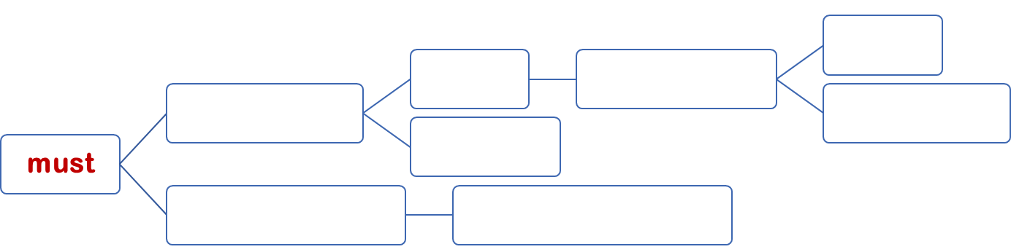
语法复习
needn’t
You must go home right now.
—Must I go home right now?
表必须
提问时否定回答
肯定形式must
don’t have to
表肯定推测
The man must be Tim.
否定形式mustn’t
表禁止不准 = can’t
You mustn’t go out without finishing your homework.

Slide 11
语法练习
D
1. — ______ you come to my house to watch the baseball match on TV?
—Sure, I’d love to.
A. May B. Must C. Should D. Can
2. —Is this book Linda's?
—It ______ be hers. Sandy's name is on the cover.
A. can’t B. mustn’t C. needn’t D. might
3. Polluted air and water ______ kill plants, animals, and even people.
A. can B. can't C. should D. shouldn't
4. —May I join the art club, Dad?
—If you have interest, you ______.
A. should B. can C. have to D. must
5. —Can you come to my party on Saturday afternoon?
—______. I must look after my grandmother.
A. Sorry, I can't B. Yes, I'd love to C. Let's go D. Sure
6. They were afraid that it _____ rain the next day.
A. must B. should C. might D. may
7. —Where's Jane? —I'm not sure. She __________ in the library.
A. might be B. must be C. can't be
A
A
B
A
C
A

Slide 12
语法复习
接受/拒绝邀请
对于用情态动词can发出的邀请，回答时主要有两种情况：
接受：①Sure/Yes, I’d love(like) to. 当然，我愿意。
②Sure/Of course. 当然。
……
拒绝：①Sorry, I’m not available. 对不起，我没空。
②I’m sorry. I’m not free. I have to … 抱歉，我没空，我得……
③I’d love to, but I’m afraid I can’t. I must …我愿意，但是恐怕不行。我必须……
……

Slide 13
语法复习
1. — Today is my birthday. Can you come to my party tonight?
— ______, but I should finish my homework first.
A. That’s too bad B. Yes, please C. No, I don’t know D. I’d love to
2. —Why didn’t you come to my party?
—I _____stay at home，because my mother was ill.
has to B. have to C. had D. had to
3. —Could you come back home for dinner?
—______. I’ll be at a very important business meeting at that time.
I think so. B. I’m afraid not. C. Yes, I hope so. D. I’m afraid so.
“你能加入我们的足球俱乐部吗?”
“当然,我很乐意。”
—Can you join our soccer club?
—Sure, . —Sorry, . (我没空)
D
D
B
I’d love/like to
I am not available

Slide 14
考点复习
1. 邀请某人去某地： invite sb. to + 地点；邀请某人做某事：invite sb. to do sth.
2. 拒绝： refuse to do sth. = turn down
3. not...until... 直到...才...
isn't, aren't, don't, doesn't, didn't
4. 照顾：look after = care for = take care of
5. 有/没有：with/without doing sth.
6. 想做某事：would like to do sth. = want to do sth.
7. 令某人惊奇的是：to one's surprise； surprised(修饰人)； surprising(修饰物)
8. 期待做某事：look forward to doing sth.
9. 太多：too much(+不可数)/too many(+可数)；非常/很：much too(+形容词)
10. on + 其他 + morning/afternoon/evening

Slide 15
考点练习
1. —When did you finish doing your homework last night?
—I _______ finish it ________ eleven.
A. did't; after B. not; until C. don't; until D.didn't; until
2. We have to do ________ homework this weekend. It’s ________ boring.
A. too many; much too B. much too; too much
C. too much; too much D. too much; much too
3. What are you doing _____ Monday morning?
A. on B. at C. in D. with
4. Thanks for _______ me to the party.
A. ask B. asking C. asks D. to ask
5.You shouldn’t go out at night without ________your parents.
A.to tell B. told C. tell D. telling
6. We are looking forward to _____ Yao Ming one day.
A. meet B. meeting C. meets D. met
D
D
A
B
D
B

Slide 16
补全对话
Dave: Hi, Mona! I am going to have a birthday party. I want to have it on Saturday evening. 1. ?
Mona: Oh, I am going to visit my grandfather on Saturday evening.
Dave: 2. ?
Mona: Great. I am free on Sunday morning. I’m sure I can come.
Dave: Oh! Can Jack come to the party?
Mona: No, he can’t. 3. .
Dave: The math exam? Well, how about Tara? Can she join us?
Mona: 4. . She is going to have a great time at your party.
Dave: Sounds great! Then I’ll see you on Sunday morning at the party.
Mona: 5. .
Can you came to my party
How about Sunday morning
He has to study for the math exam
Sure, She’d love to/ Yes, she is available
Bye/See you then

Slide 17
书面表达
请你以邀请朋友参加派对为主题，写一封邀请函。
Salutation(称呼语): 靠左侧，加 ,
Purpose(目的)
Time & Venue(时间&地点)
Activities
Advice / Preparations
Expectation(期待)
结构
Text(正文):
Signature(署名): 靠左侧，不用真实姓名

Slide 18
An invitation
Dear Jim,
How is everything going? 一切都好吗? I hope this letter finds you well. 希望你一切都好。I'm writing to invite you to a farewell party for my brother because he is leaving for a university in Shanghai. 我写这封信是想邀请您参加我哥哥的送别会，因为他要去上海上大学了。
The party will be held on the morning of Wednesday, January 1st at my house. 派对将于1月1日星期三上午在我家举行。At the party, my parents are planning to serve food and drinks so that you don't need to bring anything. 在聚会上，我父母计划提供食物和饮料，所以你不需要带任何东西。After the meal, we will have a chat and then say goodbye to my brother.饭后，我们会聊一聊，然后和我弟弟说再见。 By the way, I guess my brother would be very glad if you could give him some advice on how to study well at university. 顺便说一下，我想如果你能就如何在大学好好学习给我弟弟一些建议，他会非常高兴的。
Please let me know if you can make it by next Monday. 在下周一前请让我知道你是否能来。I am looking forward to your reply. 我期待着你的回复。
Yours,
Tom

Slide 19
书面表达
请你写一封回信。
Salutation(称呼语): 靠左侧，加 ,
Thanks
去不去
能帮什么（去）；理由（不去）
Expectation(期待)
结构
Text(正文):
Signature(署名): 靠左侧，不用真实姓名

Slide 20
A reply - accept
Hi Tom, Thank you so much for inviting me. 非常感谢你邀请我。I will definitely go to the farewell party.我一定会去送别会的。
I really like your brother a lot. 我真的很喜欢你弟弟。I’m so sad to see him go, 看到他离开我很难过，and this party is the best way to say “Come on and goodbye.” 这个派对是说“加油，再见”的最好方式。I can help to buy some of the food and drinks if you need. 如果你需要的话，我可以帮你买一些食物和饮料。Also, I do have some useful suggestions for your brother about studying at a university.并且，我确实对你弟弟上大学有一些有用的建议。
Looking forward to see you all. 期待见到你们所有人。
Best wishes,Jim

Slide 21
A reply - refuse
Dear Tom, Thanks for your invitation. 谢谢你的邀请。I’d love to go to the party, but I’m not available. 我很想去参加聚会，但我没空。
A few weeks ago, I took a trip to Beijing and I won’t get back until January 3rd. 几周前，我去了趟北京，要到1月3日才能回来。I’m really sorry about this, but anyway, I will prepare a gift for your brother and send it to him soon. 我真的很抱歉，但是无论如何，我会准备一份礼物给你弟弟，并尽快寄给他。
I hope you all have a good time at the party.我希望你们在聚会上都玩得愉快。
Best wishes,Jim

Slide 23
谢谢
21世纪教育网（www.21cnjy.com)
中小学教育资源网站
兼职招聘：
https://www.21cnjy.com/recruitment/home/admin

