Slide 1
Unit 10 If you go to the party ,
you’ll have a great time!
单元复习课件
人教版八年级上册

Slide 2











Review
Grade 8 Unit 10
If you go to the party ,you’ll have a great time!

Slide 3

If You Are Happy
If you're happy and you know it clap your hands
If you're happy and you know it clap your hands
If you're happy and you know it and you really want to show it
If you're happy and you know it clap your hands
If you're happy and you know it stamp your feet
If you're happy and you know it stamp your feet
If you're happy and you know it and you really want to show it
If you're happy and you know it stamp your feet
If you're happy and you know it shout “Hurray”
If you're happy and you know it shout “Hurray”
If you're happy and you know it and you really want to show it
If you're happy and you know it shout “Hurray”
拍拍手
跺跺脚
喊万岁

Slide 4
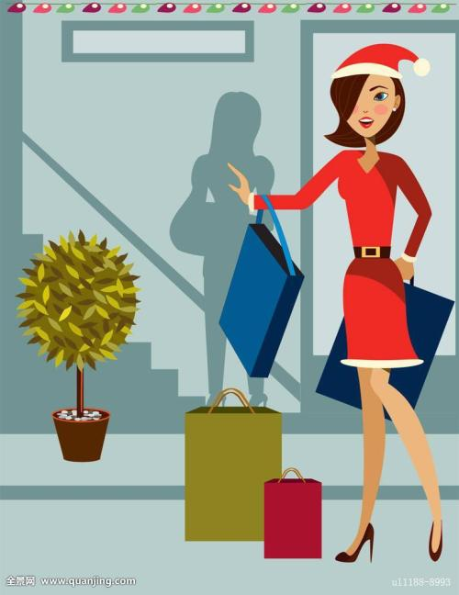
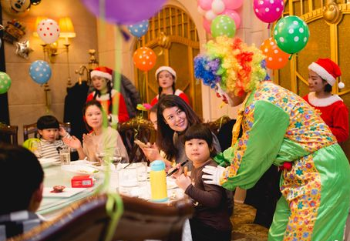
If you are happy, what will you do?
If I am happy, I will go shopping.
If I am happy, I will hold a party.

Slide 5


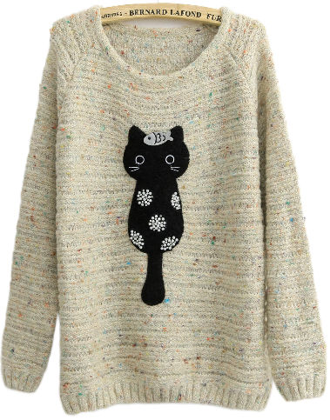
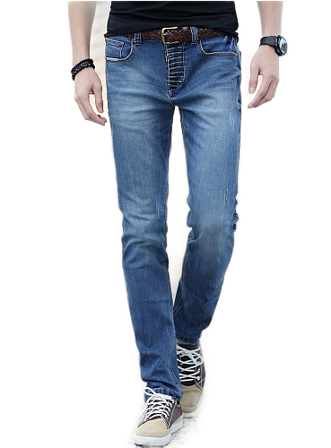
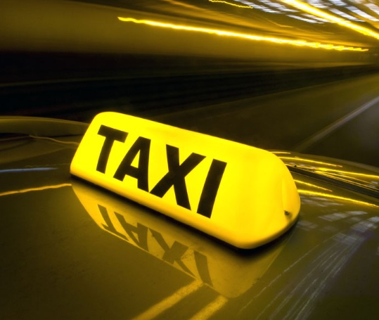
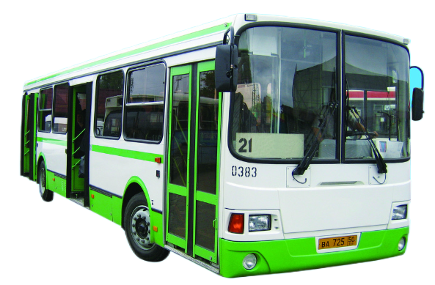
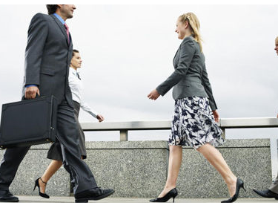
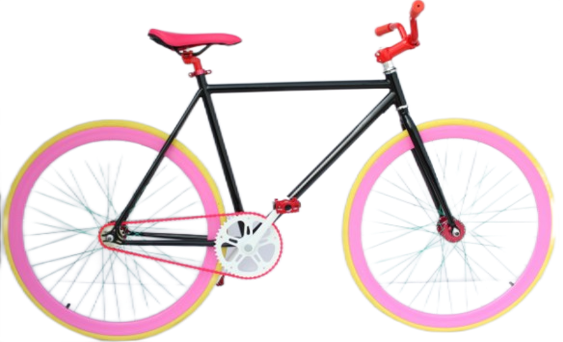
If you are invited to my party, what will you wear?
If I go to the party, I will ___________________.
If you do, I/you will ____________.
If you go to the party, how will you get there and who will you go with?

Slide 6


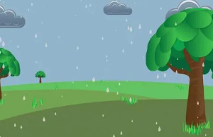
Practice
She is going to walk to school.
She will be late.
walks
will be
If she _____ to school, she _____ ___late.
rains
will saty
If it _____ tomorrow, I _____ _____ at home.
It is going to rain tomorrow.
I will stay at home.

Slide 7

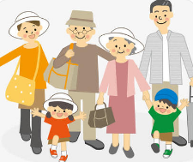
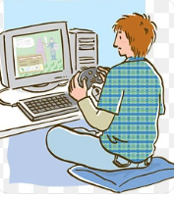
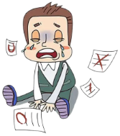
It will be sunny tomorrow.
They will have a trip tomorrow.
If it ____ sunny tomorrow, they _____ ______ a trip.
is
will have
will fail
If he _______ study hard, he ____ _____ in the exam.
doesn’t
He will play computer games.
He won’t study hard.
He will fail in the exam.

Slide 8
Grammar
一、If引导的条件状语从句
1. If意为“如果”，引导条件状语从句时，既可在
主句前，也可在主句后。若放在句首，从句后面
要加逗号与主句隔开。
例：如果你去那儿，我也会去。
________________________
If you go there, I’ll go, too.

Slide 9
2. 句型结构：
If +…,
I’ll / you’ll +…
从句
主句
条 件
结 果

Slide 10
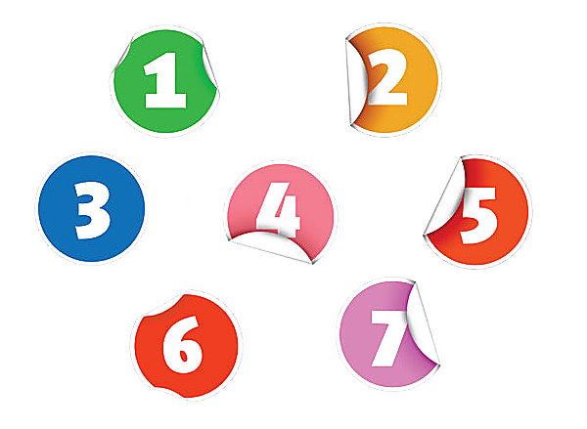
3. 时态：
主句是一般将来时，从句一般现在时。
If he comes, he will bring his violin.
主句是有情态动词may/might/can/must/
should等句子，从句一般现在时。
If you want to lose weight, you must eat less bread.
主句是祈使句，从句一般现在时。
Don’t carry the box if you are not strong enough.

Slide 11
学以致用
1. 如果明天不下雨，我就和同学们去野餐。
If it doesn’t rain tomorrow, I will have a picnic with my classmates.
2. 如果你想减肥，就锻炼身体吧。
Take some exercise if you want to lose weight.
3. 如果冬天来了，春天还会远吗？
If winter comes, can spring be far behind?
4. 如果他加入狮子队(the lions), 他将会有名的足球运动员。
If he joins the Lions, he will be a famous soccer player.
5. 如果他成为了一名的足球运动员，他将不能上大学接受教育。
If he becomes a soccer player, he won’t go to college and get an education.

Slide 12
语境小练
won’t let
1. If you wear jeans, the teacher _________(not let) you in.
2. You’d better ___________(advice) your friend to drive fast at night, since he is still a green hand.
3. He doesn’t seem happy. I think something bad _________(happen) to him.
4. Tom has a lot of _______ (advice) on how to learn English well.
5. Ted ________(hang) out with us just now.
6. Tom Sawyer has many unusual ____________ (experience).
7. You’re halfway to ________(solve) a problem just by talking to someone.
8. They need to come up with a good ________(solve) to deal with the problem.
9. Tina is such an _____________(understand) girl that everyone likes her.
10. _______(near) 250 people lost their lives in the Flight MH370.
11. I can’t go out with you, because I need to prepare ______ my test.
12. It is best not to run _______ from our problems.
13. Shareing a problem is like cutting it _____ half.
not advise
happened
advice
hung
experiences
solving
solution
understanding
Nearly
for
away
in

Slide 13
一词多义
1
B
A

Slide 14
2. turn down
►熟义：拒绝
►生义：
A. 把……调低；关小 B. 减少；降低
I'm afraid his radio is too noisy. Will you please ask him to turn it down a little？________
A

Slide 15
What can you learn from the passage?
语境综合
worries
Students these days have a lot of _________ (worry). Sometimes they have problems with their schoolwork , and sometimes with their friends. What can they do about this? Laura Mills , a teenager from London, agrees .“Problems and worries are normal in life .” says Laura , “ But I think _________ (talk) to someone helps a lot. _______ we talk to someone, we’ll certainly feel worse .”
Laura once lost her wallet and worried for days. She was afraid ______ (tell) her parents about it. She even walked three miles to school each day because she didn’t have ______ ( some) money . In the end , she talked to her parents and they were really ____________ ( understand) . They got her a new wallet and asked her to be more careful.
Robert Hunt advises students about common problems.” It is the best ________ (not run) away form our problems . We should always try to solve them .” He thinks the first step is ______ (find) someone you trust to talk to. This person doesn’t need to be _____ expert like himself. In English, we say that sharing a problem is like _______(cut)it in half. So you’re halfway to solving a problem just by talking to someone about it !
talking
Unless
to tell
any
undertanding
not to run
to find
an
cutting

Slide 22

词汇语境训练

Slide 24
语篇练
Wonderful time always leaves people good memories . Last Saturday , Steven spent a 1.____________ (meaing) evening . That day was his best friend--Tom’s birthday . So Tom organized a birthday party at his home. Many of his classmates 2. ________________( invite) by Tom , so was Steven . Steven 3._________ ( accept) it gladly .
At the party , they sang birthday song , ate birthday cake , played a lot of interesting games together and wantched 4.__________ (video)from those who couldn’t come. Meanwhile , they gave Tom many gifts ,such as 5._______ educational book , an NBA basketball and so on . Everyone gave his or her best wishes to Tom. That night , they 6.___________ (certain) enjoyed themselves . They didn’t left 7._________ 10 o’clock . On the way home , Steven thought his fifteenth birthday would come in three weeks . He decided 8.__________ ( prepare) a birthday party like Tom’s. He liked the feeling of staying 9._________ his friends . He planned to invite all 10. _________ ( he) calssmates . He thought they would have a nice party together happily . And he was looking forward to it .
meaningful
were invited
accepted
videos
an
certainly
until
to prepare
with
his

Slide 37
谢谢
21世纪教育网（www.21cnjy.com)
中小学教育资源网站
兼职招聘：
https://www.21cnjy.com/recruitment/home/admin

