Slide 1
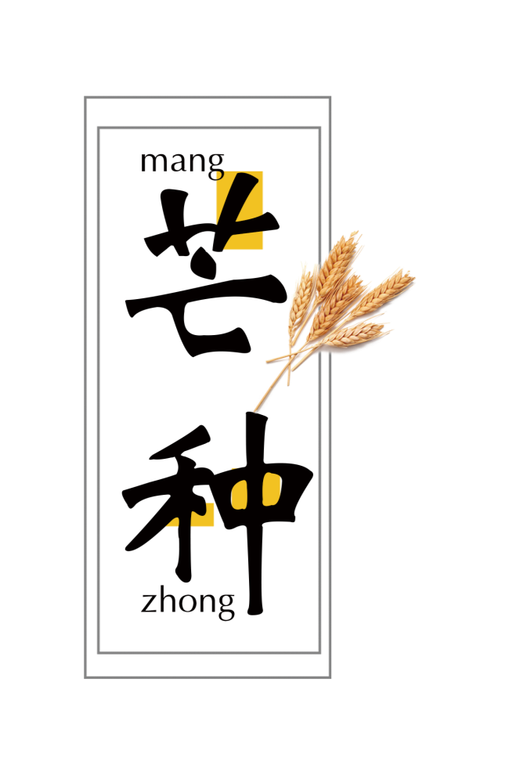
24 Solar Terms
- Grain In Ear
（芒种）

Slide 2
学习目标
认识芒种；
认识芒种的相关内容；
学会表达。

Slide 3
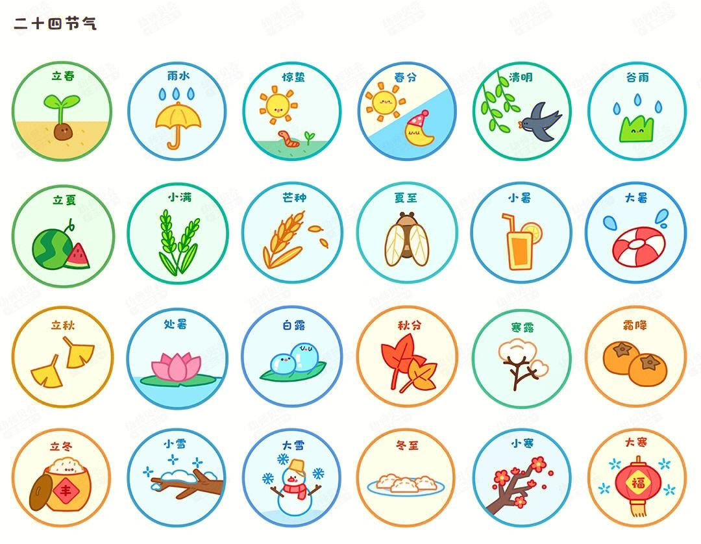

Slide 4
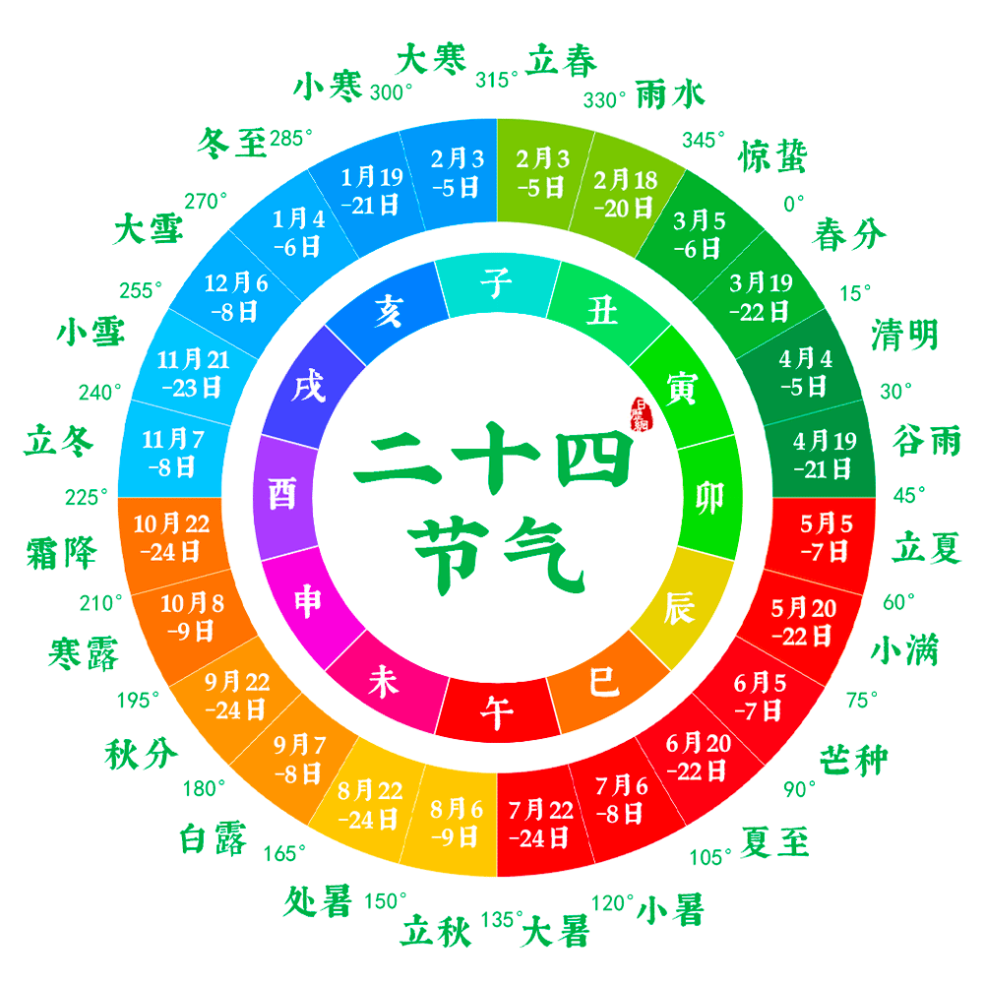

Slide 5
Video Time

Slide 7
行业PPT模板http://www.1ppt.com/hangye/
01
Vocabulary
02
The introduction
03
The custom
04
Practice

Slide 8
PART 01
Vocabulary

Slide 9
Vocabulary
calendar [ˈkælɪndər] n. 日历;挂历
【短语】solar calendar 公历
lunar calendar 阴历
【例句】In the Chinese calendar, the Spring Equinox always occurs in the second month.
在中国历法中，春分总是出现在二月份。

Slide 10
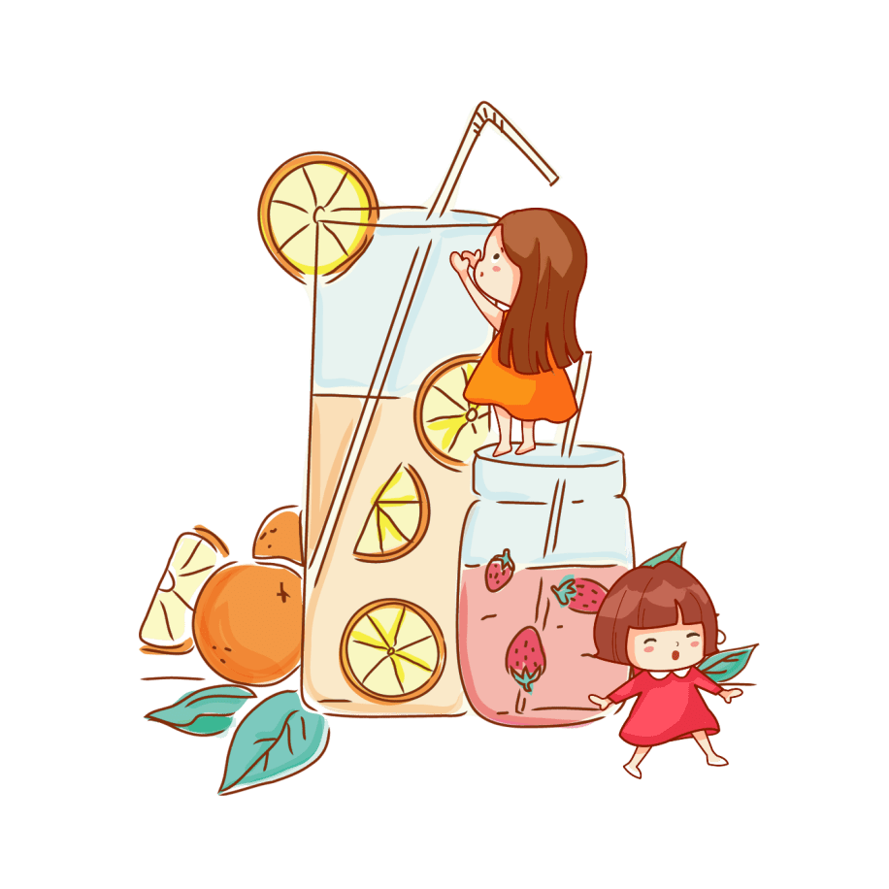
Vocabulary
signify [ˈsɪɡnɪfaɪ] v. 代表，表示，象征
【拓展】significant重大的；有效的；有意义的
【例句】A misty morning does not signify a cloudy day.
有雾的早晨并不代表就是阴天。

Slide 11
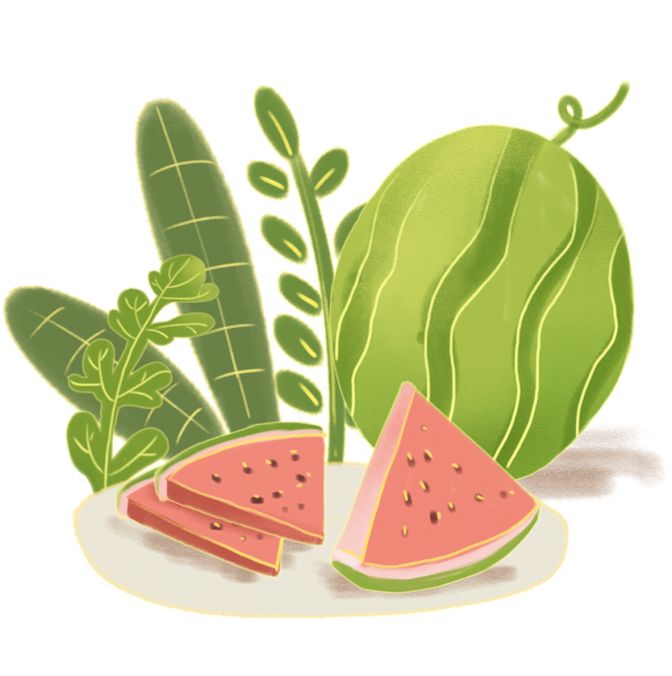
Vocabulary
ripen [ˈraɪpən] v. (使)成熟
【例句】I'm waiting for the apples to ripen.
我在等这些苹果成熟。

Slide 12
Vocabulary
agricultural [ˌæɡrɪˈkʌltʃərəl] adj. 农业的
【例句】Rivers are a blessing for an agricultural country.
河流是农业国的福祉。

Slide 13
Vocabulary
rainfall [ˈreɪnfɔːl] n. 降雨量;下雨
【拓展】Rainfall is also increased in cities.
城市的降雨量也在增加。

Slide 14
Vocabulary
plum [plʌm] n. 梅子;李子
The plum is coated with sugar.
梅子的外面裹着糖。

Slide 15
Vocabulary
sacrificial [ˌsækrɪˈfɪʃl] adj. 用于祭献的
【拓展】Only one faith worships a person known primarily for his sacrificial love.
只有一种信仰崇拜一位为爱献身的人。

Slide 16
Vocabulary
pray [preɪ] v. 祈祷;祷告
【拓展】pray for 恳求，请求
【例句】During the Spring Festival, some people would visit temples to pray for happiness, wealth and health.
春节期间，有些人会去到庙里祈求喜乐、富贵与健康。

Slide 17
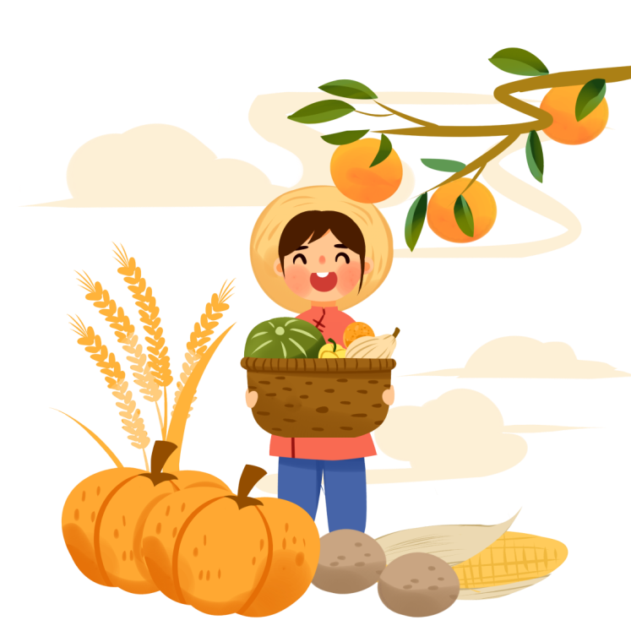
Vocabulary
harvest [ˈhɑːrvɪst] n. 收割;收获;收成
【拓展】 Rice farmers here still plant and harvest their crops by hand.
这里的稻农仍然用手工种植和收割庄稼。

Slide 18
Vocabulary
flour [ˈflaʊər] n. (尤指小麦的)面粉;(谷物磨成的)粉
【拓展】wheat flour 小麦粉rice flour 米粉
corn flour 玉米面；玉米淀粉
【例句】Flour is sold by the kilogram.
面粉按公斤出售。

Slide 19
Vocabulary
farewell [ˌferˈwel] n. 告别;辞行
【拓展】She bowed farewell to her friend.
她向朋友鞠躬告别。

Slide 20
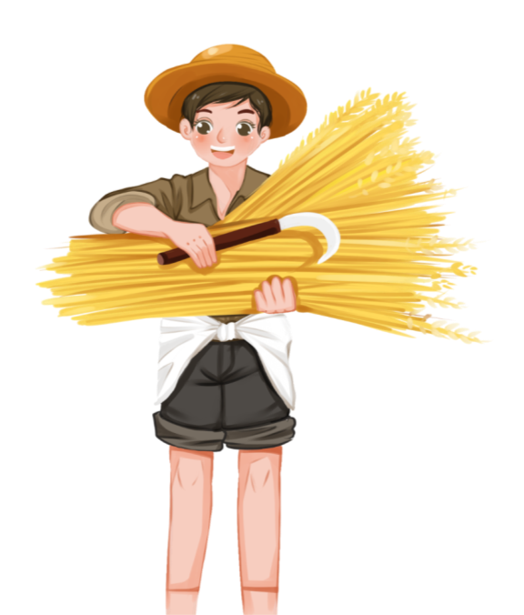
Vocabulary
gratitude [ˈɡrætɪtuːd] n. 感激;感谢
【拓展】 He smiled at them with gratitude.
他向他们笑了笑表示谢意。

Slide 21
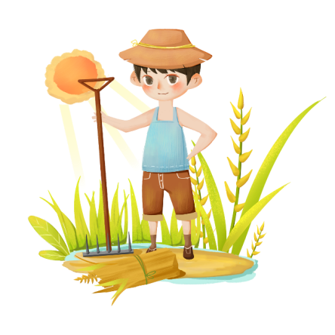
Vocabulary
liveliness [lɪvliːnəs] n. 活泼；生动
【拓展】Readers can experience the vividness and liveliness of reading.
读者可以体验阅读的生动性与活泼性。

Slide 22
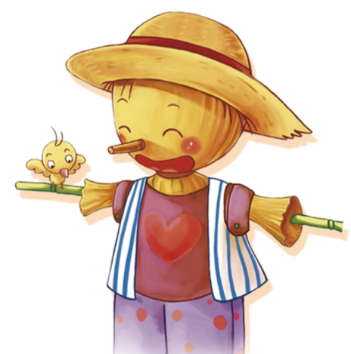
Vocabulary
excitement [ɪkˈsaɪtmənt] n. 激动;兴奋
【拓展】Excitement was shining in her eyes.
她眼里闪着兴奋的光芒。

Slide 23
Vocabulary
youngster [ˈjʌŋstər] n. 年轻人;少年
【拓展】Firefighters managed to get the youngster out.
消防员设法把小女孩救了出来。

Slide 24
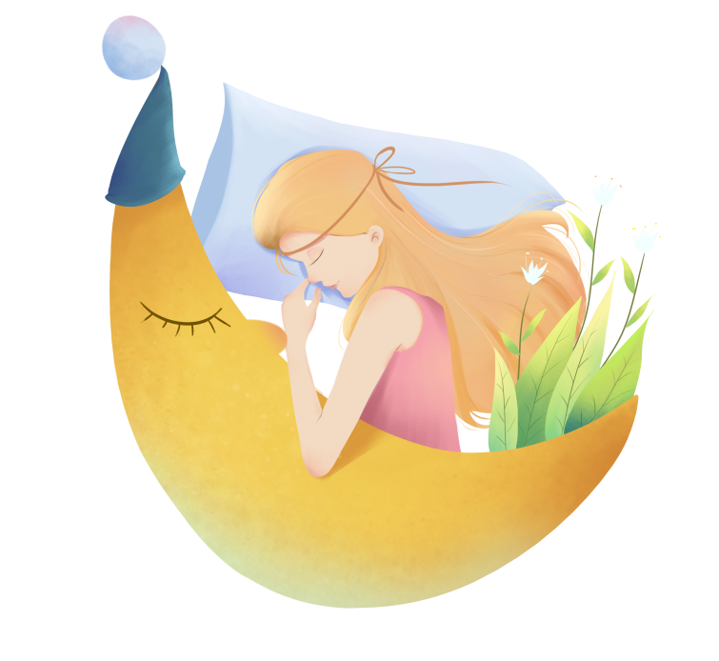
Vocabulary
southeastern [ˌsaʊˈθistərn] adj. 东南的,东南部的
【拓展】Moldova is a landlocked country located in southeastern Europe.
摩尔多瓦是一个欧洲东南部的内陆国家。

Slide 25
Vocabulary
wrestle [ˈresl] v. 摔跤;奋力对付
【拓展】They taught me to wrestle.
他们教我去摔跤。

Slide 26
Vocabulary
newlywed [ˈnuliˌwɛd] n. 新婚夫妇;新婚的人
【拓展】My newlywed wife and I are deeply in love.
我和我的新婚妻子彼此深爱着对方。

Slide 27
PART 02
The introduction

Slide 28
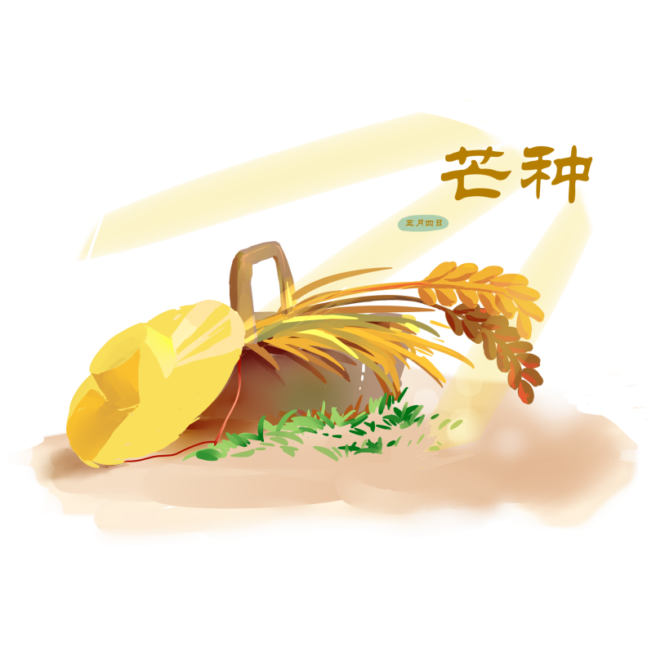

Slide 29
The introduction
The Chinese solar calendar divides the year into 24 solar terms. Grain in Ear, (Chinese 芒种), the 9th solar term, begins on June 6 this year and ends on June 20.
The arrival of Grain in Ear signifies the ripening of crops such as barley and wheat. It is also a busy period for farmers.
到来
代表着
未成熟的
大麦和小麦

Slide 30
The introduction
The solar terms were created thousands of years ago to
guide agricultural production. The culture remains useful today to guide people's lives through special foods, cultura ceremonies and healthy living tips that correspond with each term.
农业
v. 仍然是
健康生活
与......相符合

Slide 31
PART 03
The custom

Slide 32
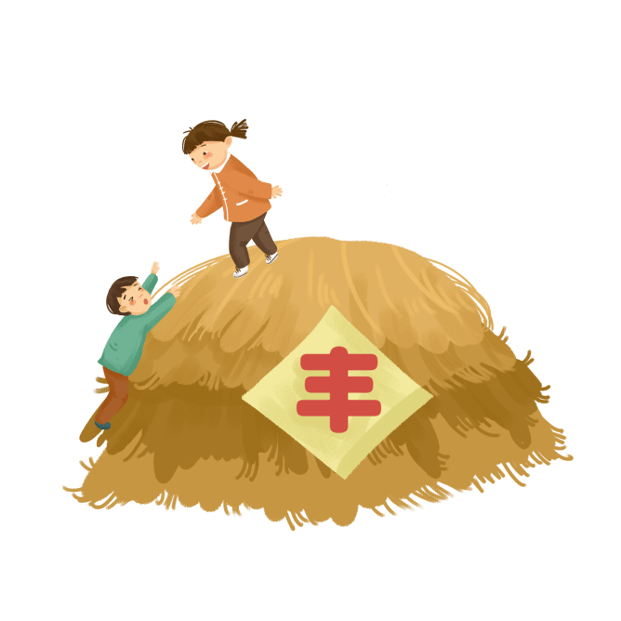
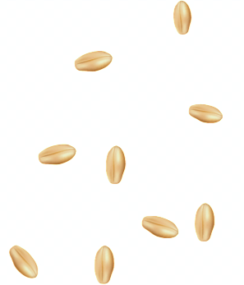
An increase in rainfall
Rainfall increases during Grain in Ear compared to the previous eight solar terms. Regions in the middle and lower reaches of the Yangtze River are about to enter the Plum Rains season.
Plum Rains, often occurring during June and July, refer to the long period of continuous rainy or cloudy weather. This happens to be the time for plums to ripen, which explains the origin of its name. Plum Rains is a good period for growing rice, vegetables and fruits.
与......相比
先前的
梅雨季节
长江中下游地区
将要
涉及
李子成熟的时候
蔬菜

Slide 33
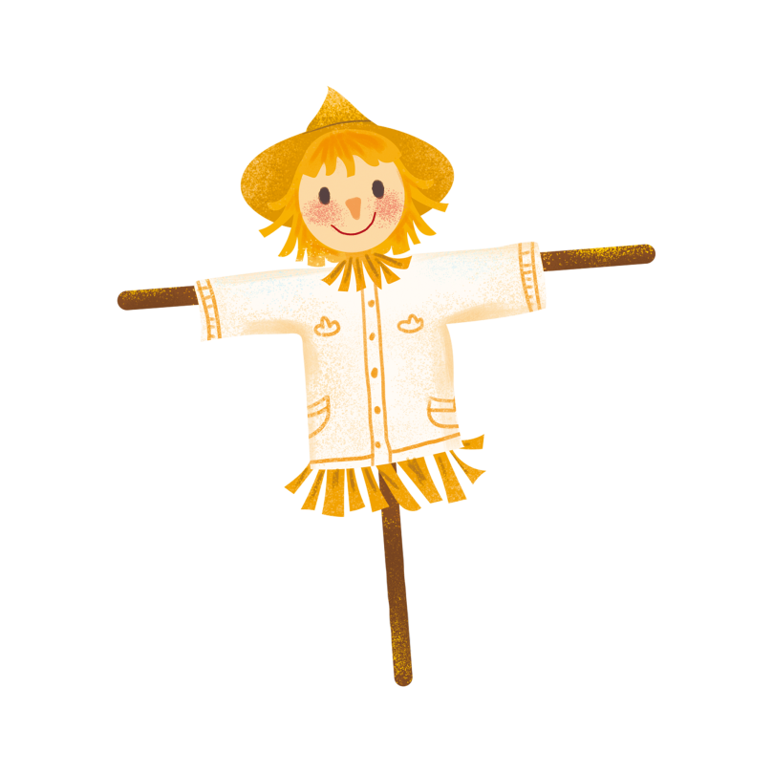
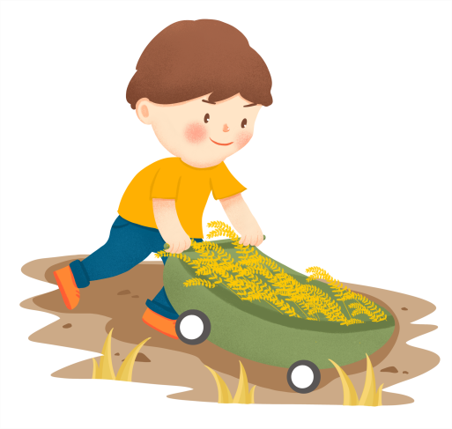
Pray for good harvest
"An Miao" (meaning seedling protection) is a traditional farming activity of southern Anhui province that has been practiced since the early Ming Dynasty (1368-1644). Every year when Grain in Ear comes, they hold the sacrificial ceremony to pray for good harvests in the fall. People make different types of bread from wheat flour and color them with vegetable juice. The bread is used as a sacrificial offering to pray for a good harvest and people's safety.
祭祀礼仪
祈求好收成
小麦粉
被用作...

Slide 34
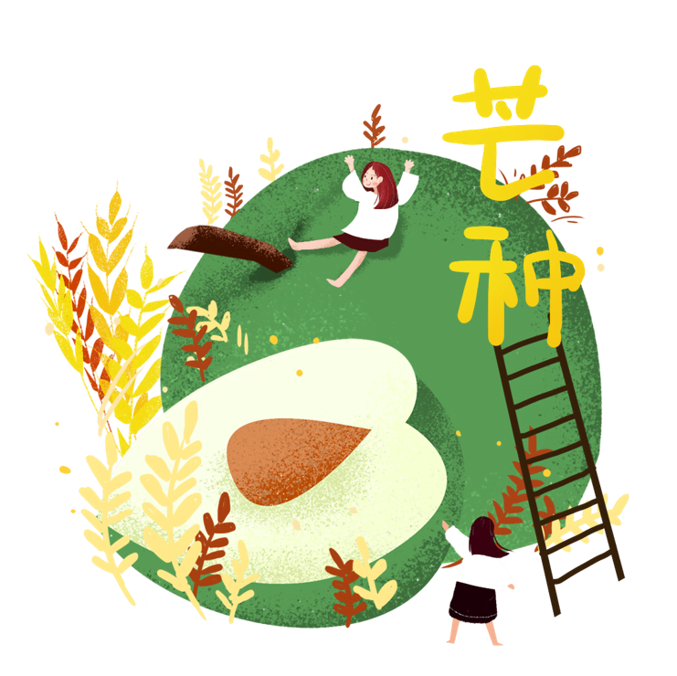
Say farewell to the flora
In ancient China, on the second day of the second solar month, people welcome the arrival of the Flower Goddess. During Grain in Ear people hold sacrificial ceremonies to bid farewell to the flora and show their gratitude.
Today, this custom does not exist in many areas of China. The liveliness and excitement of the ceremony can still be seen in the 27th chapter of the Chinese classic novel A Dream of Red Mansions by Cao Xueqin.
花神
告别
表达他们的感激之情
存在
红楼梦

Slide 35
Mud wrestling
Youngsters of the Dong people in southeastern Guizhou province hold mud wrestling matches during Grain in Ear. On this day newlyweds, accompanied by their good friends, plant rice together. While planting, they throw mud at each other. At the end of this activity, whoever has the most mud on them proves they are the most popular person.
年轻人
南部
摔跤比赛
新婚夫妻
陪伴
扔泥巴
在...的最后
最多的

Slide 36
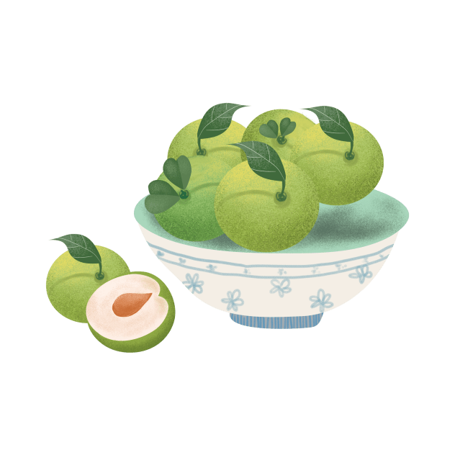
Boil green plums
In South China, May and June are the season when plums become ripe. There was an allusion that Cao Cao and Liu Bei, two central figures in the Three Kingdoms period (AD220-280), talked about heroes while boiling green plums.
Green plums contain a variety of natural and high-quality organic acids and are rich in minerals. They can help clean blood, lower blood lipids, eliminate tiredness and improve one's looks. However, fresh plums are acerbic and need to be
boiled before serving.
传说
煮青梅
酸
酸
矿物质
降低
改善

Slide 37
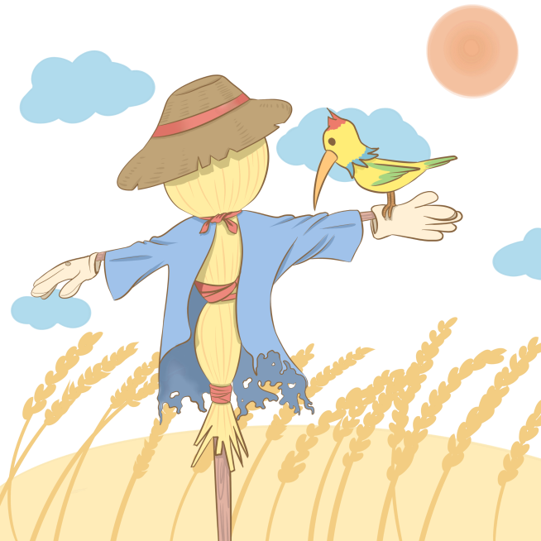
Have light food
Do not eat greasy or strongly flavored food during Grain in Ear, that's the healthcare advice given more than a thousand years agby Chinese pharmaceutical expert SunSimiao of the Tang Dynasty (AD618-907).
Generally, vegetables and coarse grains that work in lowering blood pressure and blood fat should be the first choice. During this season, people are encouraged to consume less lamb, pork, hot peppers, onions and ginger if they are frequently feeling thirsty and tired.
油腻
重口味的
健康
医药
粗粮
少吃羊肉、猪肉、辣椒、洋葱和姜
鼓励
经常

Slide 38
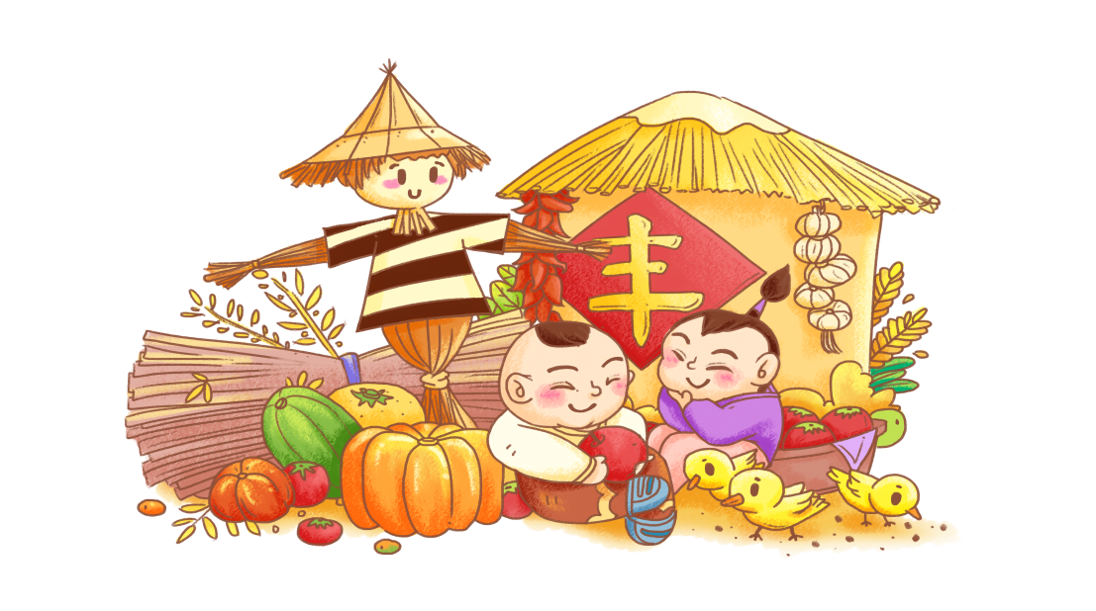
Eat fruits and vegetables with cool nature
The weather is hot during the Grain in Ear period, therefore vegetables and fruits of a cool nature are recommended.
The balsam pear is a classic choice. It contains a lot of natural and nourishing water. It's also said to have healing properties which are good for patients suffering from high blood pressure or high blood sugar.
推荐
苦瓜
天然滋养水
治疗
遭受

Slide 39
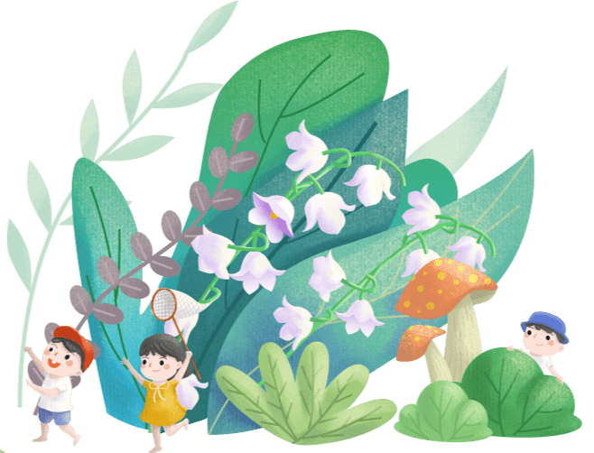
Eat fruits and vegetables with cool nature
Other recommendations include tomatoes,cucumbers, eggplant, celery, asparagus,water melon and strawberry. According to Traditional Chinese Medicine theories, they are all cool-natured and can help eliminate heat in the body and promote digestion.
推荐
西红柿、黄瓜、茄子、芹菜、芦笋、西瓜和草莓
根据
凉性
清热解毒，促进消化

Slide 40
PART 04
Practice

Slide 41
Practice
[2021黑龙江哈尔滨考试，62]Grain in Ear(芒种), the ninthsolar term, begins on June 5 this year _______ signifies the ripening of wheat.
and
解析：分析句子结构及句意可知，空处在此连接两个并列谓语，故答案为：and

Slide 42
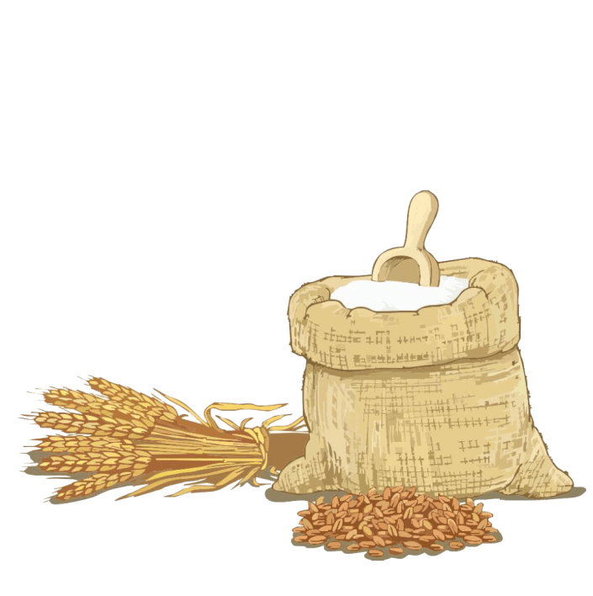
Practice
How to introduce Grain in Ear？

Slide 43
Summer
Start of Summer | May 6 | The summer season begins.
Grain Buds | May 21 | Grains are getting plump but not ripe yet.
Grain in Ear | Jun. 6 | Wheat grows ripe marking the beginning of a busy farming season.
Summer Solstice | Jun. 22 | The sun altitude arrive the highest in north; It has the longest daytime of the year.
Slight Heat | Jul. 7 | The hottest days are yet to come.
Great heat | Jul. 23 | The hottest time of a year.

Slide 44
第一PPT

