Slide 1
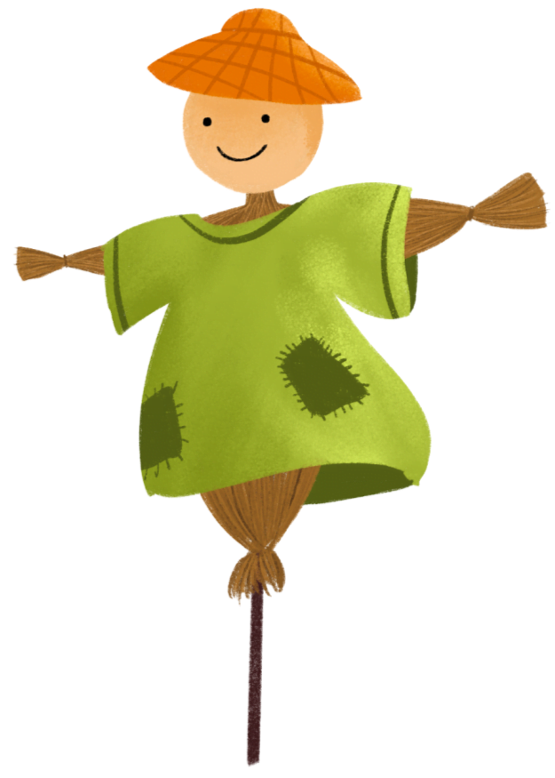
小
小
满
满
24 Solar Terms
- Grain Buds
（小满）

Slide 2
认识小满；
认识小满的相关内容；
学会表达。
学习目标

Slide 3
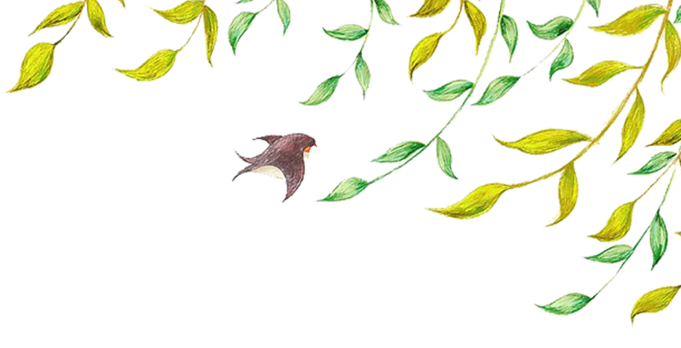
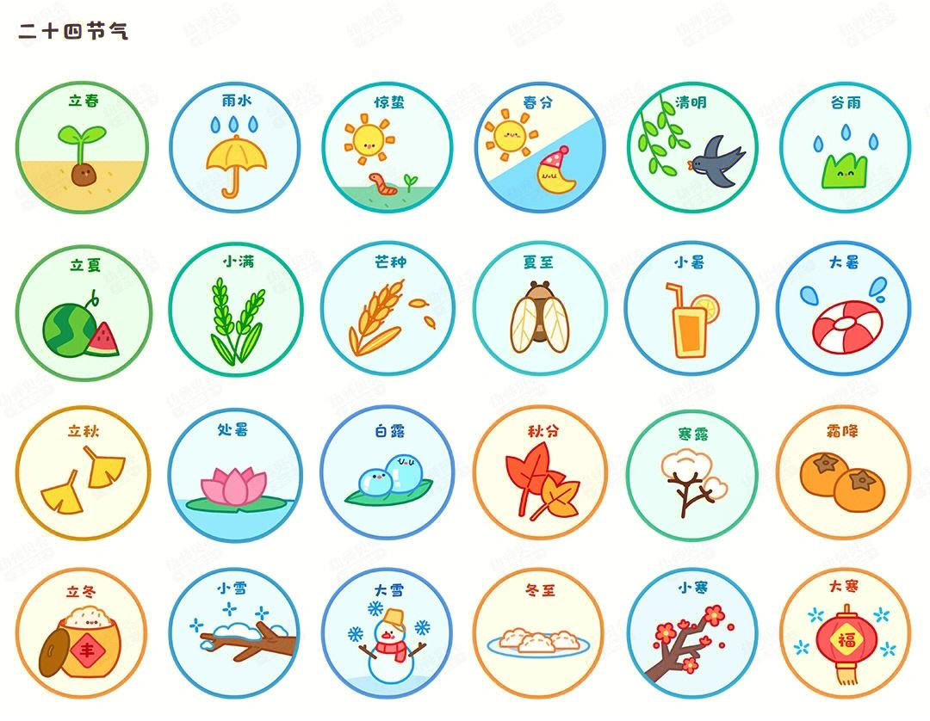

Slide 4
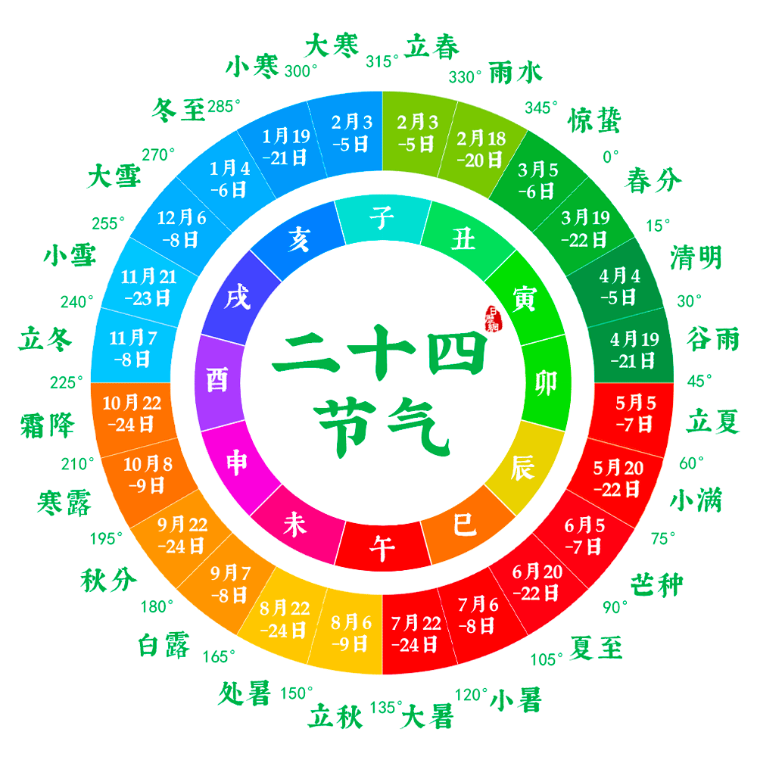

Slide 6
行业PPT模板http://www.1ppt.com/hangye/
Content 目录
Vocabulary
Text
The introduction
Practice

Slide 7
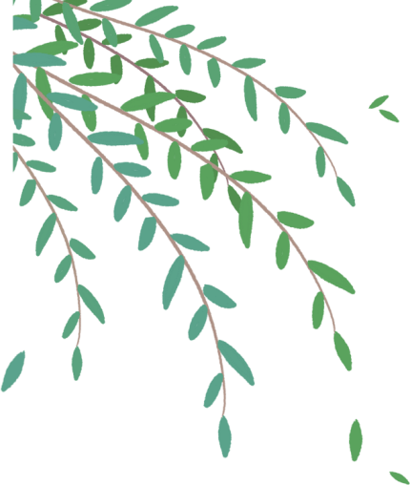
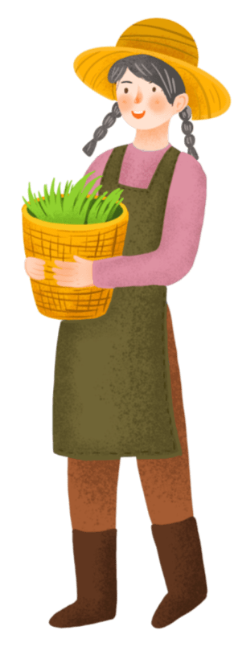
PART 01
Vocabulary

Slide 8
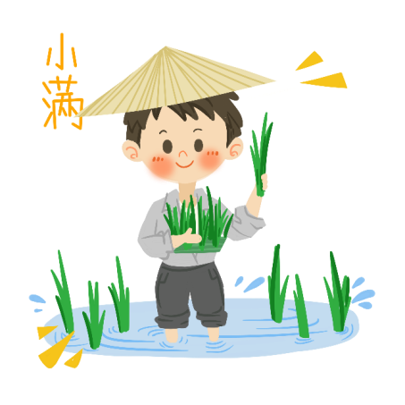
Vocabulary
traditional [trəˈdɪʃənl] adj. 传统的;习俗的
【例句】The traditional view was that marriage was meant to last.
传统的观念是结成夫妻就要白头到老。

Slide 9
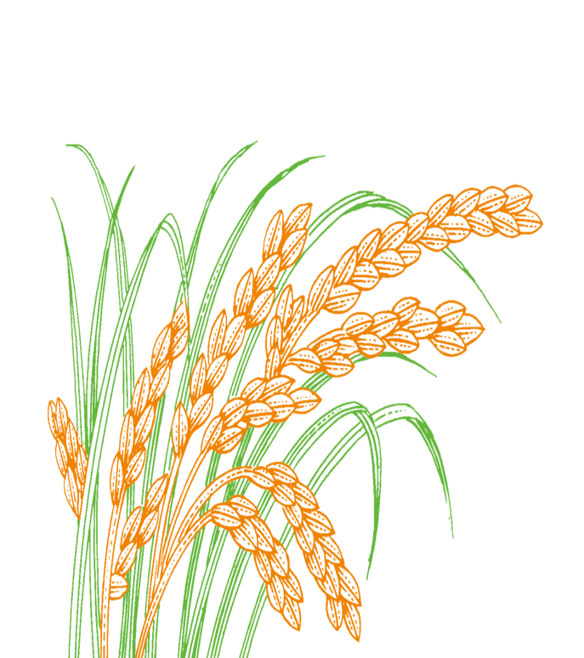
Vocabulary
grain [ɡreɪn] n. 粮食;谷物
【例句】The fine grain ran through my baskets.
细小的谷粒从我的篮子里掉出来。

Slide 10
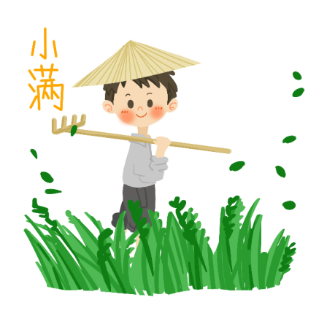
Vocabulary
agricultural [ˌæɡrɪˈkʌltʃərəl] adj. 农业的
【例句】Rivers are a blessing for an agricultural country.
河流是农业国的福祉。

Slide 11
Vocabulary
ceremony [ˈserəmoʊni] n. 典礼;仪式
【例句】He attended his graduation ceremony.
他参加了毕业典礼。

Slide 12
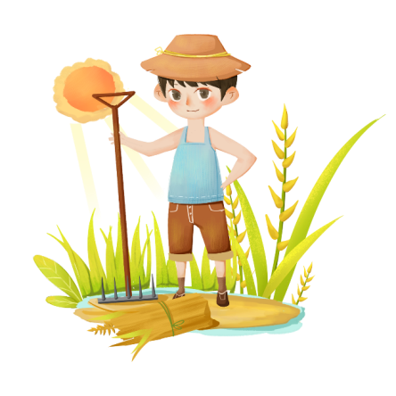
Vocabulary
garden [ˈɡɑːrdn] v. 做园艺工作
【例句】I've been digging the garden.
我一直在花园松土。

Slide 13
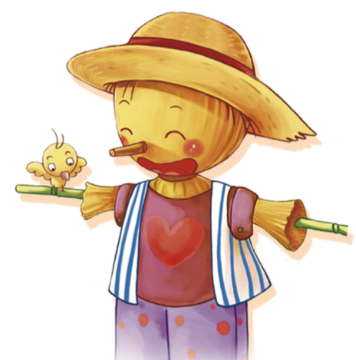
Vocabulary
correspond [ˌkɔːrəˈspɑːnd] vi. 相一致;符合
【例句】Your account of events does not correspond with hers.
你对事情的陈述与她说的不相符。

Slide 14
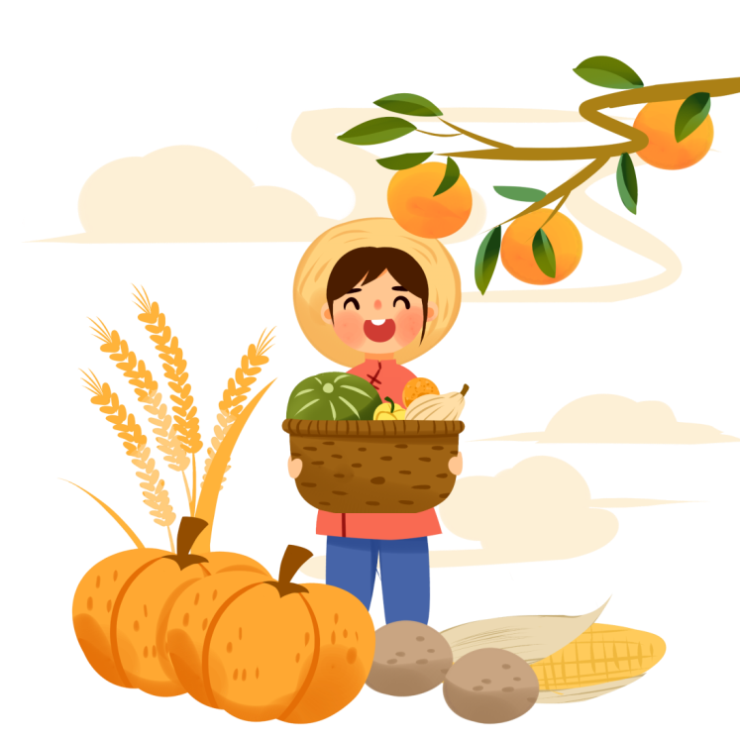
Vocabulary
harvest [ˈhɑːrvɪst] n. 收割;收获
【例句】Farmers are extremely busy during the harvest.
农民在收获季节里十分忙碌。

Slide 15
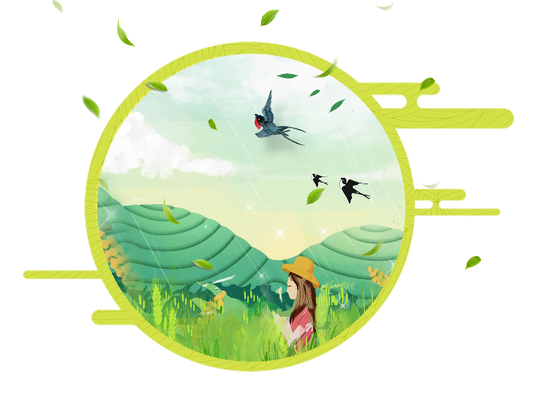
Vocabulary
proverb [ˈprɑːvɜːrb] n. 谚语;格言
【例句】A proverb is a short, well known saying that expresses a common truth or belief.
谚语是一个众所周知的简短说法，表达一个普遍的真理或信仰

Slide 16
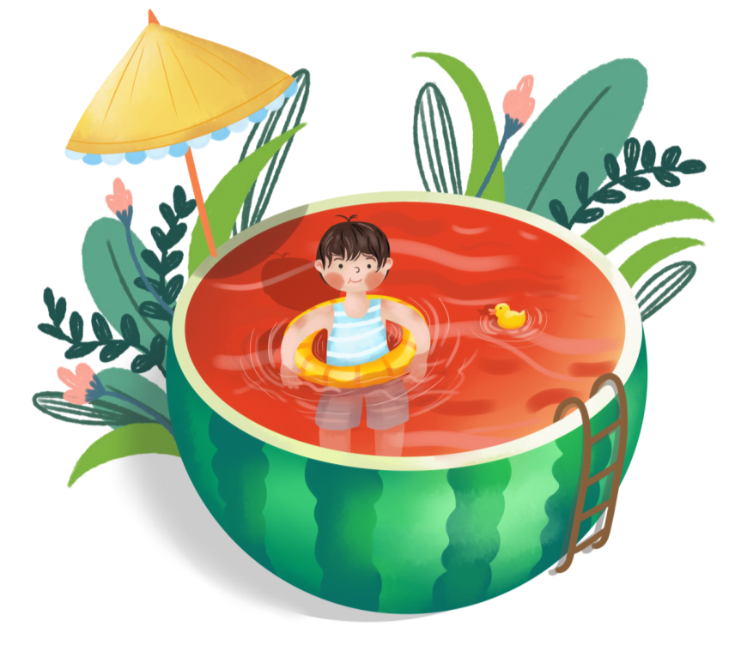
Vocabulary
edible [ˈedəbl] adj. 可食用的;适宜食用的
【例句】You rinse only fruit with edible skin.
你只清洗那些可连皮食用的蔬果。

Slide 17
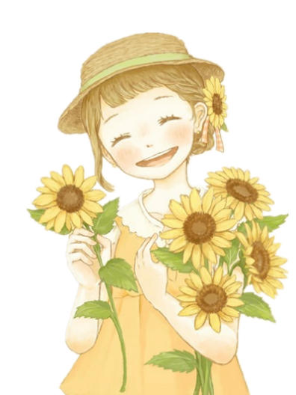
Vocabulary
savory [ˈseɪvəri] adj. 令人愉快的;体面的
【例句】Sun dry and fruit savory, Sun dry I health.
太阳晒晒果儿香，太阳晒晒我健康。

Slide 18
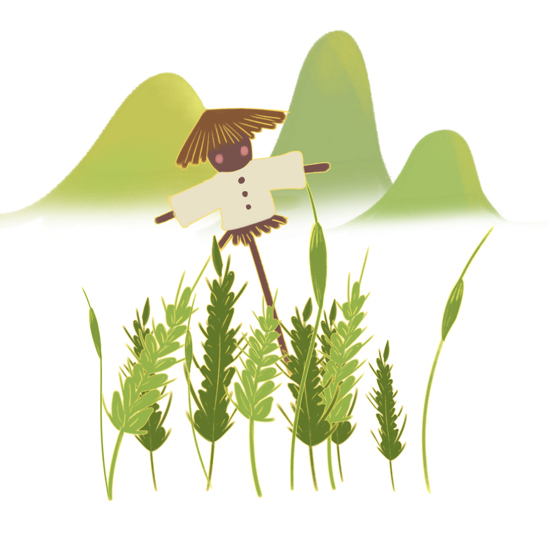
Vocabulary
humidity [hjuːˈmɪdəti] n. (空气中的)湿度;湿热
【例句】The heat and humidity were insufferable.
炎热与潮湿令人难以忍受。

Slide 19
Vocabulary
carry out 进行;实施;执行，实行;贯彻
in order to 为了，以便
squeeze out 挤出来;把…排挤出去

Slide 20
PART 02
The introduction

Slide 21
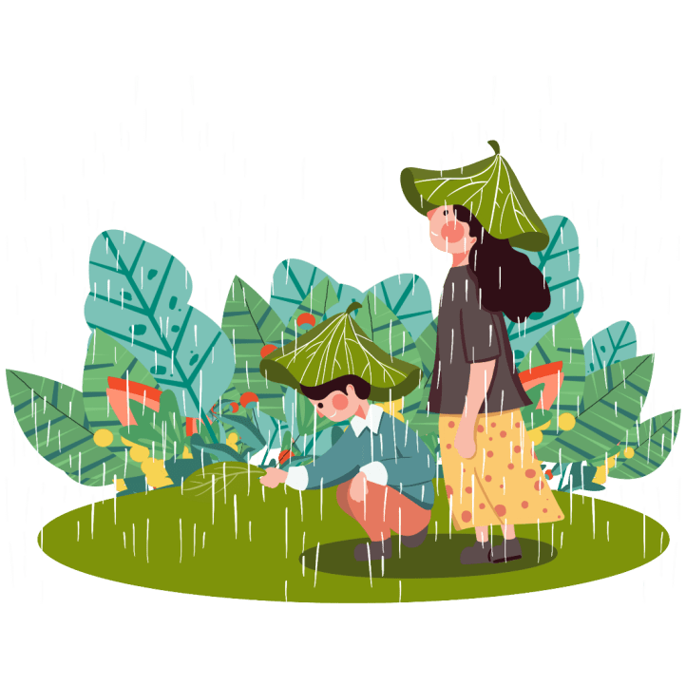
The introduction
The traditional Chinese solar calendar divides the year into 24 solar terms. Grain Buds, (Chinese:小满), the 8th solar term of a year, begins on May 21 this year, and ends on June 5. It means that the seeds from the grain are becoming full but are not ripe.
意味着
种植谷物的种子
饱满
未成熟

Slide 22
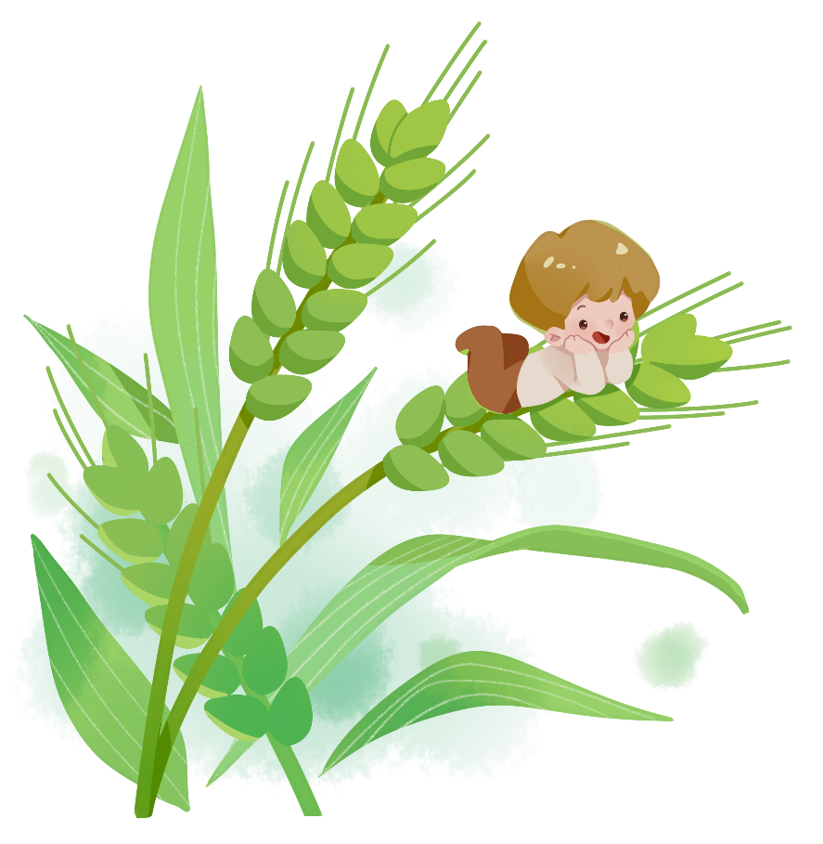
The introduction
In China, the 24 solar terms were created thousands of years ago to guide agricultural production. But the solar term culture is still useful today to guide people's lives through special foods, cultural ceremonies, gardening and even healthy living tips that correspond with each solar term. Let's see what we can do during the "Grain Buds" period.
引导
农业生产
通过
与...相符

Slide 23
PART 03
Text

Slide 24
A good season for eating fish
During the Grain Buds period, summer harvest is about to begin. A saying about rain during this time mentions, "A heavy rainfall makes the river full." Because of the great increase in rainfall, rivers are full of water, which gives rise to great tasting fish and shrimps. This is a good time to enjoy them. It is also harvest season for fishermen.
收割
将要做......
大雨使江河流满
因为
充满
虾
渔民

Slide 25
A good season for eating mulberries
A Chinese farmer proverb says, "Mulberries become black during the Grain Buds period." Thus it is a good season to eat mulberries.
谚语
小满时节桑葚黑

Slide 26
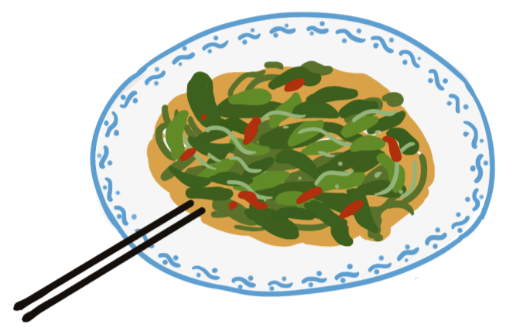
Eating herb of common sow thistle
GrainBudsis a season for eating the herb of the common sow thistle, which is one of the earliest edible potherbs in China.It tastes a little bitter and tart, but also sweet. It has the function of cooling the blood and detoxifying the body. It can be made into different types of dishes. People in Ningxia Hui autonomous region like to eat it blended with salt, vinegar, peppers or garlic. It tastes savory and helps people feel refreshed. Some people boil the herb with water and then squeeze out the juice, which can be used to make soup.
药草
最早的
可食用的 野菜
有点
苦和酸
混合
醋
大蒜
清爽
新鲜
挤出来
被用来

Slide 27
Tips on health
High temperatures and humidity are common during the Grain Buds period. The increase in temperature over this season may also give rise to nettle rash, rheumatism, sweat spots, eczema and other skin diseases.
It is also important to exercise during the hot summer days. Walking, jogging and practicing tai chi are popular.
湿度
荨麻疹、风湿病、汗斑、湿疹和其他皮肤疾病
散步、慢跑和练太极

Slide 28
Key period for flower management
快速生长
This time is a good period of the quick growth of flowers. It is also a season when plant diseases and pests are at an all-time high, which makes caring for your garden even more critical.
到达顶峰
照顾

Slide 29
Tips on health
Flower trimming and clipping is important. And a systematic fertilized water system should be carried out. Flowers need a lot of water and extra care to stay healthy.Weeding should be done as they grow quickly and have to be extirpated in order to keep the soil loose and from competing with the flowers for nutrients.
修剪
施肥
进行
除草
目的是
使土地松软
与......竞争

Slide 30
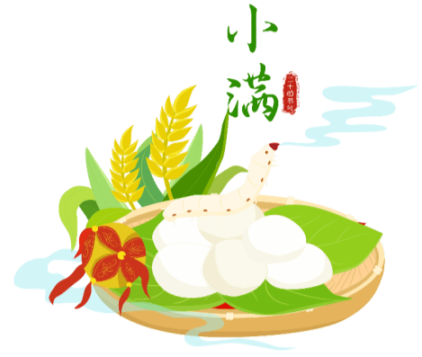
Celebrating silkworm deity birthday
副业
Silkworm rearing is a traditional byproduct for people in regions south of the Yangtze River. During the Grain Buds season, silkworms have cocooned. People begin to cook cocoons and prepare the spinning wheel for reeling silk.
养蚕
长江以南地区
蚕
吐丝
煮蚕茧
纺绸机

Slide 31
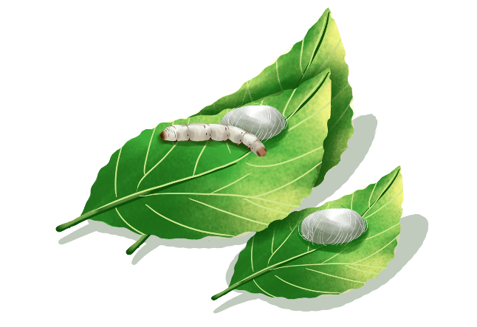
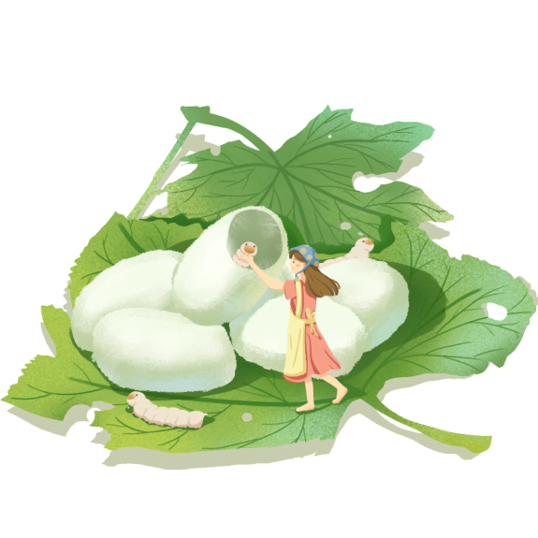
把......当作
People in Jiangsu and Zhejiang provinces regard this season as the birthday of the silkworm deity. Those who engage in the silk industry thank the deity by offering sacrifices and staging performances. They pray to the deity for blessings and a boom season for the silk business.
从事

Slide 32
PART 04
Practice

Slide 33
阅读下面短文,在空白处填入1个适当的单词或括号内单词的正确形式。
The traditional Chinese lunar calendar divides the year into 24 solar terms. Grain Buds (小满), the 8th solar term of a year,it ______(mean) that the seeds from the grain are becoming fullare not ripe.
During the Grain Buds period, the summer harvest is about to begin. A saying about rain during this time mentions, "A heavy rainfall makes the river full." Because of the great increase in rainfall,_3_(river) are full of water, which makes fish and shrimp big and fat. This is a good time_4_(eat) fish and shrimp. It is also harvest season for fishermen.

Slide 34
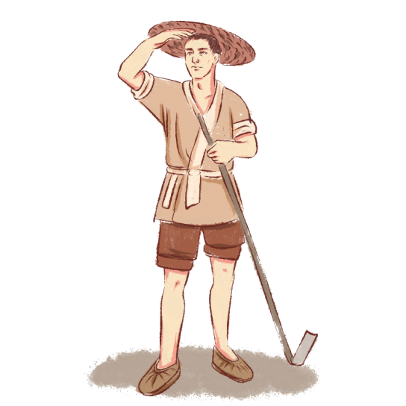
阅读下面短文,在空白处填入1个适当的单词或括号内单词的正确形式。
This time is a good period of the quick_5_(grow) of flowers. It is also a season_6_plant diseases and pests are at an alltime high, which makes growing flowers even_7_(critical).
Flower trimming and clipping(修剪) is important. And a systematic fertilized water system should be carried out.l Flowers need a lot of water and extra care to ensure the plants remain _8_(health). Weeding should ____9__ (do) as they grow quickly and have to be removed in order to keep the soil loose and 10competing with the flowers for nutrients.

Slide 35
Summer
Start of Summer | May 6 | The summer season begins.
Grain Buds | May 21 | Grains are getting plump but not ripe yet.
Grain in Ear | Jun. 6 | Wheat grows ripe marking the beginning of a busy farming season.
Summer Solstice | Jun. 22 | The sun altitude arrive the highest in north; It has the longest daytime of the year.
Slight Heat | Jul. 7 | The hottest days are yet to come.
Great heat | Jul. 23 | The hottest time of a year.

Slide 36
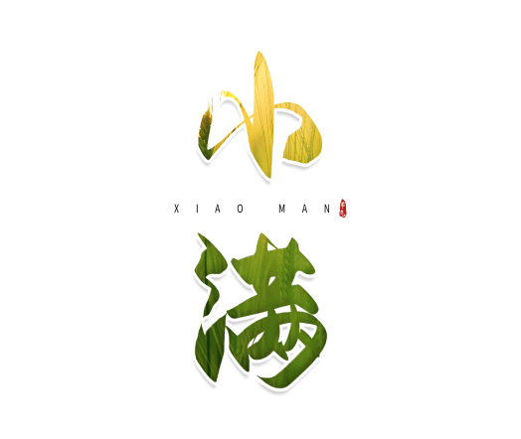
24 Solar Terms
- Grain Buds
（小满）

