Slide 1
24 Solar Terms
- Frost Descent
（霜降）

Slide 2
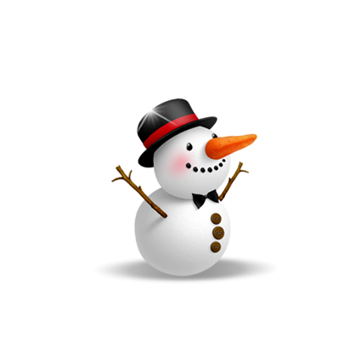
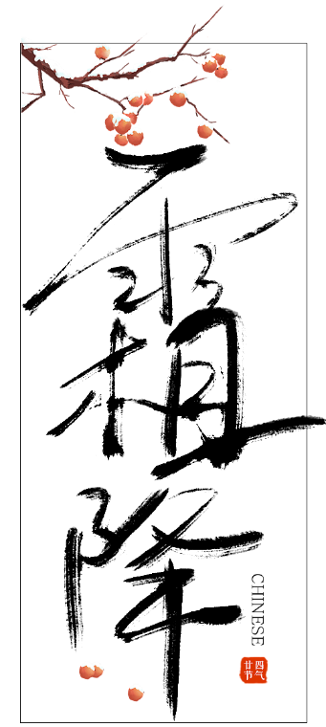
学习目标
认识霜降；
认识霜降的相关内容；
学会表达。

Slide 3
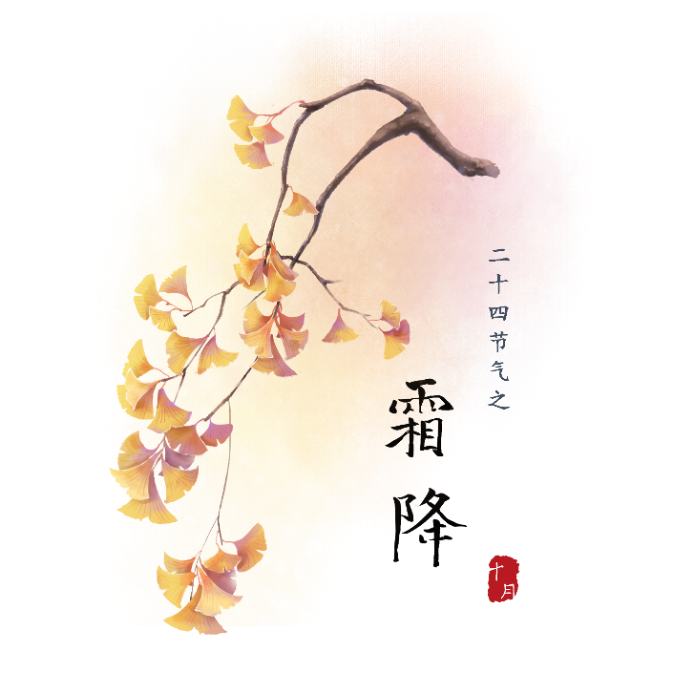
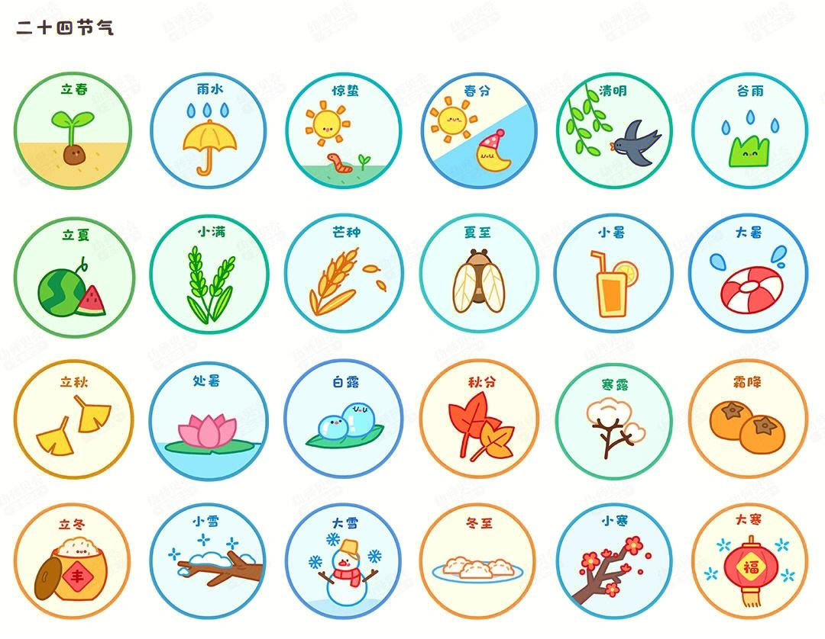

Slide 4
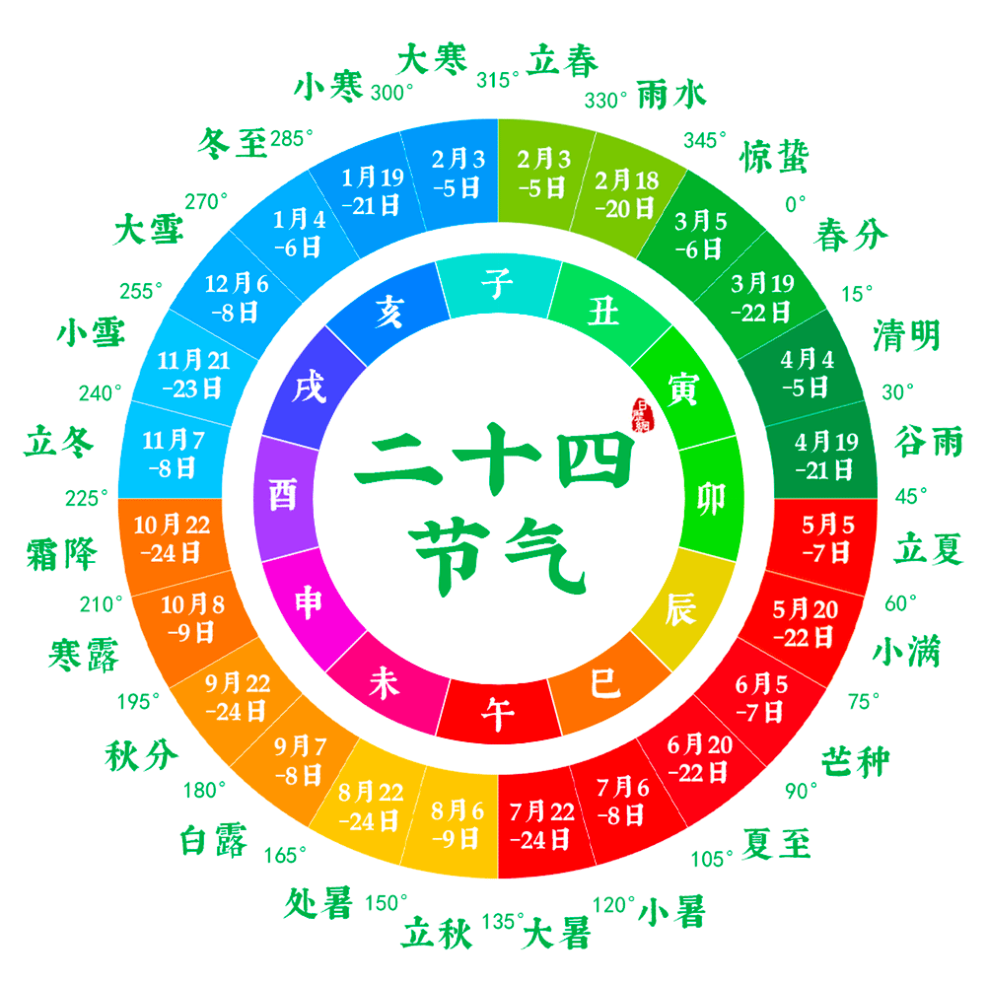

Slide 5
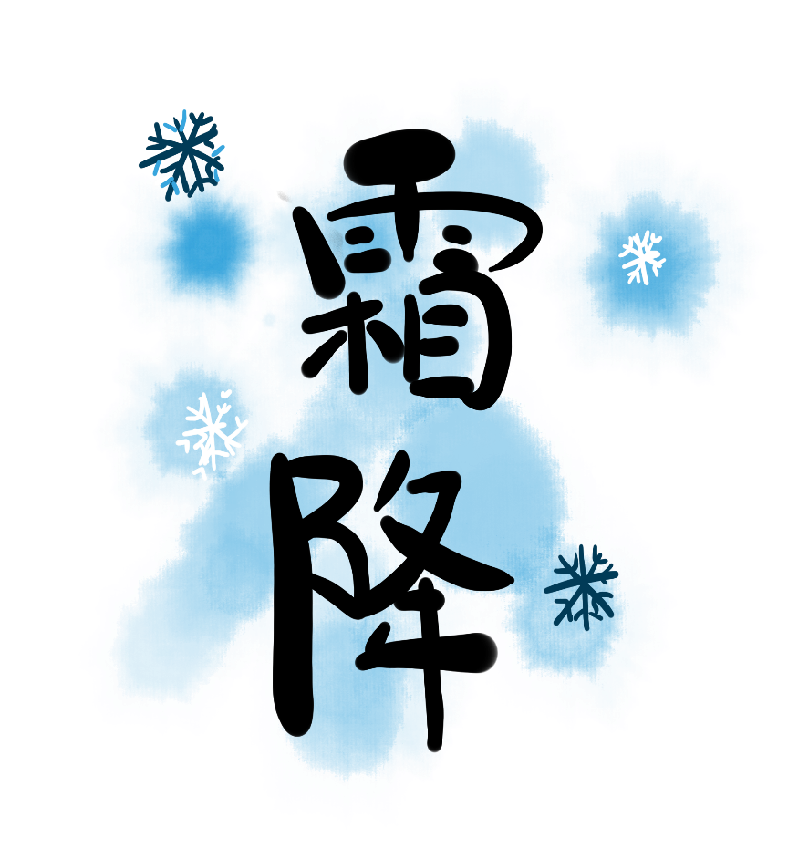

Slide 6
CONTENTS 目录
Vocabulary
The introduction
Things about Frost Descent
Practice

Slide 7
Part One
Vocabulary

Slide 8
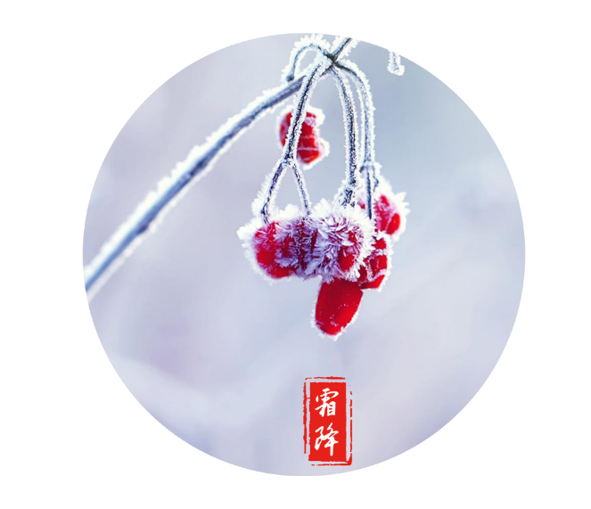
Vocabulary
descent /dɪˈsent/ n.下降,下倾
【例句】There is a gradual descent to the sea.
有一片斜坡缓缓伸延到海边。

Slide 9
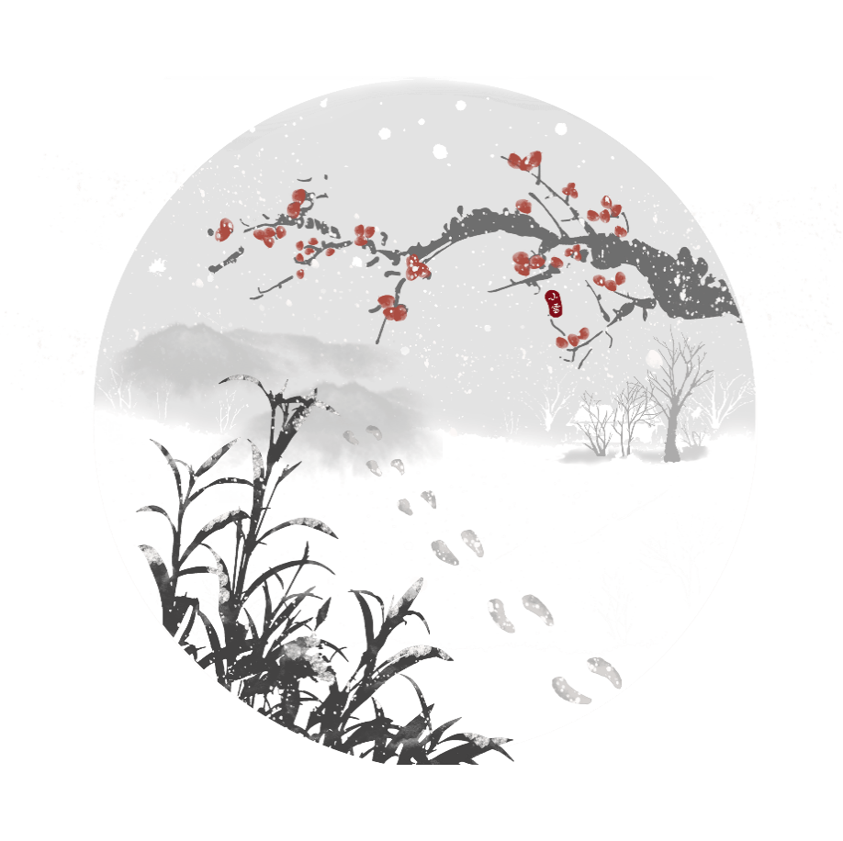
Vocabulary
crystal/ˈkrɪst(ə)l/
adj. 晶莹的清澈透明的 n. 结晶，晶体；水晶
【例句】I carefully opened the package and found a crystal bell inside.
我小心地打开包裹，发现里面有一个水晶钟。

Slide 10
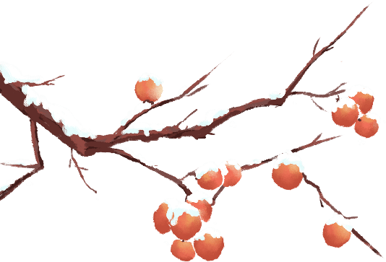
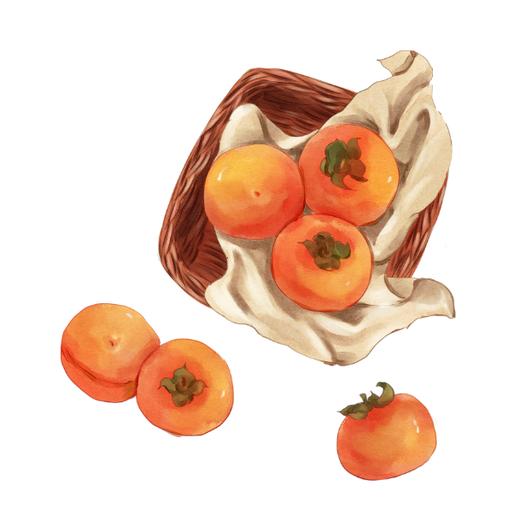
Vocabulary
persimmon /pəˈsɪmən/ n.柿子
【例句】The persimmon tastes puckery.
这柿子尝起来涩。

Slide 11
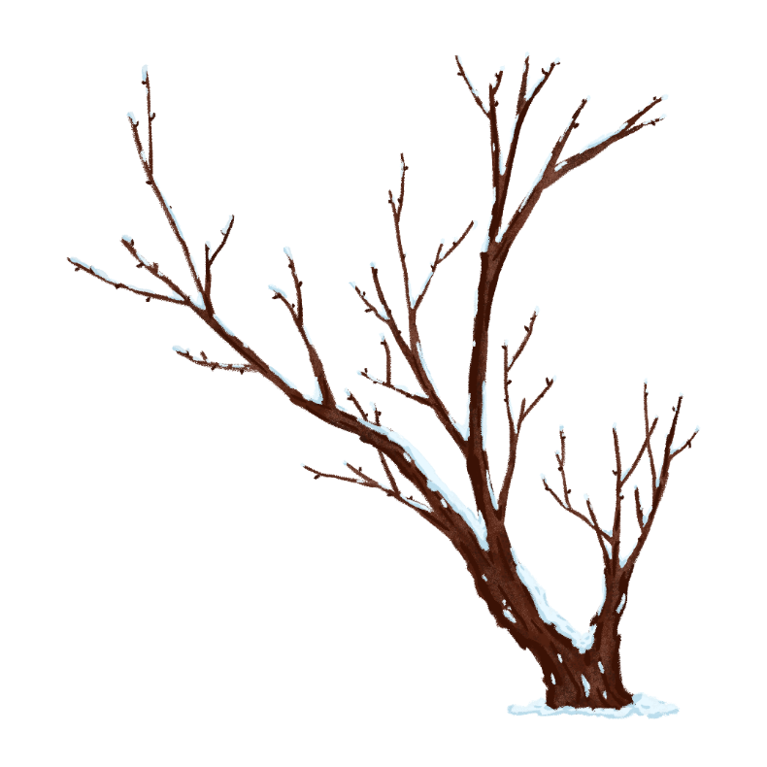
Vocabulary
crack/kræk/
v. 破裂，裂开；崩溃
n. 裂缝，裂纹；缝隙，窄缝；瑕疵
【例句】The ice cracked as I stepped onto it.
我一踩冰就裂了。

Slide 12
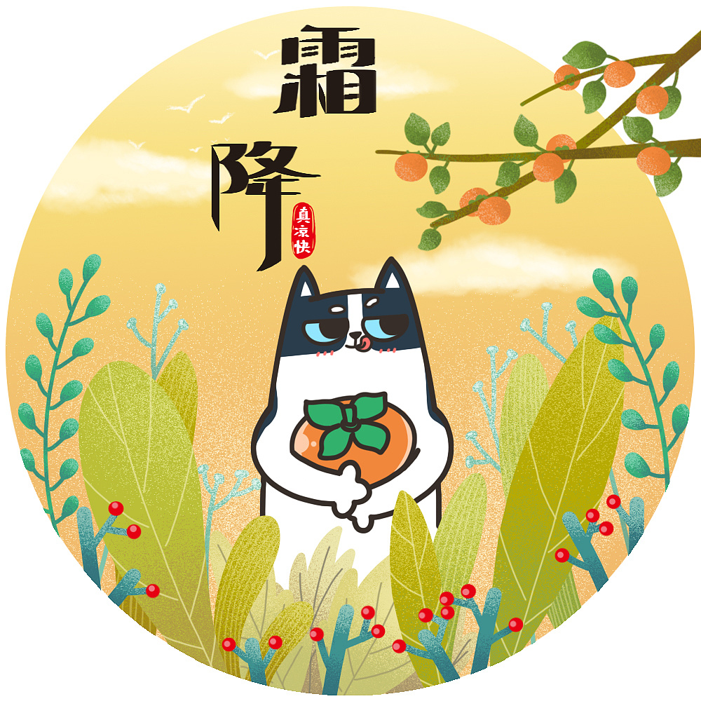
Vocabulary
moisten /ˈmɔɪsn/ vt. 弄湿；使……湿润
【例句】She took a sip of water to moisten her dry throat.
她抿了一小口水，润一润自己干燥的喉咙。

Slide 13
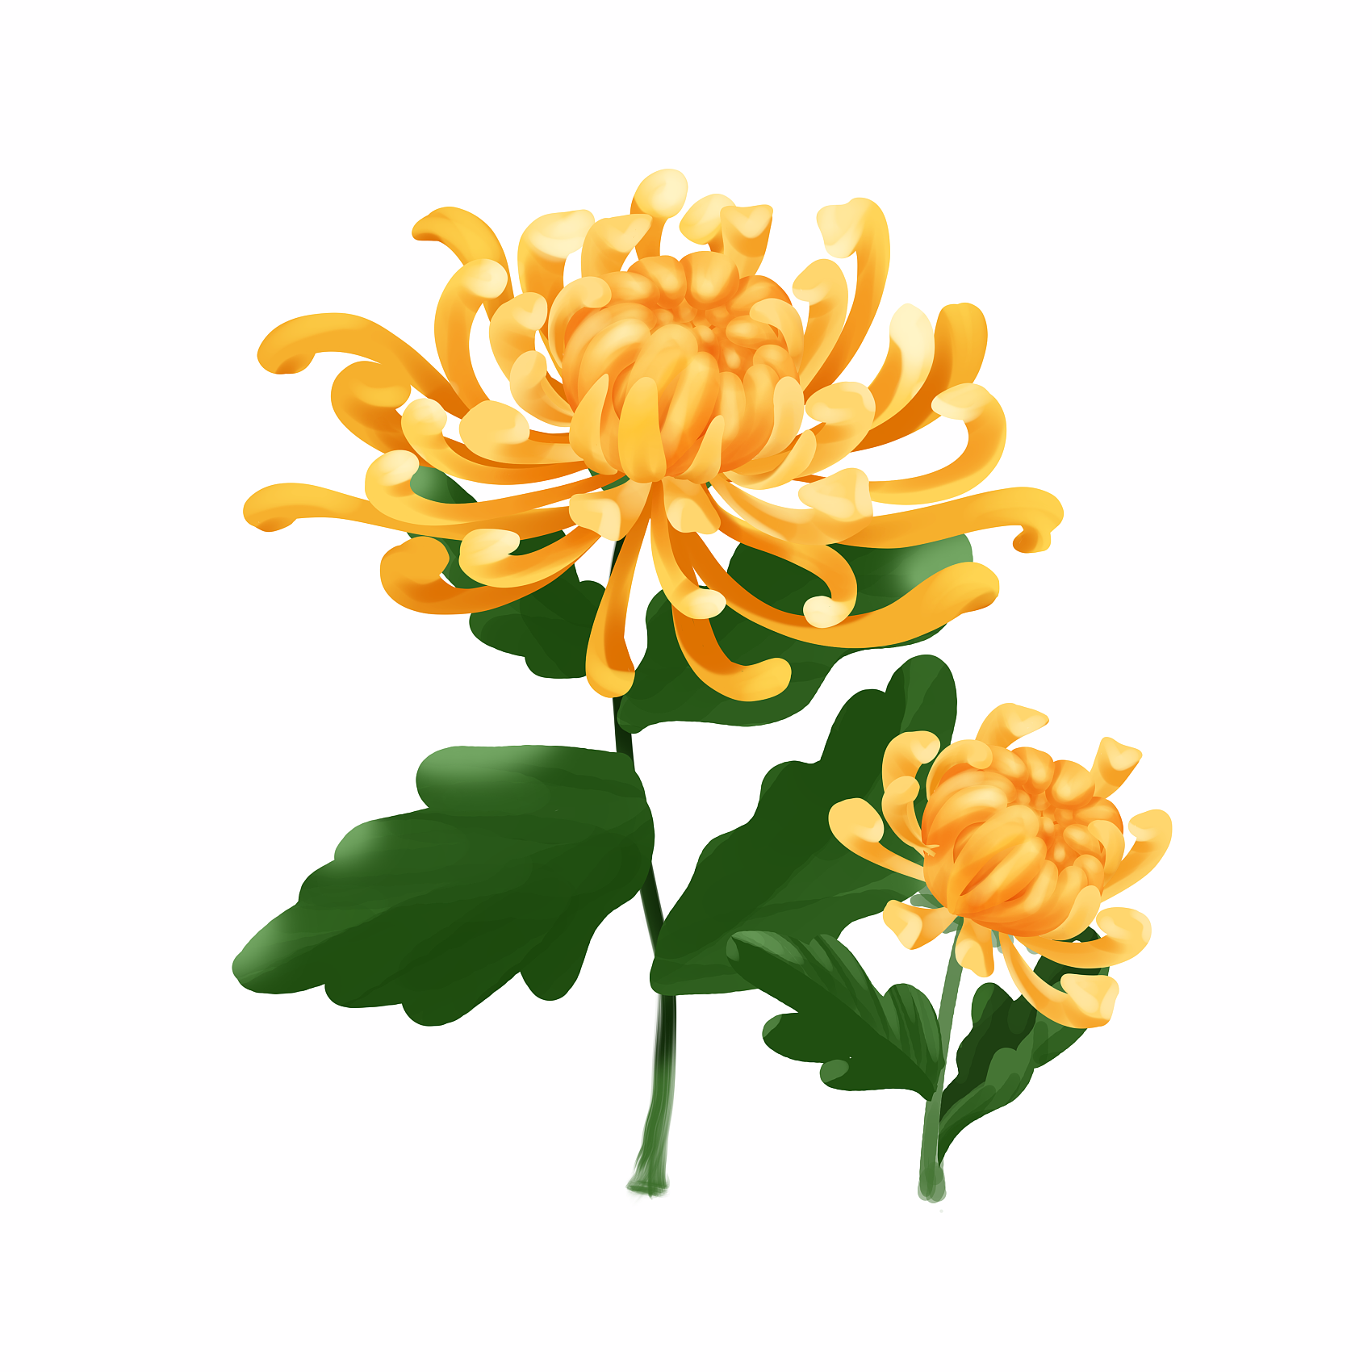
Vocabulary
quench /kwentʃ/
v. （喝水）止（渴）；满足（欲望）；扑灭，熄灭（火）
【例句】It can quench one's thirst and make people keep fit.
它既可以解渴又可以使人们保持健康。

Slide 14
Vocabulary
thirst /θɜːst/
n. 渴，口渴；干渴，缺水；渴望，渴求
v. <文>渴望，渴求；<旧>渴，口渴
【例句】Fame is a great thirst of the young.
年轻人渴望名声。

Slide 15
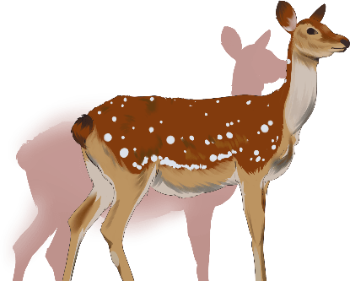
Vocabulary
secretion /sɪˈkriːʃn/ n. 分泌；分泌物；藏匿；隐藏
【例句】The sweet secretion is known as honeydew .
甜甜的分泌物就是我们所说的“蜜汁”。

Slide 16
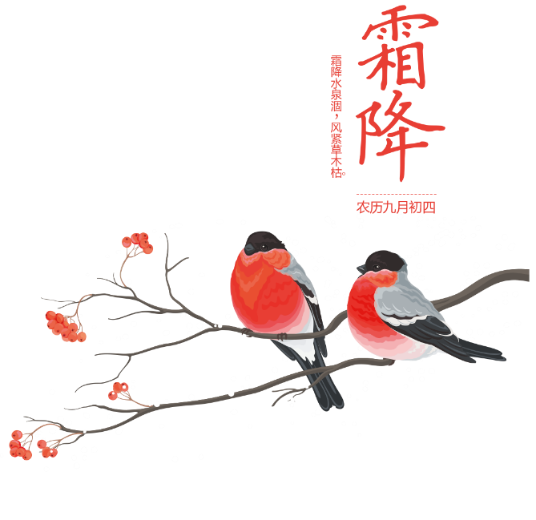
Vocabulary
sputum /ˈspjuːtəm/ n. 痰；唾液
【拓展】I coughed with sputum and feeling of malaise.
我咳嗽有浓痰，而且觉得很虚弱。

Slide 17
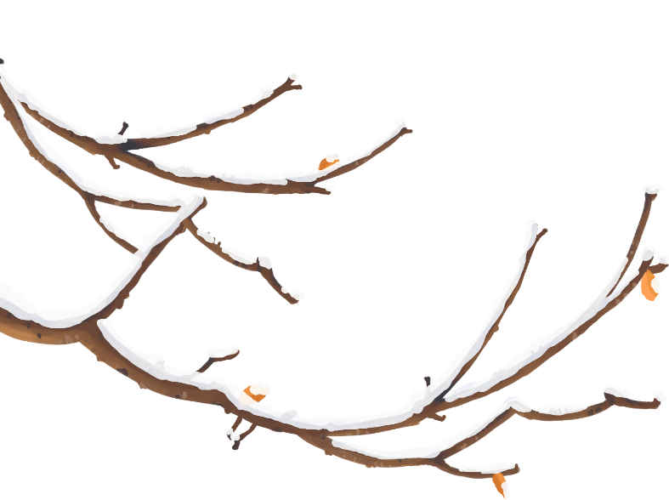
Vocabulary
chestnut /ˈtʃesnʌt/n. 栗子；栗色；adj. 栗色的
【例句】In the garden, the leaves of the horse chestnut had already fallen.
园子里的七叶树已经落叶了。

Slide 18
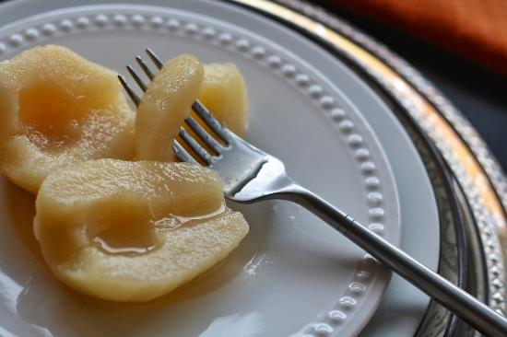
Vocabulary
spleen /spliːn/ n. 脾脏；坏脾气；怒气
【拓展】They were in my spleen.
它们插在我的脾脏上。

Slide 19
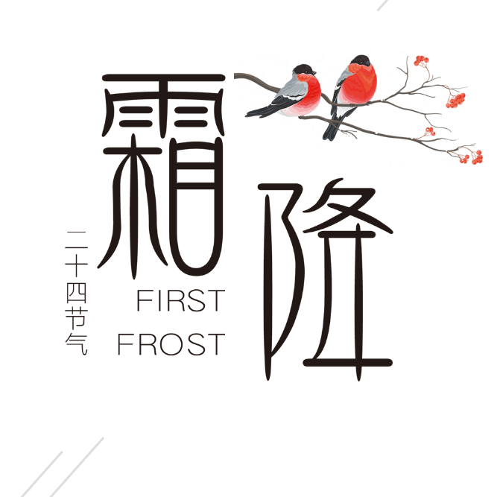
Vocabulary
dizziness /ˈdɪzinəs/ n. 头晕；头昏眼花
【拓展】A sudden dizziness overpowered him.
一阵突然的晕眩令他难以忍受。

Slide 20
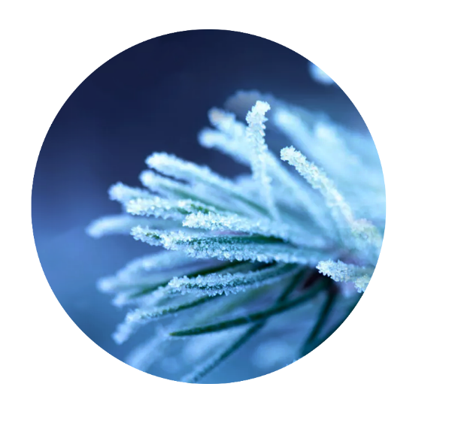
Vocabulary
date /deɪt/
n. 椰枣，海枣 n.日期，日子
v.注明日期；<美>谈恋爱，约会；过时
【拓展】These figures are very out of date.
这些数字早已过时。

Slide 21
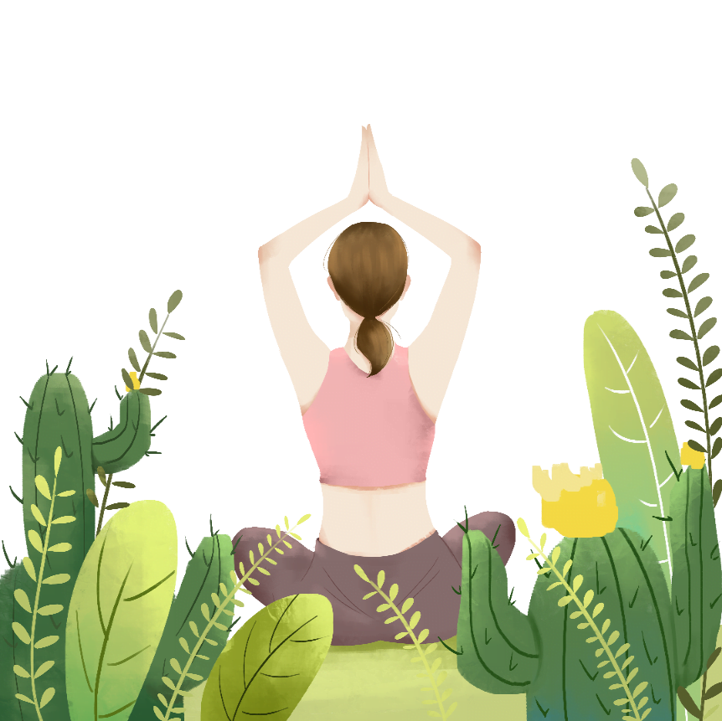
Vocabulary
immunity /ɪˈmjuːnəti/ n. 免疫力；免除，豁免
【拓展】improve one'simmunity：提高免疫力
【例句】They acquire an immunity to culture shock.
他们对文化冲击免疫了。

Slide 22
Vocabulary
autonomous /ɔːˈtɒnəməs/adj.
自治的，有自治权的；自主的，有自主权的；自动的
【拓展】I come from Guangxi Zhuang Autonomous Region.
我来自广西壮族自治区。

Slide 23
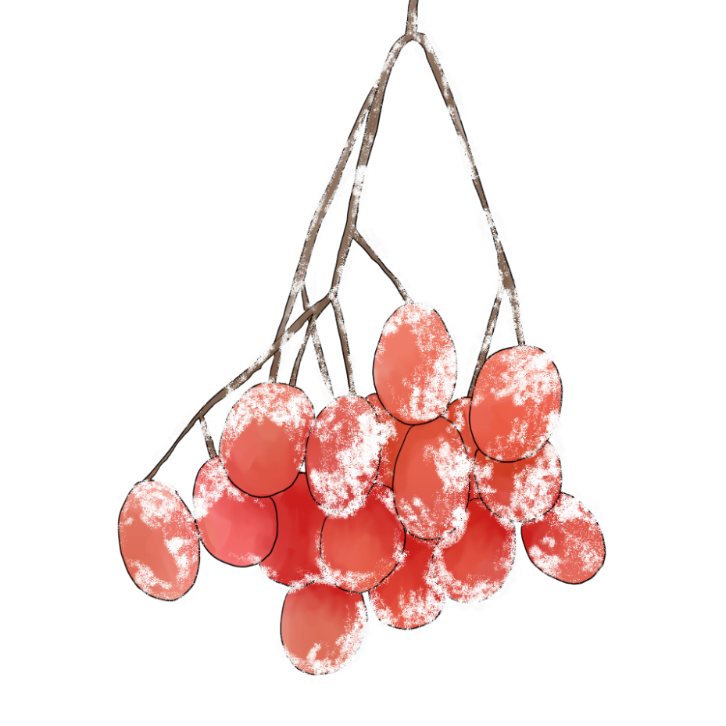
Vocabulary
rotten /ˈrɒtn/adj. 腐烂的，发臭的
【拓展】Scoop out the rotten part of the pear.
把梨烂的地方挖掉。

Slide 24
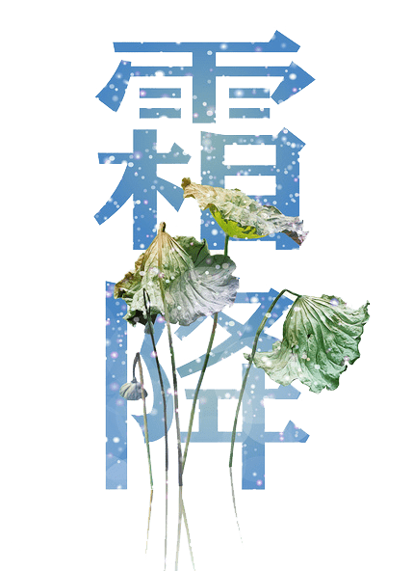
Vocabulary
aggression /əˈɡreʃ(ə)n/
n. 好斗性，攻击性；侵略，侵犯，挑衅
【拓展】Aggression is by no means a male-only trait.
攻击性决不是男性独有的特征。

Slide 25
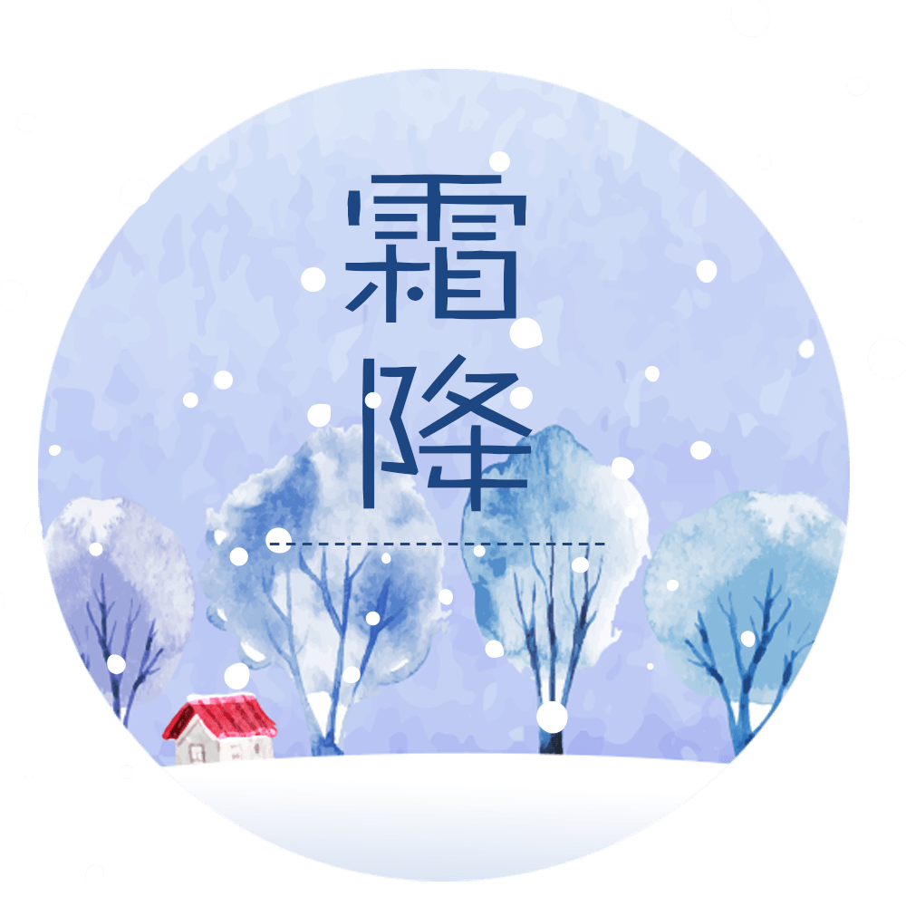
Vocabulary
commemorate /kəˈmeməreɪt/ v. 纪念，用以纪念
【拓展】The purpose is to commemorate Qu Yuan's death.
目的是为了纪念屈原的逝世。

Slide 26
Part Two
The introduction

Slide 27
The introduction
分成
The traditional Chinese lunar calendar divides the year into 24 solar terms. Frost's Descent, (Chinese: 霜降), the 18th solar term of the year, begins this year on Oct 23 and ends on Nov 6.
Frost's Descent is the last solar term of autumn, during which time the weather becomes much colder than before and frost begins to appear.
最后一个节气
比较级
霜

Slide 28
Part Three
Things about Frost Descent

Slide 29
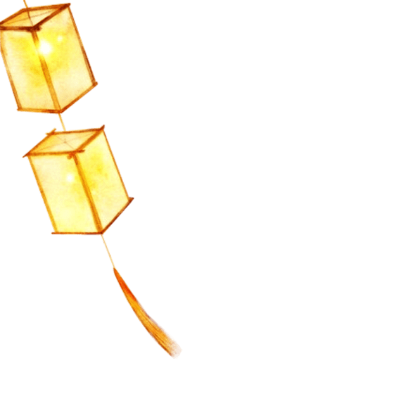
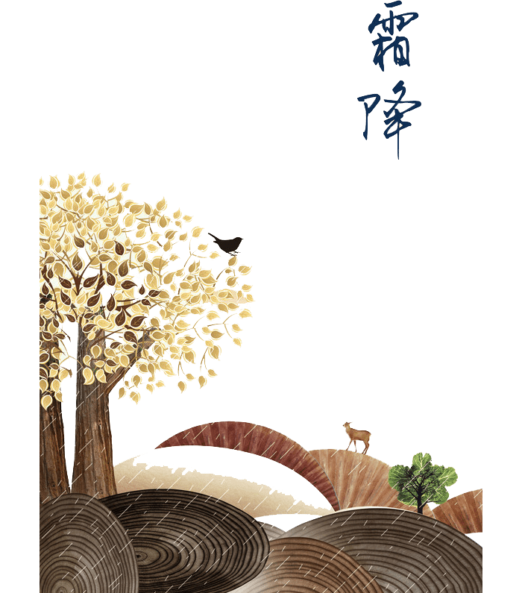
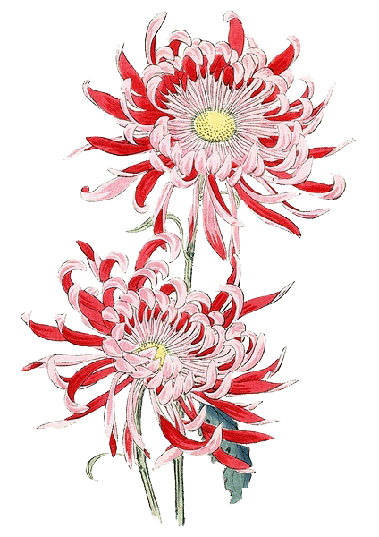
Frosty autumn结霜的秋天
Frost consists of white ice crystals of frozen water vapor near the ground. During Frost's Descent, frost begins to appear. But in the lower reaches of the Yellow River region, frost first appears in late October or early November. As Frost's Descent comes, the world is filled with the atmosphere of late autumn.
填满
...的氛围

Slide 30
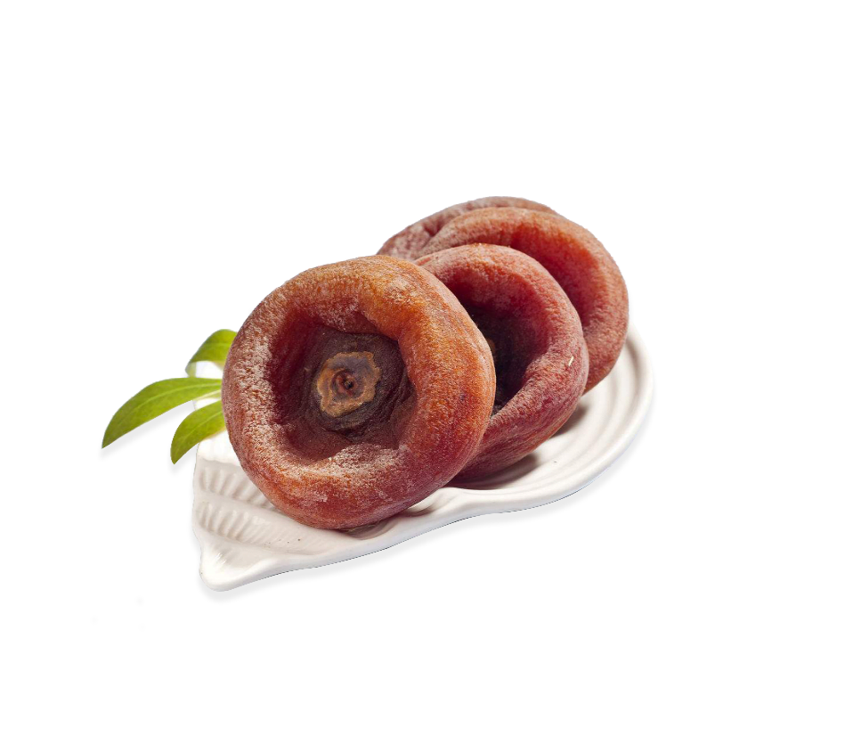
Eatingpersimmons 吃柿子
Eating persimmons during Frost's Descent can help people resist the cold and protect their bones. In the countryside, people believe that their lips will crack if they don't eat persimmons during this period.
抵御寒冷
保护骨骼
破裂

Slide 31
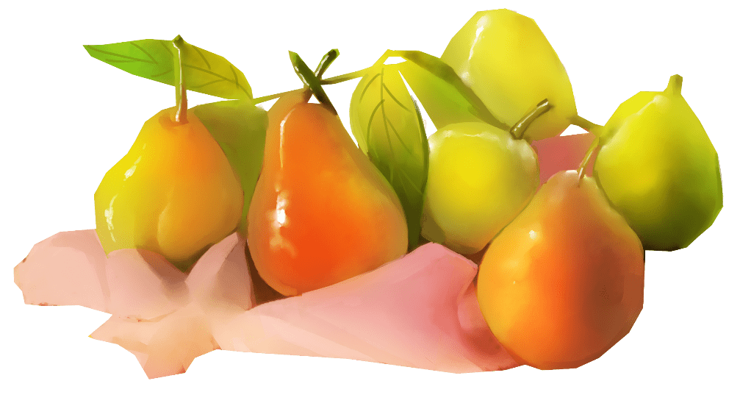
Eating apples 吃苹果
The apple is one kind of recommended fruit during Frost's Descent. There are many sayings about apples' benefits in China, such as "Eat an apple after meals, even old men can be as strong as young men," just as the Western proverb goes, "An apple a day keeps the doctor away." Apples can moisten the lungs,quench one's thirst and help one's digestion.
被推荐的水果
利益
饭后吃一个苹果，即使老人也能像年轻人一样强壮”
一天一个苹果，医生远离我。
清肺
解渴
助消化

Slide 32
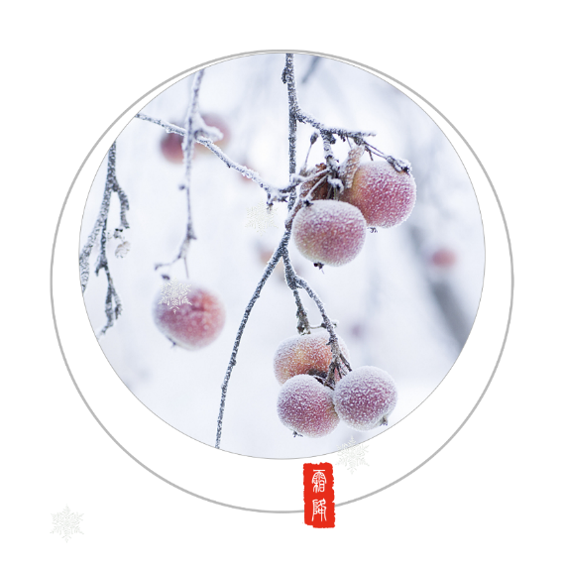
Eating duck 吃鸭子
It's a custom to eat duck on the first day of Frost's Descent in south Fujian province and Taiwan. There is a saying in Fujian which goes, "Even nourishing all year is not as good as nourishing the human body on the first day of Frost's Descent." Eating duck is a way for people there to gain weight.
即使全年滋补，也不如霜降第一天滋补人体。
增加体重

Slide 33
Eating chestnuts 吃栗子
Eating chestnuts during Frost's Descent is beneficial for one's health. Chestnuts have a warm nature and sweet flavor, and are good for nourishing the spleen and stomach, invigorating the circulation of blood, relieving coughs and reducing sputum.
性温，味甘，滋养脾胃、活血、止咳化痰

Slide 34
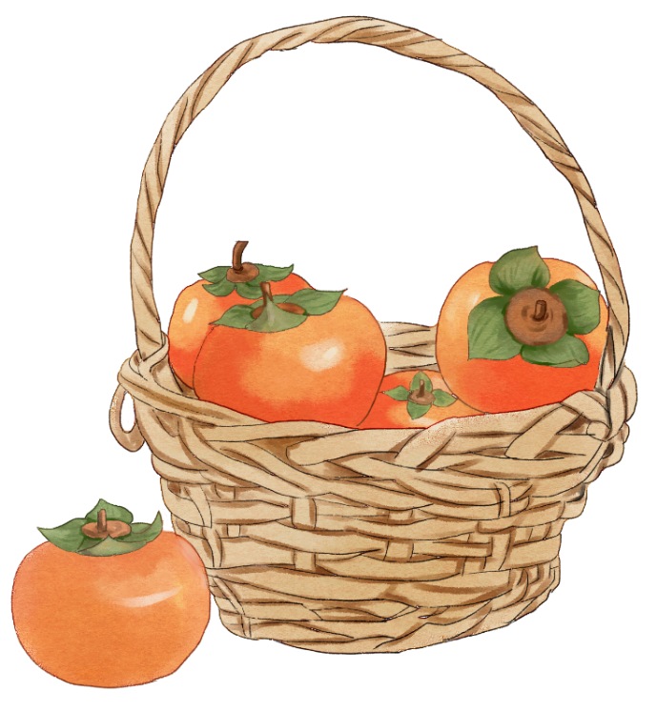
Eating dates 吃枣
The date is one of the fruits on the market during Frost's Descent. Nutritious with a great number of vitamins, dates can nourish the blood, decrease blood pressure, and improve one's immunity. But eating too many could be harmful. Rotten dates can cause headaches and dizzinessor even put people's lives in danger.
滋养血液，降低血压，提高免疫力
处于危险之中

Slide 35
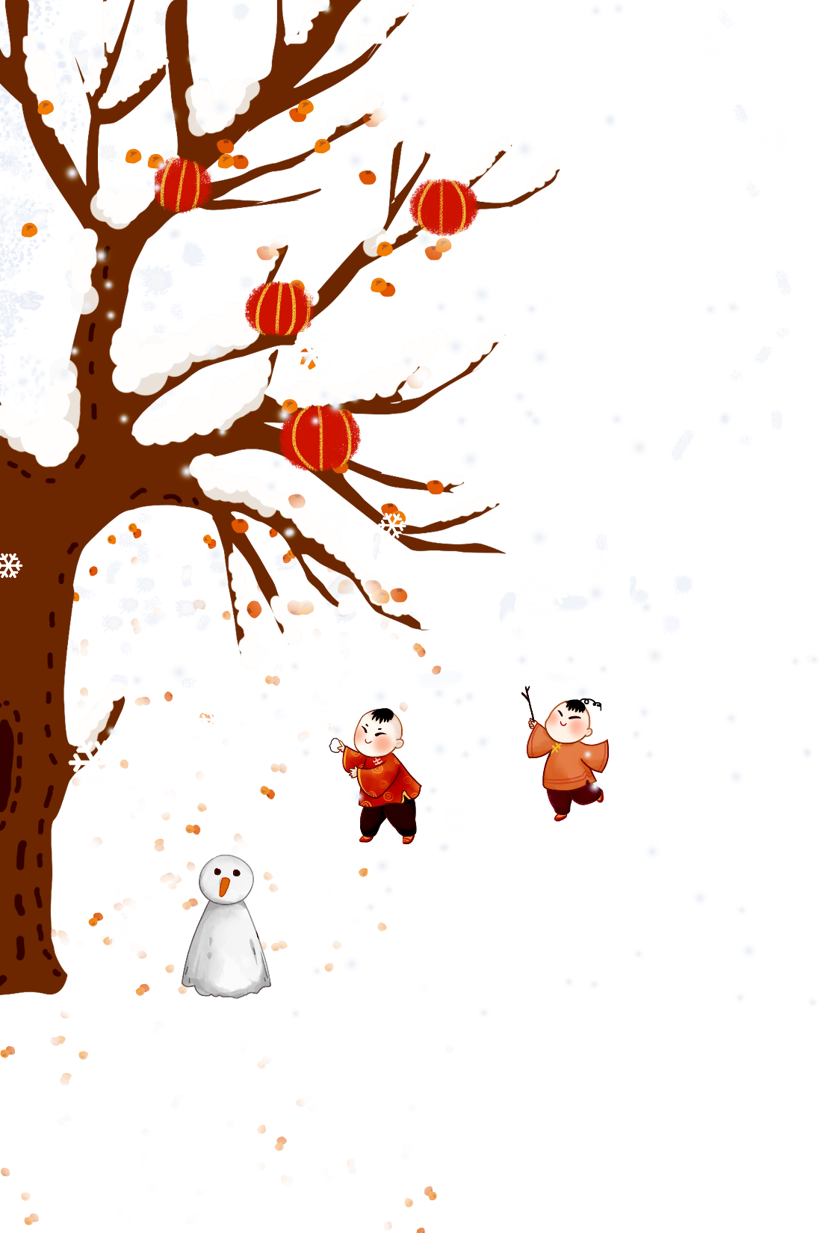
Frost's Descent Festival 霜降节
People in areas such as Daxin county in Guangxi Zhuang autonomous region celebrate the first day of Frost's Descent. In the Frost's Descent Festival, the Zhuang people offer sacrifices, dance and sing folk songs. With a history of more than 360 years, the festival is to commemorate Cen Yuyin, a heroine in battles against foreign aggression.
纪念
对抗

Slide 36
Part Four
Practice

Slide 37
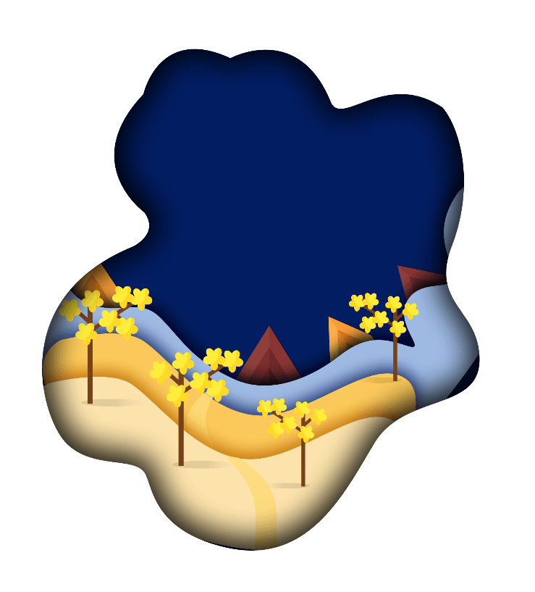
Practice
阅读理解。1. Which of the following is not true about Frost’s Descent?A. The frost begins to appear.B.It is the last solar term of autumn.C.It usually encounters late autumn.D. Water vapor turns into frozen ice.2. We can infer from the passage that frost is .A. frozen water B. white ice crystal C. frozen ice D. frozen vapor
D
B

Slide 38
Practice
阅读理解。3. What’s the meaning of the underlined word “invigorating”?A.stimulating B. improving C.promoting D.relieving4. These are the benefits of the fruit except that .A.eating persimmons can resist the cold.B.eating apples can help one’s digestion.C.eating pears can reduce sputum.D.eating rotten dates can cause dizziness.
A
D

Slide 39
选词填空。（用单词的适当形式填空）
descent quench invigorate immunity commemorate
aggression rot dizzy thirst moisten
1.She took a sip of water her dry throat.
2.A series of movies will be shown the 30th anniversary of his death.
3.They were all so I gave them a drink.
4.They acquire an to culture shock.
5.All the contributors were of African .
6.Scoop out the part of the pear.
7.A sudden overpowered him.
8.Take a deep breath in to you.
9.We must demonstrate that will not pay.
10. He stopped to quench his at a stream.

Slide 40
Autumn
Start of Autumn | Aug. 7 | The autumn season begins.
The End of Heat | Aug. 23 | The hot summer is coming to an end and heat stops.
White Dew | Sep. 8 | It is getting cooler and dewdrops appear on grass and trees in the morning.
Autumn Equinox | Sep. 23 | The mid-point for the autumn season; The temperature begins to decrease; Day and night are equally long on the day.
Cold Dew | Oct. 8 | The dews are becoming frost.
Frost Descent | Oct. 24 | Frost appears and the temperature begins to descent.

Slide 41
24 Solar Terms
- Frost Descent
（霜降）

