Slide 1
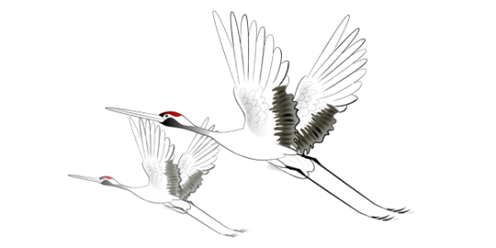
二
十
四
节
气
24 Solar Terms
- Cold Dew
（寒露）

Slide 2
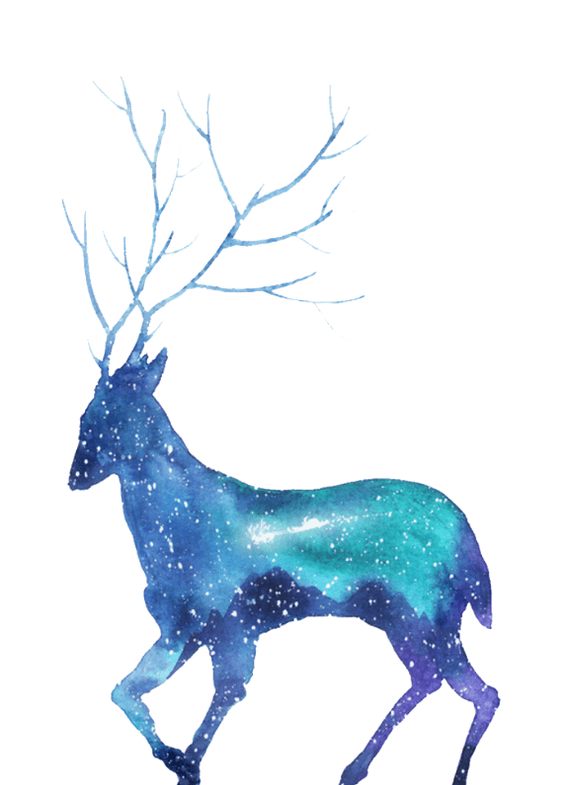
学习目标
认识寒露；
认识寒露的相关内容；
学会表达。

Slide 3
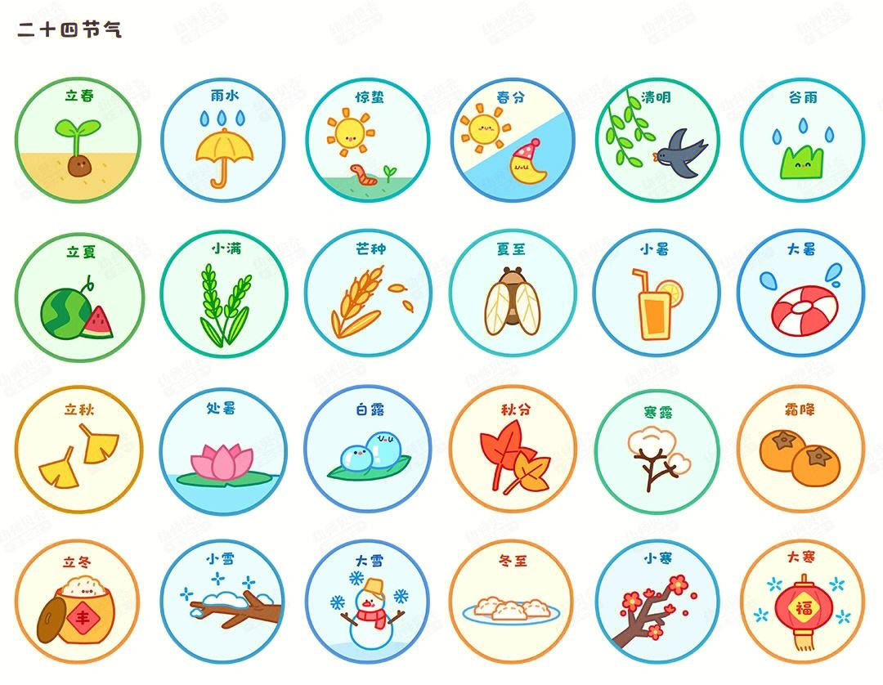

Slide 4
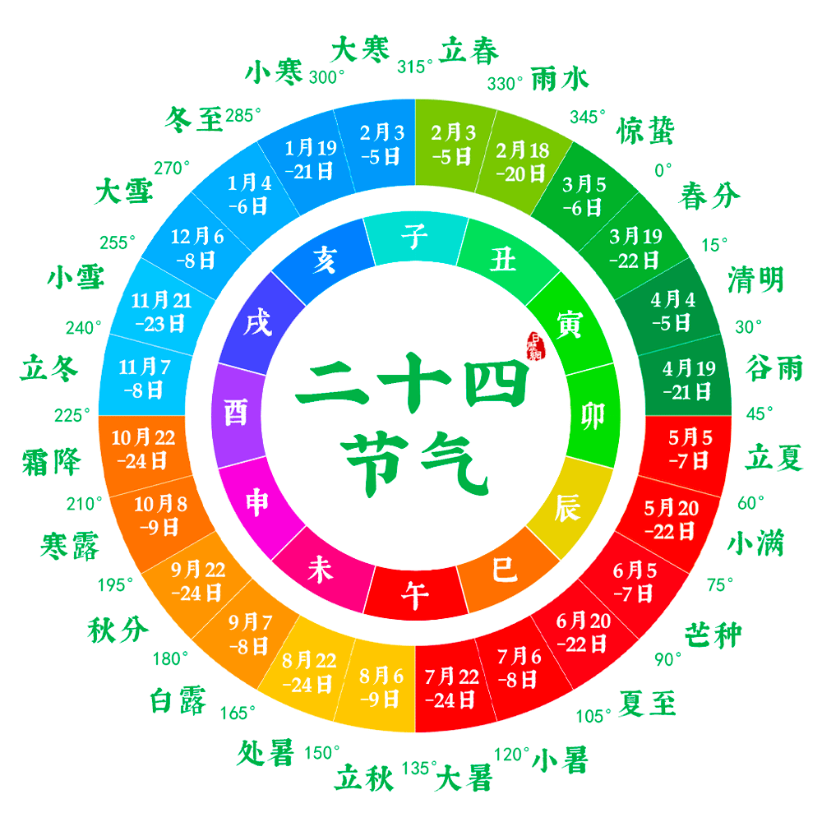

Slide 6
CONTENTS 目录
Vocabulary
The introduction
寒露
Things about Cold Dew
Practice

Slide 7
Part 1
Vocabulary

Slide 8
Vocabulary
Cold Dew /djuː/ 寒露

Slide 9
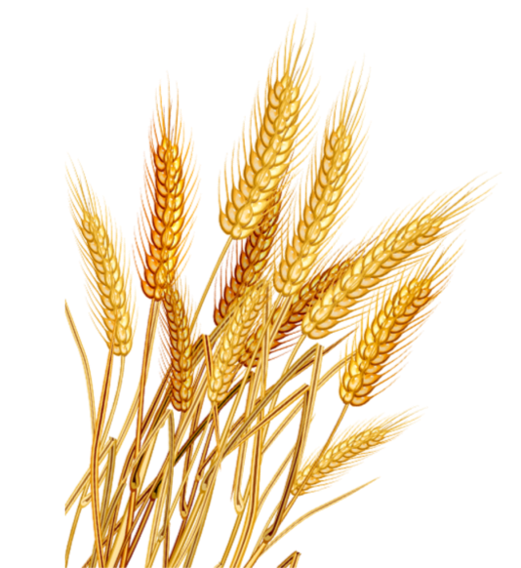
Vocabulary
crop /krɒp/ 农作物
【例句】When my crop bore its fruit, the birds discovered it.
当我的庄稼结出果实时，鸟儿们发现了它。

Slide 10
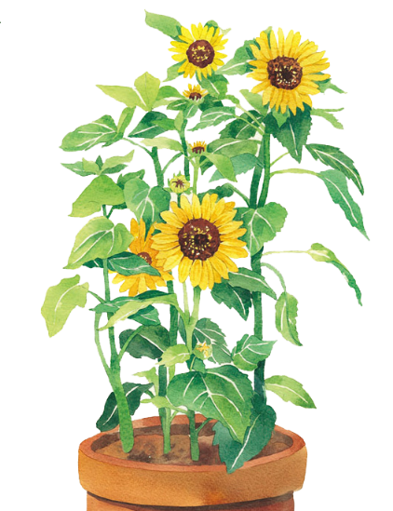
Vocabulary
ripe /raɪp/ adj.熟的，成熟的
【例句】When crops ripe in autumn, fields turn entirely golden.
秋天庄稼成熟时，田野变得一片金黄。

Slide 11
Vocabulary
significantly /sɪɡˈnɪfɪkəntli/ adv.显著地
【例句】She paused significantly before she answered.
她在回答之前意味深长地停顿了一下。

Slide 12
Vocabulary
encounter /ɪnˈkaʊntə(r)/ v. 相遇，邂逅
【例句】You should be chatting with the strangers you encounter.
你应该和你遇到的陌生人聊天。

Slide 13
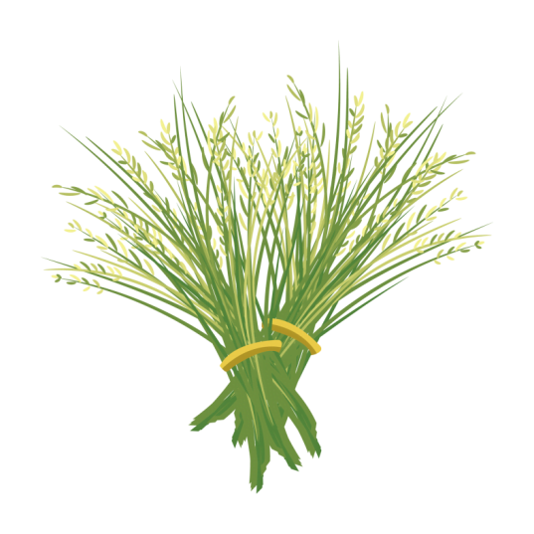
Vocabulary
abundant /əˈbʌndənt/ adj. 大量的，丰富的，充足的
【例句】Our country has a vast territory and abundant resources.
我国土地辽阔， 资源丰富。

Slide 14
Vocabulary
saturation /ˌsætʃəˈreɪʃn/ n.饱和状态；饱和度
【例句】Drop the saturation to about -77.
降低饱和度到大概- 77。

Slide 15
Vocabulary
misty /ˈmɪsti/ adj.多雾的，薄雾笼罩的
【例句】It's a little misty this morning.
今天早晨有薄雾。

Slide 16
Vocabulary
fog /fɒɡ/ n. 雾
【例句】The fog began to disperse.
雾开始散了。

Slide 17
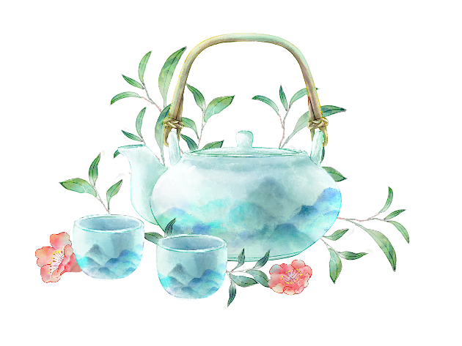
Vocabulary
humidity /hjuːˈmɪdəti/ n.湿度
【例句】The humidity was becoming unbearable.
这种潮湿使人越来越难以忍受了。

Slide 18
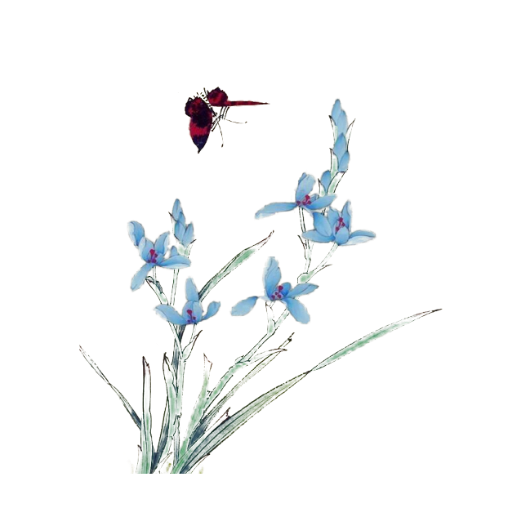
Vocabulary
region /ˈriːdʒən/ 区域
【例句】This region is steeped in tradition.
这个地区有着深厚的传统。

Slide 19
Vocabulary
shallow /ˈʃæləʊ/ adj. 浅的，肤浅的
【例句】They waded the river at a shallow point.
他们在水浅处蹚过河。

Slide 20
Vocabulary
makes sense 有意义，讲得通
【例句】 It makes no sense. 这毫无意义/讲不通

Slide 21
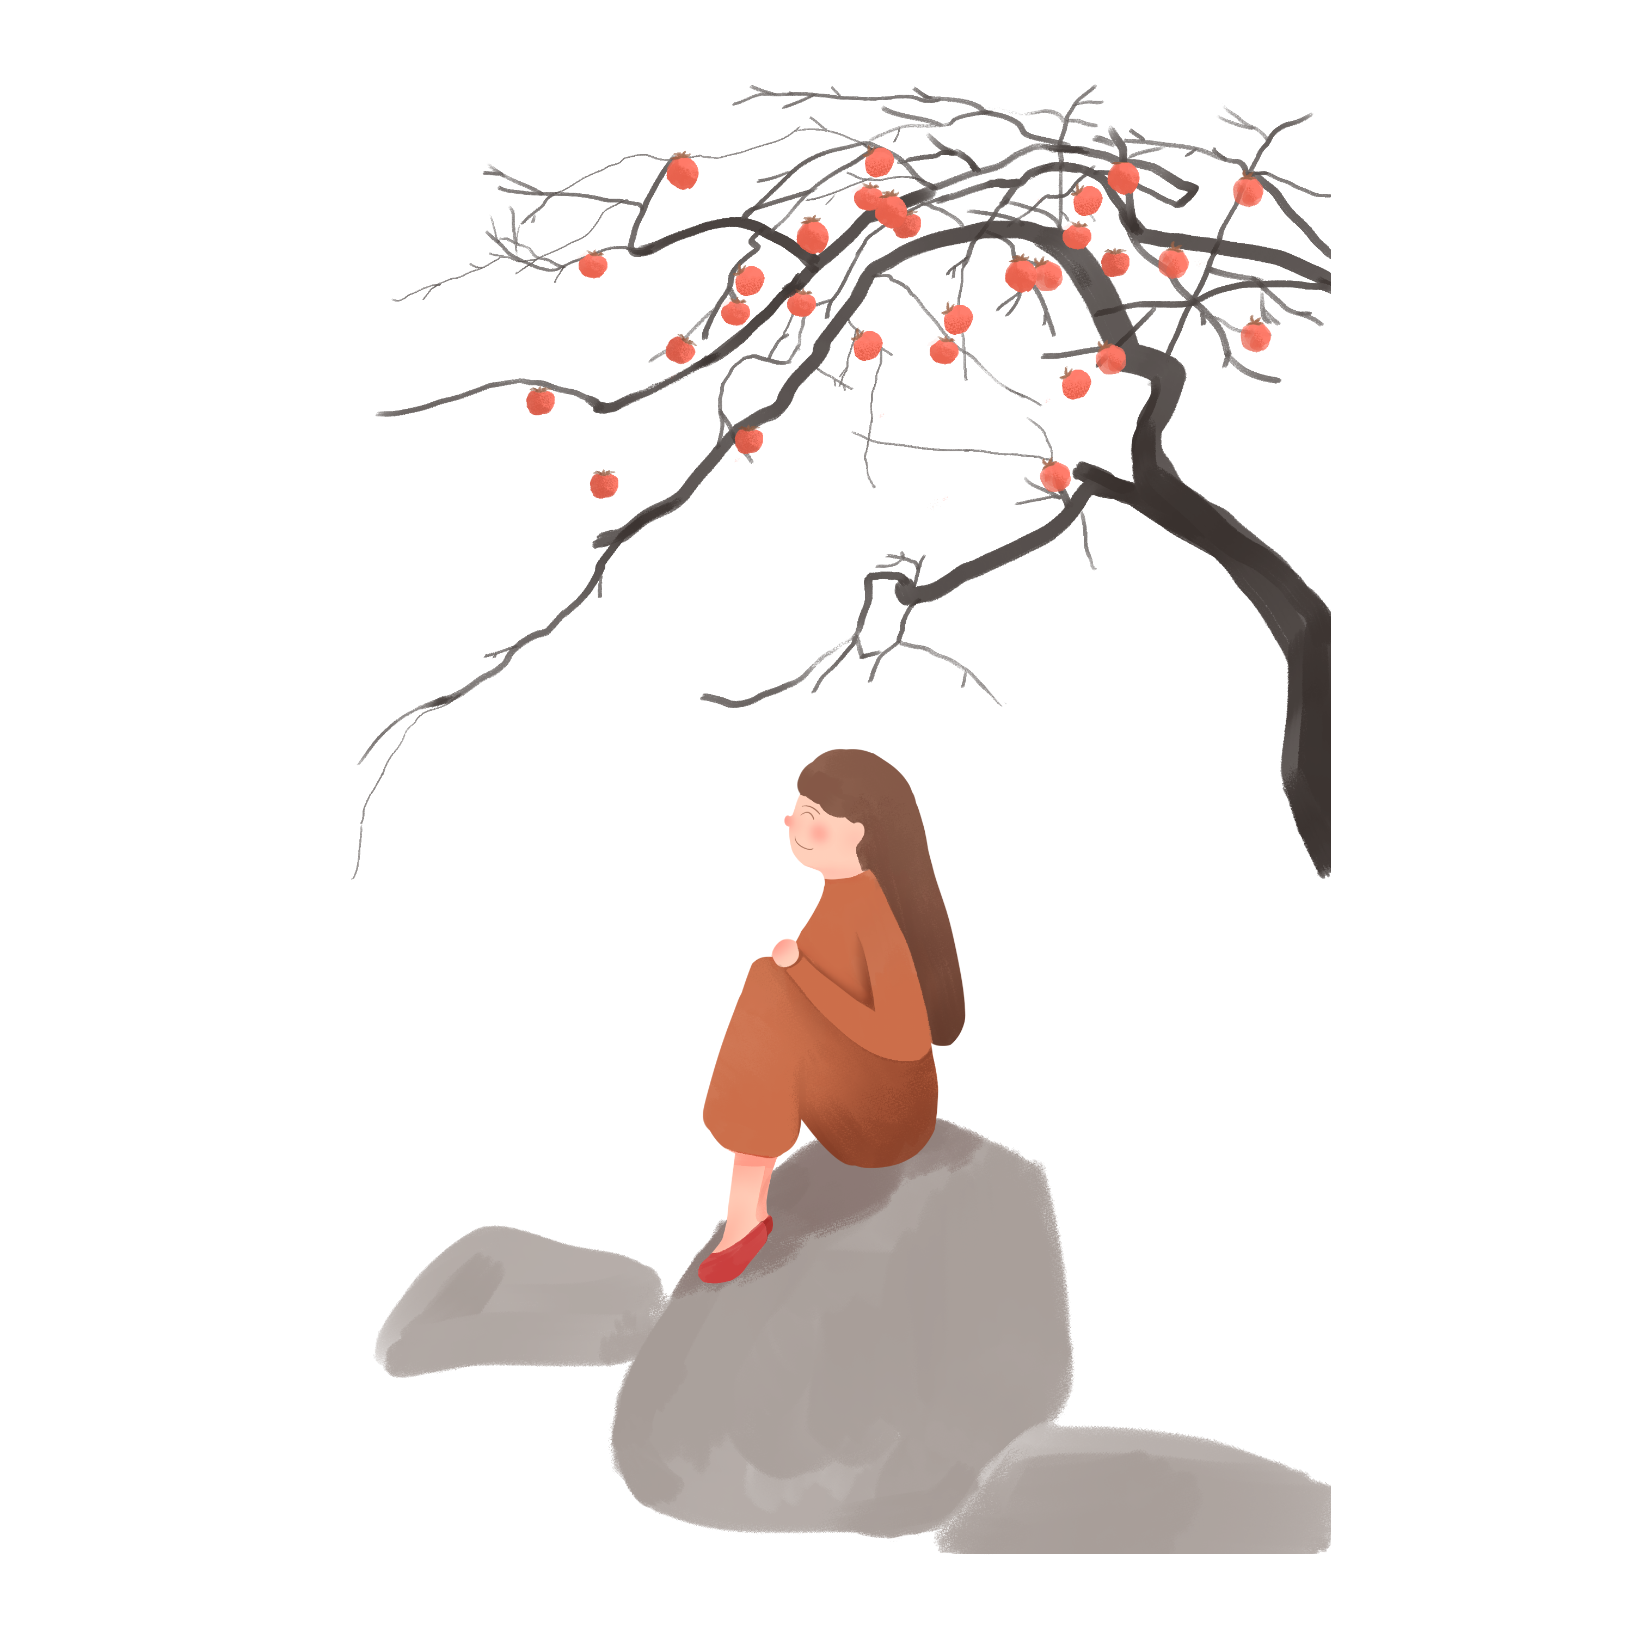
Vocabulary
thoroughly /ˈθʌrəli/ adv.彻底地，完全地
【例句】I'm thoroughly confused.
我完全给搞糊涂了。

Slide 22
Vocabulary
dispel /dɪˈspel/ v.消除；驱逐
【拓展】dispel evils 驱邪
【例句】 Sound sleep did not dispel the taste of wine.
浓睡不消残酒。

Slide 23
Part 2
The introduction

Slide 24
The introduction

Slide 25
The introduction
The traditional Chinese lunar calendar divides the year into 24 solar terms. Cold Dew, (Chinese: 寒露), the 17th solar term of the year, begins this year on Oct 8 and ends on Oct 22.

Slide 26
The introduction
At this time, temperatures are much lower than during White Dewin most areas of China. The dew is greater and colder and there will be less rain. Autumn crops will be ripe.

Slide 27
Part 3
Things about
Cold Dew

Slide 28
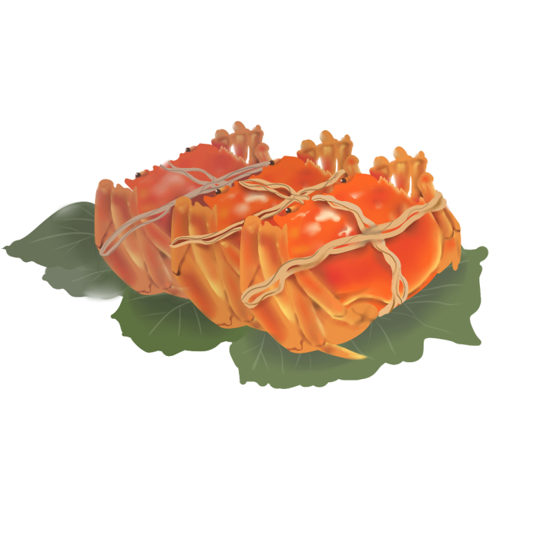
Foggy autumn
Temperatures drop significantly in October. When the cold air encounters autumn rain, the abundant water vapor in the air soon reaches saturation, and then it turns into misty rain or fog. When the humidity is high, there will be foggy regions formed in many areas of China.

Slide 29
Foggy autumn
significantly adv.显著地 encounter v. 相遇，邂逅
abundant water vapor 丰富的水蒸汽 abundant 丰富的；vapor 水蒸汽
saturation n.饱和状态；饱和度 misty adj.多雾的，薄雾笼罩的
fog n. 雾 humidity n.湿度
foggy regions 多雾的地区 region 区域 form v.形成

Slide 30
Season for fishing
People always say that fishing in shallow water in autumn makes sense. That's because during the Cold Dew period, temperatures decrease quickly and sunshine doesn't reach deep water thoroughly. Fish swim to shallow water areas where the water temperature is relatively high.

Slide 31
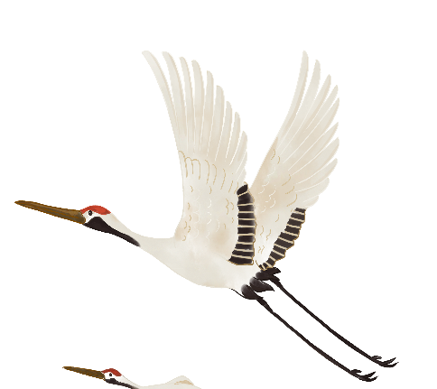
Season for fishing
in shallow water 在浅水区 shallow 浅的，肤浅的
makes sense 有意义，讲得通
It makes no sense. 这毫无意义/讲不通。
thoroughly adv.彻底地，完全地
寒
露

Slide 32
Season for eating pomegranates
Pomegranates are ripe during Cold Dew. Pomegranates have been cherished for their exquisite beauty, flavor, color, and health benefits for centuries.
exquisite精致的，精美的 exquisite beauty国色天香

Slide 33
Season for drinking chrysanthemum wine
Chrysanthemum is the iconic flower of Cold Dew. To prevent autumn dryness, many regions in China have the custom of drinking chrysanthemum wine. This is a tradition of the Double Ninth Festival (on the ninth day of the ninth month in the Chinese calendar), which often falls around Cold Dew. According to ancient records, drinking wine made with chrysanthemums, poria cocos mushroom and pine oleoresin grants people longlasting youth.

Slide 34
Season for drinking chrysanthemum wine
chrysanthemum菊花 iconic标志性的 autumn dryness秋燥
the custom of drinking chrysanthemum wine 饮菊花酒的习俗
the Double Ninth Festival重阳节 poria cocos mushroom茯苓
pine oleoresin松脂 grant给予 longlasting youth永葆青春

Slide 35
Season for eating hawthorns
There is a saying that goes "It is time to harvest hawthorn during Cold Dew." Extracts of the berries have long been used in herbal medicine. The antioxidants in hawthorn are thought to boost heart health by strengthening blood vessels and stimulating blood flow.

Slide 36
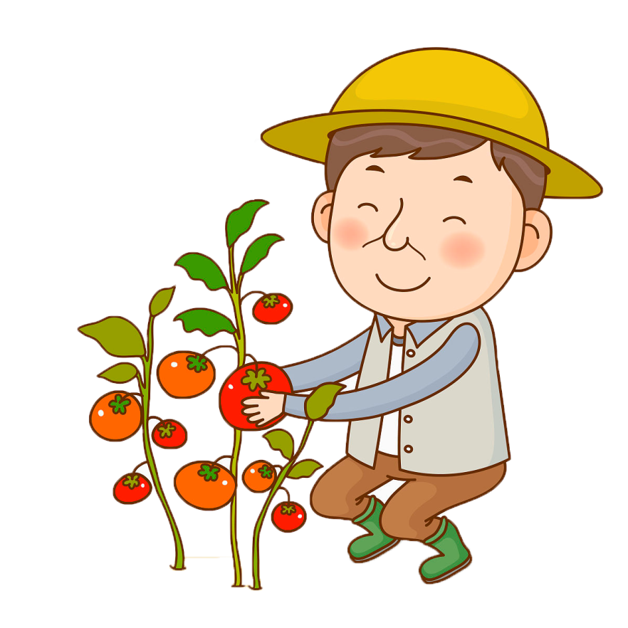
Season for eating hawthorns
hawthorn山楂 extract of提取
antioxidants抗氧化剂 boost heart health促进心脏健康
strengthen blood vessels 加强血管
stimulate blood flow 促进血液循环

Slide 37
A great time for hiking
During Cold Dew, North China takes on a look of late autumn with white clouds, red leaves and early frost. On the day of the Double Ninth Festival, people often climb hills with cornels, a kind of plant. This custom aims to dispel evils, and originated in the Eastern Han Dynasty (AD25-220).

Slide 38
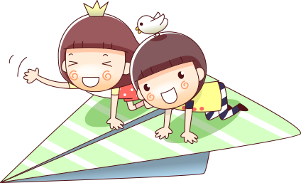
A great time for hiking
take on a look呈现…..面貌 early frost早霜
cornels茱萸 dispel evils驱邪

Slide 39
Season for making kippers
People of the Dong ethnic group in western Hunan province have the custom of making kippers during Cold Dew. It is said that kippers made on the day of Cold Dew with accessory foods, such as rice wine, salt, glutinous rice, pepper powder, paprika powder and ginger, are especially delicious.

Slide 40
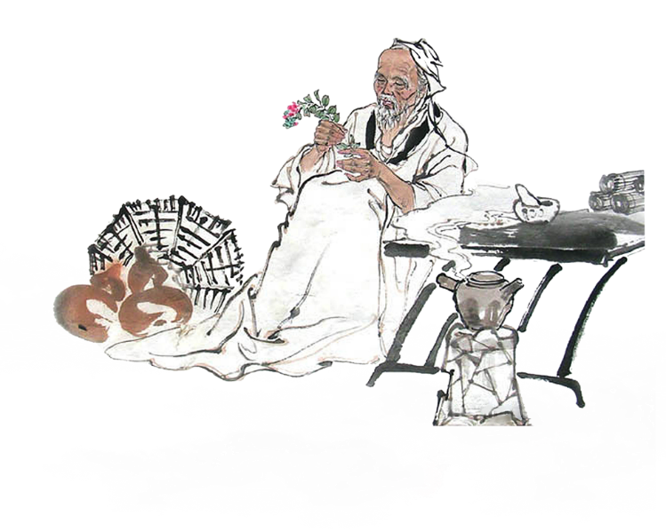
Season for making kippers
camellia山茶花 tea seed oil 茶籽油 come around 到来

Slide 41
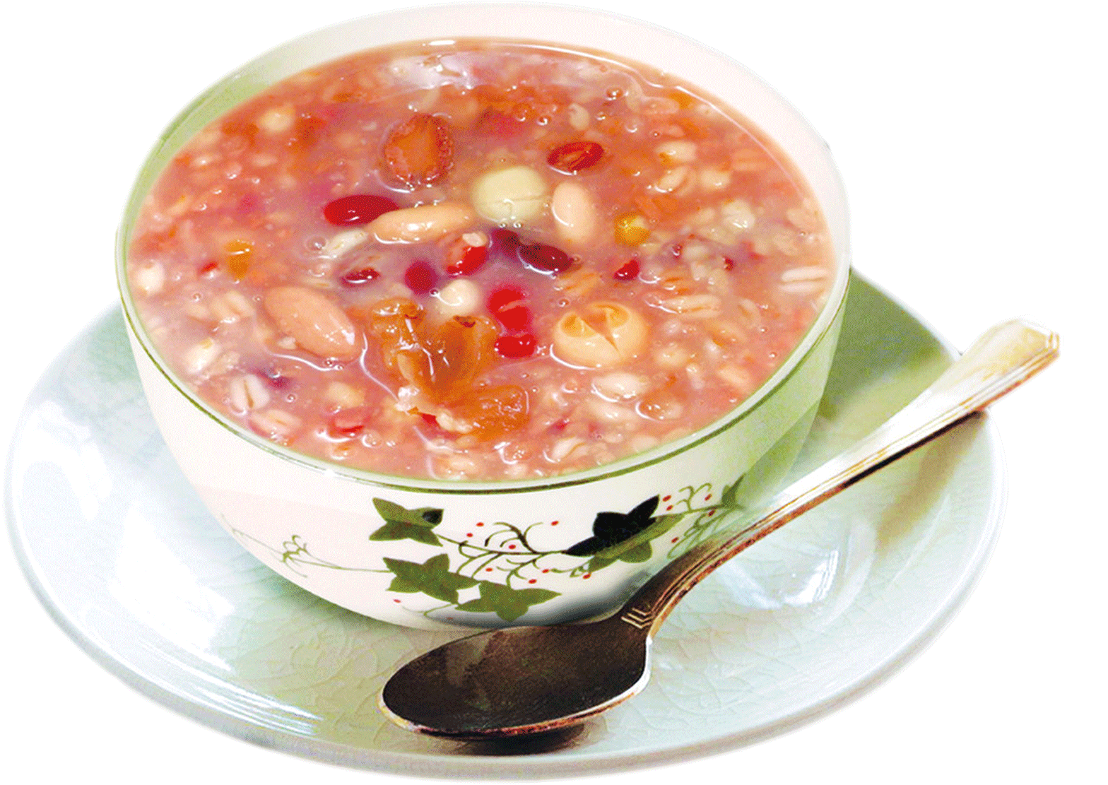
Season for picking camellia seeds
Southern Hunan province is a famous area for producing tea seed oil. People are not allowed to go to the mountains to pick the seeds until Cold Dew comes around.

Slide 42
Season for picking camellia seeds
camellia山茶花 tea seed oil茶籽油 come around到来

Slide 43
Part 4
Practice

Slide 44
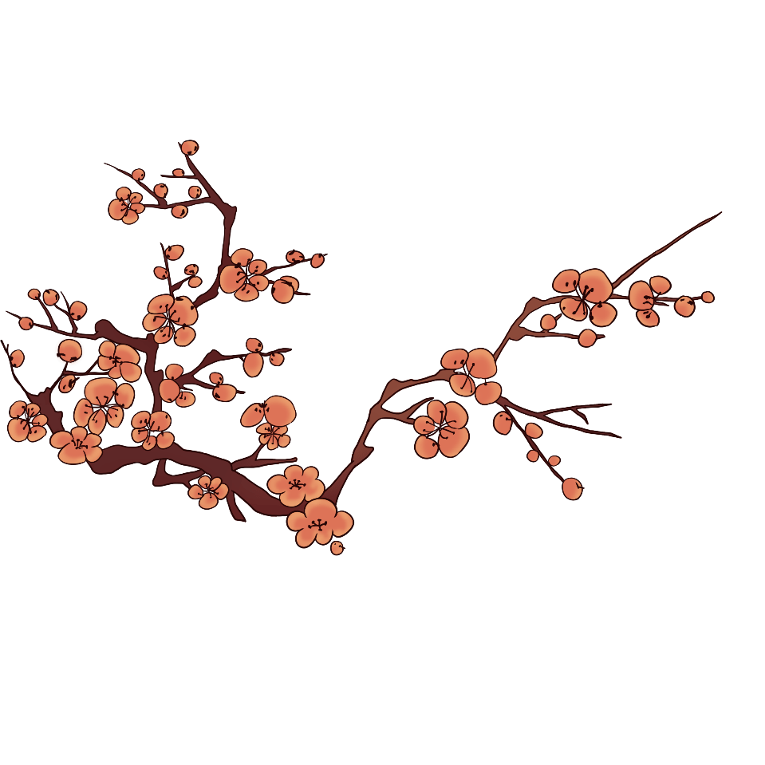
用上面提到的单词翻译句子。
1.如果没有你的帮助，我将遇到很多麻烦，大家都认为是你的功劳。(encounter)
______________________________________________________________
2. 那是一个美好的时刻， 再过许多年我们也将好好珍惜。 (cherish)
______________________________________________________________
3. 研究表明微笑可以降低血压、舒缓压力、增进快乐。(boost)
_____________________________________________________________

Slide 45
Autumn
Start of Autumn | Aug. 7 | The autumn season begins.
The End of Heat | Aug. 23 | The hot summer is coming to an end and heat stops.
White Dew | Sep. 8 | It is getting cooler and dewdrops appear on grass and trees in the morning.
Autumn Equinox | Sep. 23 | The mid-point for the autumn season; The temperature begins to decrease; Day and night are equally long on the day.
Cold Dew | Oct. 8 | The dews are becoming frost.
Frost Descent | Oct. 24 | Frost appears and the temperature begins to descent.

Slide 46
二
十
四
节
气
24 Solar Terms
- Cold Dew
（寒露）

