Slide 1
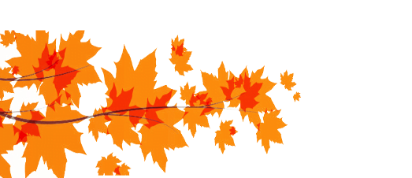
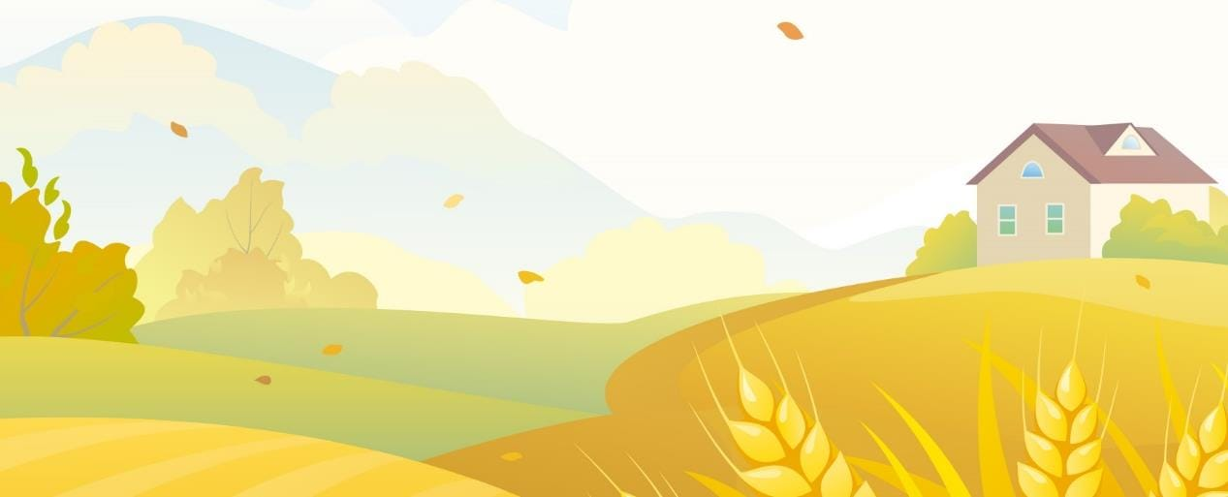
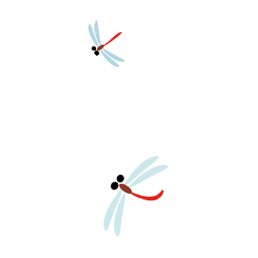
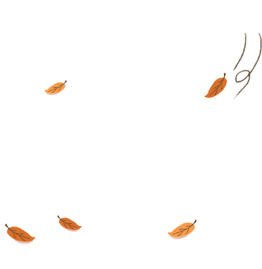
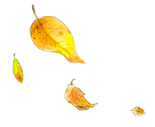
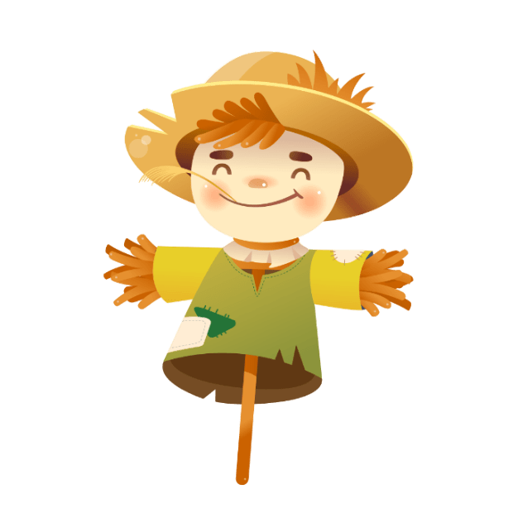
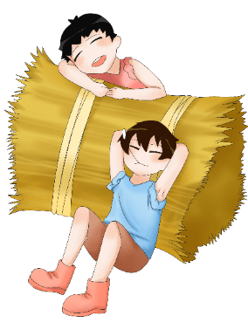
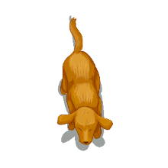
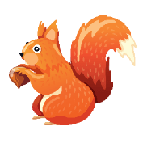
24 Solar Terms
- Autumn Equinox
（秋分）

Slide 2
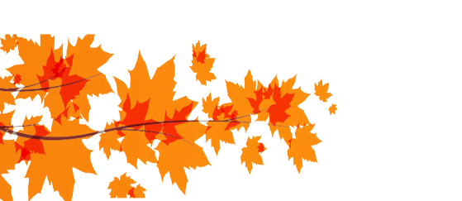
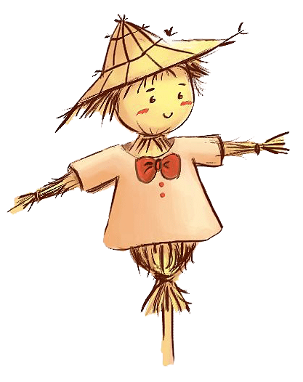
学习目标
认识秋分；
认识秋分的相关内容；
学会表达。

Slide 3
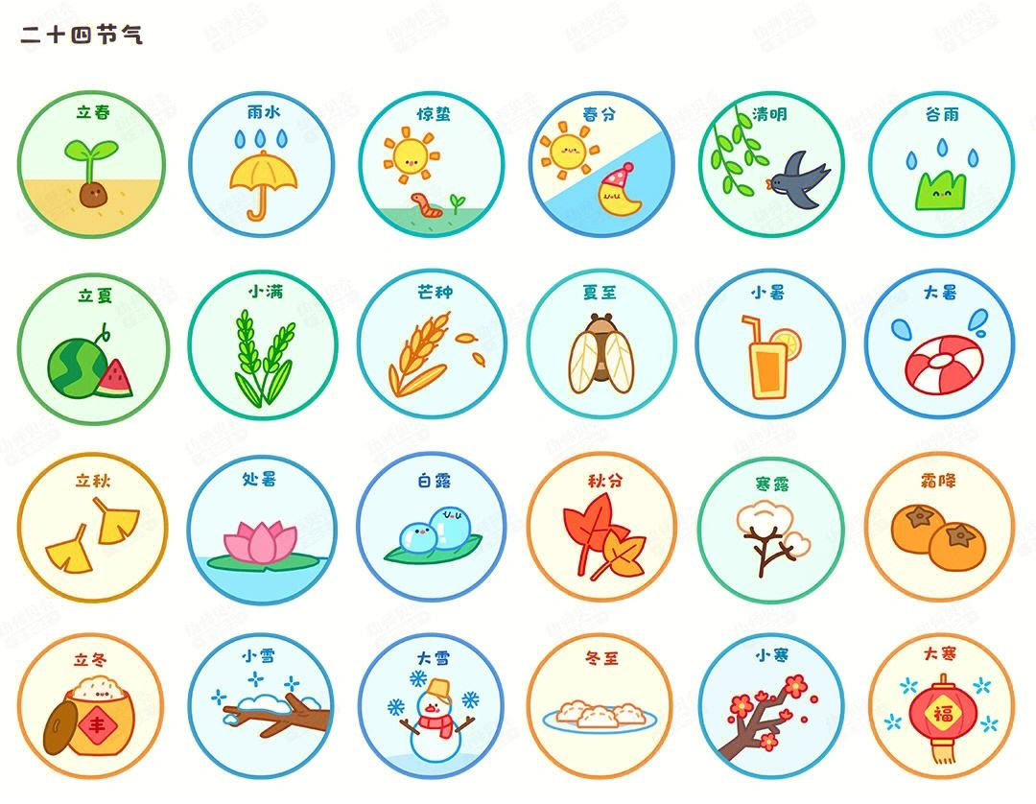

Slide 4
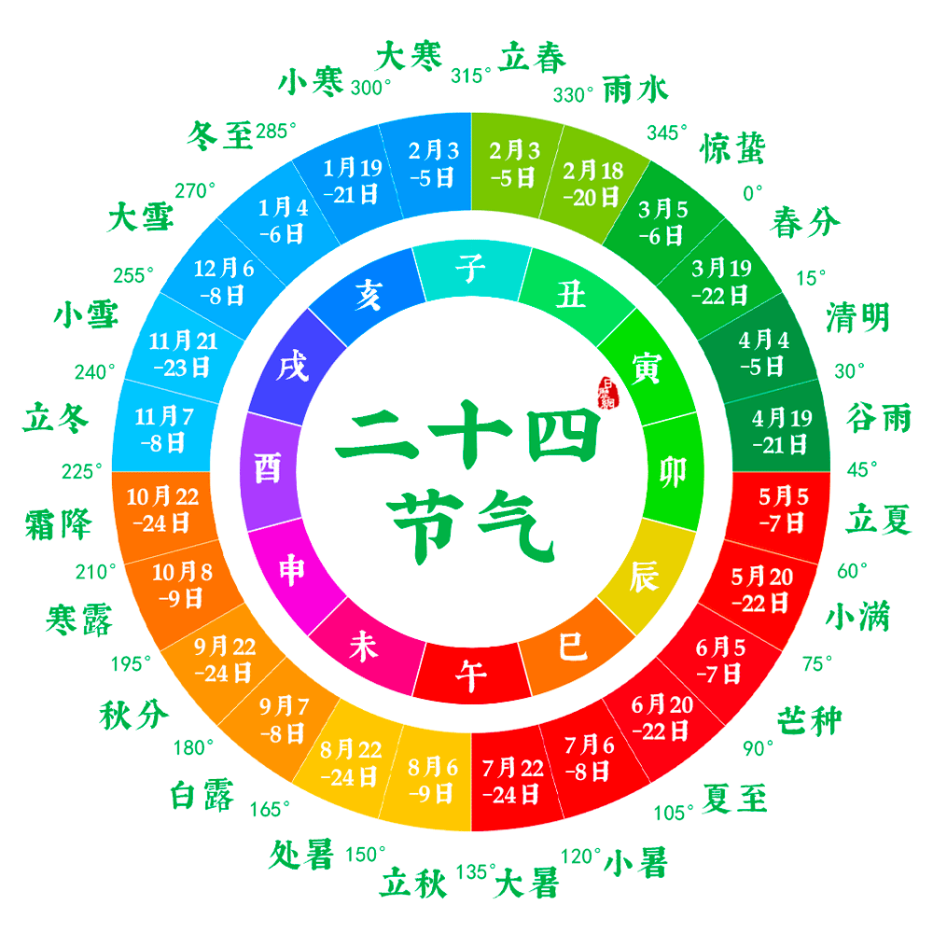

Slide 6
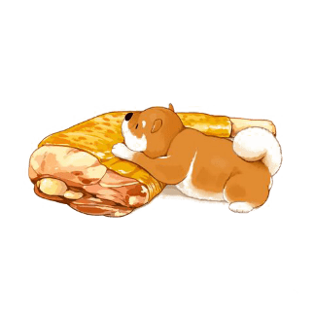
CONTENTS 目录
Part1
Vocabulary
Part2
The introduction
Part3
The customs
Part4
Practice

Slide 7
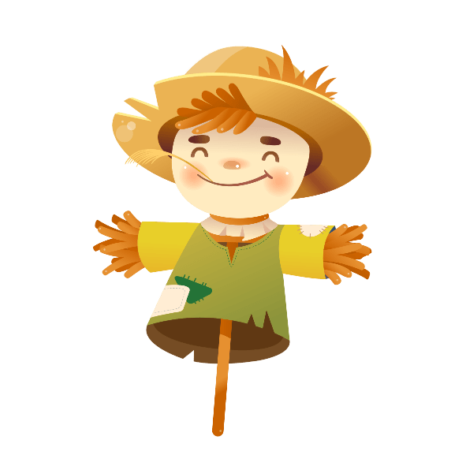
Part 1
Vocabulary

Slide 8
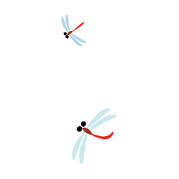
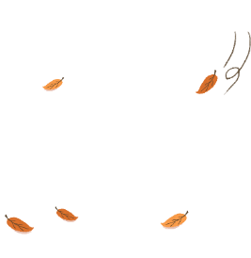
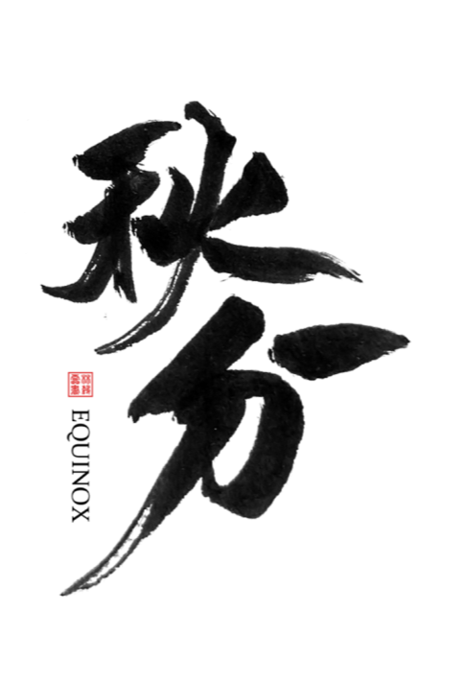
Vocabulary
equinox/ˈekwɪnɒks/n. 春分；秋分；昼夜平分点
【拓展】Autumn Equinox：秋分
Spring Equinox: 春分
【例句】Mid-Autumn Day falls during the autumn equinox.
中秋节来临时正好在秋分前后。

Slide 9
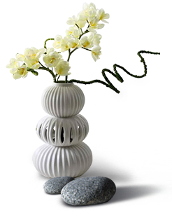
Vocabulary
midpoint /ˈmɪdpɔɪnt/ n. 中点；正中央
【拓展】common midpoint 共中心点
【例句】She has not yet reached the midpoint of her life.
她尚未达到人生历程的一半。

Slide 10
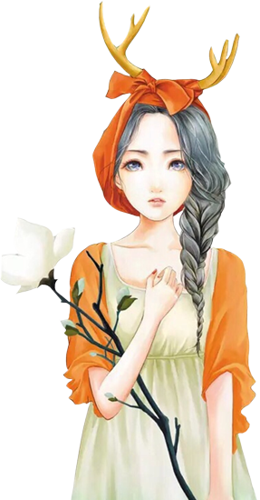
Vocabulary
precipitation /prɪˌsɪpɪˈteɪʃ(ə)n/
n. 降水（如雨，雪，冰雹）；沉淀
【例句】Most of the precipitation in the Arctic is in the form of snow.
北极的大部分降水形式为雪。

Slide 11
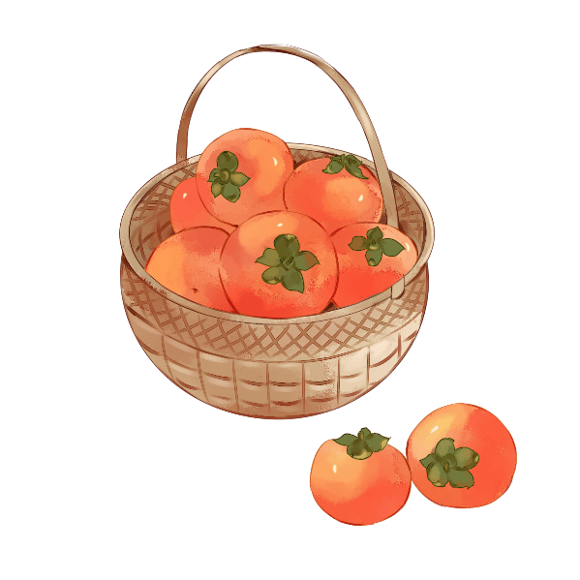
Vocabulary
marrow/ˈmærəʊ/ n. 骨髓，髓
【拓展】nourish the marrow：滋养骨髓
【例句】We're getting into the marrow of the film.
我们就要进入这部电影最精彩的部分了。

Slide 12
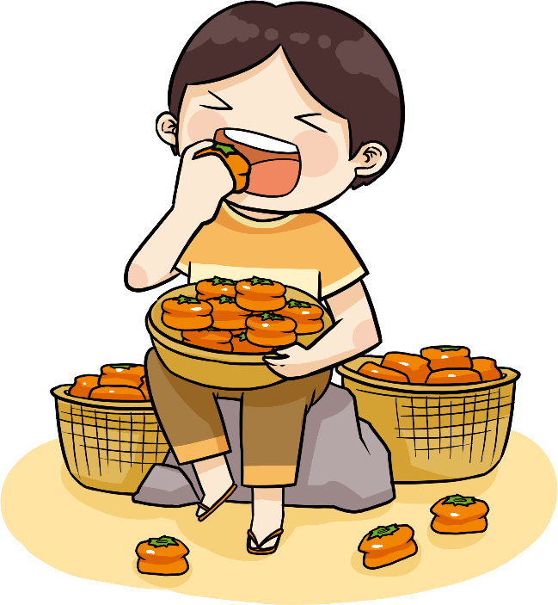
Vocabulary
amaranth /ˈæməˌrænθ/
n. 紫红色；不凋花；苋属植物
【例句】Shows the colors between deep amaranth.
酒液颜色呈现为深沉的紫红色。

Slide 13
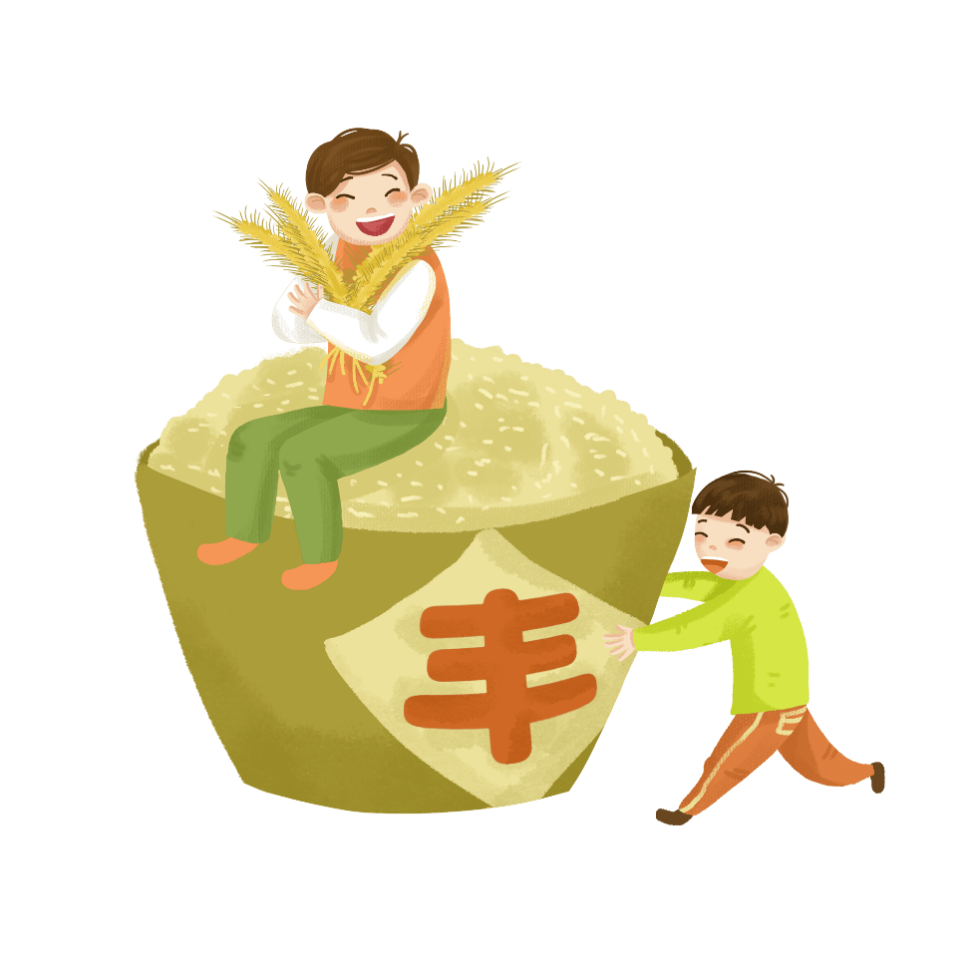
Vocabulary
verdant /ˈvɜːd(ə)nt/
adj. 青翠的；翠绿的；没有经验的；不老练的
【例句】Small children played happily in verdant parks.
小孩子们在满眼绿色的公园里快乐地玩耍。

Slide 14
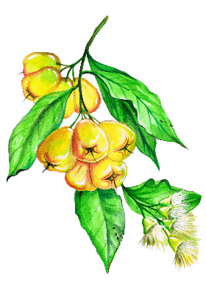
Vocabulary
verse/vɜːs/n. 诗，韵文；诗节
【拓展】free verse 自由诗体
【例句】This verse describes three signs of spring.
这节诗描述了春天的3个征兆。

Slide 15
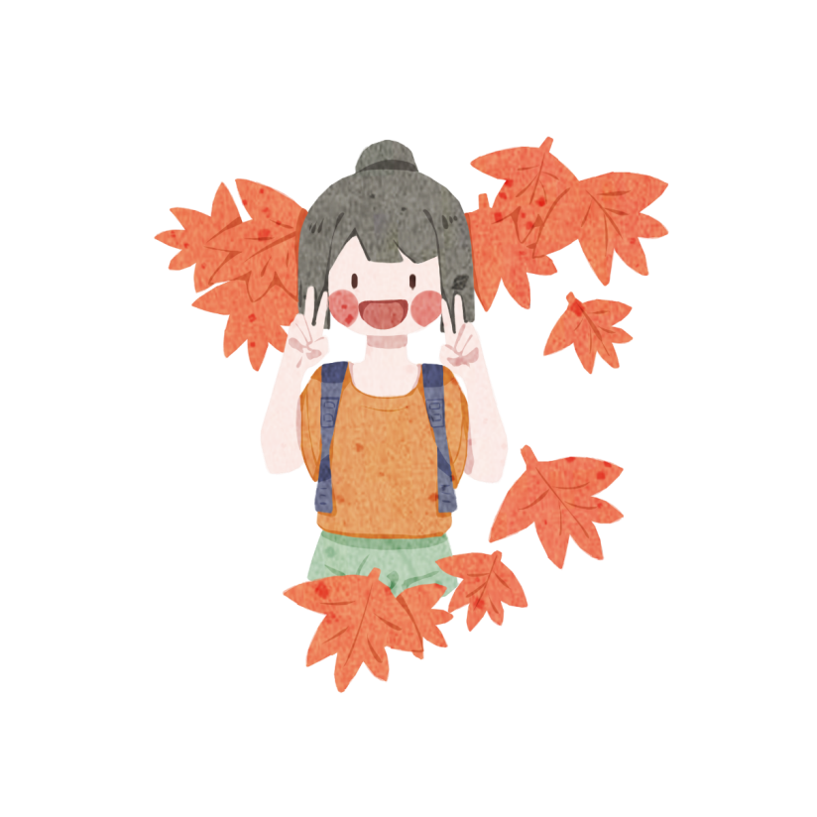
Vocabulary
intestine /ɪnˈtestɪn/
n. （脊椎动物的）肠；（尤指无脊椎动物的）肠管
adj. 内部的，国内的
【拓展】clear the liver and intestines：清肝润肠
【例句】This is the dark intestine.
这是黑暗的肠子。

Slide 16
Vocabulary
olive/ˈɒlɪv/n. 橄榄；橄榄树；橄榄色
【拓展】olive oil 橄榄油
【例句】She wore an olive-green T-shirt.
她穿了一件橄榄绿的T恤衫。

Slide 17
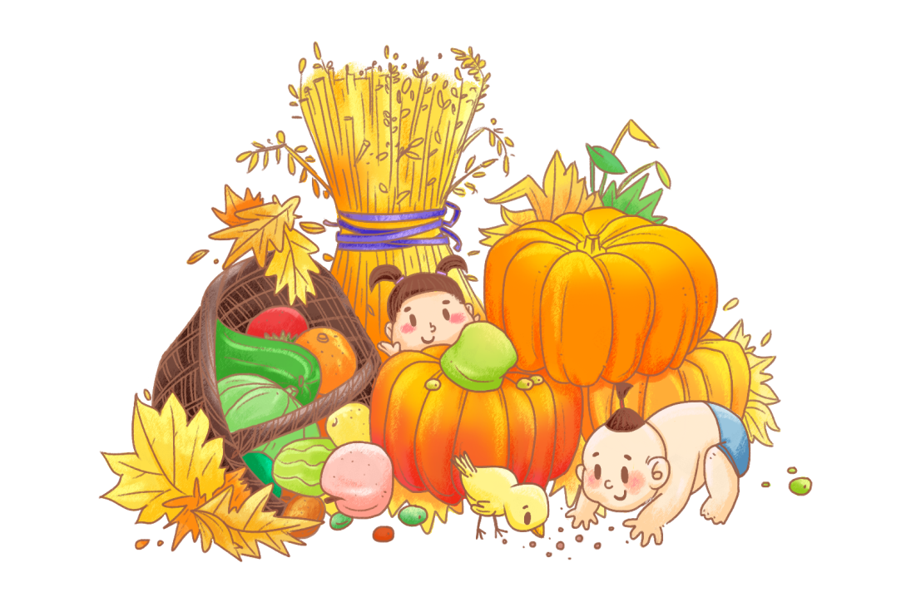
Vocabulary
papaya /pəˈpaɪə/n. 番木瓜，木瓜；番木瓜树
【例句】Apply papaya pulp on the skin.
敷木瓜浆在皮肤上。

Slide 18
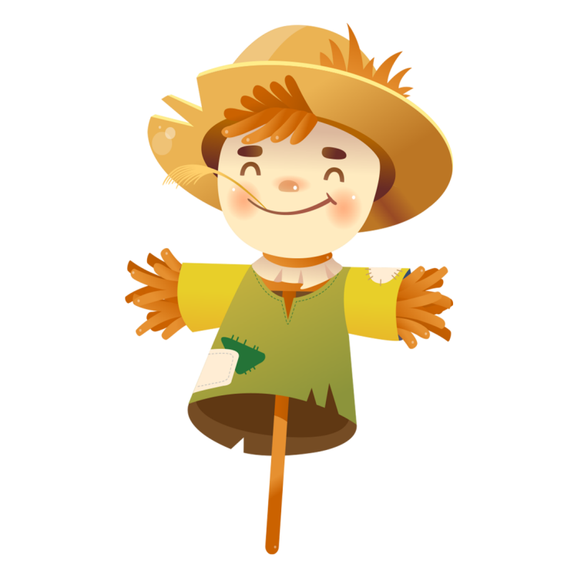
Vocabulary
phase /feɪz/ n. （发展或变化的）阶段，时期
【例句】So begins another phase of the cycle.
这样就开始了循环的另一个阶段。

Slide 19
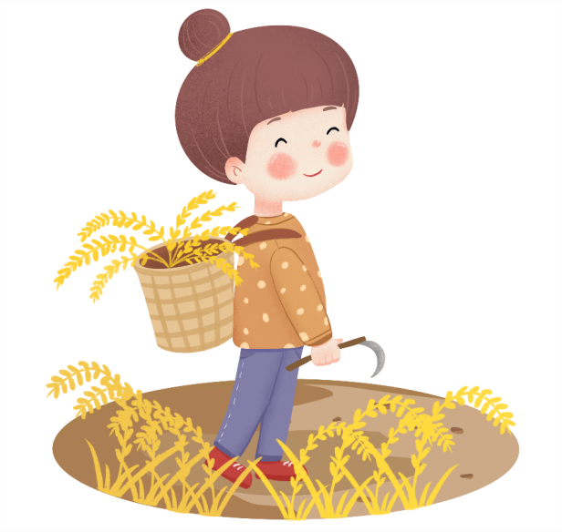
Vocabulary
chestnut/ˈtʃesnʌt/
n. 栗子；栗色；[园艺]栗树；栗色马
adj. 栗色的
【例句】And being weary she sat her down under a chestnut-tree to rest.
她太累了，于是在一棵栗子树下坐下来休息。

Slide 20
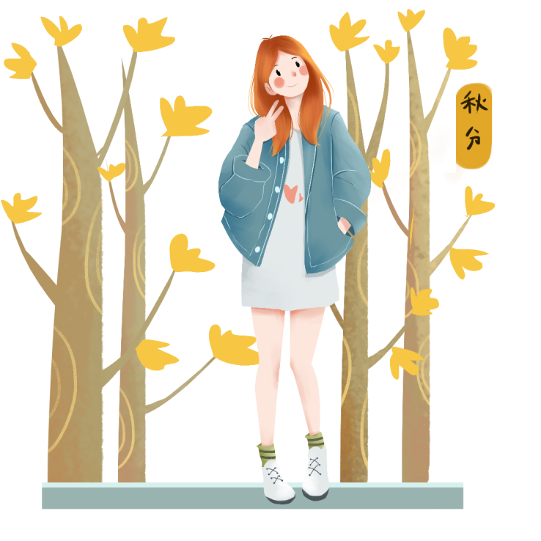
Vocabulary
maturation/ˌmætʃuˈreɪʃn/
n. 成熟；化脓；生殖细胞之形成
mature/məˈtʃʊə(r)/
adj. 明白事理的；成熟的；像成人似的
v. 成熟；长成

Slide 21
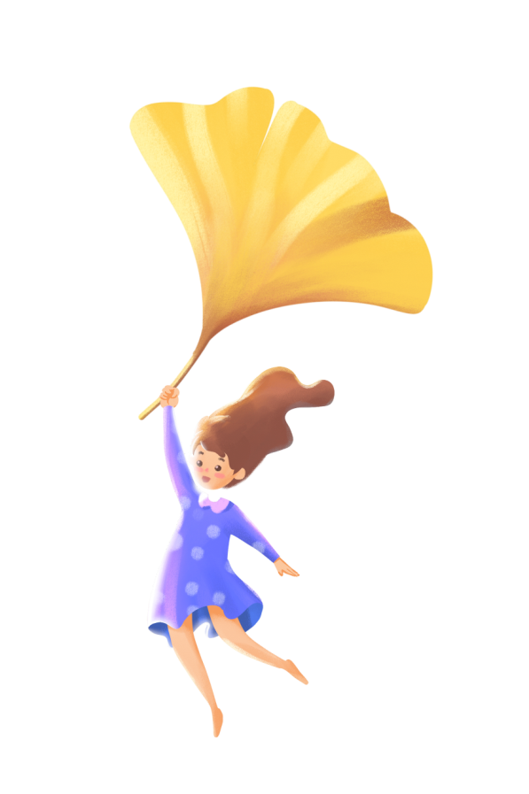
Vocabulary
osmanthus/ɒzˈmænθəs/ n.桂花
chrysanthemum/krɪˈsænθəməm/ n. 菊花

Slide 22
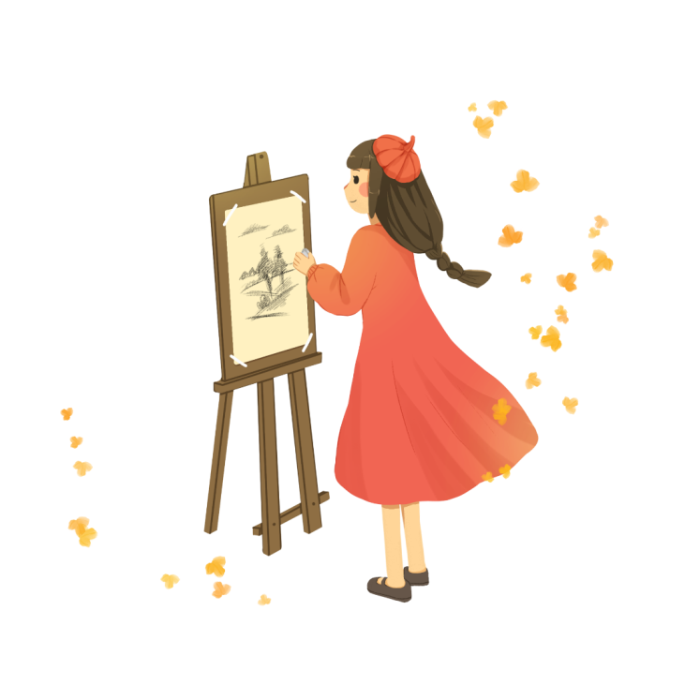
Vocabulary
fragrance/ˈfreɪɡrəns/n. 芳香，香气；香水
【例句】The air was full of the fragrance of flowers.
空气中充满了花香。

Slide 23
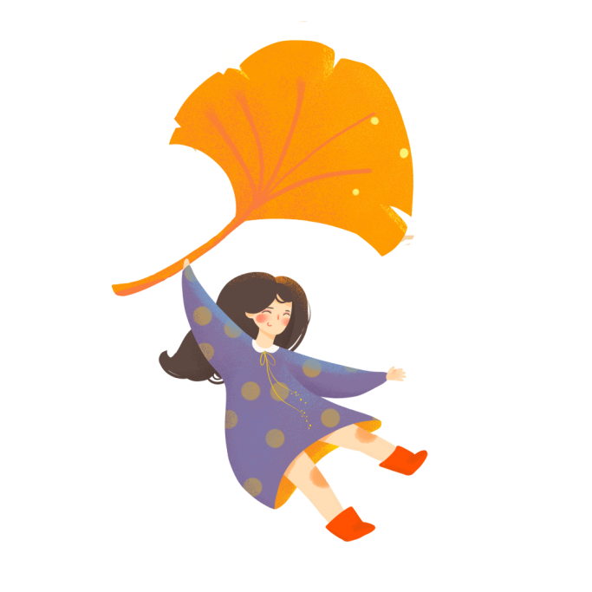
Vocabulary
layer /ˈleɪə(r)/
n. 层；表层；层次；阶层 v. 把…分层堆放
single layer: 单衣，单层
【例句】A thin layer of dust covered everything.
所有的物品上都积了薄薄的一层灰尘。

Slide 24
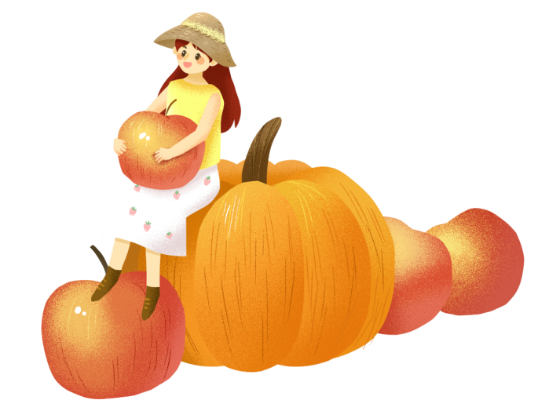
Vocabulary
lined/laɪnd/adj. 有内衬的；具线纹的
lined clothing：有内衬的衣服
mugginess n. 闷热
muggy/ˈmʌɡi/ adj. 闷热潮湿的

Slide 25
Vocabulary
axis /ˈæksɪs/ n. 轴（旋转物体假想的中心线）
earth'saxis：地轴

Slide 26
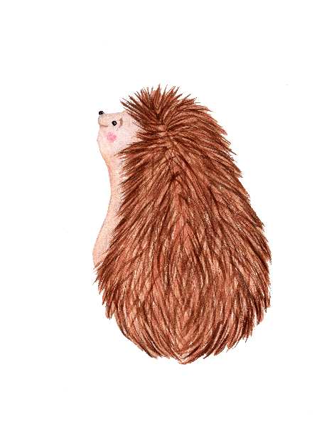
Vocabulary
tilt /tɪlt/
n. 倾斜，倾侧，倾斜度；（对某人、某信仰或某行为的）倾向，偏向
v. （使）倾斜，（使）倾侧；（使）倾向于，（使）偏向于
【例句】He answered with a tilt of his head. 他歪着头回答。

Slide 27
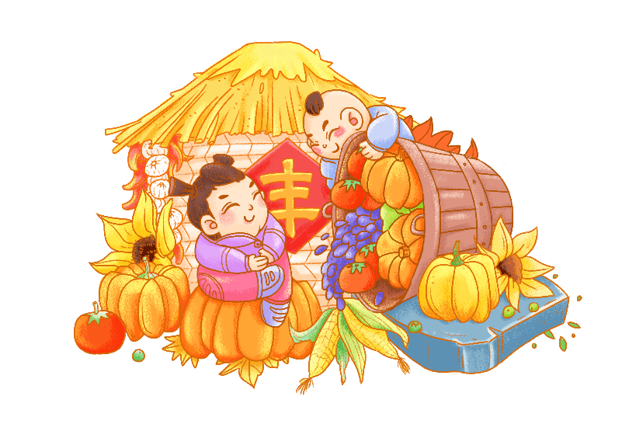
Vocabulary
conducive/kənˈdjuːsɪv/adj. 有助的，有益的
【拓展】be conducive to 有利于
【例句】Fresh air is conducive to health.
新鲜空气有利于健康。

Slide 28
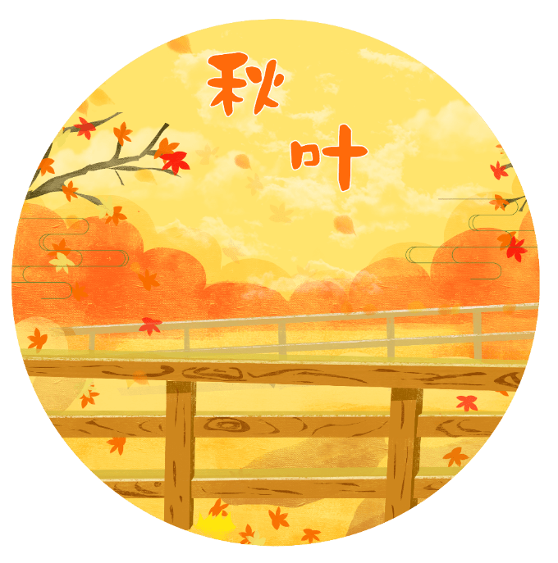
Vocabulary
yolk/jəʊk/n. 蛋黄；[胚] 卵黄
【例句】Only the yolk contains cholesterol.
只有蛋黄含胆固醇。

Slide 29
Vocabulary
inclined /ɪnˈklaɪnd/
adj. 有……意向，倾向于……；对……有兴趣的，有天赋的；
incline /ɪnˈklaɪn/ v. 点头；（使）倾向于；（使）倾斜
【拓展】be inclined to： 倾向于……；有意
【例句】The partly deaf man inclined forward to hear the conversation more clearly.
那个耳背的人向前倾斜着身子， 以便听清谈话。

Slide 30
Vocabulary
originally /əˈrɪdʒənəli/ adv.起初，原来；独创地，新颖地
【例句】The vote date was originally set for tomorrow.
投票日期原本定在明天。
original /əˈrɪdʒən(ə)l/ adj. 起初的，原先的；原作的，真迹的
【例句】I will send the original to you by post.
我将把原件邮寄给你。
originate /əˈrɪdʒɪneɪt/ v. 起源，产生；创始，开创
【例句】Current services originate in two key measures.
当前的服务起源于两个关键措施。

Slide 31
Part 2
The introduction

Slide 33
Introduction
dividing autumn into two equal parts：现在分词dividing短语做谓语动词lies的伴随状语。
Autumn Equinox lies at the midpoint of autumn,dividing autumn into two equal parts. After that day, the location of directsunlight moves to the south, making days shorter and nights longer in thenorthern hemisphere.
The traditional Chinese lunar calendar divides the yearinto 24 solar terms. Autumn Equinox, (Chinese: 秋分), the 16th solar term of the year, begins this year on Sept 23 and ends on Oct 7.
aking days shorter and nights longer in the northern hemisphere：现在分词making短语做结果状语。

Slide 34
Part 3
The customs

Slide 35
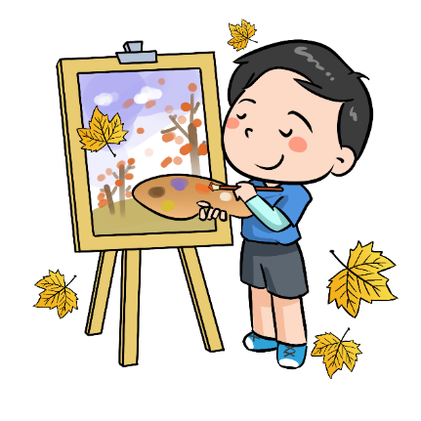
The customs
Cool autumn 凉爽的秋天
As it is said in the ancient book, The Detailed Records of the Spring and Autumn Period (770-476BC), "It is on Autumn Equinox day that the Yin and Yang are in a balance of power. Thus the day and night are of equal length, and so are the cold and hot weather."
一样长

Slide 36
The customs
"It is on Autumn Equinox day that the Yin and Yang are in a balance of power. Thus the day and night are of equal length, and so are the cold and hot weather."
.
解析：It is on Autumn Equinox day that the Yin and Yang are in a balance of power：强调句，去掉 It is ...that，仍然是一个完整的句子（on Autumn Equinox day, the Yin and Yang are in a balance of power.）

Slide 37
The customs
Cool autumn 凉爽的秋天
By Autumn Equinox, most of the areas in China have entered the cool autumn. When the cold air heading south meets the declining warm and wet air,precipitationis the result. The temperature also drops frequently.
南下的冷空气

Slide 38
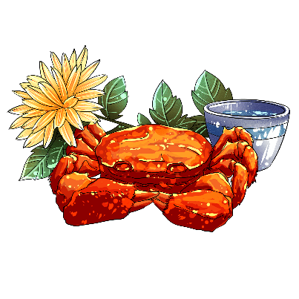
The customs
Season for eating crab
吃螃蟹的季节
In this season, crab is delicious.
It helps nourish the marrow and clear heat inside the body.
螃蟹

Slide 39
The customs
Eating Qiucai 吃秋菜
被称为
In South China, there is a custom popularly known as "having Qiucai (an autumn vegetable) on the Autumn.Equinox day". Qiucai is a kind of wild amaranth. Every Autumn Equinox day, all the villagers go to pick Qiucai in the wild. Qiucai is verdant in the field, thin, and about 20 cm in length.
一种
摘
翠绿的
在长度上

Slide 40
The customs
Eating Qiucai 吃秋菜
Qiucai is taken back and made into soup with fish, called "Qiutang" (autumn soup). There is a verse about the soup: "Drink the soup to clear the liver and intestines, thus the whole family will be safe and healthy".
拿回来
全家

Slide 41
The customs
Standing eggs on end
试着去...
On Autumn Equinox day, thousands of people around the world try to make eggs stand on end. This Chinese custom has become the world's game. According to experts, on the Spring Equinox and Autumn Equinox, the day and night are of equal time both in the southern and northern hemispheres.
数以千计的
相同的时间

Slide 42
The customs
Standing eggs on end
The earth's axis, on its 66.5 degree tilt, is in a relative balance of power with the earth's or bit around the sun. Thus it is a very conducive time for standing eggs on end..
地轴
相对的力量平衡
有利的

Slide 43
The customs
Standing eggs on end
和...无关
But some also say that standing the egg has nothing to do with the time. The most important thing is to shift the egg's center of gravity to the lowest part of the egg. In this way, the trick is holding the egg until the yolk sinks as much as possible. For this, you're better off choosing an egg that's about 4 or 5 days old, whose yolk is inclined to sink down.
最重要的事
最低的
和...一样多
倾向于……；有意
下沉

Slide 44
The customs
Sacrificing to the moon
祭月
Originally, the festival of sacrificing to the moon was set on Autumnal Equinox day According to historical records, as early as the Zhou Dynasty (c. 11th century-256BC), the ancient kings by custom sacrificed to the sun on the Spring Equinox, and to the moon on the Autumn Equinox.
早在...

Slide 45
The customs
Sacrificing to the moon
But the moon won't be full during Autumn Equinox. If there was no moon to make sacrifices to, it would spoil the fun. Thus, the day was changed to the Mid-Autumn Day.
做出牺牲
破坏乐趣

Slide 46
Part 4
Practice

Slide 47
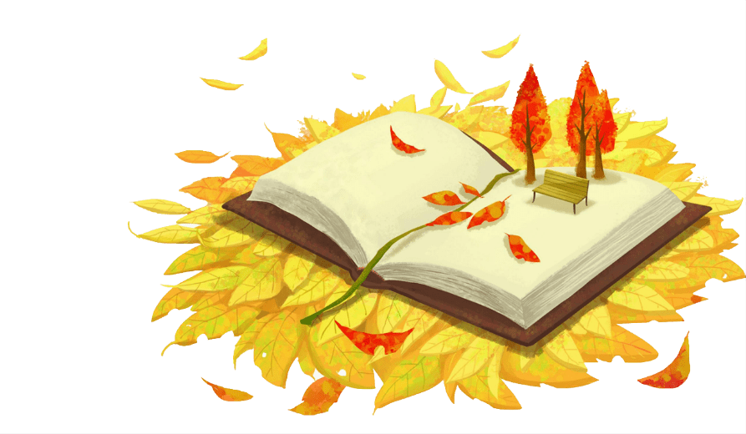
Practice
阅读理解。1. Autumn Equinox is the 16solar term which .A. divides a year into two equal partsB. makes the day shorterC. makes the night longerD. makes Yin and Yang are of equal power
D

Slide 48
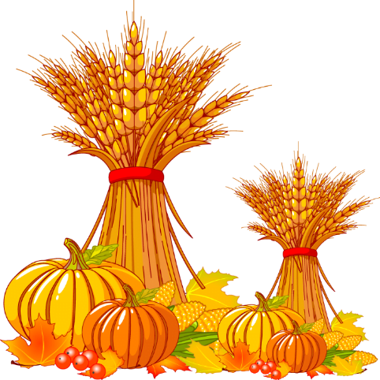
Practice
阅读理解。2.Qiucai is a kind of vegetable which _____________. A. is grown by farmers in the fieldB. is only available on the Autumn Equinox DayC. must be made into soup with fishD. can clear the liver and intestines
C

Slide 49
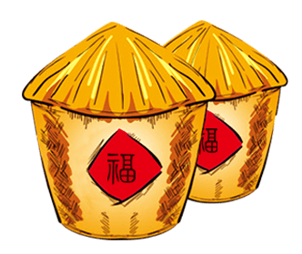
Practice
阅读理解。3.What’s the meaning of the underlined word “ mugginess”?A. 凉爽 B. 闷热 C. 寒冷 D. 炎热4.We can learn from the article that .A. solar terms are divided according to the position of the sun.B.every solar term lasts for about a month every yearC.solar terms are divided according to the agricultural activitiesD.solar terms are divided according to the old tradition
B
A

Slide 50
Practice
在右栏中找出左栏单词的解释。
1. midpoint 2.tilt
3.conducive 4.maturation 5.phase
A. possible or likely for sth to happen
B. make sth into a position with one side higher than the other
C. the process of becoming mature
D. A point at or near the center
E. a stage in a process of change or development
答案：DBACE

Slide 51
Autumn
Start of Autumn | Aug. 7 | The autumn season begins.
The End of Heat | Aug. 23 | The hot summer is coming to an end and heat stops.
White Dew | Sep. 8 | It is getting cooler and dewdrops appear on grass and trees in the morning.
Autumn Equinox | Sep. 23 | The mid-point for the autumn season; The temperature begins to decrease; Day and night are equally long on the day.
Cold Dew | Oct. 8 | The dews are becoming frost.
Frost Descent | Oct. 24 | Frost appears and the temperature begins to descent.

Slide 52
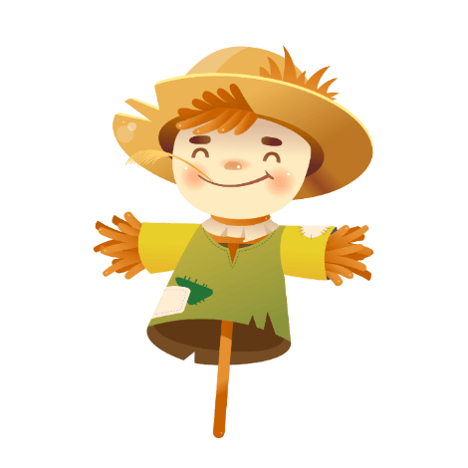
24 Solar Terms
- Autumn Equinox
（秋分）

