Slide 1
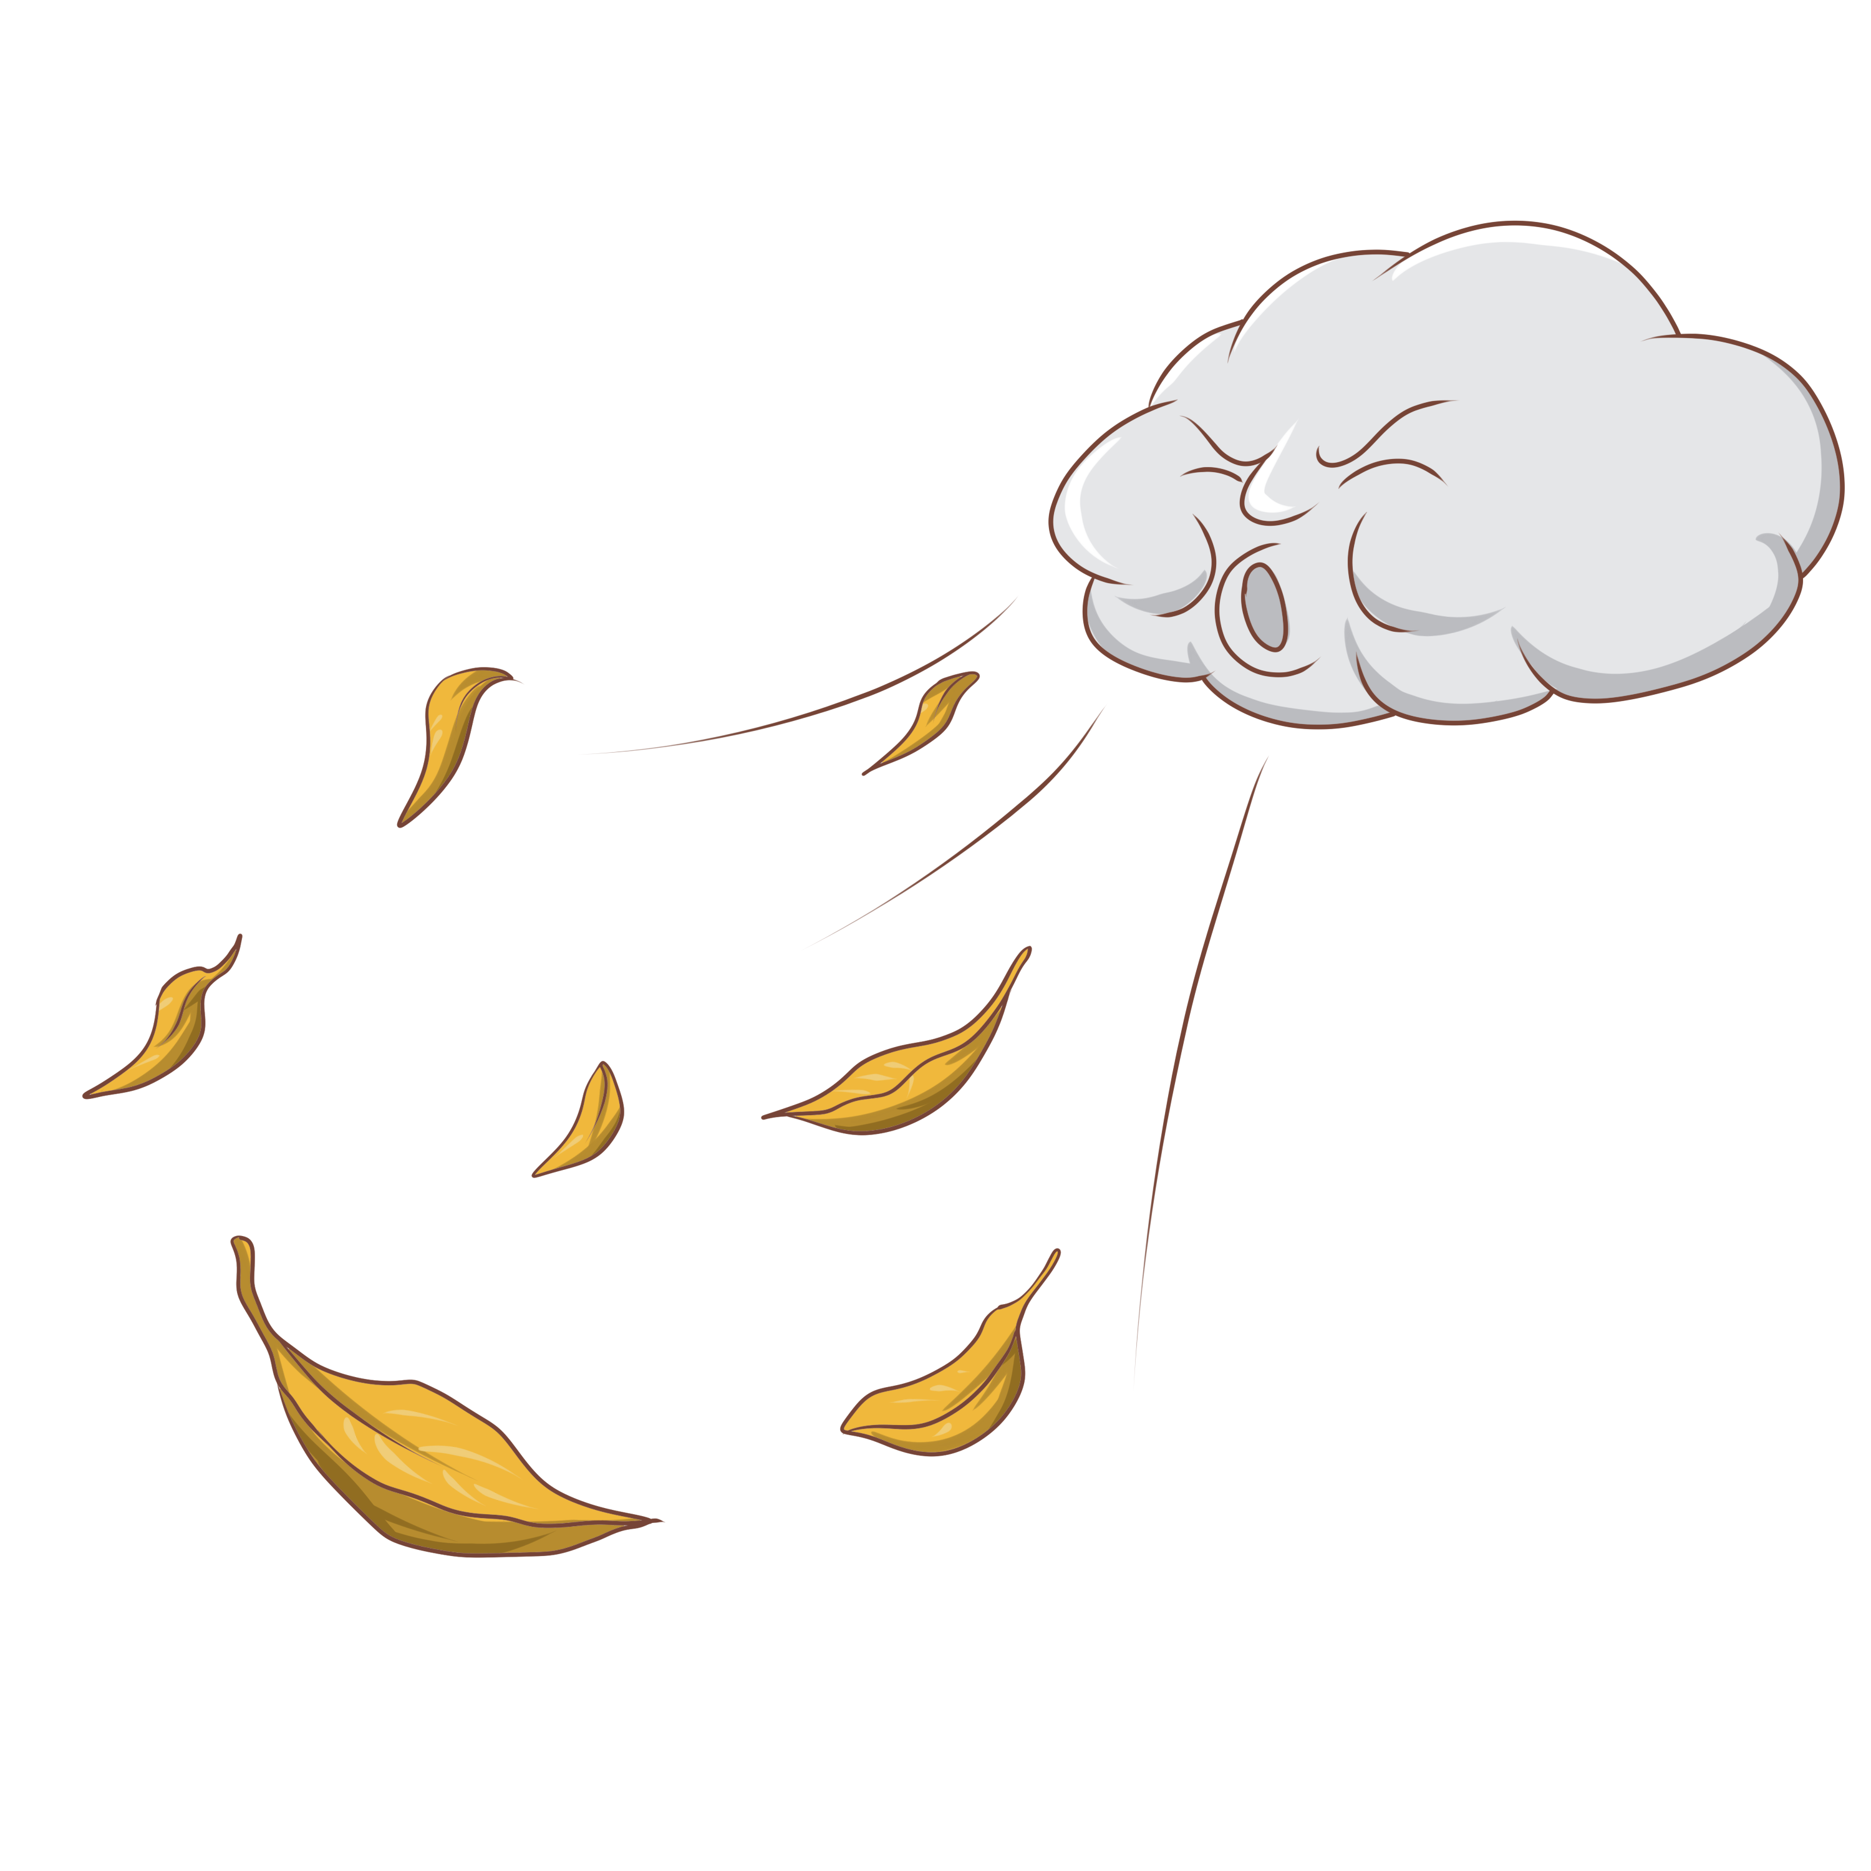
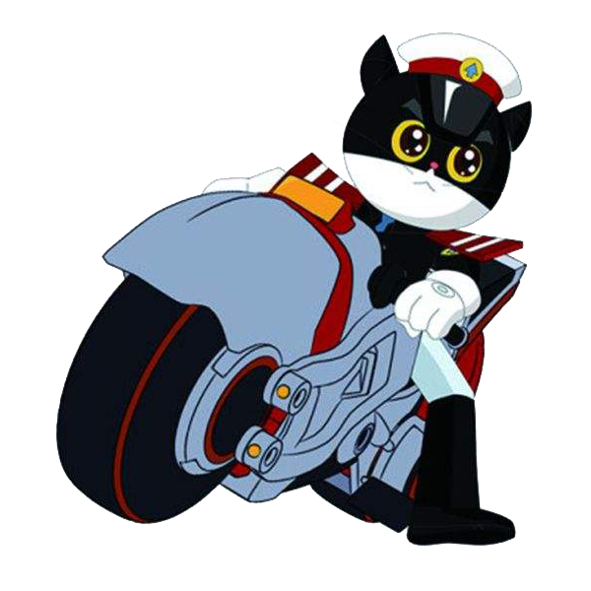
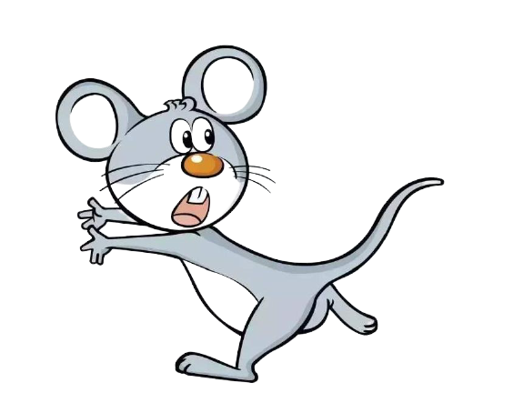
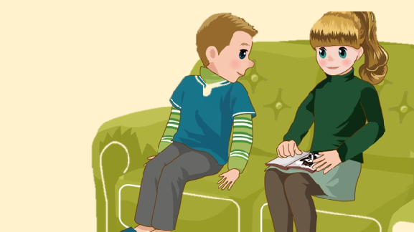
Unit 6 How do you feel？
A Let's talk

Slide 2
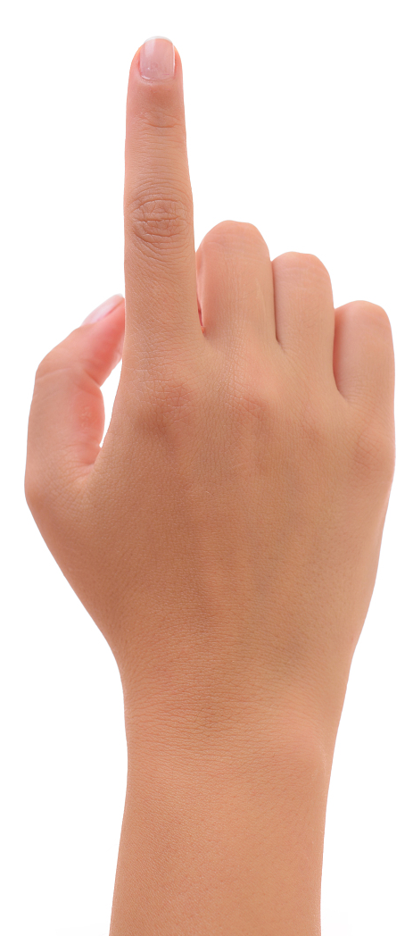
Let's sing

Slide 3
Look and answer
Who are they?
Sarah and Sam.
What's the weather like?
It’s cold/windy.

Slide 4
Let's try
Sam is talking with Sarah.
1.Where are they?
A. At home. B. At school.
√
2.What will they do?
A. Eat some fruit. B. Watch films.
√

Slide 5
Let's try
Sam: Phew! It's so cold in January.
Sarah: Yes, but we can stay inside and watch films.
Sam: Great. I like cartoons.
Sarah: Yes, me too. They make me feel happy.
stay inside: 待在里面

Slide 6
Listen and answer
What's the cartoon about?
It's about a cat.

Slide 7
Watch and answer
What does the cat do?

Slide 9
Watch and answer
What does the cat do?
The cat is chasing the mice.
He's a police officer.
mouse
复数
mice

Slide 10
Look and answer
How does the mice feel?
They‘re afraid of the cat.
How does the cat feel?
The cat is angry with them .

Slide 11
Watch and answer
Why is the cat angry with them?

Slide 13
Watch and answer
Why is the cat angry with them?
Because the mice are bad.
They hurt people.

Slide 14
Listen and imitate

Slide 15
Read in groups
Sam:
Sarah:
Sam:
Sarah:
Sam:
Sarah:
Sam:
What’s this cartoon about?
It’s about a cat. The cat is a police officer.
Cool!
He chases the mice. They’re afraid of him.
Why?
Because the mice are bad. They hurt people. The cat is angry with them.
Maybe our cat is chasing a mouse now!

Slide 16
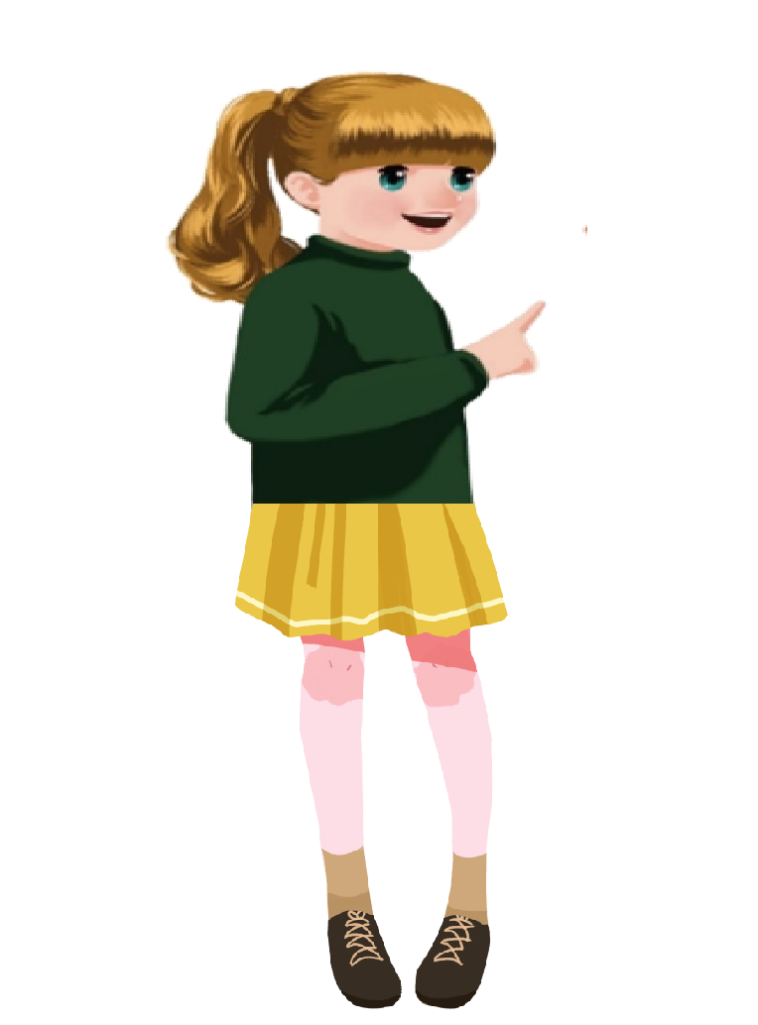
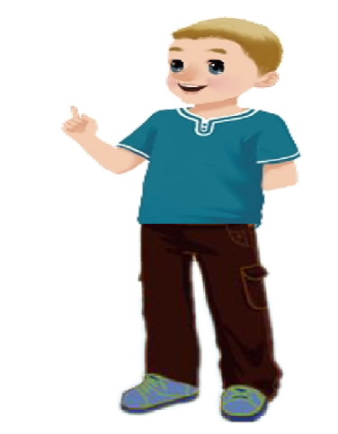
Role-play
Fluency 流利度 | Pronunciation＆Intonation 语音语调 | Acting 表演
Sam:
Sarah:
Sam:
Sarah:
Sam:
Sarah:
Sam:
What’s this cartoon about?
It’s about a cat. The cat is a police officer.
Cool!
He chases the mice. They’re afraid of him.
Why?
Because the mice are bad. They hurt people.
The cat is angry with them.
Maybe our cat is chasing a mouse now!

Slide 17
Good memory
Sam:
Sarah:
Sam:
Sarah:
Sam:
Sarah:
Sam:
What’s this cartoon about?
It’s about a cat. The cat is a police officer.
Cool!
He chases the mice. They’re afraid of him.
Why?
Because the mice are bad. They hurt people. The cat is angry with them.
Maybe our cat is chasing a mouse now!

Slide 18
Let's say
How does these pictures make you feel?
happy
angry
afraid
It makes me_____________.

Slide 19
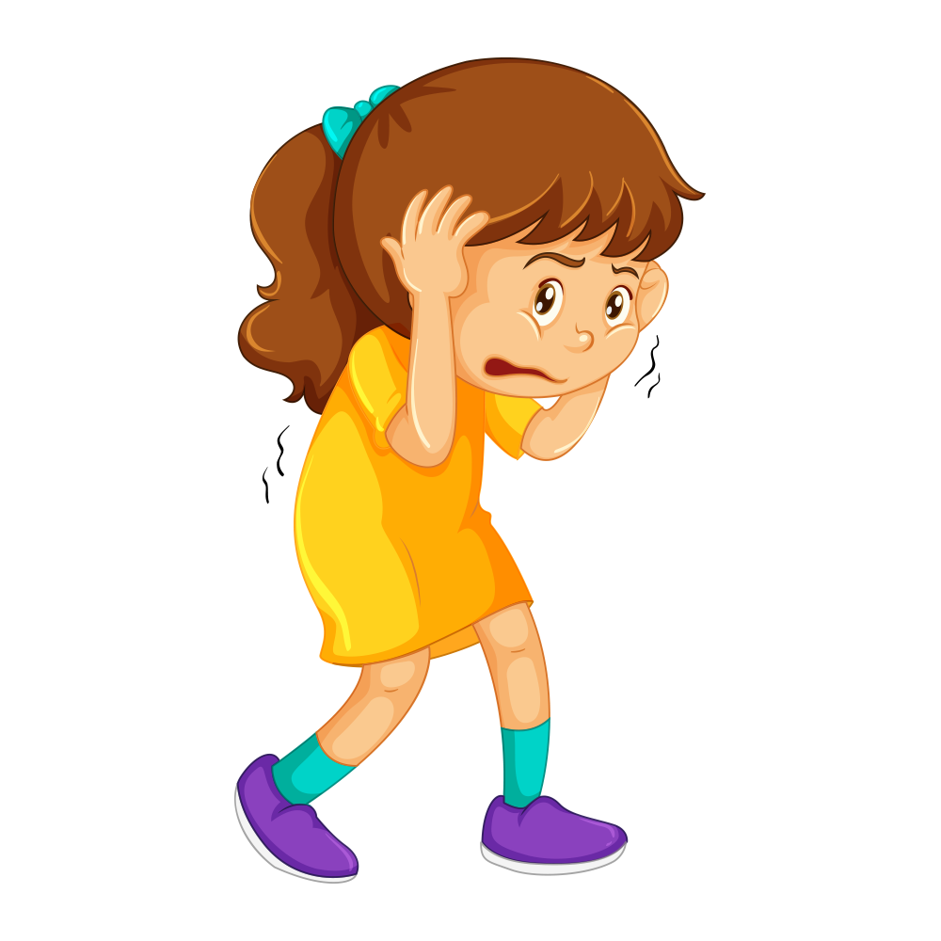
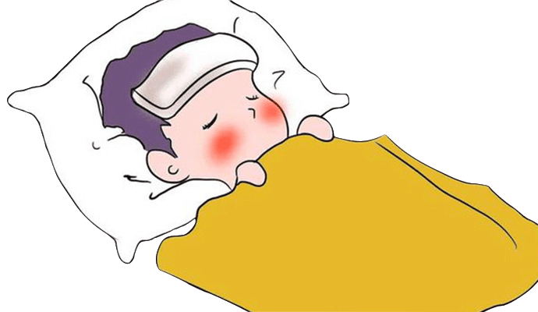
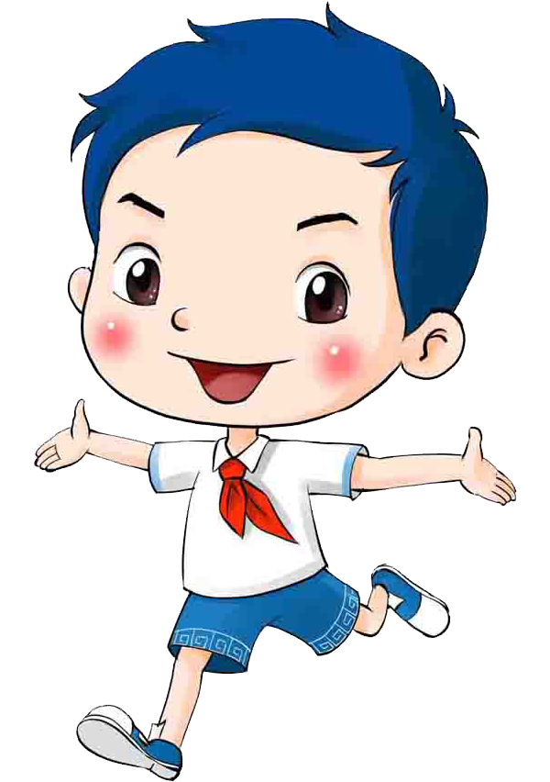
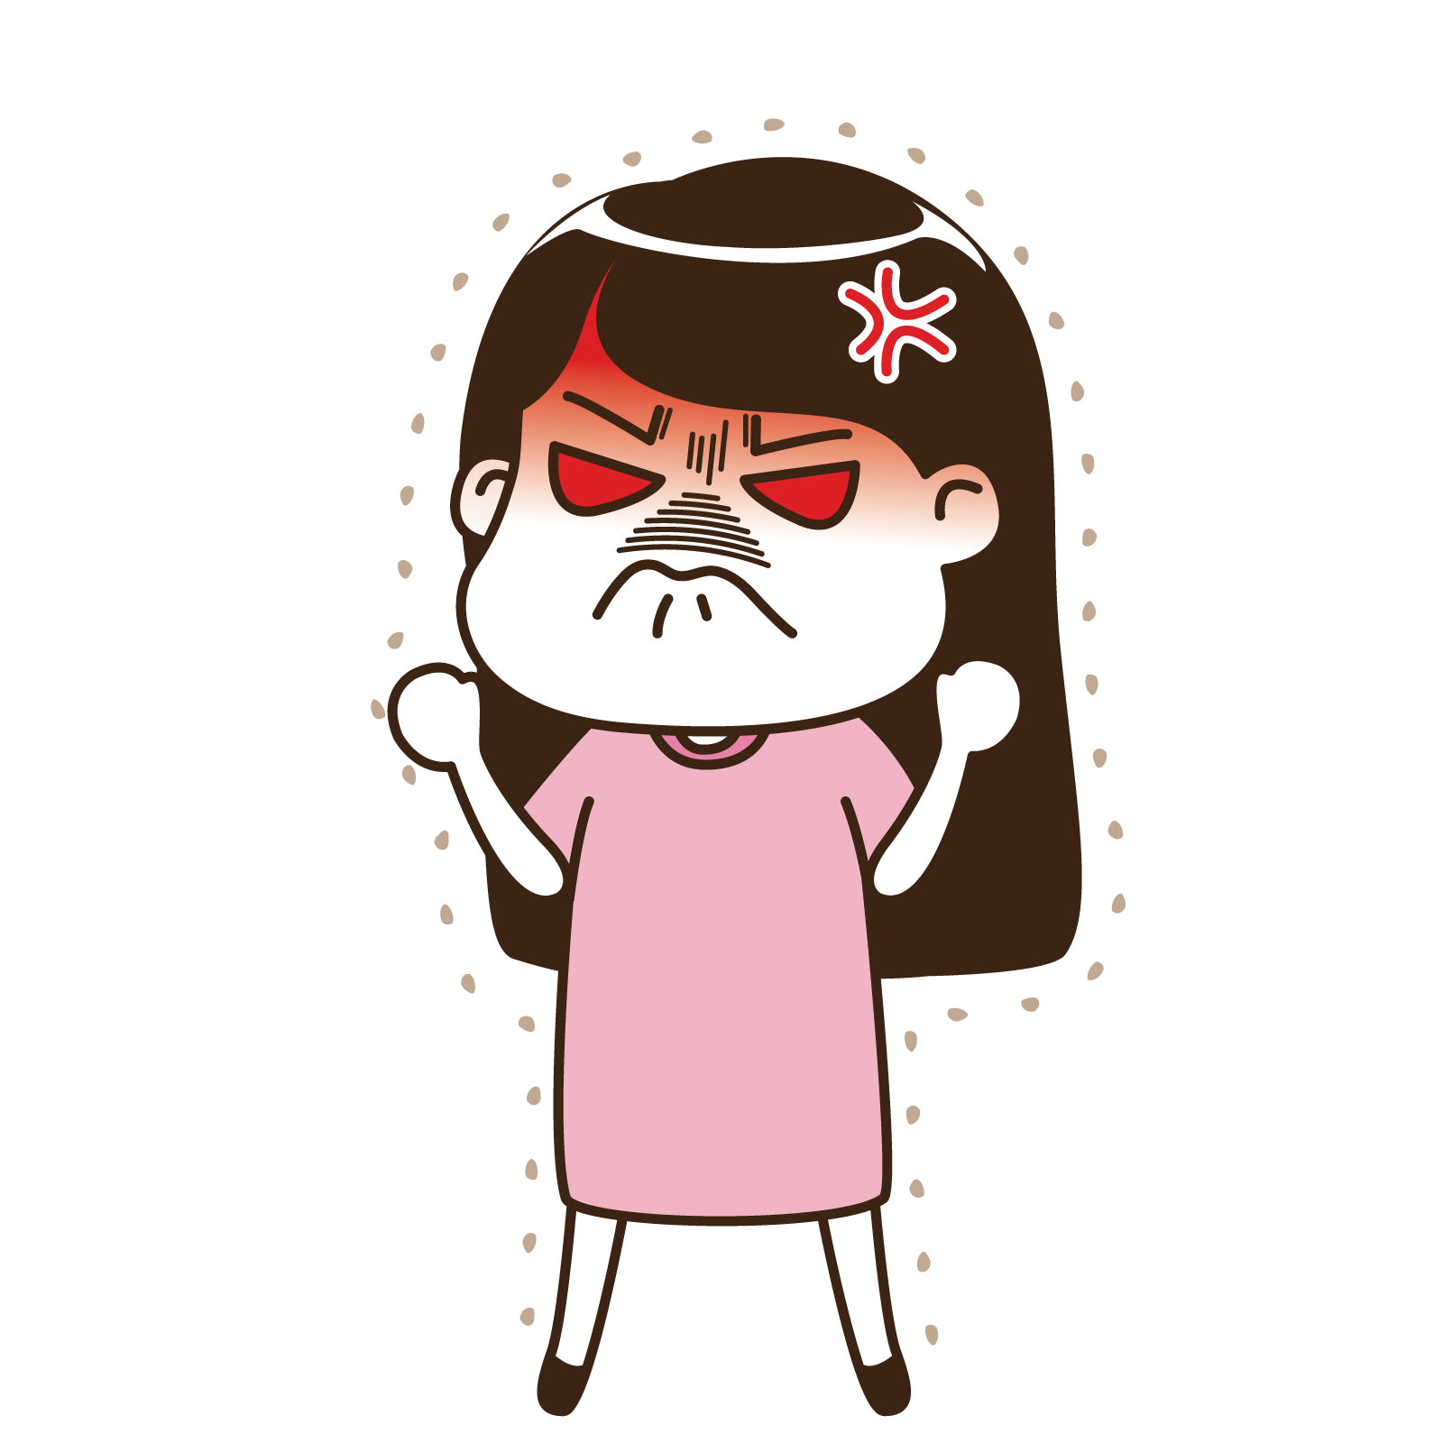
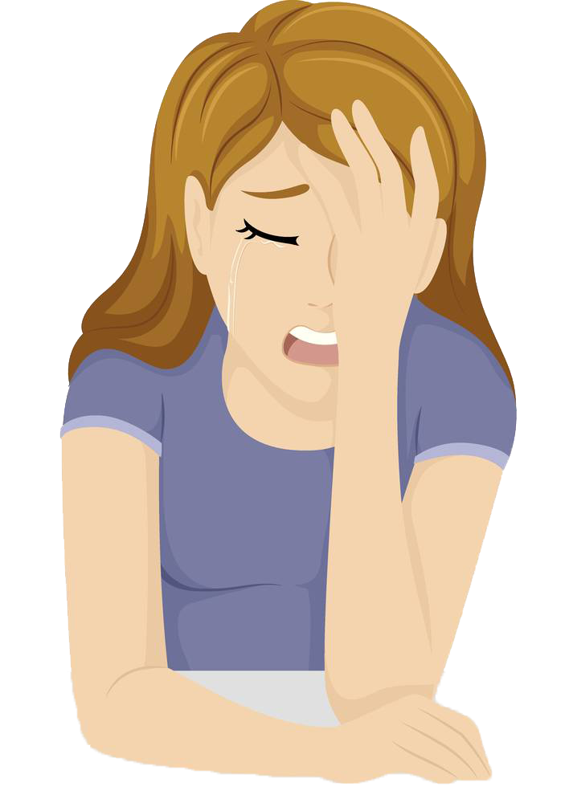
Ask and answer
How does he/she feel?
He/She is...

Slide 20
Let’s enjoy

Slide 21
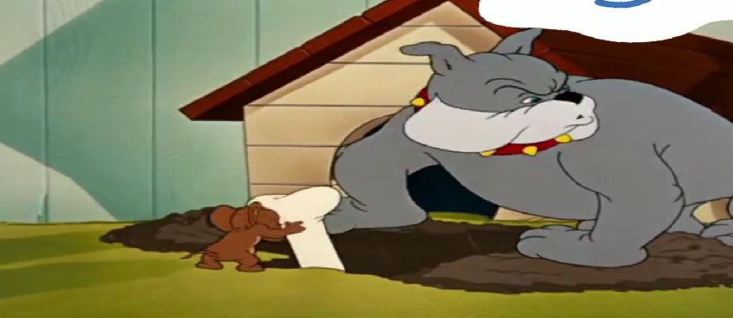
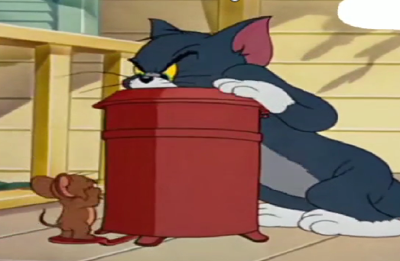
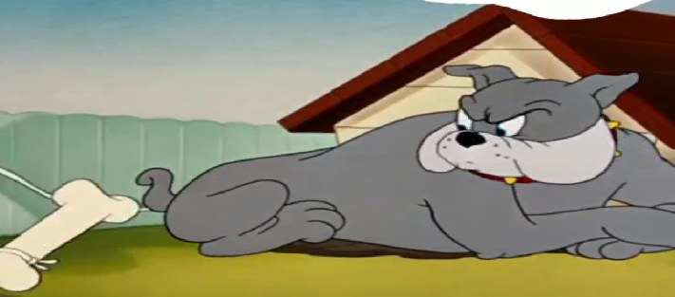
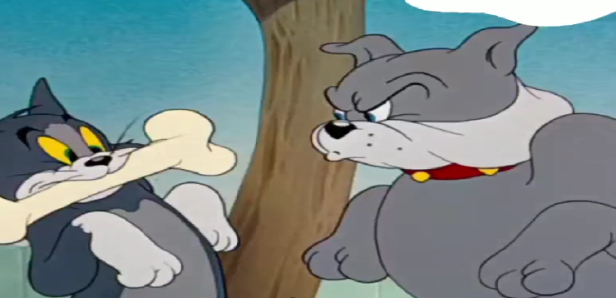
Say and fill
A:What’s the cartoon about?
B: _______________________.
The mouse is bad.
A: How does the cat feel?
B:______________________.
He chases the mouse.
A: How does the dog feel?
B:_______________________.
A: Why do the mouse and the cat run ?
B:_______________________.
It's about a cat and a mouse.
The cat is angry.
The dog is angry.
They are afraid of the dog.

Slide 22
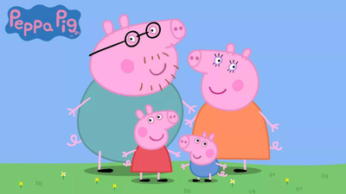
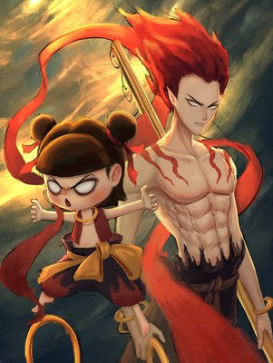
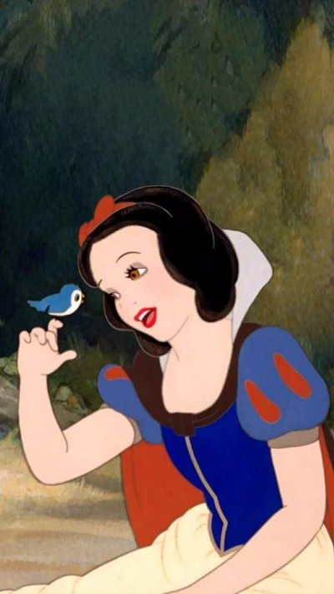
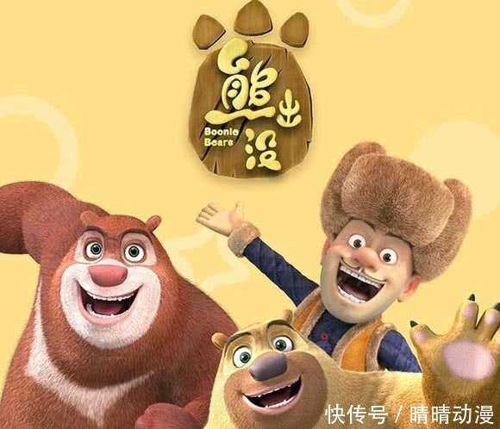
Make a new dialogue
A:What’s the cartoon about?
B: _______________________.
A: How does the ___ feel?
B:______________________.
A: How does the ___ feel?
B:_______________________.
A: Why ... ?
B:_______________________.
...
Word bank: afraid of,sad,happy,angry...

Slide 23
What have we learned today?
(今天我们学到了什么？)
1. 学习了下列单词及词组：
chase, mice, bad, hurt, be afraid of, be angry with
2. 学习了运用句型“主语 + be + 表示情绪的形容词”，表达心情和感受。

Slide 24
Homework
1
3
1. Read the text
on P58.
3. Show us your dialogue next class!
2014
2
4
2. Make a dialogue with your partners.
4.Finish your ecercises.
2014

Slide 25
Goodbye

