Slide 1
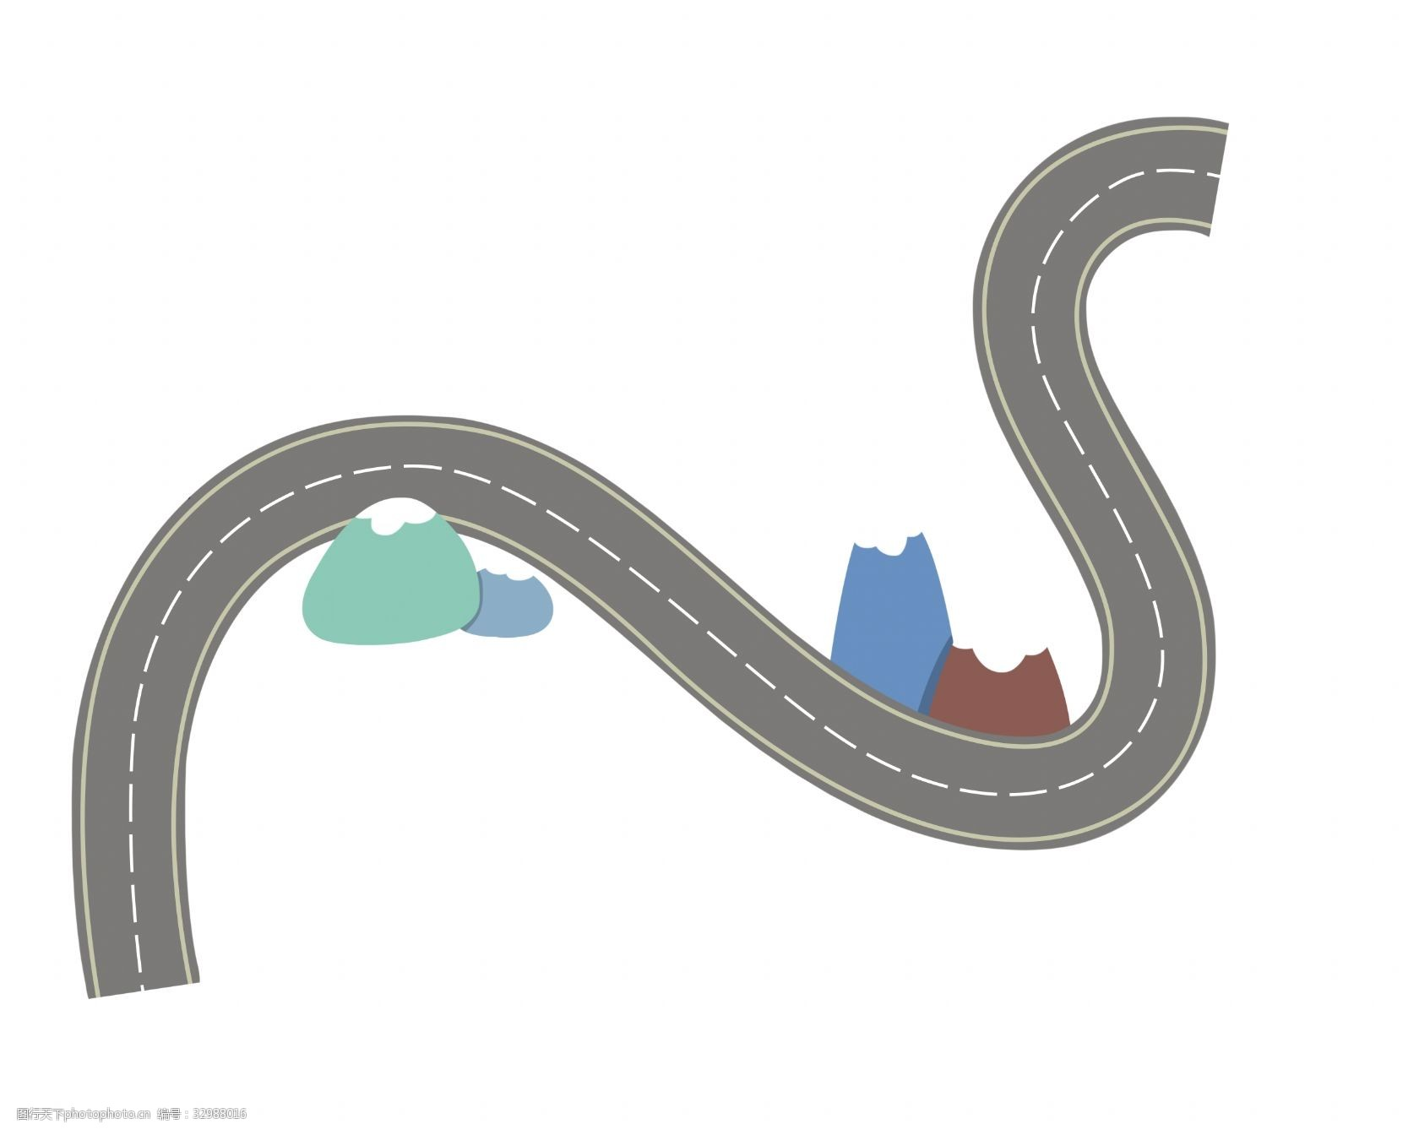
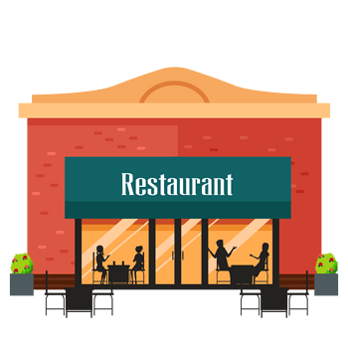
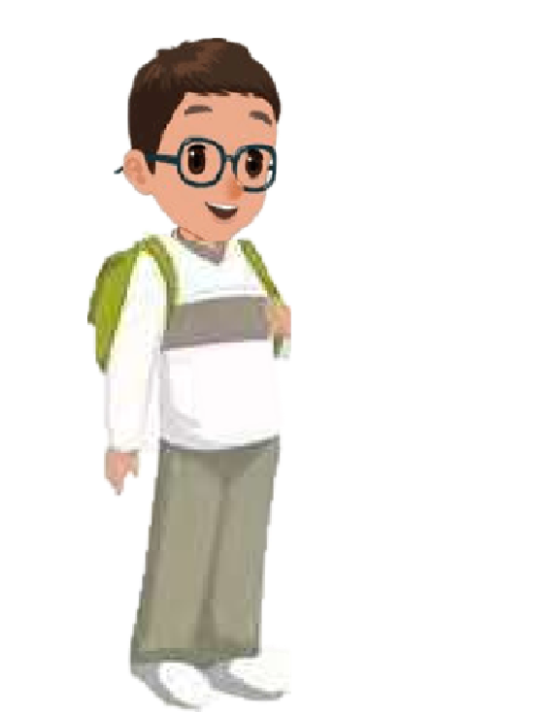
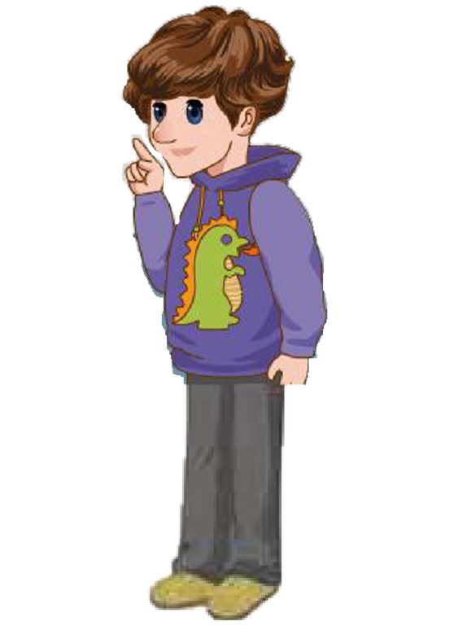
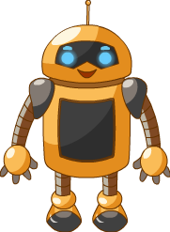
Unit 1 How can I get there？
B Read and write

Slide 2
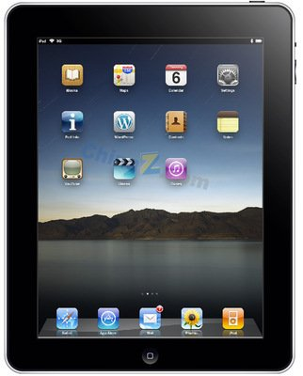
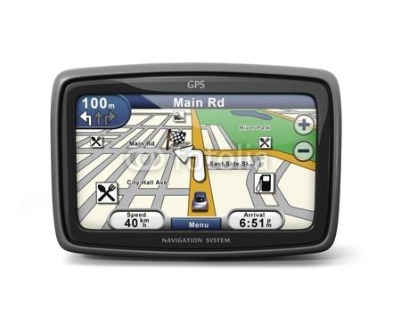
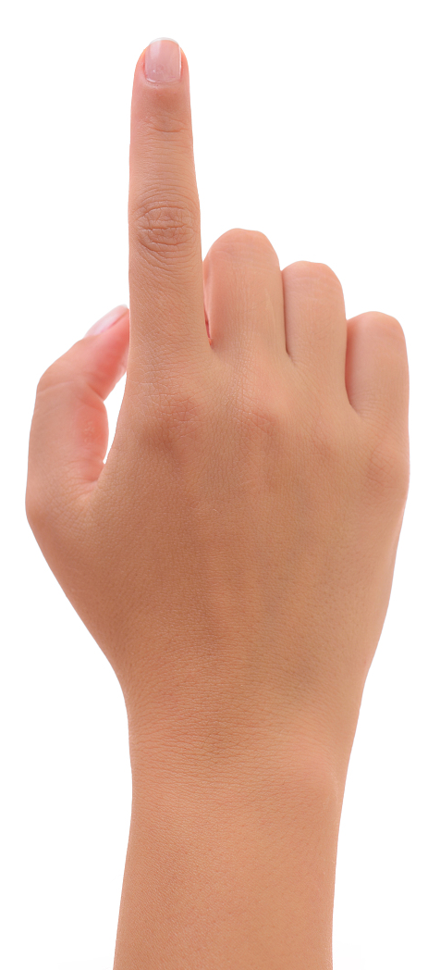
Let's sing

Slide 3
Let's chant
Cinema, cinema, where is the cinema?
It’s near the bookstore.
Bookstore, bookstore, Where is the bookstore?
Hospital. hospital，It’s behind the hospital.
Where’s the hospital?
Museum, museum, It’s next to the museum.
Where is the museum?
Restaurant, restaurant, It’s in front of the restaurant.
Where is the restaurant?
I don’t know, I don’t know.
Robin can go with you.

Slide 4
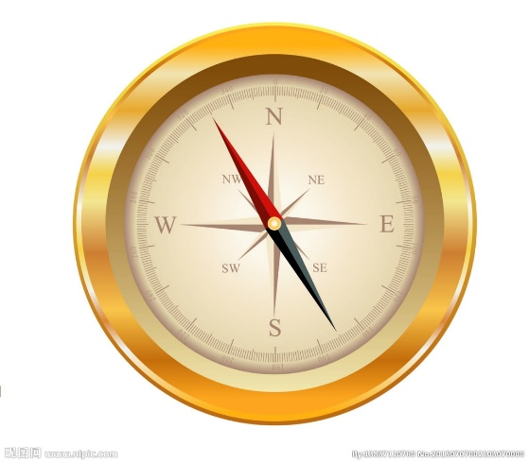
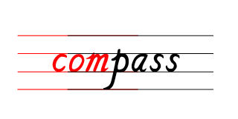
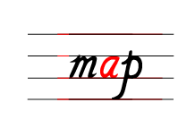
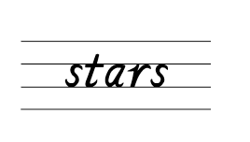
Let's know
These are some ways to help us find a place.

Slide 5
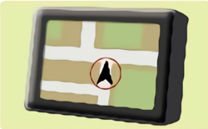
Let's answer
You are in a car. Which of these can help you find a place?
BDS北斗卫星导航系统，可在全球范围内
全天候、全天时为各类用户提供高精度、
高可靠定位、导航、授时服务。

Slide 6
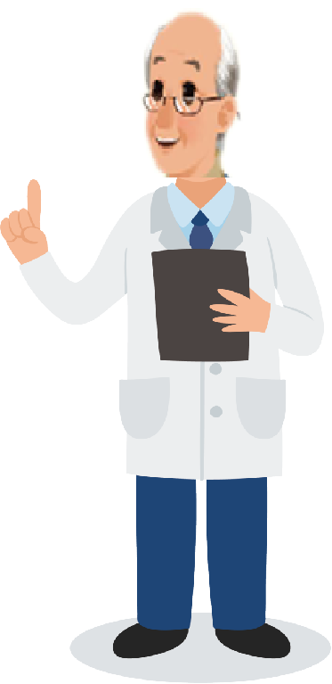
Wu Binbin’s grandpa gave Robin a new feature.
feature 特色，功能
Now Robin has BDS.

Slide 7
Fast reading
Wu Binbin and his friends wanted to go to Italian restaurant.
Read the text quickly and answer the question.
What is Robin’s new feature?
□He can find food. □He can find the way.

Slide 8
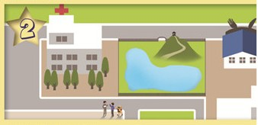
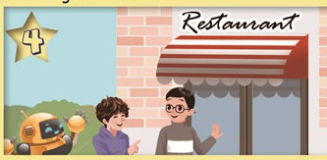
Robin has BDS!
Wu Binbin’s grandpa gave Robin a new feature. He now has BDS.
He can help the boys find the Italian restaurant.
Robin:
We’re in front of the cinema. Let’s go straight and turn
eft at the bookstore. Follow me, please!
Mike: Is it far?
Robin: No. Now we are behind the hospital. Let’s turn right and then turn right again.
Robin: My new BDS works!
Wu Binbin: Yes! I’ll tell Grandpa. But let’s eat first. I’m so hungry!
Mike: There is the restaurant!

Slide 9
Fast reading
Wu Binbin and his friends wanted to go to Italian restaurant.
Read the text quickly and answer the question.
What is Robin’s new feature?
□He can find food. □He can find the way.

Slide 10
Detailed reading
Read the text carefully and answer the questions.
1. How many places did they pass by?
2. Underline them in the text.
3. Which word under the fourth picture means “奏效，起作用”？

Slide 11
1. How many places did they pass by?
Three.
Robin:
We’re in front of the cinema. Let’s go straight and turn
eft at the bookstore. Follow me, please!
Mike: Is it far?
Robin: No. Now we are behind the hospital. Let’s turn right and then turn right again.
Robin: My new BDS works!
Wu Binbin: Yes! I’ll tell Grandpa. But let’s eat first. I’m so hungry!
Mike: There is the restaurant!

Slide 12
3. Which word under the fourth picture means “奏效，起作用”？
work
Robin:
We’re in front of the cinema. Let’s go straight and turn
eft at the bookstore. Follow me, please!
Mike: Is it far?
Robin: No. Now we are behind the hospital. Let’s turn right and then turn right again.
Robin: My new BDS works!
Wu Binbin: Yes! I’ll tell Grandpa. But let’s eat first. I’m so hungry!
Mike: There is the restaurant!

Slide 13
Listen and imitate
Robin has BDS!
Wu Binbin’s grandpa gave Robin a new feature. He now has BDS. He can help the boys find the Italian restaurant.
Robin:
We’re in front of the cinema. Let’s go straight and turn
eft at the bookstore. Follow me, please!
Mike: Is it far?
Robin: No. Now we are behind the hospital. Let’s turn right and then turn right again.
Robin: My new BDS works!
Wu Binbin: Yes! I’ll tell Grandpa. But let’s eat first. I’m so hungry!
Mike: There is the restaurant!

Slide 14
Read in groups
Robin has BDS!
Wu Binbin’s grandpa gave Robin a new feature. He now has BDS. He can help the boys find the Italian restaurant.
Robin:
We’re in front of the cinema. Let’s go straight and turn
eft at the bookstore. Follow me, please!
Mike: Is it far?
Robin: No. Now we are behind the hospital. Let’s turn right and then turn right again.
Robin: My new BDS works!
Wu Binbin: Yes! I’ll tell Grandpa. But let’s eat first. I’m so hungry!
Mike: There is the restaurant!

Slide 15
Good memory
Robin has BDS!
Wu Binbin’s grandpa gave Robin a new feature. He now has BDS. He can help the boys find the Italian restaurant.
Robin:
We’re in front of the cinema. Let’s go straight and turn
eft at the bookstore. Follow me, please!
Mike: Is it far?
Robin: No. Now we are behind the hospital. Let’s turn right and then turn right again.
Robin: My new BDS works!
Wu Binbin: Yes! I’ll tell Grandpa. But let’s eat first. I’m so hungry!
Mike: There is the restaurant!

Slide 16
Fill in the blanks
Then retell the story.
Wu Binbin and his friends want to eat some pizza in an Italian restaurant. They ___________ and ____________________. They _______________________ and then turn right again.
go straight
turn left at the bookstore
turn right

Slide 17
Tips for prounciation
Listen, look and say.
Robin has
Follow
please!
BDS.
me,
far ?
Where is the
Is it
restaurant?
陈述句、特殊疑问句祈使句常使用降调，一般疑问句常用升调。

Slide 18
Let’s judge
1. Where is the cinema?
2. Is there a park near here?
3. Can I have some chicken, please?
4. This is a cat.
5. Are you a boy?
6. What’s the weather like today?

Slide 19
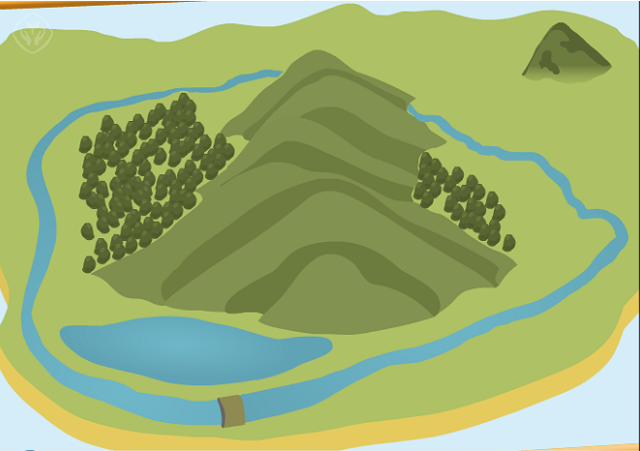
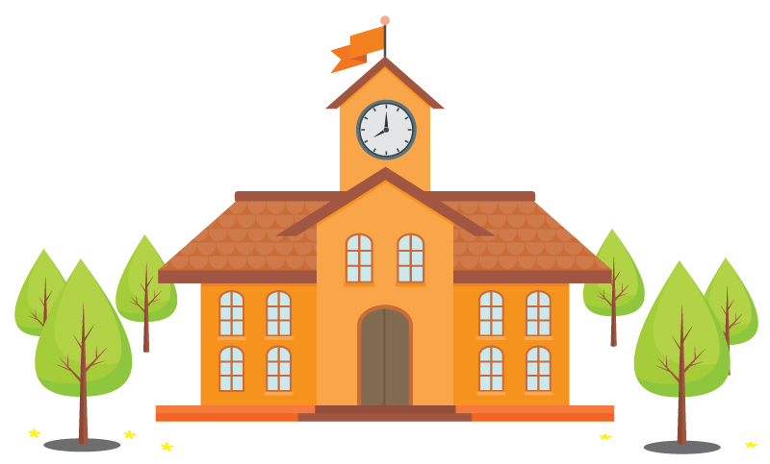
Look and fill
Chen Jie wants to go to Sarah’s home. She goes straight and turns right at the bookstore. Then she goes straight and turns left at the cinema.

Slide 20
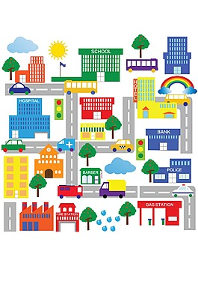
Draw a map and write
Word bank:
turn right/left,go straight,cinema...
I want to go to _______. I___________and__________at____.
Then I _________....

Slide 21
What have we learned today?
(今天我们学到了什么？)
1. 学习了下列词汇：BDS, gave, feature,
follow, far, tell
2.了解英语句子两种基本语调：降调和升调。

Slide 22
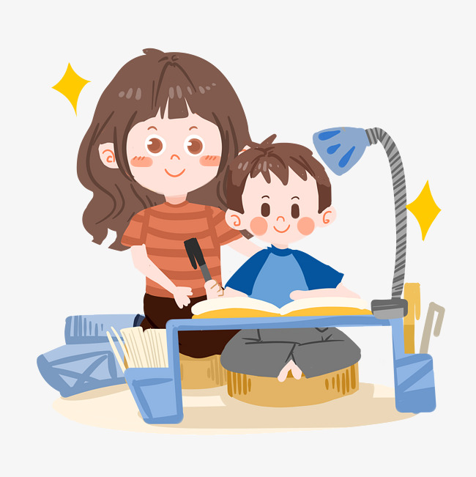
Homework:
1. Listen and repeat the text three times.
2. Try to retell the passage.
3. Show your route and try to elaborate.

Slide 23
Goodbye

