Slide 1
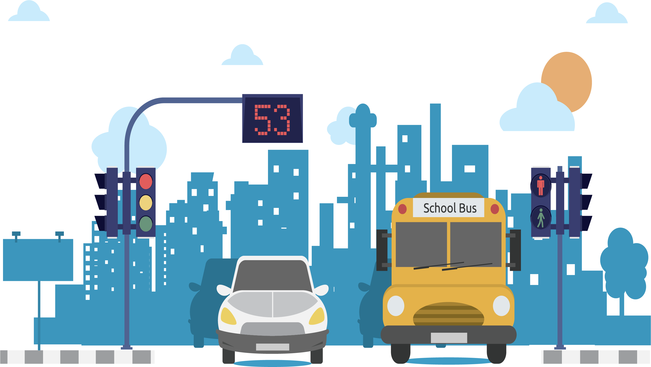
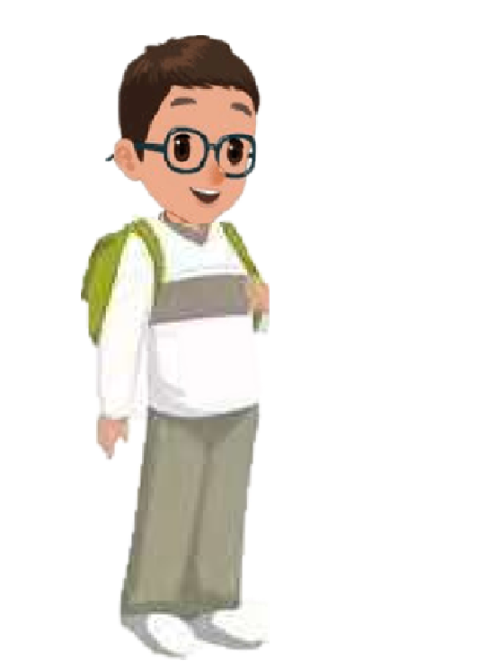
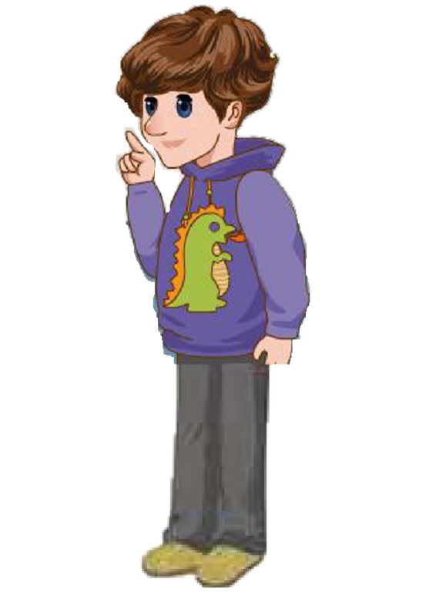
Unit 1 How can I get there？
B Let's learn

Slide 2
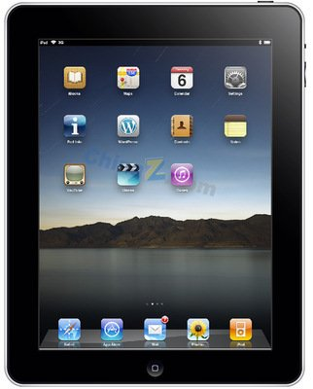
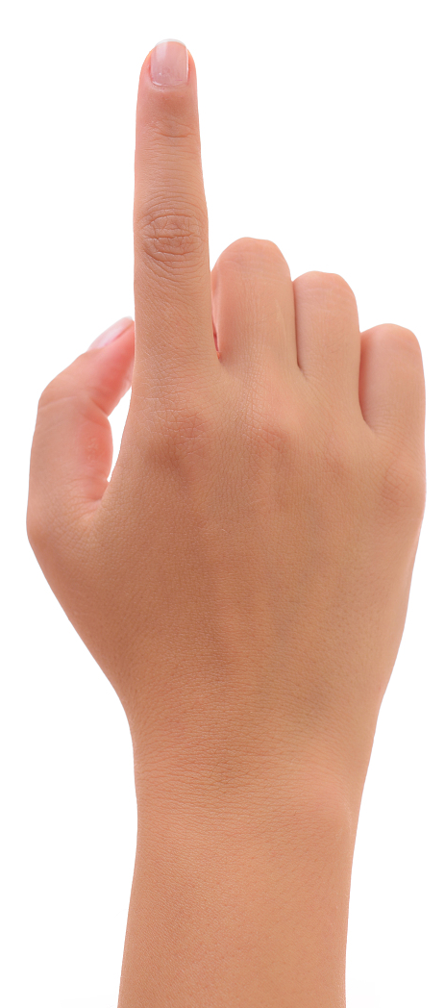
Let's sing

Slide 3
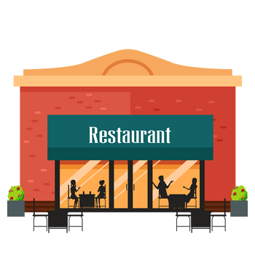
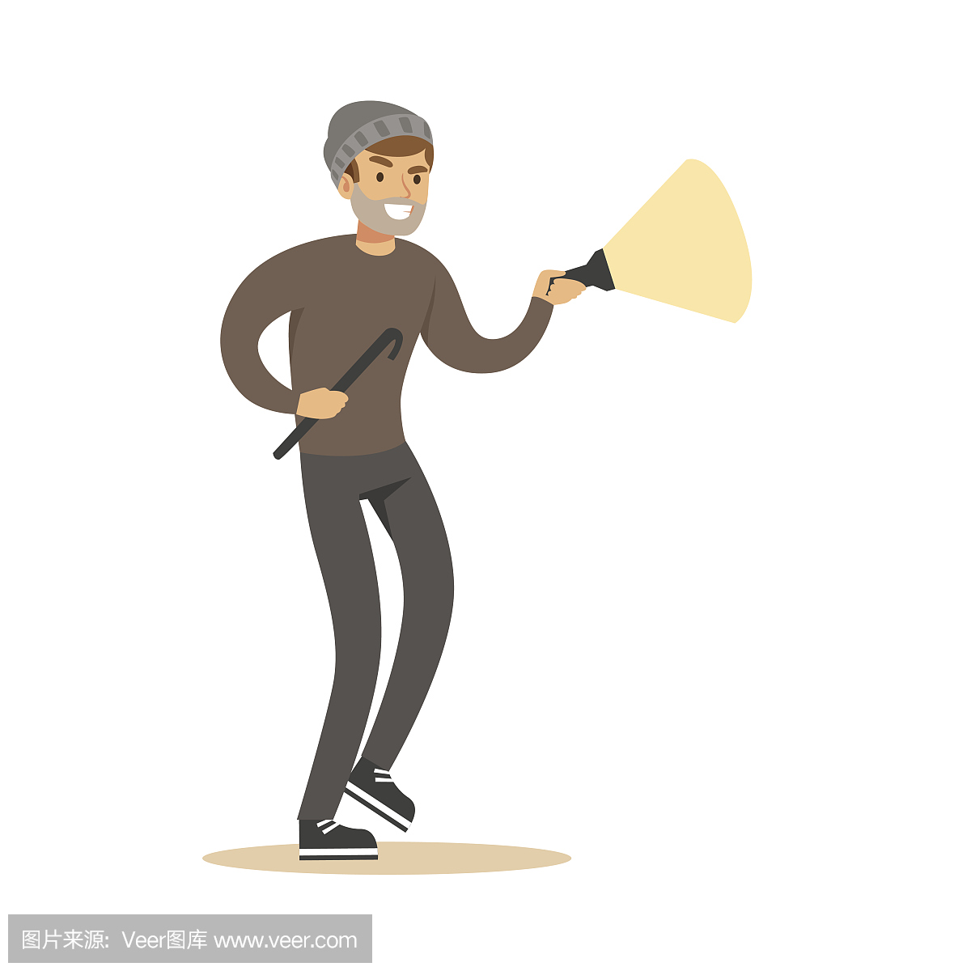
Let's review

Slide 4
It’s 12 o’clock. Mike and Wu Binbin are hungry. They want to go to the Italian restaurant.
Robin, where is the Italian restaurant?
It’s on Dongfang street.
OK. Let’s go!

Slide 5
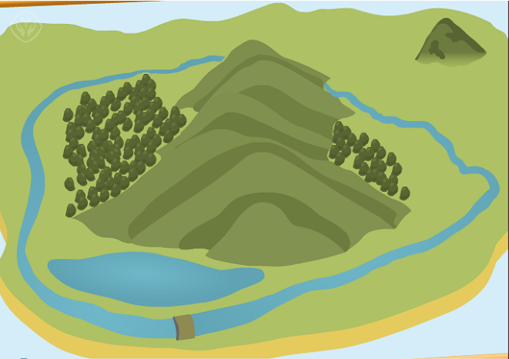
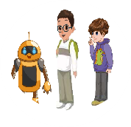
Dongfang Street

Slide 6
Turn left at the bookstore.
OK.

Slide 7
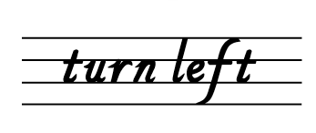

Slide 8
Dongfang Street

Slide 9
OK.
Turn right at the hospital.

Slide 11
Let's say
Turn right/left at...
Turn right at the bookstore.
Turn left at the post office.

Slide 12
Where are we?
We are at the crossing.

Slide 13
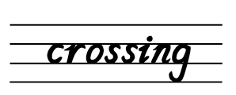
at the crossing

Slide 14
OK.
Turn right and go straight.

Slide 15
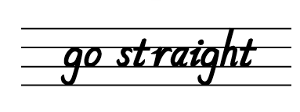

Slide 16
Listen and imitate
Mike: Where is the Italian restaurant?
Turn right here?
Robin: No, turn left.
crossing
turn left
go straight
turn right

Slide 17
Read in groups
Mike: Where is the Italian restaurant?
Turn right here?
Robin: No, turn left.
crossing
turn left
go straight
turn right

Slide 18
Let’s match
crossing
turn left
turn right
go straight

Slide 19
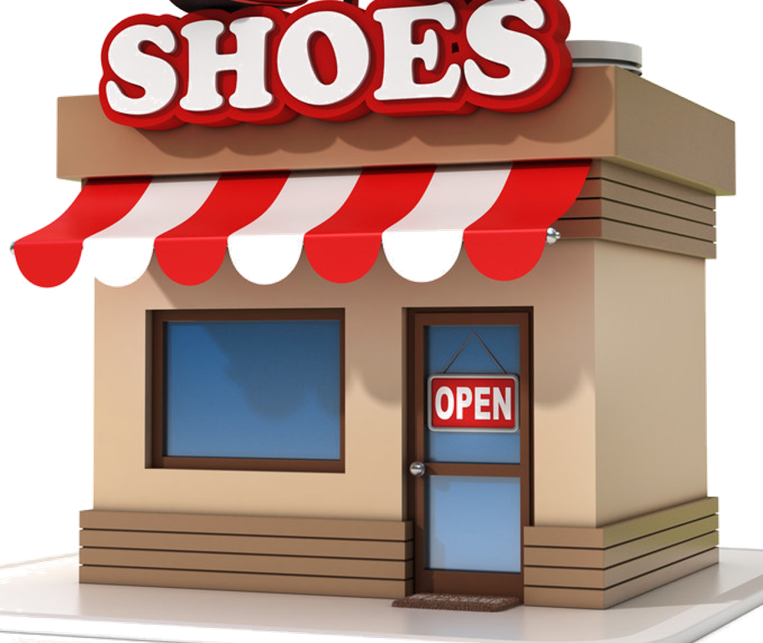
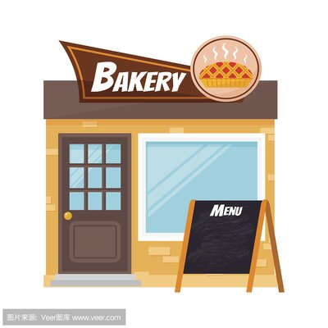
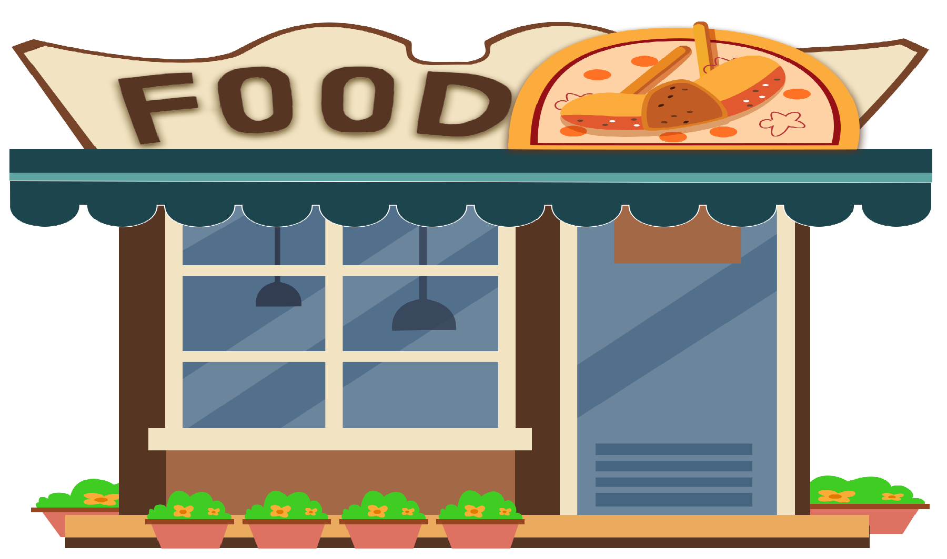
Speak out

Slide 20
Speak out

Slide 21
Speak out

Slide 22
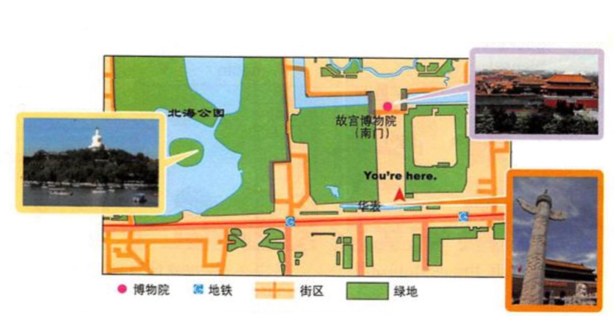
Be a tour guide
Chen Jie is trying to be a tour guide for Oliver in Beijing. Can you help her?
Palace Museum
Beihai Park
Tian’an men
Now we are in front of Tian’anmen.
Go straight and you can see the Place Museum.

Slide 23
Let’s practice
Palace Museum
Beihai Park
Tian’an men
Now we are ...

Slide 24
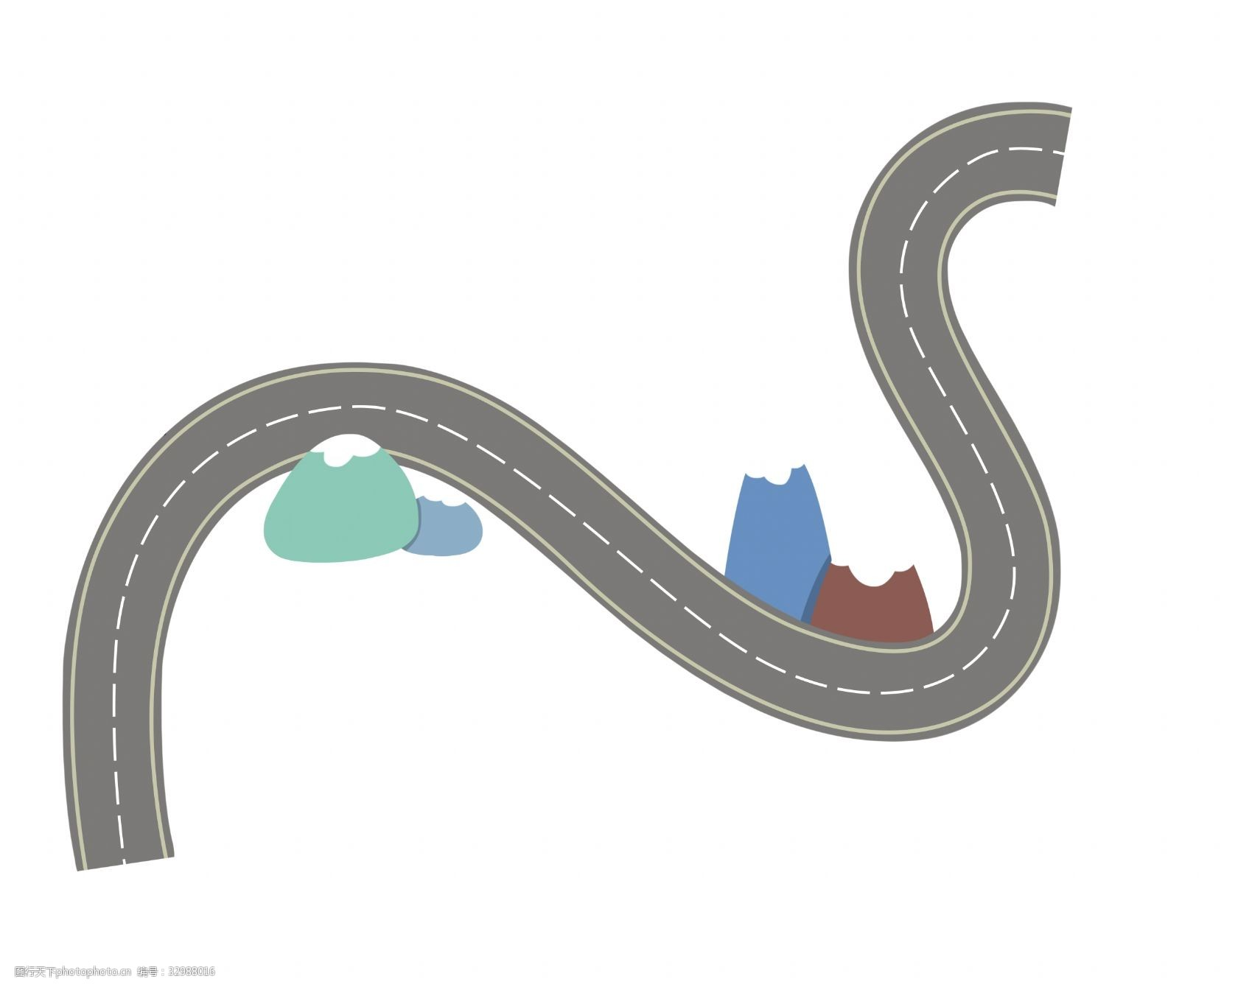
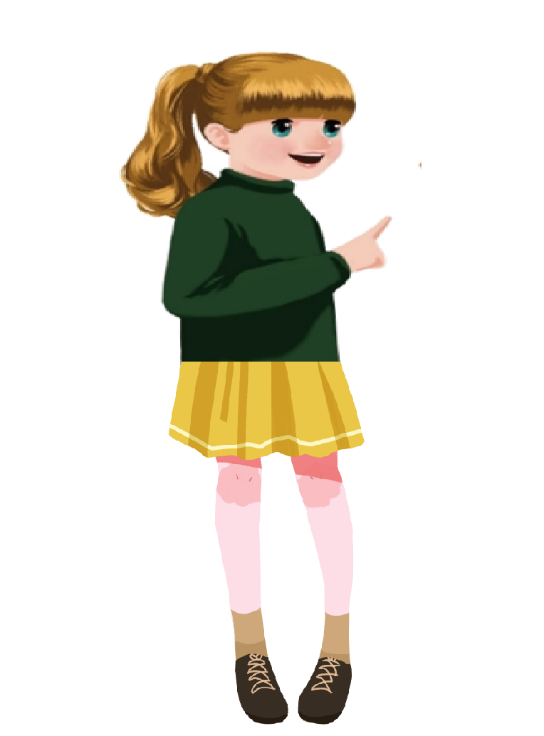
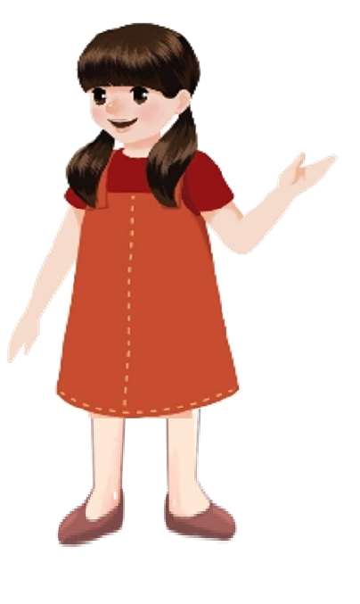
Look and fill
Chen Jie wants to go to Sarah’s house.
They are on the phone.
Let’s look and fill the dialogue.

Slide 25
Chen Jie: Hello! This is Chen Jie. Is that Sarah?
Sarah: Yes. Come and play with me，Chen Jie.
Chen Jie: OK. How can I get your home?
Sarah: Well. First____________ and __________at
the bookstore. Then__________at the cinema.
You’ll find my home. It’s next to the _______.
Chen Jie: Thanks. See you later.
go straight
turn right
turn left
cinema

Slide 26
Make a new dialogue
Word bank:
turn right/left,go straight,cinema...
A: Hello! This is ______. Is that _____?
B: Yes. Come and play with me!
A: OK. How can I get your home?
B: Well. First____________ and __________at
_________. Then__________at________.
You’ll find my home. It’s next to the _______.
A: Thanks. See you later.

Slide 27
What have we learned today?
(今天我们学到了什么？)
1. 学习了下列词汇：crossing, turn left,
go straight, turn right
2.学习了下列句型：
—Where is the Italian restaurant?
—Turn right here.

Slide 28
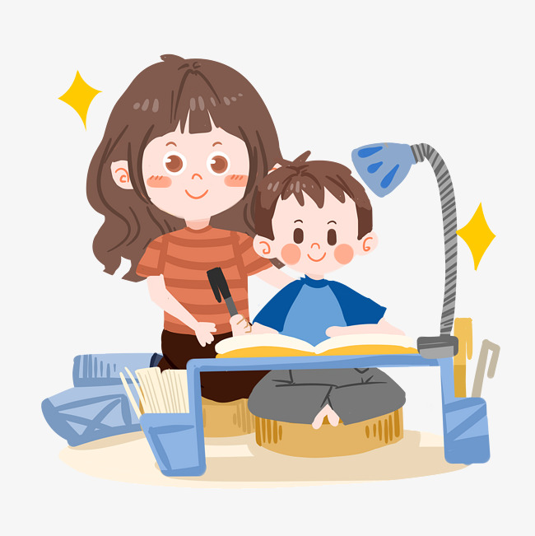
Homework:
1. Listen and recite the words in this lesson.
2.Make a traffic sign book.

Slide 29
Goodbye

