Slide 1
Unit 1 How can I get there？
A Let's talk

Slide 2
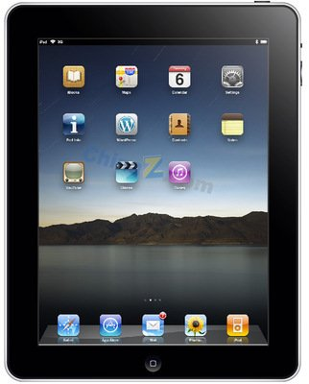
Let's sing

Slide 3
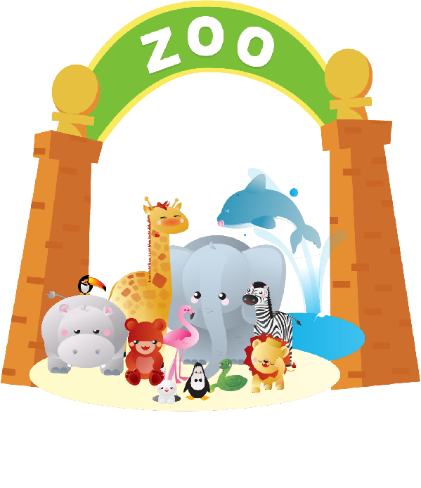
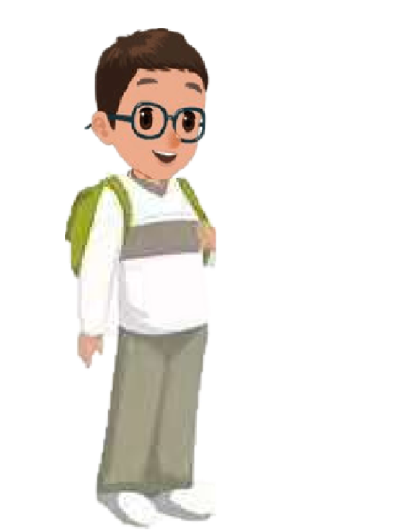
Where are they?
School is over. Wu Binbin and Robin go out from the school.
They are in front of zoo.
They are near the shop.

Slide 4
Wu Binbin and Robin are looking at some robots.

Slide 5
Let's try
Wu Binbin and Robin are looking at some robots.
Listen and tick.
1. Where are they?
In the museum. In the bookstore.
2. Is Grandpa there?
Yes, he is. No, he isn’t.

Slide 6
Let's try
听力原文：
Wu Binbin:
Robin:
Wu Binbin:
Robin:
Wu Binbin:
These robots are so cool! I love this museum!
Me too! Don't forget to buy some gifts for Grandpa.
I know. But I really need to go to the bathroom. Where is it?
It's on the second floor.
OK, thanks.
忘记

Slide 7
What a great museum!
Wu Binbin has something to do.

Slide 8
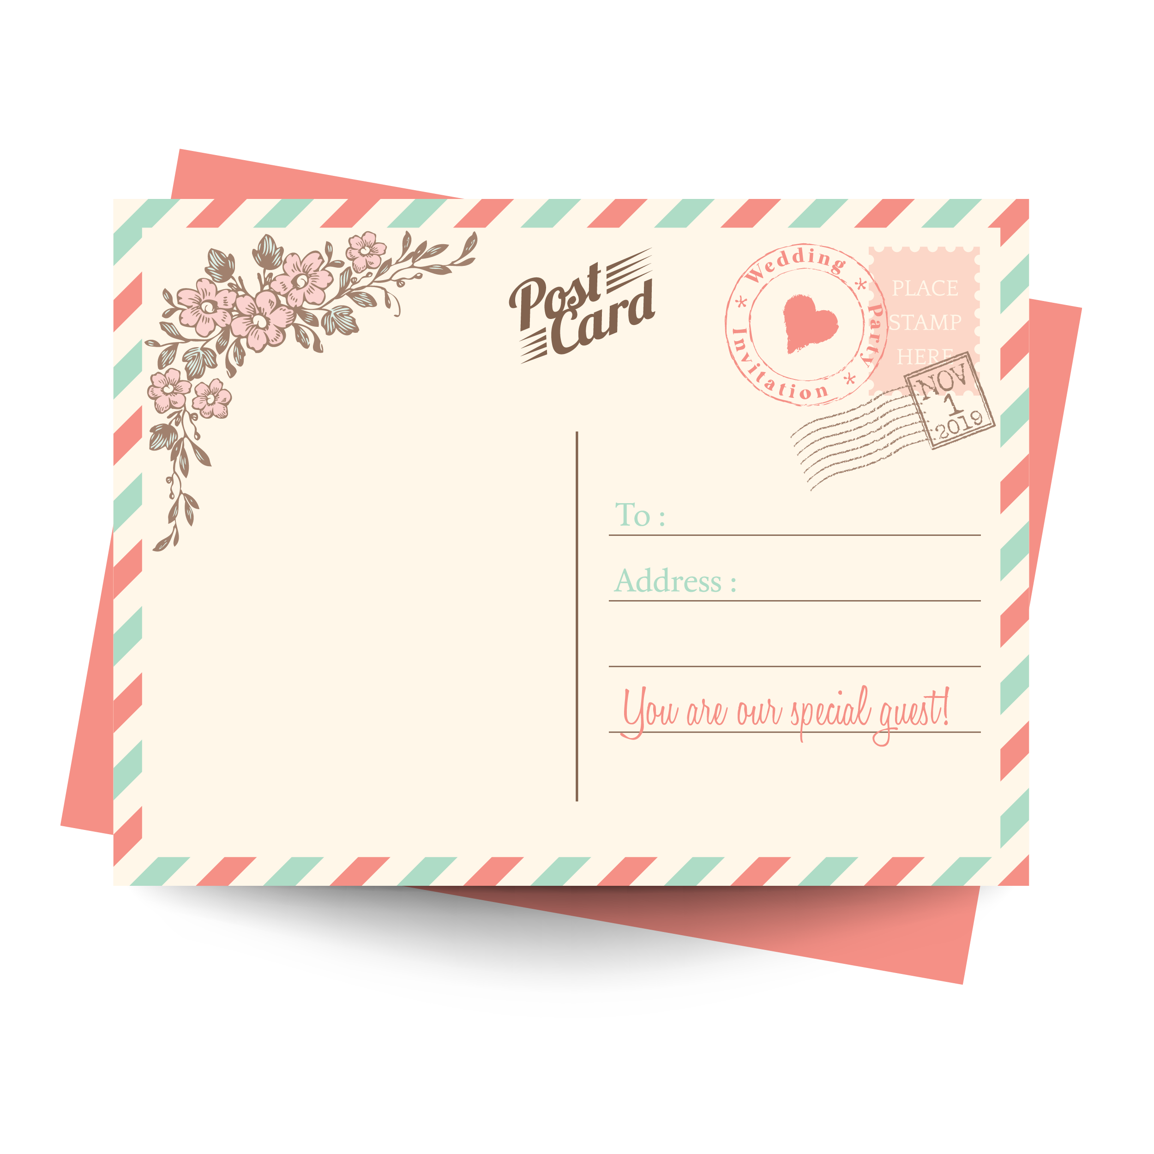
Listen and answer
What does Binbin want to do ?
He wants to buy a postcard.
I want to buy a postcard.

Slide 9
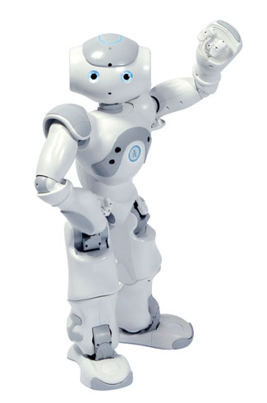
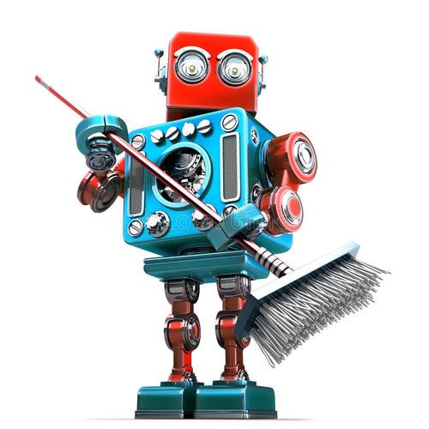
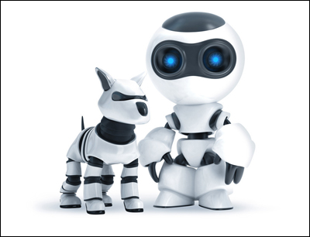
Look and answer
So Wu Binbin goes to the museum shop.
Where is the museum shop ?
It’s near the door.
museum shop

Slide 10
Watch and answer
So he wants to get to the post office.
Where is the post office ?
I want to send(邮寄）it today.

Slide 12
Watch and answer
Where is the post office ?
It's next to the museum.
I want to send(邮寄）it today.

Slide 13
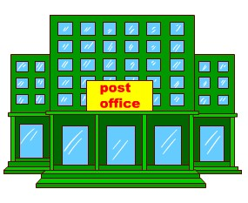
The post office is next to the museum.

Slide 14
Listen and imitate

Slide 15
1. Read the dialogue.合作朗读。
2. Role play the dialogue.
含有表情、语气、动作表演对话。
Read in groups
Wu Binbin:
Robin:
Wu Binbin:
Robin:
Man:
Robin:
Man:
Robin:
Robin, where is the museum shop? I want to buy a postcard.
It’s near the door.
Thanks. Where is the post office? I want to send it today.
I don’t know. I’ll ask. Excuse me, sir.
Wow! A talking robot! What a great museum!
Where is the post office?
It’s next to the museum.
Thanks.

Slide 16
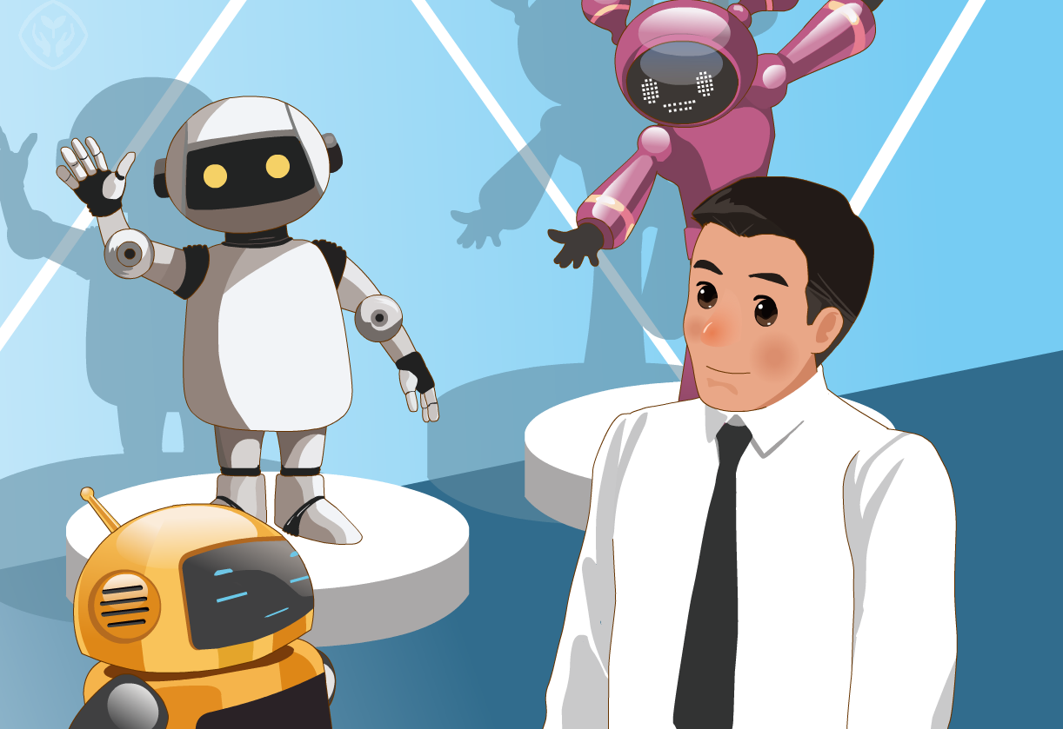
Good memory
Wu Binbin:
Robin:
Wu Binbin:
Robin:
Man:
Robin:
Man:
Robin:
Robin, where is the museum shop? I want to buy a postcard.
It’s near the door.
Thanks. Where is the post office? I want to send it today.
I don’t know. I’ll ask. Excuse me, sir.
Wow! A talking robot! What a great museum!
Where is the post office?
It’s next to the museum.
Thanks.

Slide 17
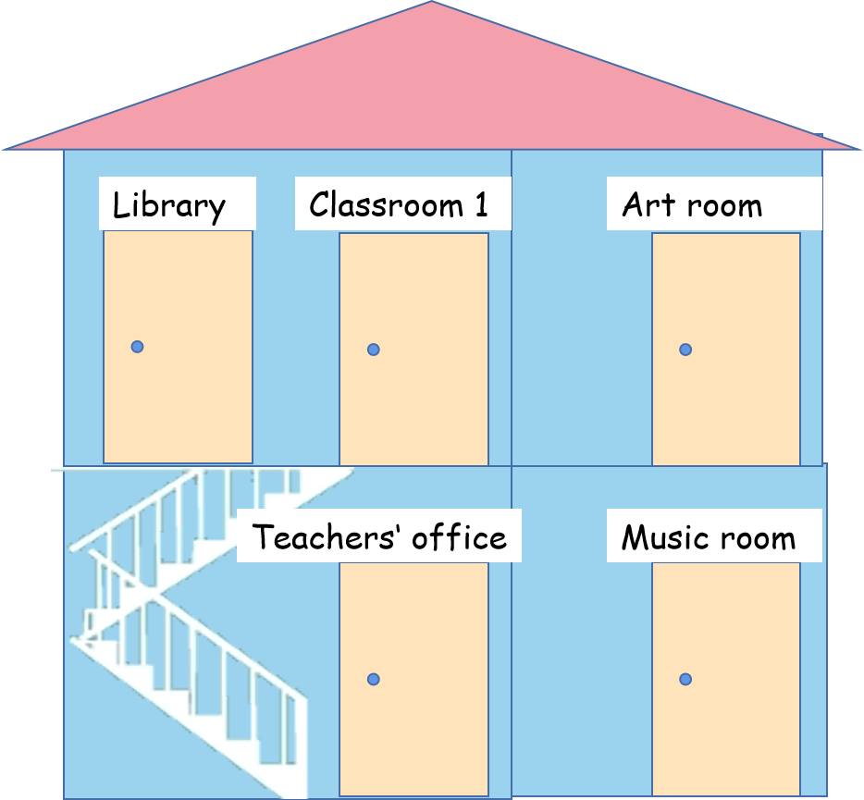
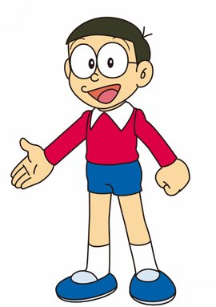
Ask and answer
Where is the library？
It's next to classroom1.

Slide 18
Ask and answer
A: Where is the...?
B: It’s...

Slide 19
Ask and answer
Talk about the places in your city/town/village.
Is there a ...?
Where is it?
It's near/next to/behind ...
park library zoo post office school museum

Slide 20
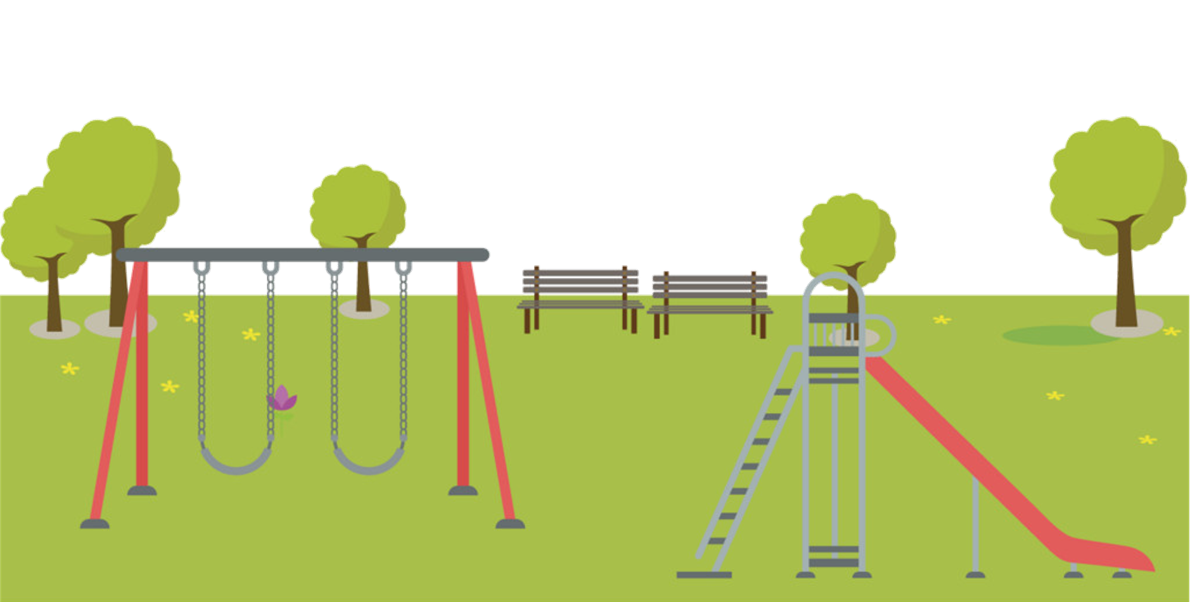

Slide 21
Is there a shop？
Yes,there is.
Where is it？
It’s next to the school.

Slide 22
Is there a park？
Yes,there is.
Where is it？
It’s next to the museum.

Slide 23
Make a new dialogue
A: Is there...?
B: ...
A: Where is it?
B: It’s...
Word bank:park, library, zoo, post office, school, museum, next to, behind...

Slide 24
What have we learned today?
(今天我们学到了什么？)
1. 学习了下列单词：postcard, sir, ask
3. 学习了在情景中运用句型：
— Where is the …?
— It’s …

Slide 25
Homework:
1. Listens and read the dialogue after class.
2. Make a dialogue with your partners with the sentences and show us next class.

Slide 26
Goodbye

