Slide 1
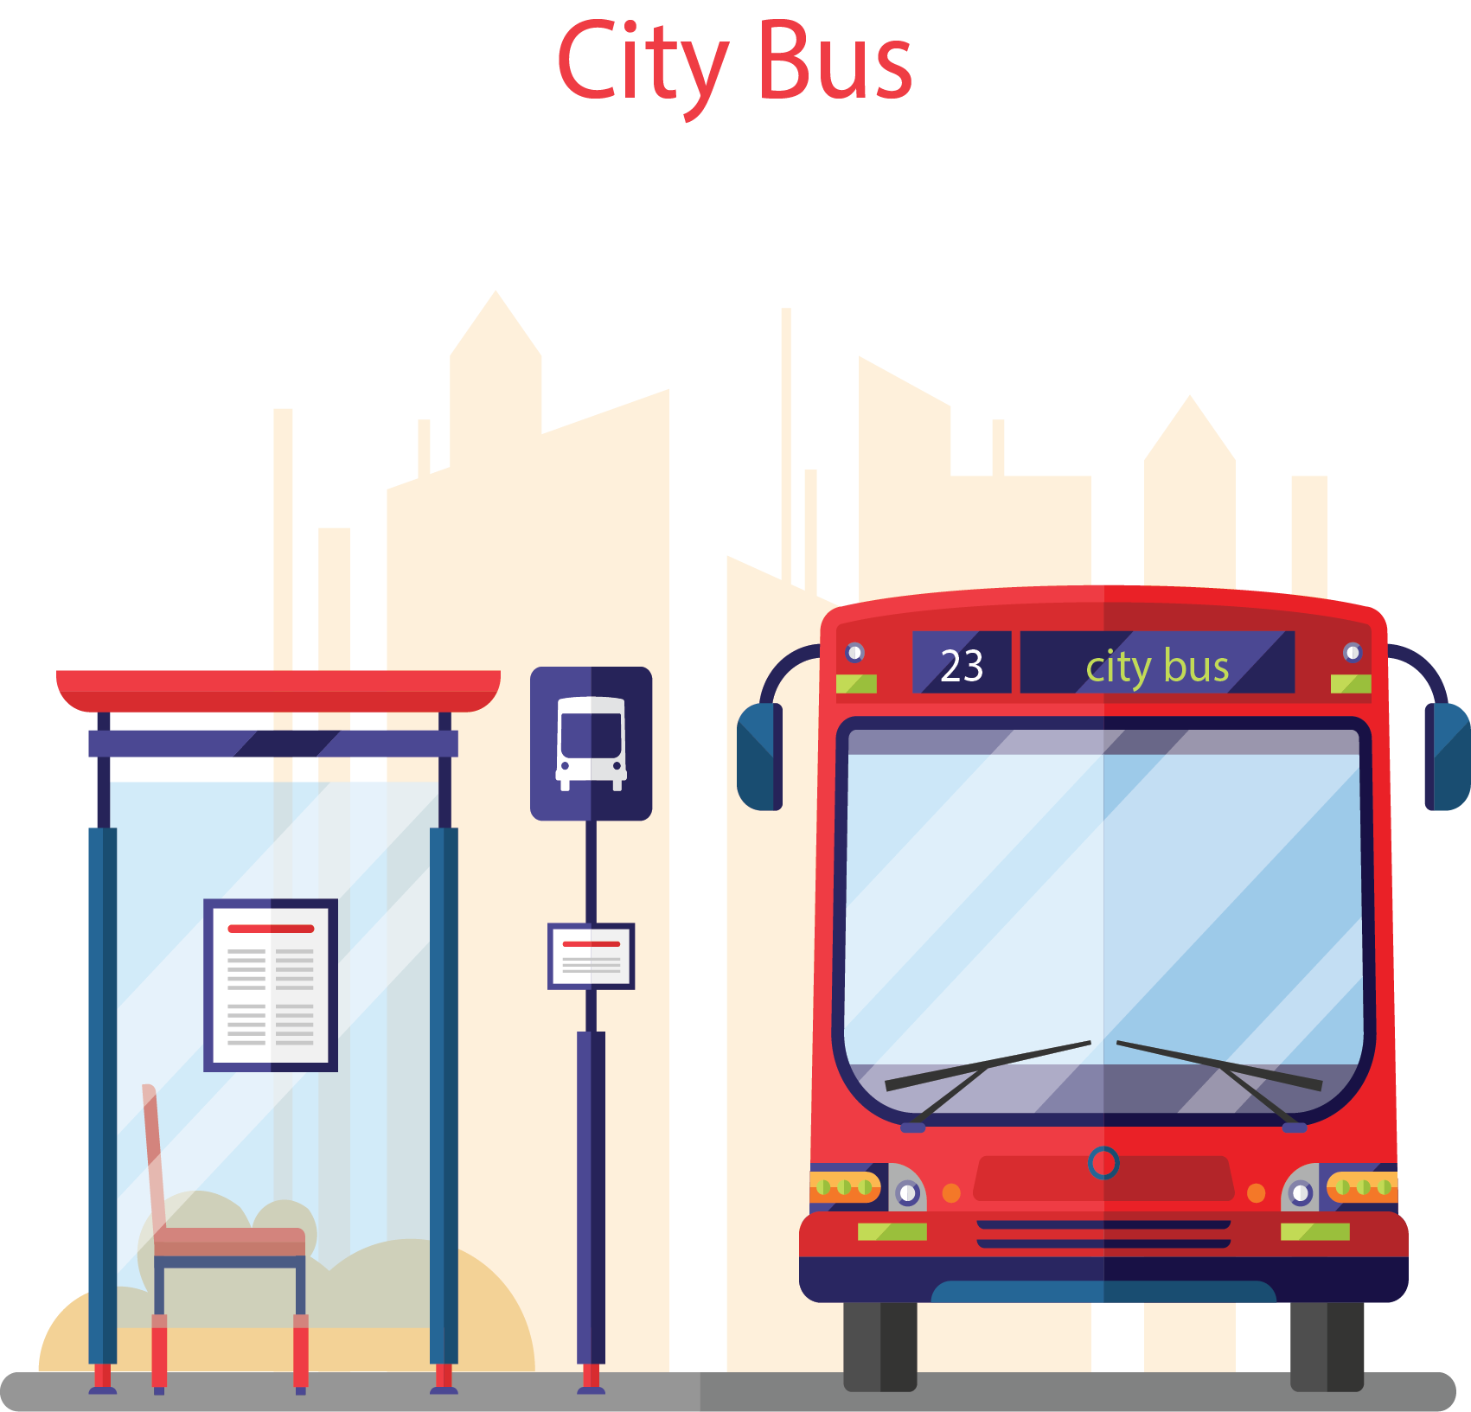
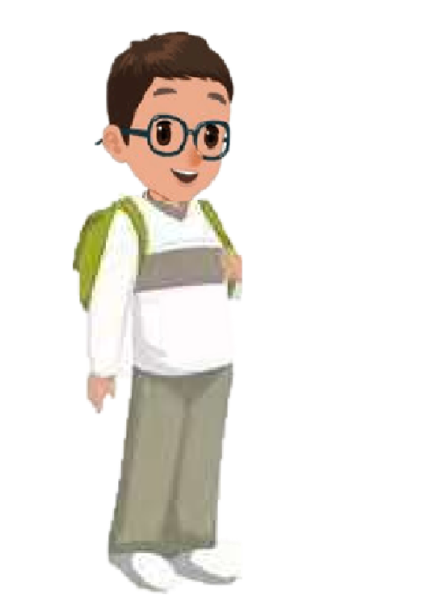
Unit 1 How can I get there？
A Let's learn

Slide 2
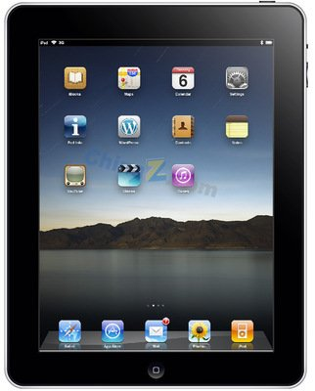
Let's sing

Slide 3
Today Wu Yifan and Robin go to the science museum.

Slide 4
Let's learn
Where is the science museum?
It’s next to the school.

Slide 5
It’s a great museum!

Slide 6
Robin, I want to send a postcard. Let’s go to the post office.
OK.

Slide 7
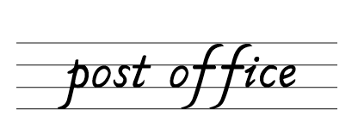
Let's learn
Where is the post office?
It’s next to science museum.

Slide 8
Robin, I want to buy some books. Let’s go to the bookstore.
OK.

Slide 9
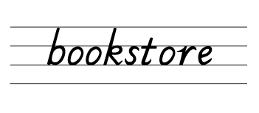
Let's learn
Where is the bookstore?
It’s next to the post office.

Slide 10
Robin, I have a cold. Let’s go to the hospital.
OK.

Slide 11
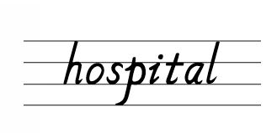
Let's learn
Where is the hospital?
It’s in front of the bookstore.

Slide 12
Robin, I feel better.
Let’s go to the cinema and have fun.
OK.

Slide 13
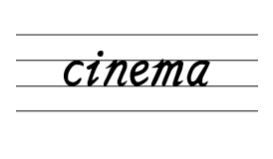
Let's learn
Where is the cinema?
It’s next to the hospital.

Slide 14
It’s a good day. Let’s go home!
OK.

Slide 15
Listen and imitate

Slide 16
Read in groups
Where is the cinema?
It’s next to the bookstore.
science museum
post office
bookstore
cinema
hospital

Slide 17
Sharp eyes
post office

Slide 18
Sharp eyes
bookstore

Slide 19
Sharp eyes
science museum

Slide 20
Sharp eyes
cinema

Slide 21
Sharp eyes
hospital

Slide 22
Make a map and talk
pet
hospital
There is a pet hospital in my city.
park
Where is it?
It's near the park.

Slide 23
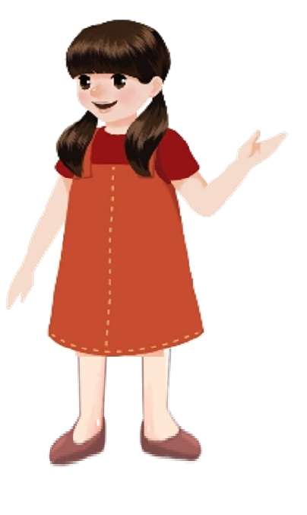
Make a map and talk
A: There is a ____in my city.
B: Where is it?
A: It’s...
pet
hospital
zoo
park
school
cinema
bookstore

Slide 24
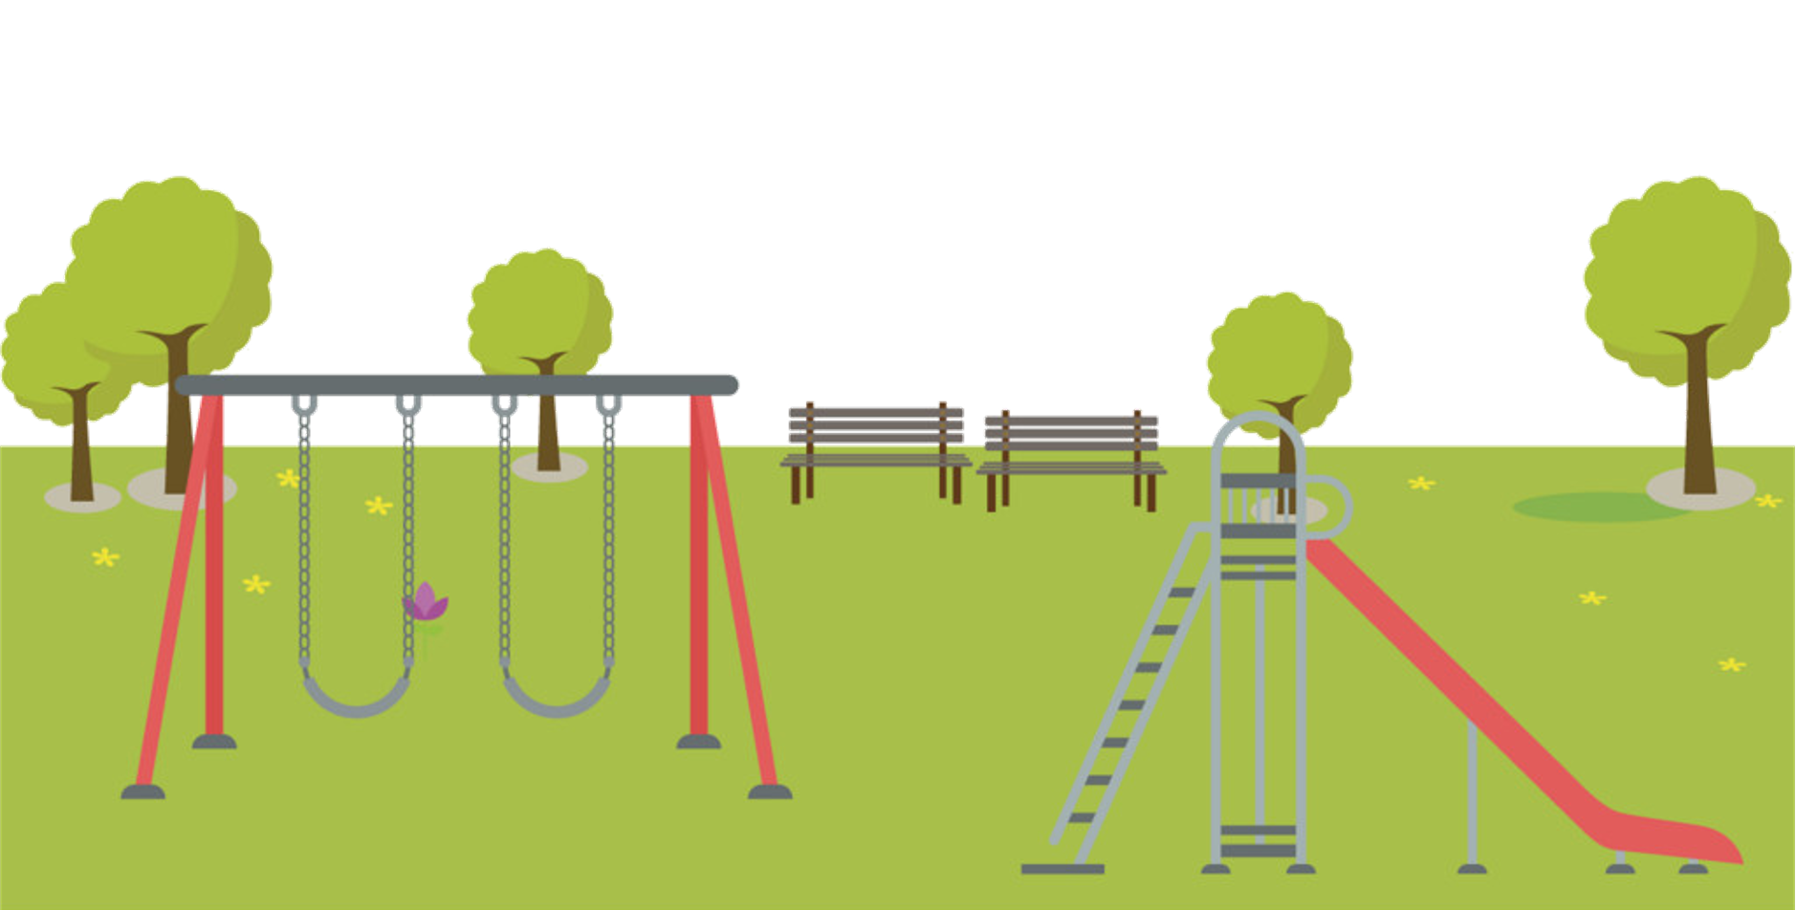
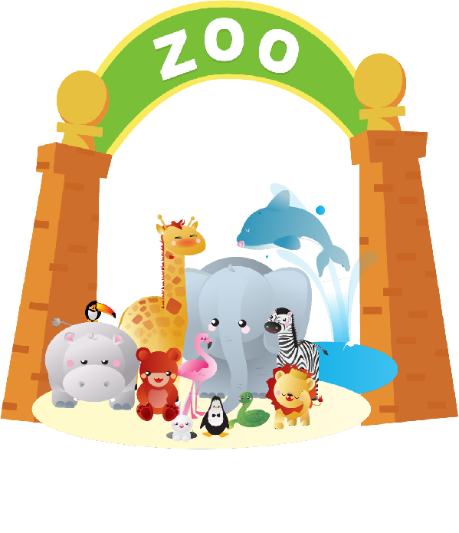
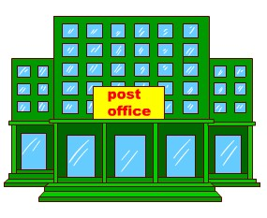
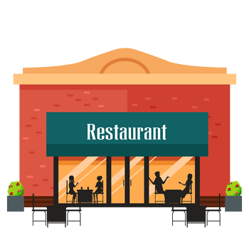
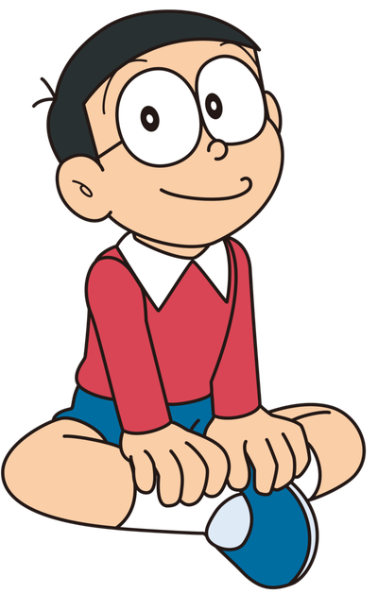
Let’s write
Design your future city.
This is a clean city.
There is a post office. It’s behind the restaurant.
There are many trees. They’re next to the post office.
What a great city!

Slide 25
Let’s write
This is a __ city. （busy/ clean / green/ ）
There is a ______, it’s _______ the _______.
There are many ______, they are ____ the _______.
What a ____ city! ( great/ beautiful /cool…. …)
Word bank:
hospital, zoo, school, gym, garden, mountain, tree, bird, flower, building, , near, in front of, next to, behind...

Slide 26
What have we learned today?
(今天我们学到了什么？)
1. 学习了五个表示建筑的单词及词组：
cinema, post office, bookstore, science museum,
hospital
2. 学习了句型：
— Where is the …?
— It’s next to …

Slide 27
Homework:
1.Listen, repeat and write the words.
2.Design a simple map about your block. And talk about it with your friends.

Slide 28
Goodbye

