Slide 1
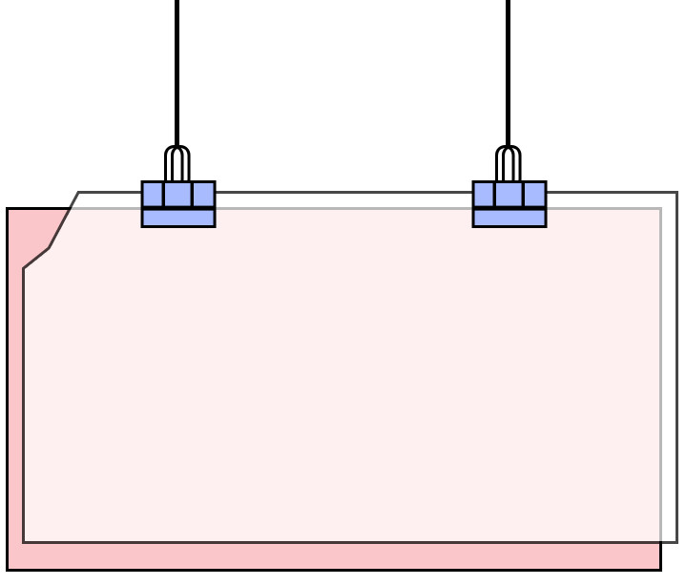





Unit 9
Can you come to my party?
Section B 2a-2e

Slide 2
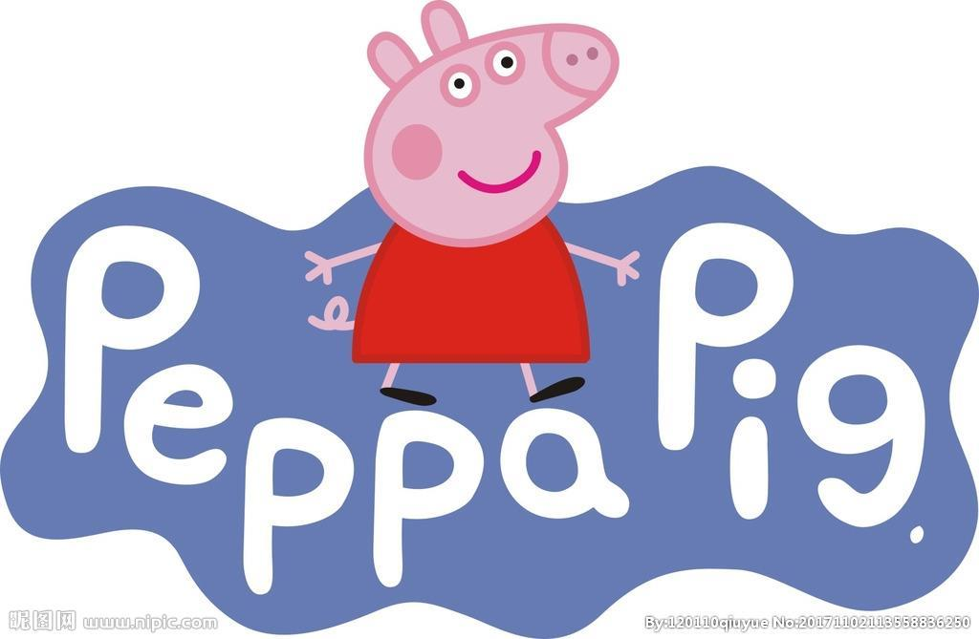
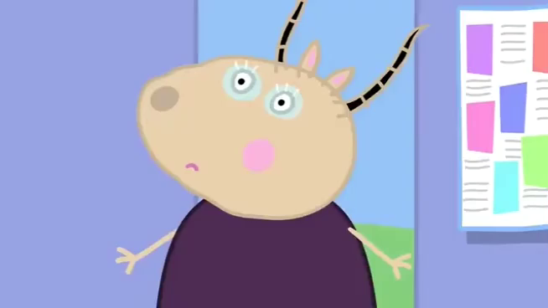
What is Peppa Pig going to do?
She is going to have a party for her teacher.
What kind of party is it?
It’s a leaving/surprise party.

Slide 3


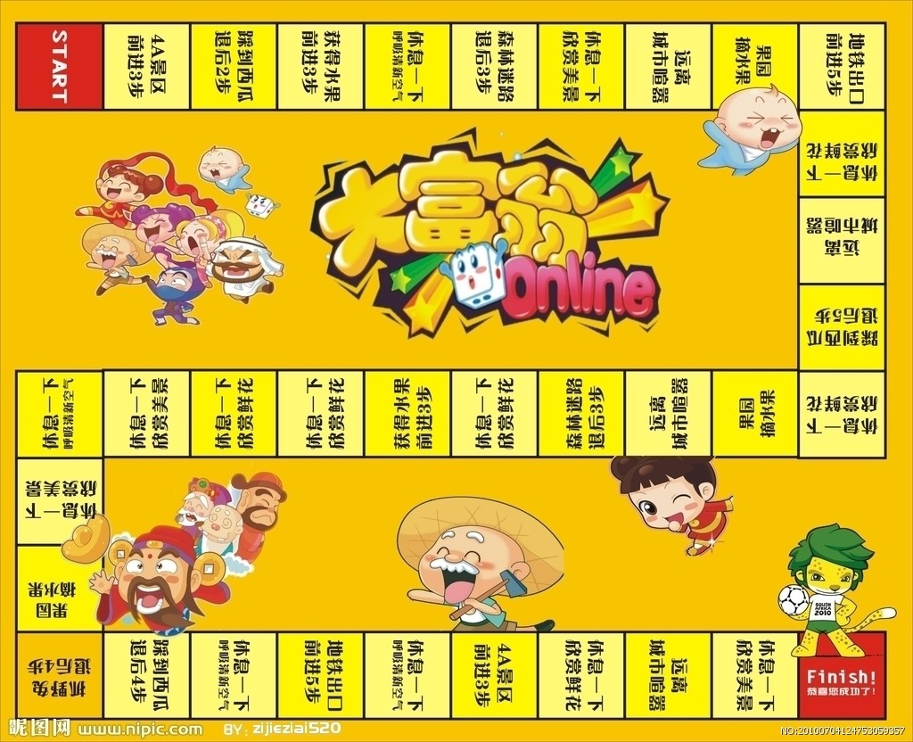








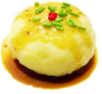



buy food and drinks
think of the games
cakes and gifts
make an invitation

Slide 4

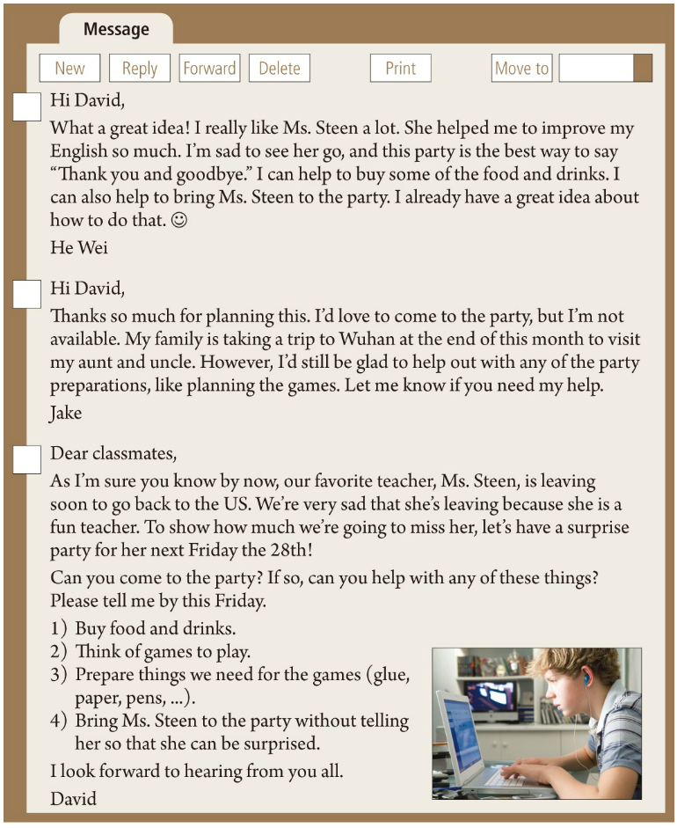






Prediction
1. The article is a/an ________.
A. newspaper
B. e-mail
C. diary
D. letter
Reading Strategy 1:
(阅读策略)
Predict what the passage is.
2. Is it written by only one person?
3. Do they write to the same person?

Slide 5
Fast-reading
Message 1
Match the reason with each message.
Message 2
1.accept an invitation
2.make an invitation
3.turn down (refuse) an invitation
Message 3

Slide 6
Fast-reading
Match the reason with each message.
2.make an invitation
1.accept an invitation
2.make an invitation
3.turn down (refuse) an invitation
1. accept an invitation
3.turn down an invitation

Slide 7
Careful-reading
Read the message 3 and answer the following questions
what
1.What kind of party is it?
who
2.Who is the party for?
why
3.Why do people have the party?
when
4.When is the party?
how
5. How can people prepare for the party?
what
6.What can people do at the party?

Slide 8
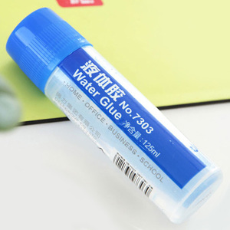
Careful-reading
Q5:How can people prepare for the party?
Q6:What can people do at the party?
Q3:Why do people have the party?
Q4:When is the party ?
Q2:Who is the party for?
Q1:What kind of party is it?
who
Dear classamates,
As I'm sure you know by now, our favorite teacher, Ms. Steen, is leaving soon to go back to the US. We're very sad that she's leaving because she is a fun teacher. To show how much we're going to miss her, let's have a surprise party for her next Friday the 28th!
Can you come to the party? If so, can yo help with any of these things?
Please tell me by this Friday.
1)Buy food and drinks.
2)Think of games to play.
3)Prepare things we need for the games (glue, paper, pens,...)
4)Bring Ms.Steen to the party without telling her so that she can be surprised.
I look forward to hearing from you all.
David
To show how much we're going to miss her
next Friday the 28th
when
why
what
Please tell me by this Friday.
Eat, drink and play games.
Reading Strategy 2:
(阅读策略)
Guess the meaning of words or sentences by context(上下文).
A. I hope to hear you sing.
B. I wish you to listen to me.
C. I hope to get an e-mail from you.
I look forward to hearing from you all.
how

Slide 9
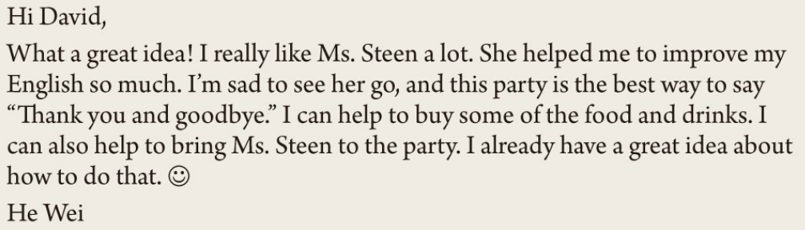
Careful-reading
Read message 1 and answer the question.
What does “sad” in the message 1 mean?
A. happy
B. not happy, sorry
C. relaxed

Slide 10

Do you know how to bring Ms. Steen to the party without telling her? What will you say?
Reasons
______________________
She helped him to ________ his _______ a lot.
Really like Ms. Steen a lot
He wei
improve
English
Accept
_______ the invitation.
Things he can help
some of the food and drinks
To buy _________________________
To _____________________________
bring Ms. Steen to the party

Slide 11
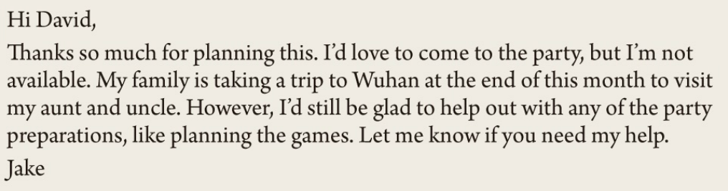
What do you think of Jake?
What does “preparation” in Message 2 mean?
A. 准备工作 B. 地理位置 C. 时间安排
Reasons
Jake
take a trip
Wuhan
not available
___________ __________to _______
Turn down
Things he may help
__________the invitation.
________________________
like _____________________
any of the party preparations
planning the games

Slide 15

Pair work
Plan a party with your partner.
Invitation
What kind of party
Why
When/Where
Who (are invited)
How to prepare
What to do at the party

Slide 16
Homework
You should do:
1.Read the passage three times.
2.Share your party plan to your friends.
You can do:
Make an invitation about your party.

