Slide 1
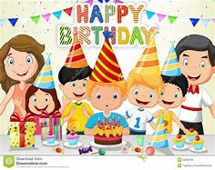
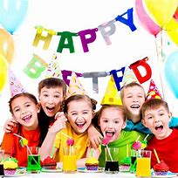
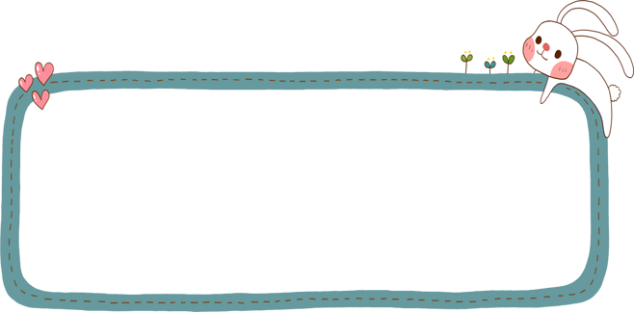
Unit 9
Can you come to my party?
Section B
Period One

Slide 2
Words review
the day before yesterday
the day after tomorrow
weekday
look after
前天
后天
n. 工作日（星期
一至星期五的
任何一天）
照顾；照料
Read after the tape and speak out the Chinese immediately.

Slide 3
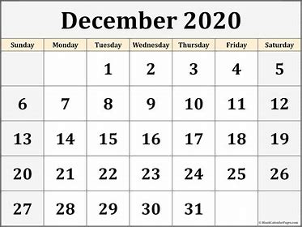
What’s the date today?
It’s December 13th.
What day is it today?
It’s Friday.
4
1 | 2 | 3 | 4 | 5 | 6 | 7
8 | 9 | 10 | 11 | 12 | 13 | 14
15 | 16 | 17 | 18 | 19 | 20 | 21
22 | 23 | 24 | 25 | 26 | 27 | 28
29 | 30 | 31
today
How to read it?

Slide 4
1st first
2nd second
3rd third
4th fourth
5th
6th
7th
8th eighth
9th ninth
10th
11th eleventh
12th twelfth
13th
14th
15th
16th
17th
18th
19th
20th twentieth
21st twenty-first
22nd twenty-second
23rd twenty-third
24th
25th
26th
27th
28th
29th
30th thirtieth
31st thirty-first
thirteenth
Can you read them?
fourteenth
twenty-fourth
fifth
fifteenth
twenty-fifth
sixth
sixteenth
twenty-sixth
seventh
seventeenth
twenty-seventh
eighteenth
twenty-eighth
nineteenth
twenty-ninth
tenth

Slide 5
Write these words below the correct dates on the calendar in 1a.
1b
P68
today
tomorrow
yesterday
weekday
weekend
the day before yesterday
the day after tomorrow
the day before yesterday
the day after tomorrow
yesterday
today
tomorrow
weekend
weekend
weekday

Slide 6
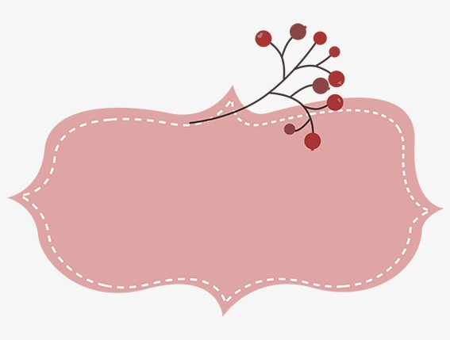
Compare and Learn
-What day is it today?
Friday
December
-It’s Friday.
-What’s the date today?
-It’s December 13th.(读作December the 13th)
13
-What’s today?
-It’s Friday the 13th.
今天是几号？星期几？
今天是13号, 星期五。

Slide 7
Write these words below the correct dates on the calendar in 1a.
1b
P68
A: What's today?
B: It's Friday the 13th.
the day before yesterday
the day after tomorrow
yesterday
today
tomorrow
weekend
weekend
weekday

Slide 8
What sport does the boy Andy like?
But today he wants to play tennis with his friend.
He likes playing soccer.

Slide 9
Listen. Can Vince play tennis with Andy? Circle “Yes” or “No”.
1d
P68
Yes No

Slide 10
1e
Listen again. Match Vince’s activities with the days in 1d.
Vince’s activities Days
__ play soccer a. today
__ go to the doctor b. tomorrow
__ study for a test c. the day after tomorrow
__ have a piano lesson
__ look after his sister
b
a
a
b
c
P68
look after 照顾，照看 =babysit

Slide 11
Can you go to the movies today?
a busy week
I have to look after my sister today.
I have to … tomorrow.
I have to … the day after tomorrow.
Sunday | help my parents
Monday | have a sports meeting
Tuesday | go to the doctor
Wednesday | have a piano lesson
Thursday | look after my sister
Friday | study for a test
Saturday | visit my friends

Slide 12
Review
课时重点回顾
1. Useful words and expressions:
the day before yesterday the day after tomorrow
weekday weekend yesterday
look after have a piano lesson study for a test
2. Useful patterns:
1) - Can you play tennis with me?
- Sorry, I can’t. I…
2) - What's today?
- It's Monday the 14th.

Slide 13
I. 根据句意及汉语提示完成句子，每空一词。
weekdays
1. I usually get up an hour earlier on _________
(工作日) than on weekends.
2. I think Linda can ____ ____ (照顾) herself.
3. I visited my teacher ____ ____ _______
___________ (前天).
4. Lucy is _______ ____ ______ ______ (正在
上钢琴课).
5. The Greens are going to have a picnic
____ ____ ______ __________ (后天).
look after
the day before
yesterday
having a piano lesson
the day after tomorrow

Slide 14
II.将下列句子翻译成英语。
1. - 你能和我一起打网球吗？
- 什么时候？
- 后天。
- 对不起，我不能。我有钢琴课。
Can you play tennis with me?
When?
The day after tomorrow.
Sorry, I can’t. I have a piano lesson.
2. 后天是我奶奶的生日。
The day after tomorrow is my grandma's birthday.

Slide 15
Checkwing
用所给词的适当形式填空。
going
1. Is Ted (go) to the dentist tomorrow?
2. I would love ( come ) to your house.
3. Thanks a lot for (look ) after my little brother.
4. Is your brother good at (swim) ?
5. I won't give the book to him until he (come) back
tomorrow afternoon.
6. Why don’t you (invite) your cousin to your party?
7. How about ________ (write) a letter to her?
8. Why ( not go ) to Wang lin’s birthday party?
9. The ( two ) Sunday in May is Mother’s Day.
10 .Look, the workers are preparing (cook) supper .
to come
looking
swimming
comes
invite
writing
not go
second
to cook

