Slide 1
Unit9
Can you come to my party?
Section A (1a-2d)

Slide 2
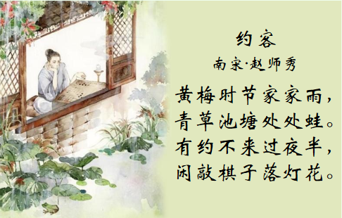
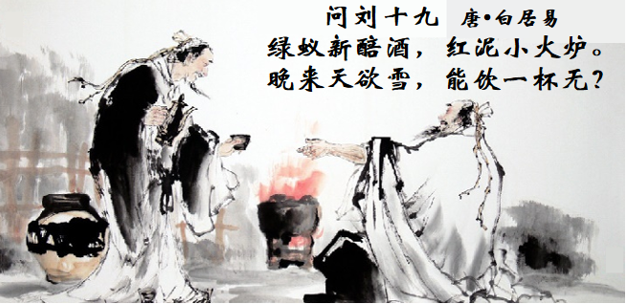
Lead in
What are the two poems(诗) about?
Do you know how to invite someone to somewhere in English?

Slide 3
a party that you give when you move into a new house 温居聚会，乔迁聚会
Lead in
Did the couple accept the woman's invitation to her housewarming party?

Slide 4
How to invite friends?
Make Invitations发出邀请：
Can you come to my party?
Could you come to my party?
Would you like to come to my party?
Can you…? 意为“你能……吗?”是客气地请求或邀请某人做某事的句子。在这种句式中,还可以用could代替can,语气更委婉,显得更有礼貌,而用can则较随意。

Slide 5
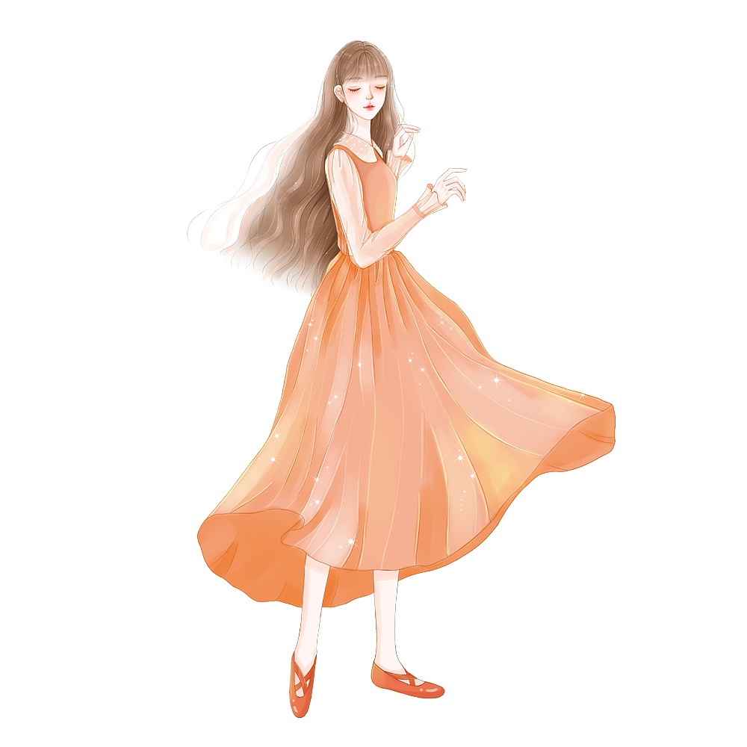
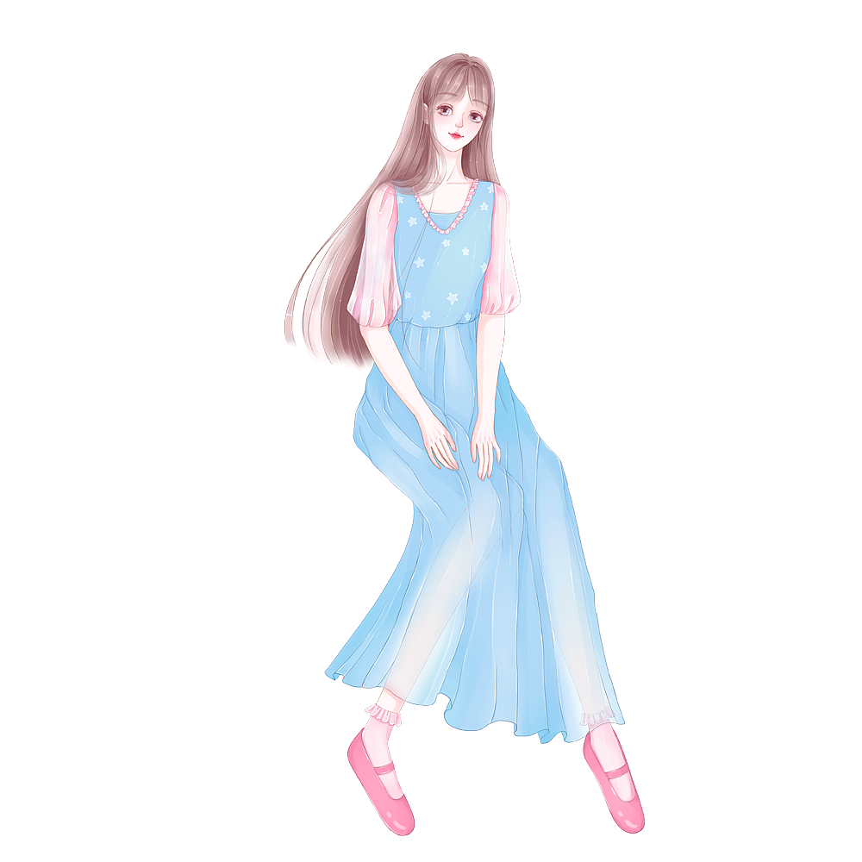
How to accept?
Accept invitations接受邀请
Sure, I’d love to.
Sure相当于Of course/ Certainly/ Yes.
I’d love to是I would love to的缩写形式,常用来回答对方客气的邀请,也可以用I’d like to来表示,意思是“我愿意”,其中的to不可以省略。
It sounds great.
Sure, thanks for asking.
Sure, thanks for your invitation.

Slide 6
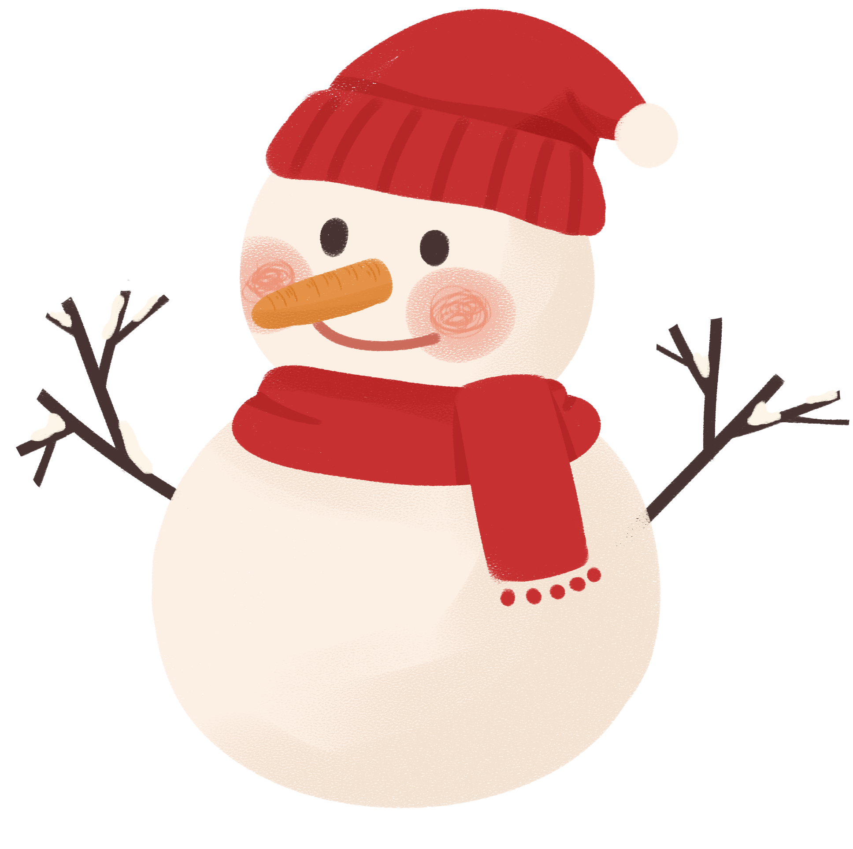
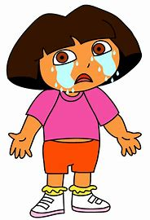
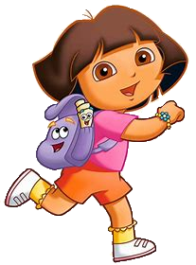
How to refuse?
Refuse invitations拒绝邀请
Sorry, I can’t.
I must ______________.
go to the doctor
情态动词must 表示主观“必须”
go to the/a doctor 相当于 go to see the doctor。

Slide 7
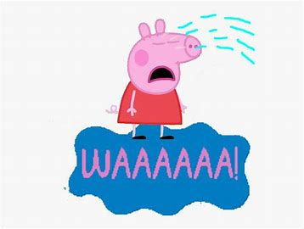
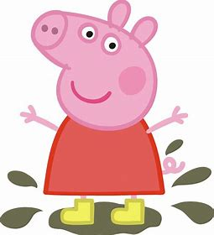
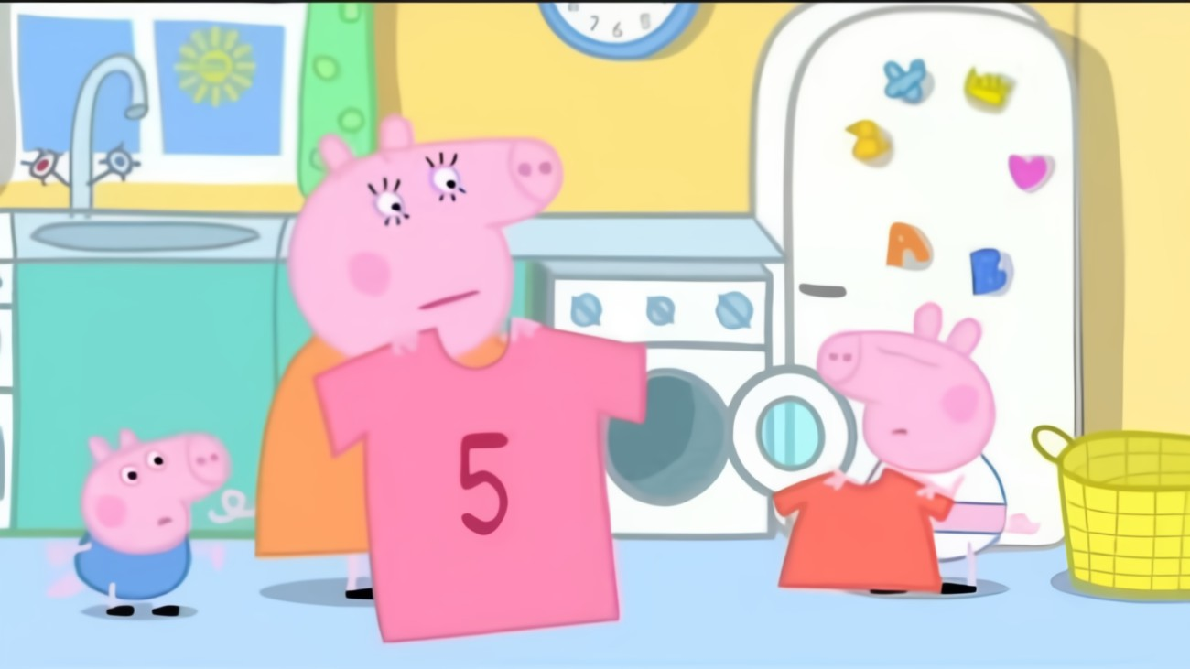
Refuse invitations拒绝邀请
Sorry, I can’t.
I have to ______________.
help my parents
help sb. with sth.在某方面帮助某人
help sb (to) do sth.帮助某人做某事
have to表示客观客观需要, 即“不得不” 。

Slide 8
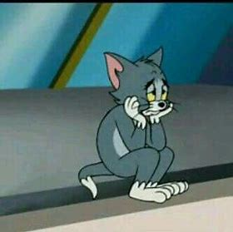
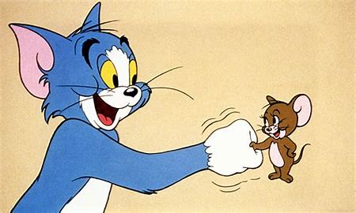
Refuse invitations拒绝邀请
Sorry, I am afraid not.
I might have to _____________.
恐怕不能
meet my friend
might在此表示推测, 意为“可能”, 语气缓和,较委婉, 可能性低于may

Slide 9
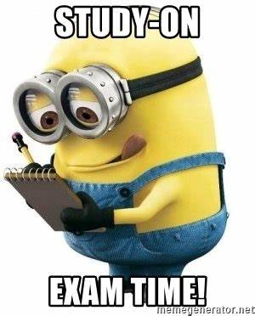
Refuse invitations拒绝邀请
Sorry, I can’t.
I ______________.
have the flu
固定搭配，“得了流感”。
此处have表示“患病”的意思。
I can’t either.
I have to____________________.
prepare for an exam
prepare for 为……做准备

Slide 10
Make an invitation:
A: Can you come to my party?
Accept the invitation:
B: Sure, I’d love to. /That sounds great...
Refuse（拒绝） the invitation:
I’m sorry, I can't.
afraid not.
not available.
not free.
I’m sorry, I’m
prepare for an exam./
go to the doctor. /
help my parents. /
meet my friend./
have the flu...
理由：I have to...
I must ....
I might have to ...

Slide 11
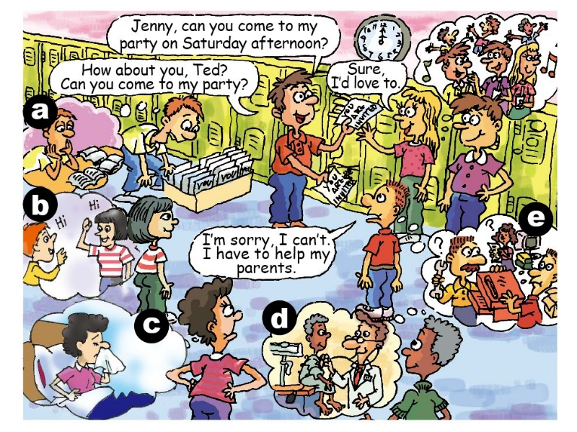
What are they going to do on Saturday afternoon?
1a
Match the phrases with the pictures[a-e].
1. prepare for an exam ___
2. help my parents ___
3. go to the doctor ___
4. meet my friend ___
5. have the flu ___
a
e
d
b
c
P65

Slide 12
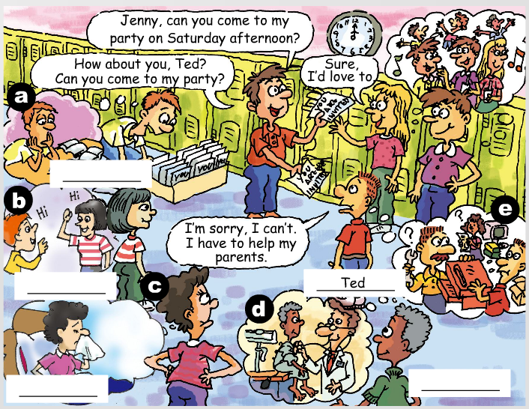
Listen and write the names (Tim, Kay, Anna and Wilson) next to the correct students in the picture.
1b
eg: Ted is going to help his parents.
技巧点拨:听时，可以先写出人名的首字母，然后再补充完整。
Tim
Anna
Kay
Wilson

Slide 13
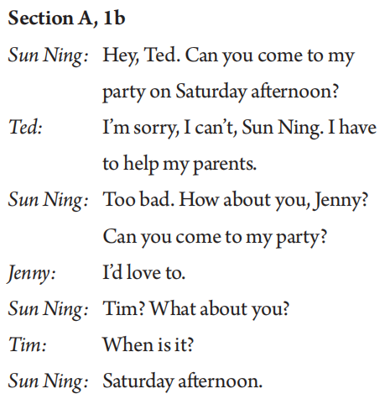
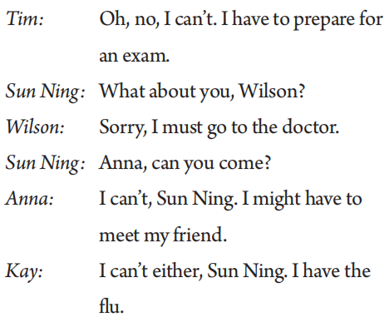
Post-listening
Pay attention to the following expressions!
接受邀请
发出邀请
拒绝邀请: (通常附加不去的原因)
• I'm sorry, I can't. I have to …
• Oh, no, I can't. I (might) have to …
• Sorry, I must …
• I can't either. I …
拒绝邀请

Slide 14
Post-listening
Pay attention to the following expressions!
为考试做准备
去看医生
见我的朋友
得了流感

Slide 15
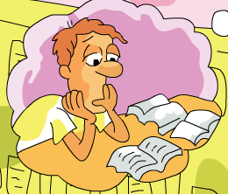
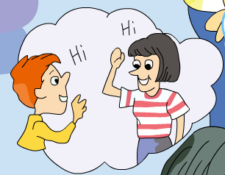
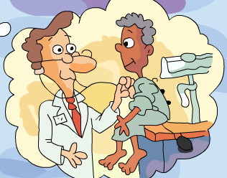
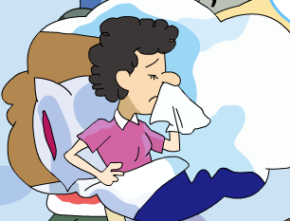
1c
You are the students in the picture. Student A, invite three
students to your party. Student B, C and D, give answers.
A: Can you come to my party on Saturday afternoon?
B: Sure, I’d love to./That sounds great.
C: Sorry, I can’t. I have to ...
D: I’m sorry, too. I must …
注意对话时礼貌邀请、快乐和遗憾的语气。

Slide 16
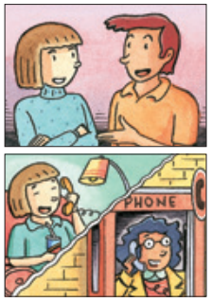
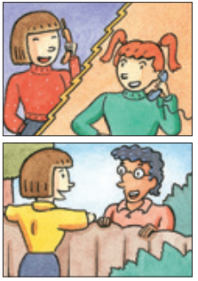
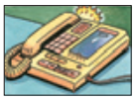
Listen and circle can or can't.
2a
1. Jeff (can/ can't) go to the party.
2. Mary (can/ can't) go to the party.
3. May (can/ can't) go to the party.
4. Mei Ling (can/ can't) go to the party.
5. Paul (can/ can't) go to the party.
P66

Slide 17
While-listening
Listen again. Who can't go to the party? Why? Complete the chart.
2b
Names | Reasons
1. Jeff
2. May
3. Mei Ling
1. He might have to meet
his friend.
2. She has the flu.
3. She must study for a
math test.
P66

Slide 18
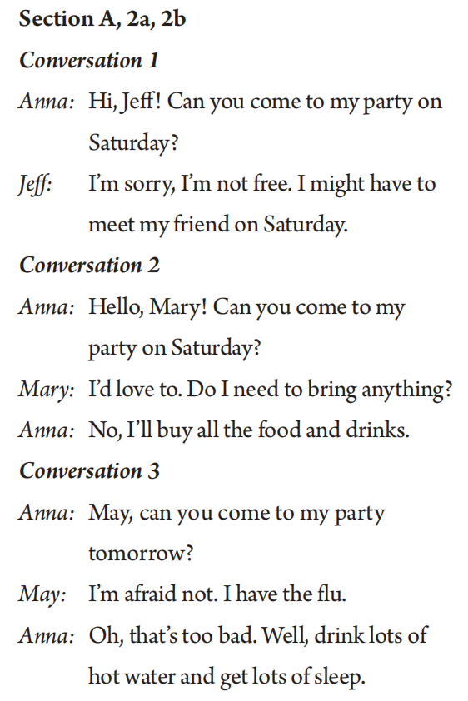
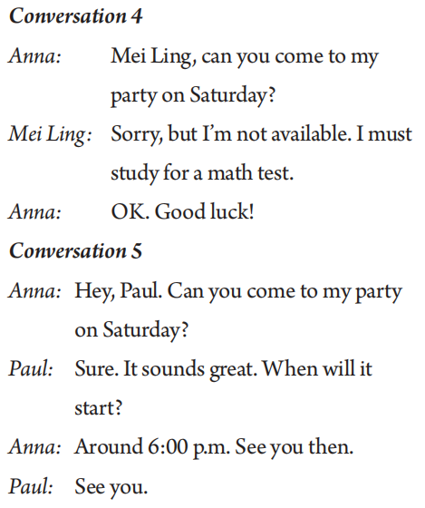
Post-listening
Pay attention to the following expressions.
我没空。
available adj. 有空的
恐怕不行。

Slide 19
Post-listening
2c
Look at the reasons in the chart in 2b. Write some more.
Then, Student A, invite your partner to do something. Student B, say you can't go and why.
Possible answers:
too much homework
1.______________________
2.______________________
3.______________________
4.______________________
visit my grandmother
go to the doctor
have piano lessons ...
A: Hey, Dave. Can you go to the movies on Saturday?
B: I'm sorry. I'm not available. I have too much
homework this weekend.
A: That's too bad. Maybe another time.
B: Sure, Joe. Thanks for asking.
P66

Slide 20
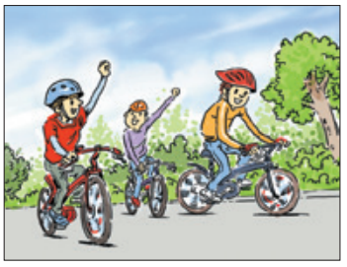
Pre-reading
Jeff is inviting Nick to come to his house on Saturday. Will Nick be available to come?
Now read their conversation and find the answer.

Slide 21
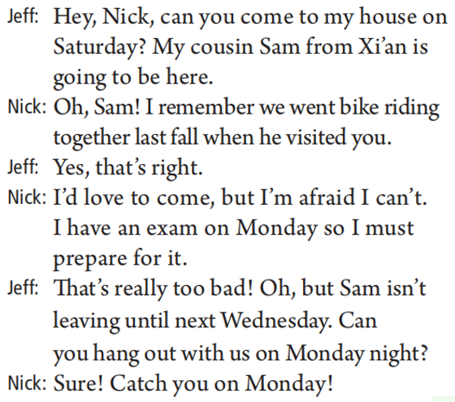
Post-reading
1. Why is Jeff inviting Nick to come to his house?
2. Is his friend Nick coming on Saturday? Why or why not?
3. When will Nick meet Jeff and Sam?
Because his cousin Sam from Xi'an is coming.
No. Because he has an exam on Monday so he must prepare for it.
On Monday night.

Slide 22
Post-reading
Pay attention to the following expressions.
你周六能来我家吗？
去骑自行车
去年秋天
我特别愿意来，但恐怕还真不行。
为......做准备
萨姆要一直待到下周三才走。
闲逛
周一见！

Slide 23
Post-reading
Translate the following expressions into English.
1. 你能……？
2. 去骑自行车
3. 去年秋天
4. 我特别愿意来，但恐怕还真不行。
5. 为……做准备
6. 直到……才……
7. 闲逛
8. 周一见。
Can you …?
go bike riding
last fall
I'd love to come, but I'm afraid I can't.
prepare for …
not … until …
hang out
Catch you on Monday!

Slide 24
Post-reading
Read and learn the conversation by heart in 3 minutes.

Slide 25
Post-reading
你周六能来我家吗？
Jeff: Hey, Nick, _____________________? My cousin Sam from Xi'an _____________.
Nick: Oh, Sam! I remember ________________________ when he visited you.
Jeff: Yes, that's right.
Nick: ________________________________. ________________________________.
Jeff: That's really too bad! Oh, but Sam __________________. Can you ________________ on Monday night?
Nick: Sure! _____________!
要来这儿
去年秋天我们一起骑自行车
我特别愿意来，但恐怕还真不行
我周一有考试，我必须得好好准备
到下周三才会离开
和我们一起玩
周一见

Slide 26
Post-reading
Fill in the blanks according to the conversation.
Jeff's cousin Sam is coming to his home from Xi'an. Jeff 1. ______ Nick to come to his house on Saturday. Nick knows Sam. He 2. __________ that they went bike riding together last 3. ______ and had a good time. He wants to meet Nick, but he is not 4. __________ on Saturday. He will have an 5. ______ on Monday and he has to study 6. ______ it. But Sam won't leave 7. ______ next Wednesday, so Nick decides to hang 8. ______ with Sam and Jeff on Monday night.
invites
remembers
fall
available
exam
for
until
out

Slide 27
Summary
Make an invitation
Can you come to ...?
Sure. I'd love to.
It/That sounds great.
Accept an invitation
Sorry. I can't. I have to ...
I'm afraid I can't.
Oh, no, I can't. I ...
I'm sorry. I must ...
Sorry. I'm not available/free. I ...
I'd love to come, but I'm afraid I can't. I ...
I'm afraid not. I ...
Decline an invitation

