Slide 1





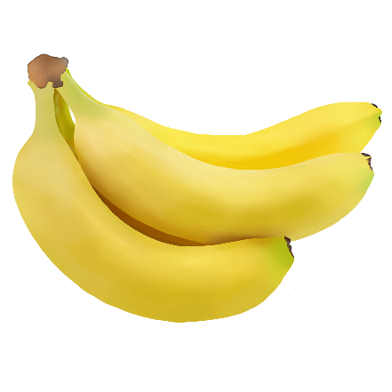


Unit8 How do you make
a banana milk shake?
Section B 2a-2c

Slide 2
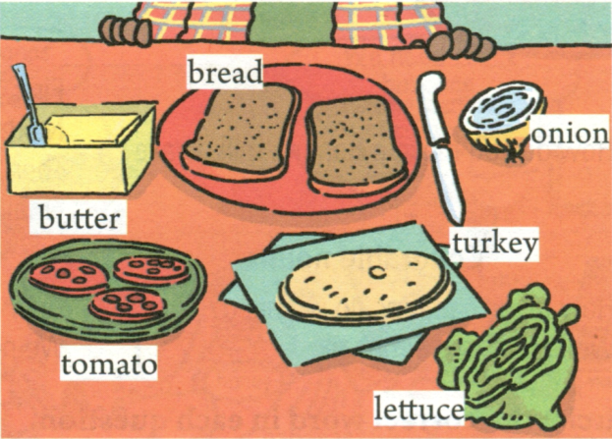
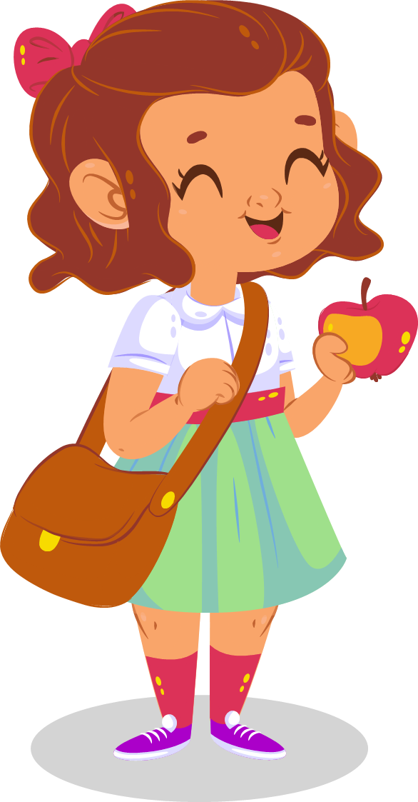
1a
Make a list of the things you like in a sandwich.
In my sandwich, I like __________________________________________.

Slide 3
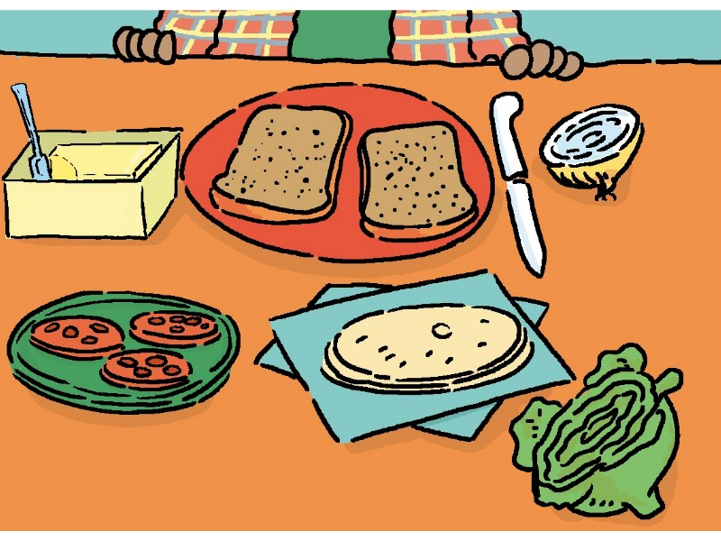

1c
Look at the picture in 1a. Listen and circle the words you hear.
bread
onions
butter
turkey
tomatoes
lettuce

Slide 4
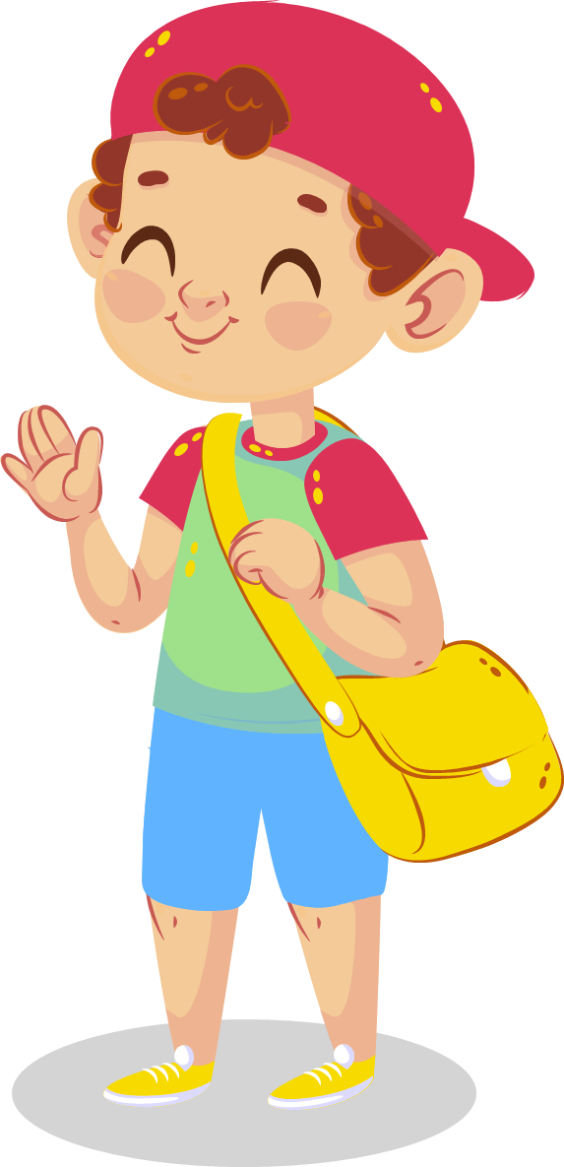
1d
Listen again and write the ingredients in the order you hear them.
Ingredients 材料
the order | First | Next | Then | Finally
the ingredients | butter
an tomato
lettuce
bread
bread
an onion
cheese

Slide 5
1d
Listen again and write the amount you need.
Mom, how many/much _____ do I need?
the order | First | Next | Then | Finally
the amount | ______ butter __________bread | _____ tomato _____ onion ______ cheese | _______ lettuce | __________________________ bread
some
one
some
another piece of
a piece of
one
some
You can put more cheese if you like.

Slide 6
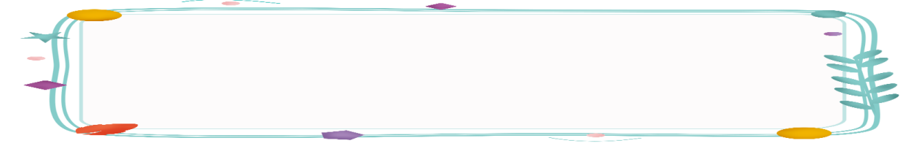
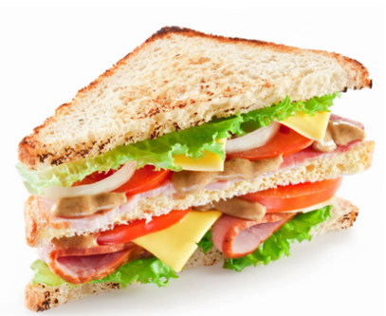
How to make a sandwich?
First,
Next,
Then,
After that,
Then,
Finally,
put the butter on a piece of bread.
cut up one tomato. Put the tomato on the sandwich.
cut up an onion.
put some cheese on the sandwich.
put some lettuce on the cheese.
put another piece of bread on top.

Slide 7
traditional festivals
In most countries,
people usually eat traditional food on special holidays.
a. 传统的
tradition n. 传统
It is our tradition to eat dumplings on special holidays.

Slide 8

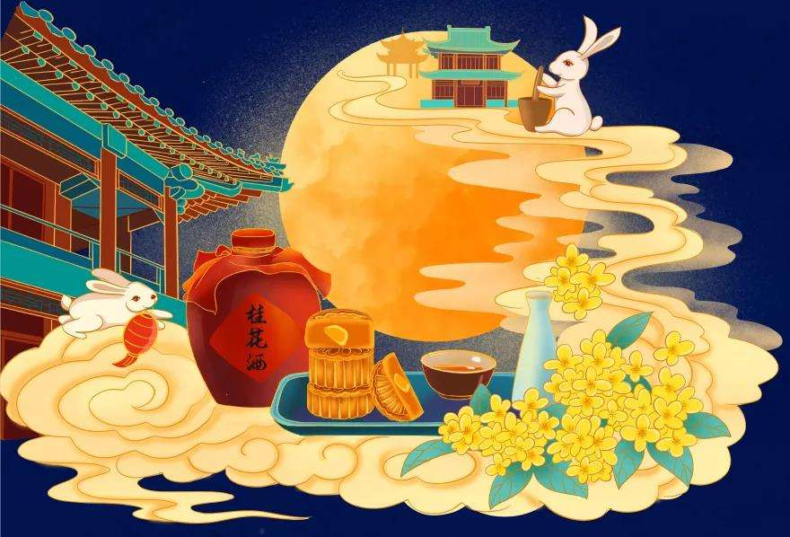
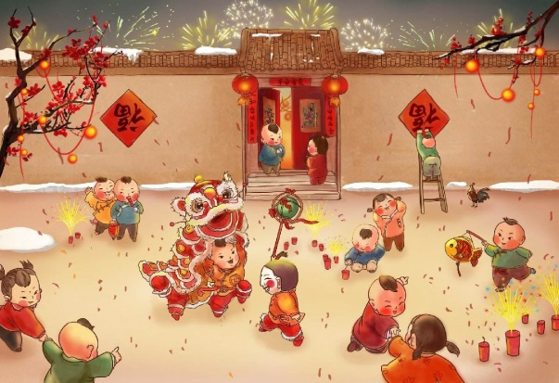
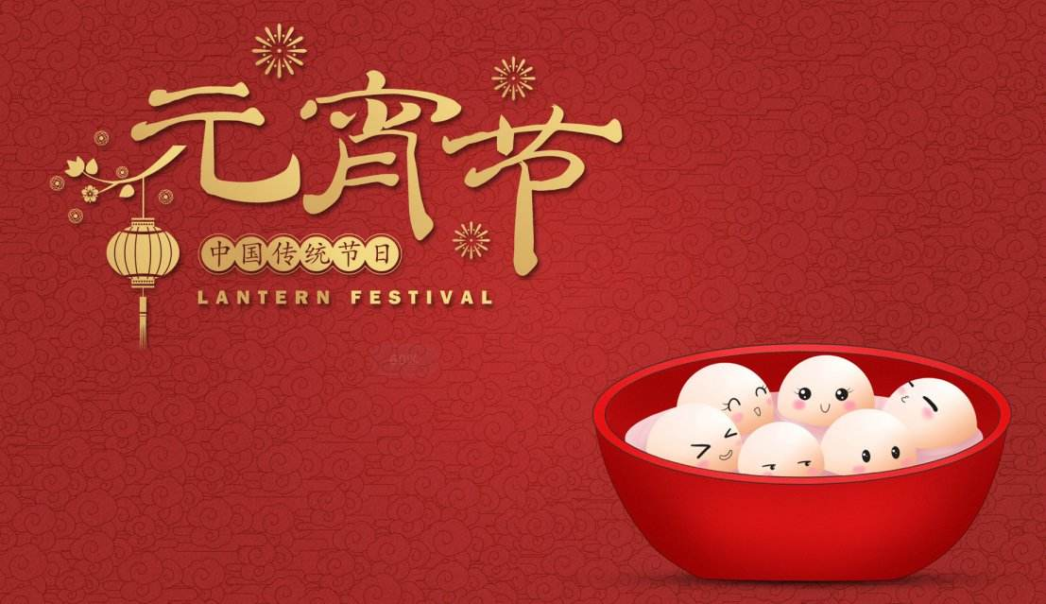
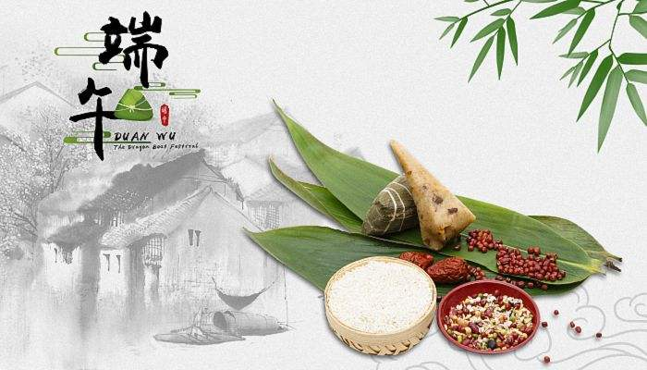
What days are special to us Chinese?
Can you name some?
Mid-Autumn festival is a time to...
Mid-Autumn Festival
Spring Festival
Lantern Festival
Dragon Boat Festival
Why are these days special to us?

Slide 9

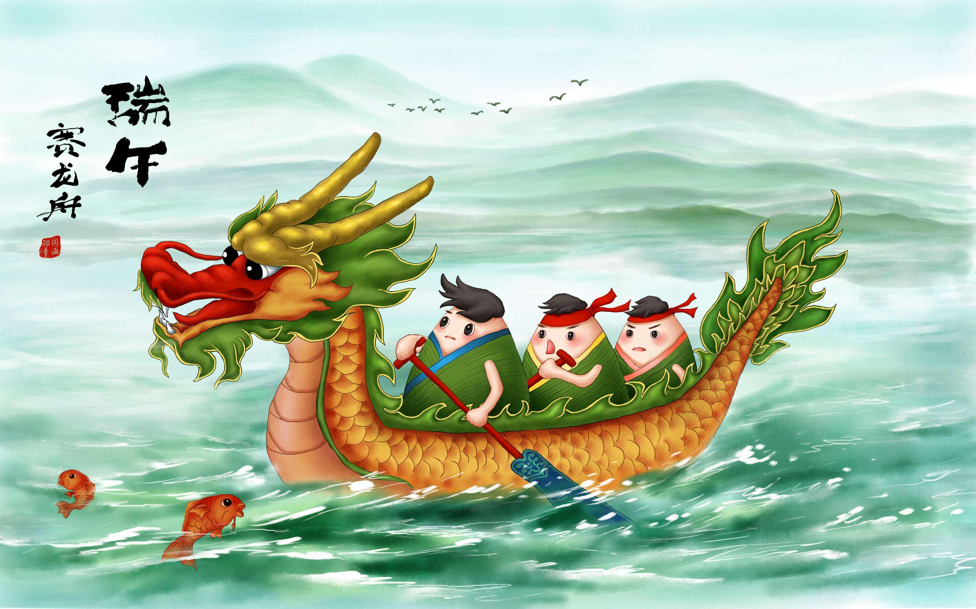
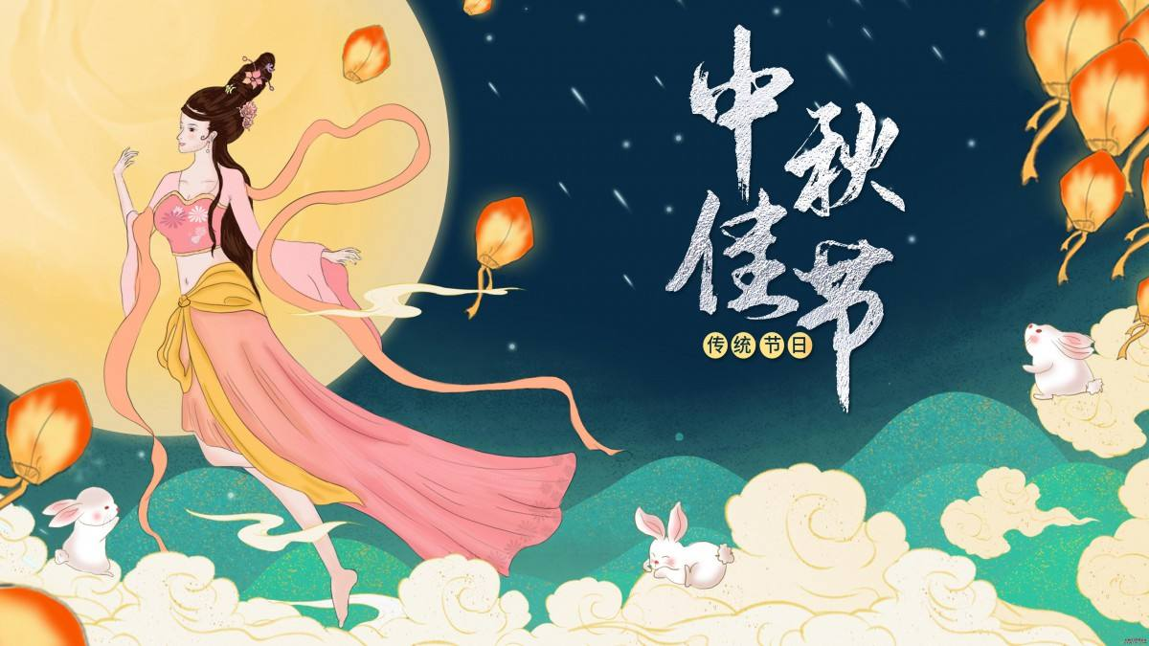
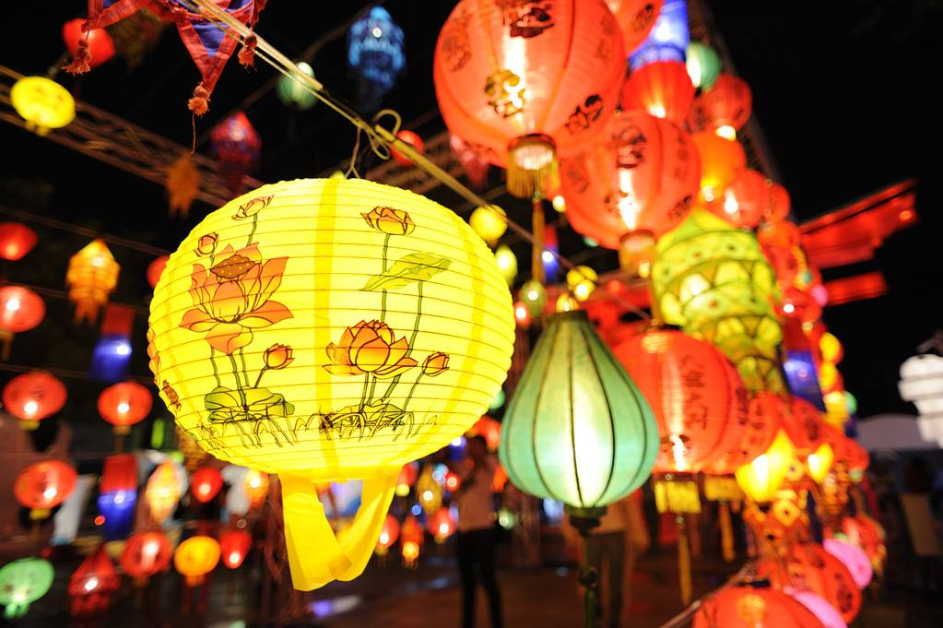
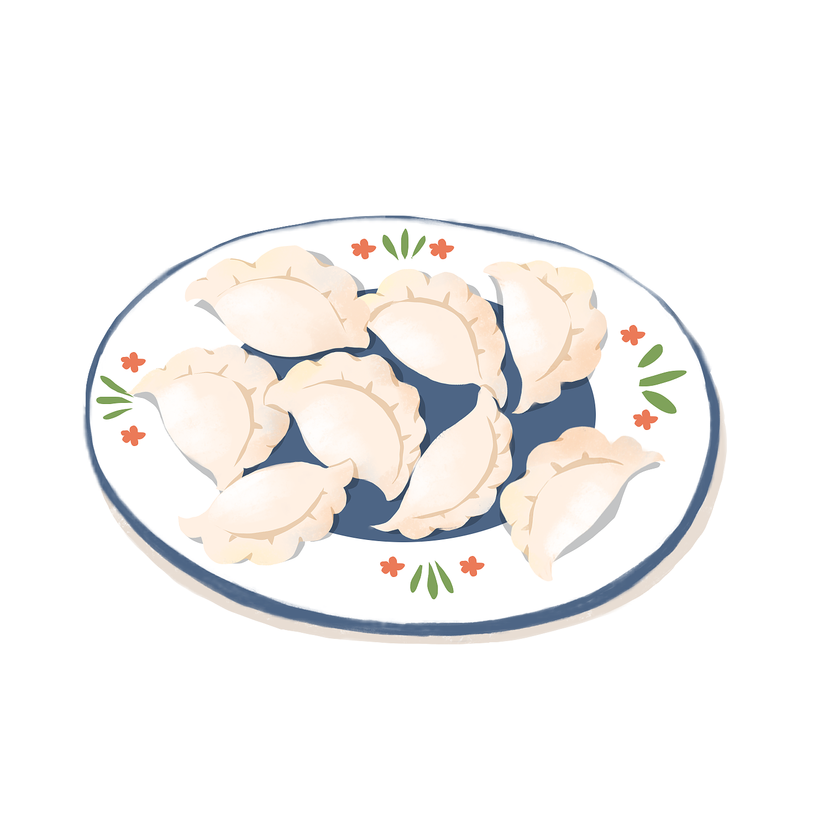
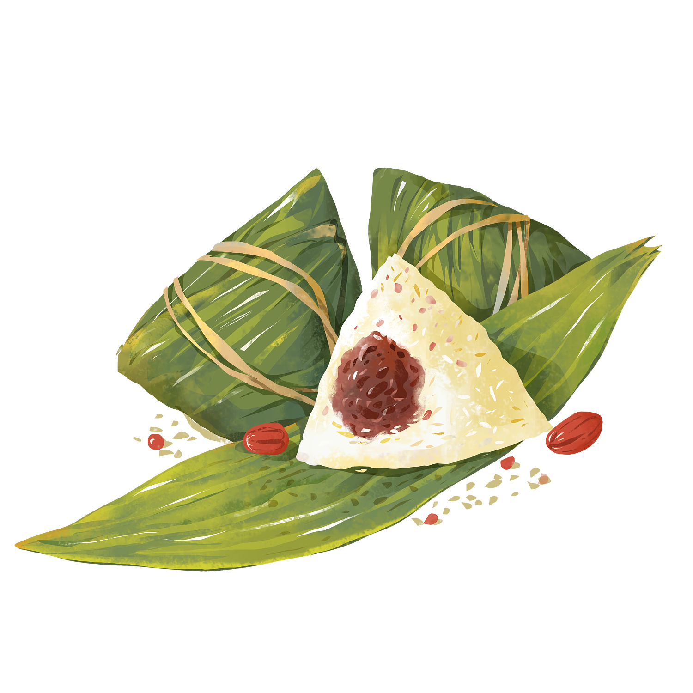
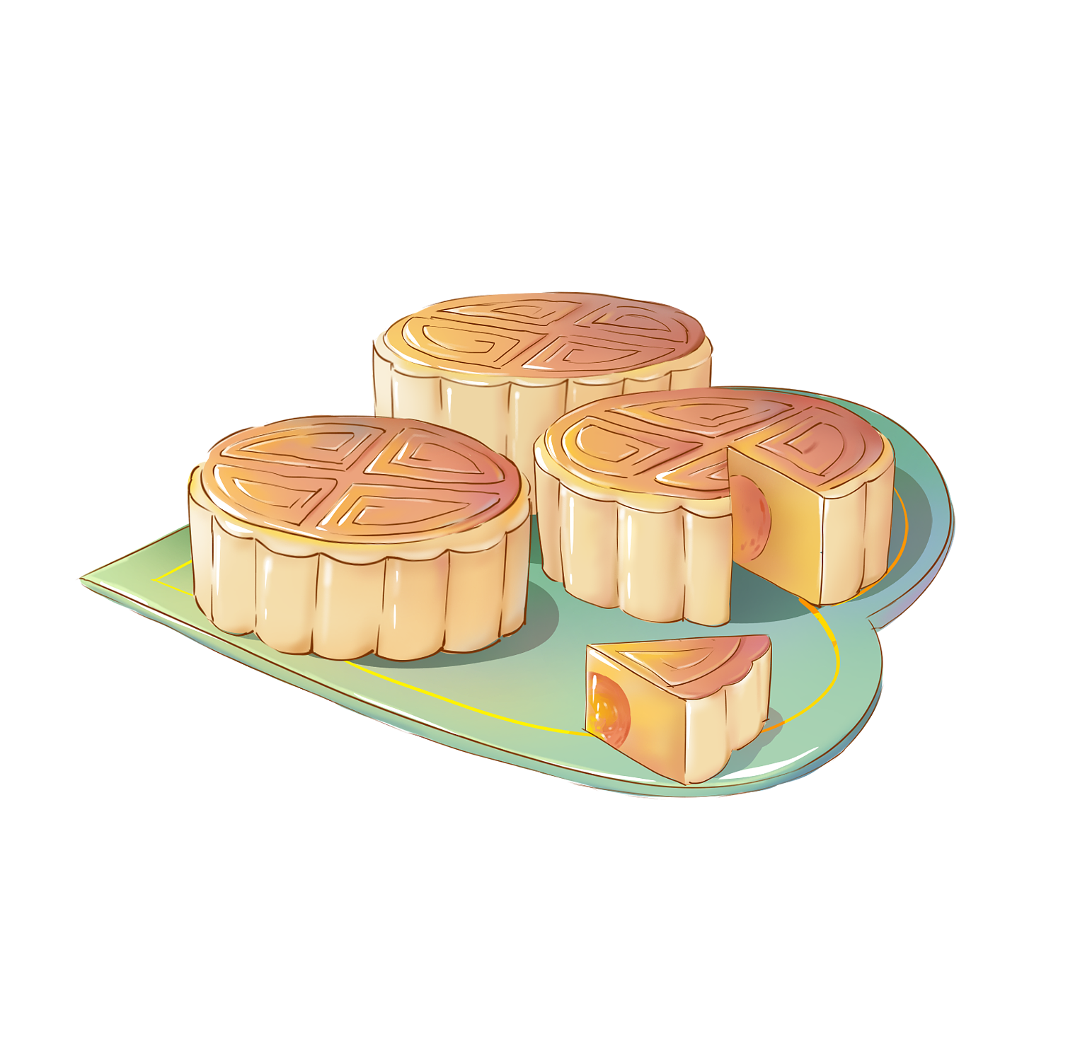
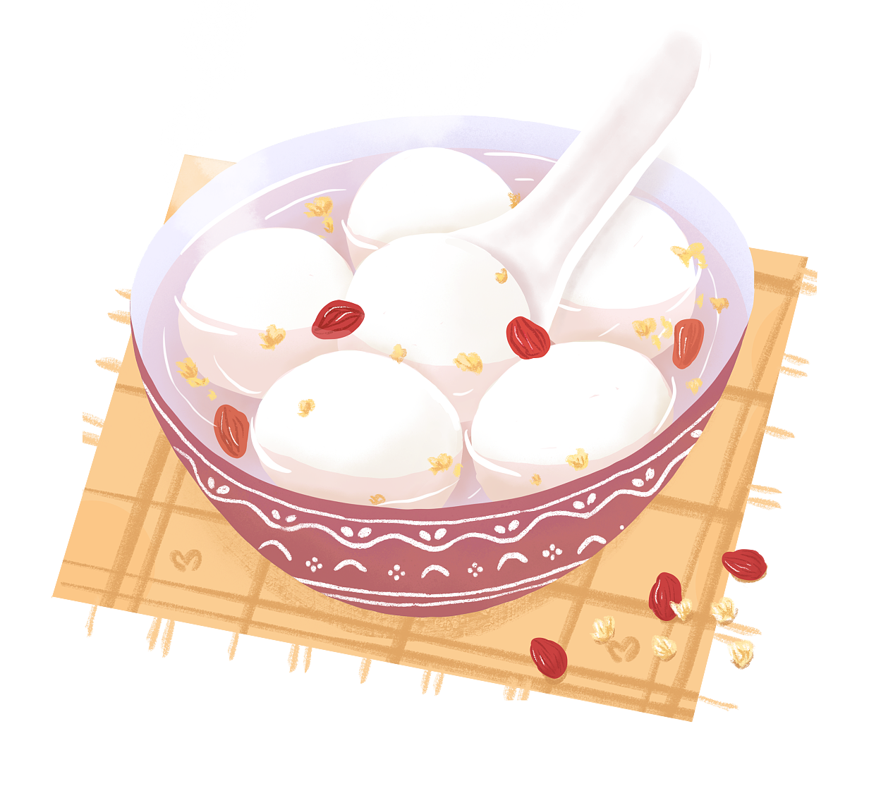
celebration
n. 庆祝
We celebrate the...with...
We celebrate the Spring Festival with dumplings.
Spring
Festival
Dragon Boat
Festival
Mid-autumn
Festival
Lantern
Festival
dumplings
zongzi
mooncakes
sweet dumplings

Slide 10
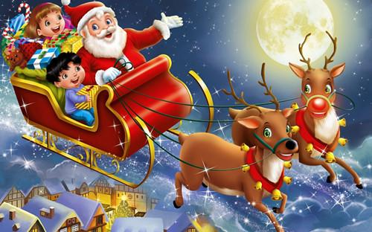

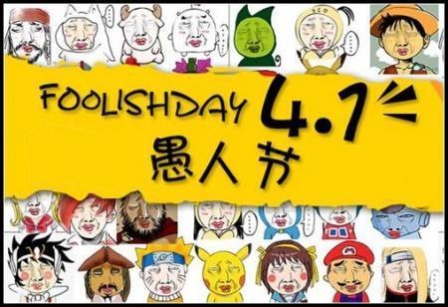
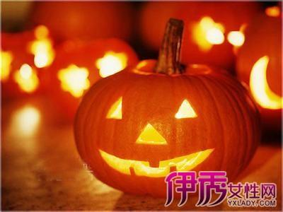
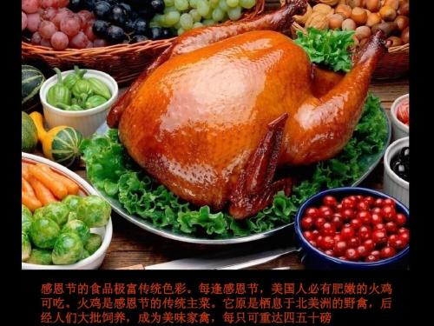
What kind of traditional festival do you know in western(西方的) countries ?
Different countries have different traditional holidays. Let’s learn something about Thanksgiving.
Christmas Day
Valentine's Day
April Fools' Day
Halloween Day
Thanksgiving Day

Slide 11

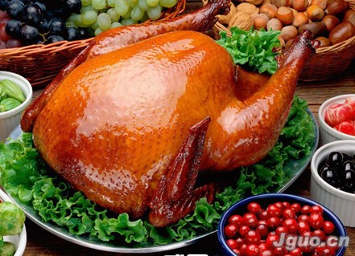
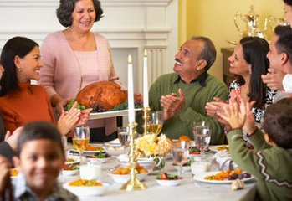
Thanksgiving is a special day in North America.(北美)
in the United States （美国）
火 鸡
Turkey is one of the main traditional food.
v. 庆祝
People usually celebrate it by having a big meal with their family.

Slide 12
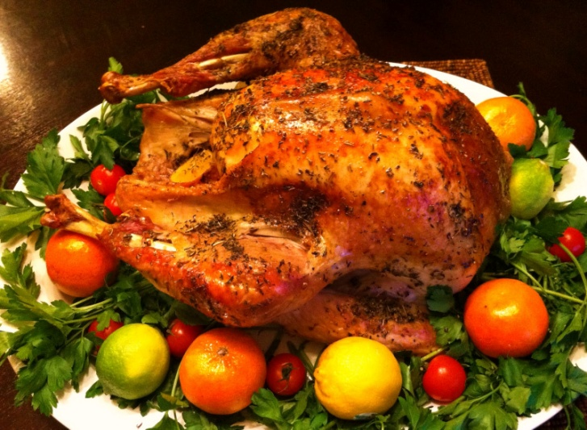
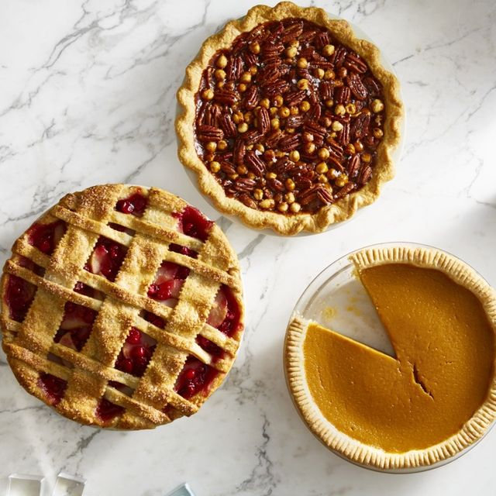
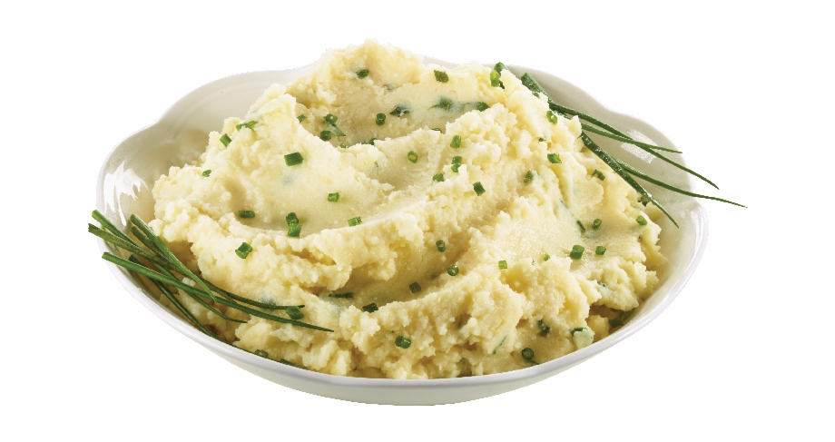
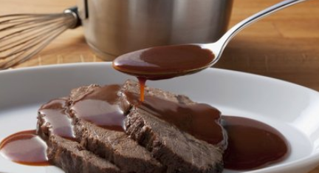
traditional food 传统食物
turkey
pumpkin pie
（南瓜派）
mashedadj. 捣烂的
pototo
(土豆泥)
gravy（肉汁）

Slide 13
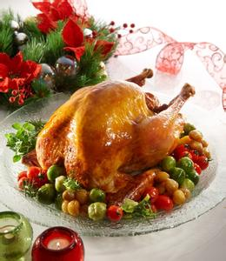
Thanksgiving Day is a __________________ (传统假日)in autumn. People __________（庆祝）it by eating____________ （南瓜派）. They also prepare other food such as gravy and mashed pototo.
traditional holiday
celebrate
pumpkin pie

Slide 14
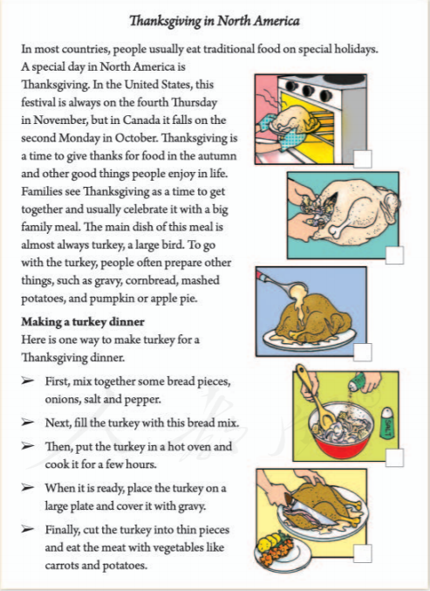
Prediction
Look at the picture and predict.
1.What kind of food are they making?
2. On which special day do people eat it?
3.What may the passage tell us ?
Turkey.
Thanksgiving Day in North America.
A.Thanksgiving and how to make turkey.
B.It talks about when is Thanksgiving Day.
C.It talks about How to make a turkey dinner

Slide 15
Fast reading
Read for the Structures（结构）
Part 1
1.What's the text type(文体)?
It's an expository text.(说明文）
2.We can divide(分) the article into ____ parts.
The main idea of each part:
2
Part 2
Part 1：The introduction(介绍) of Thanksgiving
Part 2：How to make a turkey dinner.

Slide 16
Read Part 1 again and finish the chart.
Tips: Look for key words and mark the key information.
Introduction of Thanksgiving day
where | Thanksgiving is a special day in ___________________.
when | It’s on _________________ ______________in America. | It’s on ________________ ____________ in Canada.
why | It’s a time to ____________________________ ____________________________________.
how | They celebrate it by ______________________________.
what to eat | The main dish is _________________________________. Other things:_________________________________.

Slide 17
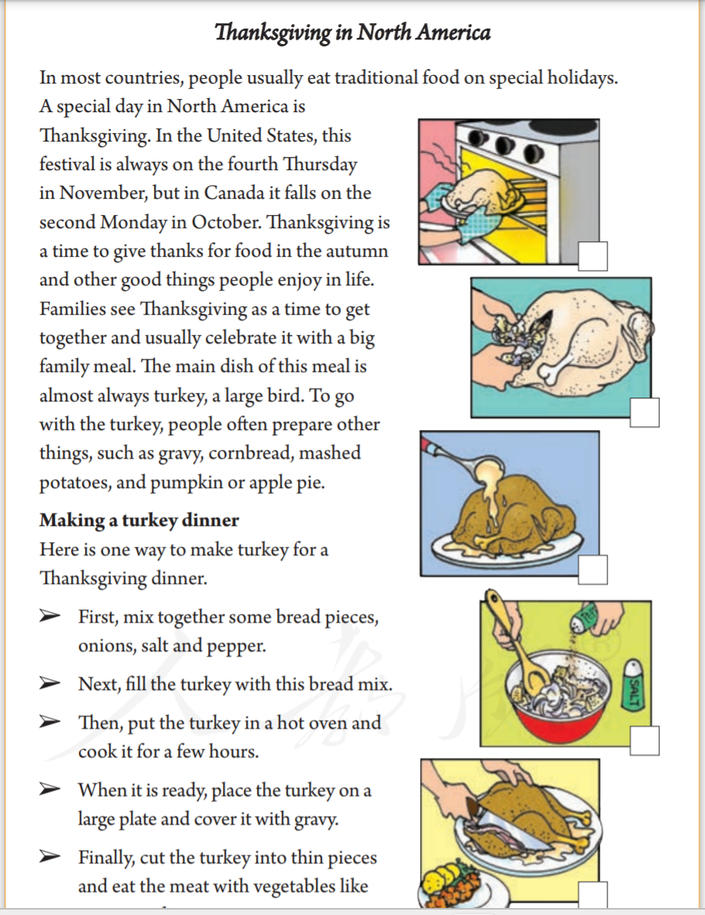
Where
When
Why
How
What
to
eat

Slide 18
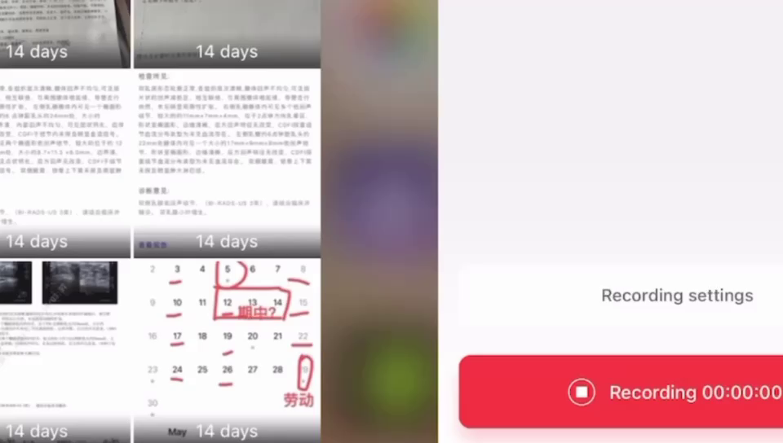

Slide 19
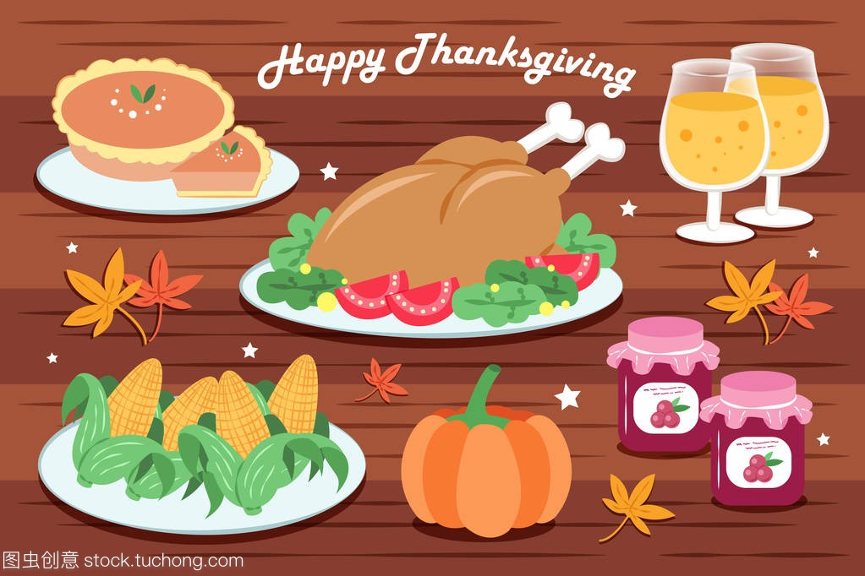
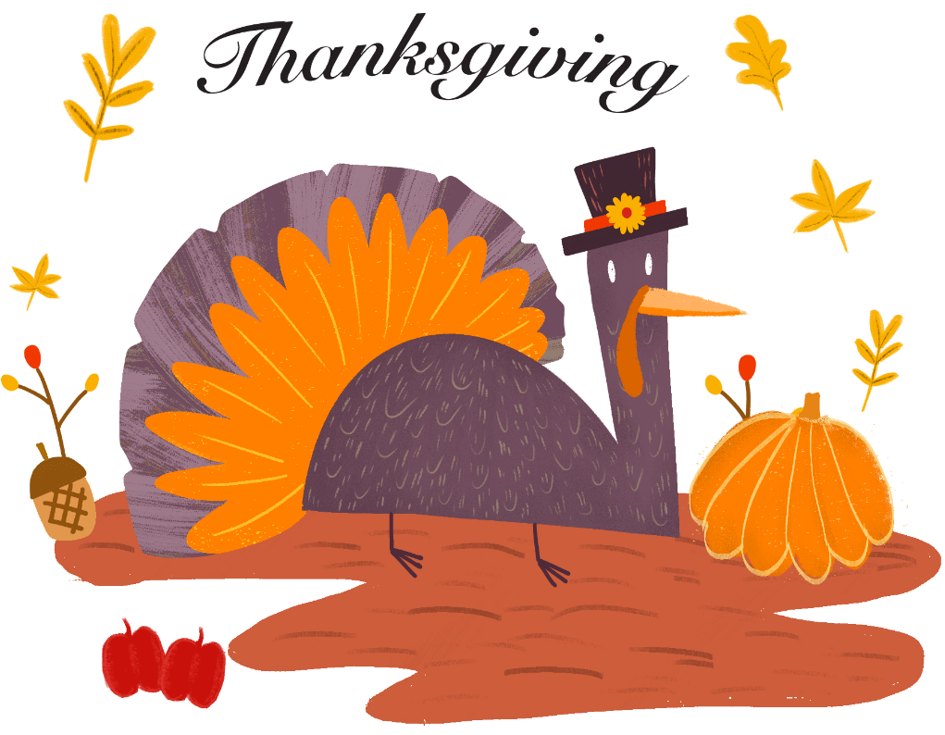
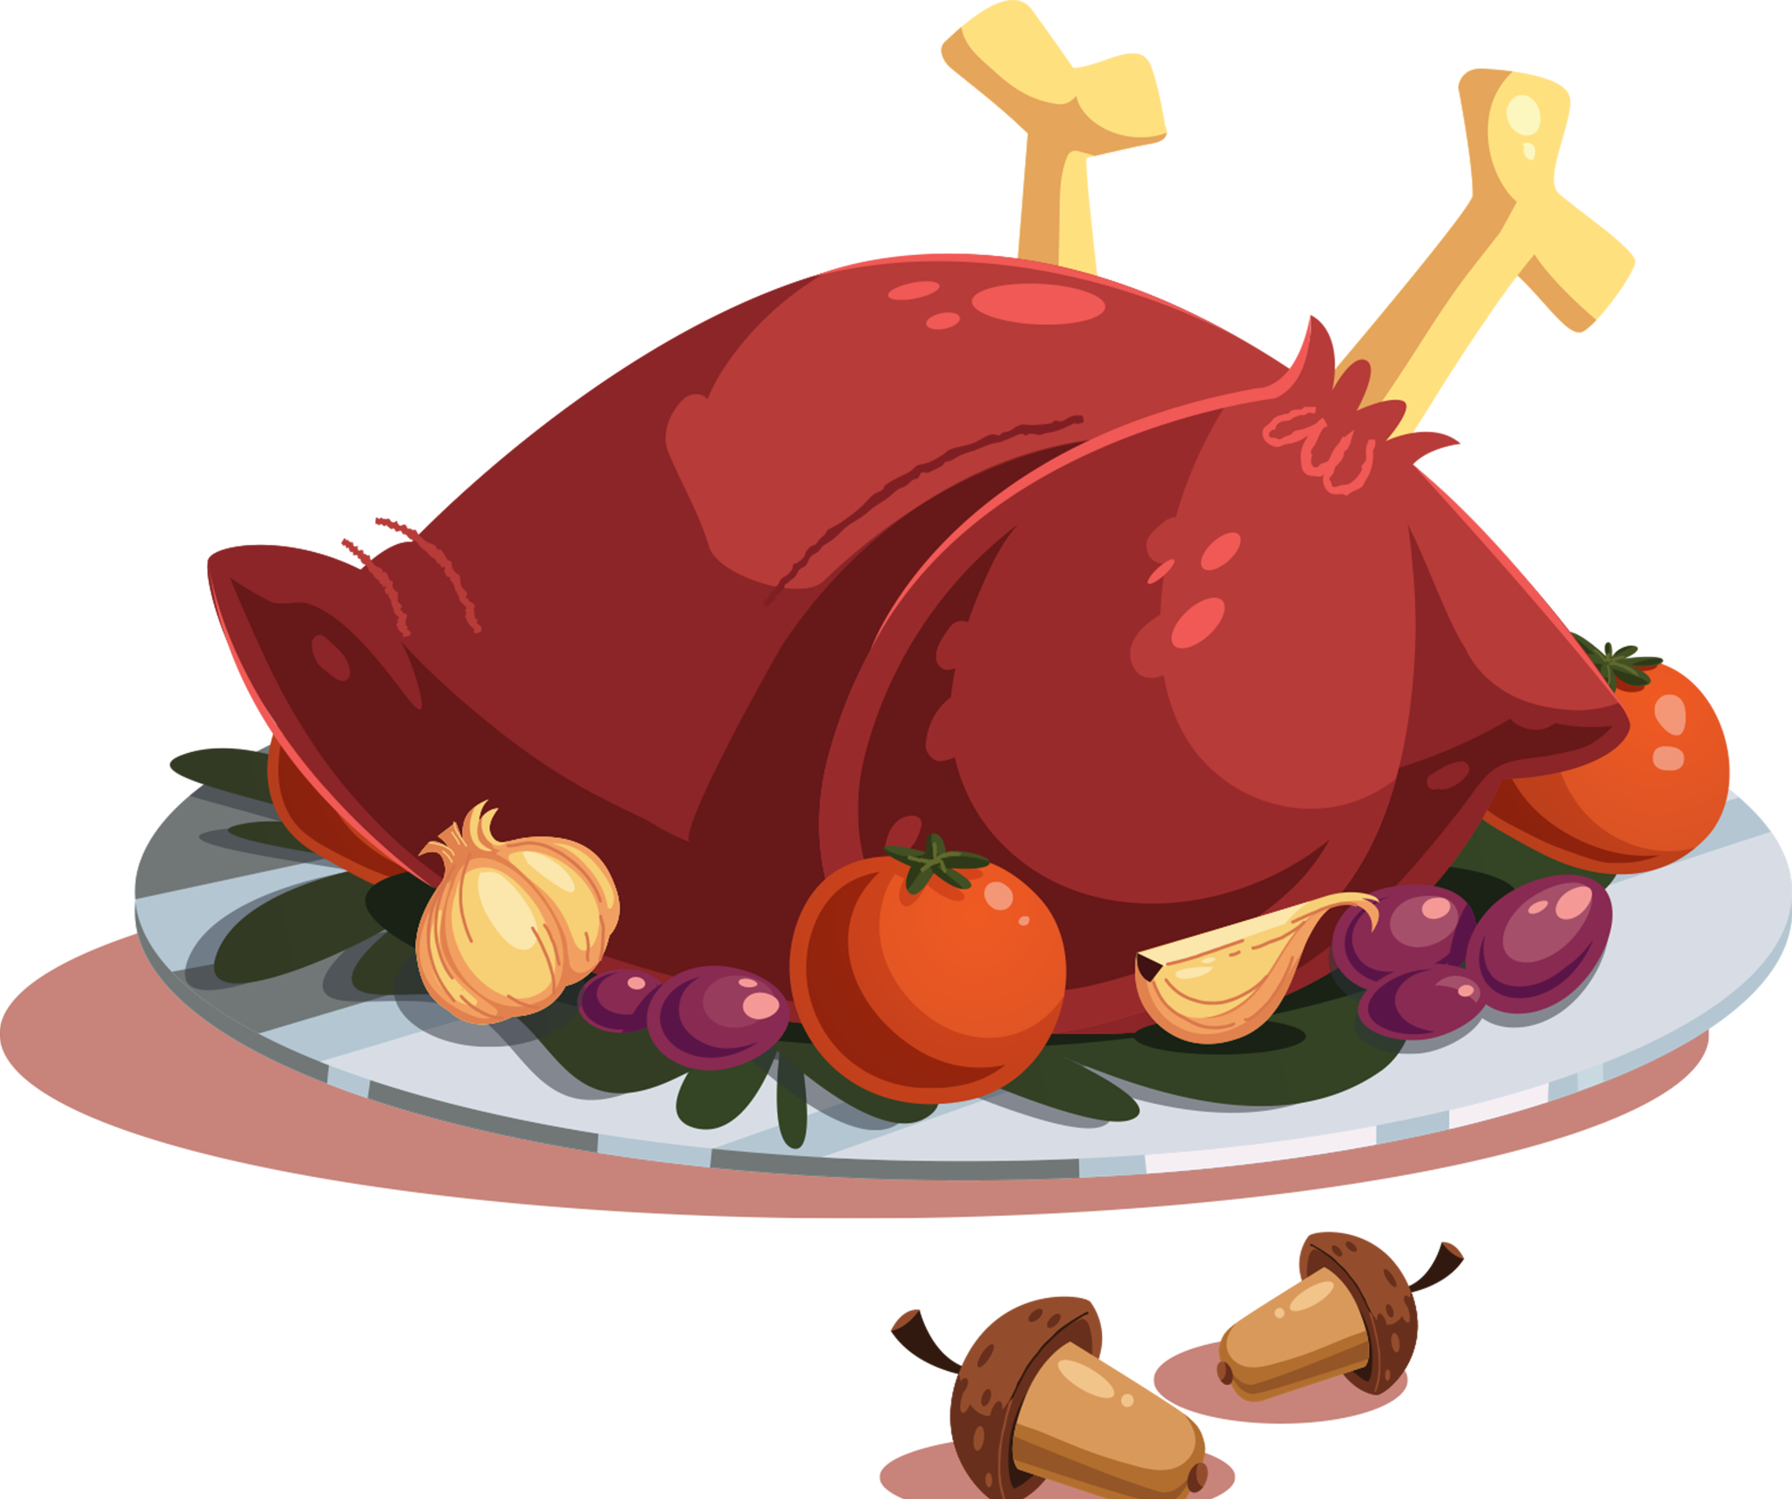

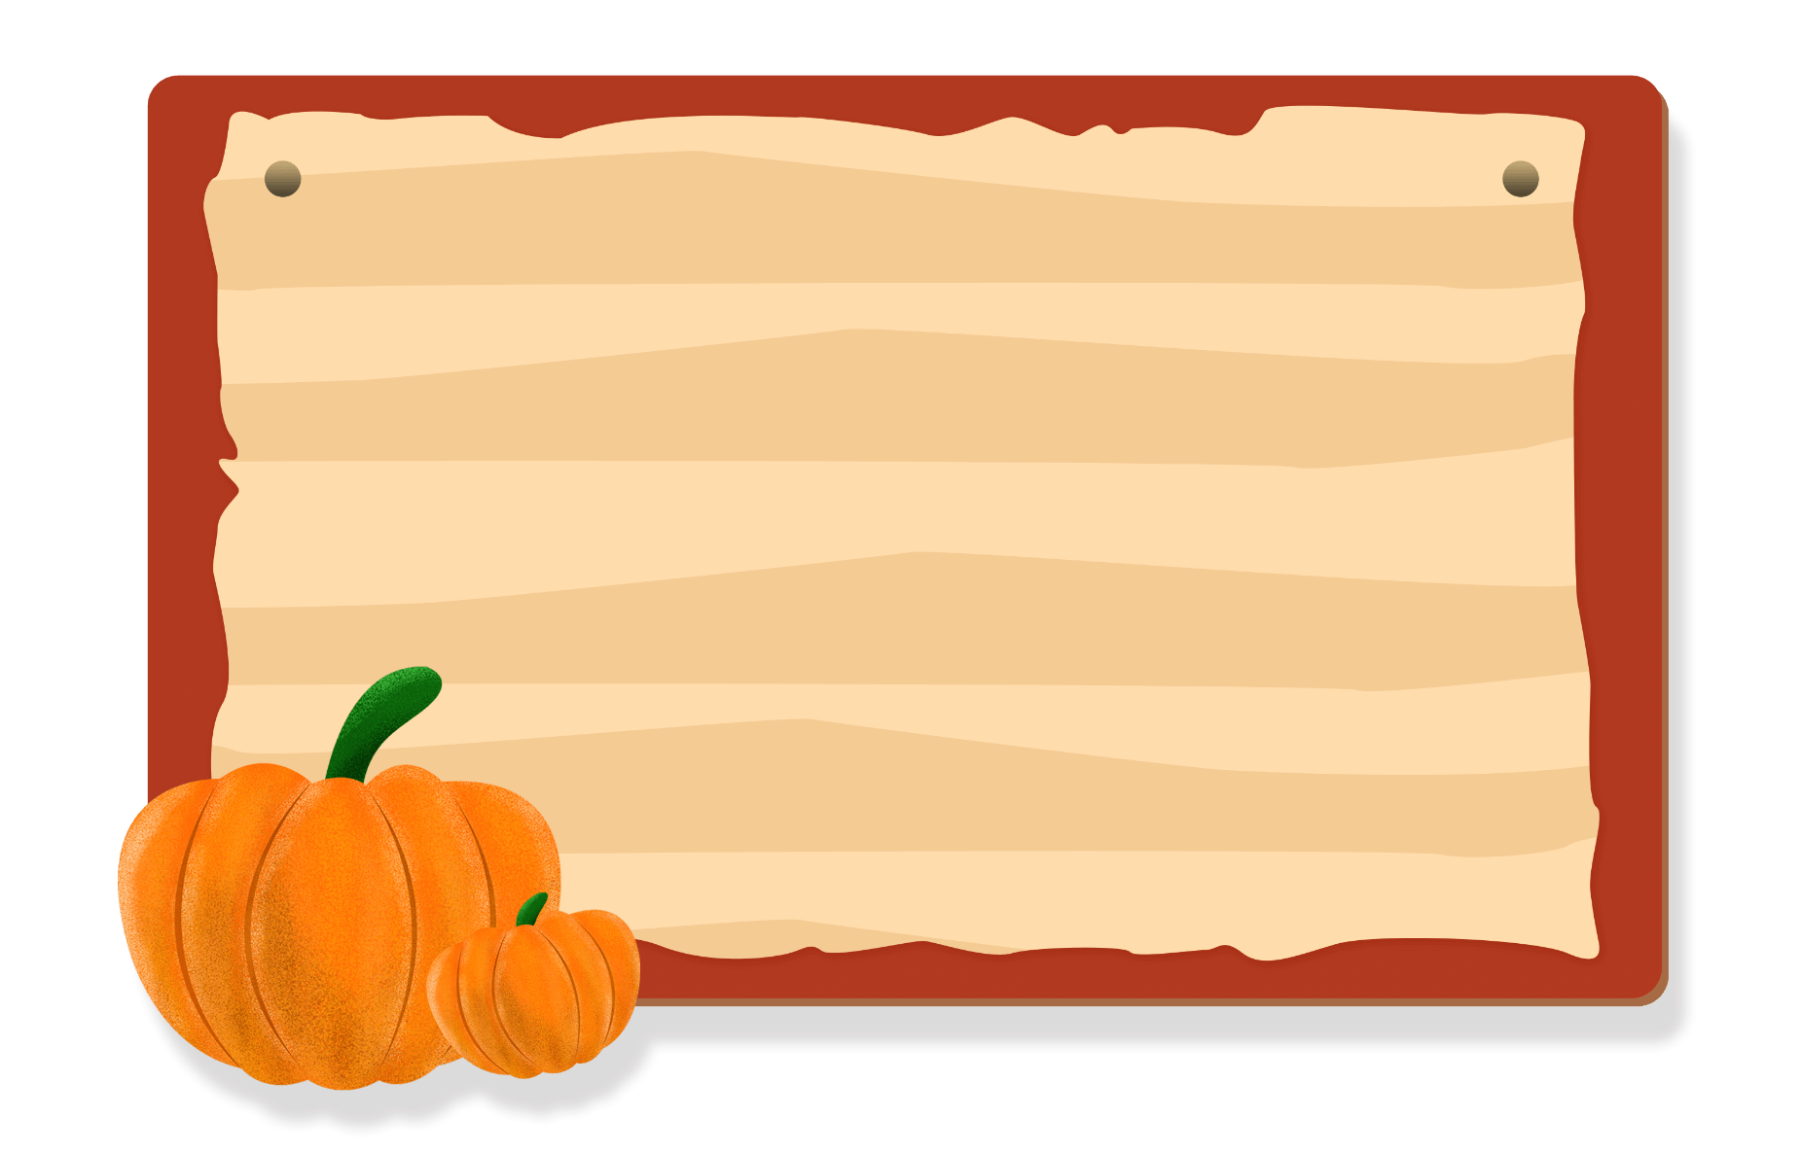
Presentation
Say thanks to the food!
Say thanks to your family!
Say thanks to your teachers!
Say thanks to your friends!
Say thanks to everyone!
Be a thankful person!

Slide 20
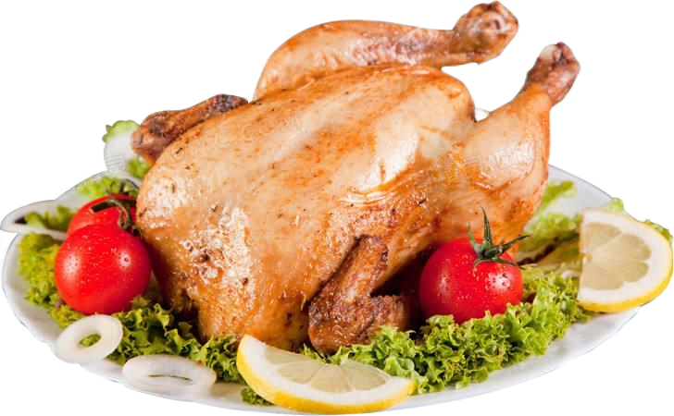
How to make turkey?
Read Part 2 and finish the tasks.

Slide 21
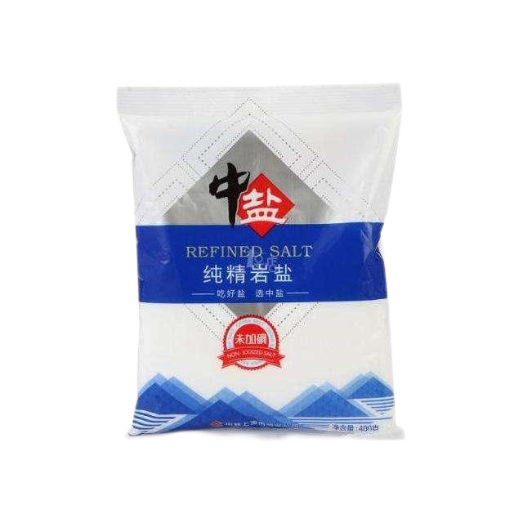
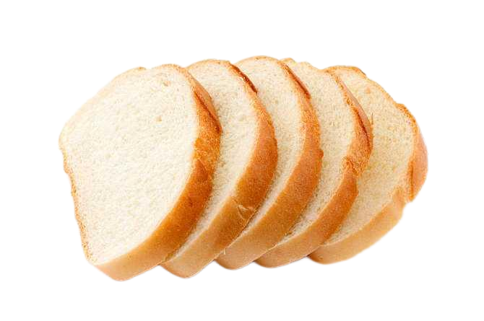
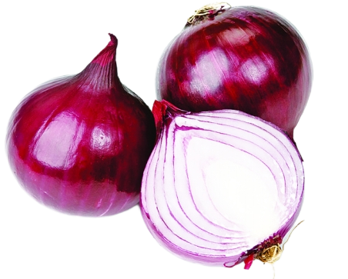
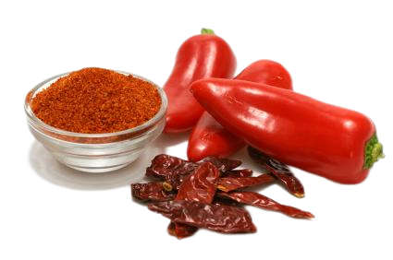
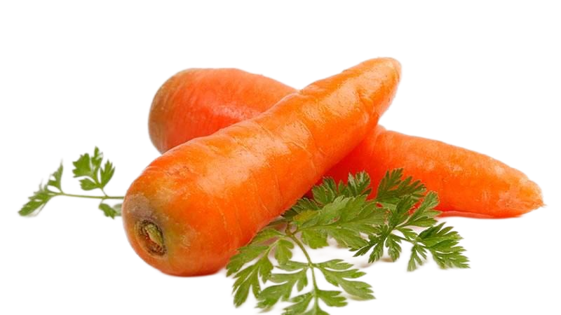
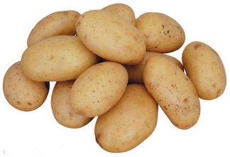
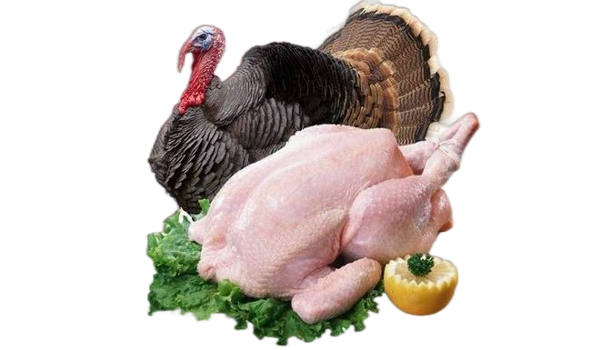
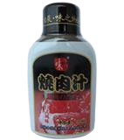
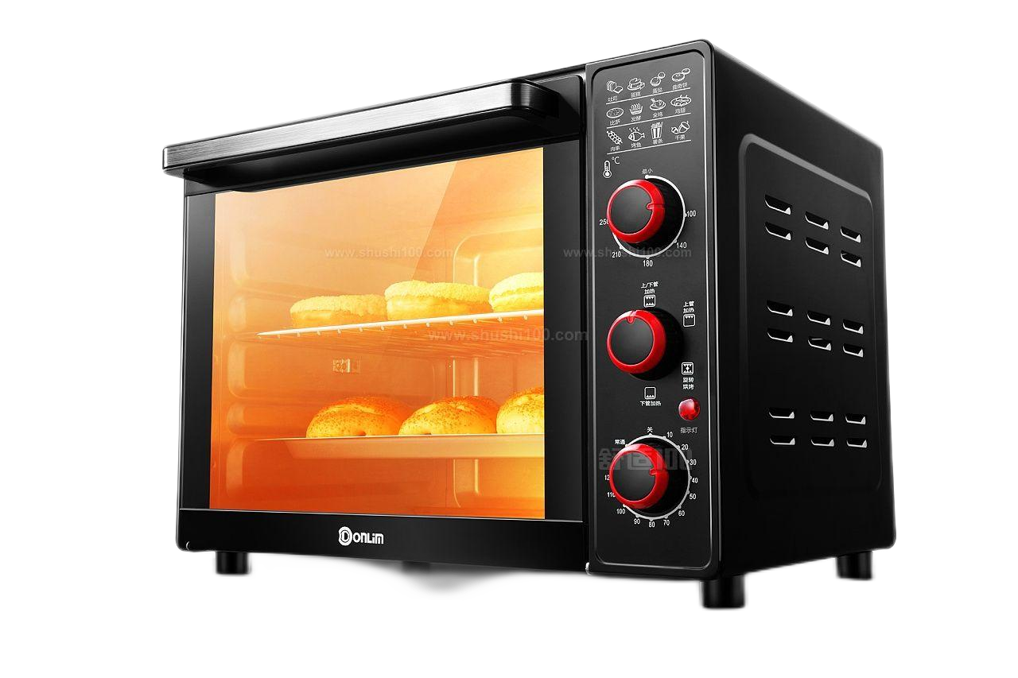
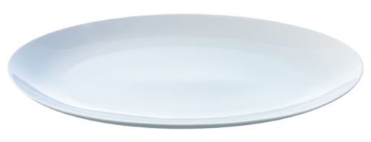
1.What do we need to make turkey?
ingredient
[ɪnˈɡriːdiənt]
n. 原料
bread pieces
onions
salt
pepper
carrots
potatoes
turkey
gravy
tool[tuːl]
n. 工具
plate
oven

Slide 22
2b
Read Part 2 and number the pictures(1-5).
3
2
4
5
1

Slide 23
2.How do we make turkey？
mix together some bread pieces, onions, salt and pepper.
First,
mix together:混合在一起
Next,
fill the turkey with this bread mix.
fill…with… 用…把…填满
被动式为be filled with，意为“装满”，相当于be full of。

Slide 24
Then,
put the turkey in a hot oven and cook it for a few hours.
put …in…：把…放在…里面
place the turkey on a large plate and cover it with gravy.
After that,
place (=put)…on:把…放置某物的上
cover … with…：用…盖…
be covered with: 被...盖住
Finally,
cut the turkey into thin pieces and eat the meat with vegetables like carrots and potatoes.
cut … into thin pieces:把…切成薄片

Slide 25
First,
mix together…
Verbs used
Next,
fill …with …
1
Then,
put …in, cook
2
When it’s ready,
3
place, cover...with
4
Finally,
cut…into..,
eat…
5
Step words

Slide 26
Here are the instructions for making a turkey dinner written in a different way. Put them in order. Write First, Next, Then and Finally.
_______, serve it to your friends with some vegetables.
_______, put this into the bird.
_______, cook it at a very high temperature for a long time.
_______, put everything you need together in a large bowl.
Finally
Next
Then
First

Slide 27
In most countries, people usually eat traditional food on special holidays. A special day in North America is Thanksgiving. In the United States, this festival is always on the fourth Thursday in November, but in Canada it falls on the second Monday in October. Thanksgiving is a time to give thanks for food in the autumn and other good things people enjoy in life. Families see Thanksgiving as a time to get together and usually celebrate it with a big family meal. The main dish of this meal is almost always turkey, a large bird. To go with the turkey, people often prepare other things, such as gravy, cornbread, mashed potatoes, and pumpkin or apple pie.

Slide 28
Making a turkey dinner
Here is one way to make turkey for a Thanksgiving dinner.
First, mix together some bread pieces, onions, salt and pepper.
Next, fill the turkey with this bread mix.
Then, put the turkey in a hot oven and cook it for a few hours.
When it is ready, place the turkey on a large plate and cover it with gravy.
Finally, cut the turkey into thin pieces and eat the meat with vegetables like carrots and potatoes.

Slide 29
Language points
1. …but in Canada it falls on the second Monday in October.
fall on + 日期
“fall on + 日期”表示“（生日、节日等）适逢……，正当……”，其中fall作动词，表示“发生”。
His birthday falls on a Saturday this year.

Slide 30
2. Thanksgiving is a time to give thanks for food in the autumn and other good things people enjoy in life.
give thanks for sth. 因某事而感谢
（1）give thanks for sth.中的for后跟感谢的原因。
I will give thanks for taking care of my baby while I am away.
（2）give thanks to sb. 意为“对某人表示感谢”。
We should give thanks to our teachers for their help.

Slide 31
3. Families see Thanksgiving as a time to get together and usually celebrate it with a big family meal.
see … as … 把……看作……
see … as … 相当于regard … as …，其中see意为“以特定的方式考虑；看待”。
I see music as a special language.
celebrate v. 庆祝；庆贺
（1）celebrate可作及物动词或不及物动词。
Celebrate every day of your life.
It’s Tom’s 24th birthday. Let’s celebrate together.
拓展延伸：celebration作名词，意为“庆典；庆祝活动”。

Slide 32
4. To go with the turkey, people often prepare other things…
prepare v. 是做好准备；把……准备好
（1）prepare作动词，常用搭配有：
prepare for sth. 为某事做准备
prepare to do sth. 准备做某事
get prepared 做好准备
Hope for the best and prepare for the worst.
He took out a piece of paper and prepared to write a letter.
My mother is preparing dinner for us in the kitchen.
拓展延伸：preparation为名词，意为“准备；准备工作”。
The Smiths are making preparations for this journey.

Slide 33
5, First，mix together some bread pieces，onions，salt and pepper.
mix v. (使)混合；融合
Don't mix all the ingredients together.
别把所有的原料混在一起。
mix A with B 把A和B混在一起
She mixed the flour with eggs.她把面粉和鸡蛋混在一起。
mixture n. 混合物

Slide 34
6. Next, fill the turkey with this bread mix.
fill … with … 用……把……填满
fill … with … 表示动作，其被动式为be filled with，意为“装满”，相当于be full of。
She filled the glass with wine.
The sky is filled with stars.
Life is full of exciting things.
图解助记

Slide 35
7. When it is ready, place the turkey on a large plate and cover it with gravy.
place v. 放置 n. 位置；地点
（1）place在此处作动词，相当于put。
He was so happy and placed the fish in the icebox.
（2）place还可作名词，表示“位置；地点”。
It is a good place for a picnic.

Slide 36
7. When it is ready, place the turkey on a large plate and cover it with gravy.
cover v. 遮盖；覆盖 n. 覆盖物；盖子
（1）cover在此处作动词，常用结构：
cover … with … 用……盖……
be covered with … 被……盖着
Cover the pot and bake for an hour.
The bulletin board was covered with messages.
（2）cover还可作名词，表示“覆盖物；盖子”。
This glass bowl has a plastic cover.
（3）cover作名词，还可表示（书刊的）封面；封皮。
图解助记

Slide 37
8. … serve it to your friends with some vegetables.
serve v.接待；服务；提供
（1）serve作及物动词，常用结构：
serve sb. sth. = serve sth. to sb. 招待某人吃某物；给某人提供某物
serve sb./sth. 为某人/某物服务
We served all the guests food. = We served food to all the guests.
The company serves the city with running water.
（2）service作名词，意为“服务；接待”。
The food was good but the service was very slow.

Slide 38
应用实践类活动
I. 根据句意及首字母或汉语提示完成句子。
1. Kate was so scared that she ________ (覆盖) her eyes with her
hands.
2. Alice stayed up late and __________ (准备) herself for the math
exam last night.
3. The ____________ (气温) is very high, and I feel very hot.
4. Don’t forget to put some __________ (胡椒粉) in the soup.
5. The Spring Festival is a __________ (传统的) festival in China.
6. Please put the pizza in the ________ (烤炉).
7. Look! The workers are ________ (装满) the truck with bags.
covered
prepared
temperature
pepper
traditional
oven
filling

Slide 39
应用实践类活动
II. 用括号内所给词的适当形式填空。
1. They are going to have a _____________ (celebrate) for their
grandpa’s birthday.
2. Mother’s Day is on the ________ (two) Sunday in May.
3. Lots of __________ (travel) choose to visit Pairs every year.
4. Here is one way __________ (make) delicious cakes.
5. The Spring Festival is a ___________ (tradition) festival in China.
6. We are working hard __________ (prepare) for the competition.
7. The box is too heavy. It is _______ (full) of old books and
magazines.
celebration
second
travelers
to make
traditional
to prepare
full

Slide 40
Let’s find and translate the phrases.
1.fill ... with ...
2.cover ... with ...
3.serve sth. to sb.
4.celebrate … by/with doing
5.see...as...
6. get together
7. prepare for
8. prepare to do sth.
= be ready to do sth.
9. place...on...=put... on...
10. cut ...into...
用...装满...
用...盖住...
用...招待某人
通过/用…庆祝
把...看作为...
团聚
为...做准备
准备做...
把... 放在...上
把...切成...

Slide 41
Let’s find and translate the phrases.
11.at a high temperature
12.fall on+日期
13.give thanks for sth.
14.It is a time to do sth
15.go with
16.on special holidays
17. one way to do sth.
18.on the fourth Thursday in November.
19. the main dish
20.mix．.. together
在一个高的温度下
适逢；落在(某一天)
因某事而感谢
是做…的时间
和...搭配一起
在特别的节假日
做某事的一个方法
在11月第四个星期四
主菜
把……混在一起

