Slide 1
Unit 8 How do you make banana milk shake?
Section B 1a-1e

Slide 2
教学目标：
一、语言能力：
能够在“早餐我来做”的情境中正确使用关于食物的新词汇、表顺序的连接词和祈使句，以听、看、说等方式理解和谈论三明治的制作；能够在听、读、看的过程中，抓住重点内容，针对语篇的内容有选择地记录信息和要点，并口头转述他人简单的谈话，对自己最喜爱的三明治的制作进行口头陈述，提高听说技能。
二、学习能力：
能够通过谈论三明治的制作，保持英语学习兴趣；通过听力及口语策略的感悟、体验和学习，形成良好的学习习惯，提高学习效率；能主动参与各种英语实践活动，注意倾听，积极使用英语进行交流。
三、文化意识：
了解西方饮食，认识并理解不同文化，体验中西方饮食文化的差异；积极为家人制作早餐，体会劳动教育，增进与家人的感情。
四、思维品质：
能够在听说活动中准确获取并清晰表达有关制作三明治的信息，提高思维的逻辑性、深刻性和批判性。

Slide 3
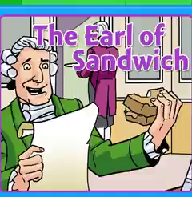
Do you know the origin of sandwiches?

Slide 4

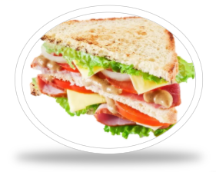
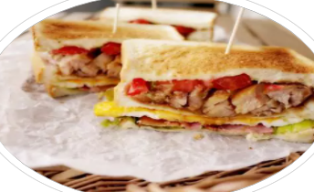
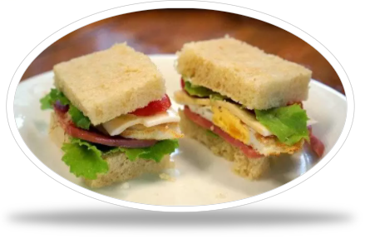
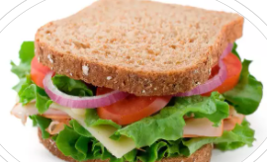
Look at the pictures and answer.
Now there are many kinds of sandwiches.
What kind of sandwich do you like best?
cheese sandwich
turkey sandwich
egg and ham sandwich
tomato sandwich

Slide 5
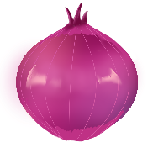
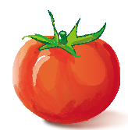
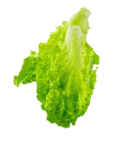
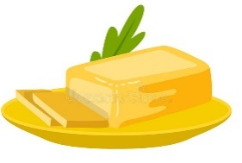
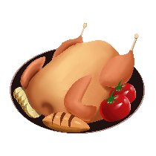

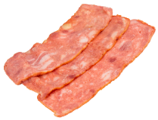

Think and share.
tomato
butter
ham
onion
lettuce
turkey
bacon
What do you like to put in your sandwich?
I like to put in my sandwich.

Slide 6
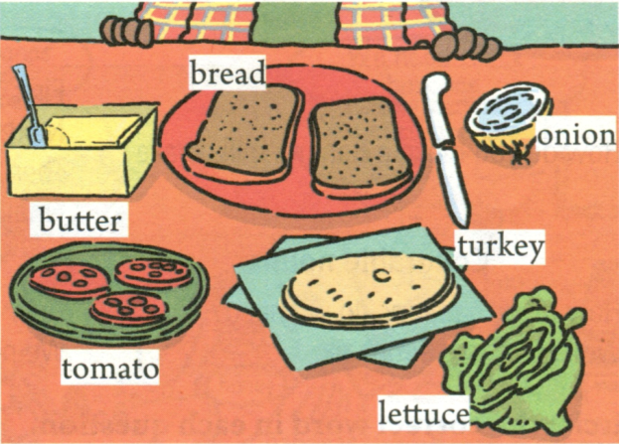
1a
Make a list of the things you like in a sandwich.
In my sandwich, I like __________________________________________.

Slide 7
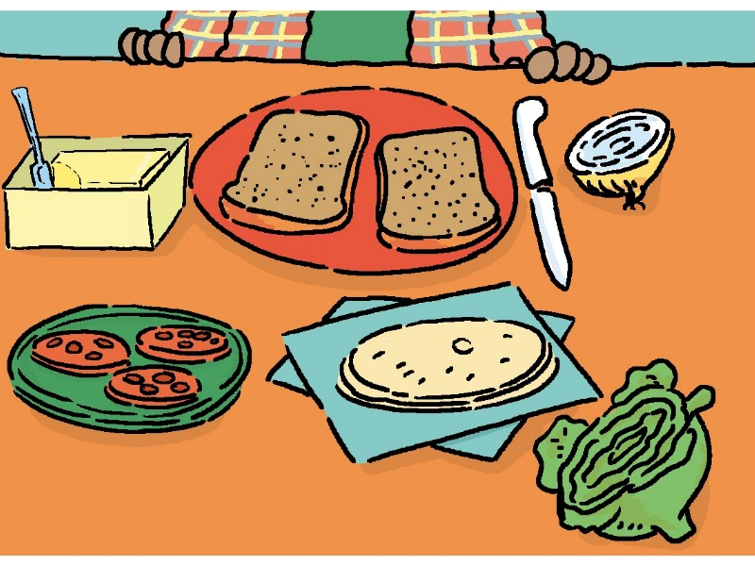

1c
Look at the picture in 1a. Listen and circle the words you hear.
bread
onions
butter
turkey
tomatoes
lettuce

Slide 8
1d
Listen again and write the ingredients in the order you hear them.
Ingredients 材料
the order | First | Next | Then | Finally
the ingredients | butter
an tomato
lettuce
bread
bread
an onion
cheese

Slide 9
1d
Listen again and write the amount you need.
Mom, how many/much _____ do I need?
the order | First | Next | Then | Finally
the amount | ______ butter __________bread | _____ tomato _____ onion ______ cheese | _______ lettuce | __________________________ bread
some
one
some
another piece of
a piece of
one
some
You can put more cheese if you like.

Slide 10

1e
Tell your partner how to make your favorite sandwich.
Today, I will teach you how to make your favorite sandwich.
A: First, put some butter on a piece of bread.
B: How much butter?
A: About one spoon.

Slide 11

Describe the production process according to the material description.
Let’s learn to make more kinds of sandwiches.
A ham sandwich
We need:
a bag of bread
an egg
some ham /hæm/ 火腿
tomato sauce /sɔːs/ 酱
mayonnaise/ˌmeɪəˈneɪz/
蛋黄酱

Slide 12
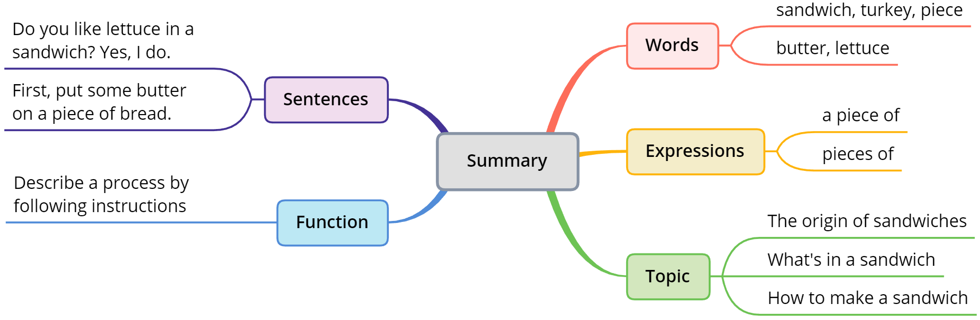
Summary
How do you make a banana milk shake?
(Section B 1a – 1e)

Slide 13
一、根据句意及首字母或汉语提示完成单词。
1．How many p________ of bread do you need?
2．My younger sister likes to eat bread with some b________ on it.
3．My uncle got one big ________(火鸡)for Thanksgiving.
4．Linda’s mother often makes a chicken _________(三明治)for her.
ieces
utter
turkey
sandwich
5．The little boy doesn't like eating ________(生菜)at all.
6．Please put a little more ________(食糖)to make the soup sweeter.
7．Yesterday our class went to plant trees. Jane and I ________ (挖)holes.
lettuce
sugar
dug

Slide 14
二、根据句意及汉语提示填写单词。
final; salt; cut; shake; onion; add; sandwich; much
1．Life is like an __________，and we cry when we peel it.
2．He ___________ the tree and some pears fell down the tree.
3．Don’t forget _____________ some sugar into the coffee.
4．Stop ___________ down trees，because they are important to humans.
onion
shook
to add
cutting
sandwiches
5．Oh, you buy ___________ again! They are fast food and bad for your health.
6．I want to buy a bag of ___________ to cook the meat.
7．So ___________ honey on the floor！Who broke the bottle?
8．___________，the boy found his parents and they were very happy.
salt
much
Finally

Slide 15
二、根据句意及汉语提示填写单词。
final; salt; cut; shake; onion; add; sandwich; much
1．Life is like an __________，and we cry when we peel it.
2．He ___________ the tree and some pears fell down the tree.
3．Don’t forget _____________ some sugar into the coffee.
4．Stop ___________ down trees，because they are important to humans.
onion
shook
to add
cutting
sandwiches
5．Oh, you buy ___________ again! They are fast food and bad for your health.
6．I want to buy a bag of ___________ to cook the meat.
7．So ___________ honey on the floor！Who broke the bottle?
8．___________，the boy found his parents and they were very happy.
salt
much
Finally

Slide 16
二、根据句意及汉语提示填写单词。
final; salt; cut; shake; onion; add; sandwich; much
1．Life is like an __________，and we cry when we peel it.
2．He ___________ the tree and some pears fell down the tree.
3．Don’t forget _____________ some sugar into the coffee.
4．Stop ___________ down trees，because they are important to humans.
onion
shook
to add
cutting
sandwiches
5．Oh, you buy ___________ again! They are fast food and bad for your health.
6．I want to buy a bag of ___________ to cook the meat.
7．So ___________ honey on the floor！Who broke the bottle?
8．___________，the boy found his parents and they were very happy.
salt
much
Finally

Slide 17
二、根据句意及汉语提示填写单词。
final; salt; cut; shake; onion; add; sandwich; much
1．Life is like an __________，and we cry when we peel it.
2．He ___________ the tree and some pears fell down the tree.
3．Don’t forget _____________ some sugar into the coffee.
4．Stop ___________ down trees，because they are important to humans.
onion
shook
to add
cutting
sandwiches
5．Oh, you buy ___________ again! They are fast food and bad for your health.
6．I want to buy a bag of ___________ to cook the meat.
7．So ___________ honey on the floor！Who broke the bottle?
8．___________，the boy found his parents and they were very happy.
salt
much
Finally

Slide 18
Thank you for listening

