Slide 1
Unit 8
How do you make
a banana milk shake?
Section A 1a-2c
Hillda

Slide 2
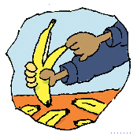
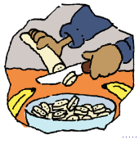
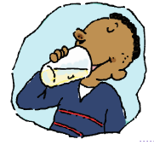
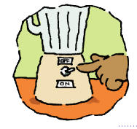
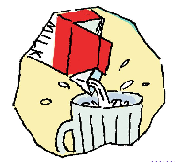
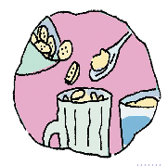
- What should we do first?
- First,...
Prediction
- What do we need to do?
- We need to ...
？
ice-
cr

Slide 3

Let’s listen
Listen and put the instructions in order.
5
_____ Turn on the blender.
_____ Cut up the bananas.
_____ Drink the milk shake.
_____ Pour the milk into the blender.
_____ Put the bananas and ice-cream
in the blender.
_____ Peel three bananas.
Next,
First, peel three bananas.
Then, cut up the bananas.
Now, put the bananas and ice-cream in the blender.
Then, pour the milk into the blender.
Next, turn on the blender.
Finally, drink the milk shake.
2
Then,
6
Finally,
4
Then,
3
Now,
1
First,

Slide 4
Let’s imitate
A: I’m hungry! Let’s make a banana milk shake.
B: How do you make a banana milk shake?
A: Well, first peel three bananas.
B: Three bananas?
A: Yes. Then cut up the bananas.
B: OK, I’ve finished.
A: Now put the bananas and ice-cream in the blender.
Then pour the milk in the blender.
B: Is this enough milk?
A: I guess so. Next, turn on the blender. Finally, pour the
milk shake in a glass and drink it.
Listening tip 1:
Rising tone means someone is not sure about sth.

Slide 5
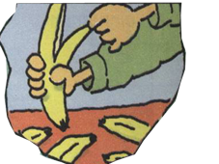
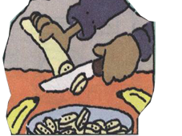
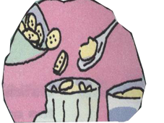
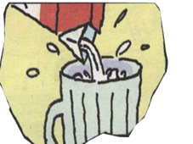
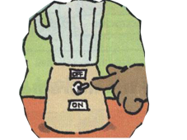
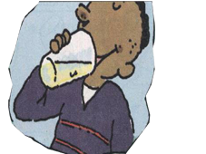
Pair work
2 students: A – speak B – act
A: Today, my friend … and I are going to make a
banana milk shake.
First, …
First, ...
Then, ...
Now, ...
And, ...
Next, ...
Finally, ...

Slide 6
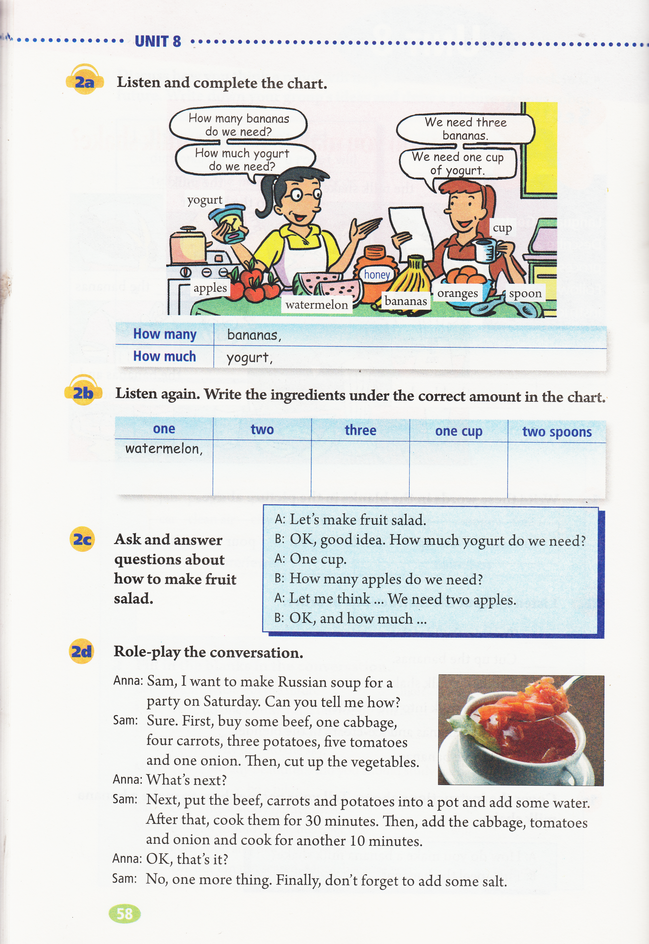
Presentation

Slide 7
Let’s listen
2a Listen and complete the chart.
2b Listen again. Write the ingredients under the correct amount in the chart.
How many | bananas
How much | yogurt
one | two | three | one cup | two spoons
watermelon,
of
of
eg:
How many/ much ... do they need?
eg:
A:How many watermelons do they need?
B:They need one watermelon.
A:How much ... do they need?
B:They need ...
Listening tip 2: Write down the first letter.
eg: watermelon-w
Rules:
How many + countablenoun(cn)
How much + uncountablenoun(un)
Listening tip 3: Pay attention to the numbers.

Slide 8
Let’s think
1. Do they often make fruit salad?
Girl1: Let’s make fruit salad.
Girl2: OK. Do you have bananas?
Girl1: Yes, I do. How many bananas do we need?
Girl2: We need three bananas.
Girl1: That sounds about right. What else?
Girl2: Watermelon.
Girl1: How many watermelons?
Girl2: Oh, only one small watermelon. And we need some honey.
Girl1: How much honey do we need?
Girl2: Let's see. Two spoons.
Girl1: Right. What else?
Girl2: Apples.
Girl1: How many apples do we need?
Girl2: Two should be enough. And yogurt.
Girl1: How much yogurt do we need?
Girl2: A cup. Now what else do we need?
Oh, do you have any oranges?
Girl1: I think so. How many oranges do we need?
Girl2: Only one. This is going to taste great!
Girl1: How many bananas do we need?
Girl2: We need three bananas.
Girl1: That sounds about right.
Girl1: How many apples do we need?
Girl2: Two should be enough.
2. Do they think they will be successful?
Girl2: Now what else do we need? Oh, do you have any oranges?
Girl1: I think so. How many oranges do we need?
Girl2: Only one. This is going to taste great!
3. Do you think they will be successful?

Slide 9
Pair work
A: Let’s make fruit salad.
B: OK. How many ... do we need?
A: ...
B: How much ... do we need?
A: ...
B: What should we do
first?
A: First, ...
B: ...
Checklist
student A | student B
1.Give the order (指令) clearly. | 1.Give proper responses (回应).
2.Use first, then, next, finally correctly. | 2.Use the rising tone correctly.
3.Use cn and un correctly.

Slide 10
Homework
You should do :
1.Talk about the order of making a banana milk shake with your classmates.
2.Write a recipe(菜谱)for your favorite food. And share it with your friends.
You can do:
Make food for your family and take photos to show us next class.

