Slide 1
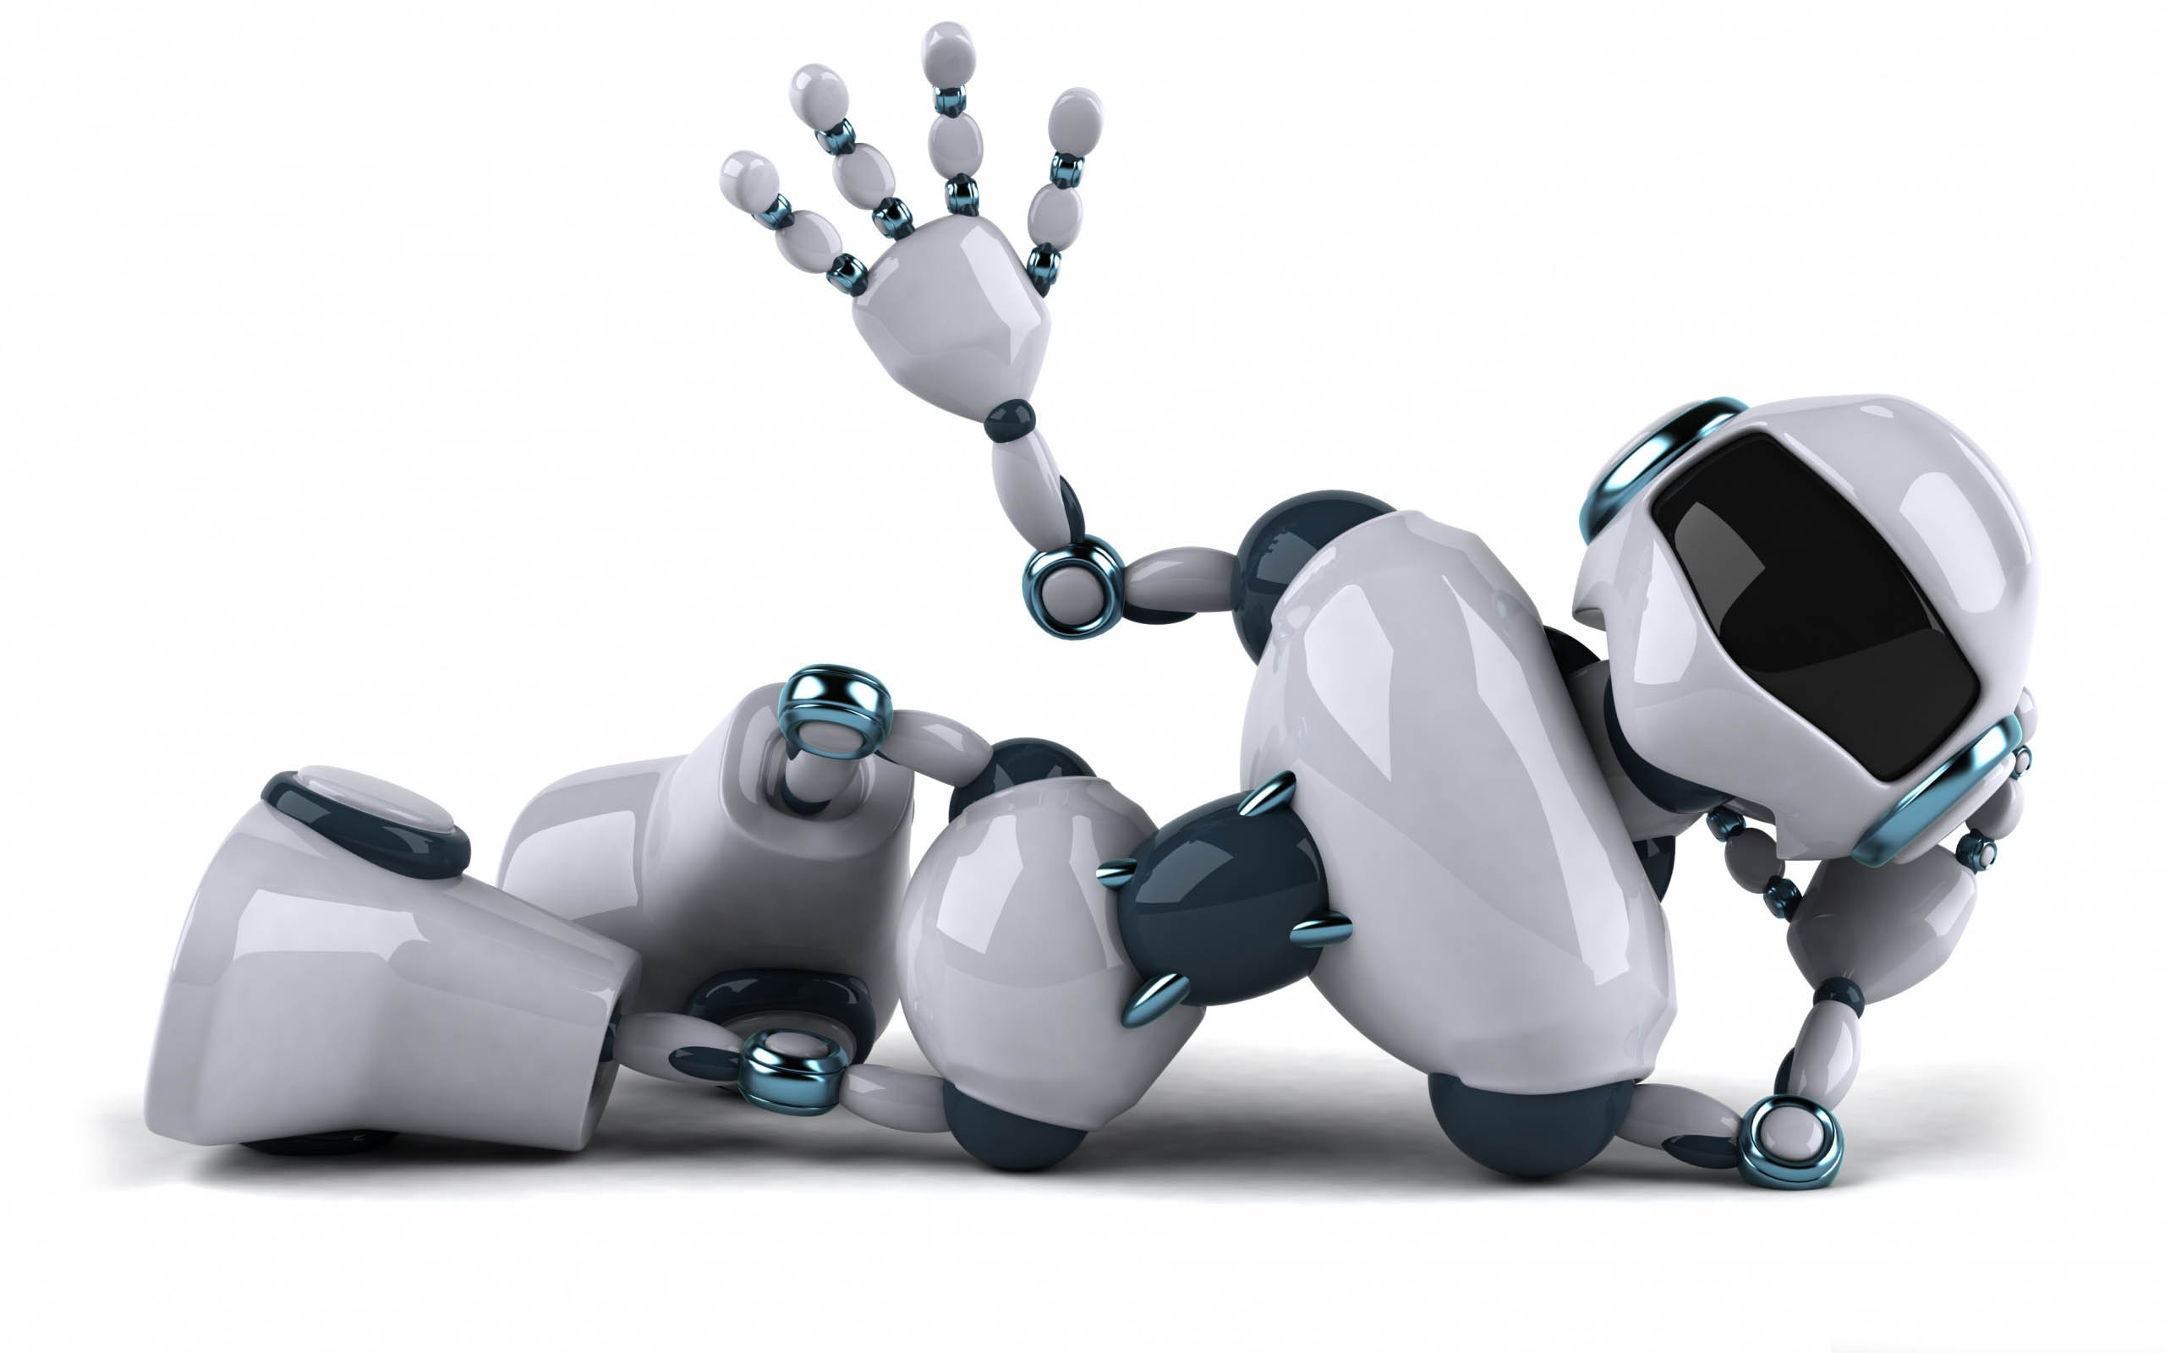
Unit 7
Will people have robots?
Section-B
1a-2e
Notes:
课前带读本单元单词。
Page 41. Today we are going to learn unit 6. I’m going to study computer science. Read after me first. ······Let’s look at the learning Aim of Unit 6.

Slide 2
New words
1.人类；人的
2.有危险的
3.已经；早已
4.工厂
5.多次；反复地
6.日本
7.相信；认为有可能
8.同意；赞成
9.不同意；有分歧
human
dangerous
already
factory
over and over again
Japan
believe
agree
disagree
10.甚至
11. 成百上千的
12. 形状；外形
13.跌落：秋天
14.跌倒；倒下
15.在…里面
16.寻找
17.可能的
18.不可能的
even
hundreds of
shape
fall
fall down
inside
look for
possible
impossible

Slide 3
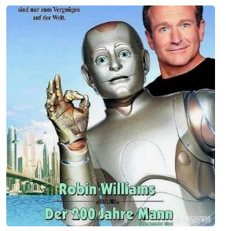
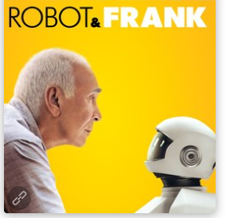
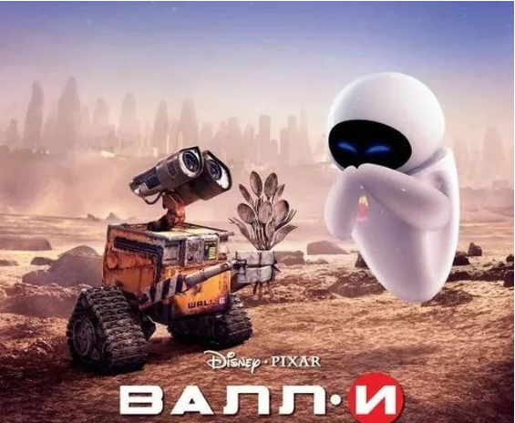
What are these about?
robots

Slide 4
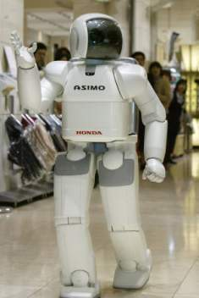
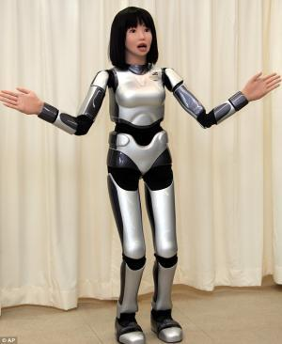
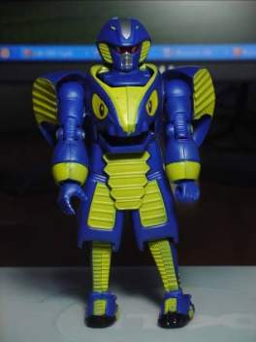

What do these robots look like?
They look like humans.
human-like robots

Slide 5
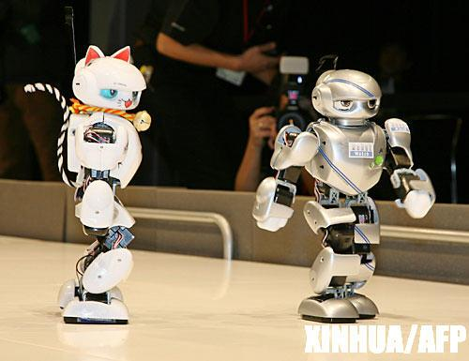
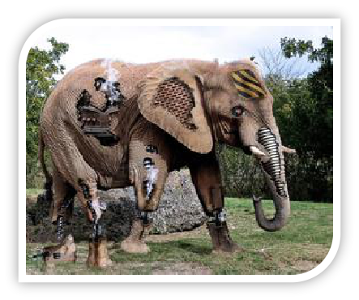
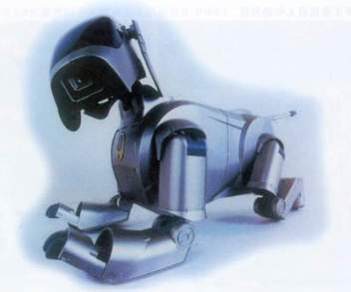
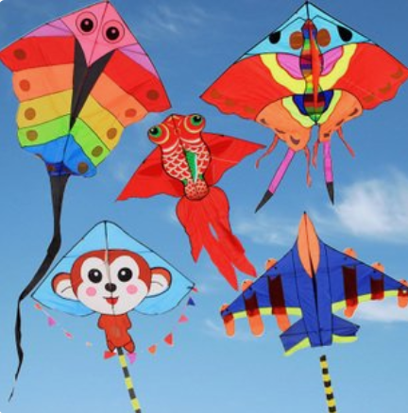
-What do these robots look like?
-They look like animals.
The robots are in different shapes.
形状
The robots have many different shapes.
The shapes of robots are different.
The kites have many different shapes.
The kites are in different shapes.
The shapes of kites are different.

Slide 6
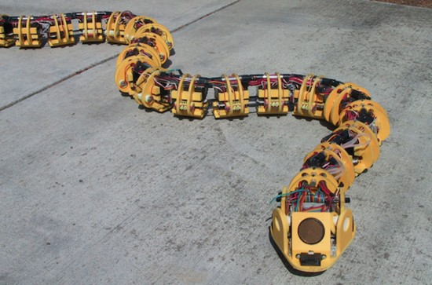
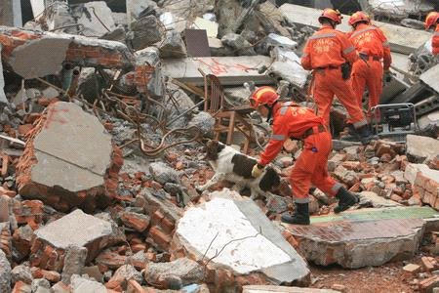
Some robots look like snakes.
fall--fell
What can this robot do?
fall down
There are some people inside buildings.
If buildings ________with people _____, these snake robots
can help ________ （寻找）people under the buildings.
fall down
inside
look for
are able to
dangerous
Some robots__________(可以) work in_________ places.
['deindʒərəs]
adj. 有危险的

Slide 7
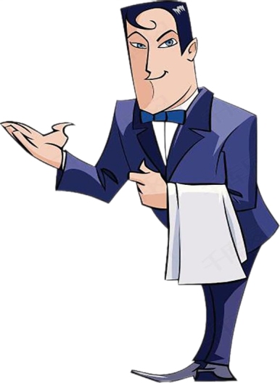
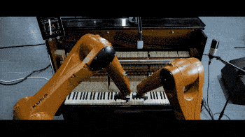
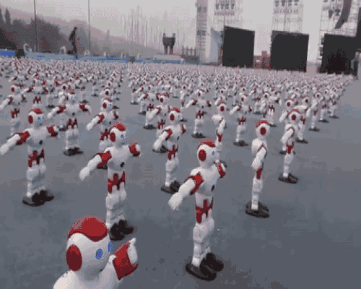
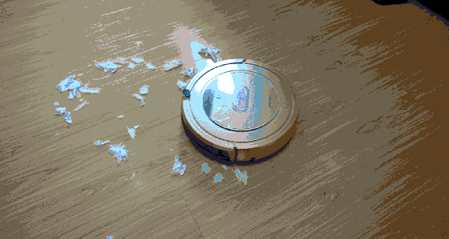
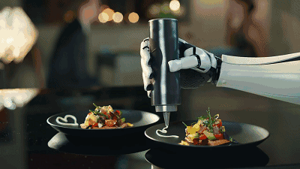
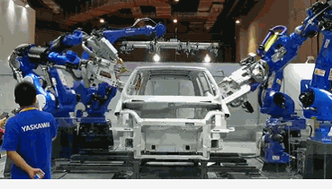
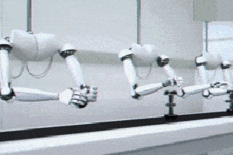

-What can the robots do?
-They can…
They can do the same things as human do.
They are like human servants.
dance
sweep the floor
cook the meals
play the piano
/‘sə:vənt/ 仆人
do simple jobs
over and over again（反复）
build cars in the factory

Slide 8
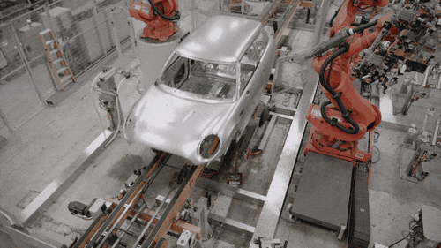
n. 工厂
adv. 早已
Today there are ______robots working in_______.
already
factories
造车
Some can help to________, and they do simple jobs _____________(反复) but never_______ (感到无聊).
build cars
over and over again
get bored

Slide 9
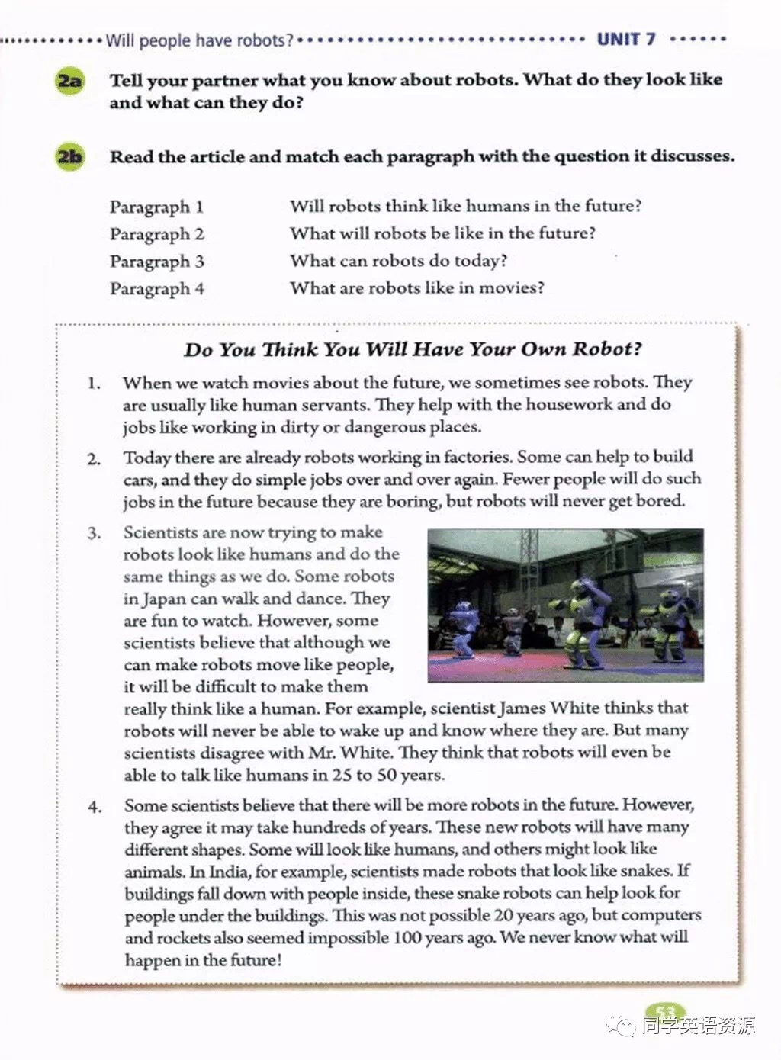

Pre-reading
Prediction
What is the passage about？
A. science fiction(科幻) movie.
B. a scientist , James White.
C. robots in the future.
Tip1: When you read, look at the title and the picture. Maybe you can predict what you will read about.

Slide 10
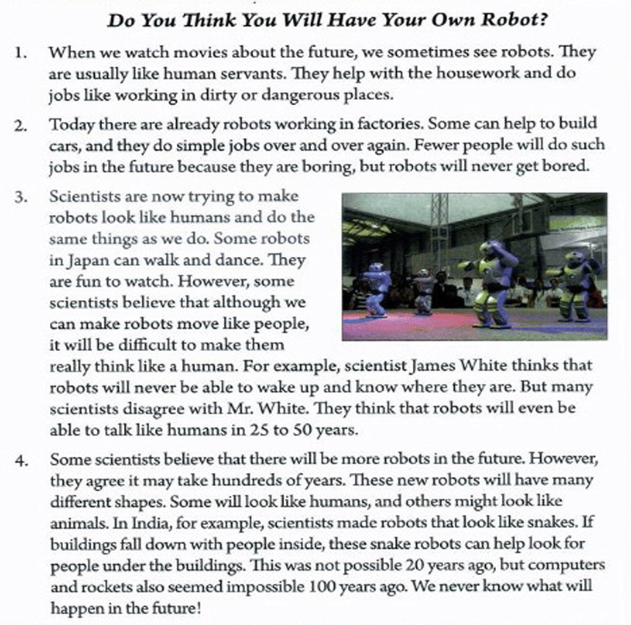
Fast-reading
This passage is a/an______.
narration （记叙文）
exposition （说明文）
argumentation（议论文）
2b
Match each paragraph with the main idea.
movies
A. Will robots think like humans in the future?
B. What will robots be like in the future?
C. What can robots do today?
D. What are robots like in movies?
Today
humans
future
Tip2: The first or the last sentence of each paragraph may help you get the main idea as fast as possible.

Slide 11
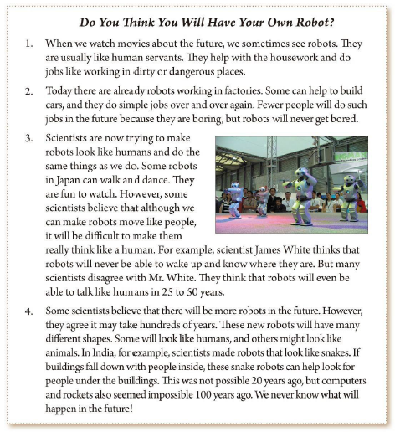
facts
Para.1
What are robots like in movies?
Para.2
What can robots do today?
Will robots think like humans in the future?
Para.3
predictions
预测
What will robots be like in the future?
Para.4

Slide 12
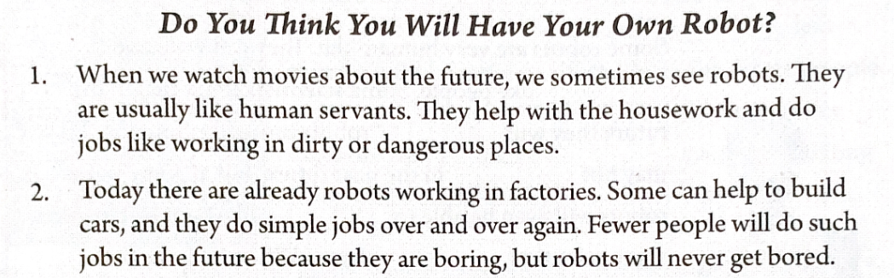
Close reading: Read para 1&2 and fill in the blanks
Reading Para1-2
市场感知能力
human servants
They’re like______________.
today’s
robots
In movies
They help with the housework and do ________ or _________ jobs.
dirty
dangerous
客户开拓能力
They work in factories. They can _________and never _________.
In real life
build cars
get bored

Slide 13
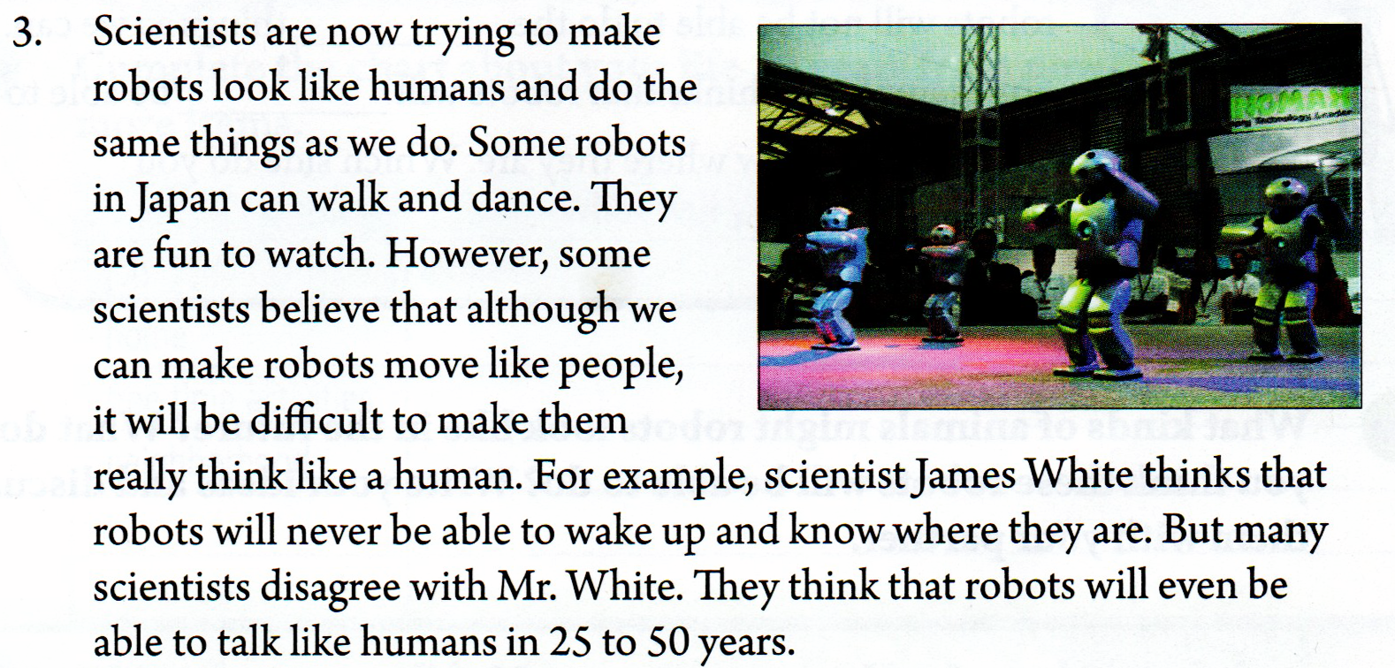
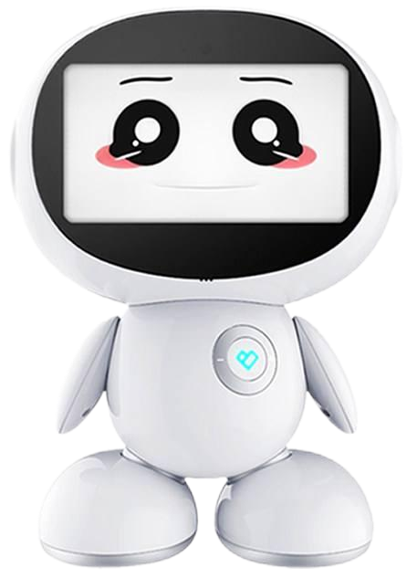
Reading Para 3
talk like look like
move ike think like
Scientists are now trying to make robots _________ humans and do the simple things as we do.
Some scientists believe although robots _________ people, it will be difficult to make them really _________ a human.
Many scientists think robots will even be able to ________ humans in 25 to 50 years.
look like
move like
think like
Robots
talk like

Slide 14
Reading Para 3
walk
dance
Robots in Japan can and .
Will robots think like humans?
who?
James White
Some scientists
many scientists
disagree
why?
agree
two sides of ideas
One side:
The other side:
never be able to
________ and
____________
be able to
______________
wake up
talk like humans
know where they are

Slide 15
Read Para 4,fill in the mind map
4. Some scientists believe that there will be more robots in the future. However, they agree it may take hundreds of years. These new robots will have many different shapes. Some will look like humans, and others might look like animals. In India, for example, scientists made robots that look like snakes. If buildings fall down with people inside, these snake robots can helplook for people under the buildings. This was not possible 20 years ago, but computers and rockets also seemed impossible 100 years ago. We never know what will happen in the future!
many different shapes
New robots will have ___________________
humans animals:________(in India)
snakes
help to look for people
They can __________________________
if the buildings __________with people ________
fall down
inside

Slide 16
What’s the writer’s prediction (预测) about the robots in the future?
A. There won’t be more robots and robots won’t be able to think.
B. It’s possible for robots to think like humans and there will be more robots.

Slide 17
Nothing is impossible ,
if you put your heart into it.
世上无难事，只怕有心人
impossible
I‘m possible.

Slide 18
What do you think is the writer's attitude(态度) towards robots?
A. Interested. B. Worried.
C. Unfavourable. D. Surprised
Do you want robots to think like us?
Why or why not?
Discuss!

Slide 19
Facts now
Appearance （外貌） | Ability （能力）
look like_______ (India) | can help with ___________ and work in _______or __________ places (movies) 2. can help____________ (factories) 3. can______ and ______ (Japan) 4. can help ___________ people (India)
snakes
housework
dirty
dangerous
build cars
walk
dance
look for

Slide 20
2d
Fill in the blanks in this paragraph with words from the article.
dance
Some robots are very human-like. They can walk and _____ like people. Some scientists think that in the future they will _______ robots more like humans. This may not _______ in the near future, but at some point, robots will even be able to ______ like people. However, some scientists ________. James White believes that robots will not be able to do the _____ things as we can. For example, he thinks that robots will ______ be able to wake up and know where they are. Which side do you _____ with?
make
happen
talk
disagree
same
never
agree
哪一方

Slide 21

Do You Think You Will Have Your Own Robot?
serve v. 给...服务
service n. 服务
servant n.仆人
宾语从句用陈述句语序
When we watch movies about the future, we sometimes see robots. They are usually like human servants. They help with the housework and do jobs like working in dirty or dangerous places.
be in great danger
处于极大的危险中
dangerous adj. 危险的+ n.
在脏的或危险的地方工作

Slide 22
there be doing sth. 有...正在做某事
2. Today there are already robots working in factories. Some can help to build cars, and they do simple jobs over and over again. Fewer people will do such jobs in the future because they are boring, but robots will never get bored.
such 这样的

Slide 23
Listen and repeat
3. Scientists are now trying to make robots look like humans and do the same things as we do. Some robots in Japan can walk and dance. They are fun to watch. However, some scientists believe that although we can make robots move like people, it will be difficult to make them really think like a human. For example, scientist James White thinks that robots will never be able to wake up and know where they are. But many scientists disagree with Mr. White. They think that robots will even be able to talk like humans in 25 to 50 years.
4. Some scientists believe that there will be more robots in the future. However, they agree it may take hundreds of years. These new robots will have many different shapes. Some will look like humans, and others might look like animals. In India, for example, scientists made robots that look like snakes. If buildings fall down with people inside, these snake robots can helplook for people under the buildings. This was not possible 20 years ago, but computers and rockets also seemed impossible 100 years ago. We never know what will happen in the future!

Slide 24
2e
What kind of animals might robots look like in the future? What do you think these robots will be able to do? Write your ideas and discuss them with your partner.
I think some future robots might look like ___________. They will _____________________
________________________________________________________________________________________________________________________________________________________________________

Slide 25
Retell 2b
Robots are like
______________.
factories
human servants
Robots are working in__________.
cars
They help with ____________.
Robots
in movies
Robots
today
They can build___
and do _____ jobs and never get ____.
housework
simple
bored
They work in _____ or_________ places.
dirty dangerous
Robots
It will be difficult to make robots ____ like humans.
There will be _____ robots.
think
more
Robots
thinking
Robots
in the future
Robots will have many different ______.
talk
Robots will ____ like humans.
shapes

Slide 26
Group work
Build your own robot.
Group in 4:
2 for building.
1 for writing.
1 for reporting.
Example:
This is ___________ robot.
It is our ______________.
It looks like ___________.
It’s able to ___________ if _____________________.

