Slide 1
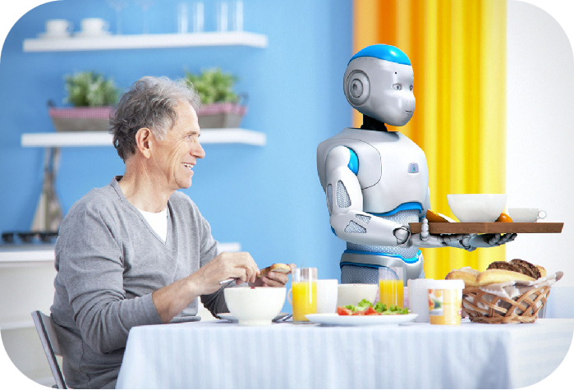
Unit7 Will people have robots ?
Section B
1a-1e

Slide 2
Learning Objectives
By the end of the class , you’ll be able to
1.Get specific information about Joe’s life in different periods through listening.
2.describe and compare your life in different periods.

Slide 3
What will you do in the future?
an astronaut

Slide 4
How will you go to work?
1a
rocket

Slide 5
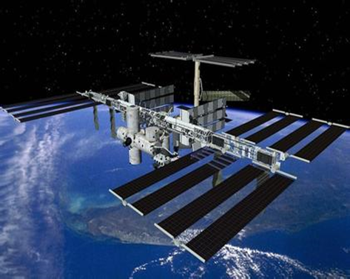
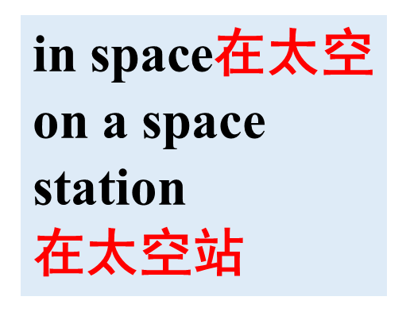
Where will you live?
1a

Slide 6
Read the new words.
astronaut 宇航员
rocket 火箭
apartment 公寓
space station 空间站
computer programmer 计算机程序员
train 火车
house 房子

Slide 7
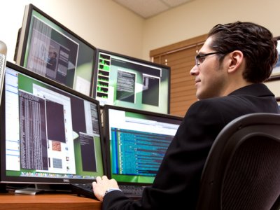
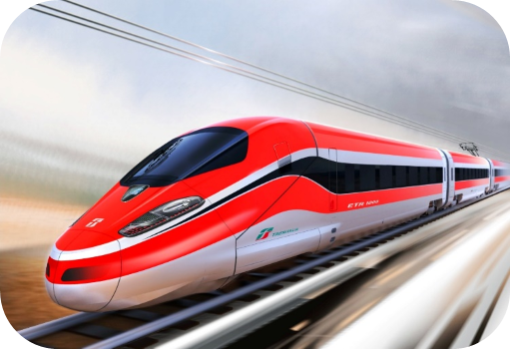
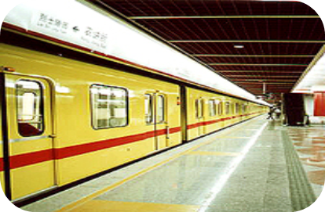
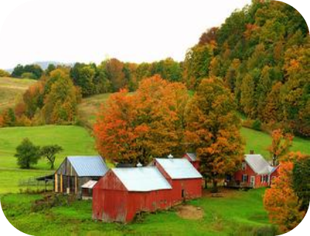
What will your future be like?
I will go to work by...
I will live in/on...
I will be a/an…

Slide 8
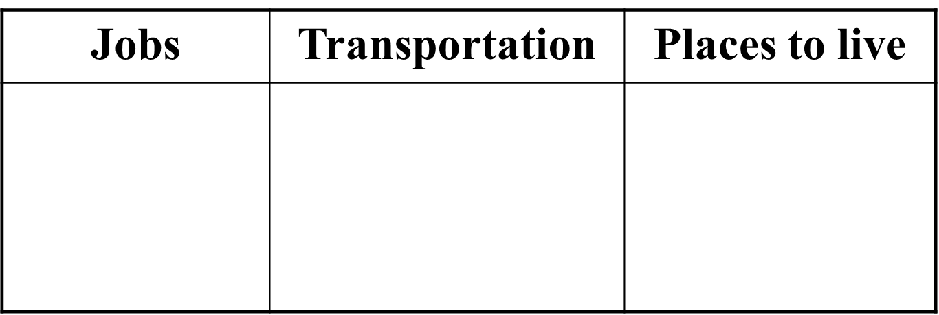
Write each word in the correct column below.
1a
astronaut house apartment train rocket space station computer programmer
astronaut
computer programmer
train
rocket
house
apartment
space station

Slide 9
Think of other words and write them in the chart in 1a.
1b
Think of other words and write them.
Jobs | Transportation | Places to live
astronaut
computer
programmer
house
apartment
space station
train
rocket
plane
bicycle
space ship
helicopter
(直升机）…
engineer
violinist
pianist
scientist
…
farm
flat(公寓)
shelter(避难所)
under the sea
in the sky
The astronaut lives in a space station.
He usually goes to work by rocket.

Slide 10
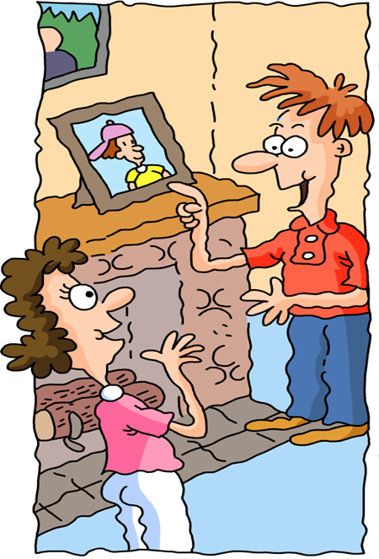
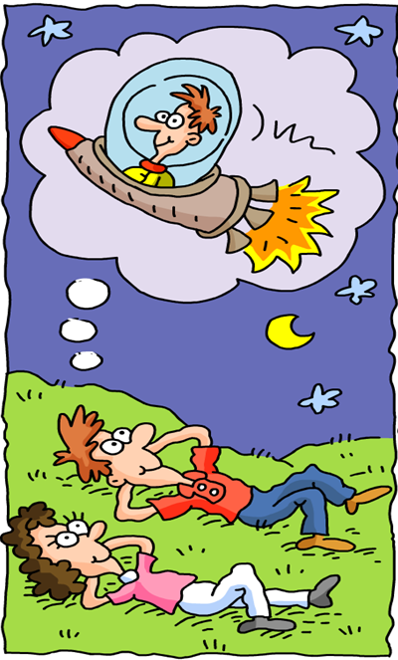
Where are the two people in each picture?
What are they doing in each picture?
What do you think they are saying to each other?

Slide 11
1c
Listen to Alexis and Joe. Number the pictures[1-3].
2

Slide 12
1d
Listen again. Fill in the blanks with the correct verbs in the box.
1. I ____ in an apartment across the street from here.
2. I _____ near here.
3. I ____ a computer programmer.
4. We _____ in a house in the country.
5. I _____ the train to school.
6. I ___________ an astronaut.
7. I ___________ rockets to the moon.
8. I ___________ on a space station.
live
work
am
boring
am
live
work
lived
took
will be
will live
will fly
lived
took
will be
will fly
will live
What do you think of Joe’s future life?
Can Joe’s dream come true?

Slide 13
Conversation 1
Alexis:Hi,I’m Alexis.
Joe:Nice to meet you,Alexis.I’m Joe.
Alexis:Nice to meet you,Joe.Do you live here in Highville?
Joe:Yes,I do.I live in an apartment across the street from here.
Alexis:Oh,really?
Joe:Yes.I work here,too.I’m a computer programmer
Alexis:A computer programmer?
That sounds interesting.
Joe:Well,actually it’s kind of boring . I do the same
thing every day.

Slide 14
Conversation 2
Alexis:Hey,Joe,is that a picture of you?
Joe:Yeah,that was me 10 years ago.
Alexis:So,did you live here in Highville 10 years ago?
Joe:No,I lived with my parents in Greenville.
We lived in a house in the country.
I went to school here in Highville,though.
Alexis:Really? That’s pretty far from here.
How did you get to school?
Joe:Oh,I took the train to school.
a photo of
pretty=very

Slide 15
Conversation 3
Alexis:So,Joe,what do you think your life will be like in 10 years?
Joe:Oh,I think I’ll be an .
Alexis:An astronaut? Are you kidding?
Joe:No,I’m .I’ll fly to the moon.
Maybe I’ll also fly to other planets.
Alexis:Oh,and where will you live?
Joe:I’ll live on a .
astronaut
serious
rockets
space station

Slide 16
Joe’s life
Life in the past
lived
Ten years ago, Joe ___________ with his parents in Greenville.
They lived in a house ______ the countryside . He _________ the train to school.
At present, Joe __________ in Highville . He _________ a computer programmer. He __________(think) his work is kind of boring ____________ he does the same thing every day.
Joe hopes his life can be different in ten years. He thinks he____________ an astronaut in ten years and he will live in a space station. He will fly to the moon and other planets.
in
took
lives
is
Life at present
thinks
because
Life in ten years
will be

Slide 17
Summary
课时重点回顾
1. To learn some new words and useful expressions
astronaut,apartment,rocket,space,space station
2.To consolidate some sentences:
Ten years ago: What did you do ten years ago?
/Where did you live ten years ago?/How did you go to school ten years ago?
Now:What do you do?/Where do you live?/How do you go to school?
In ten years: What will you be in the future?/Where will you live?/How will you go to work?

