Slide 1
Unit 3
Is this your pencil?
Section A 1a-2d

Slide 2
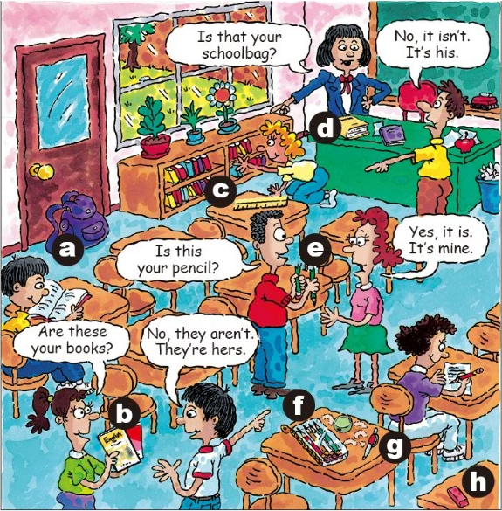
Look and find
Look at the picture!
Who are they?
Where are they?
Which school things can you see?

Slide 3
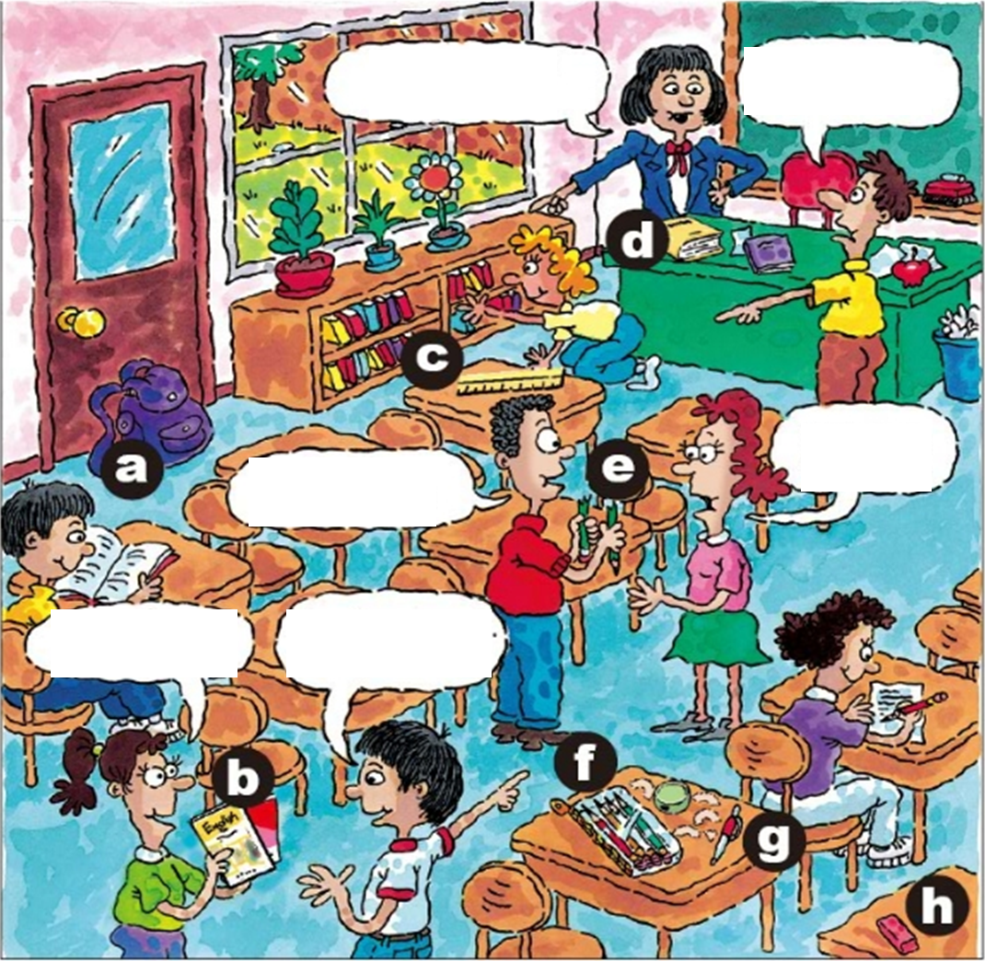
Match and write
1a
Match the words with the things in the picture.
1. pencil _______
2. pen _______
3. books _______
4. eraser _______
5. ruler _______
6. pencil box _______
7. schoolbag _______
8. dictionary _______
e
g
b
h
c
f
a
d

Slide 4
Predict （预测）
Tip 1 : Read the picture
How many books does the girl have?
What could the girl say?
What is the boy holding（拿着）in his hand?
What are they talking about?
What is the teacher pointing at（指向）？
What are they talking about?

Slide 5
Listen and number
1b
Listen and number the conversations [1-3].
mine =
my pencil
Tip 2 : Get the key words（抓住关键词）
3
A: Is this your pencil?
B: Yes, it is. It’s mine.
A: Is that your schoolbag?
B: No, it isn’t. It’s his.
2
his =
his schoolbag
hers=
her books
1
A: Are these your books?
B: No, they aren’ t. They’re hers.

Slide 6
Imitating
A: Is this your pencil?
B: Yes, it is. It’s mine.
3
A: Is that your schoolbag?
B: No, it isn’t. It’s his.
2
A: Are these your books?
B: No, they aren’ t. They’re hers.
1

Slide 7
Make your conversations
A: Is this …?
B: Yes, it is. It’s….
No, it isn’t. It’s …
1
his her
my your
A: Is that …?
B: Yes, it is. It’s….
No, it isn’t. It’s …
2
his hers
mine yours
3
A: Are these / those …?
B: Yes, they are. They’re…
No, they aren’ t. They’re ….

Slide 8
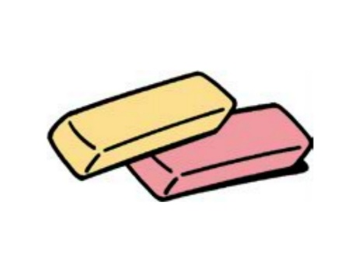
Read and learn
Look at the six pictures. What are they in English?
pencil box and pencil
eraser
s
a
a
s
book
a
a
a
ruler
pencil
schoolbag

Slide 9
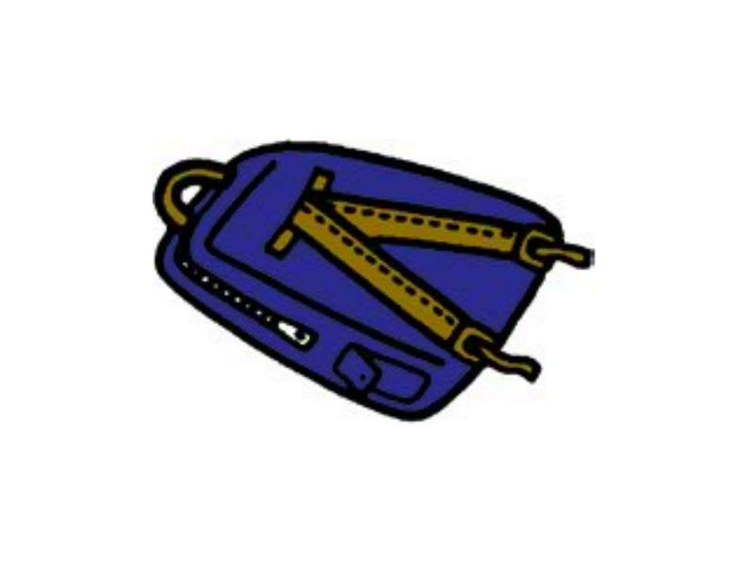
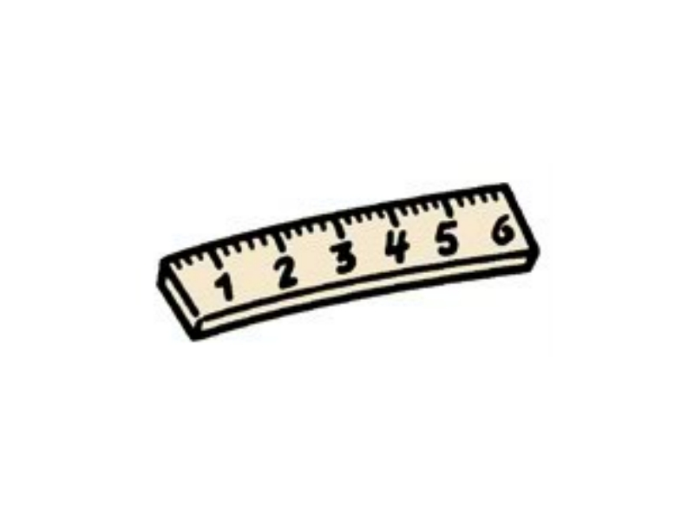
Listen and check
2a
Listen and check (√) the things you hear.
√
√
√
√
√

Slide 10
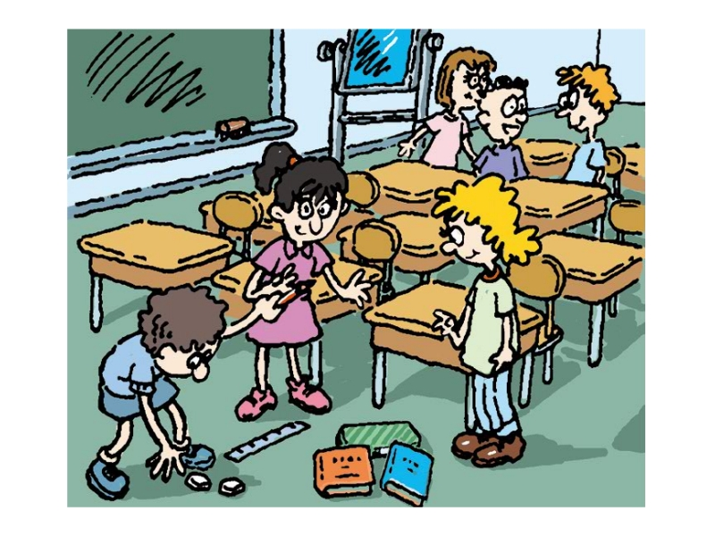
Listen and write
Listen again. Complete the conversation with the words in the box.
2b
predict
erasers pencil ruler pencil box books
Tom: Excuse me, Grace. Is this your _______?
Grace: Yes, thank you. And those are my _______.
Tom: And Jane, is this your ______?
Jane: No, it isn’t. It’s hers.
Tom: OK, and these are my ______. This is your
__________, Jane.
pencil
erasers
ruler
books
pencil box

Slide 11
Group work
2c
Practice the conversation with your partner.
Tom: Excuse me, Grace. Is this your pencil?
Grace: Yes, thank you. And those are my erasers.
Tom: And Jane, is this your ruler?
Jane: No, it isn’t. It’s hers.
Tom: OK, and these are my books. This is your pencil box, Jane.
劳驾；请原谅

Slide 12
Summary
Unit 3 Is this your pencil? (Section A 1a-2d)
Key words
pencil, pen, book, eraser, ruler, pencil box, schoolbag, dictionary
Sentences
—Is this/that your pencil?
—Yes, it is. It’s ...
—No, it isn’t. It’s ...
—Are these/those your books?
—Yes, they are. They’re...
—No, they aren’t. They’re ...
Grammar
mine, yours, his, hers

Slide 13
Thank you!
Section A 1a-2c

