Slide 1
Welcome to my English lesson!
Ye Huina

Slide 2
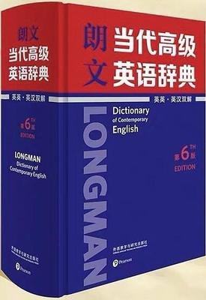
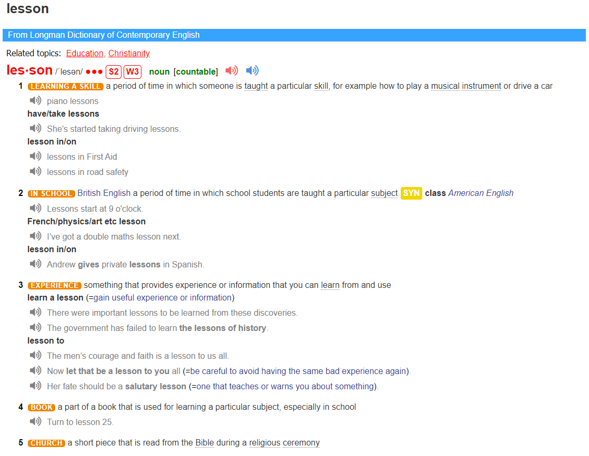
Activity 1
Look up the dictionary

Slide 3
Predict
Activity 2
A Lesson for Life
When did the lesson happen?
Where did the lesson happen?
Who did the lesson happen to?
What was the lesson?
Why did the author have a lesson?

Slide 4
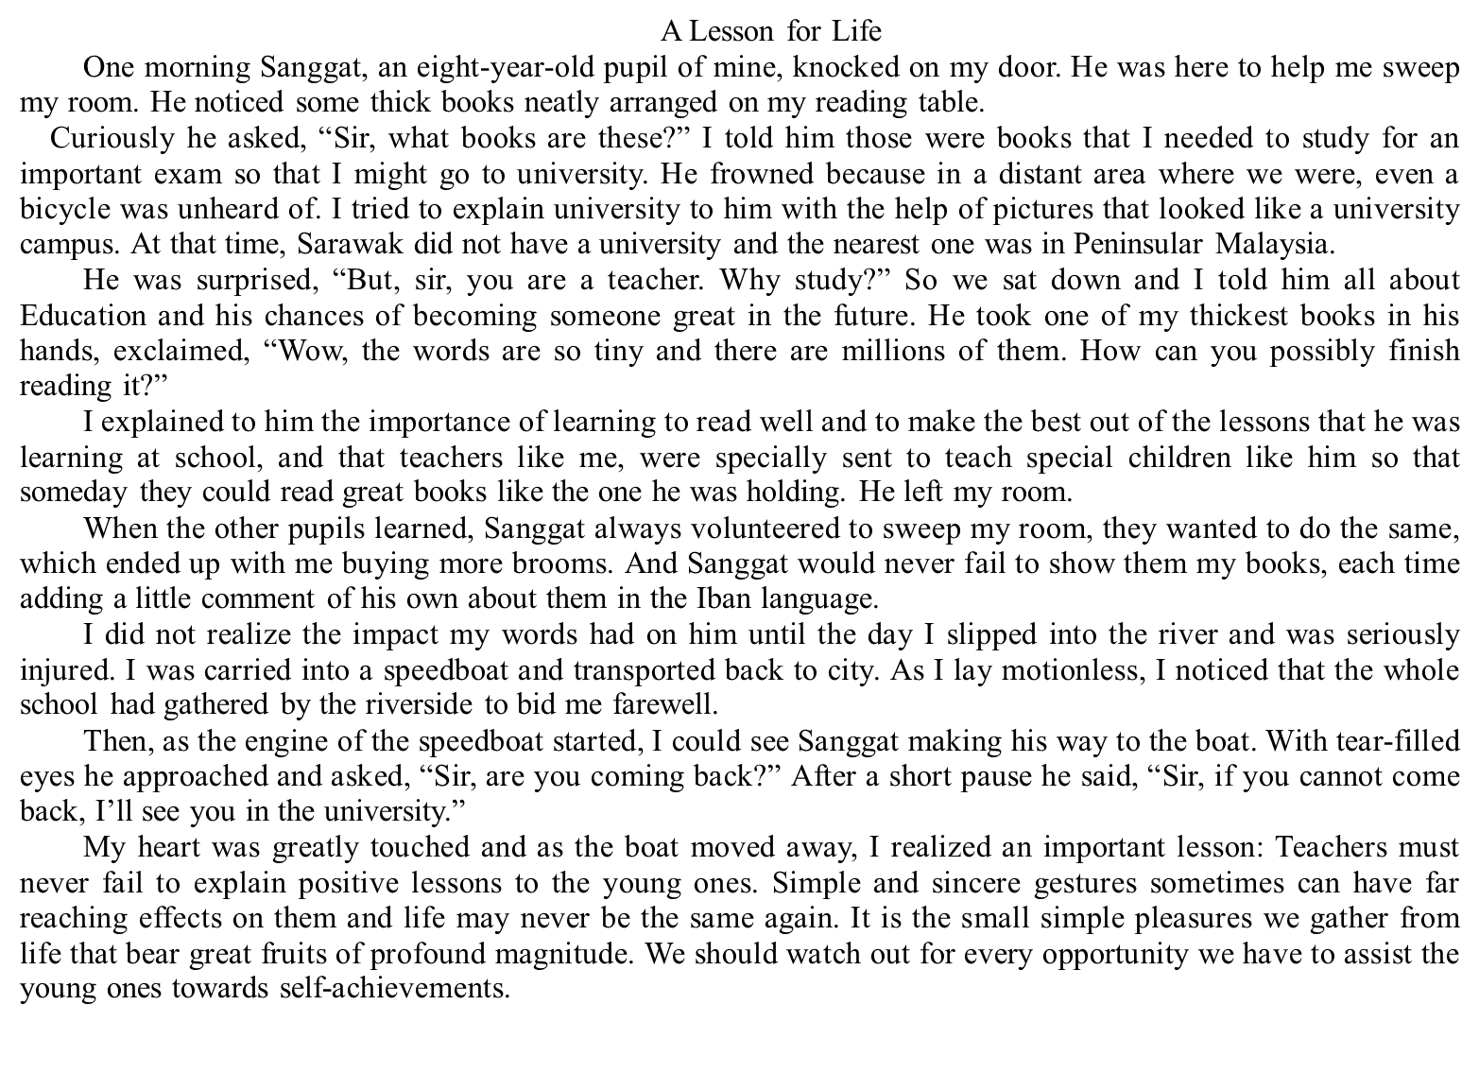
Activity 3
Read for the structure
Q1: What type of the text is it?
The story
one morning
When
Where
Who
my room in Sarawak
I and Sanggat
Q2: How many parts is the passage divided and what are their contents?
The lesson

Slide 5
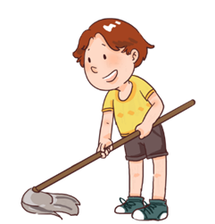
Figure out the
key points
Activity 4
Sanggat
Part1 (paragraph 1-7)
Questions | Why did he ask?
Because of thick books and curiosity.
Sir, what books are these?
Q1: What questions did Sanggat ask?
He almost had no access to the outside and was out of touch with people in other places.
But, sir, you are a teacher. Why study?
He frowned because in a distant area where we were, even a bicycle was unheard of.
Q2:Why did Sanggat ask the question?
Books were so thick, and his ability was so poor that reading it was an impossible task for him.
Wow, the words are so tiny and there millions of them.
How can you possibly finish reading it?
Q3:Why did Sanggat like the author?
He liked me and wanted me to come back to teach him as before.
Sir, are you coming back?

Slide 6
Figure out the
key points
Activity 4
actions
feelings
I (________)
Details
Sanggat (________)
I told him … I needed to
confused
His world was l_ up by great dreams.
He frowned …
I tried to explained … with the pictures.
clear
Why did Sanggat like the author?
… we sat down and I told
… all … and his chances of becoming someone great…
with my permission, …
surprised
He started to _e____ the best of himself.
He took one of my thickest books
relaxed
… , which ended up with me buying more brooms
With my permission, …
He s____ his voice.
He never failed to
show them my books and make comments.
uncertain
confident
He s____ no effort to do it.
Because I was caring and patient and willing to offer them lessons for skills out of class.

Slide 7
Figure out the
key points
Activity 4
actions
feelings
I (________)
Details
Sanggat (________)
slipped into ;seriously injured; was carried into a speedboat and transported back to city.
…making his way to the boat.
With tear-filled eyes; approached and asked;
concerned and
confused
He clearly
o________the future.
Why did Sanggat like the author?
calm and determined
How to understand the statement “Sir, if you cannot come back, I’ll see you in the university.”? Why did Sanggat make such a change in his talking?
Because my injury was a cause for him and let him get lessons for experience out of class.

Slide 8
Figure out the
key points
Activity 4
He would n______ his life to finish his goal.
Can you guess what would Sanggat do after I left the school?

Slide 9
Activity 5
Conclude and discuss
positive
confused
concerned and
confused
clear
surprised
calm and determined
relaxed
Sanggat (student)
Sir, are you coming back?
Sir, if you cannot come back, I’ll see you in the university.
uncertain
A lesson for life
(Para 8)
confident
Sir, what books are these?
Why study?
How can you possibly finish reading it?
A lesson for experience
(Para 6-7)
I
(teacher)
We should watch out for every opportunity we have to assist the young ones towards self-achievements.
A lesson for skills
(Para 2-5)

Slide 10
Activity 5
Conclude and discuss
L
E
S
S
O
N
the lesson of lighting up their dreams
the lesson of expecting the best of themselves
What lessons
should be brought to students ?
the lesson of speaking their voice
the lesson of sparing no efforts
the lesson of organizing the future
the lesson of nurturing their life

Slide 11
Continuation
writing
Assignment
Supposed that you were the author. Many years later you met Sanggat again in the university. What would happen? Continue writing a paragraph according to the given sentence.
I was quite surprised when hearing the student’s self-introduction, Sanggat, the pupil from Sarawak.

Slide 12
A Lesson for Life
Ye Huina

